Slide 1

Coffee and Data
SQL sales database presentation

Slide 2
Data
Items
Prices
Sales

Slide 3
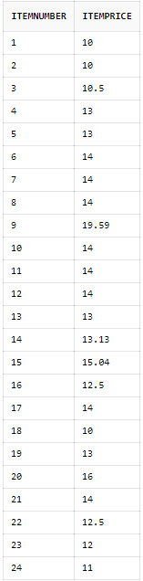
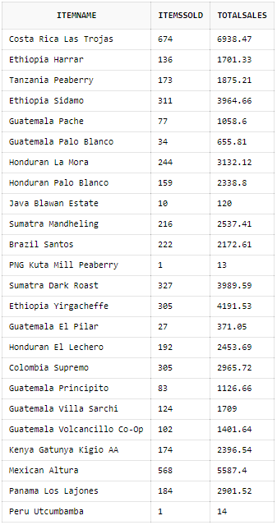
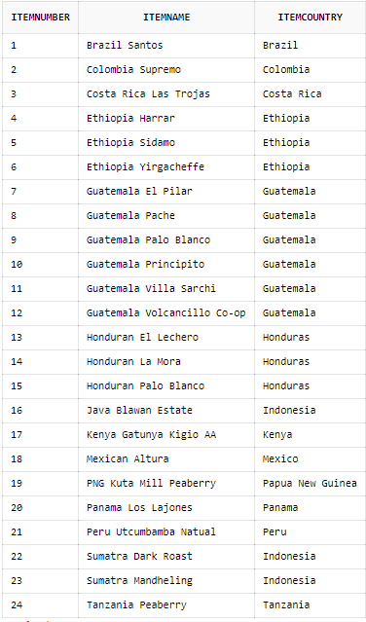
Sql data tables
Item Prices
Sales Data
Item List

Slide 4


Business questions
Top and Bottom in Sales
Item Sales
Highly priced items & sales
Sales by Country
New Items
Are any items in pre-launch phase

Slide 5
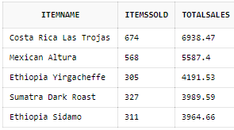
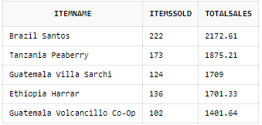
Top and bottom in sales
Top 5 Items by Sales
Bottom 5 Items by Sales

Slide 6
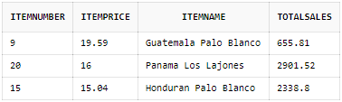
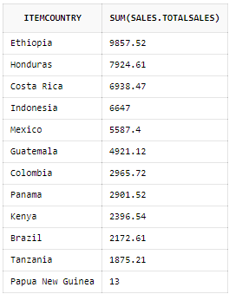
Item Sales
Highest Priced Items with Sales
Sales by Country

Slide 7
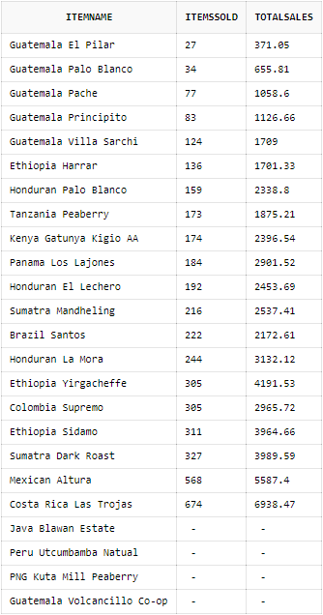
New items
Pre-Sale Items

Slide 8




Thank You
Joshua Alvarado
Github
oosh09@yahoo.com

