Slide 1

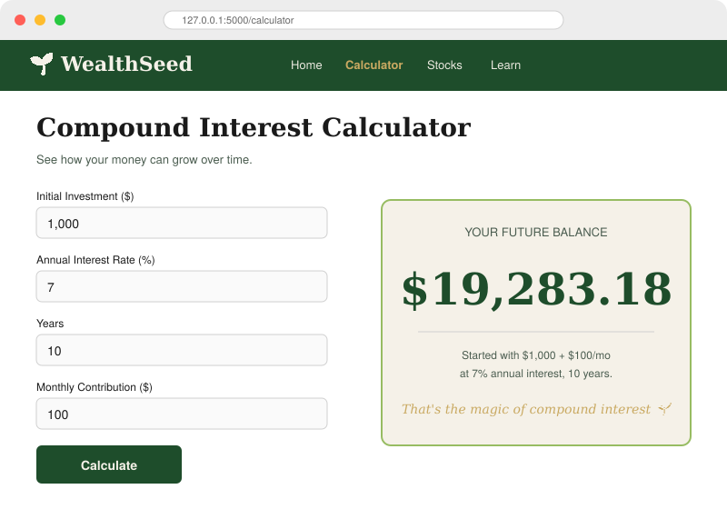



LIVE PREVIEW
Compound Interest Calculator
WealthSeed
Investing made simple
for the next generation.
THE PROJECT
WealthSeed is a Flask web app that teaches young adults the fundamentals of investing through interactive tools, real market data, and bite-sized lessons — replacing intimidating jargon with hands-on learning.
TEAM
Osi Oiboh
Solo build · Sprint 3
See exactly how $1,000 + $100/month grows at 7% over 10 years.
Compound Calculator
Stock Lookup
Learn Modules

