Slide 1



Presented by :
Ammar Yasser Mohamed
Othman Abdelrahim Othman
Presented To :
Eng. Ramy Gomaa

Slide 2
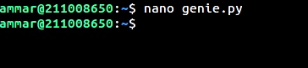
Creating 'genie.py' file

Slide 3
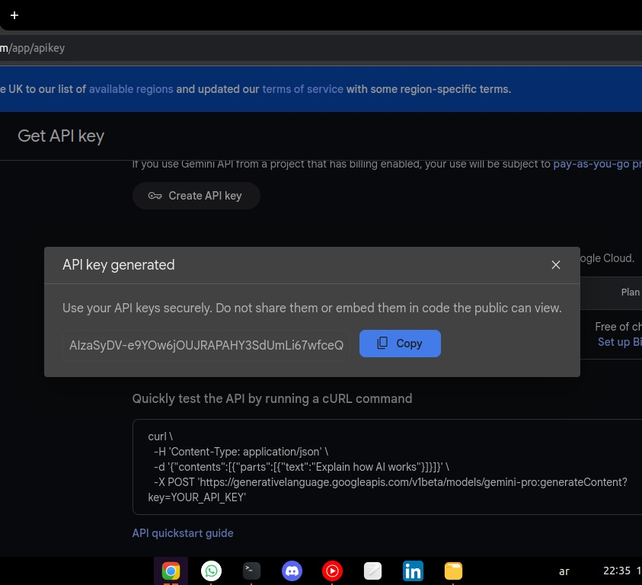
Getting the API Key

Slide 4
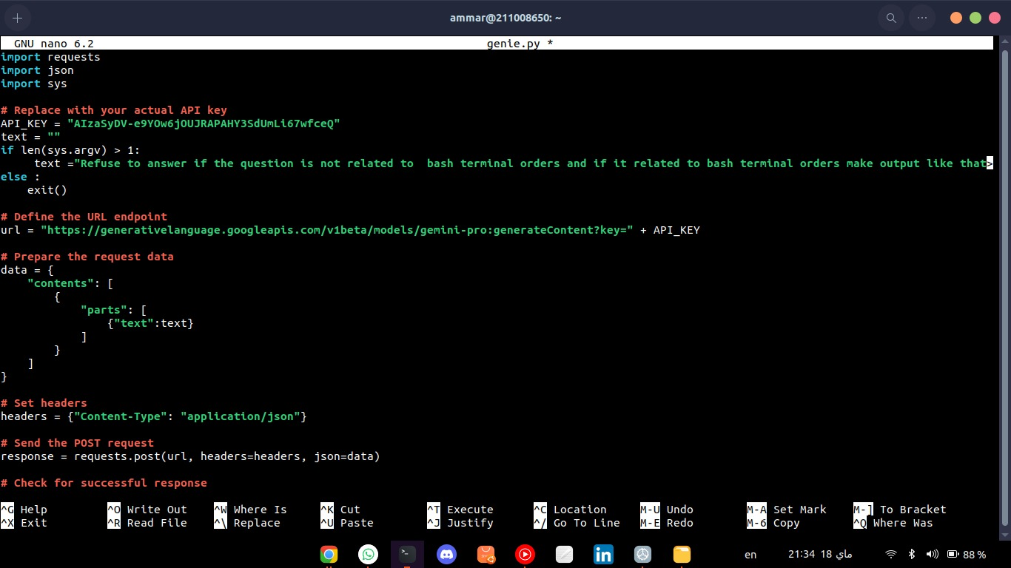
Adding libraries
Replace with actual API key

Slide 5
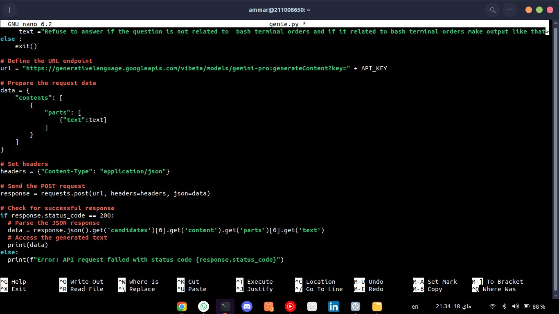

Slide 6
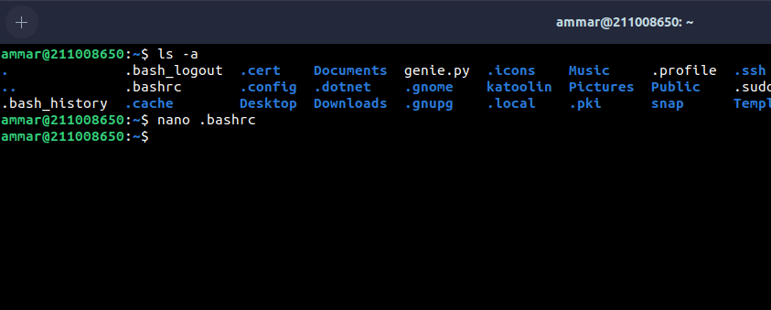
Accessibility

Slide 7
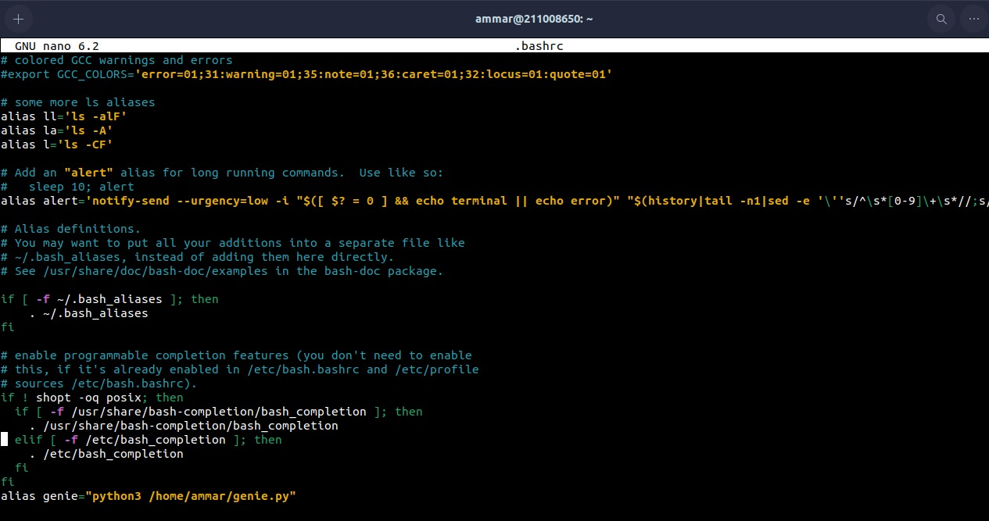
Accessibility

Slide 8
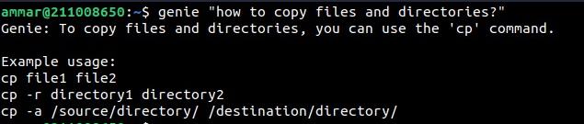

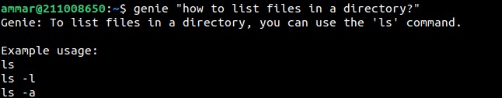
Some Qustions to genie ...

Slide 9
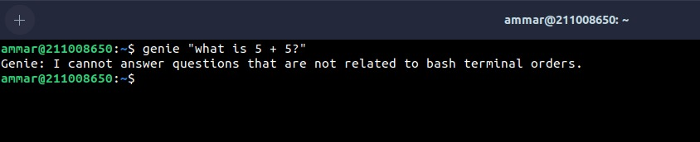
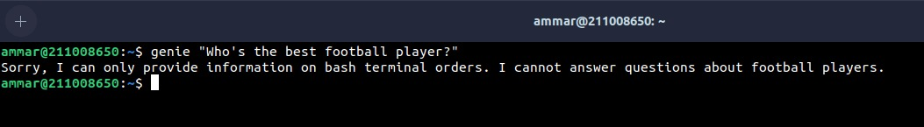
GENIE cannot answer any question that not related to terminal orders

Slide 10



