Slide 1
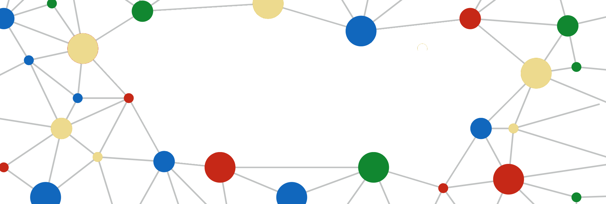
Knowledge Graphs
in Machine Learning
Ozer Ozdikis
ozer.ozdikis@ntnu.no
https://oozdikis.github.io
Slides available at:
https://oozdikis.github.io/

