Slide 1
Structured Sentiment Analysis as Dependency Graph Parsing
IIIT Delhi
Rishabh Jay (2022401), Aditya Upadhyay (2022040) , Chandan Sah (2022140)

Slide 2
Motivation
Traditional sentiment analysis fails to capture fine-grained sentiment structure.
Need to extract structured tuples: (holder, target, expression, polarity).
Overlapping sentiments, implicit holders, and multilingual contexts are challenging.
Goal: Represent sentiment as dependency graphs for better expressivity and parsing.

Slide 3
Related Work
Aspect-Based Sentiment Analysis (ABSA) extends traditional sentiment classification.
Dozat & Manning (2018): Biaffine dependency parsers for syntactic trees.
Barnes et al. (2021): Reformulated structured sentiment analysis as graph parsing.
Gap: Fusion of multiple modalities & multilingual generalization still underexplored.

Slide 4
Baseline Approach
Baseline1-
Sentiment entities modeled as nodes in a dependency graph.
Used BiLSTM encoder with mBERT, POS, Lemma, and Char embeddings.
Biaffine classifiers predict labeled arcs (e.g., holder, target, exp:pos).Support for span-to-token reductions: head-first and head-final.
Baseline2-
Uses a simplified BiLSTM encoder followed by MLP classifiers for edge and label prediction, without dependency parsing or biaffine scoring. Instead of syntactic spans, it directly considers all token pairs using concatenated BiLSTM outputs to score edge existence and sentiment polarity.
This model had a learnable structural embedding matrix.

Slide 5
Our Novel Contributions
Dynamic Learnbale Gating - We introduce a dynamic gating mechanism with learnable scalar weights for each input modality (e.g., POS, lemma, char, mBERT).Unlike simple concatenation, the model learns to weigh feature importance adaptively during training.This helps suppress noise from less useful modalities and boosts signal from informative ones.It's especially beneficial in multilingual or low-resource settings, where feature relevance varies across languages
Graph Attention Network - We enhance BiLSTM with a multi-head GAT to capture long-range and cross-lingual dependencies.The GAT selectively attends to relevant nodes, improving information flow in multilingual settings.Layer normalization and residual connections refine the output for better feature representation.This leads to higher F1 scores by focusing on key semantic regions during sentiment extraction..

Slide 6
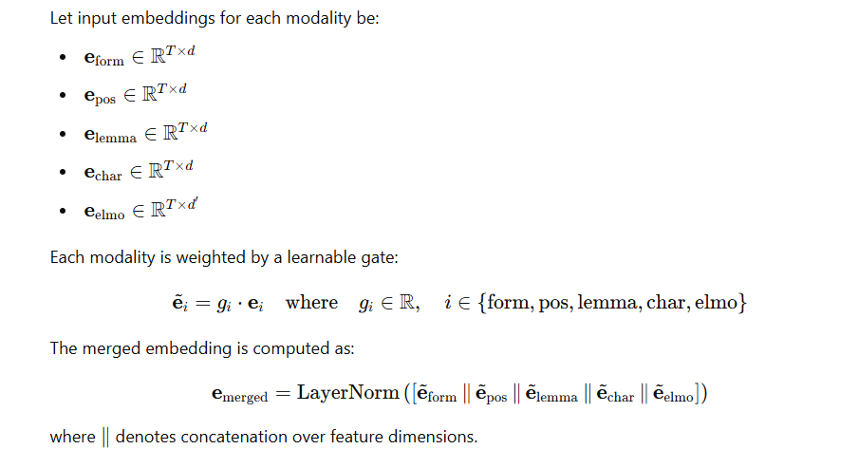
Dynamic Gating
In our modified BaseLSTM architecture, we introduce learnable scalar gates for each input modality, including word form, POS tags, lemmas, character embeddings, and contextual embeddings like ELMo or mBERT. These scalar parameters are updated during training and allow the model to dynamically control the contribution of each modality. This enables the model to suppress uninformative or noisy features, particularly in low-resource or multilingual settings, where the importance of modalities can vary significantly. The final merged embedding is layer-normalized and passed through the encoder, resulting in improved performance across both monolingual and cross-lingual tasks.

Slide 7
Graph Attention Network and its usage
Graph Attention Networks (GATs) are neural architectures designed to operate on graph-structured data by leveraging an attention mechanism that assigns learnable weights to neighboring nodes during feature aggregation. By doing so, GAT selectively passes messages from the most relevant neighbors rather than treating all neighbors equally, which significantly improves the flow of information and captures complex, multi-node relationships. This enhanced feature representation is particularly beneficial in natural language processing, where GATs can be applied to dependency graphs to model non-local dependencies and improve tasks such as sentiment analysis. Moreover, the shared embedding space in cross-lingual settings allows GAT to effectively transfer knowledge between related languages, addressing challenges in low-resource scenarios.

Slide 8
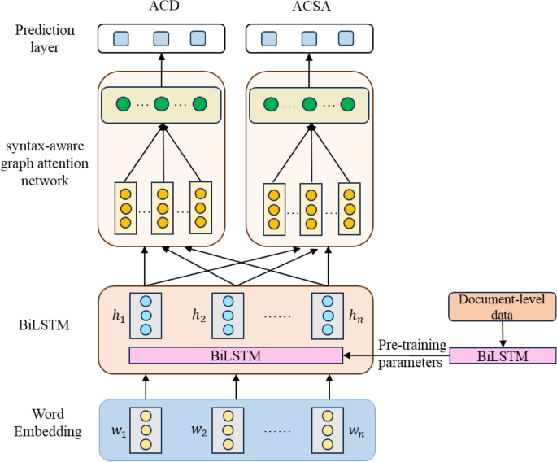


Model architecture and equations and Loss
GAT Layers: The model begins with two layers of Graph Attention Network (GATConv).
Layer 1: Applies multi-head attention with concatenation to capture rich contextual information from multiple perspectives.
Layer 2: Uses single-head attention with feature averaging to condense the representations into a unified embedding.
MultiAttentionGAT (Extended):
Composed of multiple stacked GAT layers with residual connections to preserve base information.
Includes Layer Normalization after each attention layer for stable training.
A Feed-Forward Network (FFN) is applied for further refinement of the node features.
Dropout and GELU activations are used to improve generalization and non-linearity.
Gating Mechanism & Residuals
Residual Connection: The output is computed as hout=h+FFN(h)h_{\text{out}} = h + \text{FFN}(h)hout​=h+FFN(h), which retains the initial semantic representation while allowing for deeper feature refinement.
Implicit Attention Gating: Each attention head dynamically computes attention weights αij\alpha_{ij}αij​ to determine the importance of a neighbor jjj for node iii, using:
This mechanism enables selective message passing from the most informative neighbors, enhancing the model’s ability to capture complex relational dependencies.
Loss Function
The loss function depends on the specific downstream task. For classification tasks, Cross-Entropy Loss is commonly used:
where yiy_iyi​ is the true label and y^i\hat{y}_iy^​i​ is the model’s predicted probability.

Slide 9
Experimental Setup
Datasets: MPQA, MultiBooked (ca/eu), Opener (en/es), NoReC.
Trained on head-final and head-first graph configurations.
Evaluated using Sentiment Graph F1 (tuple-level matching).
Compared Baseline, Learnable Structure Embeddings, Gating, and GAT.

Slide 10
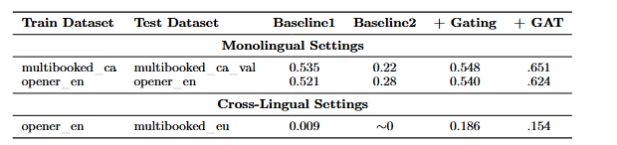
Results Summary
Gating improves both mono and cross-lingual performance. GAT is strong in mono.

Slide 11
Conclusion & Future Work
Graph-based parsing is effective for structured sentiment extraction.
Dynamic gating enables better fusion of multimodal features.
Future work: Multi-task training, contrastive fine-tuning of mBERT.
Goal: Improve generalization in low-resource and code-switched languages.

