Slide 1
MixHop: Higher-Order Graph Convolutional Architectures via Sparsified Neighborhood Mixing
Paper by Sami Abu-El-Haija, Bryan Perozzi, Amol Kapoor, Nazanin Alipourfard, Kristina Lerman, Hrayr Harutyunyan, Greg Ver Steeg, Aram Galstyan
Presented by Shea Cardozo
CS886 Winter 2024 - Graph Neural Networks
Notes:
‘taught to the test’ - an article about ai benchmarks and their problems

Slide 2
Outline
Motivation
Spectral Convolution and Vanilla GCNs - a review
The expressive power of Vanilla GCNs
Gabor Filters, Delta Operators
Argument Of Limited Expressivity of Vanilla GCNs
MixHop
Architecture
Prove of Expressivity
Efficient Implementation
Experimental Results
Paper Review
Questions

Slide 3
Motivation - What’s the Problem?
Vanilla GCNs struggle to represent some higher-order operations
E.g. arbitrary linear combinations of the K-neighbourhood of a node
Yes, even if you stack multiple Vanilla GCN layers!
This is because of approximations made in the design of Vanilla GCNs
These higher order operations are very important for certain tasks!
E.g. Gabor filters in vision
This paper presents MixHop - an *efficient* way of learning K-order graph convolutional operations on an arbitrary graph.
Efficiency is important! The reason Vanilla GCNs are approximations in the first place is because of efficiency reasons.

Slide 4
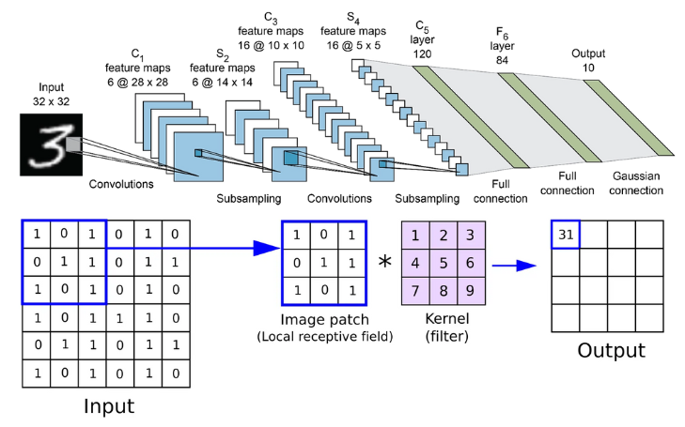
Convolution

Slide 5
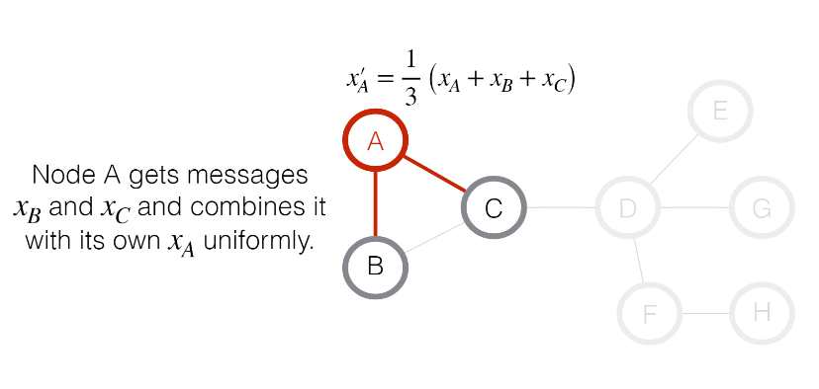
Vanilla Graph Convolution

Slide 6
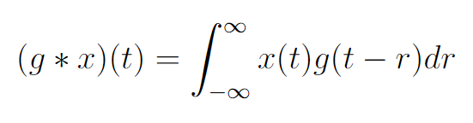


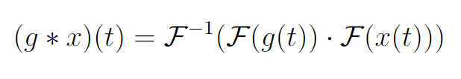
Convolution From A Signal Processing Standpoint
If you have a filter g(t) and a signal x(t):
Convolution Theorem: If is the Fourier Transform, and is the inverse Fourier Transform, then:
E.g. Multiplication in the Fourier Basis = Convolution

Slide 7



Why do we care about this?
Why not define convolution in a similar way for graphs?
Graph Fourier Transform: Start with the Laplacian of the graph (where Ā is the normalized adjacency matrix of the graph):
Diagonalize it:
Then our Graph Fourier Transform is:

Slide 8
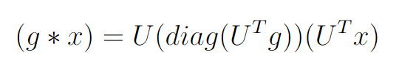
Spectral Convolution
Now we can define:
Spectral Graph Convolution:
g is the filter, x are the graph’s node features - both in R^{N} where N = |V|
Intuition: fourier transform g and x, multiply them, un-transform them. Same as in classical signal processing.
Note that g here is of the same dimensionality as the graph - convolving a graph with a filter the same ‘size’ as the graph. We usually don’t want this!
Vanilla GCNs can be seen as an approximation of this operation!

Slide 9
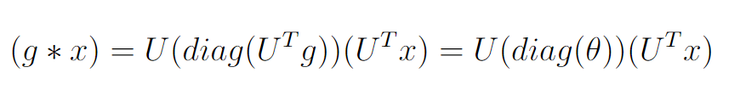
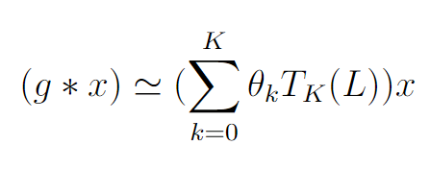
Vanilla GCNs Approximate Spectral Convolution!
Learn U^{T}g as weight parameters 𝜽, 𝜽 in R^{N}:
This is not localized and computationally expensive (U is dense!)
So, approximate U diag(𝜽) U^{T} using Chebyshev Polynomials:
This reduces 𝜽 to R^{K} and has a number of useful properties….

Slide 10
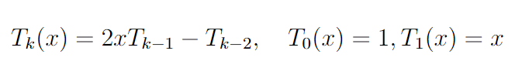
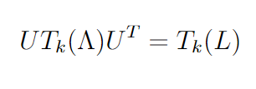

Chebyshev Approximation, a Digression
Since UU^{T} = I_{N} and L = U𝚲U^{T},
Hence:
We do this to get rid of multiplications by U (dense) and replace them with multiplications by L (sparse).

Slide 11


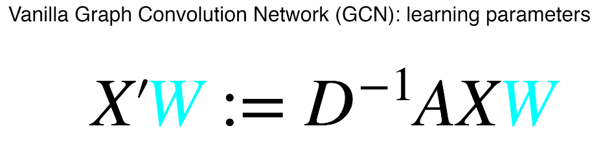
Vanilla GCNs Approximate Spectral Convolution! Continued!
3. If we let K = 1:
Note: Function of Ā -> 1-localized!
This is actually true for any K, a K-approximation is K-localized
4. The Vanilla GCN paper makes a few empirical tweaks, like assuming 𝜽₀ = -𝜽₁ , and assuming A has self-connections. Thus we get:
Generalizing this to a graph where node have C features and we train F filters:
The Same :)

Slide 12
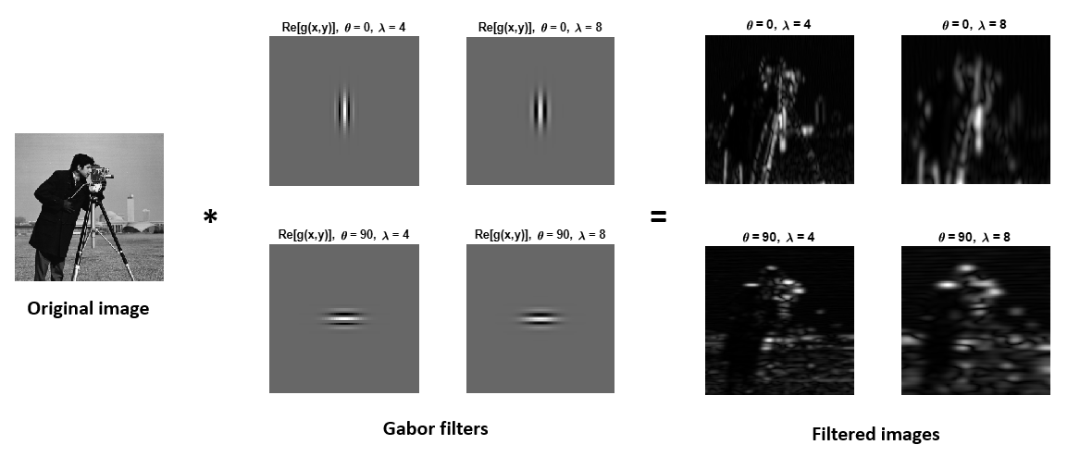
Wait, what was this presentation supposed to be about again?
Spectral Convolution is a very powerful operation
The approximations involved in Vanilla GCNs, make it substantially less so
Even when stacked together, Vanilla GCNs struggle to learn arbitrary linear combinations of the K-Neighbourhood of a node
This includes filters that image CNNs learn! e.g. Gabor filters

Slide 13
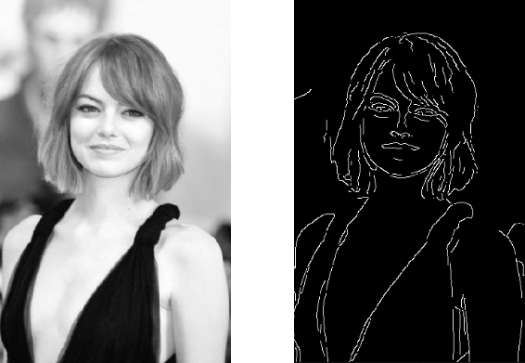
Delta Operators
A core element of Gabor-like filters is taking the difference of information from different neighborhood around a node
This is how these filters detect edges - by checking to see if the difference between neighbourhoods of pixels is large.
We would like our GCN to be able to learn similar behaviour.

Slide 14

Delta Operators
Delta Operators formalize this ‘neighbourhood difference’ behaviour
A two-hop Delta Operator is defined as:
Where 𝝈 is an elementwise activation function, 𝒇 is an injective function, and A, X are *any* adjacency matrix and node feature matrix.
In other words, it works for any arbitrary graph
A Vanilla GCN of any depth cannot directly learn this operation!

Slide 15


“Proof”
Assume a Vanilla GCN can learn a two-hop Delta Operator with injective function f. A Vanilla GCN of l-depth is of the form:
Assume* 𝝈(x) = x, X = I_{n} (recall: this has to hold for all X, A):
* Aside: I’m not entirely sure if it’s valid to assume the activation is the identity here. The paper doesn’t fully justify it. At least, this suggests it’s difficult for a Vanilla GCN to learn a K-Hop Delta Operator.

Slide 16
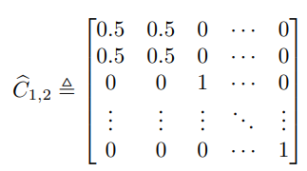

“Proof” Cont.
2. Assume we input a fully disconnected graph (Ā = I_{n}). The above implies W* = f(0).
3. Assume we input a fully disconnected graph with the exception of nodes i and j, which are connected to one another. Ā = C_{i,j} as below, implying that C_{i,j}W* = f(0)

Slide 17

“Proof” Final
4. Since W = C_{i,j}W*:
This implies that w_{i} = w_{j} , where w_{i} is the ith row of W*
i, j are arbitrary, so every row of W* must be the same
We can trivially construct Ā^{l}W*= 0 where Ā - Ā² ≠ 0.
Since Ā^{l}W*= f(Ā - Ā²), f cannot be injective. Giving us a contradiction.
It pretty straightforwardly follows that if a GCN can’t learn a two-hop delta operator, it can’t learn arbitrary linear combinations of a K-neighbourhood

Slide 18
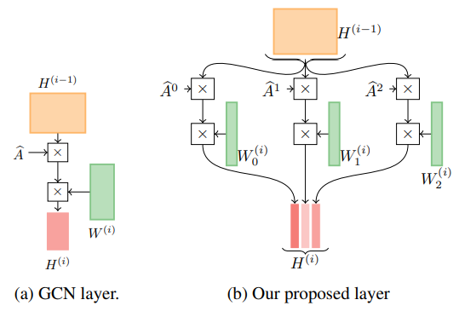
MixHop!
This paper’s solution: Split and compute activations (with trainable weights) for multiple K-Neighbourhoods, and concatenate them back together.

Slide 19



Writing It Out Mathematically:
In the Vanilla GCN, each layer is:
In MixHop, the layer is:
Where P is a set of integers. For example if P = {0, 1, 2}:
Which is combining information from the 2-neighbourhood around each node.

Slide 20
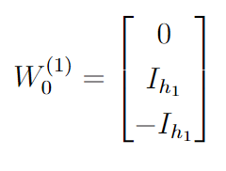
Can MixHop Learn a Two-Hop Delta Operator?
Yes! Pretty easily, with two layers with P = {0, 1, 2}.
For the first layer, let W₀⁽⁰⁾ = 0, W₁⁽⁰⁾ = W₂⁽⁰⁾ = I_{h1} and we have:
For the second layer, let W₁⁽¹⁾ = W₂⁽¹⁾ = 0 and:
Giving us:

Slide 21
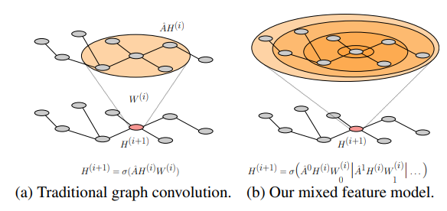
Generalized Mixing
More broadly, a two-layer MixHop network with P = {0, …, m} can create an arbitrary linear combination of the m-neighbourhood around each node.
The proof is a straightforward extension of the 2-neighbourhood case.

Slide 22



Efficiency Analysis
How to implement MixHop efficiently?
If Ā is sparse with m entries, and H is dense with h columns, computing ĀH is:
Computing left-to-right, Ā^{p}H^{(i)} = Ā(Ā(Ā(...ĀH^{(i)}...))) is thus:
If we cache and reuse computed adjacency powers among all p ∈ P, then the computational complexity of the whole layer is:
The paper argues that if p_{max} << m and h << m running an l-layer model is not that much more expensive than O(lm), which is the complexity of a Vanilla GCN.

Slide 23
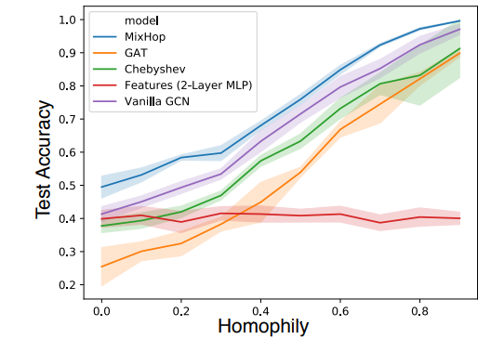
Results on Synthetic Data - Semi-Supervised Node Classification
Given the class labels of a few nodes, can we classify every node in the graph?
Synthetic graphs with different ‘homophily’ values that indicate the likelihood of a node having a connection to a neighbor with the same class.

Slide 24
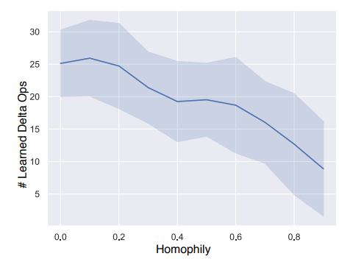
Results on Synthetic Data - Semi-Supervised Node Classification
Uses the weight matrices to inspect the number of delta operations the network learns - negative correlation with homophily!

Slide 25
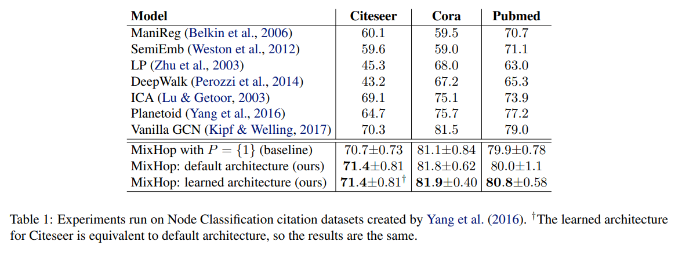
Results on Node Classification

Slide 26
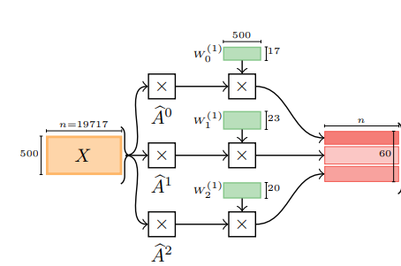
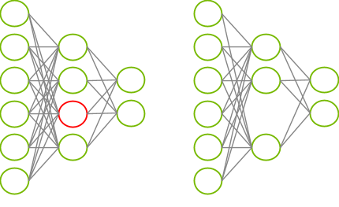
Learned Architectures
Multi-stage training approach
Independently L2-regularize the neurons in each adjacency power, and then remove the neurons whose weight norms are under a certain threshold
Improves efficiency at no cost to performance

Slide 27
Paper Discussion and Comments
Pros:
The analysis of the limitations of Vanilla GCNs and the connections to spectral convolution.
The discussion of why higher-order adjacency relationships are useful.
MixHop appears to successfully aggregate information from higher-order adjacency relationships, and the extraction of delta operator behaviour from the learned networks is very interesting from an interpretability standpoint.
Cons:
A fair amount of handwaving in the theoretical analysis - would benefit from a supplemental.
Poor empirical results.
This might be because of the task chosen. I would have liked to see testing on a task where the was a strong prior hypothesis that higher-order relationships would have been useful.
Lack of an empirical efficiency analysis, particularly as p is varied.

Slide 28
Future Work
Are there specific graph structures that may benefit from a K-Hop approach compared to Vanilla GCNs, and could we generate them synthetically?
What sort of real-world tasks may benefit from a K-Hop approach? Can we test and demonstrate this?
Delta operators are an discrete mechanistic component of a GCN. Can we isolate them in larger networks, and use them to improve interpretability?

Slide 29

References
S. Abu-El-Haija et al., “MixHop: Higher-Order Graph Convolutional Architectures via Sparsified Neighborhood Mixing”. In: ICML. 2019.
T. Kipf and M. Welling, “Semi-Supervised Classification with Graph Convolutional Networks”. In: ICLR. 2017.
M. Defferrard et al., “Convolutional Neural Networks on Graphs with Fast Localized Spectral Filtering”. In: NeurIPS. 2016.

Slide 30

Thank you!
Questions?

