Slide 1
Link Prediction Based on Graph Neural Networks
Authors: Muhan Zhang, Yixin Chen
Presenter: Bing Chen

Slide 2

Outline
Introduction
Preliminaries
Notations
Heuristic Methods
$γ$-decaying Heuristic
Proposed Solution: SEAL
Experiments
Conclusion

Slide 3
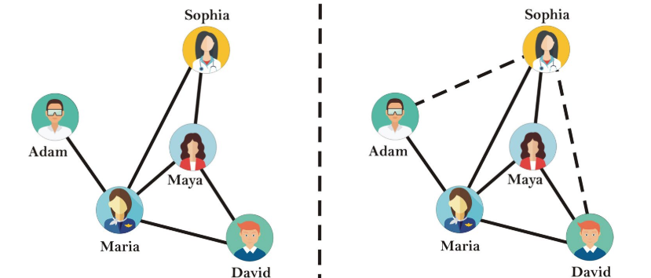
Introduction
Link Prediction: To predict whether two nodes in a network are likely to have a link.
Many Applications:
Friend/Movie Recommendation
Knowledge Graph Completion
Metabolic Network Reconstruction
[1, Fig. 1]

Slide 4
What is the problem?
One class of simple yet effective approaches for link prediction is called heuristic methods.
However:
Heuristic methods make strong assumptions about when links should exist, which only works well on certain networks.
There is no unified theory to analyze and study heuristic methods comprehensively.
We need a framework that can automatically learn heuristics instead of relying on predefined ones.

Slide 5
Why is it important?
Overcoming the limitations of heuristic methods allows for broader applicability across diverse networks.
Establishing a unified theory provides a fundamental understanding to evaluate and develop link prediction methods.
An automated learning framework enhances adaptability and effectiveness, reducing reliance on human intuition for defining heuristics.

Slide 6
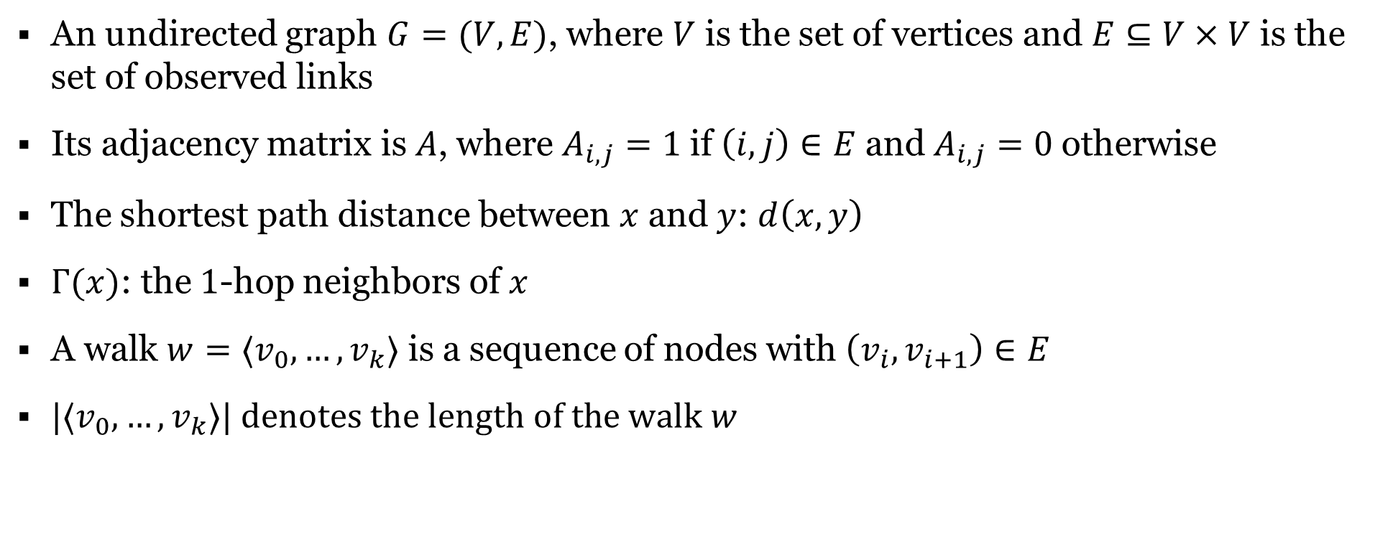
Notations
An undirected graph $G=(V, E)$, where $V$ is the set of vertices and $E⊆V×V$ is the set of observed links
Its adjacency matrix is $A$, where $A_{i, j}=1$ if $\left(i, j\right)∈E$ and $A_{i,j}=0$ otherwise
The shortest path distance between $x$ and $y$: $d\left(x, y\right)$
$Γ(x)$: the$1$-hop neighbors of $x$
A walk $w={⟨v}_{0}, …,v_{k}〉$ is a sequence of nodes with $\left(v_{i}, v_{i+1}\right)∈E$
$|{⟨v}_{0}, …,v_{k}〉|$ $denotes the length of the walk$ $w$

Slide 7
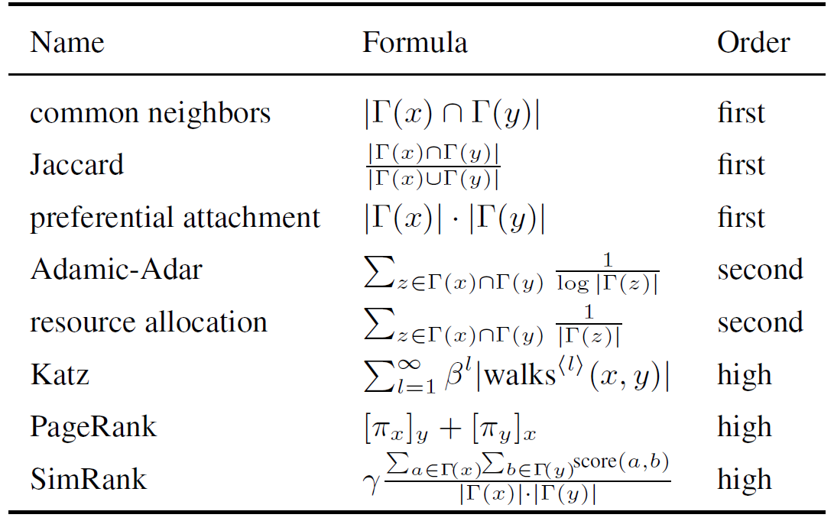
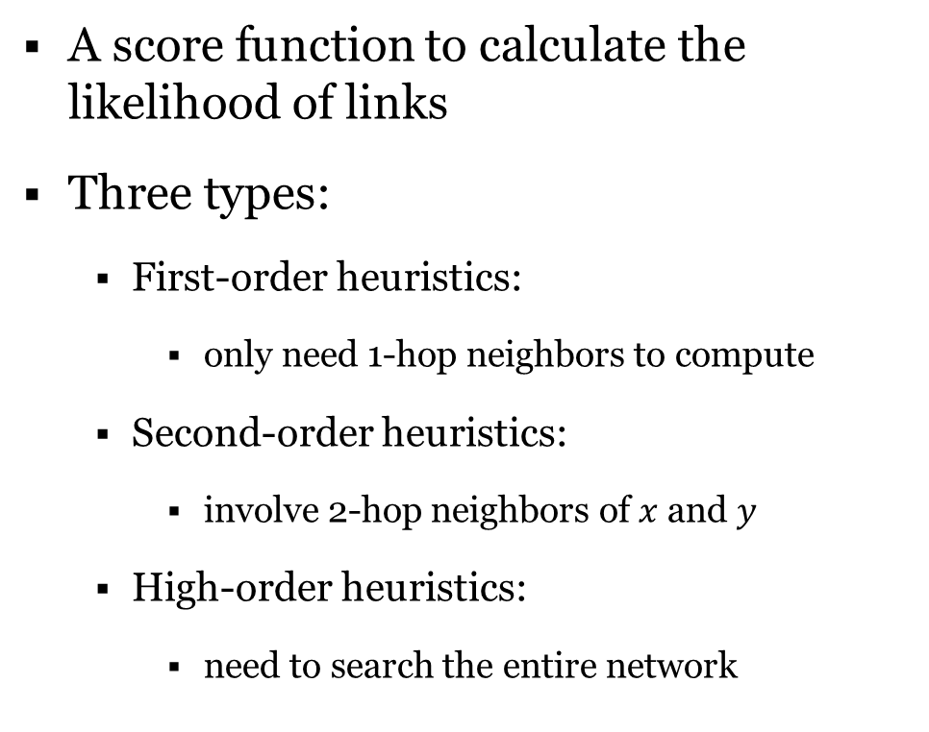
Heuristic Methods for Link Prediction
A score function to calculate the likelihood of links
Three types:
First-order heuristics:
only need 1-hop neighbors to compute
Second-order heuristics:
involve 2-hop neighbors of $x$ and $y$
High-order heuristics:
need to search the entire network
[2, Appendix A, Table 3]

Slide 8
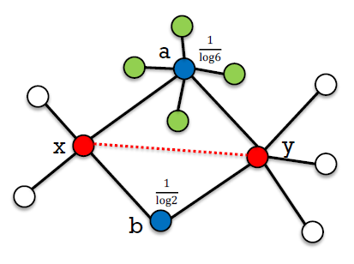
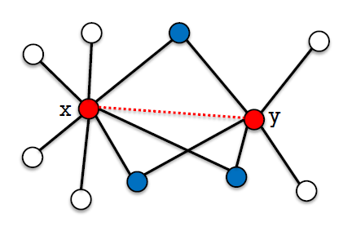
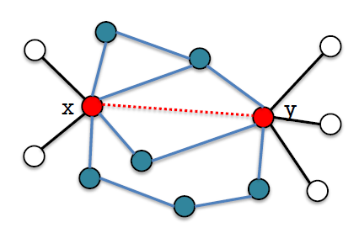
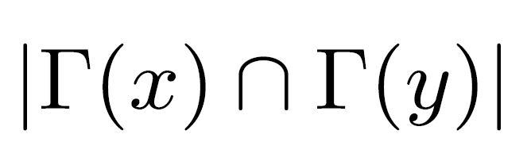
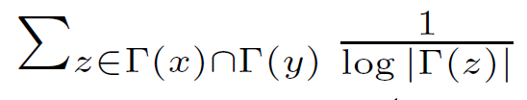
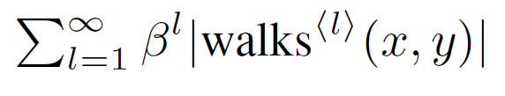
Heuristic Methods for Link Prediction
[4]
Common Neighbors
Adamic-Adar (AA)
Katz index
First-order
Second-order
High-order

Slide 9
Heuristic Methods for Link Prediction
Pros
Easy to calculate
Interpretable
No training required
Cons
Strong assumptions on link formation mechanisms
Only work well on certain networks
E.g., the common neighbor heuristic fails to predict links in protein-protein interaction (PPI) networks [3], as two proteins sharing many common neighbors are less likely to interact.
For high-order heuristics:
Need to search the entire network
Unaffordable time and memory consumption

Slide 10
Heuristic Methods for Link Prediction
High-order heuristics often perform better, but do we really need to use the entire network?
Can we learn a suitable heuristic from a given network instead of using predefined ones?

Slide 11
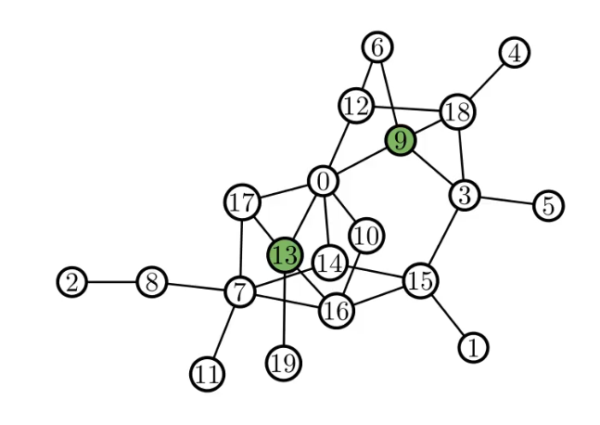
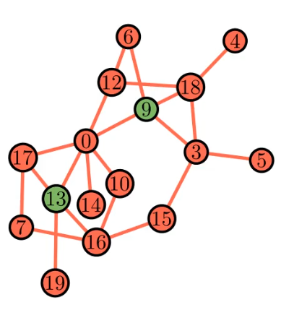

γ-decaying Heuristic: h-hop enclosing subgraph
For a graph $G=\left(V,E\right)$, the h-hop enclosing subgraph for two nodes $(x, y)$ is the subgraph $G_{x,y}^{h}$ included from $G$ by the set of nodes $\{i∣d\left(i, x\right)≤h or d\left(i, y\right)≤h\}.$
$$G_{9, 13}^{2}=$$

Slide 12

γ-decaying Heuristic
A $γ$-decaying heuristic for $(x, y)$has the following form:
$$ℋ\left(x,y\right)=η\sum_{l=1}^{∞}{γ^{l}}f\left(x,y,l\right)$$
$$γ∈\left(0, 1\right), η>0, f is nonnegative function of x, y, l$$

Slide 13
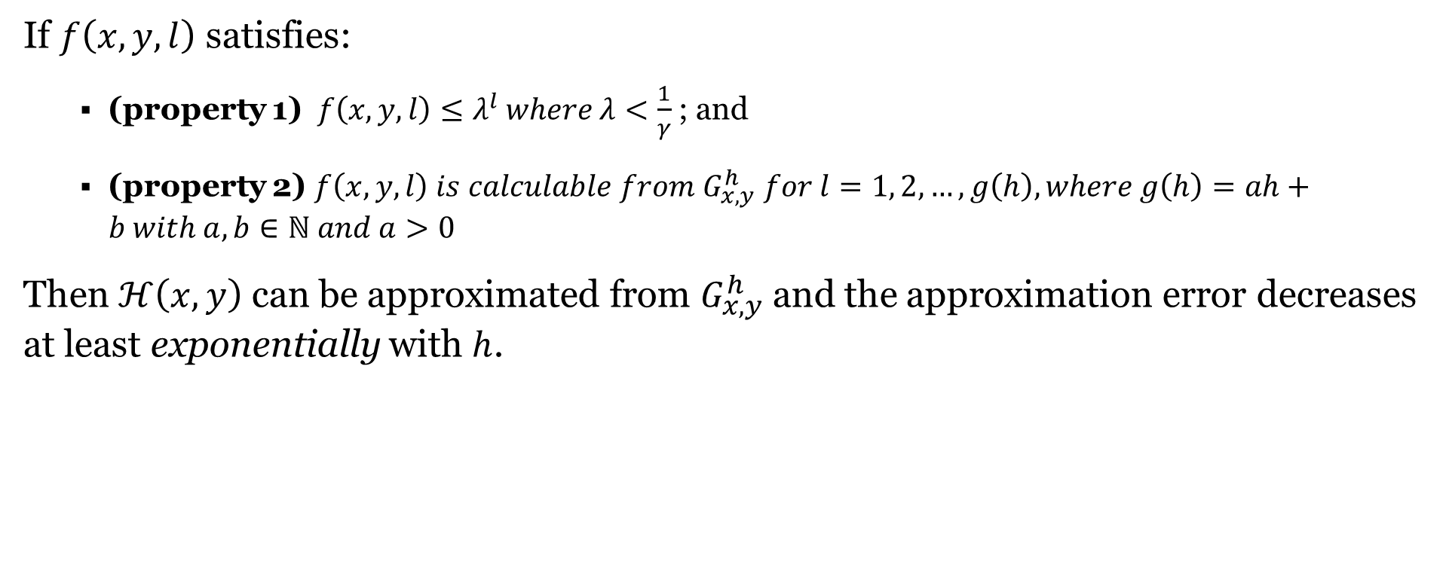
γ-decaying Heuristic
If $f\left(x, y, l\right)$ satisfies:
(property 1) $f\left(x, y, l\right)≤λ^{l} where λ<\frac{1}{γ}$; and
(property 2) $f\left(x, y,l\right) is calculable from G_{x, y}^{h} for l=1, 2, …, g\left(h\right), where g\left(h\right)=ah+b with a, b∈ℕ and a>0$
Then $ℋ\left(x,y\right)$ can be approximated from $G_{x, y}^{h}$and the approximation error decreases at least exponentially with $h$.

Slide 14

γ-decaying Heuristic
$$\tilde{ℋ}\left(x,y\right)=η\sum_{l=1}^{g(h)}{γ^{l}}f\left(x,y,l\right)$$
$$| ℋ\left(x,y\right)− \tilde{ℋ}\left(x,y\right) |=η\sum_{l=g\left(h\right)+1}^{∞}{γ^{l}}f\left(x,y,l\right)≤η\sum_{l=ah+b+1}^{∞}{γ^{l}λ^{l}=η{\left(γλ\right)}^{ah+b+1}}{\left(1−γλ\right)}^{−1}$$
$$f\left(x, y, l\right)≤λ^{l} where λ<\frac{1}{γ}$$
Let’s analyze Katz Index, Rooted PageRank and SimRank one by one.

Slide 15
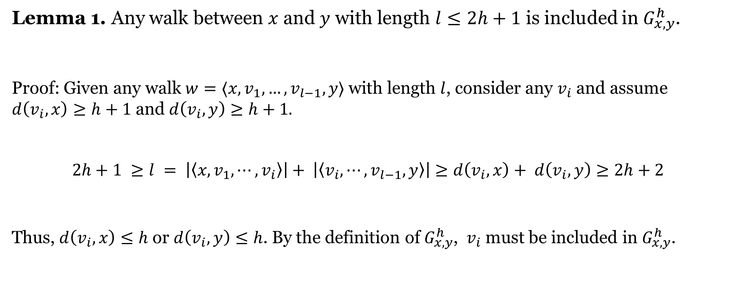
γ-decaying Heuristic
Lemma 1. Any walk between $x$ and $y$ with length $l≤2h+1$ is included in $G_{x,y}^{h}$.
Proof: Given any walk $w={⟨x, v}_{1}, …,v_{l−1},y〉$ with length $l$, consider any $v_{i}$ and assume $d\left(v_{i}, x\right)≥h+1$ and $d\left(v_{i}, y\right)≥h+1.$
$$2h+1 ≥l = \left|\left\langle x, v_{1},⋯,v_{i}\right\rangle \right|+ \left|\left\langle v_{i},⋯,v_{l−1},y\right\rangle \right|≥d\left(v_{i},x\right)+ d\left(v_{i},y\right)≥2h+2$$
Thus, $d\left(v_{i},x\right)≤h$or $d\left(v_{i},y\right)≤h$. By the definition of $G_{x, y}^{h}$, $v_{i}$ must be included in $G_{x, y}^{h}$.
a contradiction!

Slide 16

Katz Index
$${Katz}_{x,y}=\sum_{l=1}^{∞}{β^{l}}\left|{walks}^{\left\langle l\right\rangle }\left(x,y\right)\right|=\sum_{l=1}^{∞}{β^{l}{\left[A^{l}\right]}_{x,y}}$$
${walks}^{\left\langle l\right\rangle }\left(x, y\right)$: the set of length-$l$ walks between $x$and $y$
$A^{l}$ : the $l^{th}$power of the adjacency matrix
$β^{l}$ $(0<β<1)$: discount factor

Slide 17





Katz Index
$${Katz}_{x,y}=\sum_{l=1}^{∞}{β^{l}}\left|{walks}^{\left\langle l\right\rangle }\left(x,y\right)\right|=\sum_{l=1}^{∞}{β^{l}{\left[A^{l}\right]}_{x,y}}$$
0 | 1 | 0 | 0
1 | 0 | 1 | 0
0 | 1 | 0 | 1
0 | 0 | 1 | 0
1 | 0 | 1 | 0
0 | 2 | 0 | 1
1 | 0 | 2 | 0
0 | 1 | 0 | 1
0 | 2 | 0 | 1
2 | 0 | 3 | 0
0 | 3 | 0 | 2
1 | 0 | 2 | 0
1
2
3
4
$$A$$
$$A^{2}$$
$$A^{3}$$
$$walks^{\left\langle 2\right\rangle }\left(1, 4\right)= ∅$$
$$walks^{\left\langle 3\right\rangle }(2, 3)= \left\{\left\langle 2, 3, 4, 3\right\rangle ,\left\langle 2, 1, 2, 3\right\rangle ,\left\langle 2, 3, 2, 3\right\rangle \right\}$$

Slide 18

Katz Index
$${Katz}_{x,y}=\sum_{l=1}^{∞}{β^{l}}\left|{walks}^{\left\langle l\right\rangle }\left(x,y\right)\right|=\sum_{l=1}^{∞}{β^{l}{\left[A^{l}\right]}_{x,y}}$$
According to Lemma 1, $\left|{walks}^{\left\langle l\right\rangle }\left(x,y\right)\right|$ is calculable from $G_{x, y}^{h}$for $l≤g\left(h\right)=2h+1$, thus property 2 is satisfied.

Slide 19
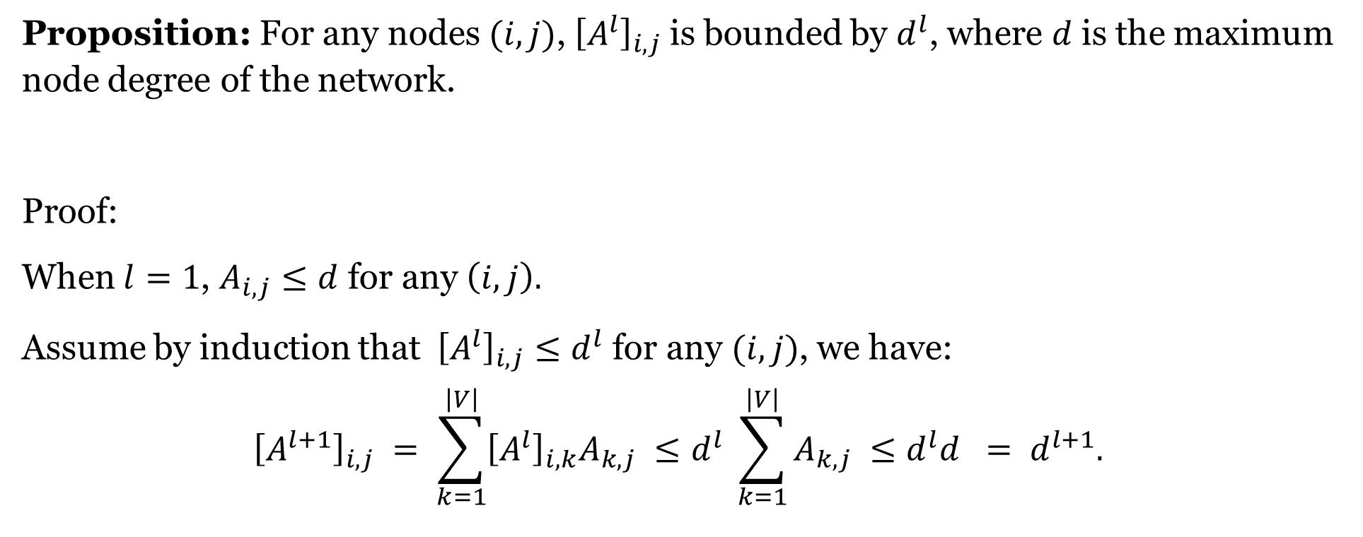
Katz Index
Proposition: For any nodes $(i,j)$, ${\left[A^{l}\right]}_{i,j}$is bounded by $d^{l}$, where $d$ is the maximum node degree of the network.
Proof:
When $l=1$, $A_{i, j}≤d$ for any $\left(i, j\right).$
Assume by induction that ${\left[A^{l}\right]}_{i,j}≤d^{l}$ for any $(i,j)$, we have:
$${\left[A^{l+1}\right]}_{i,j} = \sum_{k=1}^{\left|V\right|}{{\left[A^{l}\right]}_{i,k}A_{k,j}} ≤d^{l} \sum_{k=1}^{\left|V\right|}{A_{k,j}} ≤d^{l}d = d^{l+1}.$$

Slide 20
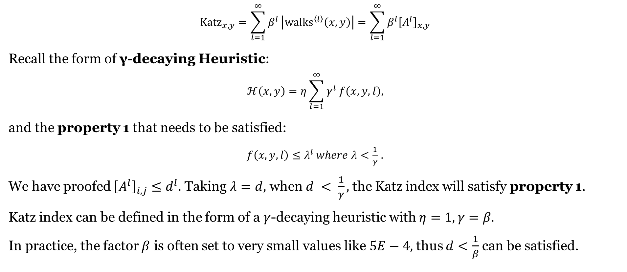
Katz Index
$${Katz}_{x,y}=\sum_{l=1}^{∞}{β^{l}}\left|{walks}^{\left\langle l\right\rangle }\left(x,y\right)\right|=\sum_{l=1}^{∞}{β^{l}{\left[A^{l}\right]}_{x,y}}$$
Recall the form of γ-decaying Heuristic:
$$ℋ\left(x,y\right)=η\sum_{l=1}^{∞}{γ^{l}}f\left(x,y,l\right),$$
and the property 1 that needs to be satisfied:
$f\left(x, y, l\right)≤λ^{l} where λ<\frac{1}{γ}$ .
We have proofed ${\left[A^{l}\right]}_{i,j}≤d^{l}.$ Taking $λ=d,$ when $d < \frac{1}{γ},$ the Katz index will satisfy property 1.
Katz index can be defined in the form of a $γ$-decaying heuristic with $η=1, γ=β.$
In practice, the factor $β$ is often set to very small values like $5E−4,$thus $d<\frac{1}{β}$can be satisfied.

Slide 21
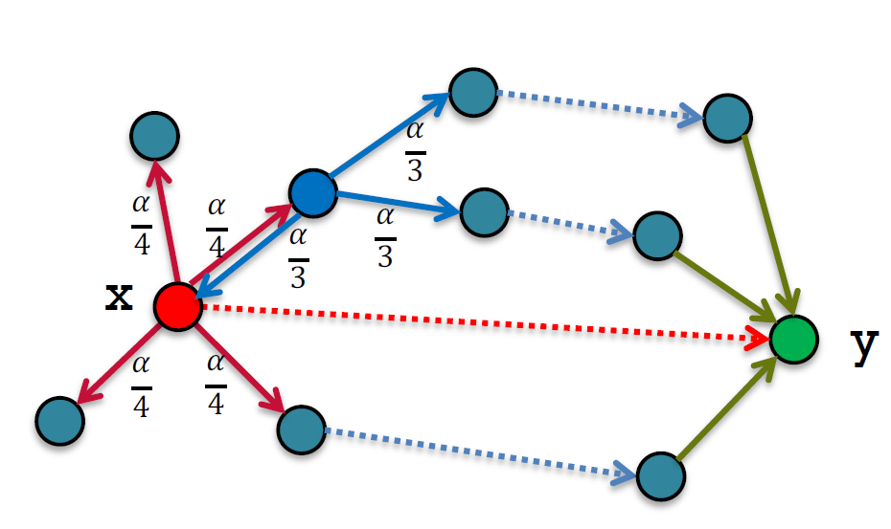
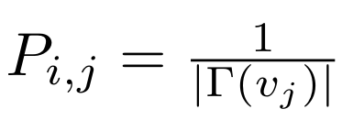
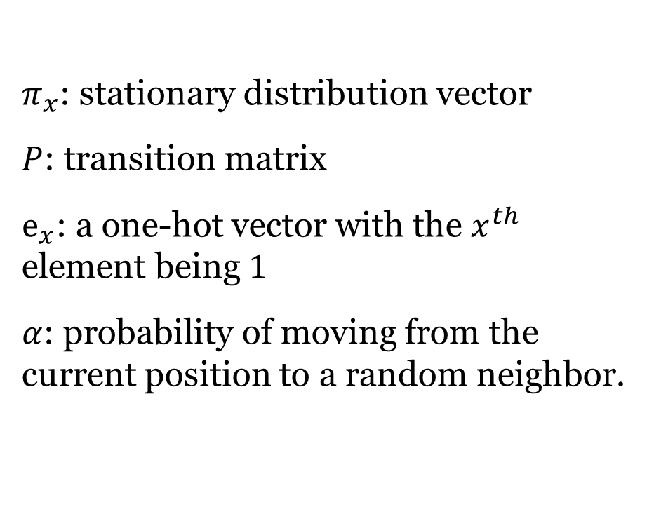
Rooted PageRank
$π_{x}$: stationary distribution vector
$P$: transition matrix
$e_{x}$: a one-hot vector with the $x^{th}$ element being $1$
$α$: probability of moving from the current position to a random neighbor.
$$π_{x} = α P π_{x}+ \left(1−α\right)e_{x}$$
[4]

Slide 22
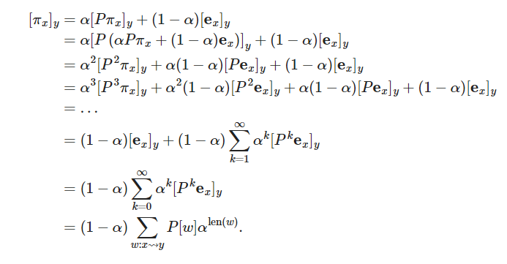
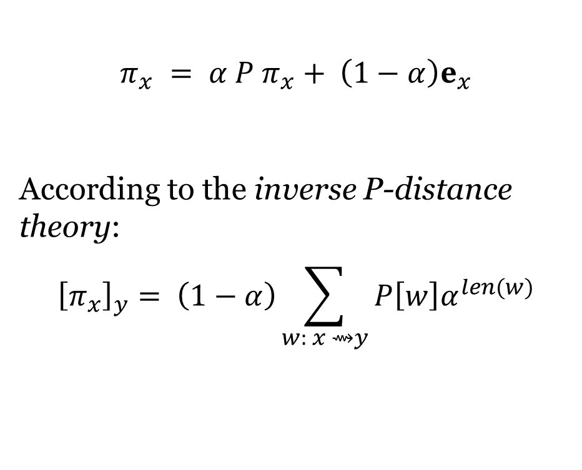
Rooted PageRank
$$π_{x} = α P π_{x}+ \left(1−α\right)e_{x}$$
According to the inverse P-distance theory:
$${\left[π_{x}\right]}_{y}= \left(1−α\right)\sum_{w: x ⇝y}{{P\left[w\right]α}^{len(w)}}$$

Slide 23

Rooted PageRank
$${\left[π_{x}\right]}_{y}= \left(1−α\right)\sum_{w: x ⇝y}{{P\left[w\right]α}^{len(w)}}$$
We can rewrite it in the following form:
$${\left[π_{x}\right]}_{y}= \left(1−α\right)\sum_{l=1}^{∞}{\sum_{\begin{aligned}w: x ⇝y \\ len\left(w\right)=l\end{aligned}}{{P\left[w\right]α}^{l}}}$$

Slide 24
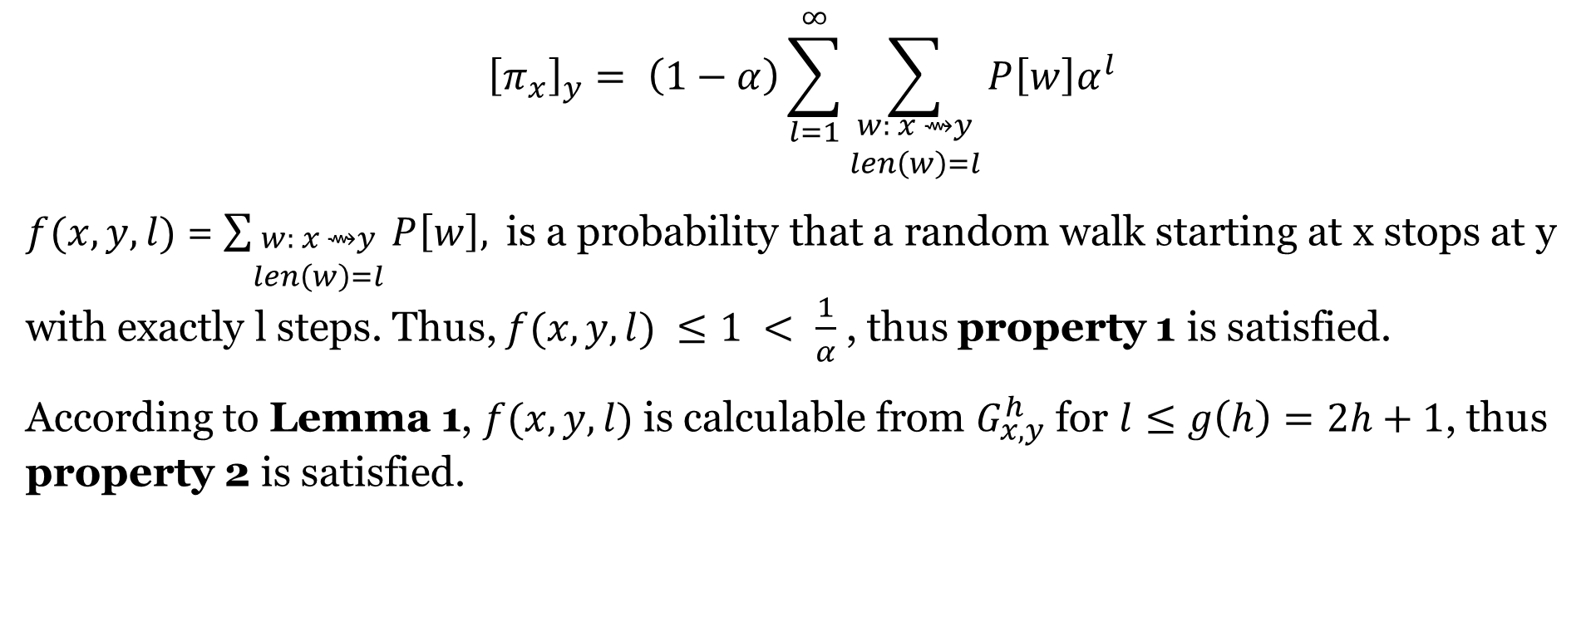
Rooted PageRank
$${\left[π_{x}\right]}_{y}= \left(1−α\right)\sum_{l=1}^{∞}{\sum_{\begin{aligned}w: x ⇝y \\ len\left(w\right)=l\end{aligned}}{{P\left[w\right]α}^{l}}}$$
$f(x, y, l)$ = $\sum_{\begin{aligned}w: x ⇝y \\ len\left(w\right)=l\end{aligned}}{P\left[w\right], }$is a probability that a random walk starting at x stops at y with exactly l steps. Thus, $f(x,y,l) ≤1 < \frac{1}{α}$ , thus property 1 is satisfied.
According to Lemma 1, $f(x, y, l)$is calculable from $G_{x, y}^{h}$for $l≤g\left(h\right)=2h+1$, thus property 2 is satisfied.

Slide 25
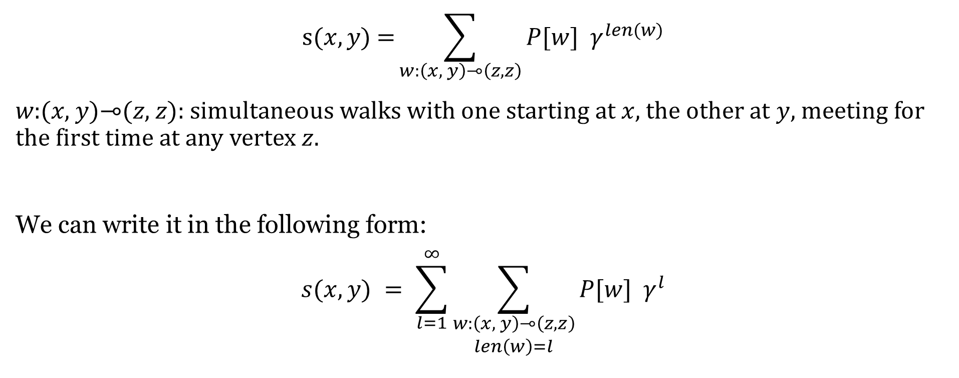
SimRank
$$\text{s}(x,y\text{) =}\sum_{w:\left(x, y\right)⊸\left(z,z\right)}{P[w] γ^{len(w)}}$$
𝑤:(𝑥, 𝑦)⊸(𝑧, 𝑧): simultaneous walks with one starting at $x,$the other at $y$, meeting for the first time at any vertex $z$.
We can write it in the following form:
$$s(x,y) = \sum_{l=1}^{∞}{\sum_{\begin{aligned}w:\left(x, y\right)⊸\left(z,z\right) \\ len\left(w\right)=l\end{aligned}}{P[w] γ^{l}}}$$

Slide 26
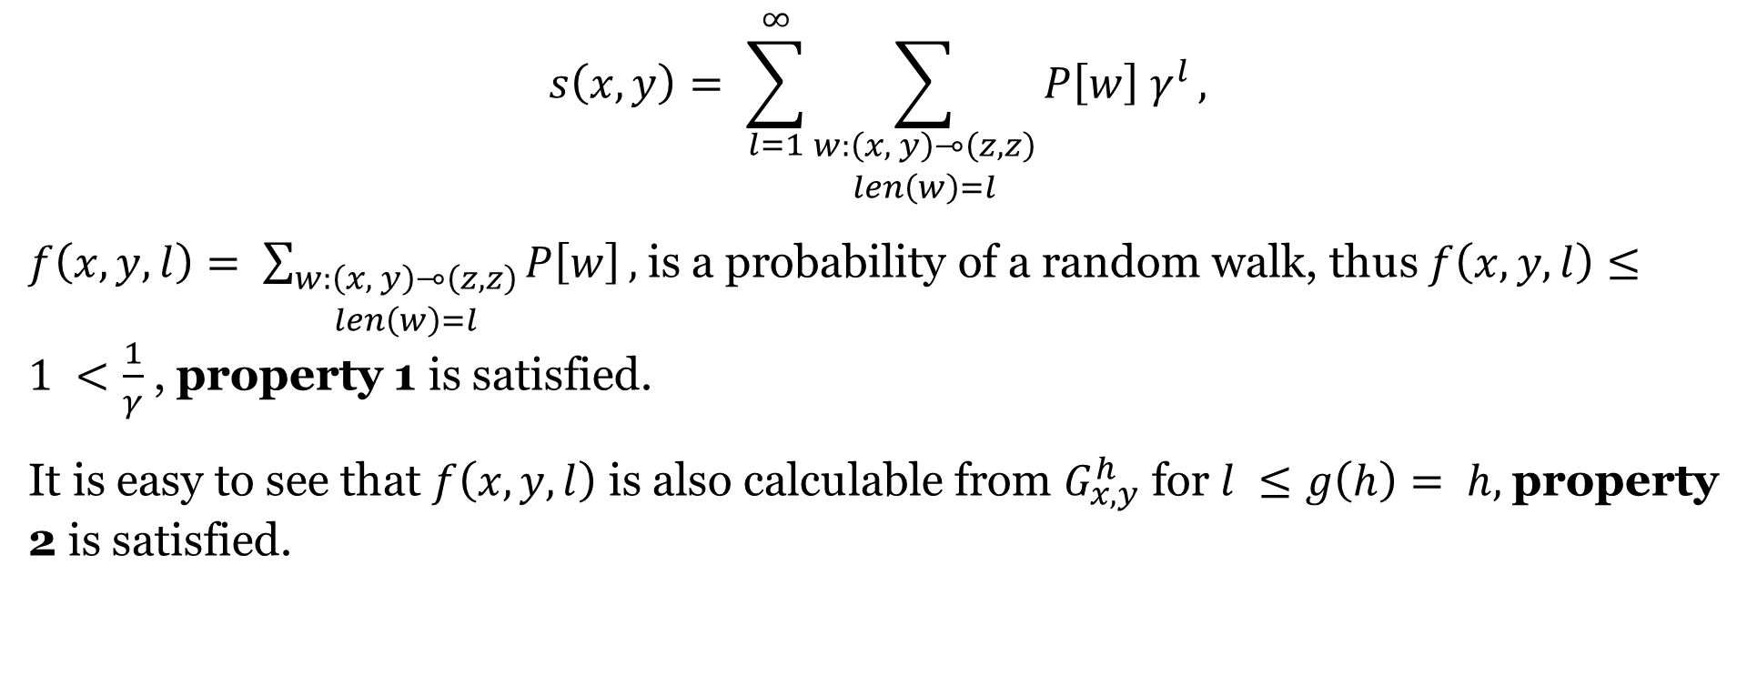
SimRank
$$s\left(x,y\right)= \sum_{l=1}^{∞}{\sum_{\begin{aligned}w:\left(x, y\right)⊸\left(z,z\right) \\ len\left(w\right)=l\end{aligned}}{P\left[w\right] γ^{l}}},$$
$f\left(x, y, l\right)= \sum_{\begin{aligned}w:\left(x, y\right)⊸\left(z,z\right) \\ len\left(w\right)=l\end{aligned}}{P\left[w\right]},$is a probability of a random walk, thus $f\left(x,y,l\right)≤1 <\frac{1}{γ}$ , property 1 is satisfied.
It is easy to see that $f\left(x,y,l\right)$ is also calculable from $G_{x,y}^{h}$ for $l ≤g\left(h\right)= h,$property 2 is satisfied.

Slide 27
γ-decaying Heuristic
What we already know:
High-order heuristics inherently share the same 𝛾-decaying heuristic form. They can be effectively approximated from an h-hop enclosing subgraph with exponentially smaller approximation error.
Local enclosing subgraphs already contain enough information to learn good graph structure features for link prediction.
If we learn a heuristic from enclosing subgraphs in a supervised manner, it is expected to achieve performance at least as good as a wide range of heuristics.

Slide 28
Previous Supervised Heuristic Learning Methods
Weisfeiler-Lehman Neural Machine (WLNM)
also learns from local subgraphs
trains a fully-connected neural network on the subgraphs’ adjacency matrices
requires truncating different subgraphs to the same size, which may lose much structural information
Train a supervised learning model on different heuristics’ combination.
still relies on predefined heuristics

Slide 29
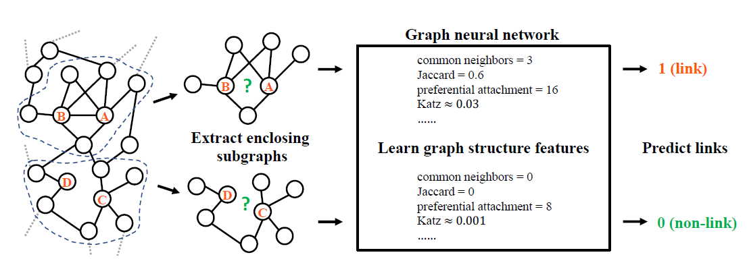
Proposed Solution: The SEAL Framework
SEAL (learning from Subgraphs, Embeddings and Attributes for Link prediction)
Three Steps:
Enclosing subgraph extraction
Node information matrix construction
GNN learning
Learns a “heuristic” that best explains the link formations automatically.
No assumption on network properties at all!
[2, Fig. 1]

Slide 30
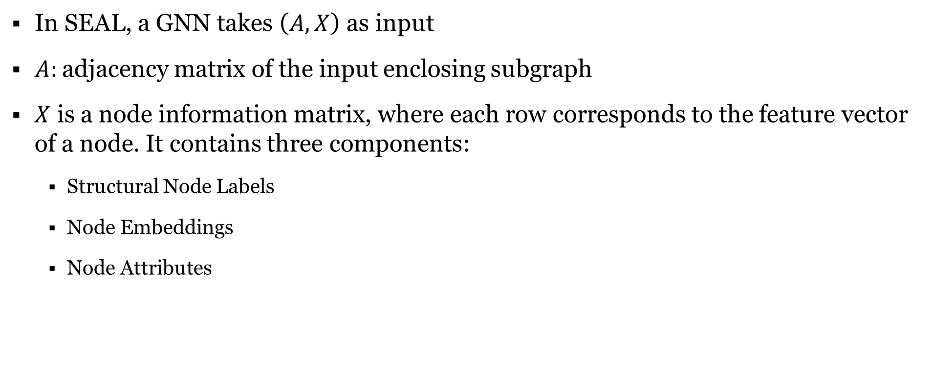
Node Information Matrix Construction
In SEAL, a GNN takes $\left(A, X\right)$ as input
$A:$adjacency matrix of the input enclosing subgraph
$X$ is a node information matrix, where each row corresponds to the feature vector of a node. It contains three components:
Structural Node Labels
Node Embeddings
Node Attributes

Slide 31
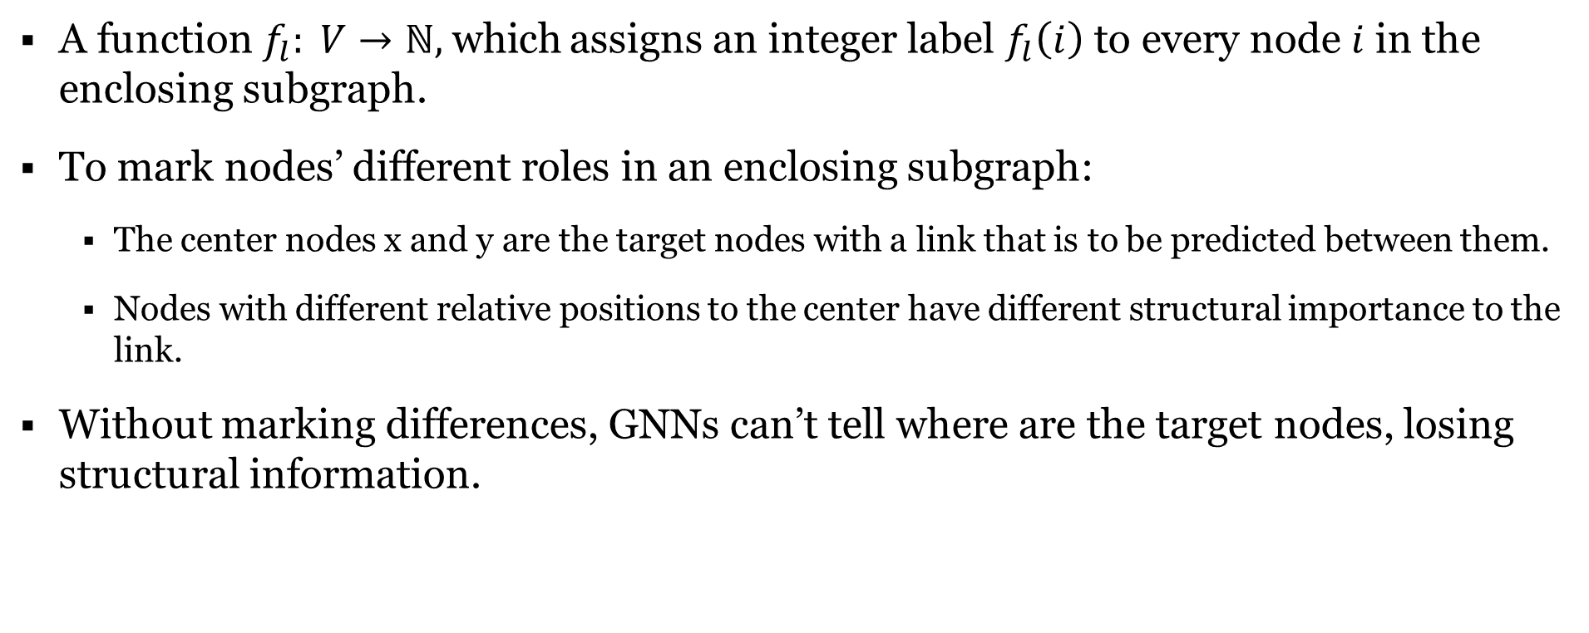
Node Labeling Trick
A function$f_{l}: V→ℕ,$which assigns an integer label $f_{l}\left(i\right)$ to every node $i$ in the enclosing subgraph.
To mark nodes’ different roles in an enclosing subgraph:
The center nodes x and y are the target nodes with a link that is to be predicted between them.
Nodes with different relative positions to the center have different structural importance to the link.
Without marking differences, GNNs can’t tell where are the target nodes, losing structural information.

Slide 32
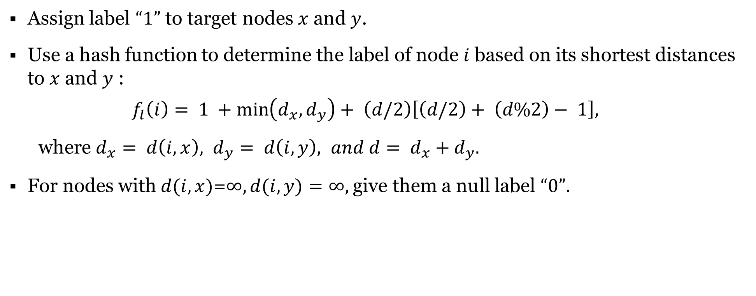
Double-Radius Node Labeling (DRNL)
Assign label $“1”$ to target nodes $x$ and $y$.
Use a hash function to determine the label of node $i$ based on its shortest distances to $x$ and $y$ :
$$f_{l}\left(i\right)= 1 +\min\left(d_{x}, d_{y}\right)+ \left(d/2\right)\left[\left(d/2\right)+ \left(d\%2\right)− 1\right],$$
where $d_{x}= d\left(i,x\right), d_{y}= d\left(i, y\right), and d= d_{x}+d_{y}.$
For nodes with $d(i,x)$=$∞, d(i, y)=∞,$give them a null label $“0”.$

Slide 33
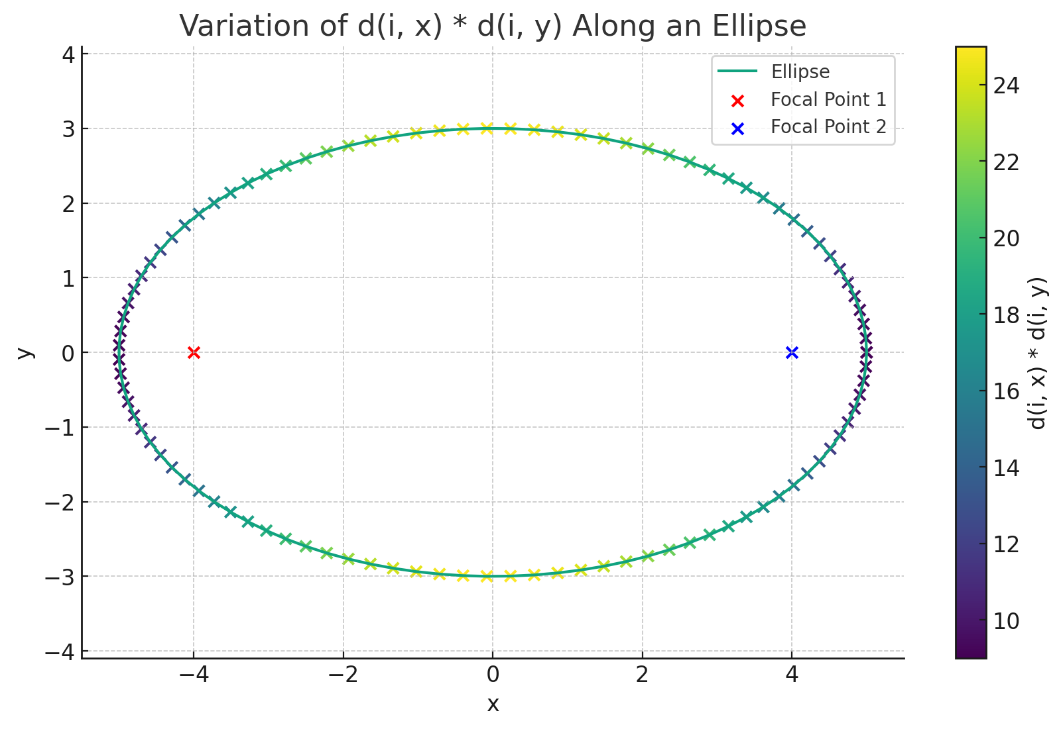

Double-Radius Node Labeling (DRNL)
the label $f_{l}(i)$ and the double-radius $(d(i, x), d(i, y))$satisfy:
$if d(i,x)+d(i,y)≠d(j, x)+d\left(j,y\right), then d(i,x)+d(i,y)<d(j,x)+d(j,y)⇔f_{l}(i)< f_{l}(j);$
$if d(i,x)+d(i,y)=d(j, x)+d(j,y), then d(i,x)d(i,y) < d(j, x)d(j,y) ⇔f_{l}(i) < f_{l}(j);$

Slide 34

Double-Radius Node Labeling (DRNL)

Slide 35
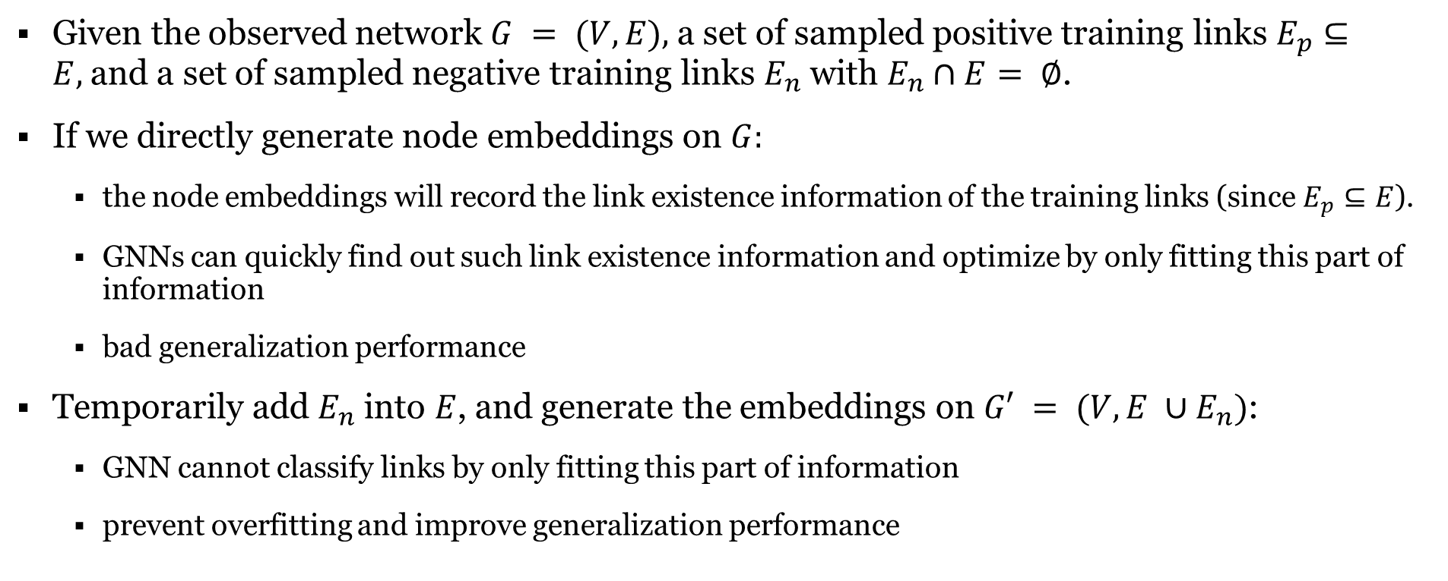
Generating The Node Embeddings for SEAL
Given the observed network $G = (V, E),$a set of sampled positive training links $E_{p}⊆E,$and a set of sampled negative training links $E_{n}$ with $E_{n}∩E= ∅$.
If we directly generate node embeddings on $G:$
the node embeddings will record the link existence information of the training links (since $E_{p}⊆E$).
GNNs can quickly find out such link existence information and optimize by only fitting this part of information
bad generalization performance
Temporarily add $E_{n}$ into $E$, and generate the embeddings on $G′ = (V, E ∪E_{n})$:
GNN cannot classify links by only fitting this part of information
prevent overfitting and improve generalization performance

Slide 36
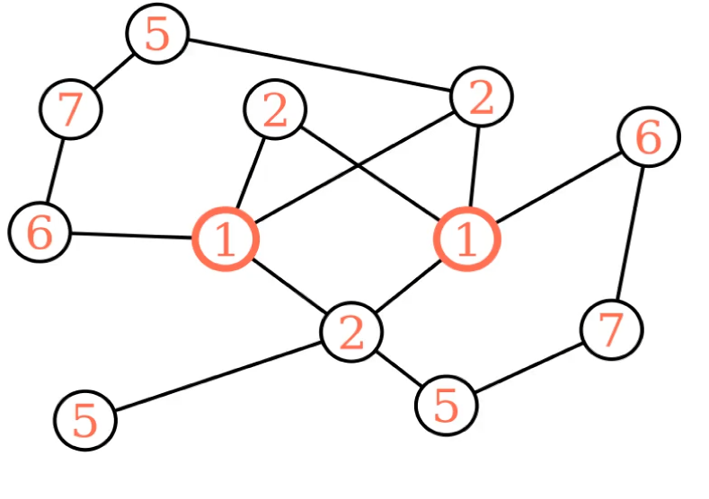
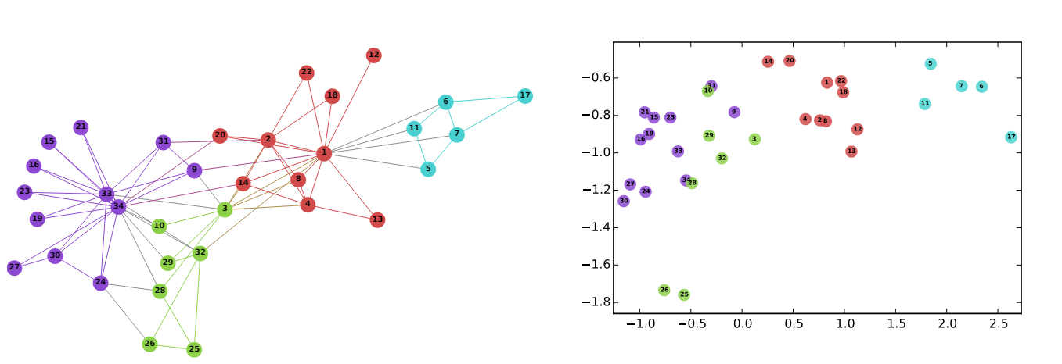
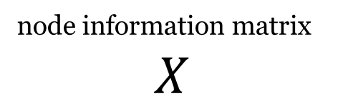
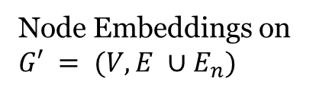
Node Information Matrix Construction
SEAL (learning from Subgraphs, Embeddings and Attributes for Link prediction)
Structural node labels
(one-hot encoding)
node information matrix
$$X$$
Node Embeddings on $G′ = (V, E ∪E_{n})$
GNN
[5, Fig. 1]
Node Attributes

Slide 37
Experiments
Datasets:
8 datasets: USAir, NS, PB, Yeast, C.ele, Power, Router, and E.coli
randomly remove 10% existing links from each dataset as positive testing data
randomly sample the same number of non-existent links (unconnected node pairs) as negative testing data
Use the remaining 90% of existing links and an equal number of additional non-existent links to build the training data

Slide 38
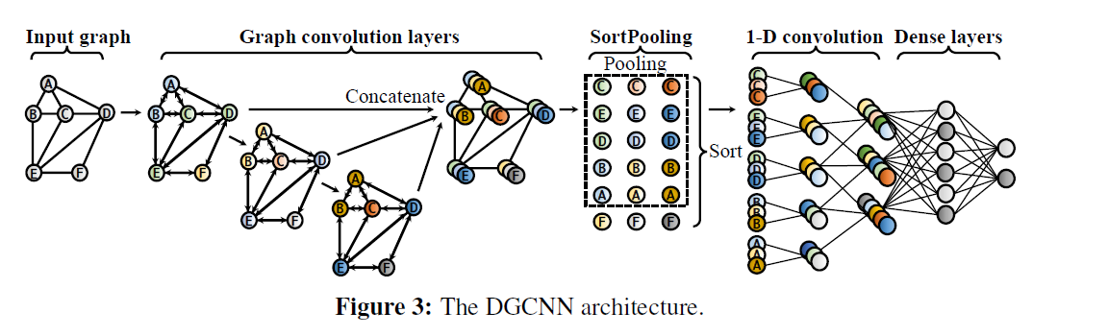

Experiments
SEAL is flexible with what GNN or node embeddings to use
In this paper:
DGCNN is used as the default GNN
node2vec is employed as the default node embeddings
$h≤3$
[2]

Slide 39
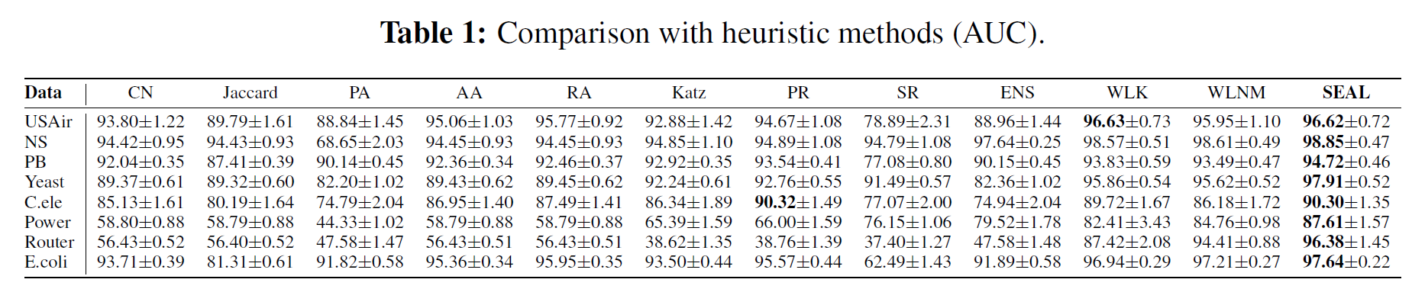
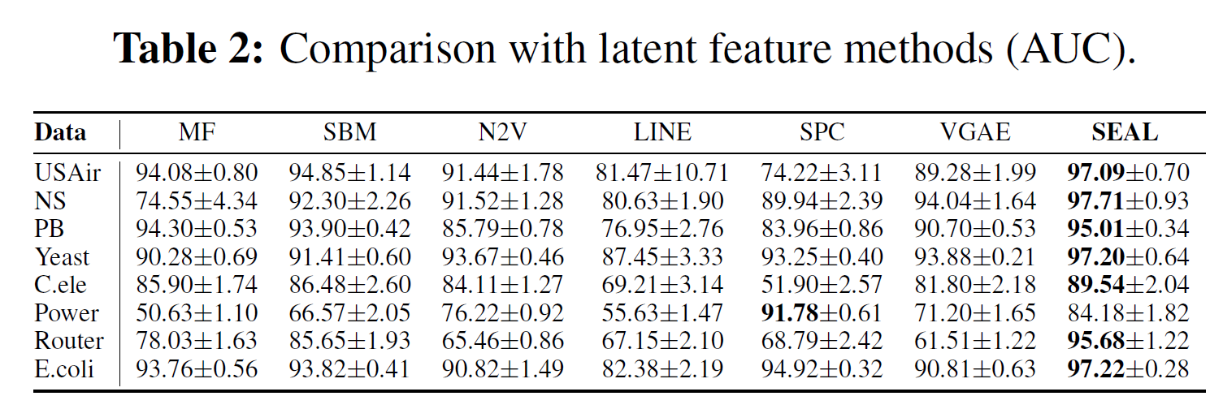
Experiments
[2]

Slide 40
Conclusion
This paper establishes a theoretical foundation for why learning from local subgraphs is effective for link prediction.
A novel γ-decaying heuristic theory is proposed:
It unifies a wide range of existing heuristics under a single framework,
And demonstrate that local subgraphs retain significant information related to link existence.
GNNs could learns the best “heuristic” automatically with local subgraphs by incorporating structural information, node embeddings, and node attributes.

Slide 41
Interesting Questions The Paper Raise
It remains an open question whether the properties essential for the γ-decay heuristic theory are intrinsically met by GNNs, or if specific conditions or architectures are needed.

Slide 42
References
[1]
[2]
[3]
[4]
[5]
I. Ahmad, M. U. Akhtar, S. Noor, and A. Shahnaz, “Missing Link Prediction using Common Neighbor and Centrality based Parameterized Algorithm,” Sci Rep, vol. 10, no. 1, p. 364, Jan. 2020, doi: 10.1038/s41598-019-57304-y
M. Zhang and Y. Chen, “Link prediction based on graph neural networks,” in Proceedings of the 32nd International Conference on Neural Information Processing Systems, in NIPS’18. Red Hook, NY, USA: Curran Associates Inc., Dec. 2018, pp. 5171–5181.
István A Kovács, Katja Luck, Kerstin Spirohn, Yang Wang, Carl Pollis, Sadie Schlabach, Wenting Bian, Dae-Kyum Kim, Nishka Kishore, Tong Hao, et al. Network-based prediction of protein interactions. bioRxiv, page 275529, 2018.
M. Zhang and Y. Chen, “Link prediction based on Graph Neural Networks – NeurIPS Slides”. Accessed: Mar. 26, 2024. [Online]. Available: https://nips.cc/media/Slides/nips/2018/220cd(06-09-45)-06-10-30-12707-Link_Prediction.pdf
B. Perozzi, R. Al-Rfou, and S. Skiena, “DeepWalk: online learning of social representations,” in Proceedings of the 20th ACM SIGKDD international conference on Knowledge discovery and data mining, in KDD ’14. New York, NY, USA: Association for Computing Machinery, Aug. 2014, pp. 701–710. doi: 10.1145/2623330.2623732.

Slide 43
Thank You!

