Slide 1
Line Graph Neural Networks for Link prediction
Authors: Lei Cai et al.
Presented by Amr Abouelkhair

Slide 2
Agenda
What is the problem?
Why is it important?
Previous approaches and their limitations
Proposed Approach
Experiments
Experimental results
Conclusion
Questions

Slide 3
What is the problem?
Most efforts in the graph and GNN space target graph and node classification tasks
Link prediction in a graph became a function or a post process of node processing.
However, this leads to loss of information as it gets aggregated into the target node before it is used for the link prediction tasks

Slide 4
Why is this problem important?
Many real-world use cases are essentially link prediction tasks like friend recommendation in social networks or detection malicious activities in intrusion detection systems

Slide 5
Current approaches
Prior to this work, the most popular approach for link prediction has been using a heuristic.
Most heuristics make strong assumptions about when links should exist
These preform well on the datasets they are built for and compute reasonably fast
This results in very poor generalization
Examples include common neighbors, PageRank and Katz Index

Slide 6
Current approaches
There has been an attempt by SEAL to learn those heuristics from h-hop neighborhood using GNNs
This method achieves state of the art performance
However, it conducts the learning on the nodes rather than the edge attributes which require graph pooling layers and could result in some loss of information

Slide 7
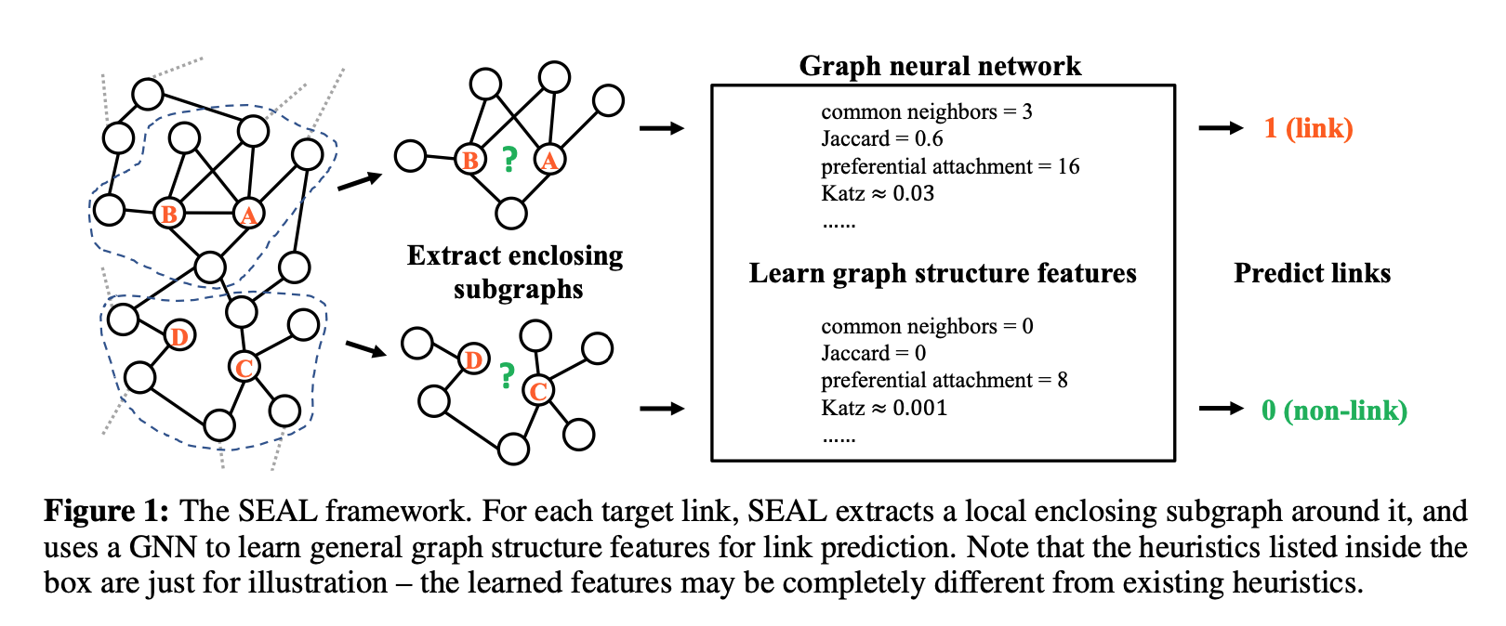
SEAL Approach
* Diagram from Zhang, Muhan, and Yixin Chen. "Link prediction based on graph neural networks." Advances in neural information processing systems 31 (2018).

Slide 8
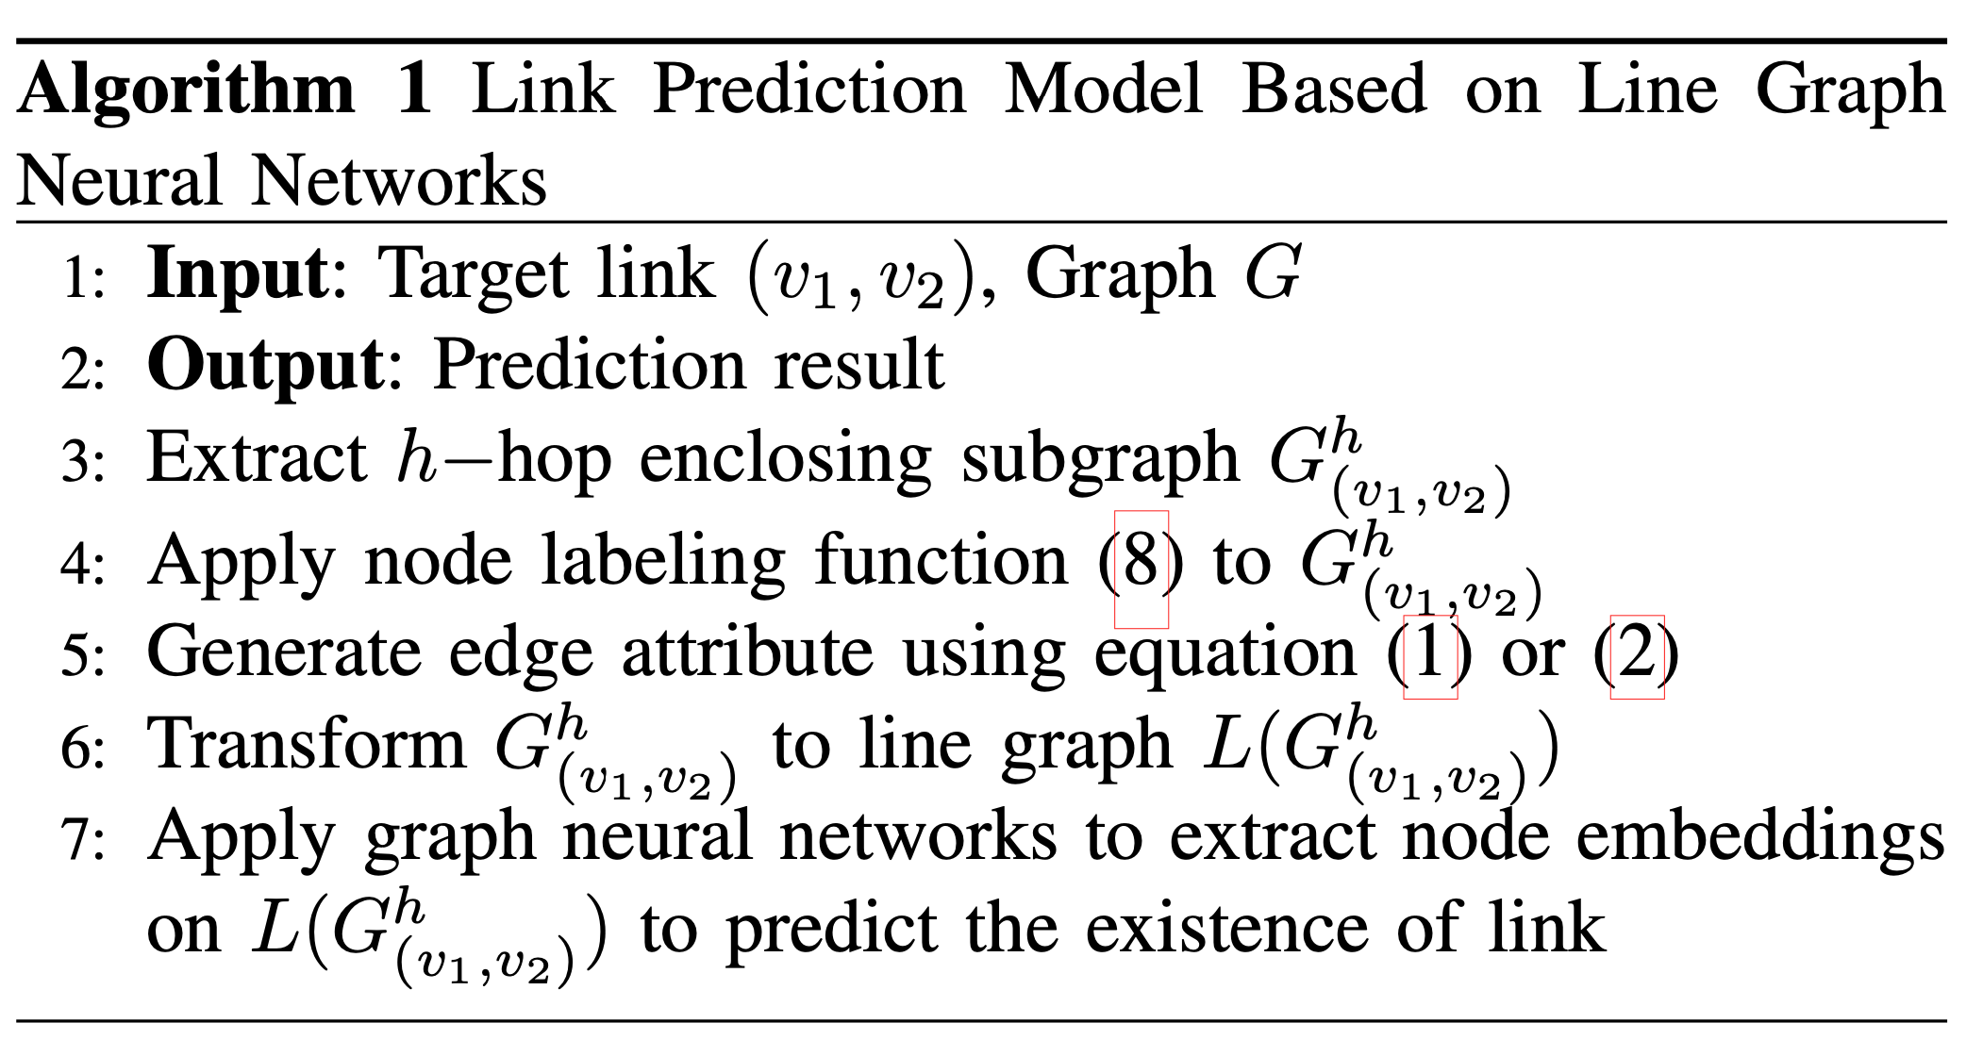
The Proposed Approach
Essentially the authors propose preprocessing the graph and reformatting it to what they call a line graph to allow us to train the GNN directly on the edges

Slide 9
The Proposed Approach (Step 1: Preprocessing)
First, we need to extract the enclosing subgraph
Therefore, we pick an h-hop neighborhood centered around the two nodes surrounding the link we want to predict the existence of
Notes:
Before we can convert the graph to a line-graph we need to do some preprocessing
The topology of the local subgraph is needed to determine whether a link exists or not
The authors propose using a 2-hop subgraph to balance performance and computation cost

Slide 10
The Proposed Approach (Step 2: Node Labeling)
Therefore, we need to label the nodes that identify the target node as well as provide the structural importance of each node w.r.t the target link
The authors proposed the following function
Notes:
Given the extracted subgraph, we want to determine the importance of each node in the structure before learning features and predicting a link
ds = d(v, v1) + d(v, v2), (ds/2) and (ds%2) are the integer quotient and remainder of d divided by 2,
These labels are then used to generate labels and embeddings for the edges in the line graph

Slide 11
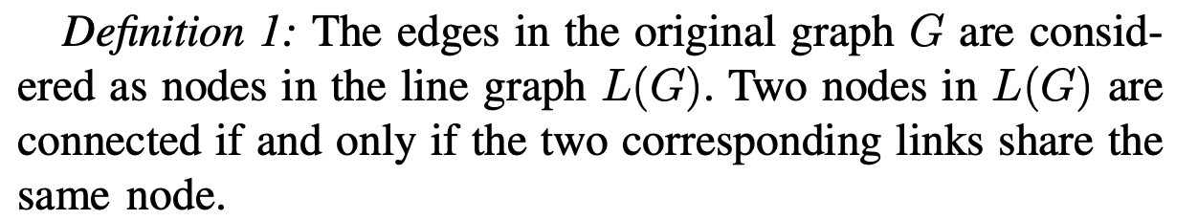
Line Graph Neural Networks (Step 3: Space transformation)
What is a line graph?
Notes:
Once we extract the enclosing subgraph and label all its nodes, we are now ready to convert it to a line graph

Slide 12
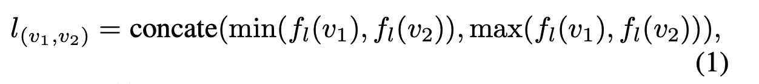
Line Graph Neural Networks (Step 4: Node label transformation)
We need to do a transformation to generate labels for edges in the original graph which could then be applied directly to nodes in the line graph
To generate the labels for edges the author propose the functions
Notes:
Prior to feeding the line graph to a GNN to predict the existence of a link we also need to label the nodes of the line graph

Slide 13
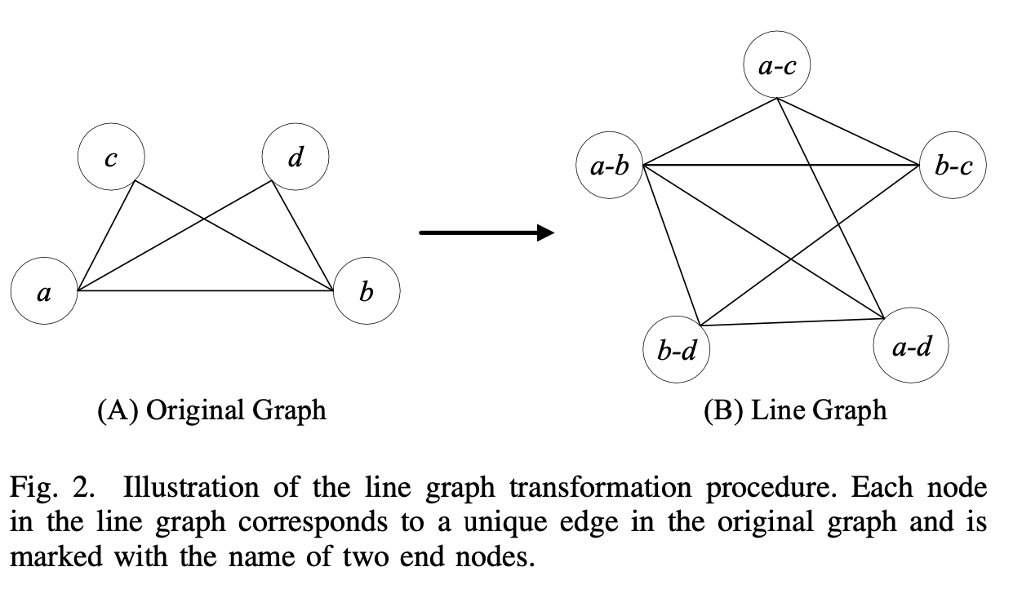
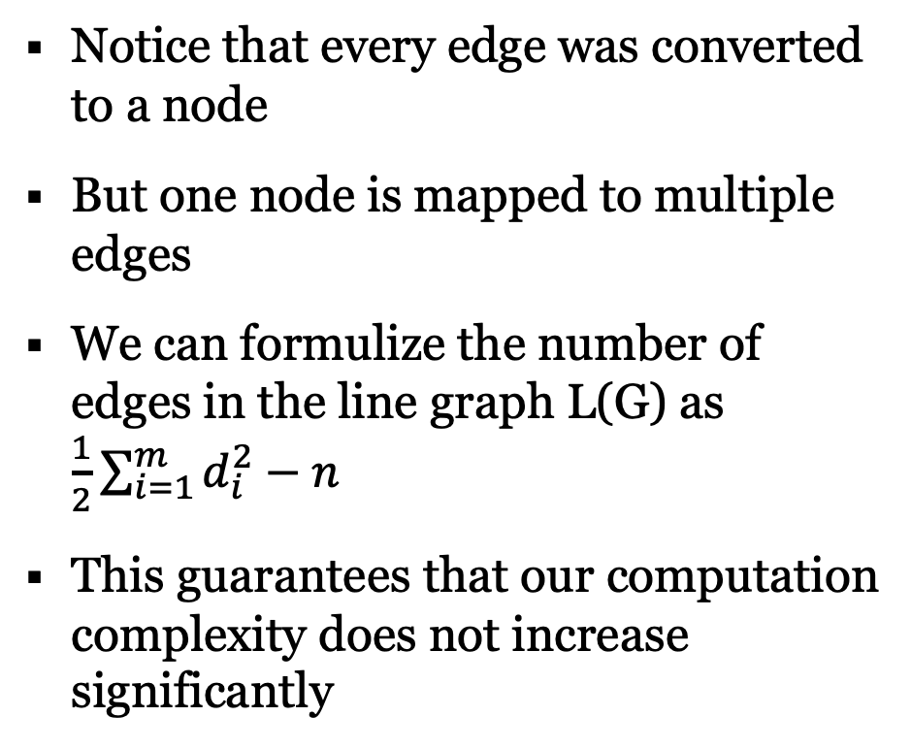
Example of Graph to Line graph conversion
Notice that every edge was converted to a node
But one node is mapped to multiple edges
We can formulize the number of edges in the line graph L(G) as $\frac{1}{2}\sum_{i=1}^{m}{d_{i}^{2}−n}$
This guarantees that our computation complexity does not increase significantly

Slide 14
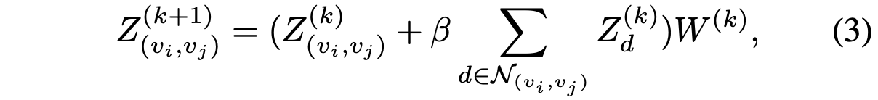

Line Graph Neural Networks (Step 5: Feature Learning)
The authors use graph convolutions NN to learn the node embeddings for the line graph
The embedding is defined as:
With $Z_{(v_{i},v_{j})}^{0}=l_{(v_{i},v_{j})}$
Notes:
Now that the line graph is generated and labeled, we can use GNNs to learn its features

Slide 15
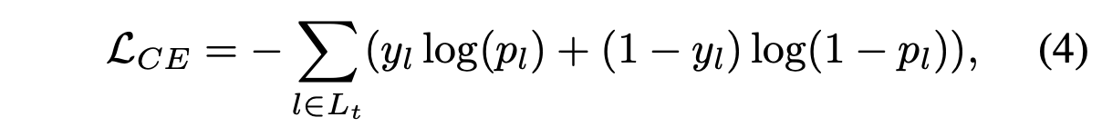
Training the GCNN
We train the NN for link prediction by treating it as a binary classification for edges the exist in the graph and those that do not
We attempt to minimize cross entropy defined as

Slide 16
Finalized Algorithm
Notes:
Go step by step here I will also link the numbers from here to slides from before

Slide 17
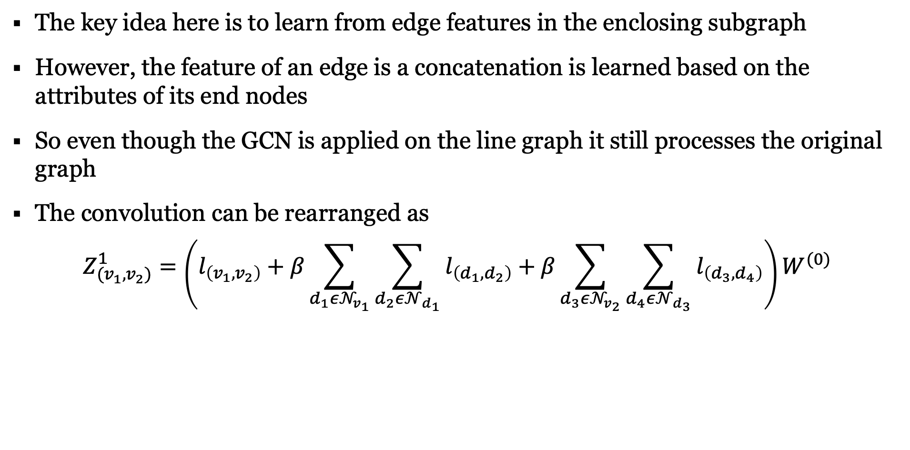
How does this relate to Learning on the original graph?
The key idea here is to learn from edge features in the enclosing subgraph
However, the feature of an edge is a concatenation is learned based on the attributes of its end nodes
So even though the GCN is applied on the line graph it still processes the original graph
The convolution can be rearranged as
$$Z_{(v_{1},v_{2})}^{1}=\left(l_{\left(v_{1},v_{2}\right)}+β\sum_{d_{1}ε𝒩_{v_{1}}}{\sum_{d_{2}ε𝒩_{d_{1}}}{l_{\left(d_{1},d_{2}\right)}}}+β\sum_{d_{3}ε𝒩_{v_{2}}}{\sum_{d_{4}ε𝒩_{d_{3}}}{l_{\left(d_{3},d_{4}\right)}}}\right)W^{(0)}$$
Notes:
Too much text
Fix typo for the equation
Simplify it further

Slide 18
How does this relate to Learning on the original graph?
Note that in 1-hop convolution of the line graph we aggregate information from the 2-hop neighborhood in the original graph
That’s because in the line graph each node is derived from 2 nodes in the original graph
This shows the learning the embeddings and applying the convolution on the line graph can be more efficient than the original graph in terms of aggregation

Slide 19
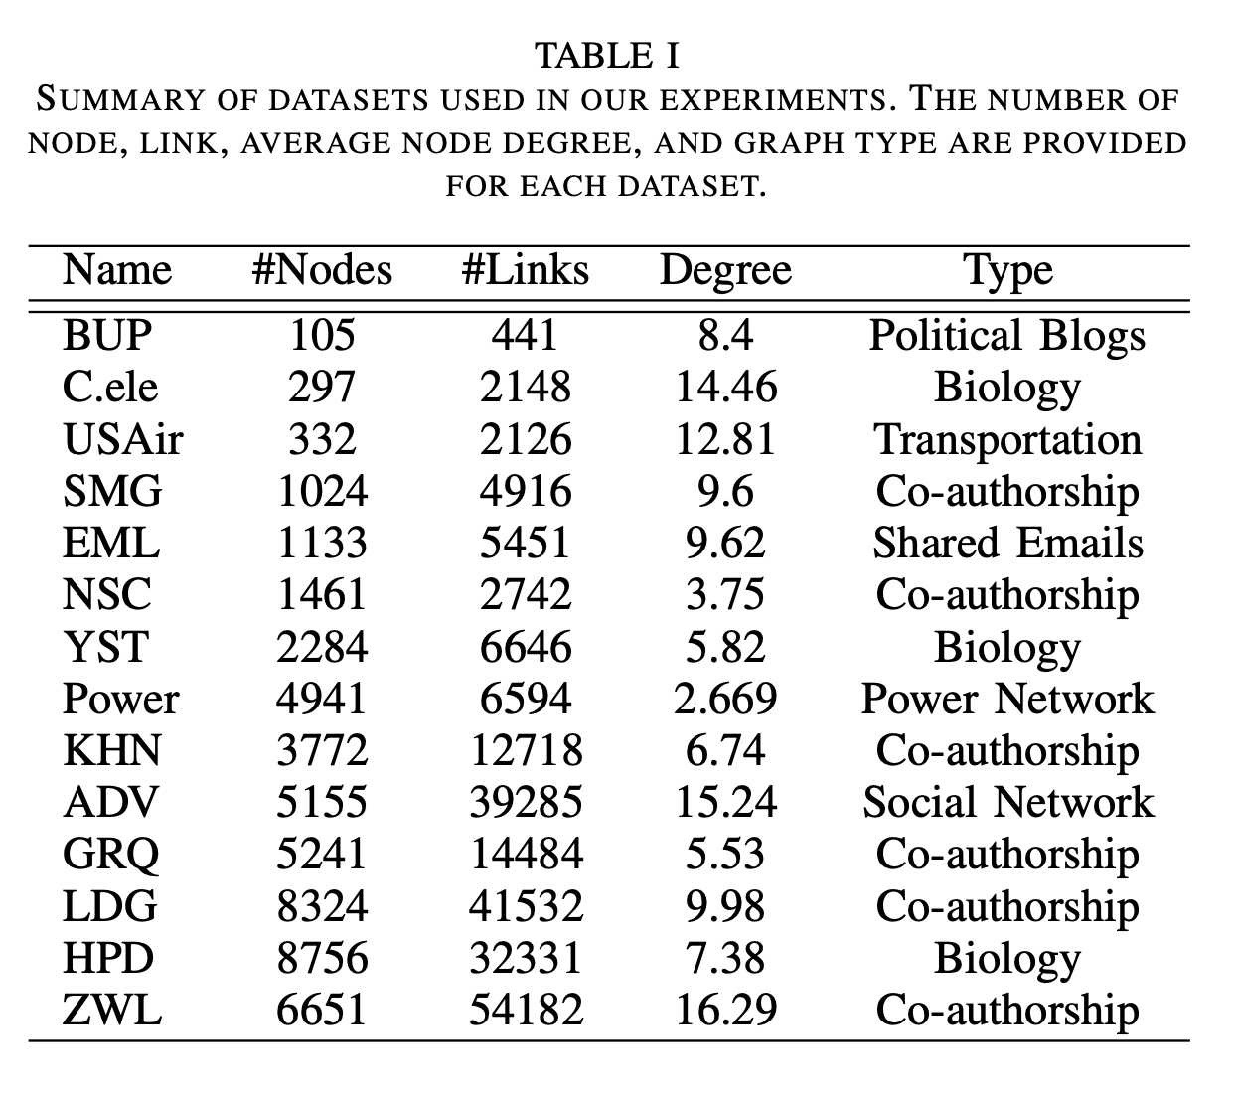
Experimentation Datasets
The proposed method was evaluated on 14 datasets for link prediction task
The performance was compared against SEAL the current state of the art as well as heuristic methods includes Katz, PageRank and SimRank

Slide 20
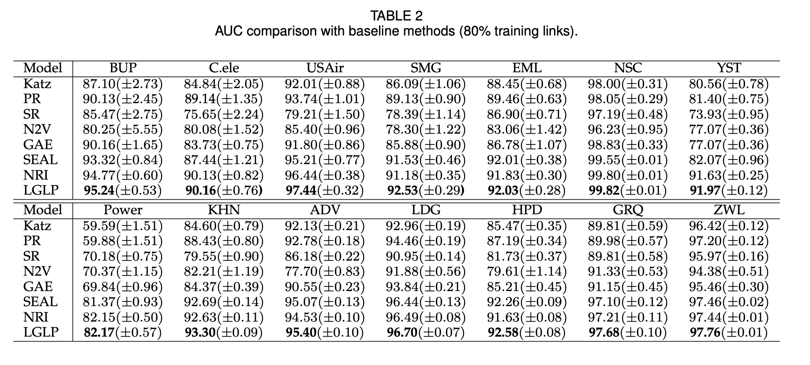
AUC Comparison with Plain graphs

Slide 21
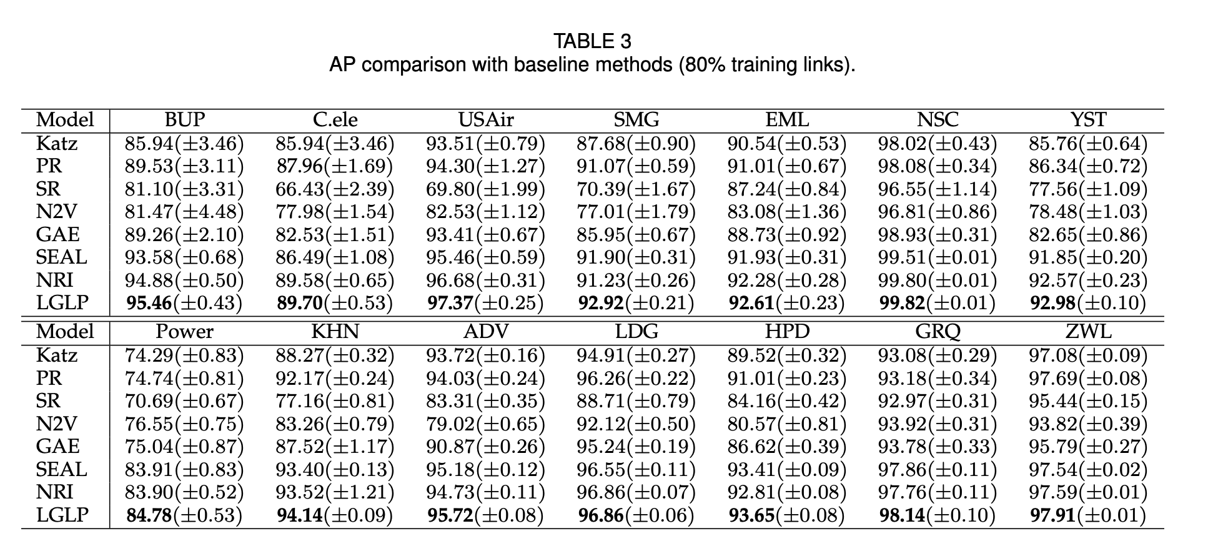
AP Comparison with Plain graphs

Slide 22
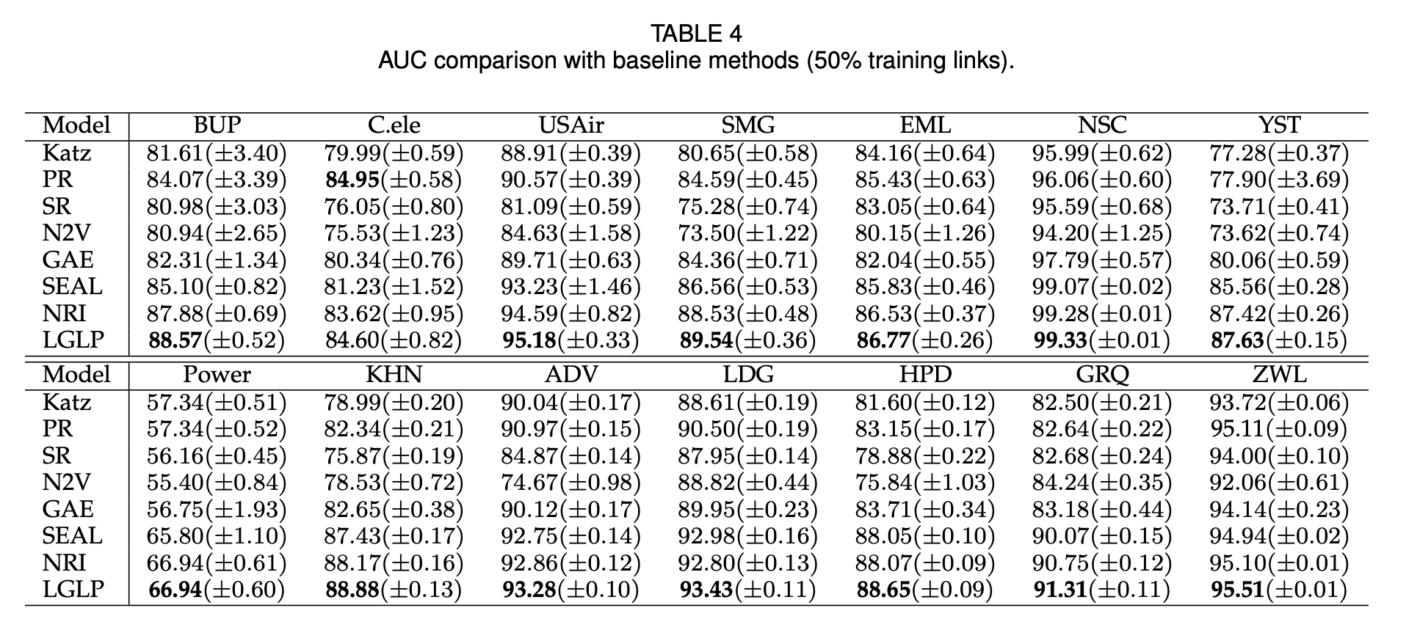
AUC Comparison with less training links

Slide 23
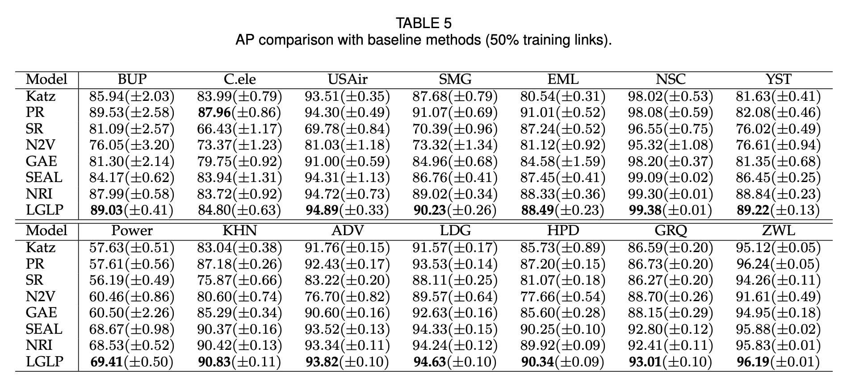
AP Comparison with less training links

Slide 24
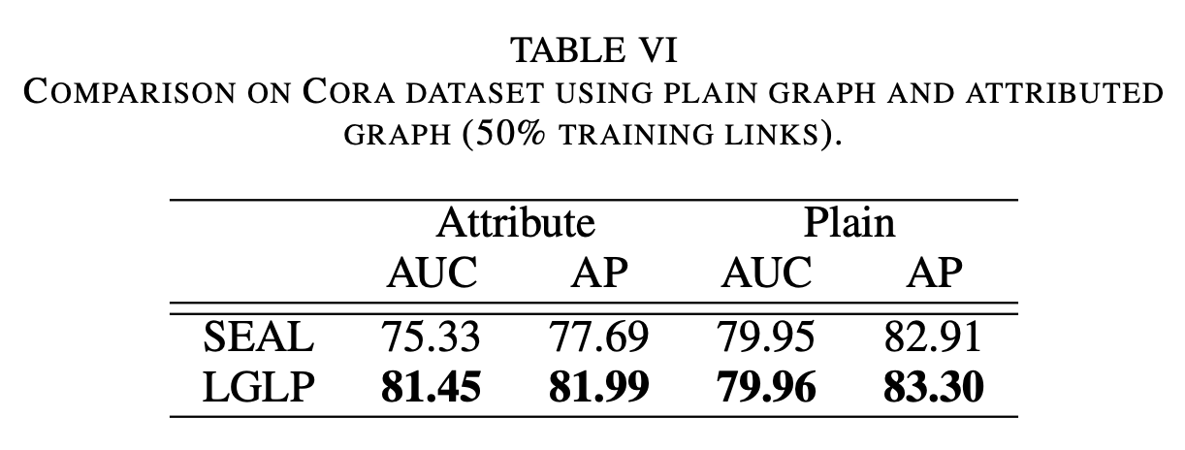
Comparison against seal with attributed graphs
Heuristic methods are only designed for plain graphs
Seal is the only method that predicts links in attributed graphs
We see a much significant improvement when comparing LGLP to SEAL with attributed graphs vs when comparing using plain graphs

Slide 25
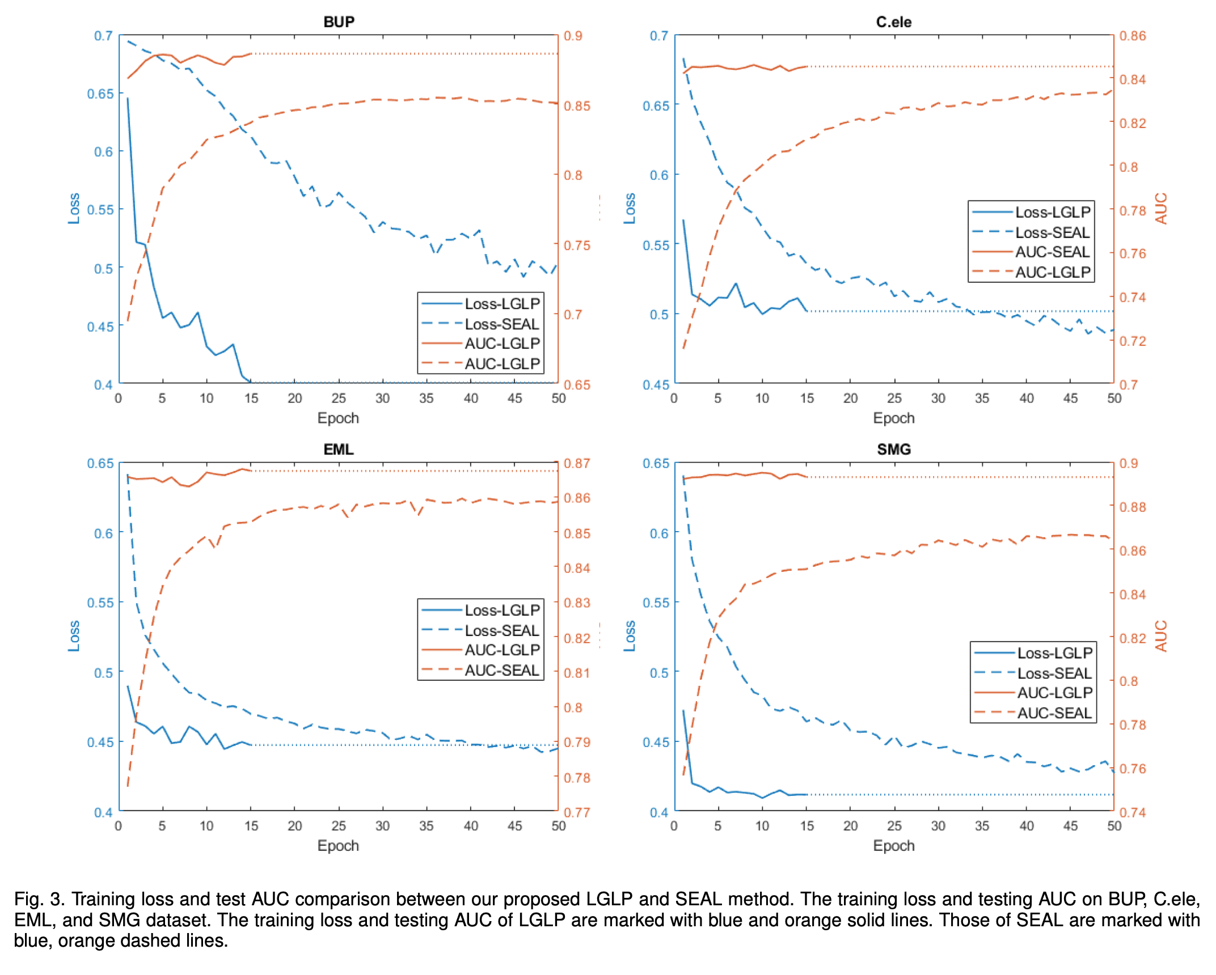
Train Loss and AUC comparison against SEAL

Slide 26
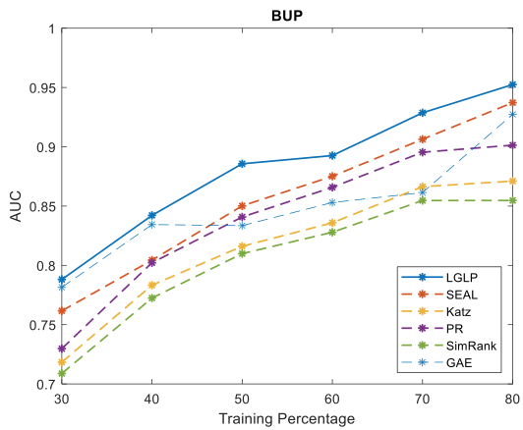
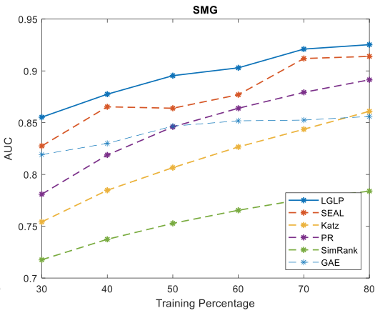
Performance with varying percentage of training links

Slide 27
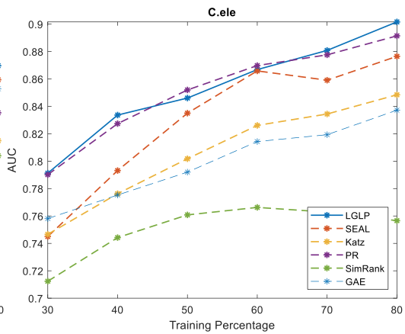
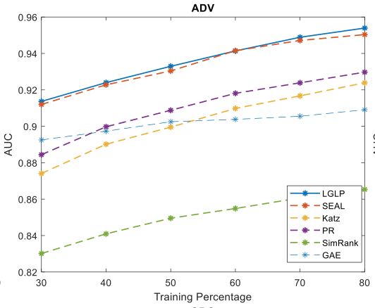
Performance with varying percentage of training links

Slide 28
Questions
Can we apply other techniques on line graphs and how do they perform?

Slide 29
Thank you!
Questions?

