Slide 1
A Generalist Neural Algorithmic Learner
Paper by Borja Ibarz, Vitaly Kurin, George Papamakarios, Kyriacos Nikiforou, Mehdi Bennani, Róbert Csordás, Andrew Dudzik, Matko Bošnjak, Alex Vitvitskyi, Yulia Rubanova, Andreea Deac, Beatrice Bevilacqua, Yaroslav Ganin, Charles Blundell and Petar Veličković
Presented by Allen Zhang
CS886 - Graph Neural Networks
April 1, 2024

Slide 2
Outline
Introduction
Problem
Importance
Generalist Neural Algorithmic Learner
Experiment Results
Future Works
Questions
2

Slide 3
Introduction
Perception vs Reasoning
Tasks dominated by perception
Require models to generalize in-distribution (training and validation data representative of the testing data)
Ex. Given only images of cats or dogs, predict the class
Tasks dominated by reasoning:
Require models to generalize out-of-distribution (provide sensible outputs even when the testing inputs are not expected)
Ex. Sort an array of any lengths.
3

Slide 4
Problem
Generalizability of machine learning models
Lots of models work well for problems when generalizing in-distribution
Models don’t perform well when generalizing out-of-distribution (OOD)
OOD generalization are useful because it can generate new knowledge based on existing observations.
4

Slide 5
Importance
A general model that can solve any classical algorithmic tasks.
It can incorporate reasoning capabilities even across tasks
It can match the performance of specialist models.
5

Slide 6
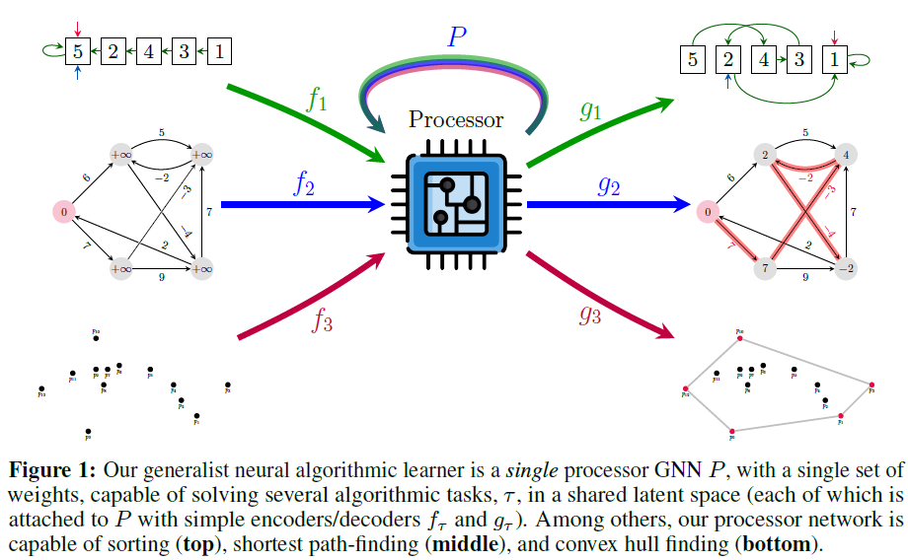
Generalist Neural Algorithmic Learner
Related to neural algorithmic reasoning: same general pipeline
Do not focus on one single task such as sorting or shortest path
Capable of solving all algorithmic tasks
6

Slide 7
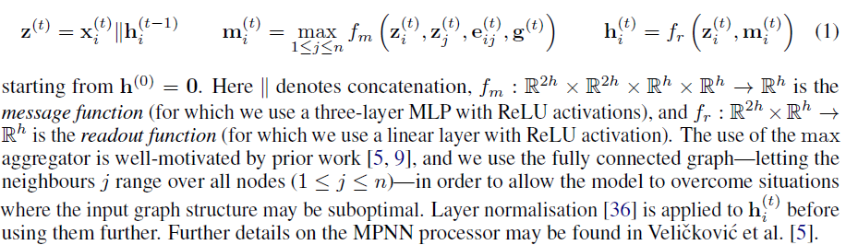

Generalist Neural Algorithmic Learner
Architecture
Similar encoder and decoder ideas from before
Processor:
A message-passing neural network (MPNN)
$h_{i}^{(t)}$ is the processed node embeddings.
7

Slide 8
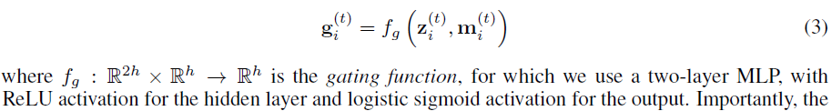
Generalist Neural Algorithmic Learner
Architecture
Processor:
Gating: Adding an update gate to the MPNN and biased to closed as default. It can stabilize training and increase performance. However not beneficial to multi-task case.
8

Slide 9
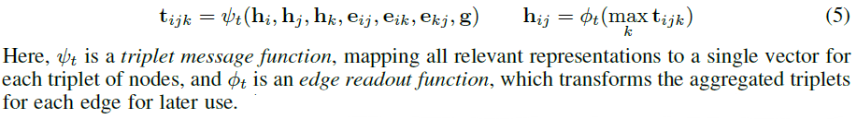






Generalist Neural Algorithmic Learner
Architecture
Processor:
Triplet reasoning: compute representations over triplets of nodes, and then reducing over one node to obtain edge latents
$$h_{i}$$
$$h_{ij}$$
$$h_{ik}$$
$$h_{j}$$
$$h_{k}$$
$$h_{jk}$$
9

Slide 10

Generalist Neural Algorithmic Learner
Key Model Improvements
Removed Teacher forcing:.
Stop using ground truth as $h_{i}^{(t)}$values at each iteration instead of network’s own prediction
Model stop always expecting correct hint values.
Results in significant better performance in some algorithms
Augmenting training data: to prevent overfitting
Soft hint propagation: use probability to decided whether gradients flow back to predicted hints ($h_{i}^{(t)}$)
Improve training stability with encoder initialization and gradient clipping
10

Slide 11
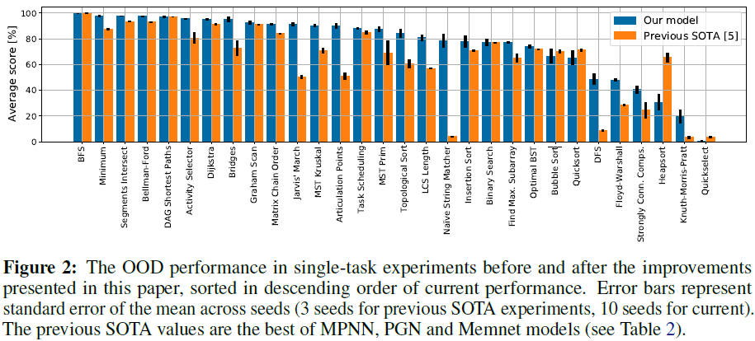
Results
Single Task Experiments
11

Slide 12
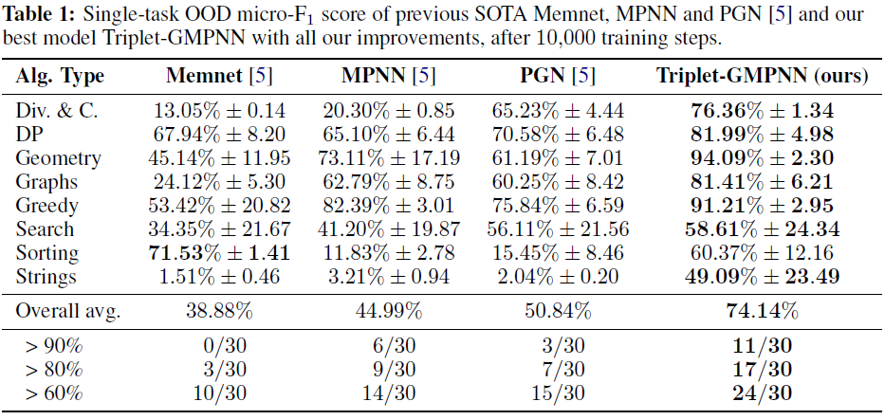
Results
Single Task Experiments
12

Slide 13
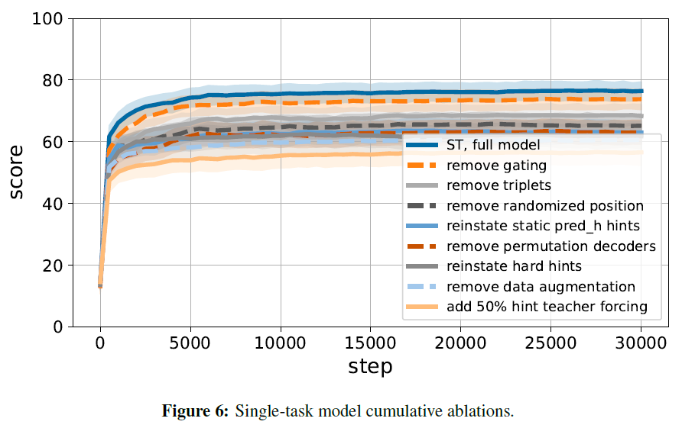
Results
Single Task Experiments
13

Slide 14
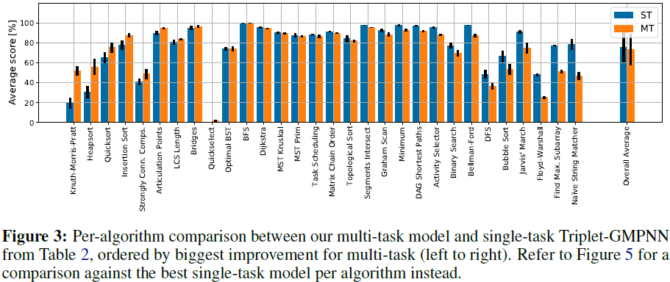
Results
Multi-task Experiment
14

Slide 15
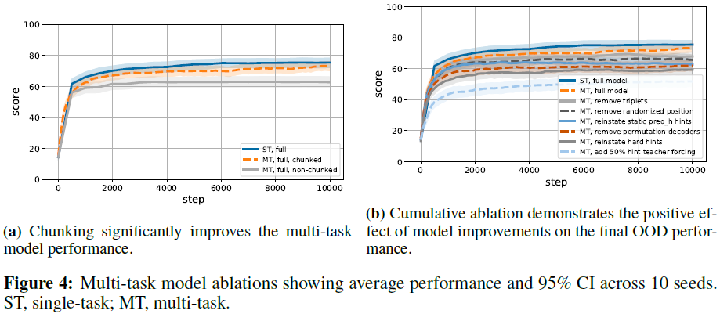
Results
Multi-task Experiment
15

Slide 16
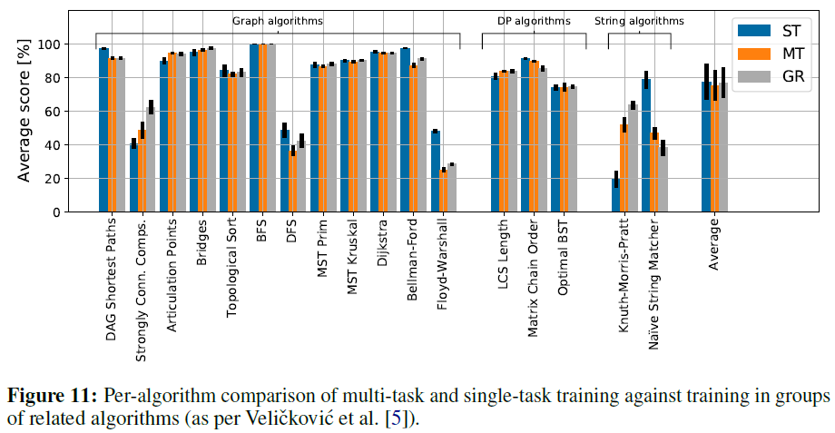
Results
Multi-task Experiment
16

Slide 17
Questions

Slide 18
Thank you!

