Slide 1
Neural Algorithmic Reasoning
Paper by Petar Velickovic and Charles Blundell
Presented by Allen Zhang
CS886 - Graph Neural Networks
April 1, 2024

Slide 2
Outline
Introduction
Problem
Importance
Previous Methods
Neural Algorithmic Reasoning
The Blue Print
Example
Future Works
Questions
2

Slide 3
Introduction
What is an algorithm?
An algorithm is a finite sequence of rigorous instructions, typically used to solve a class of specific problems or to perform a computation.
Input
x
Algorithm
A
Output
y
A(x) = y
3

Slide 4
Introduction
How is algorithm useful?
Many different applications:
Elevators, Elections, Microwave Ovens
The same algorithm can be applied in different domain with adjustment:
Control algorithms in both microwave oven and heart pacemaker
Strong general guarantees:
If inputs satisfy some conditions (preconditions), then the algorithm can guarantee outputs satisfy some conditions (post conditions)
4

Slide 5
Problem
Generalizability of algorithms
Algorithms usually works in abstract space
Inputs satisfy the preconditions
Outputs satisfy the postconditions
Real world problems are different:
Rarely do inputs and outputs satisfy the required conditions for the algorithm
Information is lost when converting the real world problem to a problem that the algorithm can directly solve
5

Slide 6
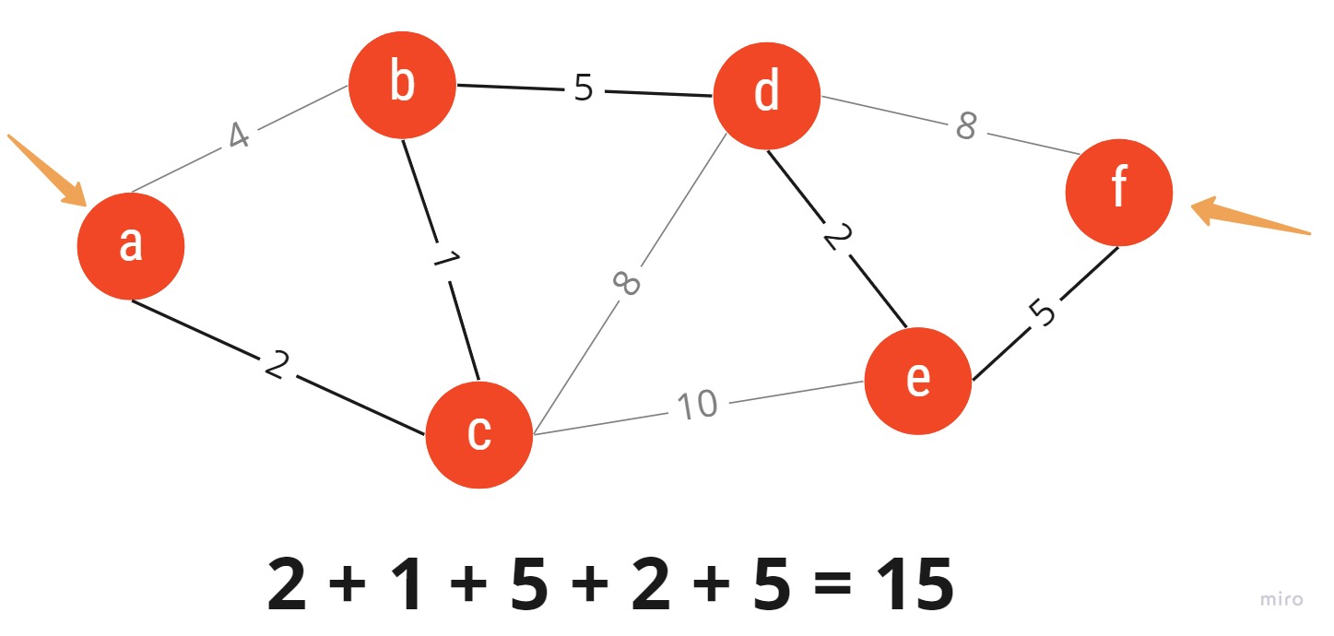
Problem
Example
Path that takes the shortest amount of time from my home to the classroom:
Abstract Space:
Algorithm: Dijkstra’s shortest path
Each intersection as nodes, and roads connecting the intersection as edges
Edge weights are the time it takes to me walk that distance
Real World:
Intersection have red lights and green lights, and not all have the same waiting time
Some roads are more crowded, so I am slower because I cannot get past the people walking in front of me, and this depends on the time of day too
The weather could be bad, and making walking outside more difficult than walking inside buildings
6

Slide 7
Importance
It’s difficult to convert the real world problem to an abstract space
Algorithms provide guarantees so we want to reuse them as much as possible
For example, sorting algorithms can guarantee the array is sorted in the end, neural networks cannot
Neural networks are flexible though
If we can combine the flexibility of neural networks and the guarantees of the algorithms, then we have a more robust model that can solve more problems but do not require a new approach when the fundamental abstraction are the same
Using the previous example, one problem can be walking, another problem can be driving, another problem can be least of amount of calories burnt instead of shortest time.
7

Slide 8
Previous Methods
Make manual adjustment:
Ex. If the algorithm needs to have only 1-dimensional edge weight, the real world multi dimensional data is compressed to 1-dimensional via estimation
Results in information loss and suboptimal result
Train a model that can use different algorithms as external tools
Ex. Invoke an suitable algorithm given certain inputs
Only work well when the algorithm already fit the problem
Encode the algorithm into the neural network
Allow neural network to learn a more fluid representation and combination of algorithms
Not really improving the generalizability in terms of inputs and outputs
8

Slide 9
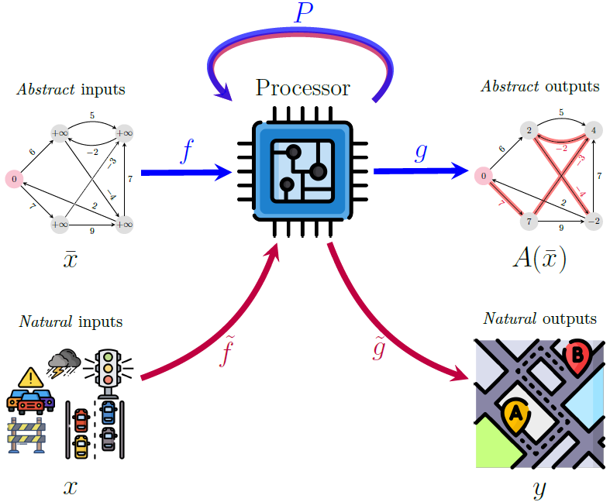
Neural Algorithmic Reasoning
Blueprint
9

Slide 10
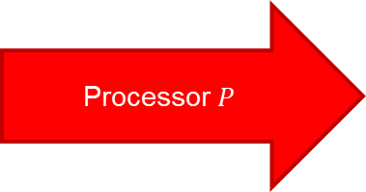
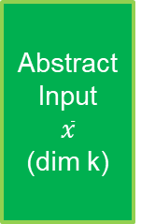
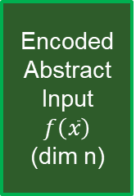

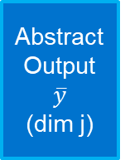


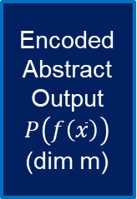
Neural Algorithmic Reasoning
Blueprint
First step:
Train three neural networks: encoder $f$, processor $P$, decoder $g$ in the abstract space
Encoder transforms the abstract input to inputs for the processor
Decoder transforms the processor output to the abstract output
The training goal is so that $g\left(P\left(f\left(\overline{x}\right)\right)\right)=A\left(\overline{x}\right)=\overline{y}$This three-component neural network model will imitate the algorithm A in the abstract space
Abstract Input
$$\overline{x}$$
(dim k)
Encoded Abstract Input
$$f\left(\overline{x}\right)$$
(dim n)
Encoded Abstract Output
$$P\left(f\left(\overline{x}\right)\right)$$
(dim m)
Processor $P$
Abstract Output
$$\overline{y}$$
(dim j)
encoder $f$
decoder $g$
10

Slide 11
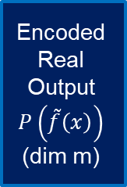
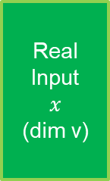
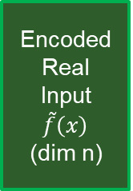

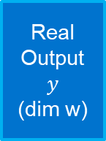


Neural Algorithmic Reasoning
Blueprint
Second step:
Set up encoder and decoder for real world input and output
The dimension lines up with the already trained processor
Third step:
Keep the processor trained weights fixed.
Train the encoder and decoder in the model with real world data with gradient descent.
The training goal is that $\tilde{g}\left(P\left(\tilde{f}\left(x\right)\right)\right)=y$
Real Input
$$x$$
(dim v)
Encoded Real Input
$$\tilde{f}\left(x\right)$$
(dim n)
Encoded Real Output
$$P\left(\tilde{f}\left(x\right)\right)$$
(dim m)
Processor P
Real Output
$$y$$
(dim w)
encoder $\tilde{f}$
Decoder $\tilde{g}$
11

Slide 12

Neural Algorithmic Reasoning
Blueprint
Benefits:
Everything is trainable, no information loss and manual adjustment of data
The function $\tilde{g}\left(P\left(\tilde{f}\left(x\right)\right)\right)$is end-to-end differentiable, allowing better model optimization
Only need to train the processor once, and for different problems, train specific encoder and decoder for that problem.
Real Input
x
(dim v)
Encoded Real Input
f(x)
(dim n)
Encoded Real Output
P(f(x))
(dim m)
Processor P
Real Output
y
(dim w)
encoder f
decoder g
12

Slide 13
Neural Algorithmic Reasoning
Example: Dijkstra Algorithm in abstract space
GNN
Edge Weight
Abstract Input
Dim 1
Whether node on path
Dim 3
Encoder
Decoder
Processor
13

Slide 14
Neural Algorithmic Reasoning
Example: Apply processor in real world
Time on road
GNN
Intersection wait time
Weather condition
Real Input
Dim 1
Whether node on path
Dim 4
Encoder
Decoder
Processor
14

Slide 15
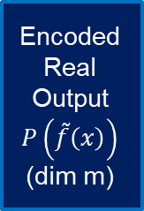
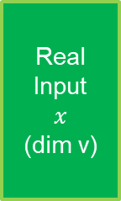
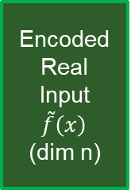

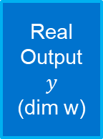

Neural Algorithmic Reasoning
Future Works
The authors want to continue explore this architecture by applying it to solve more real-world problems that can be fundamentally solved by classical algorithms
Real Input
$$x$$
(dim v)
Encoded Real Input
$$\tilde{f}\left(x\right)$$
(dim n)
Encoded Real Output
$$P\left(\tilde{f}\left(x\right)\right)$$
(dim m)
Processor P
Real Output
$$y$$
(dim w)
encoder $\tilde{f}$
Decoder $\tilde{g}$
15

Slide 16
Questions

Slide 17
Thank you!

