Slide 1
Pointer Graph Networks
Paper by Petar Velickovic, Lars Buesing, Mathew C. Overlan, Razvan Pascanu, Oriol Vinyals and Charles Blundell
Presented by Allen Zhang
CS886 - Graph Neural Networks
April 1, 2024

Slide 2
Outline
Introduction
Problem
Importance
Previous Methods
Pointer Graph Networks
Problem Setup
Architecture
Example
Experiment Results
Future Works
Questions
2

Slide 3
Introduction
What problems can Graph Neural Networks solve?
Typically applied to static graphs where the graph structure is known or can be approximated.
Works well with problems involving few nodes and fully connected graphs
Successful applications include quantum chemistry, social networks, and physics simulations
3

Slide 4
Problem
What about graphs with unknown structure?
When the graph structure is unknown, to use GNN, the practitioners need to choose a graph structure themselves
Difficult to create the correct graph structure
Large problems require sparsely connected graphs
GNN do not work well on these
Making it fully connected increases computation complexity
GNN doesn’t support dynamic edges either
4

Slide 5
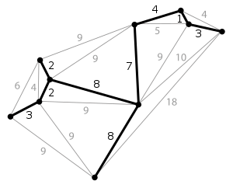
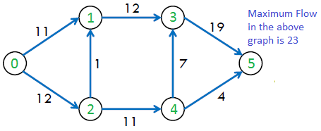
Problem
Example
Dynamic graph connectivity querying
Compute the minimum spanning trees
Decide if an edge can be included in the solution without inducing cycles
Kruskal Algorithm
Compute the maximum flow:
Detecting existence of paths from source to sink with available capacity
Find the maximum possible capacity
Ford-Fulkerson Algorithm
Connectivity Query:
Determine whether there is a path exist between them in the graph
5

Slide 6
Importance
Expand the space of general-purpose algorithms which can replicate classical algorithms with more complicated data structures
Find a supervised method for sparse and efficient latent graph inference
Allow trained model to deviate from the imitated data structures, and can be applied on useful and parallelizable data structures
6

Slide 7
Previous Methods
GNNs:
Learn all graph structures possible given the data
Number of graphs grows super-exponentially (faster than exponential) with respect to the number of nodes
Learn through message passed on top of the learnt structure, and thus distinguishing whether errors come from wrong structure or wrong message is difficult.
Cannot learn complicated, data-driven manipulations that is used by optimal algorithms to solve non-local problems, where relying on pointer-based data structure is preferred over dynamic programming principles (e.g. disjoint set unions and link/cut trees)
Classical Algorithms
Not generalizable
7

Slide 8

Pointer Graph Networks (PGN)
Problem Setup
Number of entities: $n$
At each time $t≥1$, there is an input ${\text{Ɛ}}^{(t)}=({\vec{e}}_{1}^{\left(t\right)},{\vec{e}}_{2}^{\left(t\right)}, . . ., {\vec{e}}_{n}^{\left(t\right)})$
Each ${\vec{e}}_{i}^{\left(t\right)}$ is called an operation on the entity $i∈\left\{1, 2, …, n\right\}$
${\vec{e}}_{i}^{\left(t\right)}∈R^{m}$, meaning that they are feature vectors with dimension $m$
The task is to predict target outputs ${\vec{\text{y}}}^{(t)}∈R^{l}$ based on operation sequence ${\text{Ɛ}}^{(1)},{\text{Ɛ}}^{(2)},…,{\text{Ɛ}}^{\left(t\right)}$ until time $t$
Pointer adjacency matrix at time $t$ is $Π^{(t)}∈R^{n×n}$
8

Slide 9
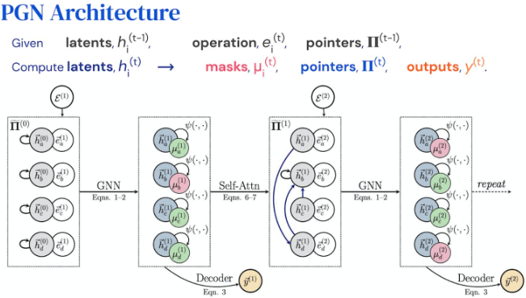
Pointer Graph Networks (PGN)
Architecture
9

Slide 10

Pointer Graph Networks (PGN)
Architecture
In summary, At each step $t$:
PGN computes latent features ${\vec{h}}_{i}^{\left(t\right)}∈R^{k}$ for each entity $i$, and ${\vec{h}}_{i}^{\left(0\right)}=0$
PGN then determines the dynamic pointers that can be adjacency matrix $Π^{(t)}∈R^{n×n}$
$Π^{(0)}=I_{n}$, where $I_{n}$ is the identity matrix, meaning we start with each node pointing to itself
PGN also follows the encoder-processor-decoder architecture discussed in the previous paper we discussed
10

Slide 11

Pointer Graph Networks (PGN)
Architecture
Encoder:
The encoder network is $f$ where ${\vec{z}}_{i}^{\left(t\right)}=f({\vec{e}}_{i}^{\left(t\right)},{\vec{h}}_{i}^{\left(t−1\right)})$, equation 1
And using the encoder, we can get an entity representation ${\text{Z}}^{(t)}=\left({\vec{z}}_{1}^{\left(t\right)},{\vec{z}}_{2}^{\left(t\right)}, . . ., {\vec{z}}_{n}^{\left(t\right)}\right)$
This representation ${\text{Z}}^{(t)}$ is then fed into the processor network $\text{P}$
11

Slide 12

Pointer Graph Networks (PGN)
Architecture
Processor:
The processor $\text{P}$ generate the next-step latent features, where ${\text{H}}^{(t)}=\text{P}({\text{Z}}^{\left(t\right)},Π^{(t−1)})$, equation 2
And thus yield ${\text{H}}^{(t)}=({\vec{h}}_{1}^{\left(t\right)},{\vec{h}}_{2}^{\left(t\right)}, . . .,{\vec{h}}_{n}^{\left(t\right)})$
This representation ${\text{Z}}^{(t)}$ is then fed into the processor network $\text{P}$
12

Slide 13

Pointer Graph Networks (PGN)
Architecture
Decoder:
The decoder $g$ uses entity representation ${\text{Z}}^{(t)}$and latent feature ${\text{H}}^{(t)}$ to generate ${\text{y}}^{(t)}$
$y^{(t)}=g(⨁_{i}{\vec{z}}_{i}^{\left(t\right)}, ⨁_{i}{\vec{h}}_{i}^{\left(t\right)})$, equation 3
$⨁_{i}$ is any permutation-invariant readout aggregator over all $i$, such as summation or maximization. Using max gives the best result
13

Slide 14

Pointer Graph Networks (PGN)
Architecture
How to update the adjacency list in each iteration:
To be efficient, only modify a small subset of entities at once
So we introduce a masking function $ψ$ such that $ψ\left({\vec{z}}_{i}^{\left(t\right)},{\vec{h}}_{i}^{\left(t\right)}\right)=P(μ_{i}^{\left(t\right)}=1)$
This means that the masking function generate a mask $μ_{i}^{\left(t\right)}∈\{0, 1\}$ for each entity at each time step where the mask is sparse, and we will only modify the entity with mask being 1. Here $P(μ_{i}^{\left(t\right)}=1)$ is the probability that $μ_{i}^{\left(t\right)}=1$
To rewrite how to get this mask value, we have $μ_{i}^{\left(t\right)}=I_{ψ\left({\vec{z}}_{i}^{\left(t\right)},{\vec{h}}_{i}^{\left(t\right)}\right)>0.5}$
14

Slide 15

Pointer Graph Networks (PGN)
Architecture
How to update the adjacency matrix in each iteration - continued:
Now we also use self-attention. We have queries ${\vec{q}}_{i}^{\left(t\right)}=W_{q}{\vec{h}}_{i}^{\left(t\right)}$ and keys ${\vec{k}}_{i}^{\left(t\right)}=W_{k}{\vec{h}}_{i}^{\left(t\right)}$, where $W_{q}$ and $W_{k}$ are trainable weights
We want to calculate the relevance of entity $j$ to entity $i$, and we represent this with $α_{ij}^{\left(t\right)}$ and is calculated by $α_{ij}^{\left(t\right)}={\text{softmax}}_{j}\left(\left\langle {\vec{q}}_{i}^{\left(t\right)},{\vec{k}}_{j}^{\left(t\right)}\right\rangle \right)$ where $\left\langle {\vec{q}}_{i}^{\left(t\right)},{\vec{k}}_{j}^{\left(t\right)}\right\rangle$ is the dot product between queries ${\vec{q}}_{i}^{\left(t\right)}$ and keys ${\vec{k}}_{j}^{\left(t\right)}$
15

Slide 16

Pointer Graph Networks (PGN)
Architecture
How to update the adjacency matrix in each iteration - continued:
Finally, we update the adjacency matrix from $Π^{(t−1)}$ to $Π^{(t)}$ using the relevance $α_{ij}^{\left(t\right)}$ and the mask value $μ_{i}^{\left(t\right)}$
${\tilde{Π}}_{ij}^{\left(t\right)}=μ_{i}^{\left(t\right)}{\tilde{Π}}_{ij}^{\left(t−1\right)}+\left(1−μ_{i}^{\left(t\right)}\right)I_{j={\text{argmax}}_{k}\left(α_{ik}^{\left(t\right)}\right)}$ , where ${\tilde{Π}}_{ij}^{\left(t\right)}$ is the adjacency matrix before symmetrization. So only nodes $i$ with $μ_{i}^{\left(t\right)}=0$ has its adjacency changed to point to node $j$ where $j$maximizes $α_{ij}^{\left(t\right)}$
We then use the logical disjunction to symmetrize the adjacency matrix: $Π_{ij}^{\left(t\right)}= {\tilde{Π}}_{ij}^{\left(t\right)}⋁{\tilde{Π}}_{ji}^{\left(t\right)}$
Doing this, we get entity $i$ and entity $j$ will be linked together if $j$ is most relevant to $i$ and vise versa.
The model is trained with direct supervision of ground truth pointers ${\hat{Π}}_{}^{\left(t\right)}$
16

Slide 17

Pointer Graph Networks (PGN)
Architecture
Details for the processor:
The processor is a GNN, operating over the edges given by the adjacency matrix $Π^{(t−1)}$
The performance is the best when using message passing neural networks (MPNNs)
The computation of the hidden layer becomes the following using MPNN:
${\vec{h}}_{i}^{\left(t\right)}=U\left({\vec{z}}_{i}^{\left(t\right)},{\text{m}\text{a}\text{x}}_{Π_{ji}^{\left(t−1\right)}=1}M\left({\vec{z}}_{i}^{\left(t\right)},{\vec{z}}_{j}^{\left(t\right)}\right)\right)I_{j={\text{argmax}}_{k}\left(α_{ik}^{\left(t\right)}\right)}$ , where $U$ and $M$ are linear layers producing vector messages.
ReLU are used as activation function for $U$ and $M$
17

Slide 18

Pointer Graph Networks (PGN)
Architecture
Training:
PGN optimizes three losses:
The downstream query loss in ${\vec{\text{y}}}^{(t)}$ against the target outputs
The cross-entropy loss of the attentional coefficients $α_{ij}^{\left(t\right)}$ against the ground-truth pointers ${\hat{Π}}_{}^{\left(t\right)}$
The binary cross-entropy of the masking network $ψ$ against the ground-truth entities being modified at time $t$
Teacher-forcing is used during training, where ground-truth pointers and masks are input when required. The gradients flow back to previous time $t$ through the latent states ${\vec{h}}_{i}^{\left(t\right)}$ and ${\vec{z}}_{i}^{\left(t\right)}$
18

Slide 19

Pointer Graph Networks (PGN) - Example
Dynamic graph connectivity
Consider an undirected and unweighted graphs of $n$ nodes, where the edges evolve with respect to time.
We denote $G^{(t)}=\left(V,E^{(t)}\right)$ . Assume $E^{(0)}=∅$ , i.e. the graph is disconnected with no edges at time $t=0$.
At each time step $t>0$, we add or remove an edge from the set of edges in the previous time step $t−1$:
i.e. $E^{(t)}=E^{(t−1)}⊖\left\{\left(u, v\right)\right\}$, where $⊖$ is the symmetric difference operator.
The connectivity query is defined as follows: for a given pair of vertices $\left(u, v\right)$, does there exist a path between them in $G^{(t)}$? This query has a binary result which can be compared to the ground-truth query answers ${\hat{y}}^{(t)}$.
19

Slide 20

Pointer Graph Networks (PGN) - Example
Dynamic graph connectivity
For simplicity, first only consider incremental graph connectivity, where there is only addition of edges and no removing of edges
Then, the problem only requires combining connected components through set union. To do this, we maintain disjoint sets that allows for an efficient $union\left(u, v\right)$ operation which performs a union of the edge sets that contains both $u$ and $v$.
Querying connectivity between $u$ and $v$ is then checking whether $u$ and $v$ are in the same edge set, requiring an efficient $find\left(u\right)$ operation which can retrieve the set containing $u$.
20

Slide 21
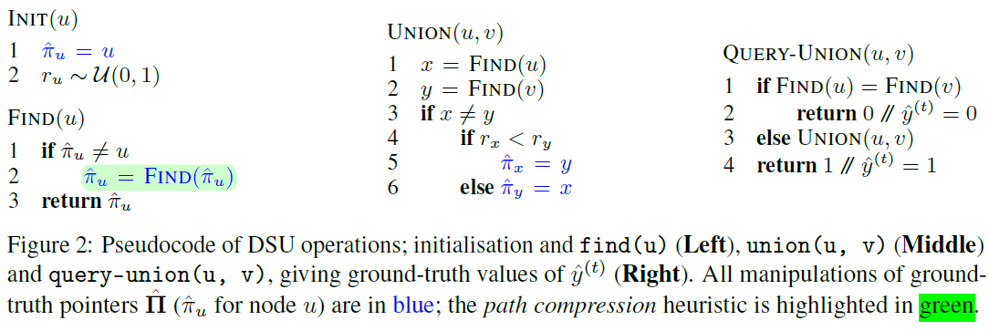

Each node, $u$, has a parent pointer ${\hat{π}}_{u}$ that initially point to itself. The root node will always point to itself.
FIND($u$) find the root node recursively.
UNION($u, v$) makes one of the roots of $u$ and $v$ point to the other root. $r_{u}$ is a random priority valued created from a uniform distribution during initialization.
QUERY-UNION($u, v$) returns the target output ${\vec{\text{y}}}^{(t)}$ which equals either $\text{1}$ or $\text{0}$. If $u$ and $v$have the same root, we return $\text{0}$, else we call UNION($u, v$) and return $\text{1}$.
21
Notes:
Figure 2 in “Pointer Graph Networks” by P. Velickovic et al.

Slide 22

Pointer Graph Networks (PGN) - Example
Dynamic graph connectivity
Then, we use ground-truth DSU’s pointers to provide supervision for the PGN’s asymmetric pointers ${\tilde{Π}}_{}^{\left(t\right)}$. Specifically, ${\hat{Π}}_{ij}^{\left(t\right)}=1$ iff ${\hat{π}}_{i}=j$ and ${\hat{Π}}_{ij}^{\left(t\right)}=0$ otherwise.
Ground-truth mask values, ${\hat{μ}}_{i}^{\left(t\right)}$, are set to $0$ for only the paths from $u$ and $v$ to their respective roots so that their pointer adjacency can change. All other nodes have ${\hat{μ}}_{i}^{\left(t\right)}=1$ thus state is unchanged.
The query on checking the connectivity of $u$ and $v$ is simplified to following their pointer links and checking if they meet, which relieves the learning pressure of the processor.
If removing the edges possible, we can use the link/cut trees to solve the connectivity problem efficiently in $O(\text{log} n)$ time given that the graph is acyclic.
22

Slide 23
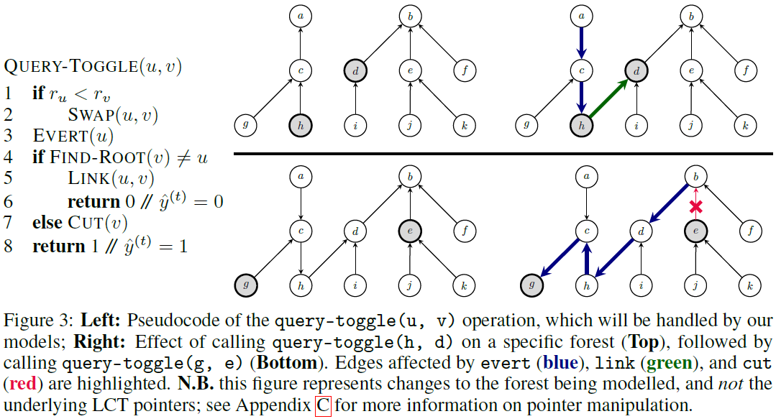
23
Notes:
Figure 2 in “Pointer Graph Networks” by P. Velickovic et al.

Slide 24
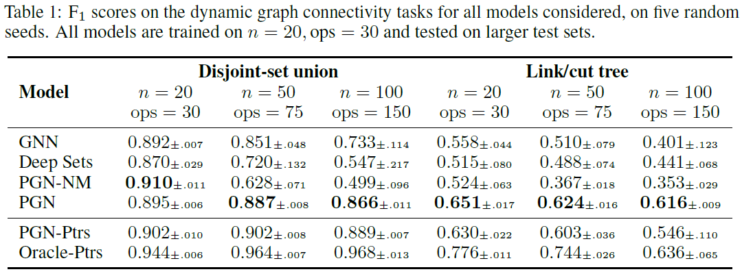

Experiment Result
GNN: fully connected at all iterations
Deep Sets: only-self-pointers in adjacency matrix, $∀t Π^{(t)}=I_{n}$, only query loss are used.
PGN-NM: PGN without masking mechanism, always updates all adjacencies
PGN-Ptrs: PGN is first trained then used to infer pointers. Then a new GNN use the inferred pointers to answer queries
Oracle-Ptrs: A GNN is trained on ground-truth pointers to answer queries. The model no longer needs to imitate complex pointer rotations for link/cut trees
24

Slide 25
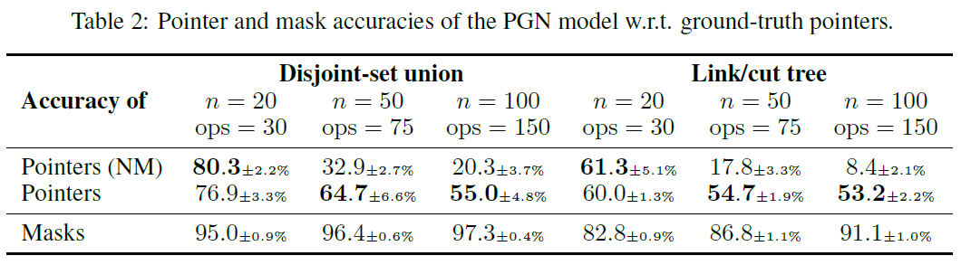
Experiment Result
No mask PGN is a lot worse on larger test data sets then PGN with masks when modeling pointers.
Mask accuracy is consistently high
25

Slide 26
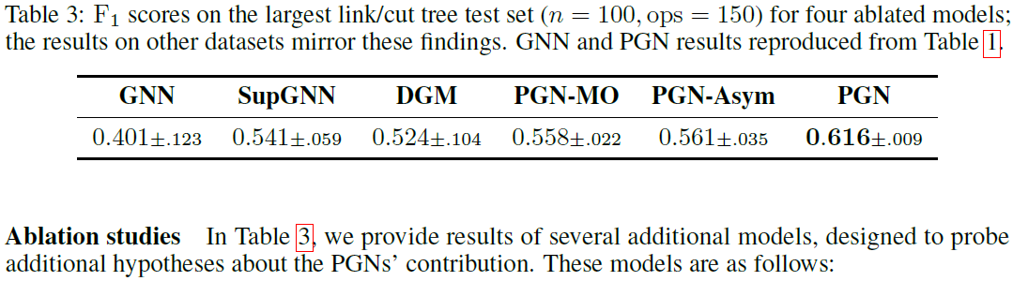
Experiment Result
PGN’s gain are mainly from inductive biases and additional supervision
SupGNN: GNN with additional supervision, which are the same on PGN, added
DGM: using the differentiable graph module loss function (performance as reward function for pointers)
PGN-MO: PGN with supervising on mask only (limited supervision)
PGN-Asym: PGN with asymmetric adjacency graph
26

Slide 27
Future Works
PGN is not meant to beat the classical algorithms but an extension that make their concepts more accessible
The PGN did not apply to real-world applications in this paper. It will be interesting to find an applicable problem and apply it. There might be ethical risk in applications
The processor uses GNNs and improvement in GNNs can carry over ethical risks associated in those GNNs.
27

Slide 28
Questions

Slide 29
Thank you!

