Slide 1
MAGNN: Metapath Aggregated Graph Neural Network for Heterogeneous Graph Embedding
Xinyu Fu, Jiani Zhang, Ziqiao Meng, Irwin King
Presenter: Niousha Sadjadi

Slide 2
Outline
Introduction: problem and its importance
Background:
Notations
Previous methods
Proposed method: MAGNN
Experiments

Slide 3
Introduction
Many real-world datasets are presented in a graph structure
Most real-world graphs are heterogenous
Homogeneous
Heterogeneous
User
Review
Product

Slide 4
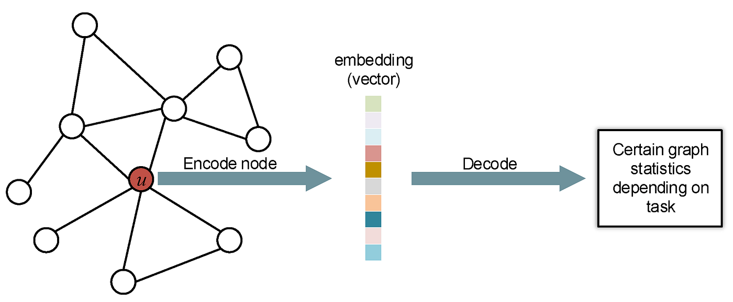
What is the problem?
Obtaining meaningful low-dimensional representations from the heterogeneous graphs
u

Slide 5
Why is it important?
Nature of the graphs is non-Euclidean
It is difficult to model them by traditional machine learning models
Graph embeddings convert graph information to meaningful low-dimensional vectors in the Euclidean space
Now, we can compare graphs with each other, find similarities among different graphs, and use them for many downstream tasks (node classification, etc.)
Compare

Slide 6
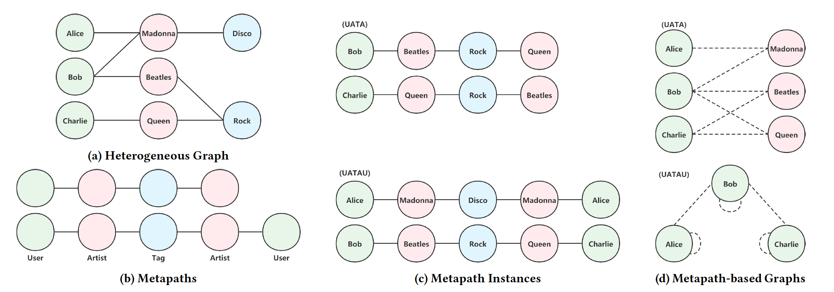
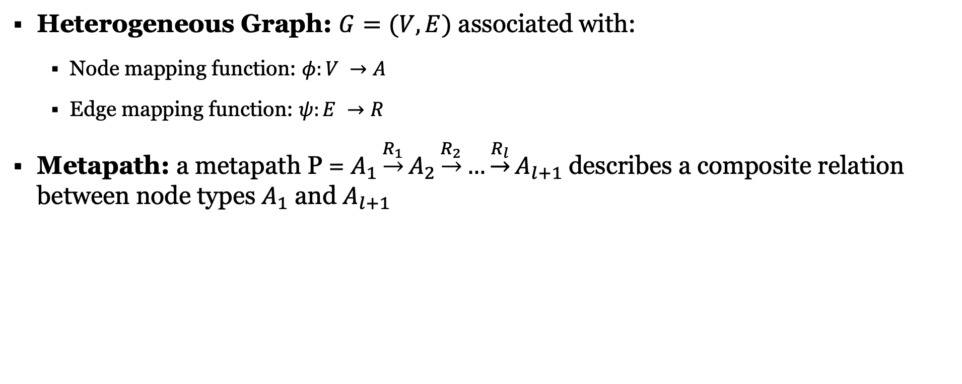
Background: Notations
Heterogeneous Graph: $G=(V, E)$ associated with:
Node mapping function: $φ:V →A$
Edge mapping function: $ψ:E →R$
Metapath: a metapath P = $A_{1}\underset{→}{R_{1}}A_{2}\underset{→}{R_{2}}…\underset{→}{R_{l}}A_{l+1}$describes a composite relation between node types $A_{1}$ and $A_{l+1}$
V: Set of vertices
E: Set of edges
A: Set of node types
R: Set of edge types

Slide 7
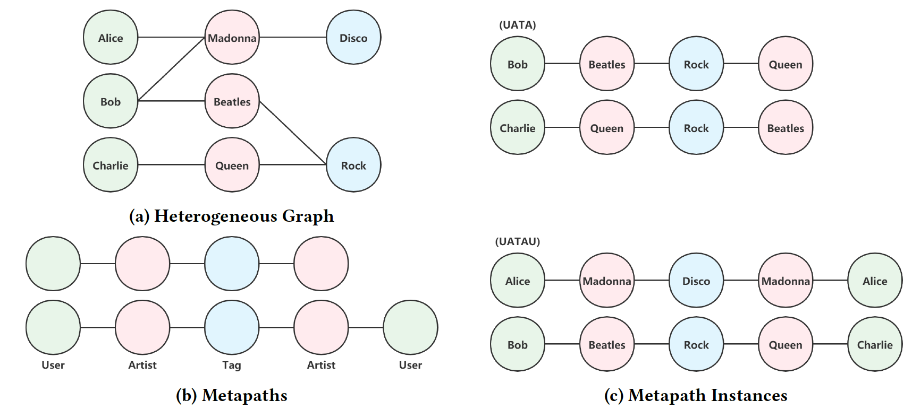
Background: Notations (2)
Metapath instance: an instance p of P is a node sequence in the graph following the schema defined by P.

Slide 8

Background: Notations (3)
Metapath-based Neighbor: Given a metapath P, for node $v$ in the graph the metapath-based neighbor $N_{v}^{P}$ contains the set of nodes that connect with node $v$ through metapath instances of P.
Bob

Slide 9
Background: Previous methods
Different graph embedding techniques
Classic methods (LINE, node2vec, DeepWalk, etc.)
Rapid development of Deep Learning -> GNN-based methods
Spectral-based GNNs (ChebNet, GCN, etc.)
Limitation: Suffers from poor scalability and generalization ability
Spatial-based GNNs (GraphSAGE, GAT, etc.)
All these GNN-based models built for homogenous graph structure -> heterogenous graph embedding methods

Slide 10
Background: Previous methods (2)
Heterogenous graph embedding techniques
Based on the idea of metapaths
Limitations:
Do not consider node content features (ESim, etc.)
Node Content Transformation
Discard intermediate nodes along the metapath (HERec, etc.)
Intra-metapath Aggregation
Rely on a single metapath (metapath2vec, etc.)
Inter-metapath Aggregation
To address these limitations -> MAGNN
Heterogeneous
Metapaths

Slide 11
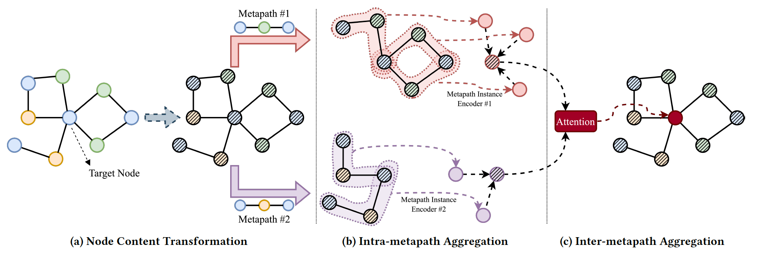
Proposed method: MAGNN

Slide 12
MAGNN: Node Content Transformation

Slide 13
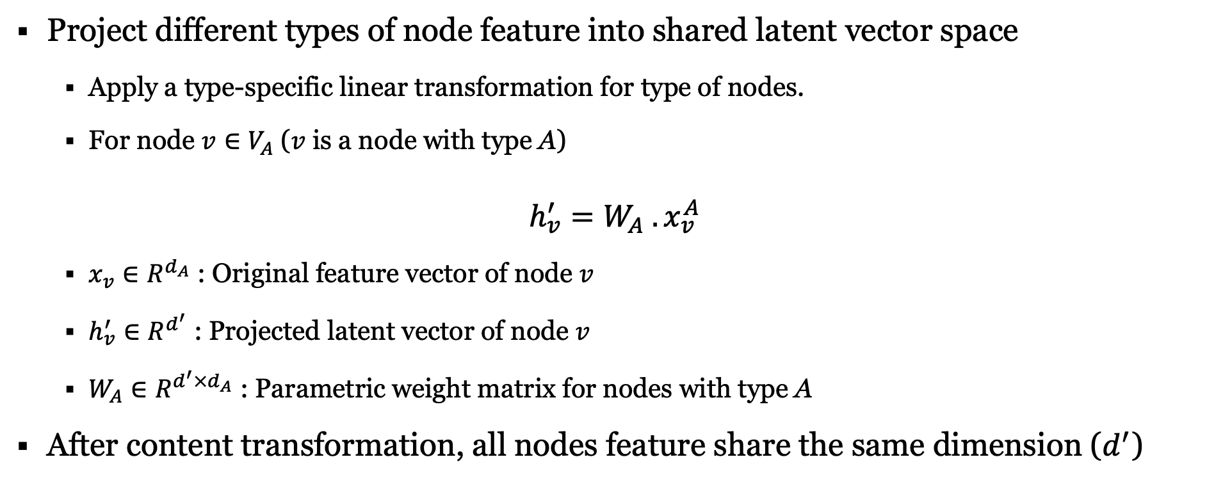
MAGNN: Node Content Transformation (1)
Project different types of node feature into shared latent vector space
Apply a type-specific linear transformation for type of nodes.
For node $v∈V_{A}$ ($v$ is a node with type A)
$$h_{v}^{′}=W_{A} . x_{v}^{A}$$
$x_{v}∈R^{d_{A}}$ : Original feature vector of node $v$
$h_{v}^{′}∈R^{d^{′}}$ : Projected latent vector of node $v$
$W_{A}∈R^{d^{′}×d_{A}}$ : Parametric weight matrix for nodes with type A
After content transformation, all nodes feature share the same dimension ($d^{′}$)

Slide 14
MAGNN: Node Content Transformation (2)

Slide 15
MAGNN: Intra-metapath Aggregation

Slide 16
MAGNN: Intra-metapath Aggregation (1)
Recap: To consider intermediate nodes along the metapath
For a metapath P, intra-metapath aggregation learns the structural and semantic information embedded in
The target node,
The metapath-based neighbors,
The context in between
By encoding the metapath instances of P.

Slide 17
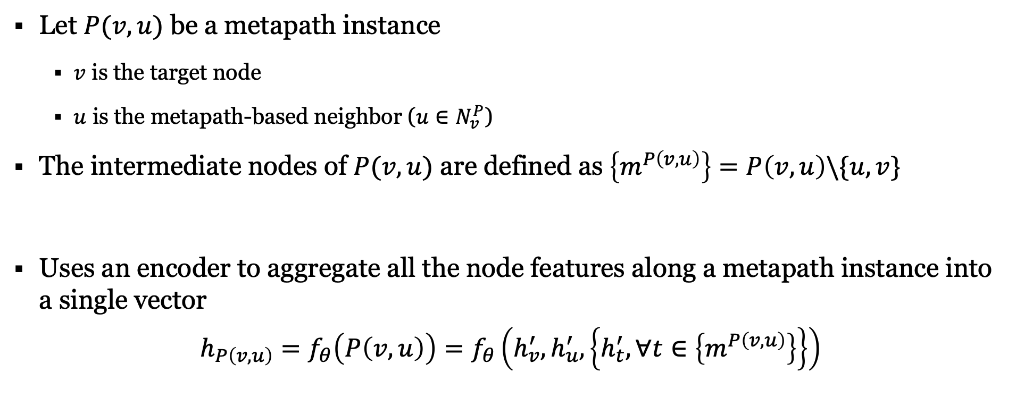
MAGNN: Intra-metapath Aggregation (2)
Let $P(v,u)$ be a metapath instance
$v$ is the target node
$u$ is the metapath-based neighbor ($u∈N_{v}^{P}$)
The intermediate nodes of $P(v,u)$ are defined as $\left\{m^{P\left(v,u\right)}\right\}=P\left(v,u\right)\backslash \{u,v\}$
Uses an encoder to aggregate all the node features along a metapath instance into a single vector
$$h_{P\left(v,u\right)}=f_{θ}\left(P\left(v,u\right)\right)=f_{θ}\left(h_{v}^{′},h_{u}^{′}, \left\{h_{t}^{′}, ∀t∈\left\{m^{P\left(v,u\right)}\right\}\right\}\right)$$

Slide 18
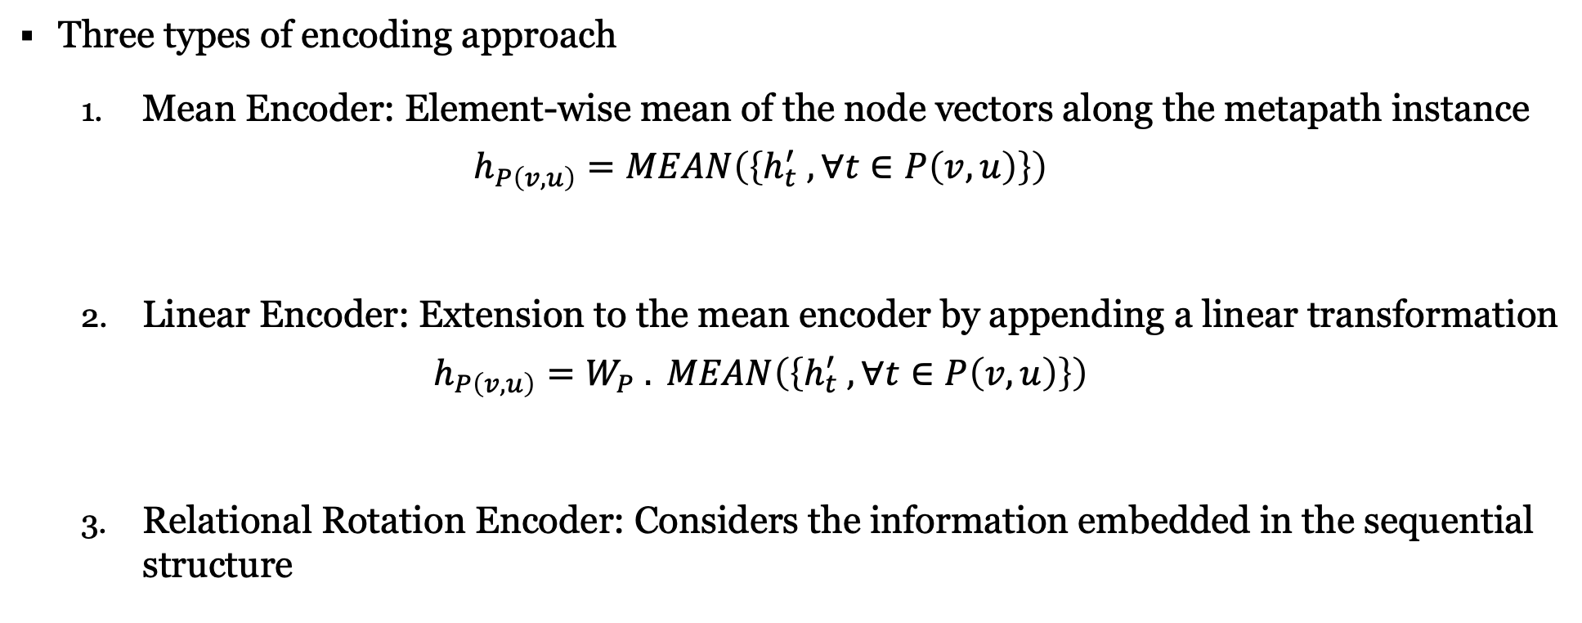
MAGNN: Intra-metapath Aggregation (3)
Three types of encoding approach
Mean Encoder: Element-wise mean of the node vectors along the metapath instance
$$h_{P\left(v,u\right)}=MEAN\left(\left\{h_{t}^{′} , ∀t∈P\left(v,u\right)\right\}\right)$$
Linear Encoder: Extension to the mean encoder by appending a linear transformation
$$h_{P\left(v,u\right)}=W_{P} . MEAN\left(\left\{h_{t}^{′} , ∀t∈P\left(v,u\right)\right\}\right)$$
Relational Rotation Encoder: Considers the information embedded in the sequential structure

Slide 19
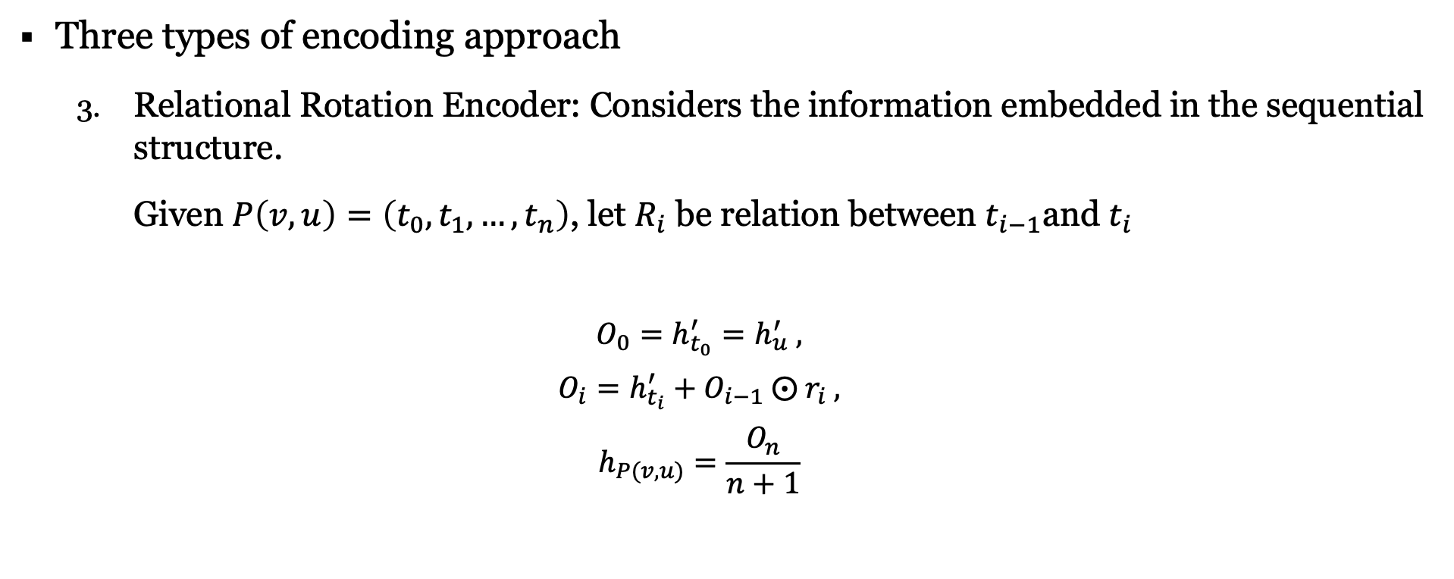



MAGNN: Intra-metapath Aggregation (4)
Three types of encoding approach
Relational Rotation Encoder: Considers the information embedded in the sequential structure.
Given $P\left(v,u\right)=\left(t_{0}, t_{1}, …, t_{n}\right)$, let $R_{i}$ be relation between $t_{i−1}$and $t_{i}$
$$O_{0}=h_{t_{0}}^{′}=h_{u}^{′} ,$$
$$O_{i}=h_{t_{i}}^{′}+O_{i−1} ⨀{ r}_{i} ,$$
$$h_{P(v,u)}=\frac{O_{n}}{n+1}$$
$$u$$
$$v$$
Relation vector of $R_{i}$

Slide 20
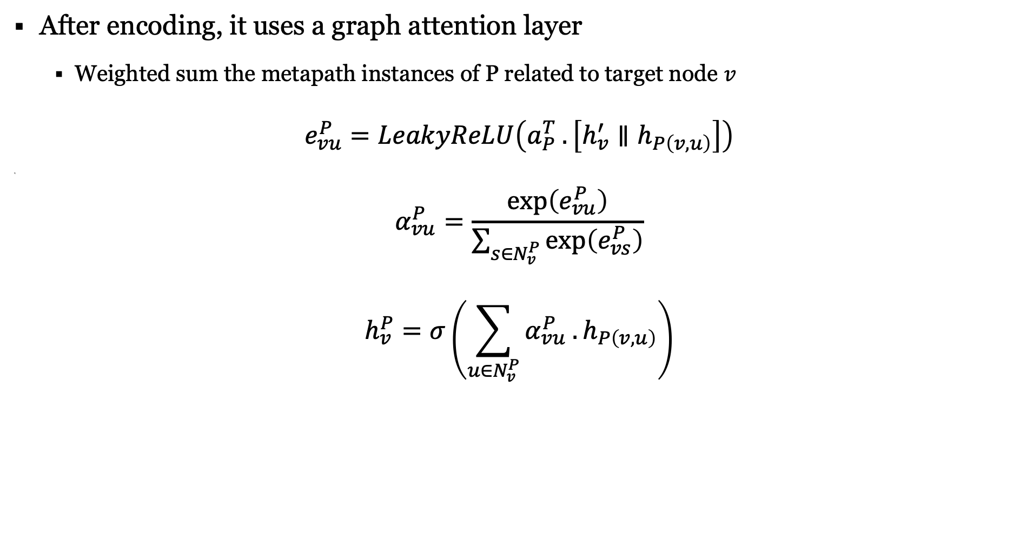
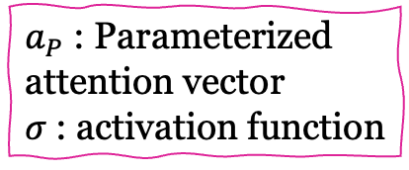
MAGNN: Intra-metapath Aggregation (5)
After encoding, it uses a graph attention layer
Weighted sum the metapath instances of P related to target node $v$
$$e_{vu}^{P}=LeakyReLU\left(a_{P}^{T} . \left[h_{v}^{′}∥h_{P\left(v,u\right)}\right]\right)$$
q
$$α_{vu}^{P}=\frac{\exp\left(e_{vu}^{P}\right)}{\sum_{s∈N_{v}^{P}}{\exp\left(e_{vs}^{P}\right)}}$$
$$h_{v}^{P}=σ\left(\sum_{u∈N_{v}^{P}}{α_{vu}^{P} . h_{P\left(v,u\right)}}\right)$$
$a_{P}$ : Parameterized attention vector
$σ$ : activation function

Slide 21
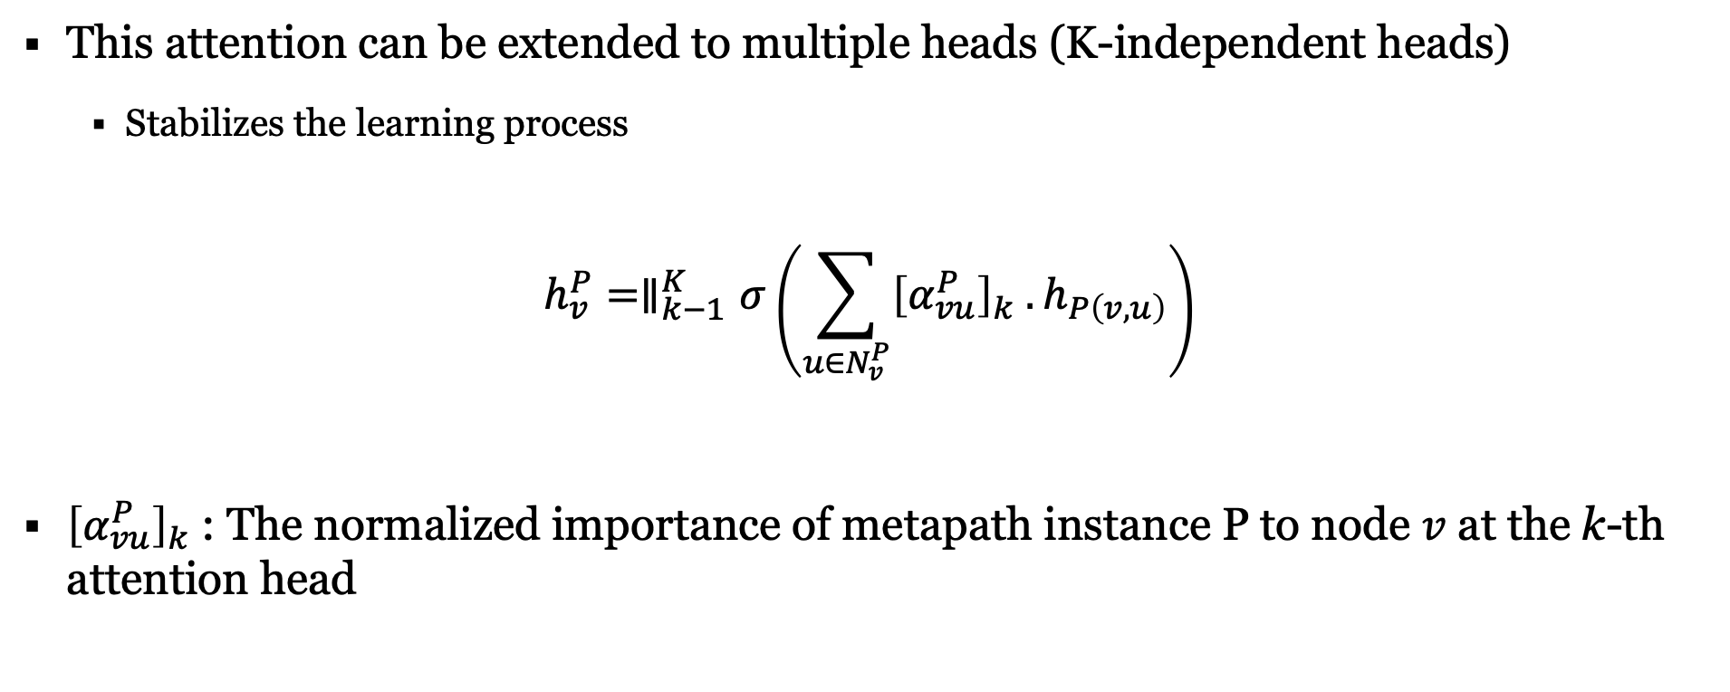
MAGNN: Intra-metapath Aggregation (6)
This attention can be extended to multiple heads (K-independent heads)
Stabilizes the learning process
$$h_{v}^{P}=∥_{k−1}^{K}σ\left(\sum_{u∈N_{v}^{P}}{{\left[α_{vu}^{P}\right]}_{k} .h_{P\left(v,u\right)}}\right)$$
${\left[α_{vu}^{P}\right]}_{k}$ : The normalized importance of metapath instance P to node $v$ at the k-th attention head

Slide 22

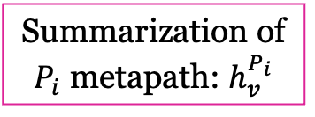
MAGNN: Intra-metapath Aggregation Summary
For a target node $v$ and metapath P, intra-metapath aggregation has two steps:
Encoding: Aggregating information along each metapath instances
Graph Attention Layer: Weighted sum of encoded vectors
Summarization of $P_{i}$ metapath: $h_{v}^{P_{i}}$

Slide 23
MAGNN: Inter-metapath Aggregation

Slide 24
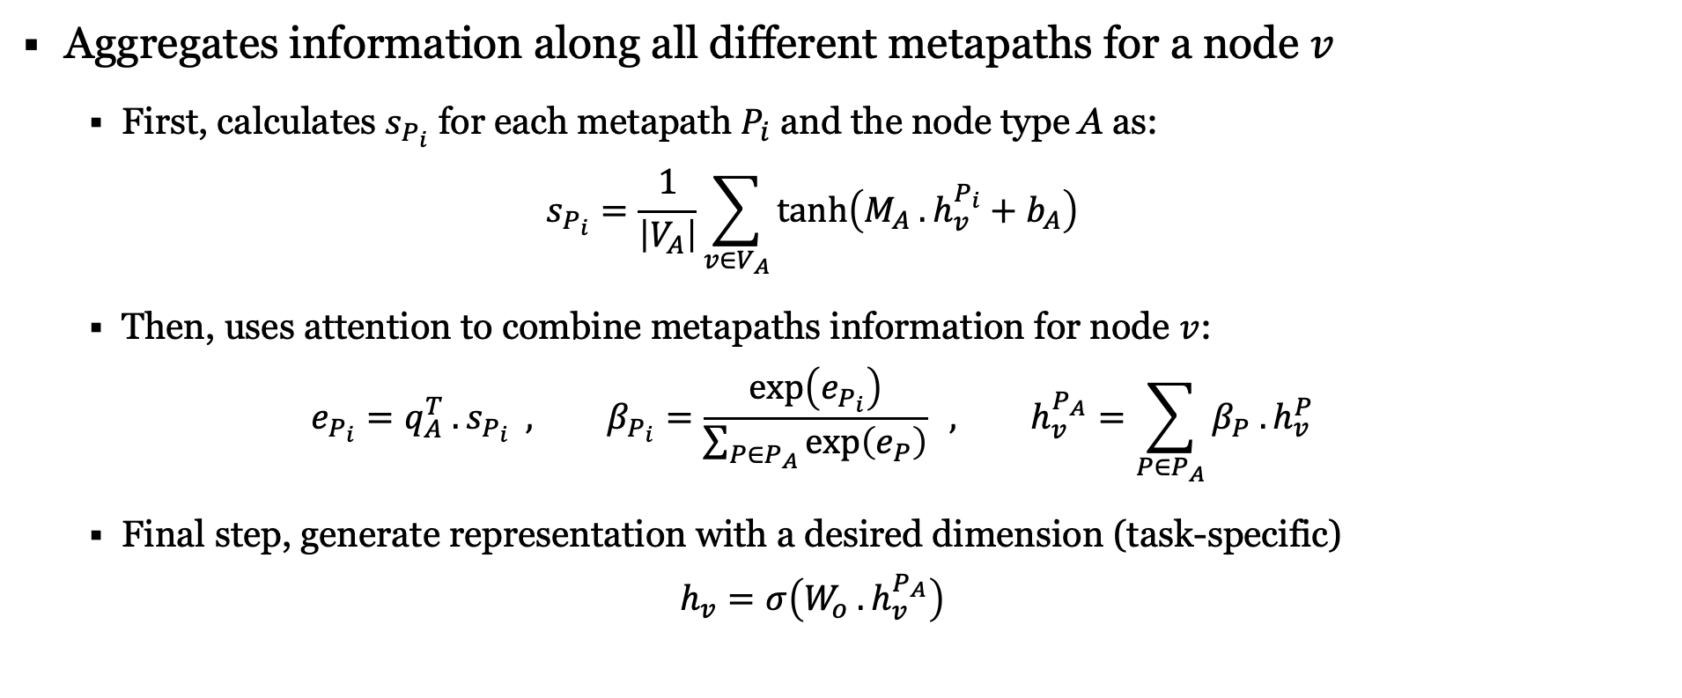

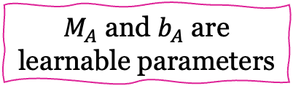
MAGNN: Inter-metapath Aggregation (1)
Aggregates information along all different metapaths for a node $v$
First, calculates $s_{P_{i}}$ for each metapath $P_{i}$ and the node type A as:
$$s_{P_{i}}=\frac{1}{\left|V_{A}\right|}\sum_{v∈V_{A}}{\tanh\left(M_{A} . h_{v}^{P_{i}}+b_{A}\right)}$$
Then, uses attention to combine metapaths information for node $v$:
$$e_{P_{i}}=q_{A}^{T} . s_{P_{i}} , β_{P_{i}}=\frac{\exp\left(e_{P_{i}}\right)}{\sum_{P∈P_{A}}{\exp\left(e_{P}\right)}} , h_{v}^{P_{A}}=\sum_{P∈P_{A}}{β_{P} . h_{v}^{P}}$$
Final step, generate representation with a desired dimension (task-specific)
$$h_{v}=σ\left(W_{o} .h_{v}^{P_{A}}\right)$$
$M_{A}$ and $b_{A}$ are learnable parameters
$W_{o}$ is a weighted matrix

Slide 25
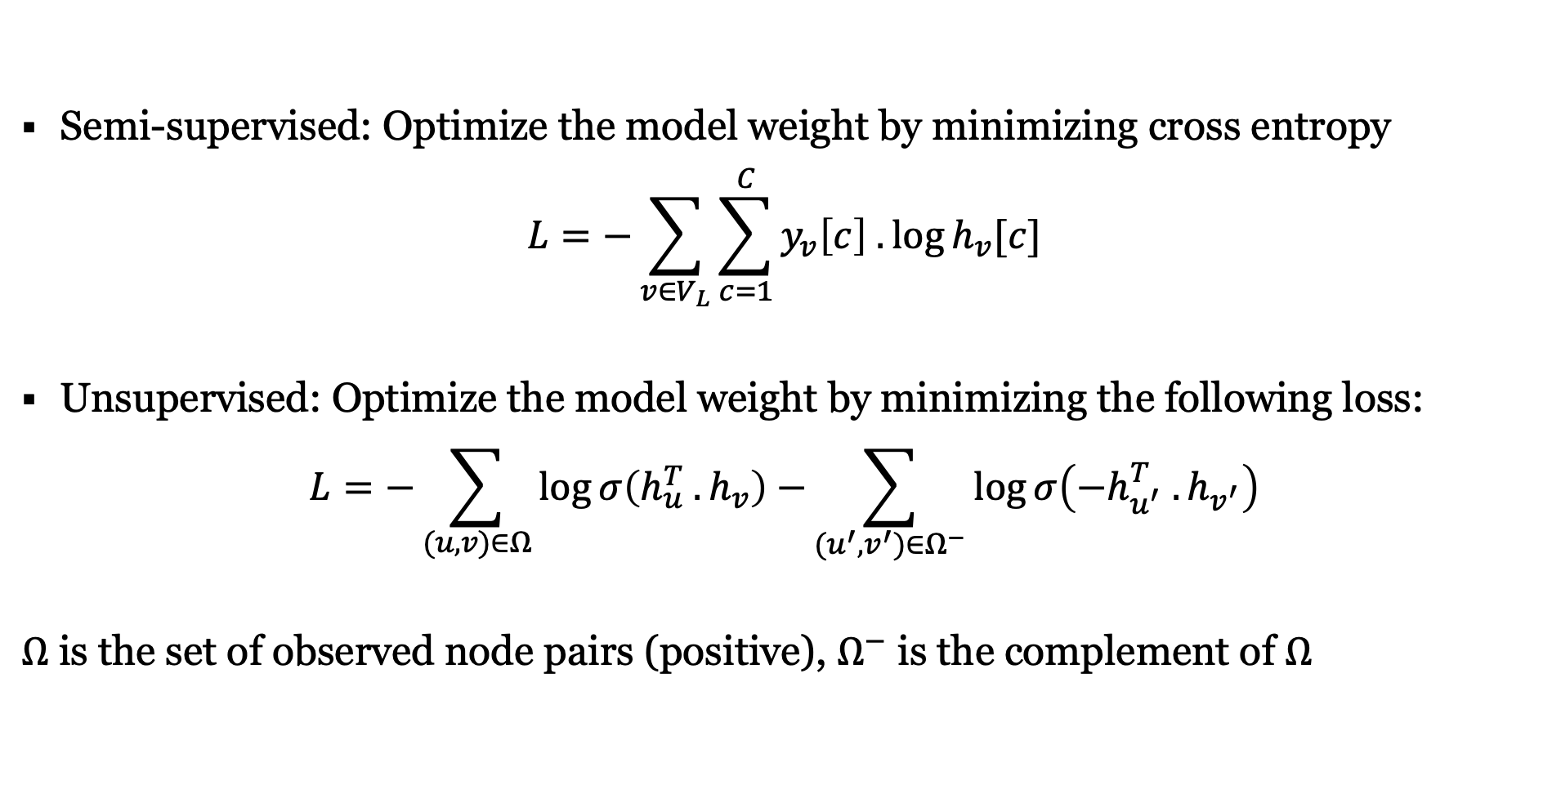
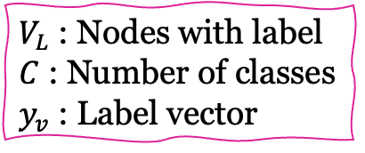
MAGNN Training
Semi-supervised: Optimize the model weight by minimizing cross entropy
$$L=−\sum_{v∈V_{L}}{\sum_{c=1}^{C}{y_{v}\left[c\right] .\log{h_{v}[c]}}}$$
Unsupervised: Optimize the model weight by minimizing the following loss:
$$L=−\sum_{(u,v)∈Ω}{\log{σ\left(h_{u}^{T} . h_{v}\right)}−}\sum_{(u^{′},v^{′})∈Ω^{−}}{\log{σ\left({−h}_{u^{′}}^{T} . h_{v^{′}}\right)}}$$
$Ω$ is the set of observed node pairs (positive), $Ω^{−}$ is the complement of $Ω$
$V_{L}$ : Nodes with label
$C$ : Number of classes $y_{v}$ : Label vector

Slide 26
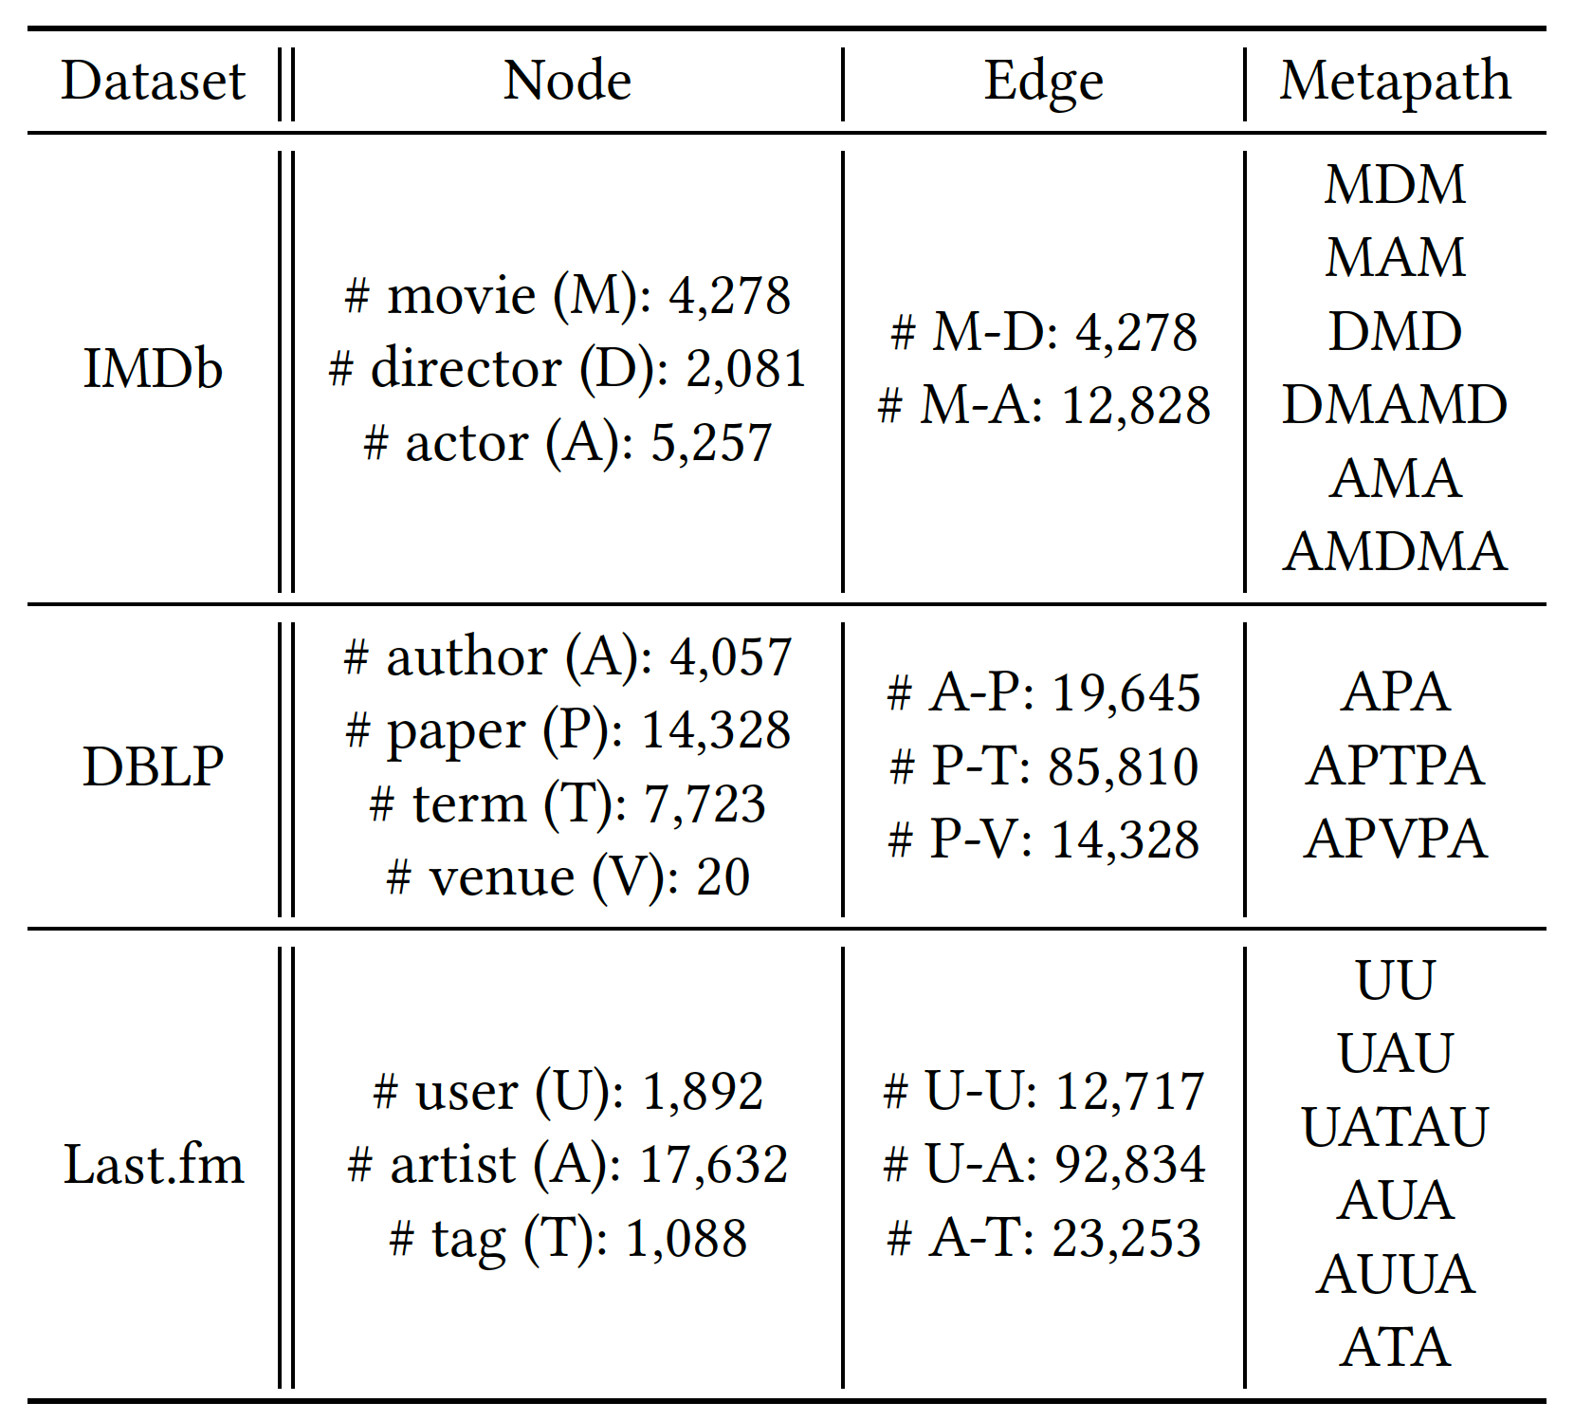
Experiments Dataset
IMDb: Online dataset for movies and TV programs
DBLP: Computer science bibliography website
Last.fm: Music website that keeps track of users’ listening information

Slide 27
Experiments Overview
Baseline models
Traditional homogeneous: LINE, node2vec
Traditional heterogeneous: Esim, metapath2vec, HERec
Homogeneous GNN: GCN, GAT
Heterogeneous GNN: GATNE, HAN
Tests
Node Classification
Node Clustering
Link Prediction

Slide 28
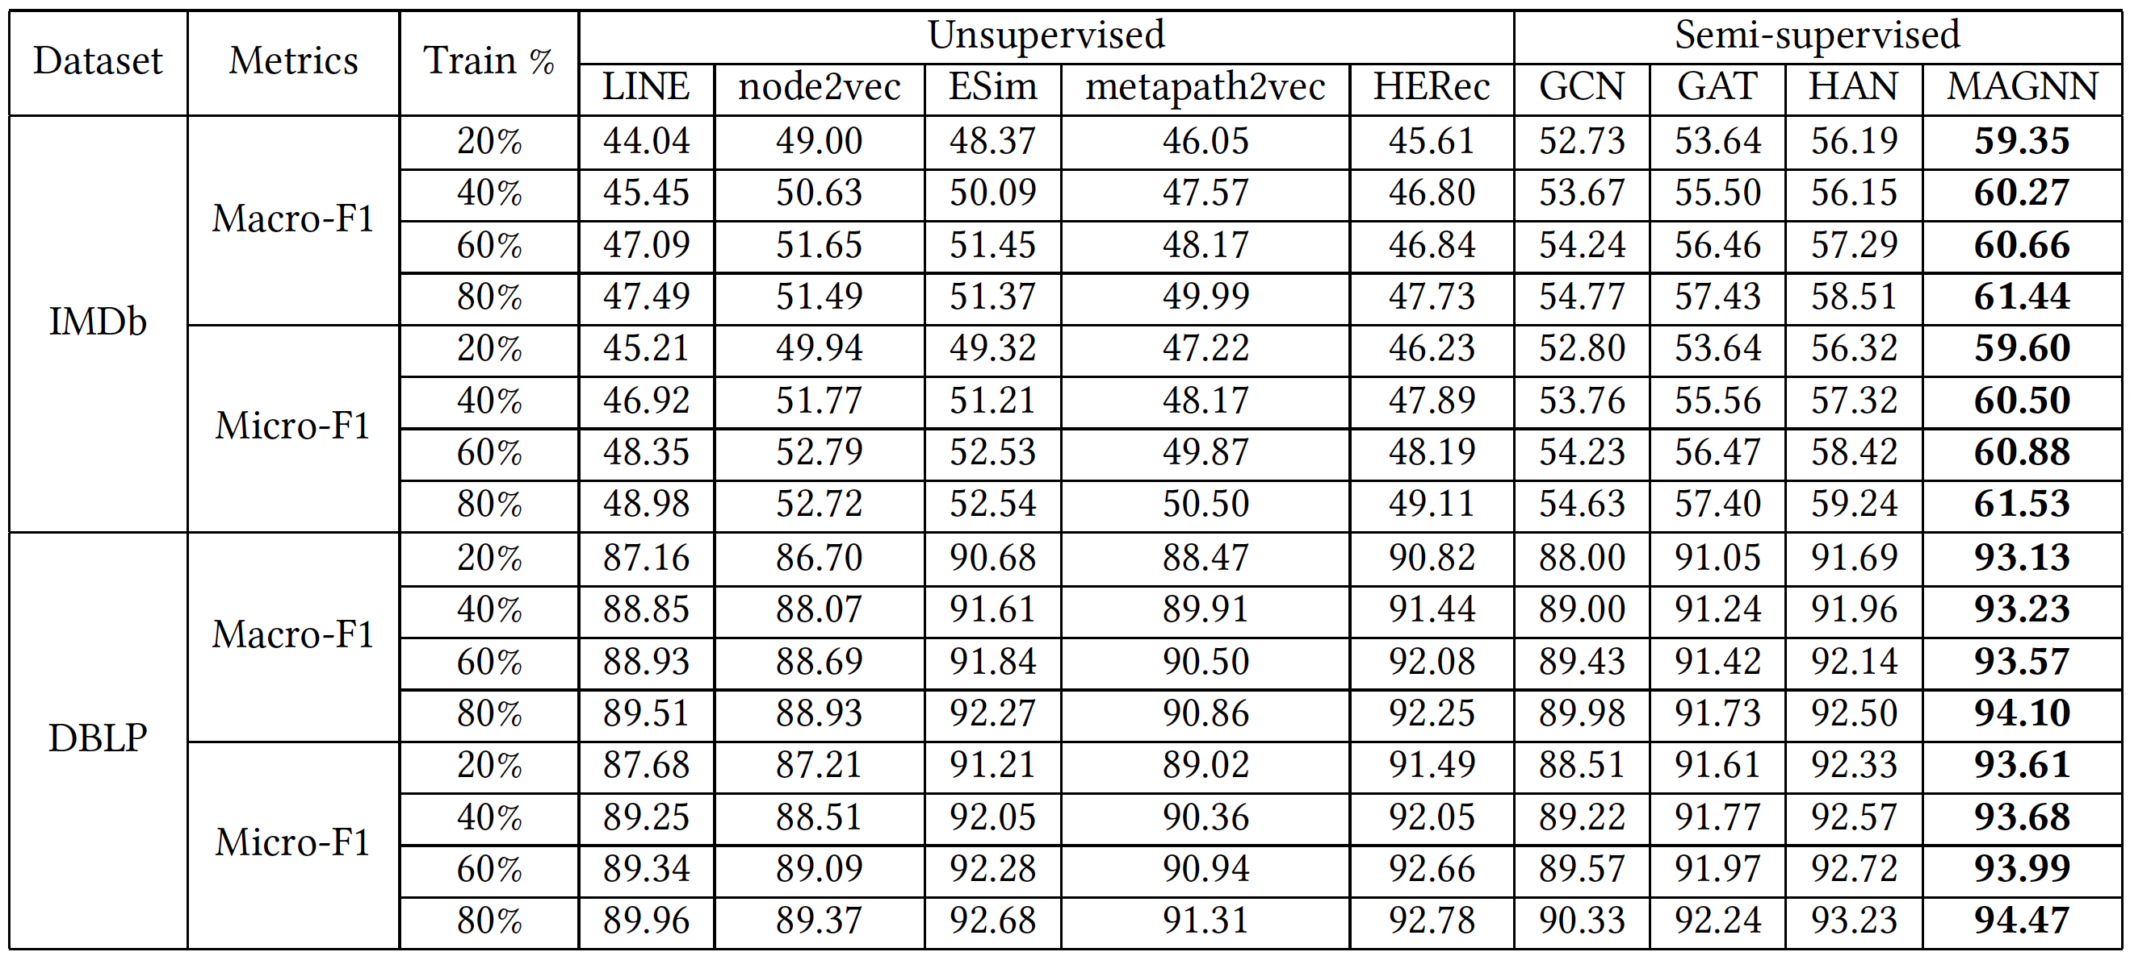
Node Classification
Using SVM (Report average Macro-F1 and Micro-F1 of 10 runs)

Slide 29
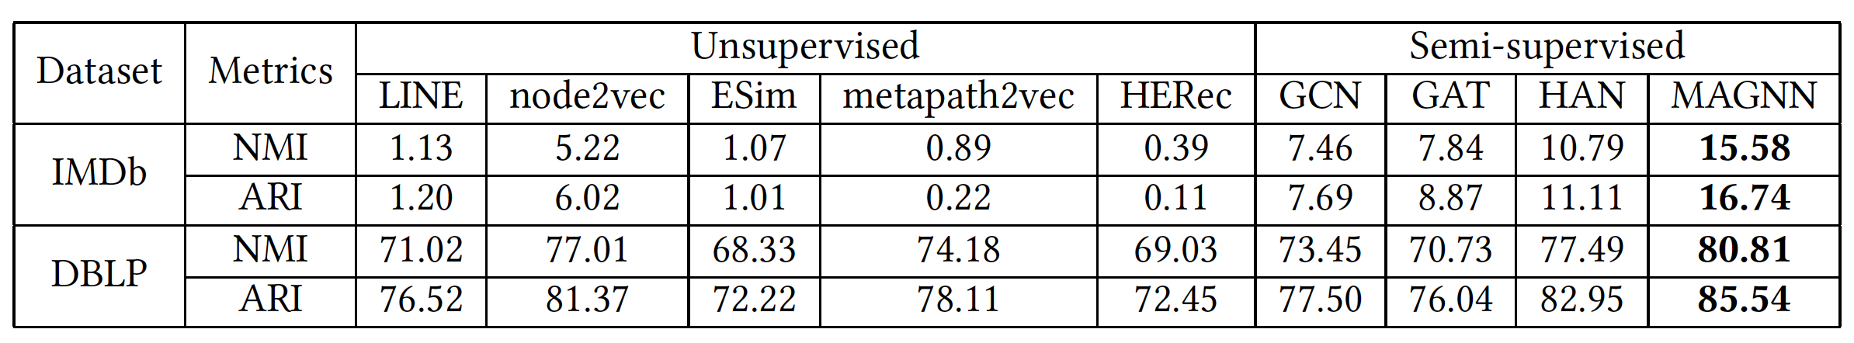
Node clustering
Use K-Means
Employ normalized mutual information and adjusted Rand Index

Slide 30
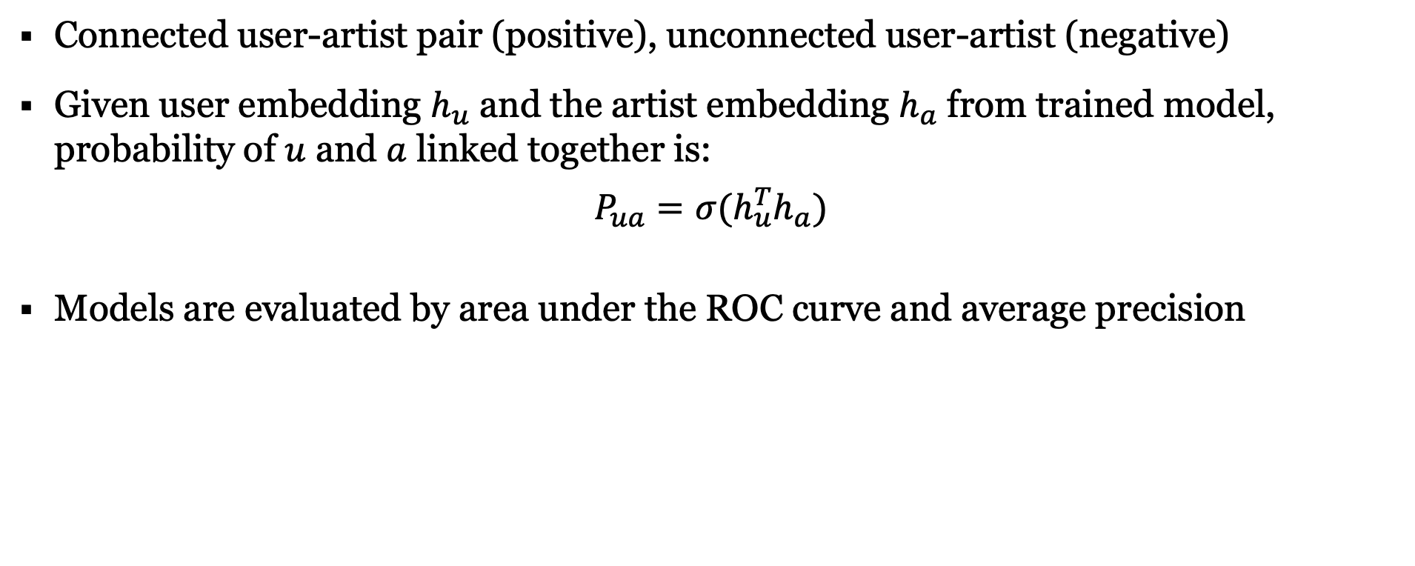
Link Prediction
Connected user-artist pair (positive), unconnected user-artist (negative)
Given user embedding $h_{u}$ and the artist embedding $h_{a}$ from trained model, probability of $u$ and $a$ linked together is:
$$P_{ua}=σ(h_{u}^{T}h_{a})$$
Models are evaluated by area under the ROC curve and average precision

Slide 31
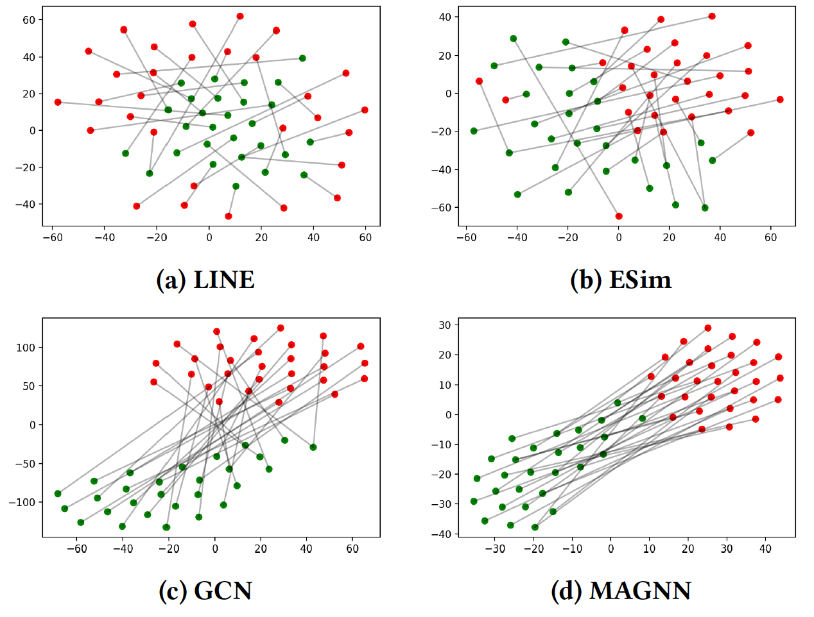
Visualization
Randomly select 30 user-artist pairs from the positive samples
Projects the embeddings into a 2-dimensional space using t-SNE.
Red nodes: Users
Green nodes: Artists

Slide 32
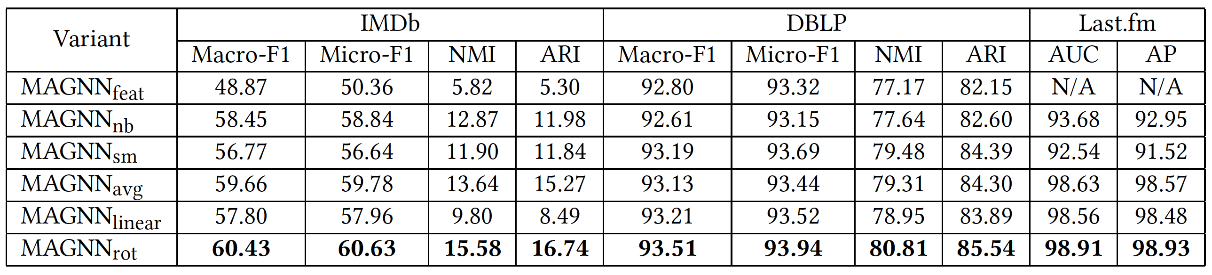
Ablation Studies
MAGNN_{rot}: Proposed method using relational rotation encoder
MAGNN_{feat}: Does not use node content features
MAGNN_{nb}: Considers only the metapath-based neighbors
MAGNN_{sm}: Considers the single best metapath
MAGNN_{avg}, MAGNN_{linear}: Uses mean and linear encoder respectively

Slide 33
Thank You!

