Slide 1
Deep Equilibrium Algorithmic Reasoning
Khushee Kapoor

Slide 2






Motivation
Scalar bottleneck: Algorithms need simplified inputs, losing real-world complexity.
NAR approach: Runs algorithms in vector spaces using neural networks.
Automated mapping: Uses gradient-based optimization, not human intuition.

Slide 3
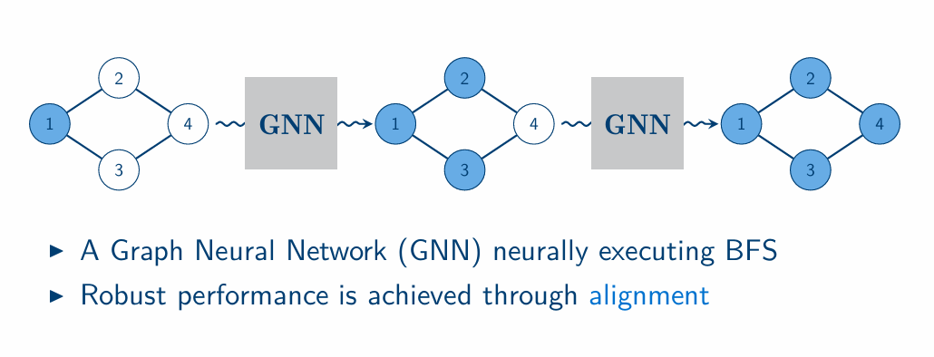
A Quick Primer on neural algorithmic reasoning (NAR)

Slide 4
Background
Neural Algorithmic Reasoners learn to simulate algorithms. (sub-modules correspond to sub-parts of the algorithm)
NAR iterations match algorithm iterations.
Termination signal is provided at train, and often at test time.

Slide 5
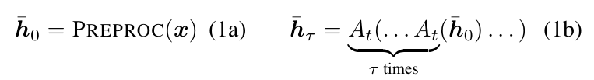

Background
Algorithmic Reasoning

Slide 6


Background
Deep Equilibrium Models
It eliminates the need for step-by-step unrolling.
Memory usage is constant — we don’t have to store all intermediate states.
It models "settling" behavior — which is perfect for simulating algorithms that stop when a solution is found

Slide 7
Background
Expander Graphs
Oversquashing in GNNs: Too much info compressed into fixed-size vectors during message passing.
Solution: Use expander graphs — sparse, highly connected graphs with low diameter.
Why Expanders Help: Enable efficient long-range communication; reduce bottlenecks.
Metric: High Cheeger constant ⇒ better connectivity, less oversquashing.
Construction: Use Cayley graphs via deterministic algebraic methods [12].

Slide 8
Key Contribution
Deep Equilibrium Algorithmic Reasoning (DEAR)
Requires no termination supervision.
Competitive performance to more computationally expensive models.
Substantially faster inference times.

Slide 9
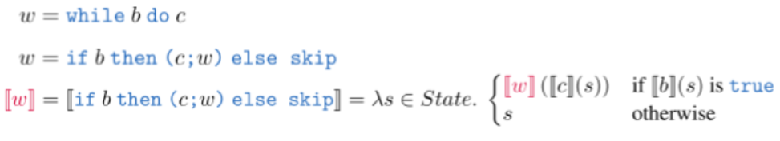
Equilibrium is a missed alignment
Denotational semantics assigns (strictly) compositional meanings to programs.
Achieving this for loops requires finding the equilibrium (a.k.a the fixed point)

Slide 10
Equilibrium is a missed alignment
Denotational semantics assigns (strictly) compositional meanings to programs.
Achieving this for loops requires finding the equilibrium (a.k.a the fixed point)

Slide 11
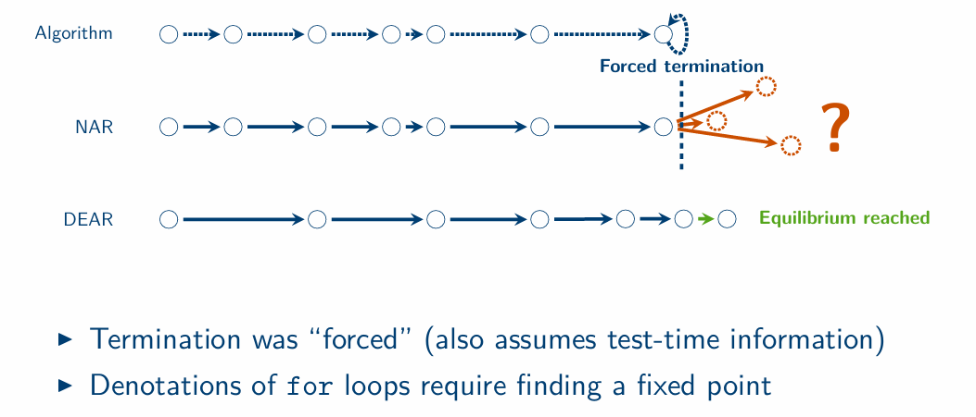
Equilibrium is a missed alignment
Algorithms possess equilibriums and so should neural algorithmic reasoners!

Slide 12
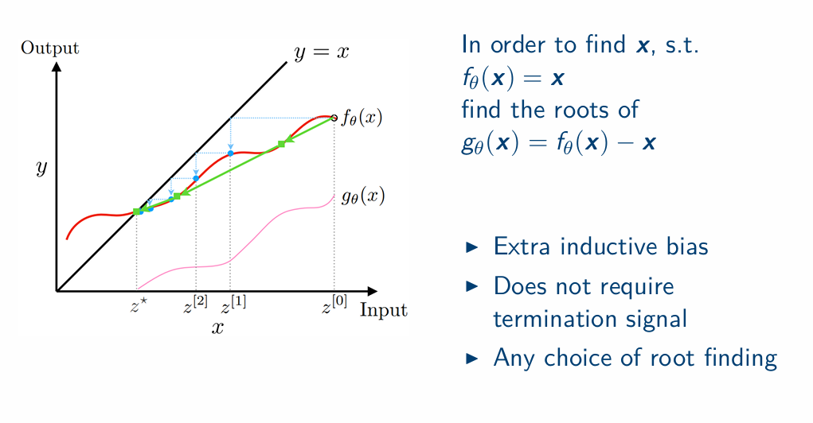
How? DEQs [Bai et. al, 2019]

Slide 13


Architecture
Sparse graph representation
Node embeddings

Slide 14



Finding the fixed point
Anderson solver

Slide 15
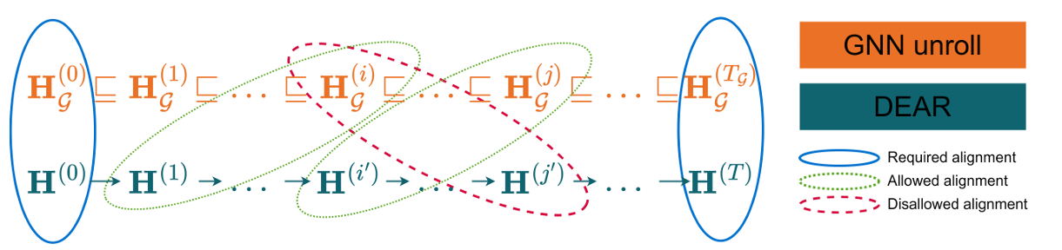
Alignment

Slide 16
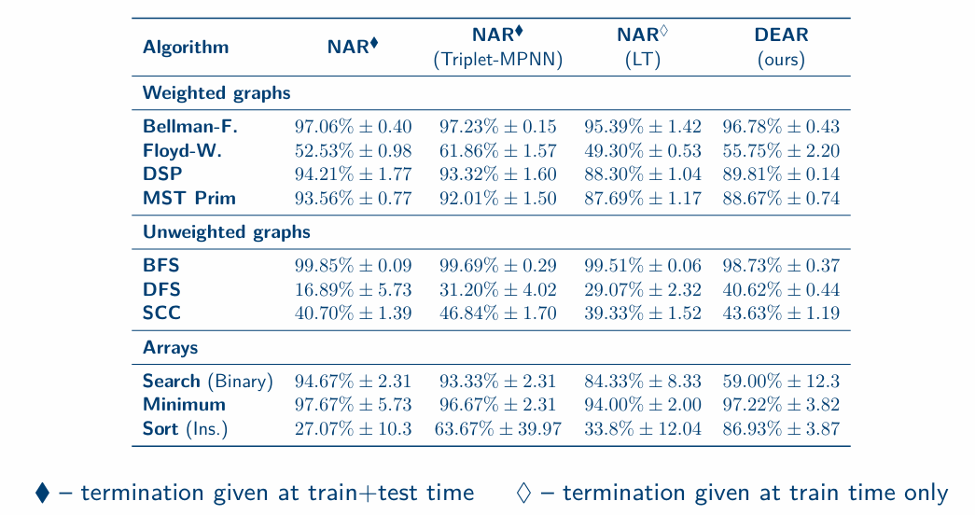
Results

Slide 17
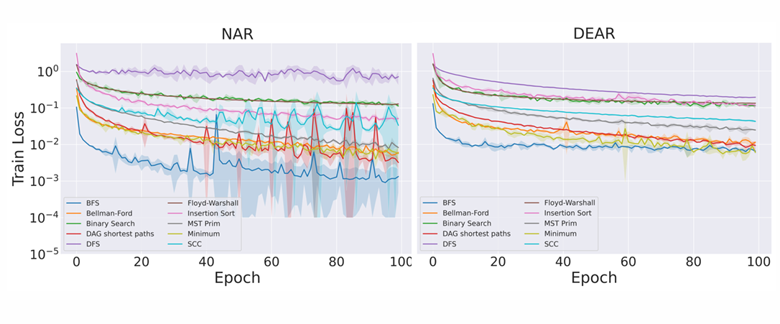
Results
Despite converging to slightly higher train loss our models remain stable during optimization

Slide 18
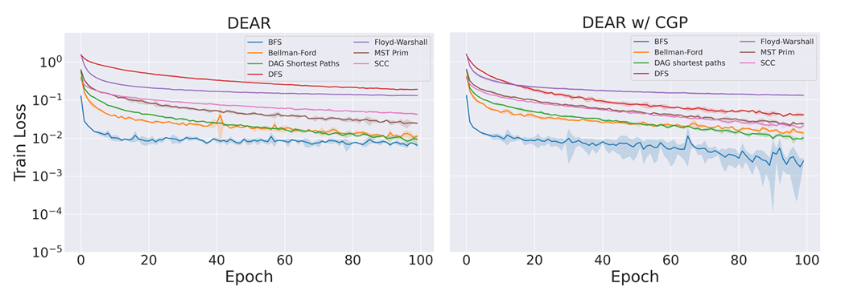
Results
Cayely graph propagation can help with convergence

Slide 19
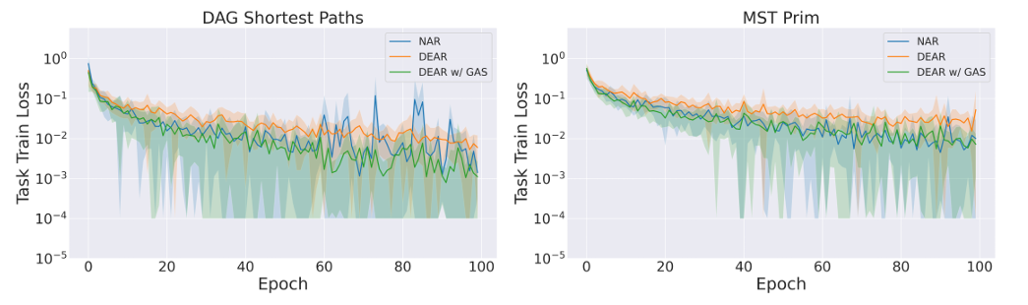
Results
Alignment (with GRANOLA and stochasticity; DEAR w/ GAS) gives better convergence

Slide 20
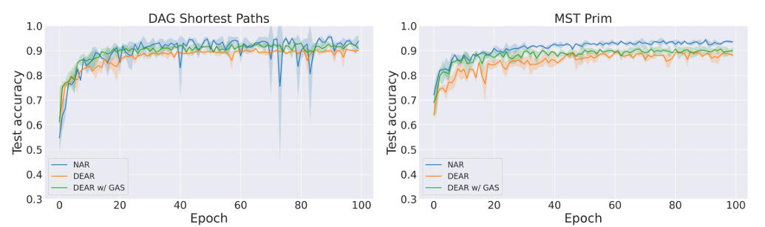
Results
Alignment (DEAR w/ GAS) leads to improvements OOD

Slide 21
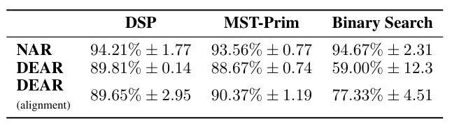
Results
Test accuracy with and without alignment.

Slide 22
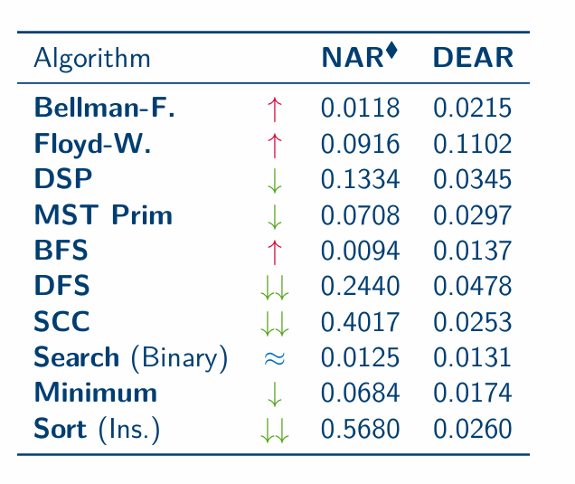
Results
Inference Times

Slide 23
Conclusions
Better algorithms for alignment can help close the gap even further for Prim’s algorithm and binary search
Better model selection is needed in order to know which DEARs would perform well OOD
Graph rewiring techniques may be needed to prevent overfitting with CGP
Algorithmic-aligned criteria for fixed-point may boost OOD generalisation for sequential algorithms

