Slide 1
WHAT GRAPH NEURAL NETWORKS CANNOT LEARN: DEPTH VS WIDTH
Khushee Kapoor
Master of Data Science and Artificial Intelligence
Notes:
A fundamental question in machine learning is to determine what a model can and cannot learn. In deep learning, there has been significant research effort in establishing expressivity results for feed and recurrent neural networks, as well as more recently for Transformers and Neural GPUs. This paper is focused on the expressive power of (message-passing) graph neural networks (GNNs).

Slide 2
THEORY OF UNIVERSALITY
Given enough data and the right training procedure, a universal network will be able to solve any task that it is presented with, allowing us to grasp the expressive power of models in the limit -> impossibility results can yield practical advice on how to select model hyperparameters.
Focus on networks deeper than the lower bound when performing experiments!
Notes:
A recurring theme in this paper is the theory of universality. Universality statements allow us to grasp the expressive power of models in the limit. In theory, given enough data and the right training procedure, a universal network will be able to solve any task that it is presented with. Nevertheless, the insight brought by such results can also be limited. Knowing that a sufficiently large network can be used to solve any problem does not reveal much about how neural networks should be designed in practice. It also cannot guarantee that said network will be able to solve a given task given a particular training procedure, such as stochastic gradient descent.
On the other hand, it might be easier to obtain insights about models by studying their limitations. After all, the knowledge of what cannot be computed (and thus learned) by a network of specific characteristics applies independently of the training procedure. Further, by helping us comprehend the difficulty of a task in relation to a model, impossibility results can yield practical advice on how to select model hyperparameters. Take, for instance, the problem of graph classification. Training a graph classifier entails identifying what constitutes a class, i.e., finding properties shared by graphs in one class but not the other, and then deciding whether new graphs abide to said learned properties. However, if the aforementioned decision problem is shown to be impossible by a graph neural network of certain depth then we can be certain that the same network will not learn how to classify a sufficiently diverse test set correctly, independently of which learning algorithm is employed. We should, therefore, focus on networks deeper that the lower bound when performing experiments.

Slide 3
RESULTS
Graph Neural Networks are Turing Universal
GNNs lose a significant portion of their power when their capacity – defined as the product of depth and width – is restricted
Since Turing Universality is a strictly stronger property than universal approximation -> Turing Universal GNNmp can solve the graph isomorphism problem.
Notes:
The key contributions are two-fold:
Graph Neural Networks are Turing Universal -> In other words, GNNs can be used as general purpose graph learning machines—given enough data and the right training procedure, a universal GNN can solve any task that it is presented with. Since Turing universality is a strictly stronger property than universal approximation, Chen et al. (2019)’s argument further implies that a Turing universal GNNmp can solve the graph isomorphism problem. As expected, universality hinges on some strong conditions on the network’s operation. A key condition is that the depth and width of the network has to be very large. Unfortunately, the latter condition is also necessary:
GNNs lose a significant portion of their power when their capacity –defined as the product of depth and width– is restricted. The proposed impossibility statements stem from a new technique that leads to lower bounds for an array of decision, optimization, verification, and estimation problems involving graphs (e.g., does my graph contain a cycle, find a minimum cut, or estimate the diameter). Strikingly, several of these problems are deemed impossible whenever the product of a GNN’s depth and width is sub-linear on the number of nodes. The dependence remains significant even for tasks that appear simple or when considering approximation.

Slide 4
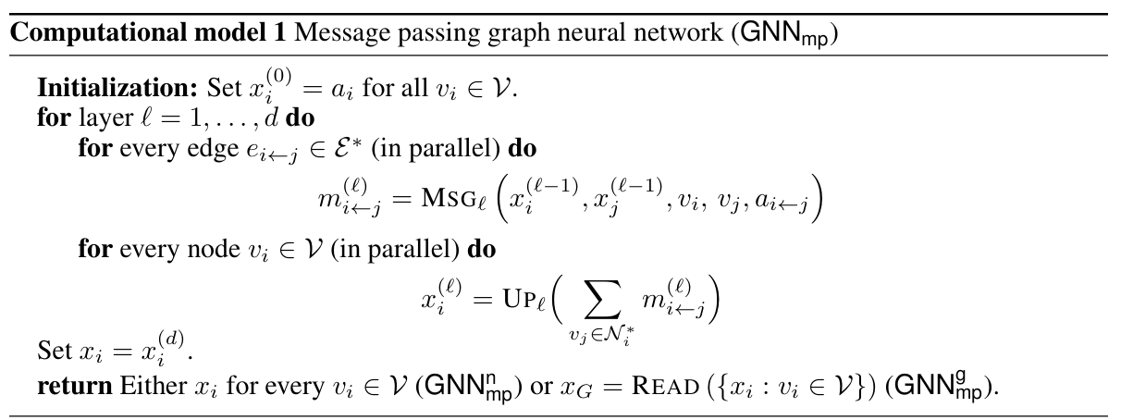
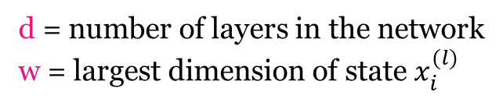
GRAPH NEURAL NETWORK: COMPUTATIONAL MODEL
Attributed Graph
$$G_{a}=(G, \left(a_{i} : v_{i} ∈θ\right), \left(a_{i→j} : e_{i→j} ∈ε\right))$$
multiset
READ
vector
dimension squashing operator;
feed forward network
d = number of layers in the network
w = largest dimension of state $x_{i}^{(l)}$
by universal approximation theorem, the MSG/ UP/ READ functions can approximate any general function that maps vectors onto vectors, given sufficient depth and/or width.
Notes:
Graph neural networks are parametric and differentiable learning machines. Their input is usually an attributed graph Ga = (G(ai : vi V) (ai j : ei j E)), where vectors a1…an encode relevant node attributes and ai<- j are edge attributes, e.g., encoding edge direction.
Model 1 formalizes the graph neural network operation by placing it in the message passing model. The computation proceeds in layers, within which a message mi<-j is passed along each directed edge ei<-j eps E going from vj to vi and each node updates its internal representation by aggregating its state with the messages sent by its incoming neighbors vj eps Ni. The network output can be either of two things: a vector xi for each node vi or a single vector xG obtained by combining the representations of all nodes using a readout function. Vectors xi/xG could be scalars (node/graph regression), binary variables (node/graph classification) or multi-dimensional (node/graph embedding). I use the symbols GNNn mp and GNNg mp to distinguish between models that return a vector per node and one per graph, respectively.
The operation of a GNNmp is primarily determined by the messaging, update, and readout functions. I assume that MSG and UP are general functions that act on intermediate node representations and node ids (the notation is overloaded such that vi refers to both the i-th node as well as its unique id). As is common in the literature these functions are instantiated by feed-forward neural networks. Thus, by the universal approximation theorem and its variants, they can approximate any general function that maps vectors onto vectors, given sufficient depth and/or width. Function READ is useful when one needs to retrieve a representation that is invariant of the number of nodes. The function takes as an input a multiset, i.e., a set with possibly repeating elements, and returns a vector. Commonly, READ is chosen to be a dimension squashing operator, such as a sum or a histogram, followed by a feed-forward neural network (Xu et al., 2018; Seo et al., 2019).

Slide 5
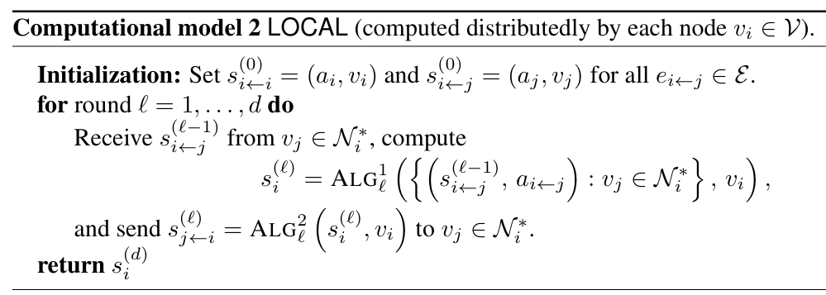
GRAPH NEURAL NETWORK: LOCAL MODEL
Nodes play the role of both – the machine where the computation takes place and the variables of the graph theoretic problem to be solved.
Edges model communication links between models as well as relation between nodes.
All nodes execute the same algorithm (distributed computing), are fault-free and provided with unique identifiers.
No restrictions on how much information a node can send at every round.
Notes:
he LOCAL model, initially studied by Angluin (1980), Linial (1992), and Naor & Stockmeyer (1993), provides a common framework for analyzing the effect of local decision. Akin to GNNmp, in LOCAL a graph plays a double role: it is both the input of the system and captures the network topology of the distributed system that solves the problem. In this spirit, the nodes of the graph are here both the machines where computation takes place as well as the variables of the graph-theoretic problem we wish to solve—similarly, edges model communication links between machines as well as relations between nodes. Each node vi V is given a problem-specific local input and has to produce a local output. The input contains necessary the information that specifies the problem instance. All nodes execute the same algorithm, they are fault-free, and they are provided with unique identifiers. A pseudo-code description is given in Model 2. Variables s(l) i and s(l) i j refer respectively to the state of vi in round l and to the message sent by vj to vi in the same round. Both are represented as strings. The computation starts simultaneously and unfolds in synchronous rounds l = 1 d. Three things can occur within each round: each node receives a string of unbounded size from its incoming neighbors; each node updates its internal state by performing some local computation; and each node sends a string to every one of its outgoing neighbors. Functions ALG1 l and ALG2 l are algorithms computed locally by a Turing machine running on node vi. Before any computation is done, each node vi is aware of its own attribute ai as well as of all edge attributes ai j : vj Ni . In LOCAL, there are no restrictions on how much information a node can send at every round. Asserting that each message s( ) i j is at most b bits yields the CONGEST model (Peleg, 2000).

Slide 6
GNNmp vs LOCAL
Notes:
The reader might have observed that LOCAL resembles closely GNNn mp in its structure, with only a few minor differences: firstly, whereas a LOCAL algorithm A may utilize messages in any way it chooses, a GNNn mp network N always sums received messages before any local computation. The two models also differ in the arguments of the messaging function and the choice of information representation (string versus vector). Yet, as the following theorem shows, the differences between GNNn mp and LOCAL are inconsequential when seen from the perspective of their expressive power

Slide 7
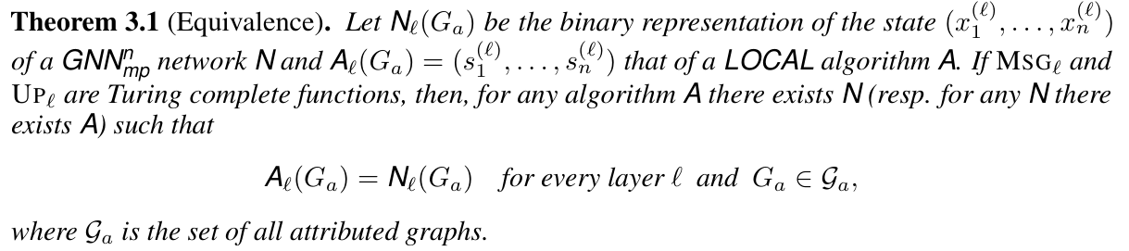
GNNmp vs LOCAL
Notes:
This equivalence enables us to reason about the power of GNNn mp by building on the well-studied properties of LOCAL. In particular, it is well known in distributed computing that, as long as the number of rounds d of a distributed algorithm is larger than the graph diameter G, every node in a LOCAL can effectively make decisions based on the entire graph (Linial, 1992). Together with Theorem 3.1, the above imply that, if computation and memory are not an issue, one may construct a GNNn mp that effectively computes any computable function w.r.t. its input.
Why is this result relevant? From a cursory review, it might seem that universality is an abstract result with little implication to machine learning architects. After all, the utility of a learning machine is usually determined not with regards to its expressive power but with its ability to generalize to unseen examples. Nevertheless, it can be argued that universality is an essential property of a good learning model. This is for two main reasons: First, universality guarantees that the learner does not have blind-spots in its hypothesis space. No matter how good the optimization algorithm is, how rich the dataset, and how overparameterized the network is, there will always be functions which a non universal learner cannot learn. Second, a universality result provides a glimpse on how the size of the learner’s hypothesis space is affected by different design choices. For instance, Corollary 3.1 puts forth four necessary conditions for universality: the GNNn mp should be sufficiently deep and wide, nodes should be able to uniquely and consistently identify each other, and finally, the functions utilized in each layer should be sufficiently complex. The following section delves further into the importance of two of these universality conditions. It will be shown that GNNn mp lose a significant portion of their power when the depth and width conditions are relaxed.

Slide 8
RESULT 1: UNIVERSALITY OF GNNmp
GNNmp studied so far are anonymous (nodes have no features).
With unique node features GNNmp are more powerful:
If unique features do not exist:
they can be randomly assigned (in theory)
but generalization is an issue
GNNmp is computationally universal if:
it has powerful layers
it is sufficiently deep and wide
nodes are given unique features

Slide 9
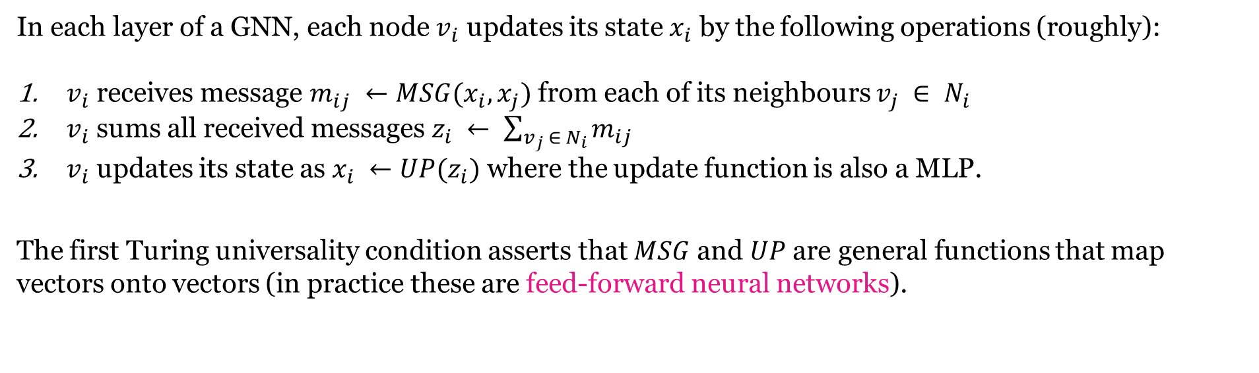
1.1 POWERFUL LAYERS
In each layer of a GNN, each node $v_{i}$ updates its state $x_{i}$ by the following operations (roughly):
$v_{i}$ receives message $m_{ij} ←MSG(x_{i}, x_{j})$ from each of its neighbours $v_{j} ∈ N_{i}$
$v_{i}$ sums all received messages $z_{i} ← \sum_{v_{j} ∈ N_{i}}{m_{ij}}$
$v_{i}$ updates its state as $x_{i} ←UP(z_{i})$ where the update function is also a MLP.
The first Turing universality condition asserts that $MSG$ and $UP$ are general functions that map vectors onto vectors (in practice these are feed-forward neural networks).
Notes:
Recall that, in each layer of a GNN, each node updates its state by the following operations (roughly):
The first Turing universality condition asserts that and are general functions that map vectors onto vectors. In practice, these functions are instantiated by feed-forward neural networks. Thus, by the universal approximation theorem and its variants, given sufficient depth and/or width, these networks can approximate any continuous function to arbitrary precision. MLPs with appropriate activations are also Turing universal.

Slide 10
1.2 SUFFICIENT DEPTH AND WIDTH
depth d = number of layers that a GNN contains.
width w = size of its node representations.
Why should the depth be large?
A GNN’s output is limited to local d-radius neighborhoods, so shallow networks can't capture global graph properties.
Why should the width be large?
In narrow, deep GNNs, slow information propagation may prevent nodes from accessing necessary graph-wide information.
Notes:
It is easy to understand why the depth should be large: the representation of any node in the output of the GNN is a function of the input within a -radius neighborhood of the node (the receptive field). It directly follows that a network whose depth is strictly smaller than the graph diameter cannot compute quantities that are inherently global. For instance, without a readout function, the network cannot learn to count the total number of nodes/edges of a graph.
The role of width is somewhat more subtle. Intuitively, in narrow networks information propagates more slowly. Thus, the nodes of a very narrow but deep GNN may be unable to gather required information about the rest of the graph if the network.
The relation between depth and width becomes more clear when considering what GNNs cannot learn

Slide 11
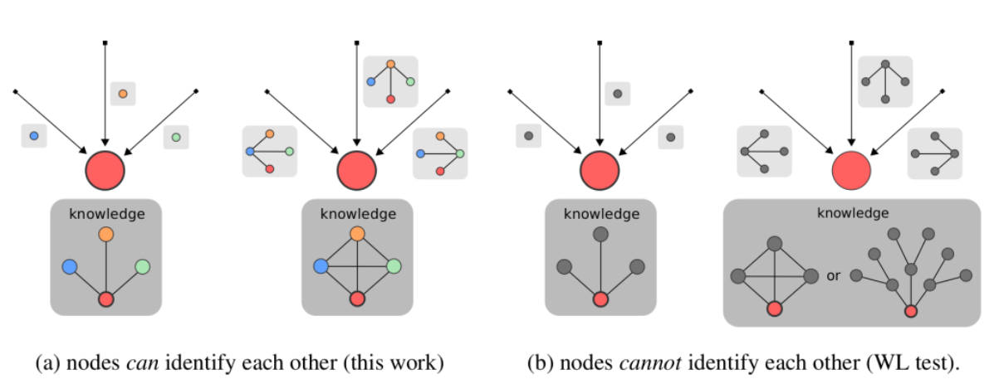
1.3 DISCRIMINATIVE ATTRIBUTES (beyond W-L test)
Notes:
There is a striking difference between the power of anonymous GNNs and those in which nodes have the capacity to uniquely identify each other (e.g., based on unique ids, random features, or discriminative node attributes).
Previous analyses of GNN expressivity focused on the anonymous case. It is perhaps of little surprise that in this setting GNN are not particularly powerful. In fact, it was shown independently by Xu et al. (2018) and Morris et al. (2019) that (anonymous) GNN are as powerful as the Weisfeiler-Lehman (WL) graph isomorphism test. This is disheartening as it implies that anonymous networks are blind to the many graph properties that WL-test cannot see: e.g., any two regular graphs with the same number of nodes are identical from the perspective of the WL test.
To illustrate the problem with anonymity, I consider a thought experiment where a red node is tasked with reconstructing the graph topology by communicating with its neighbors. Figure 1. GNNs with discriminative node attributes are significantly more powerful. Toy example of message exchange from the perspective of the red node. The arrows show where each received message comes from and the message content is shown in light gray boxes. Red’s knowledge of the graph topology is depicted at the bottom.
The figure above depicts the red node’s understanding of the world after the first and second message exchange round.
Left: each node possesses a unique identifier (color). At the end of the first round, each node is aware of its neighbors and after two rounds the entire graph has been successfully reconstructed in red’s memory.
Right: nodes do not possess ids and cannot distinguish which of their neighbors are themselves adjacent. As such, the red node cannot tell whether the graph contains cycles: after two rounds there are at least two plausible topologies that could explain its observations.

Slide 12
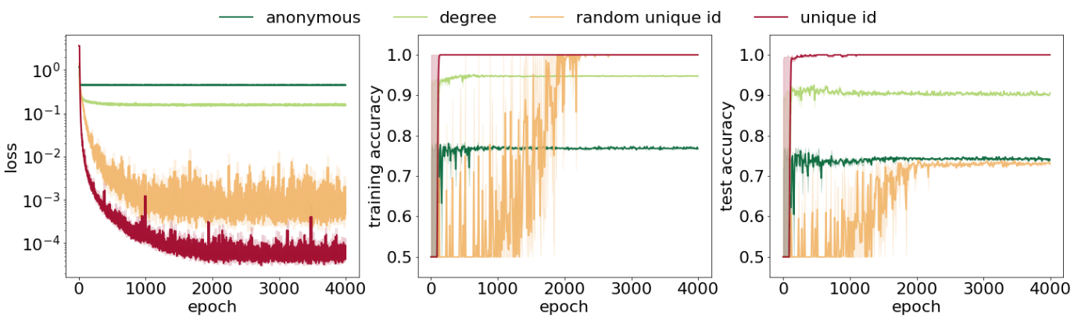
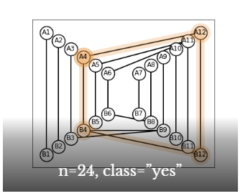
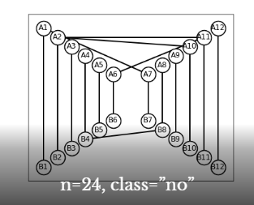
EXPERIMENT: EFFECT OF ANONYMITY
Classifying graphs based on whether they contain a 4-cycle.
With non-unique features, GNNmp could not detect cycles.
Problem solved when nodes given unique features.
Random features don’t generalize well.
Notes:
The effect of anonymity becomes apparent when testing how well a GNN solves the 4-cycle detection task: classifying a directed graph as having a 4-cycle or not. To demonstrate this effect, I built an adversarial dataset by starting from a template graph and changing a subset of its edges stochastically (The specifics are quite intricate and follow from a lower bound construction. For more information see the Appendix C of paper). This resulted in 1200 graphs (1000 for training and 200 for testing) out of which exactly half contained a 4-cycle and the rest didn’t. I then constructed a (sufficiently deep and wide) GNN and tasked it with learning to classify the former from the latter.
Figure 2 depicts the training and test curves for four GNN variants.
Figure 2. GNNs are significantly more powerful when given discriminative node attributes. The four different curves correspond to different input node attributes: (a) All nodes had the same (non-discriminative) attribute (anonymous). (b) Each node started by having access to a one-hot encoding of its degree. This is a partially discriminative node attribute (degree). (c) Each node was given a one-hot encoding of its id. This is a fully discriminating node attribute and thus condition 3 is satisfied (unique id). (d) Similar to the unique id setting, but not the same node was given a different at each graph (random unique id).
As seen, more discriminative node attributes yield significantly better performance. When the nodes were given non- or partially-discriminative attributes, the network could not detect cycles—even in the training set. The cycle detection problem was solved exactly when nodes were given unique attributes. Though, when there was no consistent way of assigning ids across graphs, the network could not learn to generalize.

Slide 13
RESULT 2: WHAT GNNmp CANNOT LEARN
Importance of Negative Results
Universality result does not reveal much about how neural networks should be designed in practice.
It may be easier to obtain insights about models by studying their limitations -> knowledge of what cannot be learnt applies independently of training procedure.
Helps us comprehend the difficulty of a task in relation to a network and can yield practical advice on how to select model hyperparameters.
Notes:
Universality statements allow us to grasp the capacity of models in the limit. In theory, given enough data and the right training, a universal network can solve any task that it is presented with. Nevertheless, a universality result does not reveal much about how neural networks should be designed in practice. It also certainly cannot guarantee that said network will be able to solve a given task given a particular optimization procedure, such as stochastic gradient descent.
On the other hand, it may be easier to obtain insights about models by studying their limitations. After all, the knowledge of what cannot be learned by a network of specific characteristics applies independently of the training procedure. Further, impossibility results helps us comprehend the difficulty of a task in relation to a network and can yield practical advice on how to select model hyperparameters.
Take, for instance, the problem of graph classification. Training a graph classifier entails identifying what constitutes a class, i.e., finding properties shared by graphs in one class but not the other, and then deciding whether new graphs abide to said learned properties. However, if the aforementioned decision problem is shown to be impossible by a graph neural network of certain depth then we can be certain that the same network will not learn how to classify a sufficiently diverse test set correctly, independently of the training procedure employed. We should, therefore, focus on networks deeper that the lower bound when performing experiments.

Slide 14
RESULT 2: WHAT GNNmp CANNOT LEARN
Graph problems considered:
property testing: k-cycle testing
verification: verify if a given subgraph is connected, a spanning tree, bipartite, a simple path, a cut, or a Hamiltonian cycle
estimation: diameter, girth
optimization: find a maximum independent set, a minimum vertex cover, a perfect coloring, the shortest path, the minimum cut, and the minimum spanning tree

Slide 15
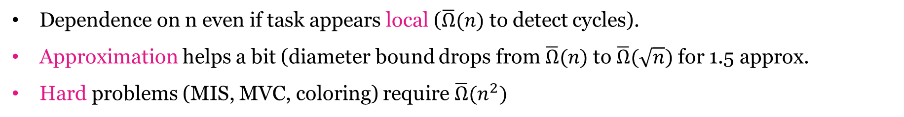
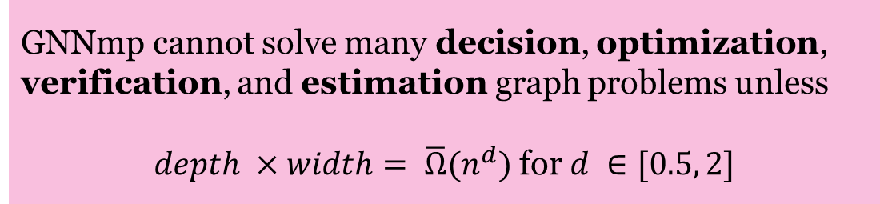
RESULT 2: WHAT GNNmp CANNOT LEARN
GNNmp size should depend on number of nodes.
GNNmp cannot solve many decision, optimization, verification, and estimation graph problems unless
$depth ×width= \overline{Ω}(n^{d})$ for $d ∈[0.5, 2]$
Dependence on n even if task appears local ($\overline{Ω}(n)$ to detect cycles).
Approximation helps a bit (diameter bound drops from $\overline{Ω}(n)$ to $\overline{Ω}(\sqrt{n})$ for 1.5 approx.
Hard problems (MIS, MVC, coloring) require $\overline{Ω}(n^{2})$

Slide 16
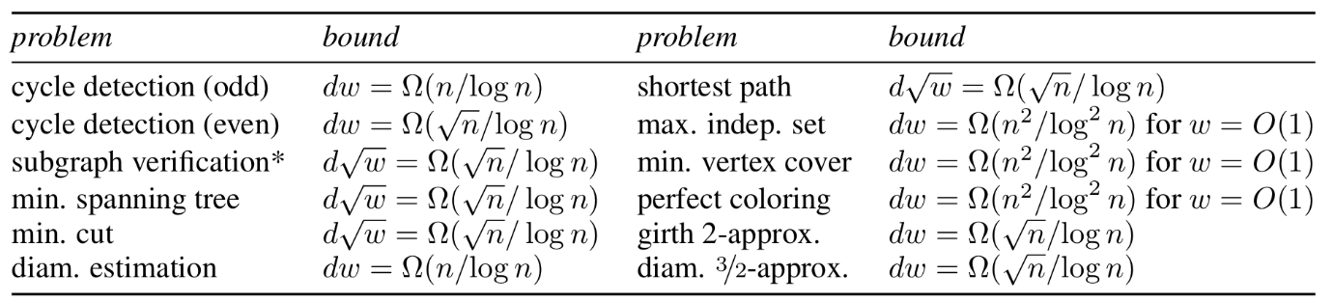
RESULT 2: WHAT GNNmp CANNOT LEARN
The bounds indicate a trade-off between depth and width.
None of the above problems can be solved by a network with linear memory footprint..
Finally, for truly hard problems, the network capacity may even need to be super-linear on n.
No GNN can solve the problem if its capacity is $dw<cn^{p}$, where $n$ is the number of nodes in the input graph, $c$ is a constant, and $p ∈\left[0.5, 2\right]$.
Notes:
The bounds indicate a trade-off between depth and width. Of course, one should not deduce that depth and width are completely exchangeable—such a statement could be made if the bounds were not only necessary but also sufficient. Nevertheless, as we will see empirically in the following, depth and width can be exchangeable in some cases.
None of the above problems can be solved by a network with linear memory footprint. Storing the entire state of the forward pass of a GNN requires at least omega(dwn) bits, even if the feed-forward networks MSG and UP consist of a single layer. Hence, to avoid a super linear on the number of nodes, one should choose the depth and width satisfying dw=o(1), which according to the bounds is impossible.
Finally, for truly hard problems, the network capacity may even need to be super-linear on n. Specifically, it is shown that, even if the layers of the GNN are allowed to take exponential time, solving certain NP-hard problems, such as the minimum independent set, the minimum vertex cover, and the perfect coloring, necessitates d=omega(n^2) depth for any constant-width network.

Slide 17
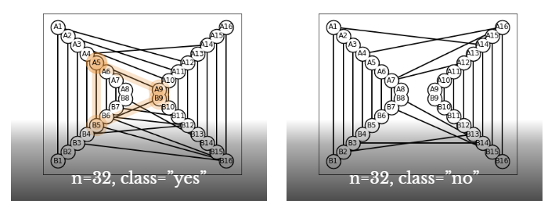
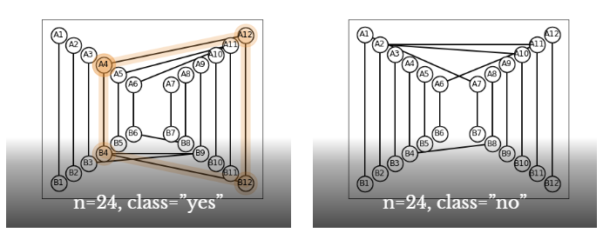
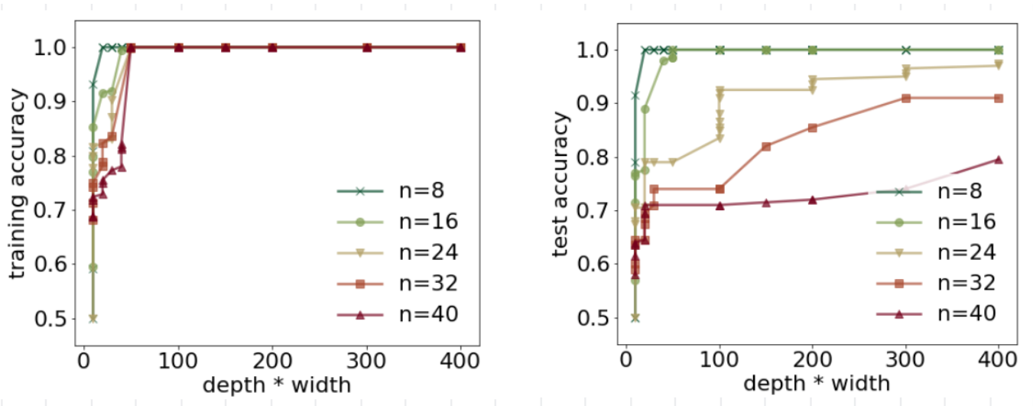
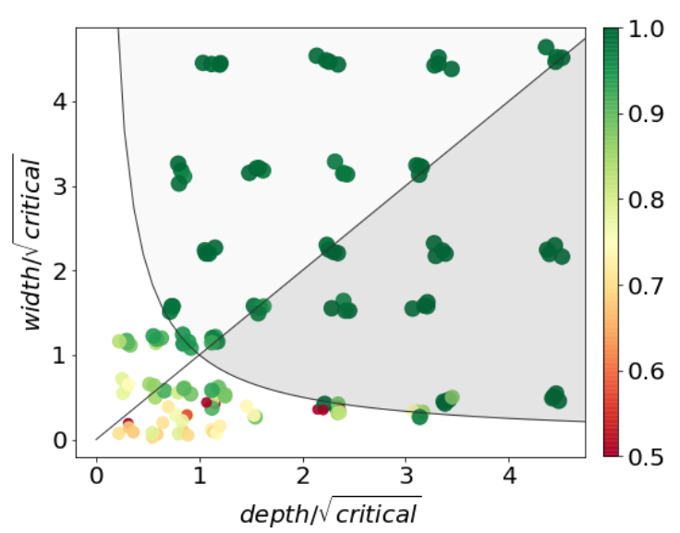
EXPERIMENT: DEPTH vs WIDTH
Train GIN0 to classify whether graph has a 4-cycle.
For same accuracy, increasing n always necessitates increasing depth*width
Notes:
Empirically evaluating lower bounds for neural networks is a very challenging task, as it involves searching over the space of all possible networks in order to find the ones that perform the best. For this reason, an experiment cannot be used to confirm the tightness of the bounds: we can never be certain whether the results obtained are the best possible or whether the optimization resulted in a local minimum.
In the experiment, the neural network was trained to classify whether a graph contained a 4-cycle or not. Following the lower bound construction described in the paper, I generated distributions over graphs with increasing size n =(8, 16, 24, 32, 44) and an average diameter of (4,6,8,9,11), respectively. Four example graphs are shown below. It should be noted that, due to the construction, the resulting graphs are often disconnected and have directed edges. The experiment tested how well GNNs of different capacity could classify the test set. I performed grid search over the hyperparameters w = (2, 10, 20) and d = (5, 10, 20, 15). To reduce the dependence on the initial conditions and training length, I trained 4 networks independently for each hyperparameter combination.
The question that I ask is: does the ability of a network to solve a task depend on the relation between its capacity dw and the size of the input graph?
Figure 3 depicts the accuracy of the best performing networks. As seen, even small neural networks could consistently classify all test examples perfectly when n<=16. Moreover, there is a strong correlation between test accuracy, dw and n (recall that the theory predicts dw = omega(root(n))).
Networks of the same capacity were consistently less accurate on the test set as increased. It can be observed that even the most powerful networks considered could not achieve a test accuracy above 95% for n>16 and for n=40 the best accuracy was below 80%.
Figure 4: . Test accuracy (indicated by color) as a function of normalized depth and width. Points in highlighted areas correspond to networks with super-critical capacity, whereas the diagonal line separates networks that are more deep than wide.
Figure 4 examines further the relationship between depth, width, and test accuracy. This time networks are separated depending on their depth and width normalized by the square root of the critical capacity. For each n, the critical capacity is the minimum dw of a network that was able to solve the task on a graph of n nodes (here, solving amounts to a test accuracy above 95%). In this way, a network of depth d and width w tested on n nodes corresponds to a point positioned at x=d/root(critical), y=w/root(critical) and no network positioned at xy<=1 can solve the task (non-highlighted region).
It can be seen that there is a crisp phase transition between the regime of under- and super-critical capacity—almost every network meeting the condition dw>=critical was able to solve the task, independently of whether the depth or width was larger.

Slide 18
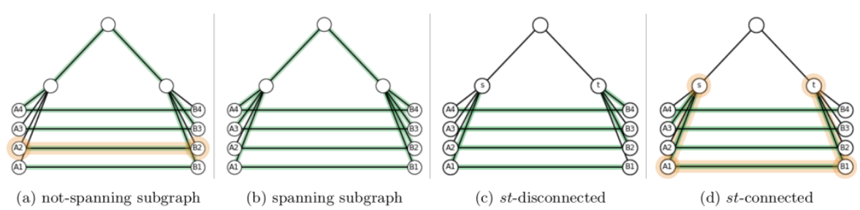
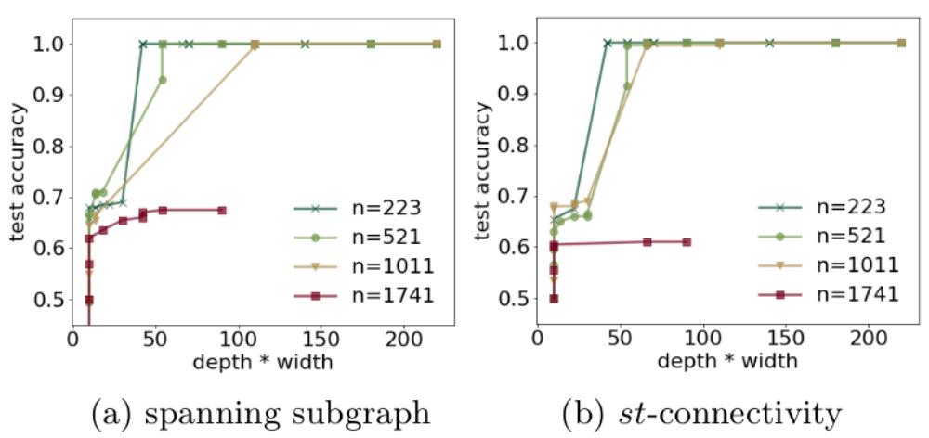
FURTHER EMPIRICAL RESULTS
Notes:
Toy examples of connectivity verification. In spanning subgraph verification (a-b), the neural network should verify whether a given subgraph (in green) of a graph (in black) is connected and spans all nodes: the subgraph in (a) is not spanning due to being disconnected (see edge highlighted in orange), whereas (b) is spanning. In st-connectivity verification, the network should verify whether nodes s and t are connected on the green subgraph: in (c) no such path exists, whereas in (b) the path is highlighted in orange.
The results exhibit similar trends to cycle classification:
It can be seen that critical capacity increases with n, but more mildly (theory predicts a dependency of omega(root(n))). In particular, while even modestly sized networks could solve all tasks when n was in the hundreds, no network was able to do the same for a graph of 1741 nodes.

Slide 19
LIMITATIONS
Limitations of current theoretical results:
All lower bounds are of a worst-case nature and concern specific adversarial inputs.
Rather than taking into account specific parametric functions, each layer is assumed to be sufficiently powerful to compute any function of its input.
It is assumed that nodes can uniquely identify each other.
Notes:
No study is without its limitations. Here are three for this work:
First, all lower bounds are of a worst-case nature and concern specific adversarial inputs: a problem is deemed impossible if there exists a graph for which it cannot be solved. The discovery of non worst-case depth-vs-width bounds remains an open problem.
Second, rather than taking into account specific parametric functions, each layer is assumed to be sufficiently powerful to compute any function of its input. This strong assumption does not significantly limit the applicability of the results, simply because all lower bounds that hold with layers of unbounded capacity also apply to those limited computationally. What is perhaps surprising is that, even with unbounded capacity layers, many seemingly simple problems are shown to be unsolvable by networks of small depth and width.
Lastly, it is assumed that nodes can uniquely identify each other. Node identification is compatible with permutation invariance/equivariance as long as the network output is asked to be invariant to the particular way the ids have been assigned. In the literature, one-hot encoded node ids have found use when working on a single graph or across graphs with same node sets but different edges. When attempting to learn functions across multiple arbitrary graphs, ids should be ideally substituted by sufficiently discriminative node attributes (attributes that uniquely identify each node within each receptive field it belongs to can serve as ids). Nevertheless, similar to the unbounded computation assumption, if a problem cannot be solved by a graph neural network in the studied setting, it also cannot be solved without identifiers and discriminative attributes. Thus, the presented bounds also apply to partially anonymous networks.

Slide 20
LIMITATIONS
Limitations of experiments:
Naive sampling led to imbalanced class distributions with denser graphs in one class. Adjusted sampling probabilities and rejection sampling were used to balance distributions.
Theoretical bounds assume binary neuron states, but practical training precision impacts constants in bounds. Sensitivity varies across input regions.
Directed edges increased problem complexity due to lower-bound construction. Undirected graphs simplify tasks like cycle detection, with slight improvements from adding node attributes.
Notes:
Talking about the limitations of experiments:
Even though the theoretical constructions concern the worst-case behavior over an exponential number of inputs, in practice we must content with experiments that involve finite-size training and test sets. My approach was to generate different datasets by sampling the instances randomly (internally, the lower bound constructions translate a bit-string into a graph–thus, one may sample instances by sampling bit-strings). However, when doing this one of the difficulties one faces is that naive sampling can yield imbalanced class distributions, with the graphs in one of the two classes being significantly denser. To avoid situations were the neural network simply learned to classify the instances by looking at the graph density, I had to change the sampling procedure (by carefully select the sampling probabilities and by using rejection sampling) in order to match the distribution statistics of the two classes.
Though neural networks operate with fixed precision arithmetic (and the lower bounds take this into account), it’s not easy to directly control the number of bits that they use to store weights (rounding is a non-differentiable operation). One can argue that, in theory, the network can exploit its full precision, but in practice this is very far from reality: it’s unlikely that we can train networks that are so sensitive to tiny changes of their input. When calculating the bounds, I assumed that each neuron can be in two states: active or not. From a theory point of view, this is not a big issue since the precision will only change the constant in front of the bound. Nevertheless, I acknowledge that in practice trained neurons can learn to be more sensitive at some regions of the input space, which would yield different non-asymptotics for the bound.
In the experiments, the neural networks were given access to directed edges (this is an artifact of the lower bound construction procedure). Changing the graph to undirected renders the problem significantly simpler. For instance, the cycle problem becomes much simpler to solve by anonymous GNNs, even though adding node attributes can yield a slight advantage (see comparison here).

Slide 21
ANALYSIS
Strengths:
Exploration of similarities between GNNs and Distributed Computing.
The depth and width dependency are novel in the context of GNNs.
The authors successfully derived many lower bounds in a systematic way, proving the effectiveness of their strategy.
Weaknesses:
Non-worst-case depth-vs-width lower bounds remains an open problem.

