Slide 1
Link Prediction Based on Graph Neural Networks

Slide 2
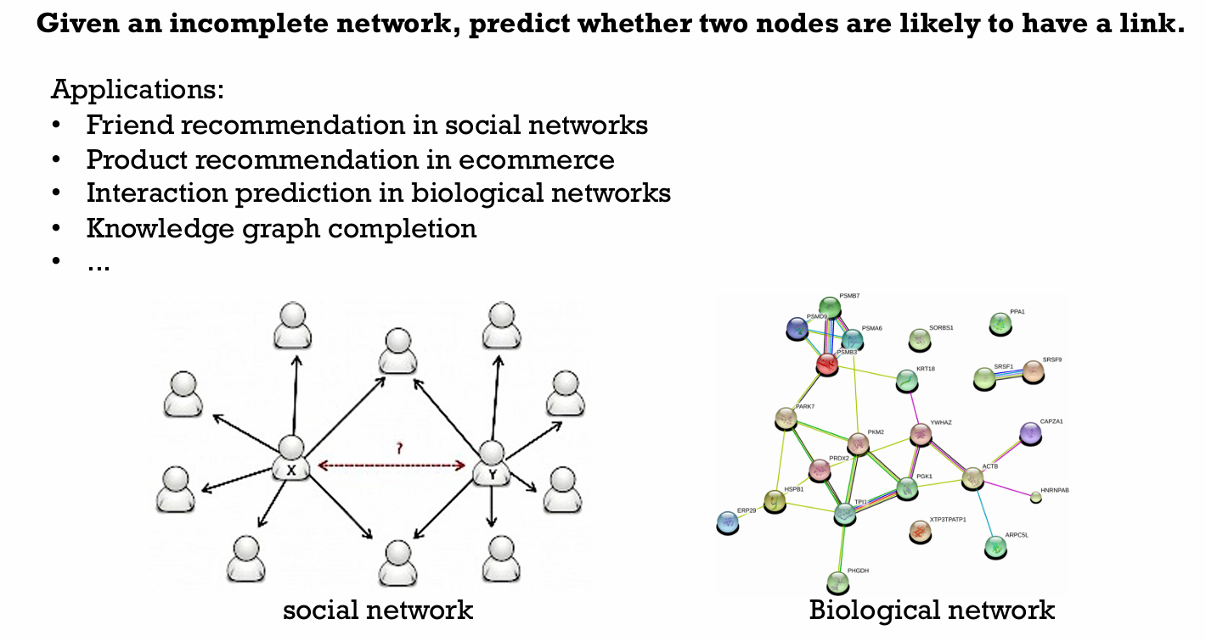
Link Prediction (LP) Problem

Slide 3
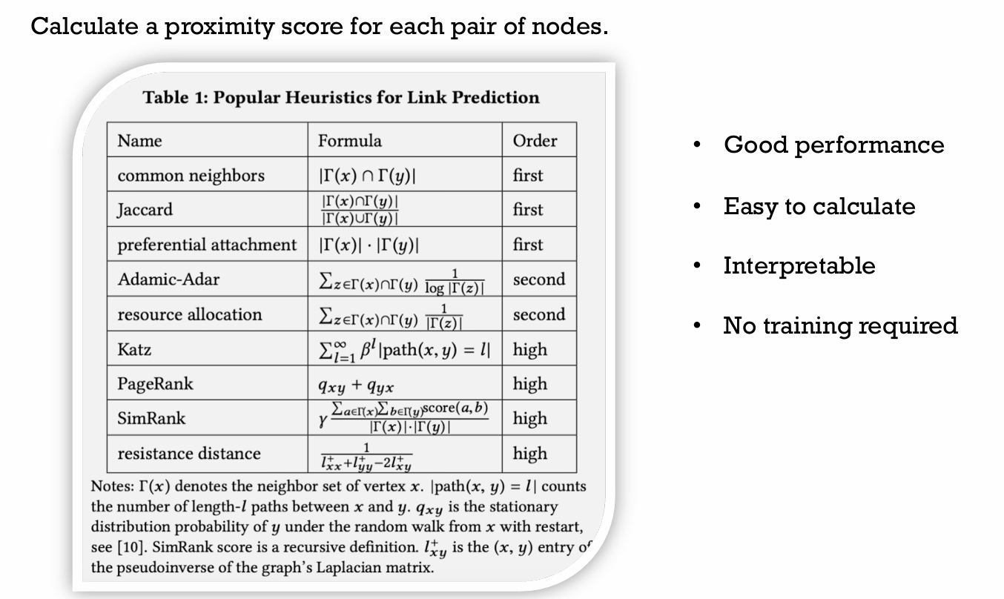
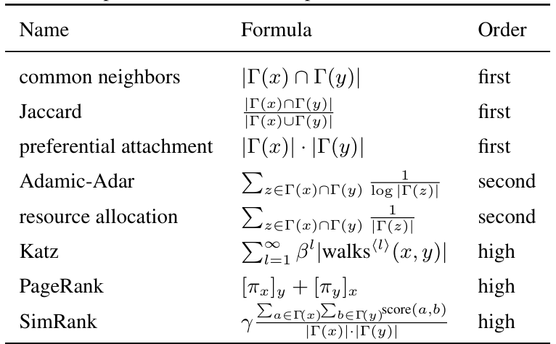
Heuristic Methods for LP

Slide 4
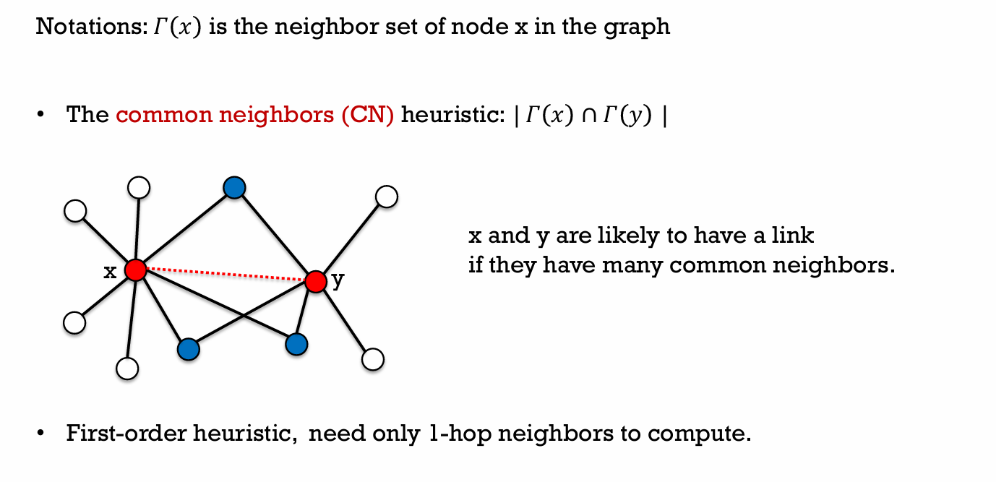
First Order Heuristics

Slide 5
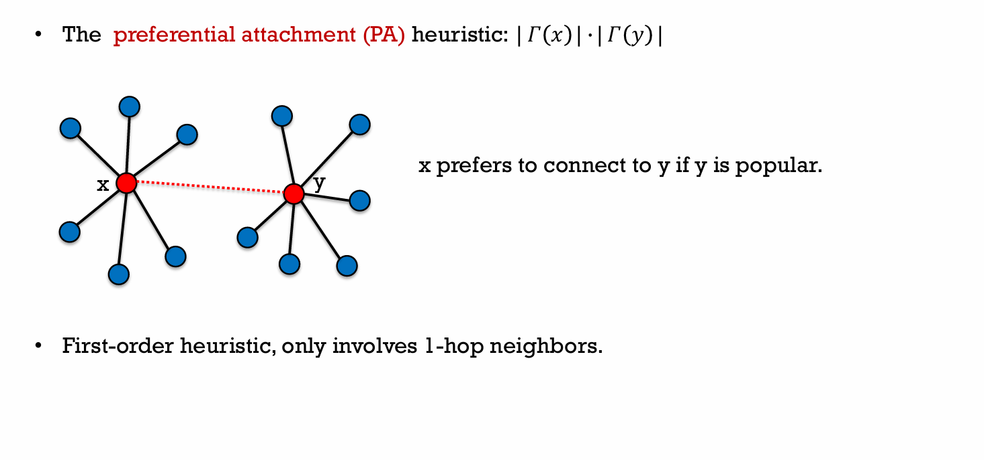
First Order Heuristics

Slide 6
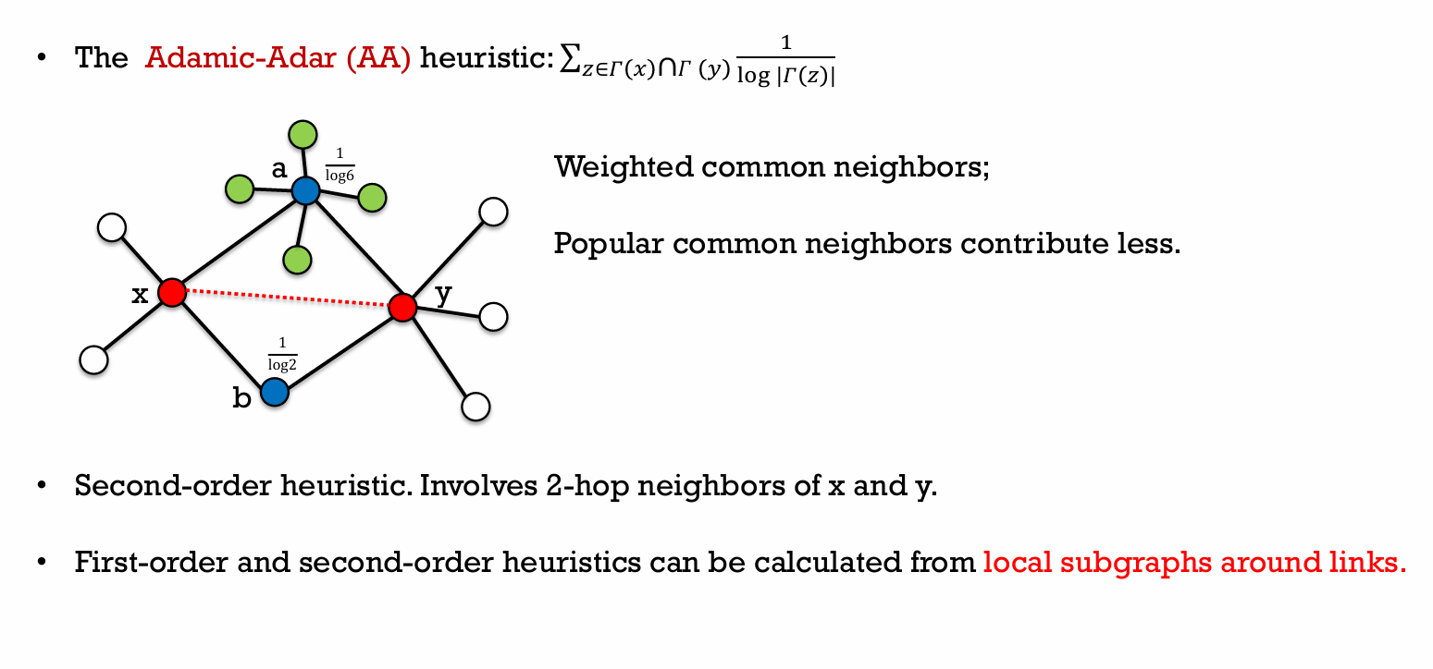
Second Order Heuristics

Slide 7
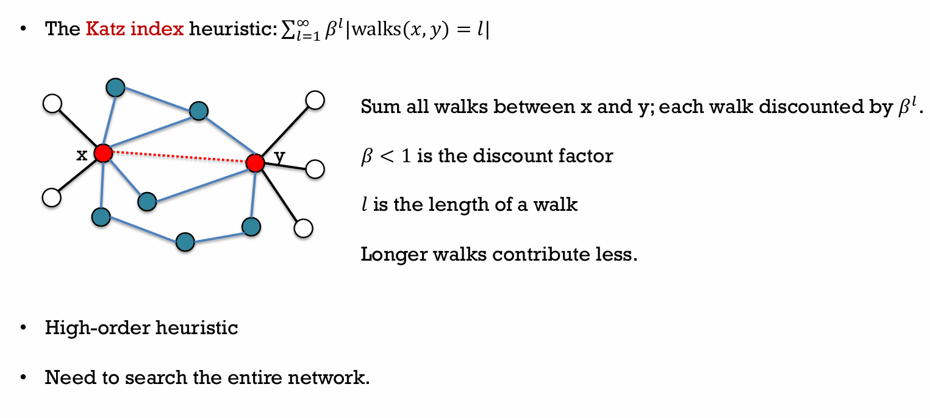
High Order Heuristics

Slide 8
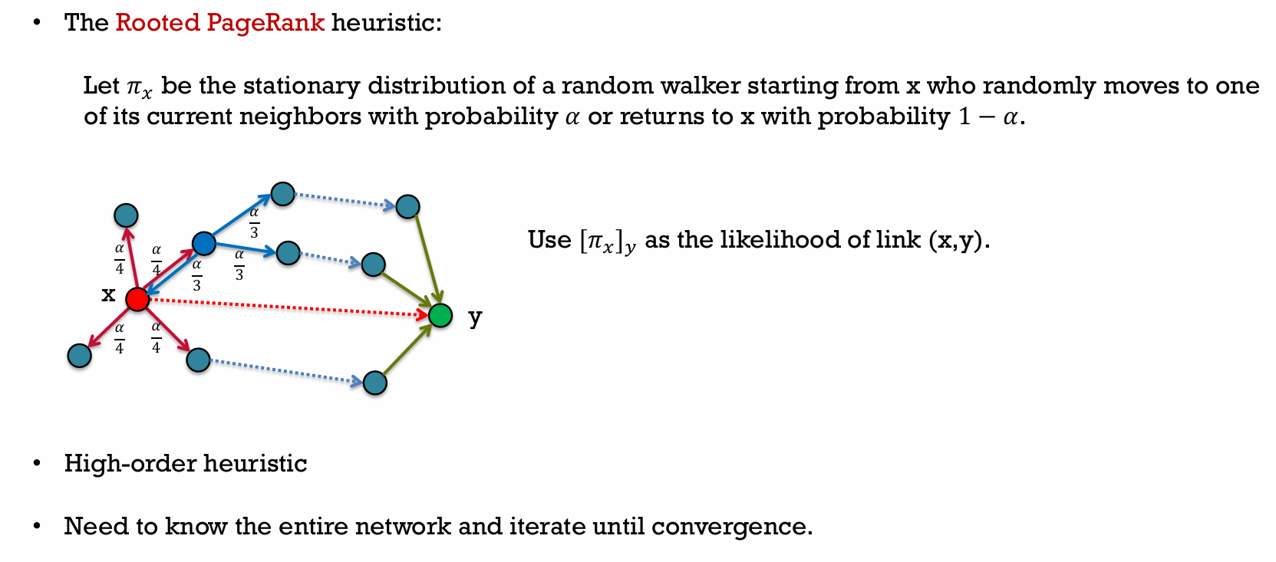
High Order Heuristics

Slide 9
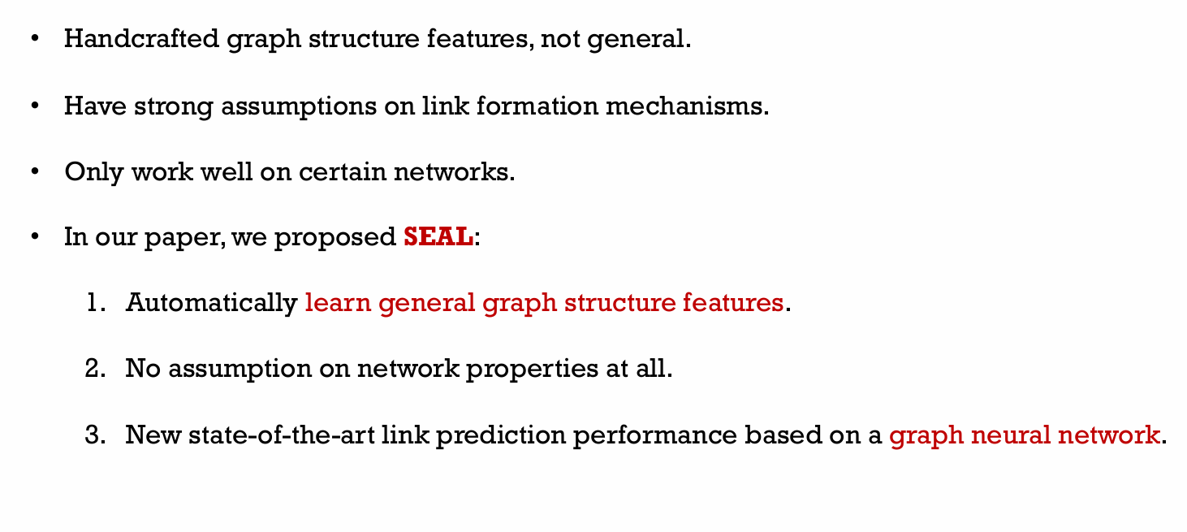
Drawbacks of Heuristic Methods

Slide 10
Latent and Explicit Features
Latent Features
Obtained by factorizing matrix representations of the network.
Provide low-dimensional embeddings for each node.
Examples: Matrix Factorization, Stochastic Block Model, DeepWalk, LINE, node2vec.
Capture hidden patterns in the network structure.
Explicit Features
Node attributes that provide additional side information.
Examples: User profiles in social networks, document metadata in citation networks.
Help enhance prediction accuracy when combined with latent and graph structure features.

Slide 11

A $γ−$decaying Heuristic Theory

Slide 12
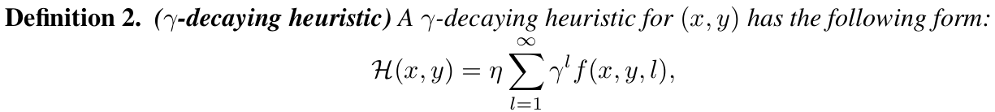
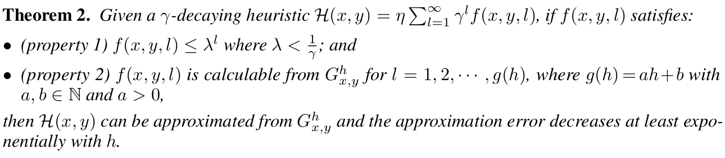
A $γ−$decaying Heuristic Theory

Slide 13
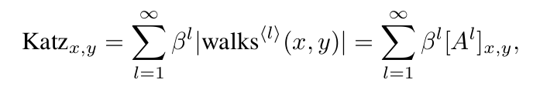
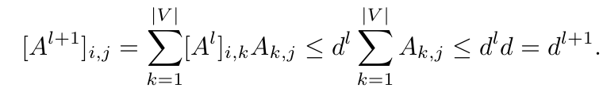

A $γ−$decaying Heuristic Theory – Katz Index

Slide 14


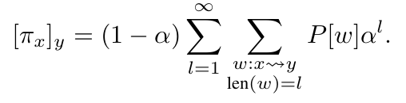

A $γ−$decaying Heuristic Theory - PageRank

Slide 15

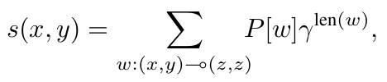
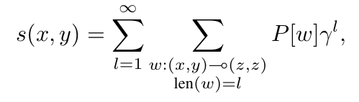

A $γ−$decaying Heuristic Theory - SimRank

Slide 16
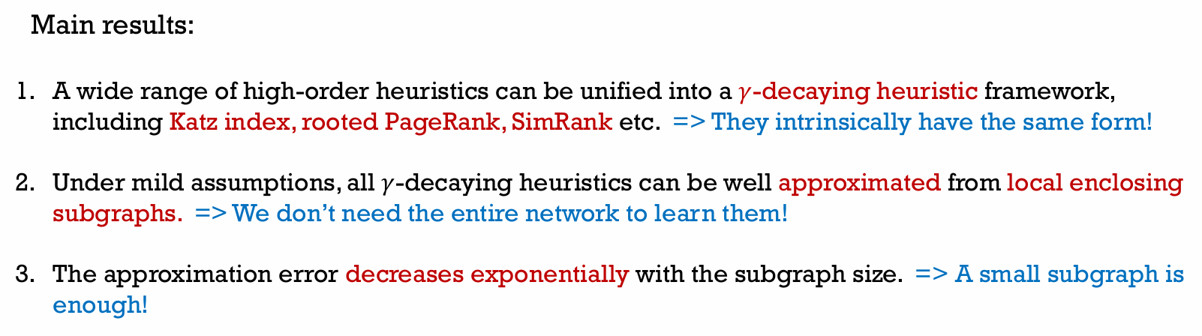
A $γ−$decaying Heuristic Theory

Slide 17
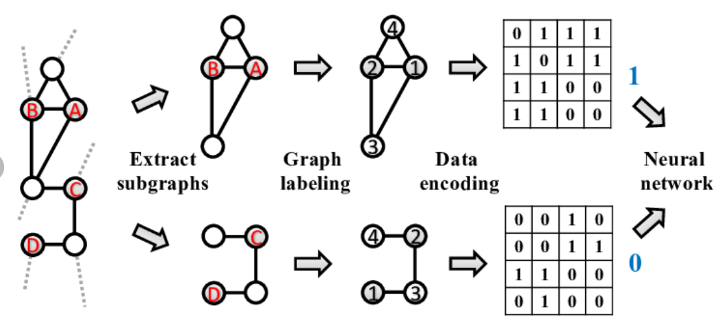
Supervised Heuristic Learning - WLNM
Uses fully connected networks, requires fixed-size subgraphs, leading to information loss.
Cannot learn from latent or explicit features.
Theoretical justifications missing, depend on graph structure and predefined heuristics.
GNNs
Subgraph features + latent and explicit node features

Slide 18
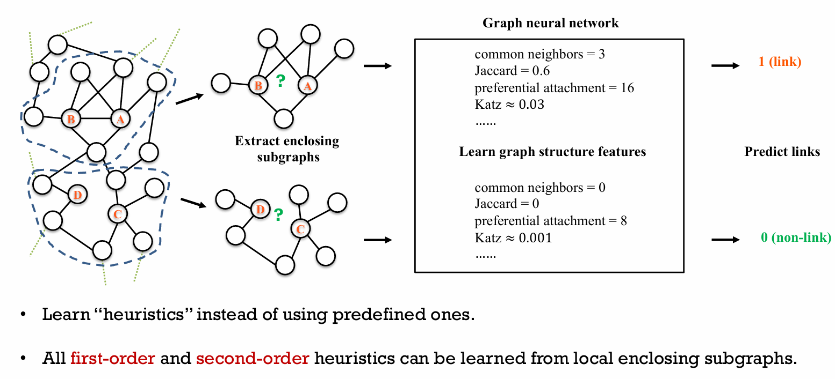
Proposed SEAL Framework
GNN Learning
Node Information Matrix
Node Labels
Node Embeddings
Node Attributes

Slide 19
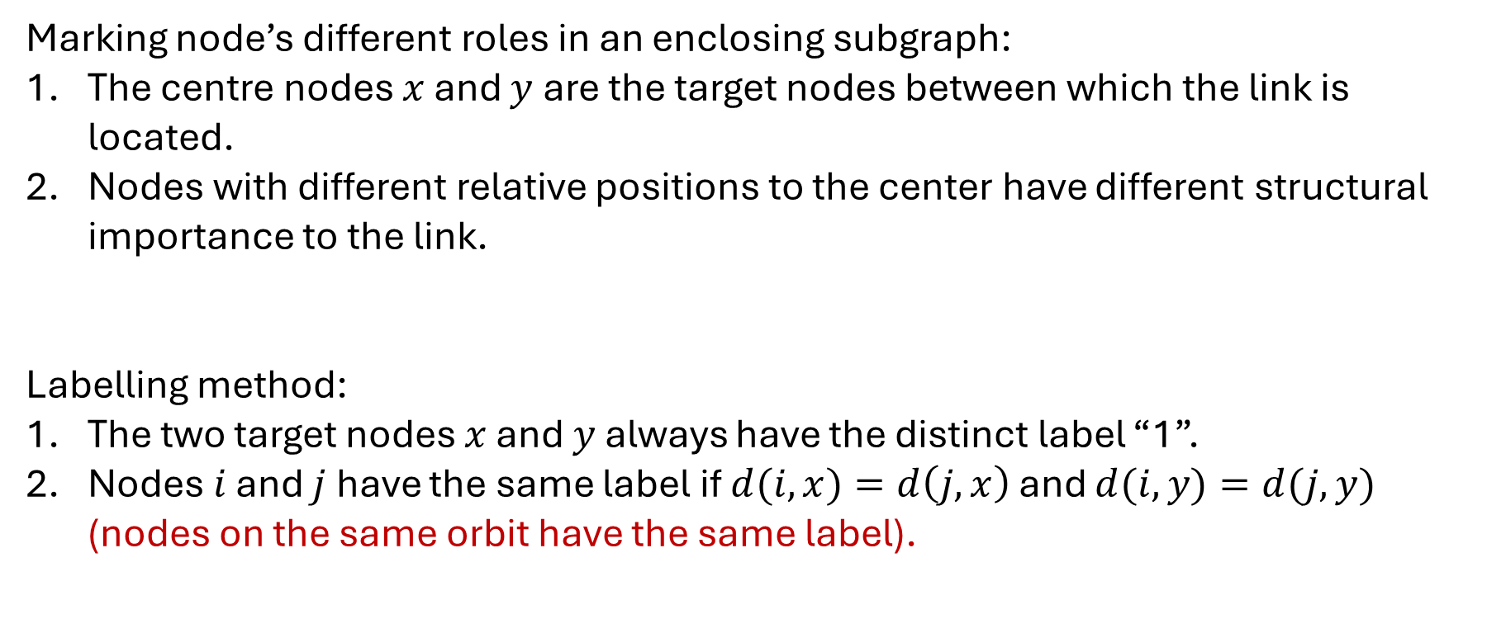
Node Labelling
Marking node’s different roles in an enclosing subgraph:
The centre nodes $x$ and $y$ are the target nodes between which the link is located.
Nodes with different relative positions to the center have different structural importance to the link.
Labelling method:
The two target nodes $x$ and $y$ always have the distinct label “1”.
Nodes $i$ and $j$ have the same label if $d(i, x)=d\left(j,x\right)$ and $d(i, y)=d(j, y)$ (nodes on the same orbit have the same label).

Slide 20
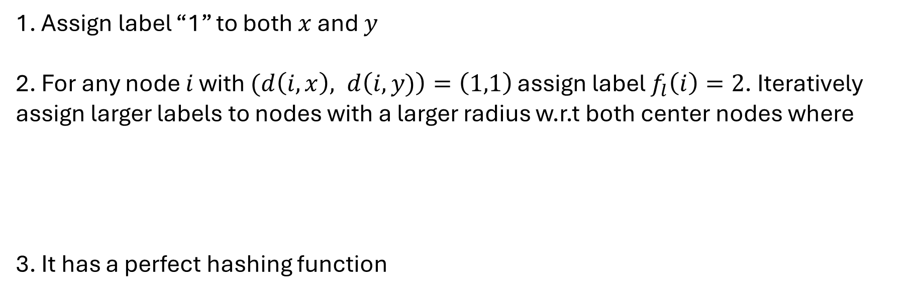
Double Radius Node Labelling
1. Assign label “1” to both $x$ and $y$
2. For any node $i$ with $(d\left(i,x\right), d\left(i,y)\right)=\left(1,1\right)$ assign label $f_{l}\left(i\right)=2$. Iteratively assign larger labels to nodes with a larger radius w.r.t both center nodes where
3. It has a perfect hashing function

Slide 21
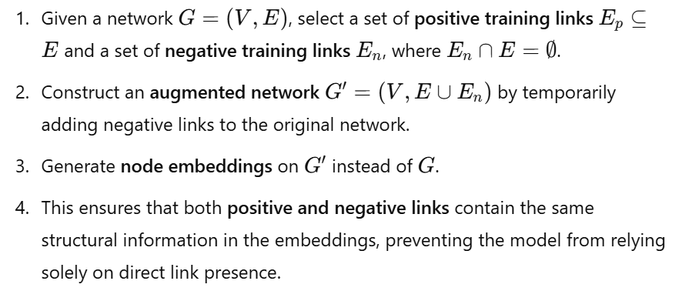
Incorporating Latent and Explicit Features
Concatenating node’s embedding/ attribute vector to its corresponding row in X.
Negative Injection:

Slide 22
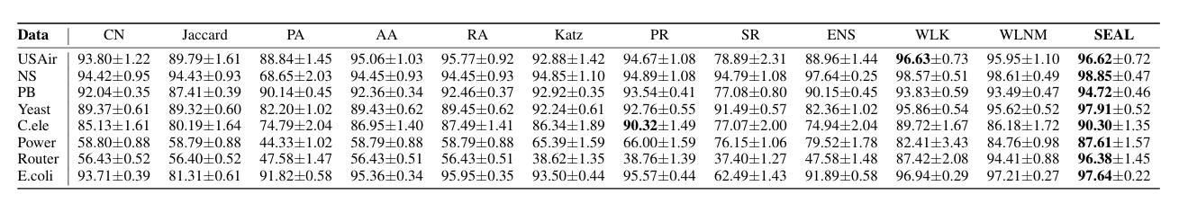
Comparison with Heuristic Methods

Slide 23
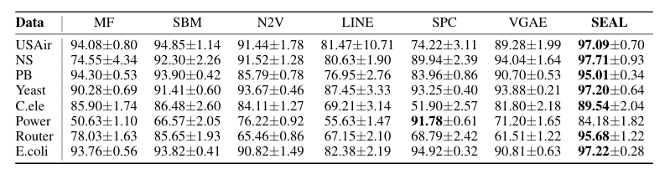
Comparison with Latent Feature Methods

Slide 24
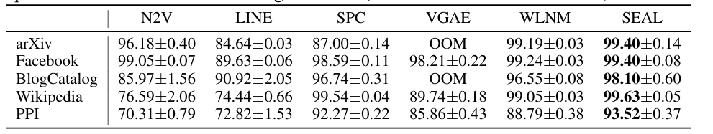
Comparison with Network Embedding Models

Slide 25
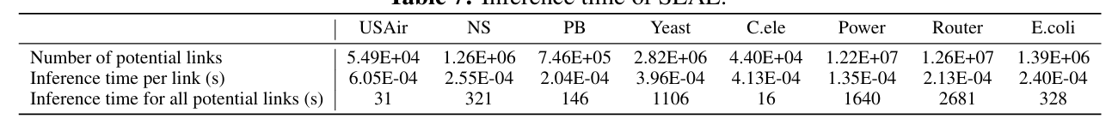
Inference Time of SEAL

