Slide 1
[Vignac et al., Neurips’20] Building powerful and Equivalent graph neural networks with structural message-passing
Presenter: John Lu

Slide 2
Motivation
MPNNs have been successful due to:
Inductive bias: learn relationships between nearby nodes; exploit sparsity
Permutation equivariance
However, MPNNs are limited in expressiveness, e.g., cannot learn connected graph/not, local clustering coefficient, a cycle present/not…
For tasks where graph structure is important, such as predicting molecule chemical properties,
solving combinatorial problems:
Structural message-passing (SMP): strictly more expressive while keeping the good properties

Slide 3
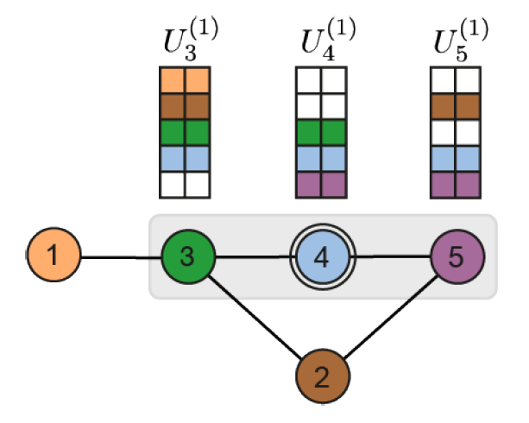



Main Idea
Each node is represented by a hidden states expressed as:
$$h_{3}^{(1)}$$
$$h_{4}^{(1)}$$
$$h_{5}^{(1)}$$
Traditional Message-Passing:
A feature vector
SMP:
A “local context” matrix

Slide 4
Main Idea
Local context matrix:
Initialized with one hot encoding of nodes and node features (leveraging node identifiers)
Later propagation is permutation equivalent
Analysis:
Computationally universal over the space of equivalent functions
Experiments:
Better on tasks such as cycle detection, connectivity testing, diameter and shortest path distance computation
SOTA on ZINC (chemistry dataset)
SMP:
A “local context” matrix

Slide 5
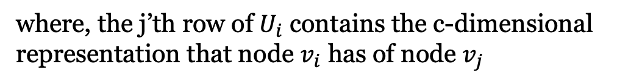
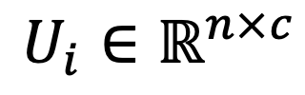
Structural message-passing
Each node maintains a local context matrix
$$U_{i}∈ℝ^{n×c}$$
where, the j’th row of $U_{i}$ contains the c-dimensional representation that node $v_{i}$ has of node $v_{j}$

Slide 6



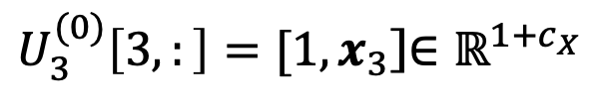
Structural message-passing
$$U_{3}^{(0)}$$
$$U_{4}^{(0)}$$
$$U_{5}^{(0)}$$
Initialization (layer 0)
One-hot encoding (a unique identifier) + node features
…0…1…0…
0 1 …0…
1 …0…
$U_{3}^{(0)}\left[3,:\right]=[1,x_{3}$]$∈ℝ^{1+c_{X}}$
where, $x_{i}$ is the node feature of node $v_{i}$ of size $c_{X}$

Slide 7



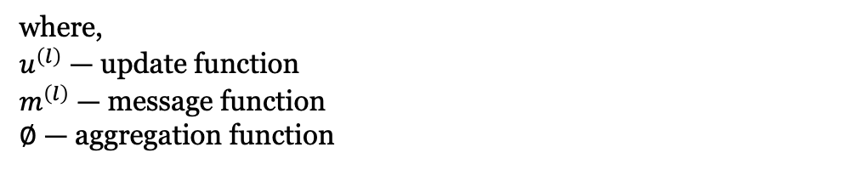
Structural message-passing
Passing through Layers
$$U_{3}^{(0)}$$
$$U_{4}^{(0)}$$
$$U_{5}^{(0)}$$
…0…1…0…
0 1 …0…
1 …0…
Layer 0 to Layer 1
$U_{i}^{(l+1)}=u^{\left(l\right)}\left(U_{i}^{\left(l\right)},{\tilde{U}}_{i}^{\left(l\right)}\right)∈ℝ^{n×c_{l+1}}$ with ${\tilde{U}}_{i}^{(l)}={∅(\{m}^{\left(l\right)}(U_{i}^{\left(l\right)},U_{j}^{\left(l\right)},y_{ij})_{v_{j}∈N_{i}})$
where,
$u^{\left(l\right)}$ — update function
$m^{\left(l\right)}$ — message function
$∅$ — aggregation function

Slide 8
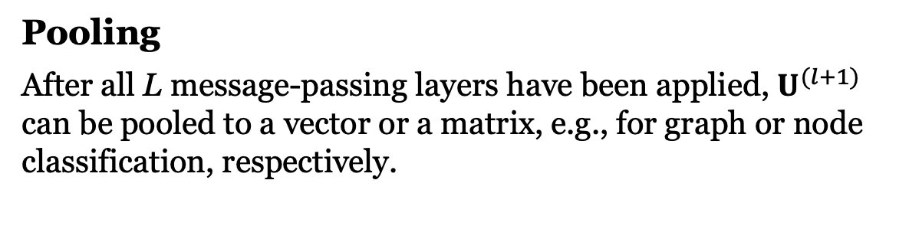
Structural message-passing
Denote
$$U_{}^{(l+1)}=f^{\left(l\right)}\left(U_{}^{\left(l\right)},Y,A\right)=[U_{1}^{\left(l+1\right)},…,U_{n}^{\left(l+1\right)}]∈ℝ^{n×n×c_{l+1}}$$
Pooling
After all L message-passing layers have been applied, $U^{(l+1)}$ can be pooled to a vector or a matrix, e.g., for graph or node classification, respectively.

Slide 9
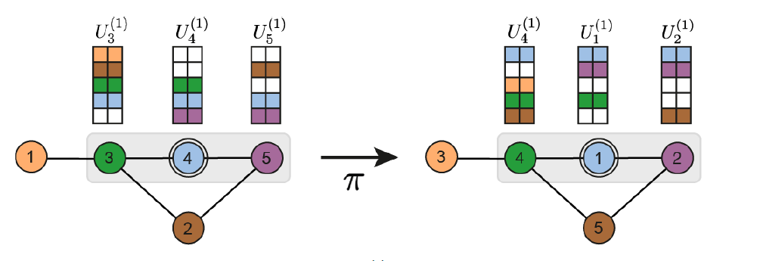
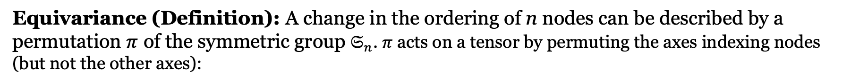
Analysis: Equivariance
Equivariance (Definition): A change in the ordering of n nodes can be described by a permutation $π$ of the symmetric group $𝔖_{n}$. $π$ acts on a tensor by permuting the axes indexing nodes
(but not the other axes):

Slide 10
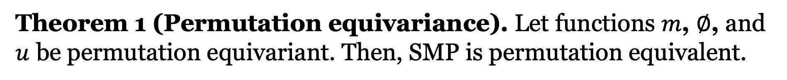
Analysis: Equivariance
Theorem 1 (Permutation equivariance). Let functions $m$, $∅$, and $u$ be permutation equivariant. Then, SMP is permutation equivalent.

Slide 11
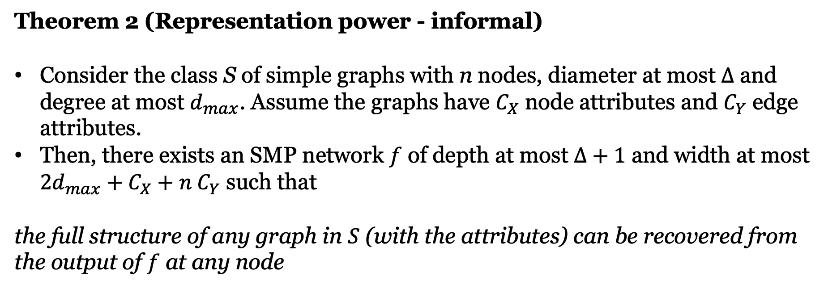
Analysis: Representation and Expressive Power
Theorem 2 (Representation power - informal)
Consider the class S of simple graphs with n nodes, diameter at most $∆$ and degree at most $d_{max}$. Assume the graphs have $C_{X}$ node attributes and $C_{Y}$ edge attributes.
Then, there exists an SMP network $f$ of depth at most $∆+1$ and width at most $2d_{max}+C_{X}+n{ C}_{Y}$ such that
the full structure of any graph in $S$ (with the attributes) can be recovered from the output of $f$ at any node

Slide 12
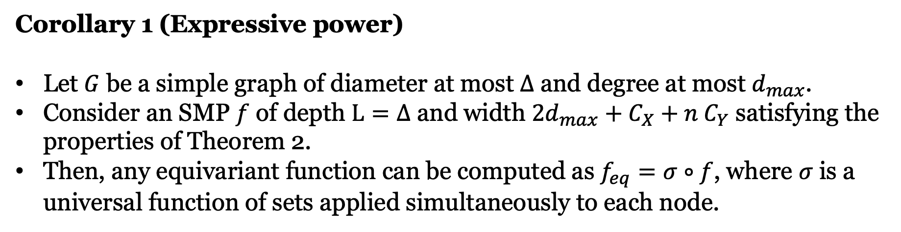
Analysis: Representation and Expressive Power
Corollary 1 (Expressive power)
Let $G$ be a simple graph of diameter at most $∆$ and degree at most $d_{max}$.
Consider an SMP $f$ of depth $L=∆$ and width $2d_{max}+C_{X}+n{ C}_{Y}$ satisfying the properties of Theorem 2.
Then, any equivariant function can be computed as $f_{eq}=σ∘f$, where $σ$ is a universal function of sets applied simultaneously to each node.

Slide 13
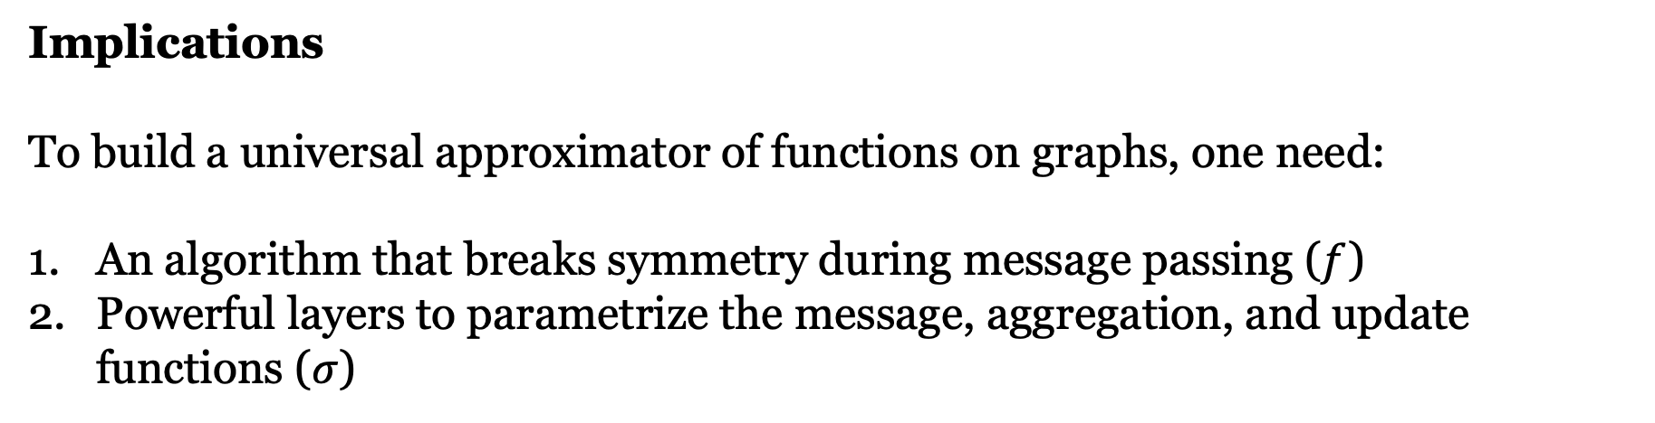
Analysis: Representation and Expressive Power
Corollary 1 (Expressive power)
…, then, any equivariant function can be computed as $f_{eq}=σ∘f$
Implications
To build a universal approximator of functions on graphs, one need:
An algorithm that breaks symmetry during message passing ($f$)
Powerful layers to parametrize the message, aggregation, and update functions ($σ$)

Slide 14
Analysis: Representation and Expressive Power
Proposition 1. Expressiveness SMP v.s. MPNN
SMP is strictly more powerful than MPNN:
SMP can simulate any MPNN with the same number of layers
MPNN cannot simulate SMPs

Slide 15
Implementation
Step 1: the local context of each node is updated using a neural network for sets:
Step 2: a message passing network is applied separately on each row of the local contexts

Slide 16
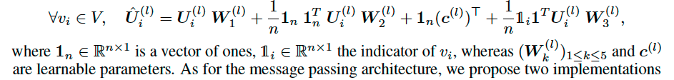
Implementation
Step 1: the local context of each node is updated using a neural network for sets:
3

Slide 17

Implementation
Step 2: a message passing network is applied separately on each row of the local contexts
Method 1: Default SMP

Slide 18


Implementation
Step 2: a message passing network is applied separately on each row of the local contexts
Method 2: Fast SMP (without edge features)
where $W_{4}$ and $W_{5}$ are learnable matrices

Slide 19
Related Work
Standard MPNNs [1] without special node attributes have limited expressive power, even with infinite depth and width
They are as good as WL test in isomorphism testing [20, 13]
Corresponding to more powerful k-WL, there is theoretically more powerful k-WL networks. These higher-order networks are global by iteratively updating the state of a k-tuple of nodes.
k-WL networks are very costly in both time and memory
Incorporating hand-crafted topological features [29], which requires domain expert knowledge
Equivariant functions on high-order tensors [31,30], at least as powerful as k-WL test; high memory requirements.
More expressive Provably powerful graph networks (PPGN)

Slide 20
Related Work
Equivariant functions on high-order tensors [31,30], at least as powerful as k-WL test; high memory requirements.
More expressive Provably powerful graph networks (PPGN) [32] w.r.t. same tensor order.
Ring-GNN [22] similar principle as PPGN
Difference between SMP and PPGN/Ring-GNN:
SMP has lower time complexity due to exploitation of adjacency-matrix sparsity
SMP retains the message-passing inductive bias, showing better empirical performance in tasks requiring topological substructure info

Slide 21
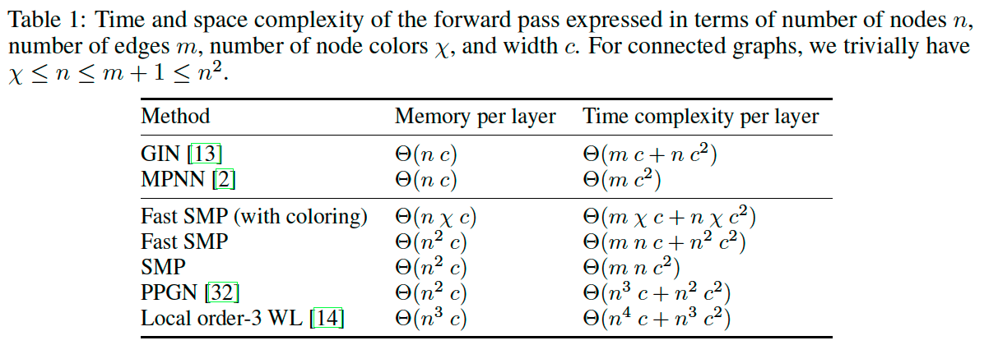
Complexity
Notes:
local order-3 Weisfeiler-Lehman networks need to store all triplets of nodes, both PPGN and SMP only store information for pairs of nodes.
However, message-passing architectures (such as SMP) can leverage the sparsity of the adjacency matrix and hence benefit from a more favorable time complexity than architectures which
perform global updates (as PPGN).
An apparent drawback of SMP is the need for more memory than MPNN.
It implies that nodes which are far apart can use the same identifier without conflict.
We propose in Appendix E a procedure (Fast SMP with coloring) based on greedy coloring which can replace the initial one-hot encoding, so that each node can manipulate smaller
matrices Ui.
This method allows to theoretically improve both the time and space complexity of SMP, although the number of colors needed usually grows fast with the number of layers in the network.

Slide 22
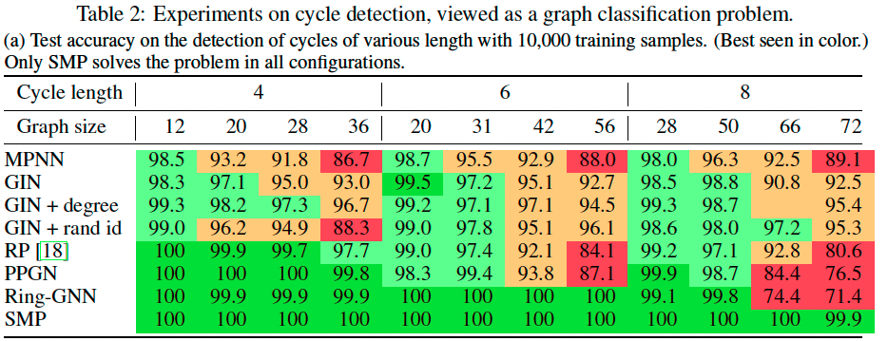
Experiment: Cycle detection
In-Distribution Experiment

Slide 23
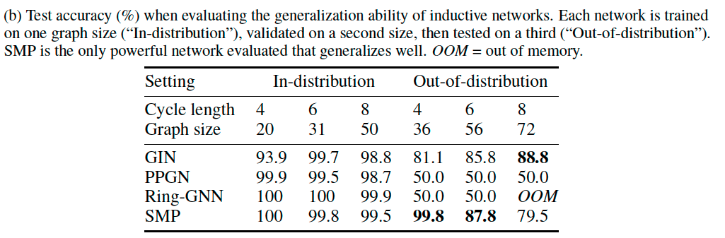
Experiment: Cycle detection
Out-Of-Distribution Experiment

Slide 24
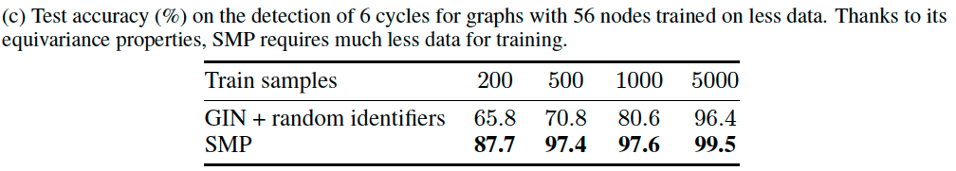
Experiment: Cycle detection
Small Training Size

Slide 25
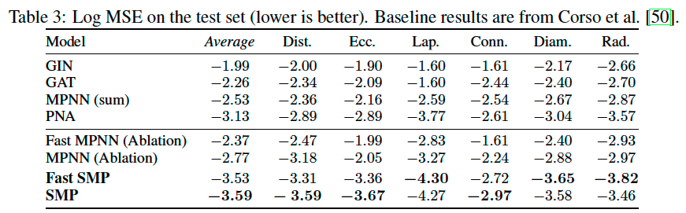
Experiment: Multi-task detection of graph properties
Three Node-Defined Targets
Dist. — geodesic distance
Ecc. — eccentricity
Lap. — Laplacian features
Three Graph-Defined Targets
Conn. — connectivity
Diam. — graph diameter
Rad. — spectral radius

Slide 26
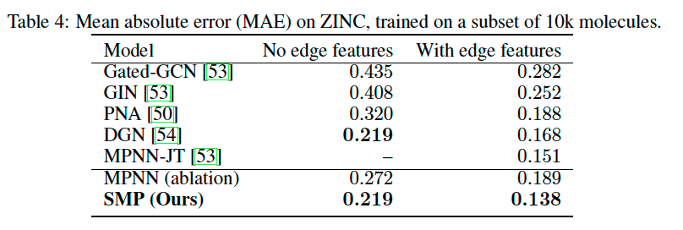
Experiment: Constrained solubility regression on ZINC

