Slide 1
[chen et al., ICML’20] SIMPLE and Deep Graph convolutional networks
Presenter: John Lu

Slide 2
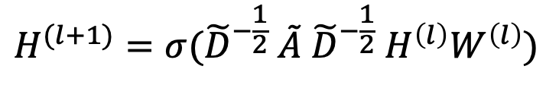
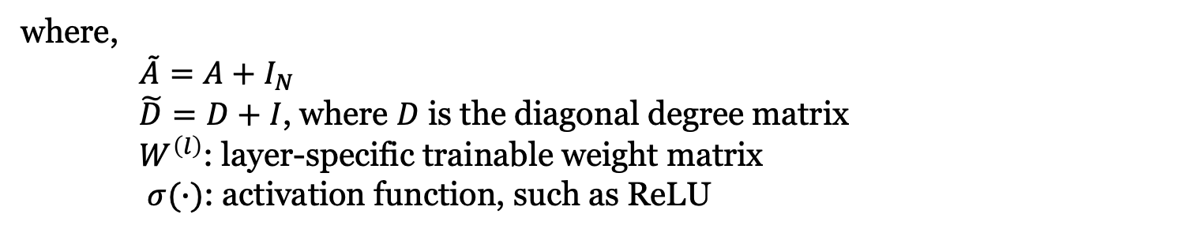
Motivation: GCN
Vanilla Graph Convolutional Network (GCN) (Kipf & Welling, 2017):
One Layer:
$$H^{(l+1)}=σ({\tilde{D}}^{−\frac{1}{2}} \tilde{A} {\tilde{D}}^{−\frac{1}{2}} H^{\left(l\right)}W^{\left(l\right)})$$
where,
$\tilde{A}=A+I_{N}$
$\tilde{D}=D+I$, where $D$ is the diagonal degree matrix
$W^{\left(l\right)}$: layer-specific trainable weight matrix
$σ(∙)$: activation function, such as ReLU

Slide 3
Motivation: GCN
Vanilla Graph Convolutional Network (GCN) (Kipf & Welling, 2017):
One Layer:
$$H^{(l+1)}=σ({\tilde{D}}^{−\frac{1}{2}} \tilde{A} {\tilde{D}}^{−\frac{1}{2}} H^{\left(l\right)}W^{\left(l\right)})$$
Most GCNs are shallow: usually achieve the best performance with 2 layers
Shallow networks fail to leverage information from high-order neighbors
However, stacking more layers leads to over-smoothing…

Slide 4
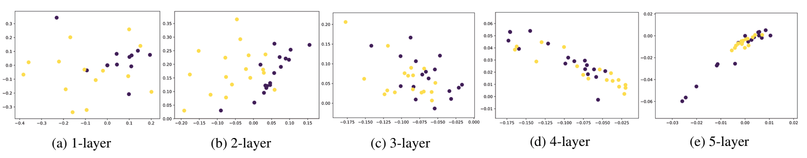
Motivation: GCN over-smoothing
Figure from Li et al. (2018) shows the results of vertex embeddings of applying GCN to a small dataset, Zachary’s karate club (semi-supervised learning, 34 vertices, 2 classes, 78 edges)

Slide 5
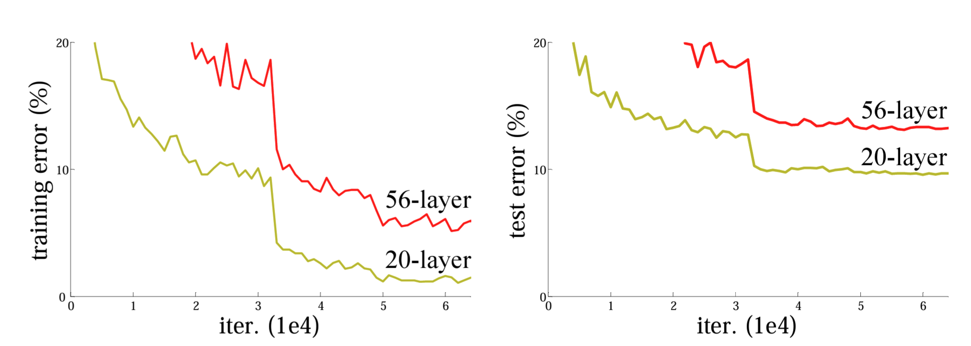
Motivation: ResNet
Figure from He et al. (2016) shows the training error and test error on CIFAR-10 with 20-layer and 56-layer “plain” networks

Slide 6
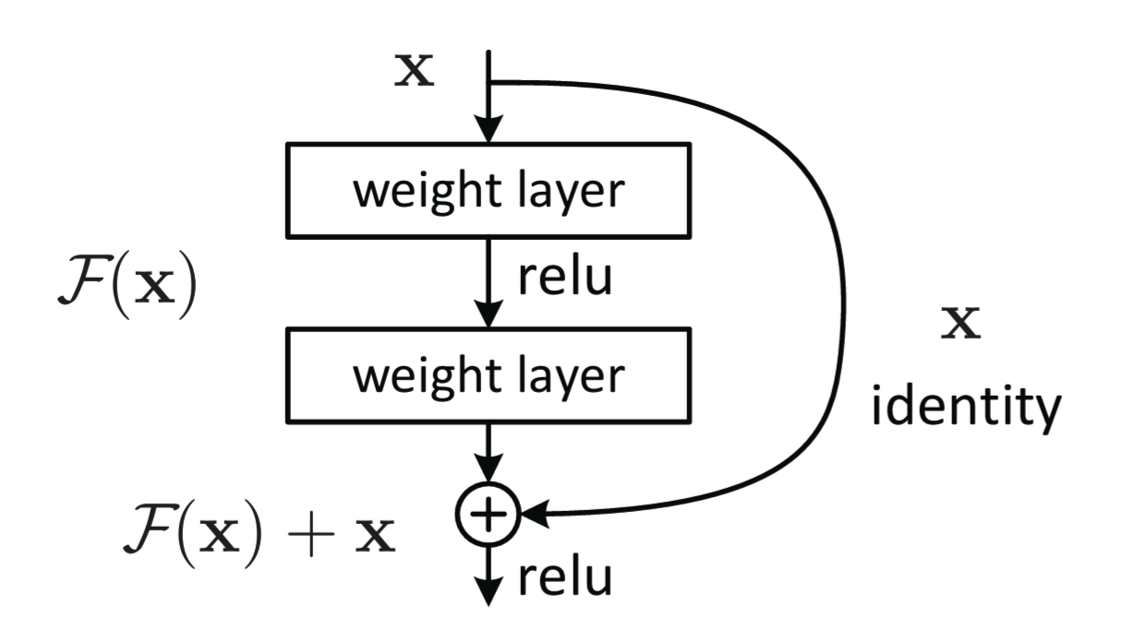
Motivation: ResNet
Residual block from ResNet (He et al., 2016)

Slide 7
Motivation: GCN with Residual Connection
Vanilla GCN: $H^{(l+1)}=σ(\tilde{P} H^{\left(l\right)} W^{\left(l\right)})$, where ${\tilde{P}=\tilde{D}}^{−\frac{1}{2}} \tilde{A}{ \tilde{D}}^{−\frac{1}{2}}$
GCN with residual connection: $H^{(l+1)}=σ\left(\left(\tilde{P} H^{\left(l\right)}+H^{\left(l\right)}\right)W^{\left(l\right)}\right)$
Only partially relieves the over-smoothing problem: performance still degrades with deeper layers

Slide 8
GCNII Model
Vanilla GCN: $H^{(l+1)}=σ(\tilde{P} H^{\left(l\right)} W^{\left(l\right)})$, where ${\tilde{P}=\tilde{D}}^{−\frac{1}{2}} \tilde{A}{ \tilde{D}}^{−\frac{1}{2}}$
GCN with residual connection: $H^{(l+1)}=σ\left(\left(\tilde{P} H^{\left(l\right)}+H^{\left(l\right)}\right)W^{\left(l\right)}\right)$
Graph Convolutional Network via Initial residual and Identity mapping (GCNII):
$H^{(l+1)}=σ\left(\left(\left(1−α_{l}\right)\tilde{P}H^{\left(l\right)}+α_{l}H^{\left(0\right)}\right)\left(\left(1−β_{l}\right)I_{n}+β_{l}W^{(l)}\right)\right)$ where $α_{l}$ and $β_{l}$ are hyperparameters
initial residual
identity mapping

Slide 9
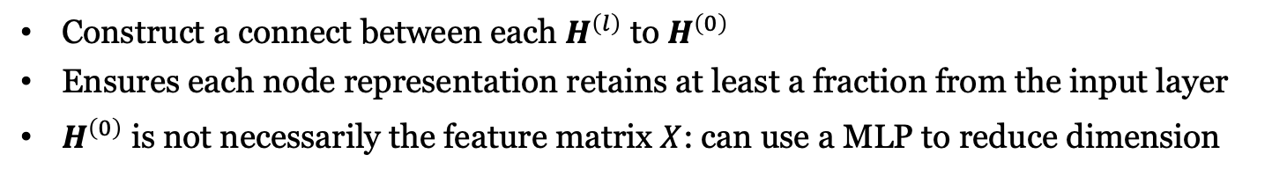
GCNII Model: Initial Residual
$$H^{(l+1)}=σ\left(\left(\left(1−α_{l}\right)\tilde{P}H^{\left(l\right)}+α_{l}H^{\left(0\right)}\right)\left(\left(1−β_{l}\right)I_{n}+β_{l}W^{(l)}\right)\right)$$
Construct a connect between each $H^{\left(l\right)}$ to $H^{\left(0\right)}$
Ensures each node representation retains at least a fraction from the input layer
$H^{\left(0\right)}$ is not necessarily the feature matrix $X$: can use a MLP to reduce dimension

Slide 10
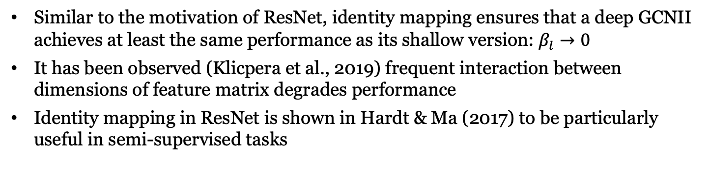
GCNII Model: Identity Mapping
$$H^{(l+1)}=σ\left(\left(\left(1−α_{l}\right)\tilde{P}H^{\left(l\right)}+α_{l}H^{\left(0\right)}\right)\left(\left(1−β_{l}\right)I_{n}+β_{l}W^{(l)}\right)\right)$$
Similar to the motivation of ResNet, identity mapping ensures that a deep GCNII achieves at least the same performance as its shallow version: $β_{l}→0$
It has been observed (Klicpera et al., 2019) frequent interaction between dimensions of feature matrix degrades performance
Identity mapping in ResNet is shown in Hardt & Ma (2017) to be particularly useful in semi-supervised tasks

Slide 11
GCNII Model: Identity Mapping
$$H^{(l+1)}=σ\left(\left(\left(1−α_{l}\right)\tilde{P}H^{\left(l\right)}+α_{l}H^{\left(0\right)}\right)\left(\left(1−β_{l}\right)I_{n}+β_{l}W^{(l)}\right)\right)$$
Principle of setting $β_{l}$: ensure the decay of the weight matrix adaptively increases as stacking more layers In practice: set $β_{l}=log⁡(\frac{λ}{l}+1)≈\frac{λ}{l}$, where $λ$ is a hyperparameter

Slide 12
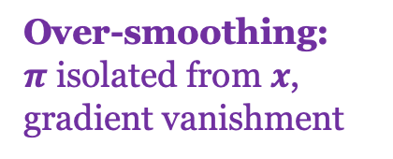
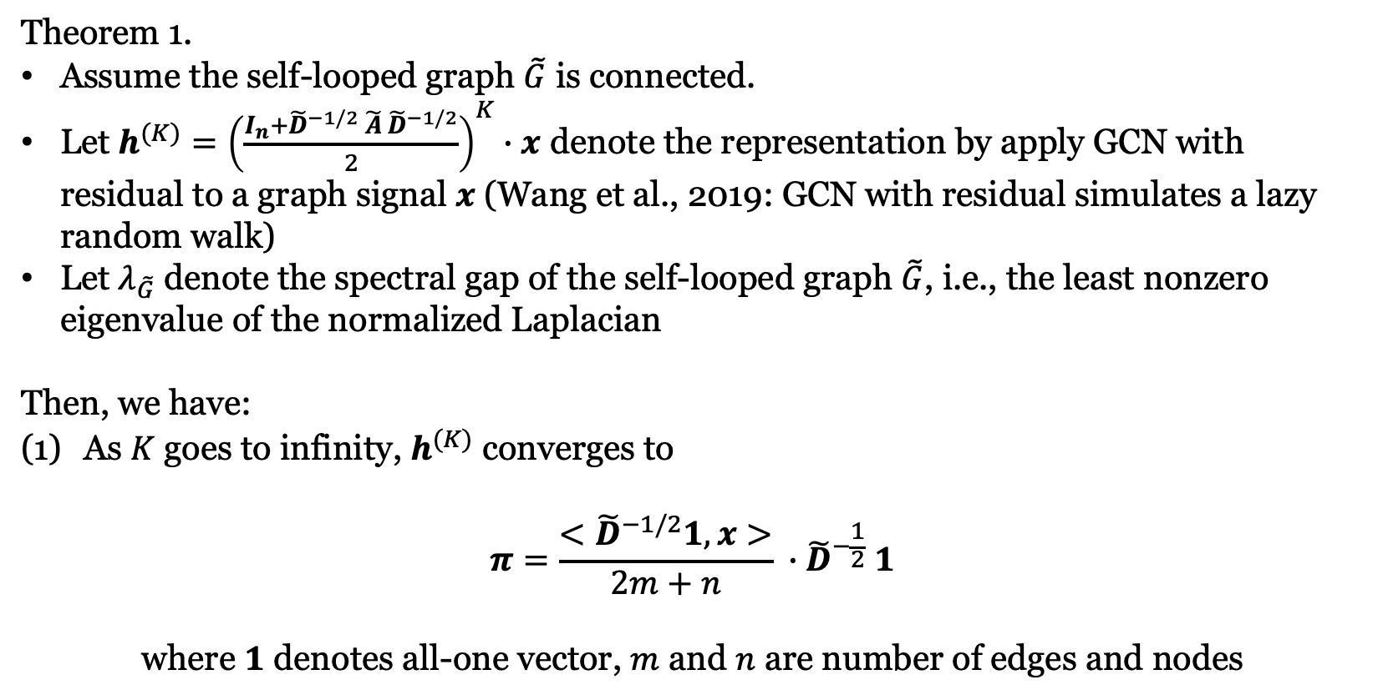
Spectral Analysis: GCN with Residual
GCN with residual connection: $H^{(l+1)}=σ\left(\left(\tilde{P} H^{\left(l\right)}+H^{\left(l\right)}\right)W^{\left(l\right)}\right)$, where ${\tilde{P}=\tilde{D}}^{−\frac{1}{2}} \tilde{A}{ \tilde{D}}^{−\frac{1}{2}}$
Theorem 1.
Assume the self-looped graph $\tilde{G}$ is connected.
Let $h^{(K)}={\left(\frac{I_{n}+{\tilde{D}}^{−1/2} \tilde{A} {\tilde{D}}^{−1/2}}{2}\right)}^{K}∙x$ denote the representation by apply GCN with residual to a graph signal $x$ (Wang et al., 2019: GCN with residual simulates a lazy random walk)
Let $λ_{\tilde{G}}$ denote the spectral gap of the self-looped graph $\tilde{G}$, i.e., the least nonzero eigenvalue of the normalized Laplacian
Then, we have:
As $K$ goes to infinity, $h^{(K)}$ converges to
$$π=\frac{<{\tilde{D}}^{−1/2}1, x>}{2m+n} ∙{\tilde{D}}^{−\frac{1}{2}} 1$$
where $1$ denotes all-one vector, $m$ and $n$ are number of edges and nodes
Over-smoothing:
$π$ isolated from $x$, gradient vanishment

Slide 13
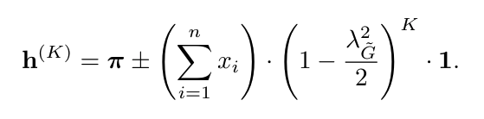
Spectral Analysis: GCN with Residual
(2) Convergence rate

Slide 14
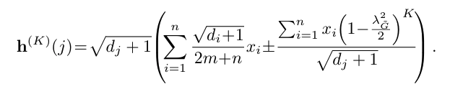
Spectral Analysis: GCN with Residual
Node-wise relative converge rate
Conjecture 1. Nodes with higher degrees are more likely to suffer
from over-smoothing.

Slide 15
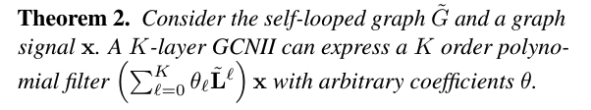
Spectral Analysis: GCNII
Proof Intuition: the parameter $β$ in identity mapping allows GCNII to simulate the coefficient $θ_{l}$ of the polynomial filter

Slide 16
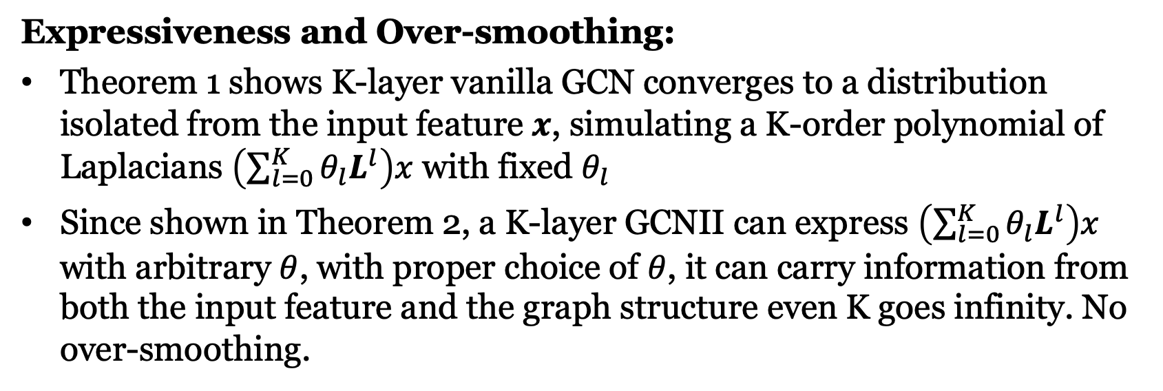
Spectral Analysis: GCNII
Expressiveness and Over-smoothing:
Theorem 1 shows K-layer vanilla GCN converges to a distribution isolated from the input feature $x$, simulating a K-order polynomial of Laplacians $\left(\sum_{l=0}^{K}{θ_{l}L^{l}}\right)x$ with fixed $θ_{l}$
Since shown in Theorem 2, a K-layer GCNII can express $\left(\sum_{l=0}^{K}{θ_{l}L^{l}}\right)x$ with arbitrary $θ$, with proper choice of $θ$, it can carry information from both the input feature and the graph structure even K goes infinity. No over-smoothing.

Slide 17

Other Related Work
APPNP
Klicpera et al. (2019) uses Personalized PageRank to derive a fixed filter of order K.
where $f_{θ}(∙)$ denote the output of a two-layer MLP
Personalized PageRank preserves node locality
Similar to GCNII’s initial residual
Applies linear combinations between layers; still shallow

Slide 18

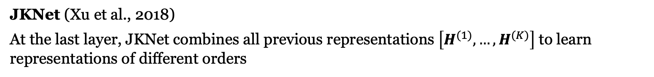
Other Related Work
JKNet (Xu et al., 2018)
At the last layer, JKNet combines all previous representations $\left[H^{(1)},…,H^{(K)}\right]$ to learn representations of different orders
DropEdge (Rong et al., 2020)
where ${\tilde{P}}_{drop}$ denote $\tilde{P}$ with some edge removed at random
Both methods slow down over-smoothing; however still underperform shallow GCNs

Slide 19
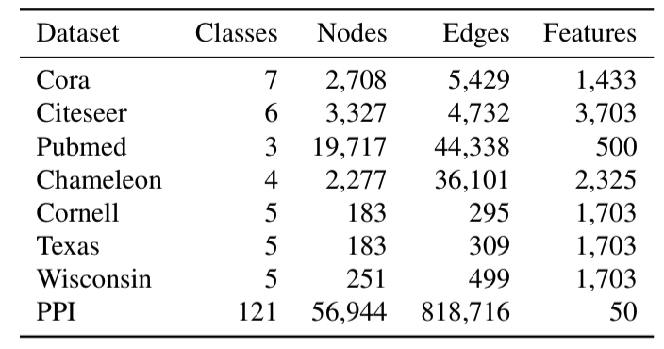
Experiment: Tasks and Dataset
Semi-Supervised Node Classification
Full-Supervised
Node Classification
Inductive Learning

Slide 20
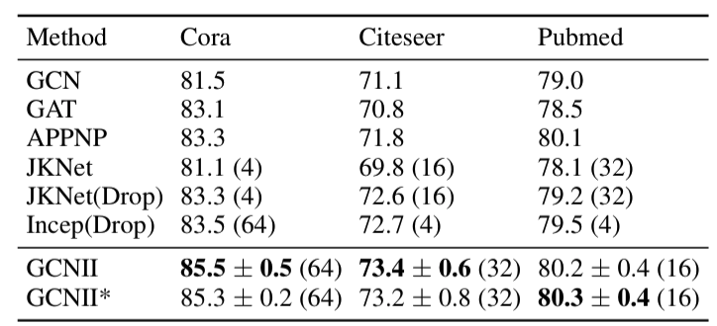
Experiment Results: Semi-Supervised Node Classification
Accuracy (%)
Split:
Training: 20 nodes/class
Validation: 500 nodes
Testing: 1000 nodes

Slide 21
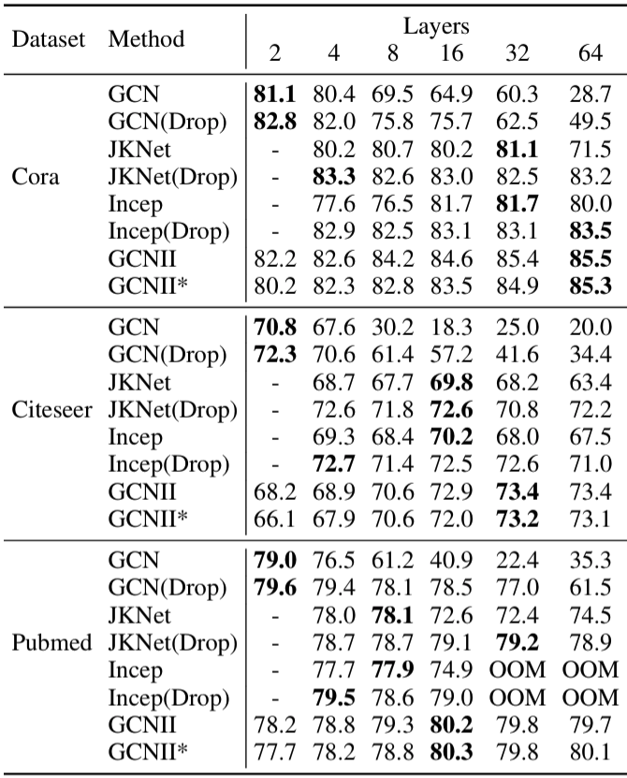
Experiment Results: Semi-Supervised Node Classification
Accuracy (%)

Slide 22
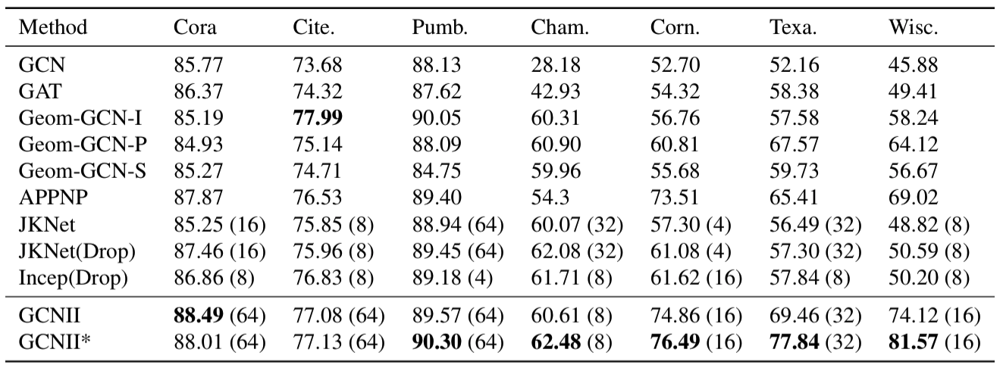
Experiment Results: Full-Supervised Node Classification
Split (for each class):
Training: 60%
Validation: 20%
Testing: 20%
Accuracy (%)

Slide 23
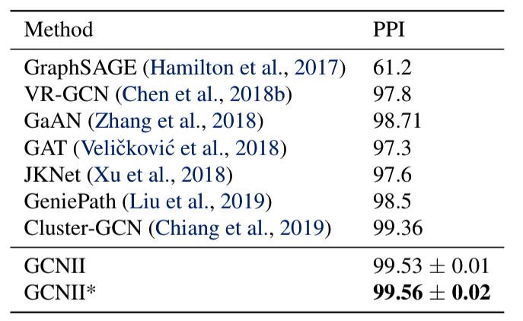
Experiment Results: Inductive Learning
Split:
Training: 20 graphs
Validation:2 graphs
Testing: rest
Averaged F1

