Slide 1
[zeng et al., ICLR’20] Graphsaint: Graph sampling based inductive learning method
Presenter: John Lu

Slide 2
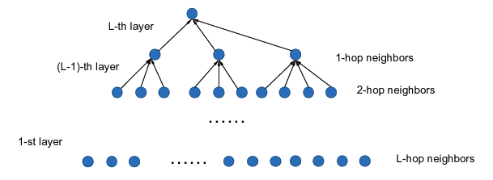
Motivation
Neighbor Explosion

Slide 3
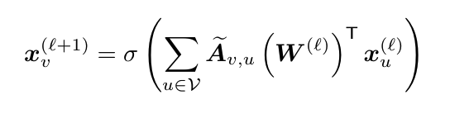
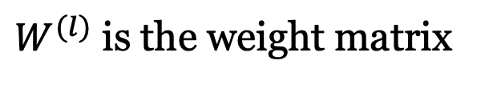
Notation
GCN propagation rule of a layer
$W^{(l)}$ is the weight matrix

Slide 4
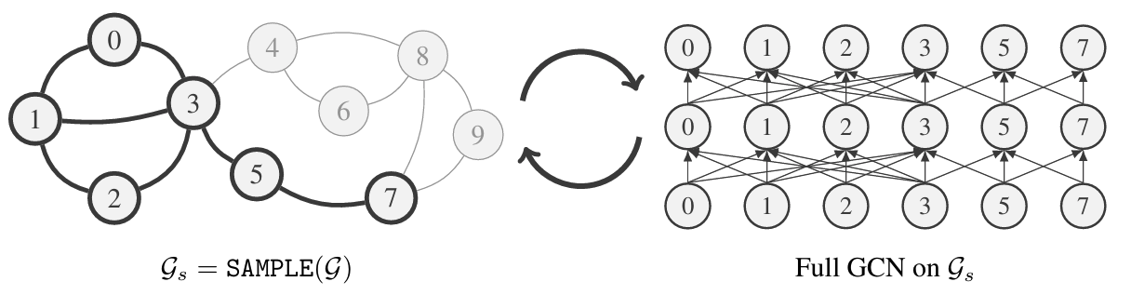
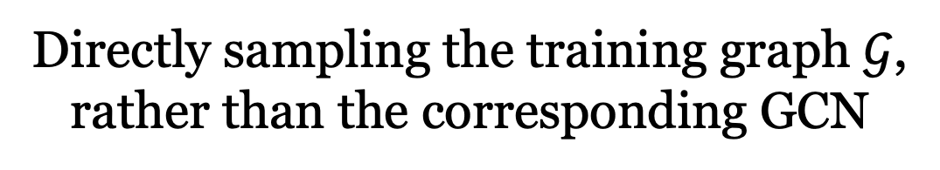
GraphSAINT
Directly sampling the training graph $𝒢$,
rather than the corresponding GCN

Slide 5
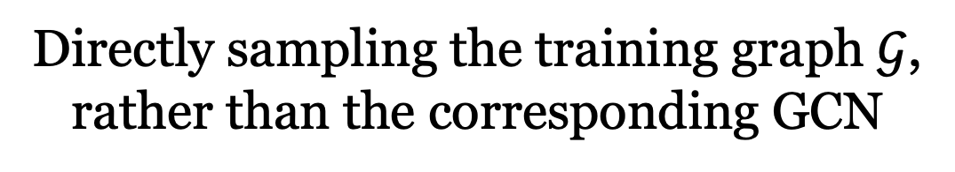
GraphSAINT
Directly sampling the training graph $𝒢$,
rather than the corresponding GCN
Extract appropriately connected subgraphs so that little information is lost when propagating within the subgraphs
Combine information of many subgraphs together so that the training process overall learns good representation of the full graph

Slide 6
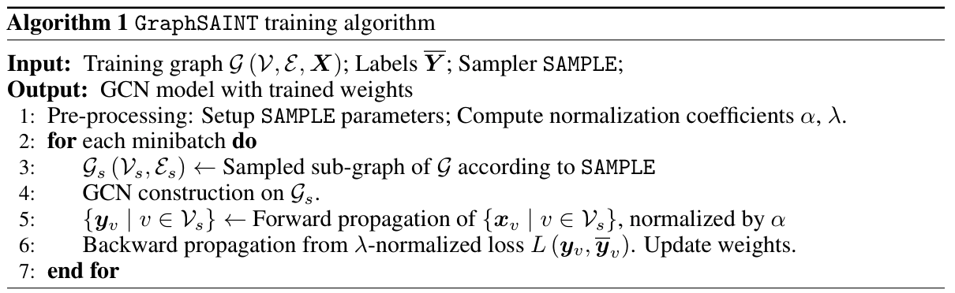
GraphSAINT: SAMPLE
SAMPLE outputs a probability for each node $v∈𝒱$ and each edge $e∈ℰ$

Slide 7
GraphSAINT: SAMPLE
SAMPLE requirements:
Nodes having high influence on each other should be sampled in the same subgraph
Each edge should have non-negligible probability to be sampled
An ideal SAMPLE would consider the joint information from the node connections as well as attributes. For simplicity, only consider graph connectivity perspective.

Slide 8
GraphSAINT: Normalization
A sampler that preserves connectivity will almost inevitably introduce bias into minibatch estimation;
Normalization to eliminate biases.

Slide 9
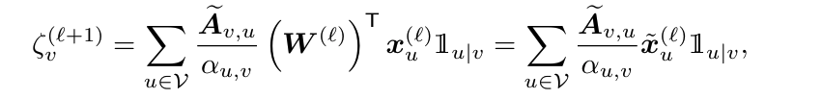

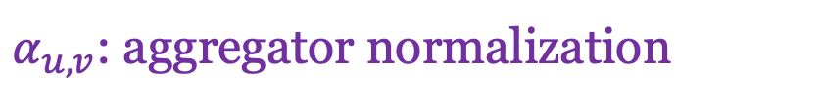
GraphSAINT: Normalization
$α_{u,v}$: aggregator normalization

Slide 10
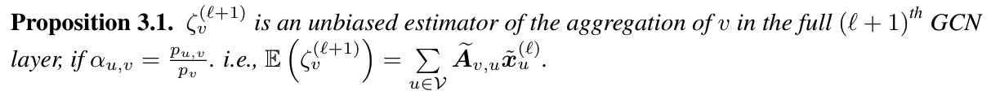
GraphSAINT: Normalization
define

Slide 11
GraphSAINT: Normalization

Slide 12


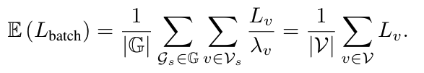
GraphSAINT: Normalization

Slide 13
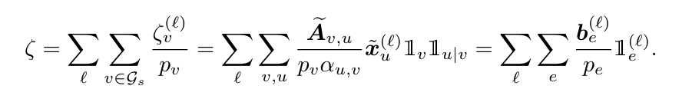


GraphSAINT: Variance
Define:

Slide 14

GraphSAINT: Variance
Define:
The presence of $p_{v}$ ensures

Slide 15
GraphSAINT: Variance
Define:

Slide 16


GraphSAINT: Samplers
Random Node Sampler
Sample $|V_{S}|$ nodes from $V$ randomly according to
Random Edge Sampler
Sample $m$ edges from $ℇ$ randomly according to

Slide 17


GraphSAINT: Samplers
Random Walk Based Samplers
Ignoring activations, $L$ layers can be represented as a single layer with edge weights:
Sample pairs of nodes $u$ and $v$ according to

Slide 18
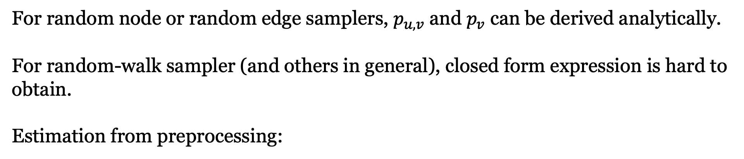
GraphSAINT: Samplers
For random node or random edge samplers, $p_{u,v}$ and $p_{v}$ can be derived analytically.
For random-walk sampler (and others in general), closed form expression is hard to obtain.
Estimation from preprocessing:

Slide 19
Related Work
GCN
GraphSAGE (Hamilton et al, 2018)
FastGCN (Chen et al, 2018b)
S-GCN (Chen et al, 2018a)
AS-GCN (Huang et al, 2018)
ClusterGCN (Chiang et al, 2019)

Slide 20
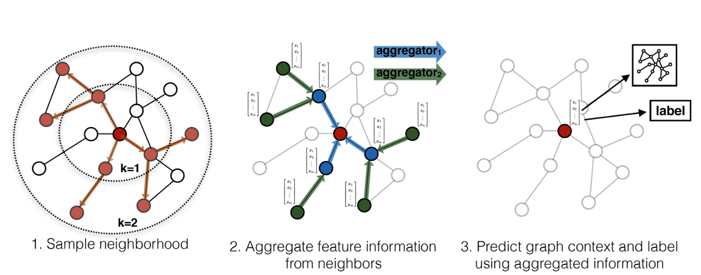
Related Work: GraphSAGE (SAmple and aggreGatE)
Neighbor Sampling:
Uniform

Slide 21
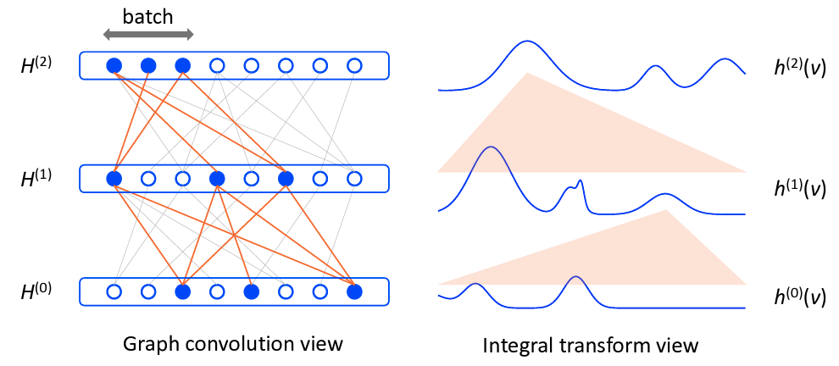
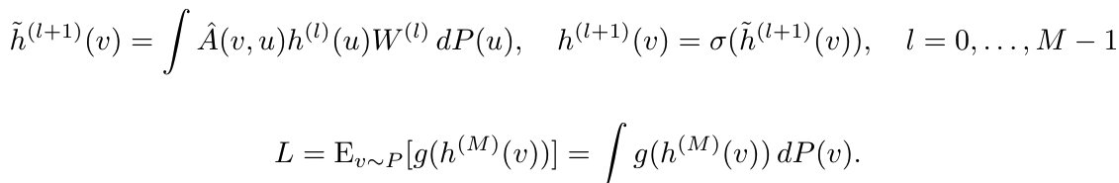
Related Work: FastGCN
Monte Carlo Sampling: Importance Sampling
Notes:
To resolve the problem of lack of independence caused by convolution, we interpret that each layer of the network defines an embedding function of the vertices (random variable) that are tied to the same probability measure but are independent.
Writing GCN in the functional form allows for evaluating the integrals in the Monte Carlo manner,

Slide 22
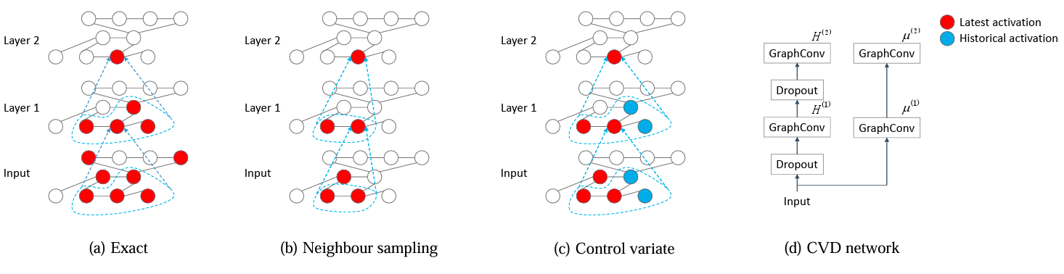
S-GCN (stochastic training of GCN)
AS-GCN (Adaptive Sampling Towards Fast Graph Representation Learning)

Slide 23
Related Work
Layer Sampling: neighbor explosion
Construct a complete GCN on the full training graph.
Sample nodes or edges of each layer to form minibatches.
Propagate forward and backward among the sampled GCN.
ClusterGCN (Chiang et al, 2019): graph clustering based minibatch training
Heuristic based; not account for bias due to the unequal probability of each node / edge appearing in a minibatch.
Notes:
The layer sampling algorithm of GraphSAGE (Hamilton et al., 2017) performs uniform node sampling on the previous layer neighbors. It enforces a pre-defined budget on the sample size, so as to bound the minibatch computation complexity.
S-GCN (Chen et al., 2018a) further restricts neighborhood size by requiring only two support nodes in the previous layer. The idea is to use the historical activations in the previous layer to avoid redundant re-evaluation.
FastGCN (Chen et al., 2018b) performs sampling from another perspective. Instead of tracking down the inter-layer connections, node sampling is performed independently for each layer. It applies importance sampling to reduce variance, and results in constant sample size in all layers. However, the minibatches potentially become too sparse to achieve high accuracy.
Huang et al. (2018) improves FastGCN by an additional sampling neural network. It ensures high accuracy, since sampling is conditioned on the selected nodes in the next layer.

Slide 24
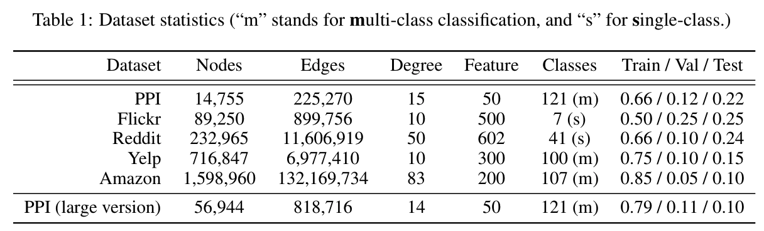
Experiments

Slide 25
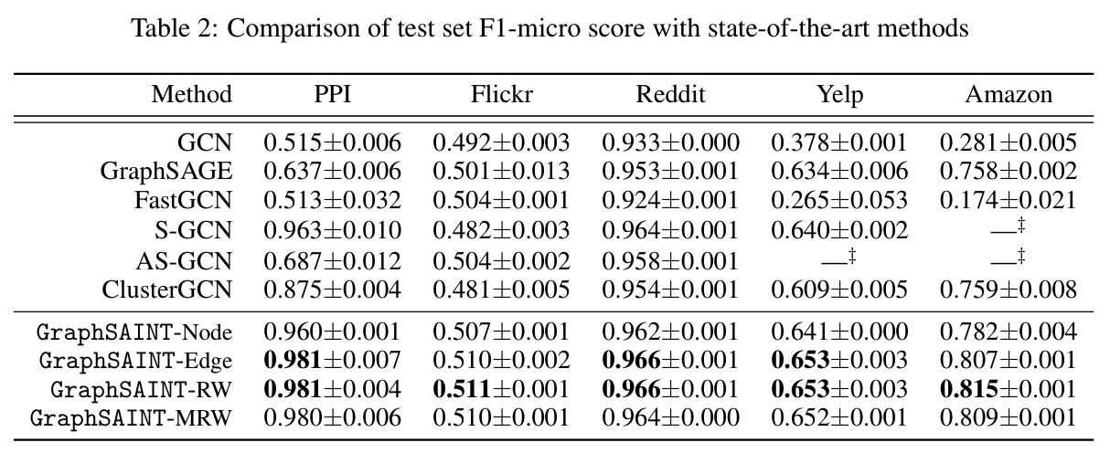
Experiments

Slide 26
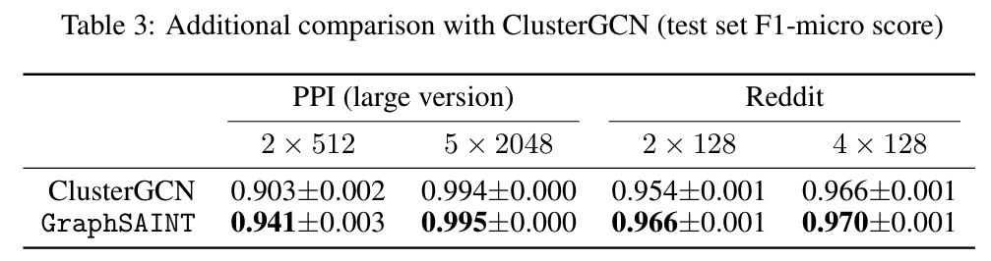
Experiments

Slide 27
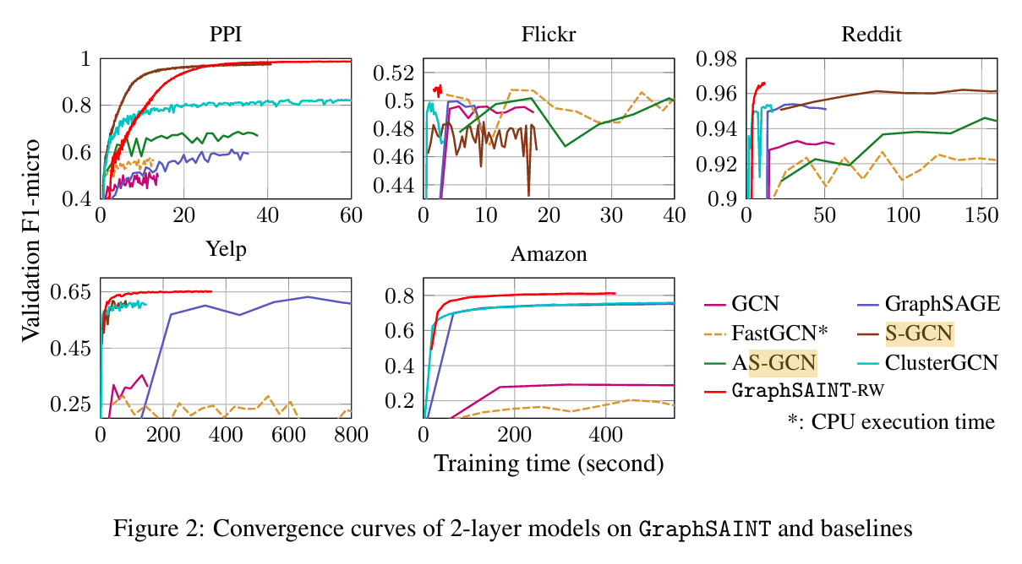
Experiments

