Slide 1
ANALYSIS OF CORRECTED GRAPH CONVOLUTIONS
Khushee Kapoor Master of Data Science and Artificial Intelligence

Slide 2
Graph Neural Networks
Input: A graph with an associated feature vector at each node.
Assumption: graph and the features are correlated, and we wish to learn some signal from the input
GNN takes the features as input to the neural network, and incorporates the graph into its architecture
Notes:
Before diving into our specific problem, let's first understand the role of Graph Neural Networks. A GNN takes a graph as input, where each node is associated with a feature vector. The assumption is that there exists a correlation between the graph structure and node features, and our goal is to learn some meaningful signal from the input. Traditional GCNs propagate information across connected nodes, aggregating features and allowing for improved classification performance. However, as we’ll see, this process can have drawbacks when taken too far

Slide 3
Oversmoothing
Using graph convolutions to the feature data enhances the prediction performance of a model.
Too many graph convolutions can have the opposite effect – oversmoothing
Effect can be alleviated by excluding the principal eigenvector component.

Slide 4
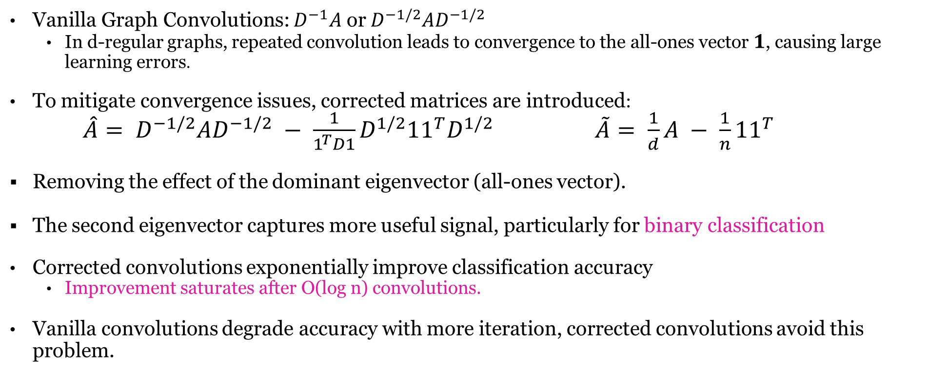
Intuition
Vanilla Graph Convolutions: $D^{−1}A$ or $D^{−1/2}AD^{−1/2}$
In d-regular graphs, repeated convolution leads to convergence to the all-ones vector $1$, causing large learning errors.
To mitigate convergence issues, corrected matrices are introduced:
$\hat{A}= D^{−1/2}AD^{−1/2} − \frac{1}{1^{T}D1}D^{1/2}{11}^{T}D^{1/2}$ $\tilde{A}= \frac{1}{d}A − \frac{1}{n}{11}^{T}$
Removing the effect of the dominant eigenvector (all-ones vector).
The second eigenvector captures more useful signal, particularly for binary classification
Corrected convolutions exponentially improve classification accuracy
Improvement saturates after O(log n) convolutions.
Vanilla convolutions degrade accuracy with more iteration, corrected convolutions avoid this problem.
Notes:
Let A be the adjacency matrix of the given graph, and D be the degree matrix. Vanilla graph convolutions are represented using matrices such as D−1A or D−1/2AD−1/2 [Kipf and Welling, 2017]. Suppose our graph is d−regular, meaning that each node has exactly d neighbors. In this case, both graph convolutions reduce to 1 dA. The top eigenvector of A is 1 with eigenvalue d, where 1 is the vector of all ones. This means that limk→∞ 1 dk Ak = 1 n11⊤, which implies that applying many convolutions is equivalent to projecting our data onto the all-ones vector. Thus, all feature values will converge to the same point. Therefore, we should expect, as verified by most real-world and synthetic experiments, that many rounds of the convolution x → 1 dAx will lead to a large learning error. However, if we instead perform convolution with the corrected matrix ˜ A:= 1 dA− 1 n11⊤, then the convergent behavior of x → ˜ Akx would be equivalent to projecting x onto the second eigenvector of A. This eigenvector is known to capture information about sparse bipartitions in the graph G [Cheeger, 1970, Alon and Milman, 1985, Alon, 1986], and so for certain problems, like binary classification, we may expect this eigenvector to capture a larger amount of information about our signal. We note that another well-studied graph matrix is the Laplacian, D-A. In the regular case, this has the same eigenvectors as the adjacency matrix, but with reversed spectrum. The trivial eigenvector we remove is exactly the Nullspace of the Laplacian. In our analysis, we study the classification problem in the contextual stochastic block model, with a focus on linear, binary classification. Our results are stated in terms of the following corrected convolution matrices: ˆ A=D−1/2AD−1/2 − 1 1⊤D1 D1/211⊤D1/2 ˜ and A= 1 dA− 1 n11⊤, (1) where d := 2|E|/n is the empirical average degree in A, where |E| is the number of edges in the graph. Note that ˆ A is derived from the normalized adjacency matrix, while ˜ A is (up to a scalar multiple) its unnormalized counterpart. Briefly, we demonstrate that when the graph is of reasonable quality, the corrected graph convolutions exponentially improve both partial and exact classification guarantees. Depending on the density and quality of the given graph, improvement becomes saturated after O(logn) convolutions in our partial and exact classification results. However, in comparison to a similar analysis in [Wu et al., 2023] for vanilla graph convolutions (without correction), we show that classification accuracy does not become worse as the number of convolutions increases

Slide 5
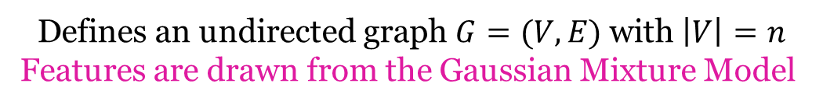
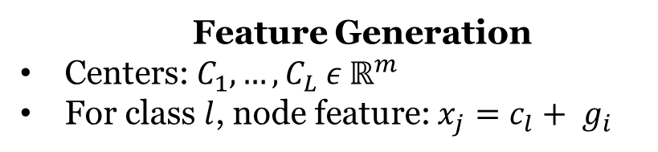
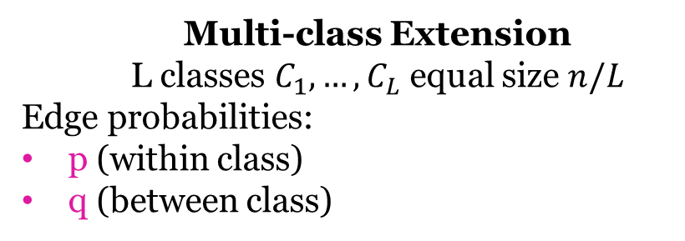
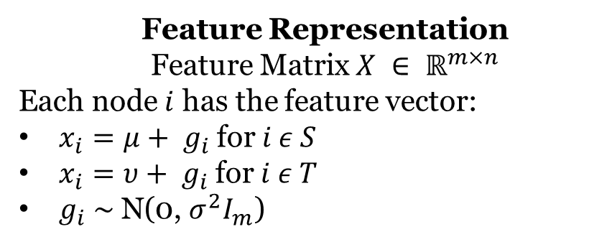
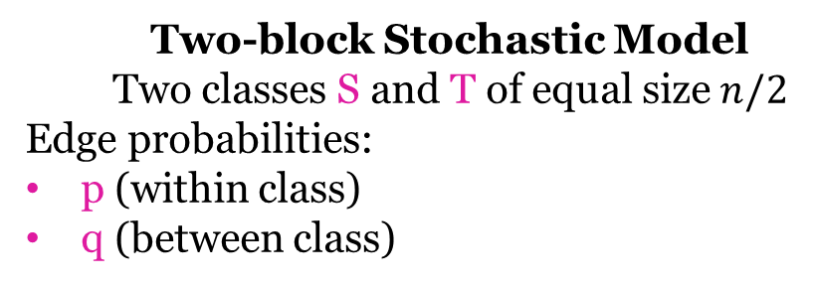
Contextual Stochastic Block Model (CSBM)
Defines an undirected graph $G=(V,E)$ with $\left|V\right|=n$ Features are drawn from the Gaussian Mixture Model
Two-block Stochastic Model Two classes S and T of equal size $n/2$
Edge probabilities:
p (within class)
q (between class)
Multi-class Extension L classes $C_{1}, …, C_{L}$ equal size $n/L$
Edge probabilities:
p (within class)
q (between class)
Feature Representation Feature Matrix $X ∈ ℝ^{m×n}$
Each node $i$ has the feature vector:
$x_{i}=μ+ g_{i}$ for $i ε S$
$x_{i}=υ+ g_{i}$ for $i ε T$
$g_{i} \sim \text{N}\text{(0, }σ^{2}I_{m}\text{)}$
Feature Generation
Centers: $C_{1}, …, C_{L} ε ℝ^{m}$
For class $l$, node feature: $x_{j}=c_{l}+ g_{i}$
Notes:
In this section, we formally describe the contextual stochastic block model introduced by [Deshpande et al., 2018]. Our model is defined by parameters n,m ∈ N, p,q ∈ [0,1], µ,ν,∈ Rm and σ ∈ R+ In the model, we are given a random undirected graph, G = (V,E), where |V | = n, drawn from the 2-block stochastic block model and features drawn from the Gaussian mixture model. Our vertices are partitioned into two classes, S and T, of size n/2, which we want to recover. For each pair of vertices i,j ∈ S and i,j ∈ T, the edge (i,j) is in E independently with probability p while for each pair i ∈ S and j ∈ T, the edge (i,j) is in E with probability q. In addition to the graph, we are also given a feature matrix X ∈ Rn×m drawn from a Gaussian mixture model with two centers µ and ν. For each i ∈ V, we let gi ∼ N(0,σ2Im) be an i.i.d. Gaussian noise vector. Now let (xi)i∈n be the rows of X. For i ∈ S, we have xi = µ+gi and for each i ∈ T, we have xi = ν +gi. In the multi-class setting, our nodes are partitioned into L classes, C1,...CL, of size n/L. The inter-class edge probability is p and intra-class edge probability is q. We assume the features are generated by a Gaussian mixture with L centers c1,...cL ∈ Rm. If node i is in class l, then we observe its feature vector as xj = cl +gi. In addition, we will let µi := cl, for i ∈ Cl, denote the center for vertex i

Slide 6
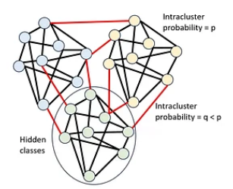
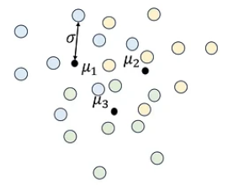
Contextual Stochastic Block Model (CSBM)
Graph ~ Stochastic Block Model
+
Features ~ Gaussian Mixture Model
Intracluster
probability = p
Intracluster
probability = q < p
Hidden
classes

Slide 7









Graph Convolution
$$X ↦ M^{k}X$$
}
}
Feature Matrix
Convolution Matrix
Adjacency Matrix
Degree Matrix
Graph
0 | 1 | 1 | 1
1 | 0 | 1 | 0
1 | 1 | 0 | 1
1 | 0 | 1 | 0
3 | 0 | 0 | 0
0 | 2 | 0 | 0
0 | 0 | 3 | 0
0 | 0 | 0 | 2
$$A=$$
$$D=$$
average degree
d = 2.5
$M$ Matrix
Un-normalized
Normalized
Standard
$$A$$
$$D^{−1/2}AD^{−1/2}$$
Corrected
$A − \frac{d}{n}{11}^{T}$
$D^{−1/2}AD^{−1/2} − \frac{1}{1^{T}D1}D^{1/2}{11}^{T}D^{1/2}$
“Expected” top eigenvector
Normalized top eigenvector

Slide 8
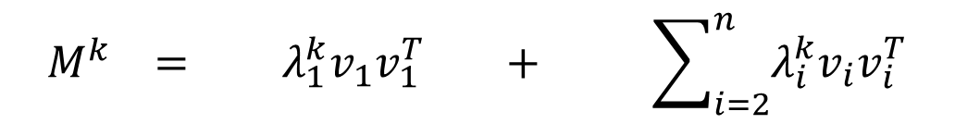
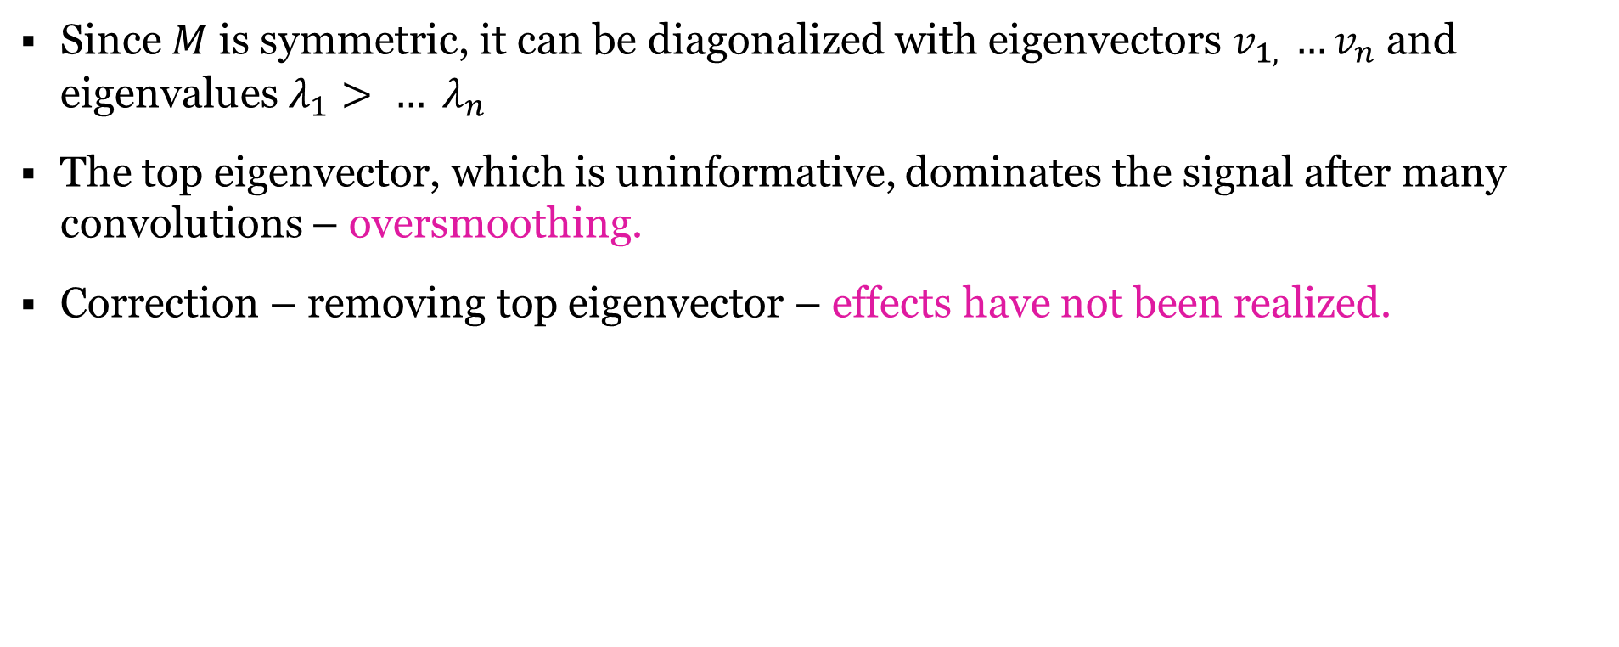
Spectral Decomposition
Since $M$ is symmetric, it can be diagonalized with eigenvectors $v_{1, }{…v}_{n}$ and eigenvalues $λ_{1}> … λ_{n}$
The top eigenvector, which is uninformative, dominates the signal after many convolutions – oversmoothing.
Correction – removing top eigenvector – effects have not been realized.
$$M^{k} = λ_{1}^{k}v_{1}v_{1}^{T} + \sum_{i=2}^{n}{λ_{i}^{k}v_{i}v_{i}^{T}}$$
Dominating signal
Corrected convolution matrix

Slide 9
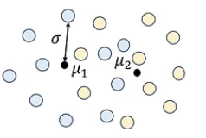
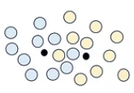



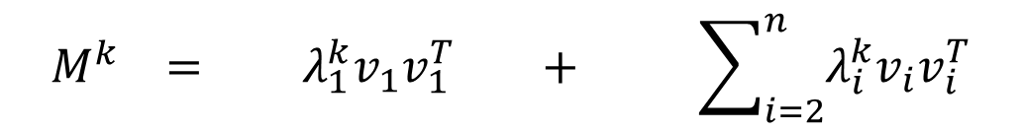


$$M^{k} = λ_{1}^{k}v_{1}v_{1}^{T} + \sum_{i=2}^{n}{λ_{i}^{k}v_{i}v_{i}^{T}}$$
Spectral Decomposition
Dominating signal
Corrected convolution matrix
Oversmoothing in uncorrected Convolutions
$$M$$
$$M^{k}$$
$$→$$
$$→$$
Variance reduction leads to increased accuracy
Aggregation of means leads to decreased accuracy

Slide 10
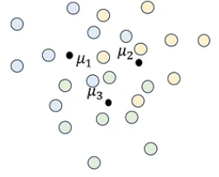
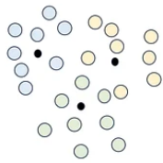
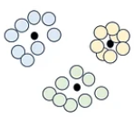
$$M^{k} = λ_{1}^{k}v_{1}v_{1}^{T} + \sum_{i=2}^{n}{λ_{i}^{k}v_{i}v_{i}^{T}}$$
Spectral Decomposition
Dominating signal
Corrected convolution matrix
Corrected Convolution
$$M$$
$$M^{k}$$
$$→$$
$$→$$
This work: Removing the top eigenvector leads to variance reduction without aggregation of the means

Slide 11

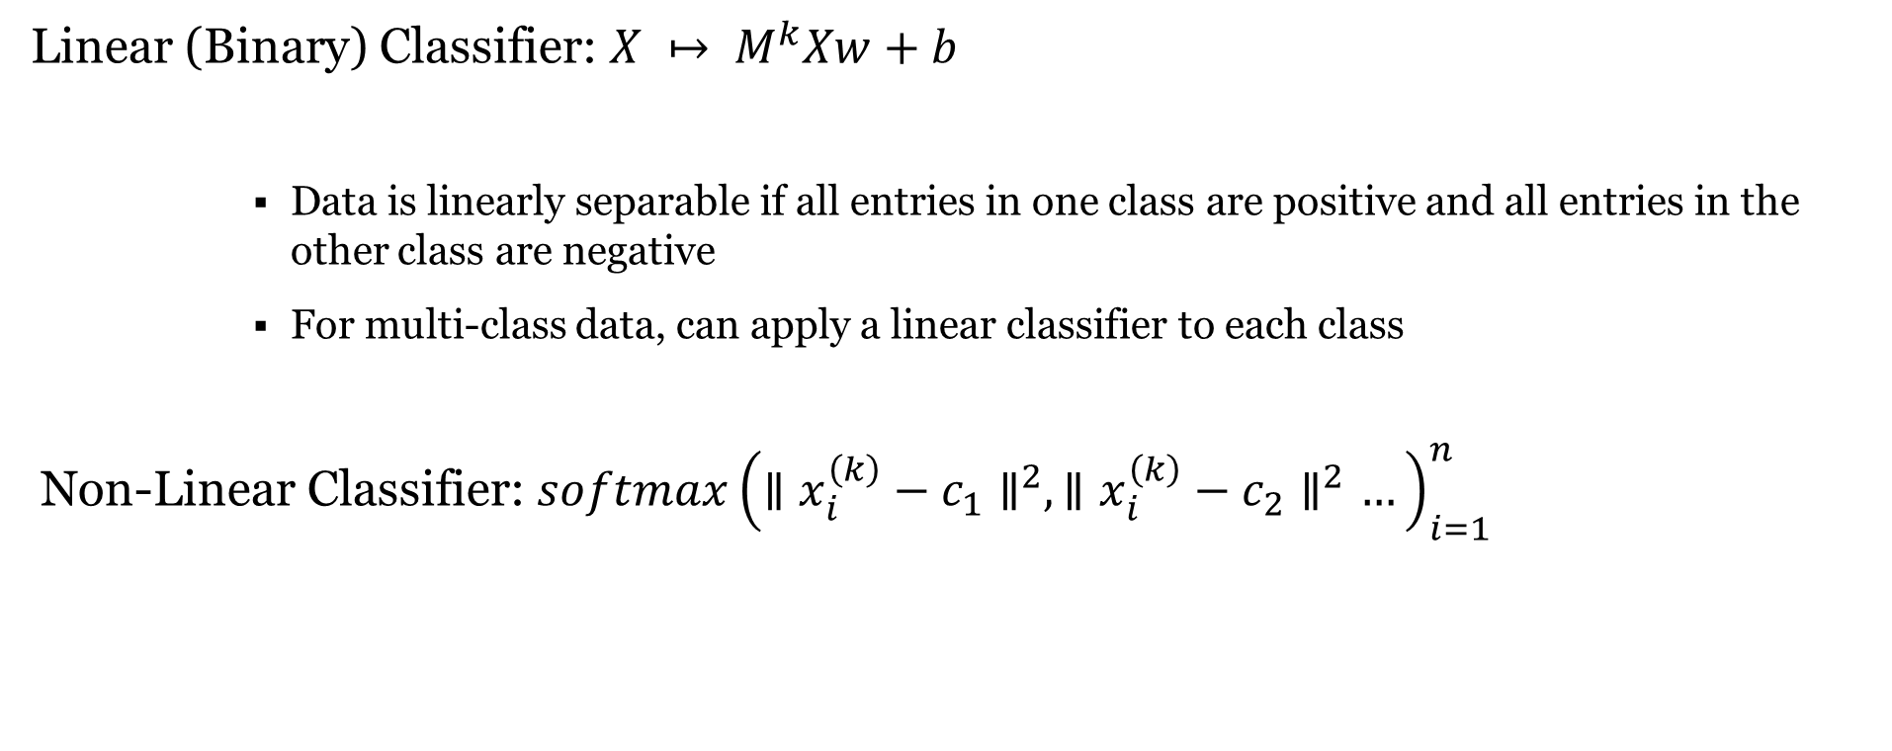
Classifiers
Linear (Binary) Classifier: $X ↦ M^{k}Xw+b$
Data is linearly separable if all entries in one class are positive and all entries in the other class are negative
For multi-class data, can apply a linear classifier to each class
Non-Linear Classifier: ${softmax\left(∥x_{i}^{\left(k\right)}−c_{1}∥^{2},∥x_{i}^{\left(k\right)}−c_{2}∥^{2}…\right)}_{i=1}^{n}$
}
}
trainable parameters
trainable parameters
Where $x_{1}^{(k)}…x_{n}^{(k)}$ are rows of the matrix $M^{k}X$

Slide 12
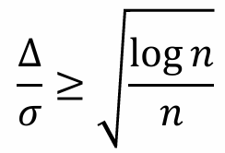
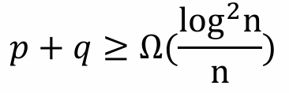

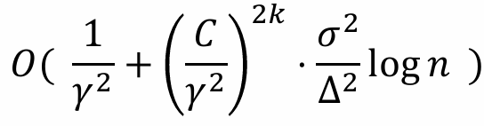
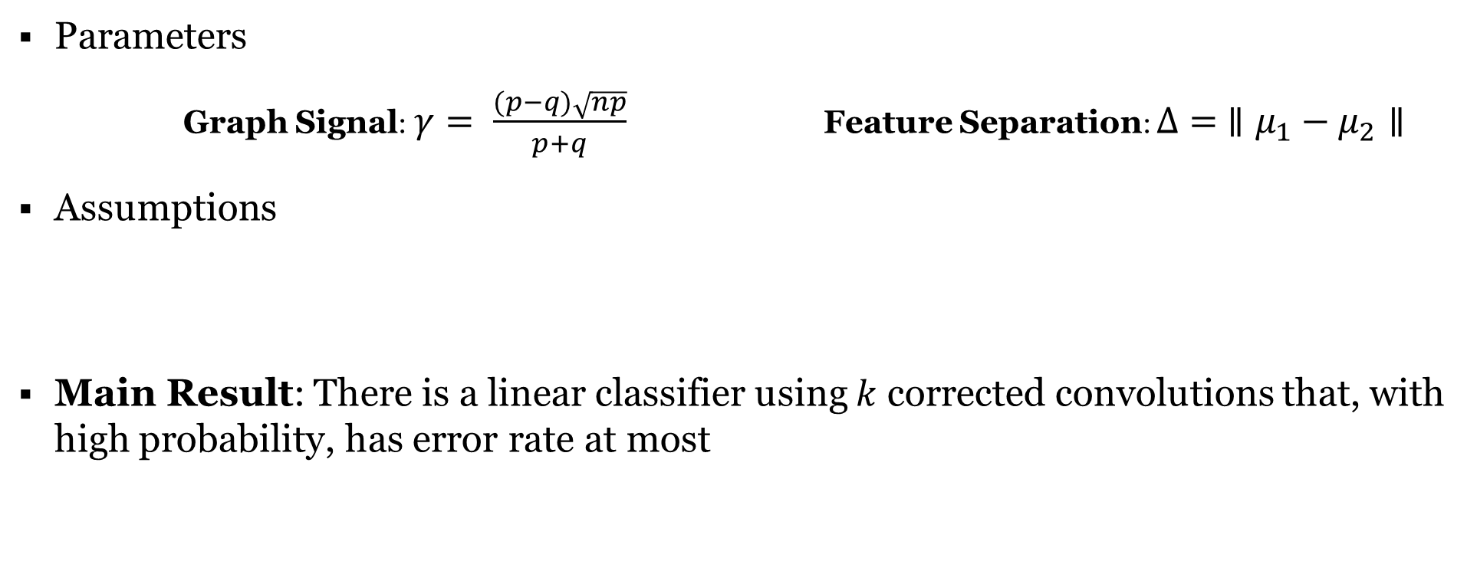
Binary Classification: Partial Recovery
Parameters
Graph Signal: $γ= \frac{(p−q)\sqrt{np}}{p+q}$ Feature Separation: $Δ= ∥μ_{1}−μ_{2}∥$
Assumptions
Main Result: There is a linear classifier using $k$ corrected convolutions that, with high probability, has error rate at most

Slide 13
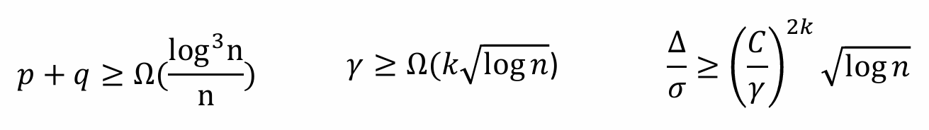
Binary Classification: Exact Recovery
Suppose our parameter satisfy the additional assumptions that:
Then the features are linearly separable after k convolutions with high probability

Slide 14
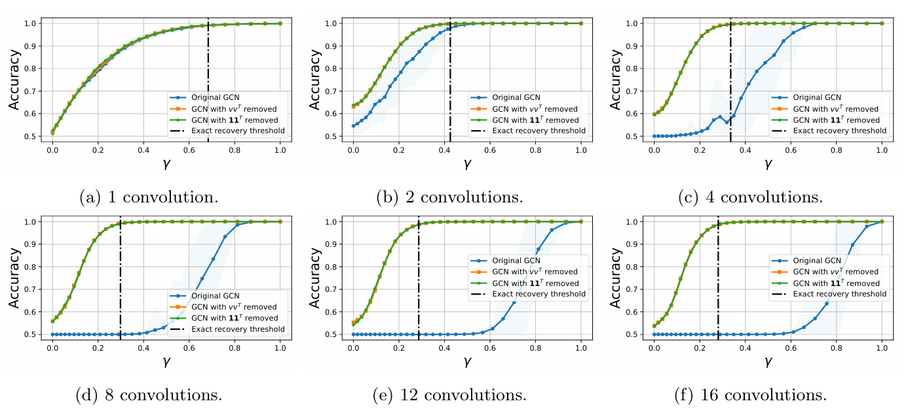
Two-Class Experiments: Synthetic Data
Accuracy plot (average over 50 trials) against signal-to-noise ratio of the features and fixing γ=|p−q|/(p+q)=2/3 for increasing number of convolutions.
Notes:
For synthetic data from the CSBM, we demonstrate the benefits of removing the principal component of the adjacency matrix before performing convolutions for both variants of convolution described in Equation (1). 9 Wechoosen=2000nodeswith20featuresforeachnode, sampledfromaGaussianmixture.Theintra-edge probability isfixedtop=O(log3n/n). Weperformlinear classificationtodemonstrate the results in Theorem4.1andTheorem4.2, trainingaone-layerGCNnetworkbothwithandwithout thecorrected convolutionsandperformanempiricalcomparison.

Slide 15
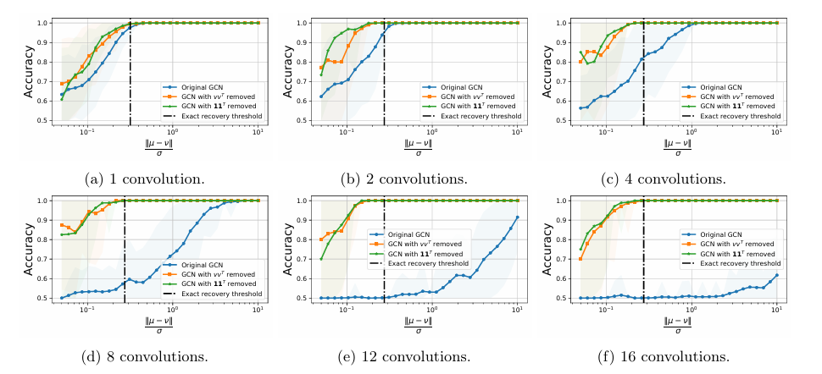
Two-Class Experiments: Synthetic Data
Accuracy plot (average over 50 trials) against graph relative strength (γ=|p−q|/(p+q)) and fixing ∥µ−ν∥/σ=1 for various number of convolutions

Slide 16
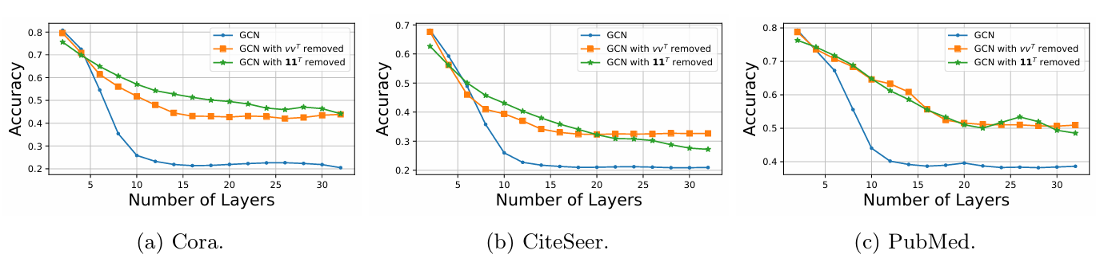
Two-Class Experiments: Real Data
Important information about class memberships is typically captured by the top C eigenvectors, where C > no. of classes
Notes:
Similar to the synthetic data experiments, we compare the results of corrected graph convolution with the original GCN on real-world graph benchmark datasets: CORA, CiteSeer, and PubMed citation networks [Sen et al., 2008] in a multi-class setting.
In Figure 3, we observe that, in general, the accuracy of all learning methods decreases as the number of convolutions increases. However, the corrected convolution method converges to a much higher accuracy compared to the uncorrected convolution.
This improvement can be attributed to the fact that, in multi-class classification on general graphs, important information about class memberships is typically captured by the top C eigenvectors (excluding the first one), where C is greater than the number of classes [Lee et al., 2014]. In general, these eigenvectors can have different eigenvalues.
Since the limiting behavior of multiple rounds of convolutions projects features onto the eigenvector(s) corresponding to the second eigenvalue, this method only captures partial information about the multi-class structure. By contrast, as shown in Appendix E.1, for synthetic data with balanced classes, classification accuracy continues to improve with more convolutions only if they are corrected to remove the top eigenvector.

Slide 17
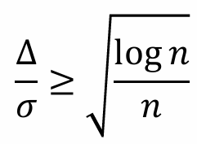
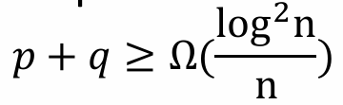

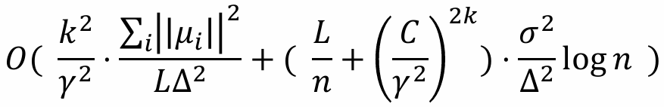
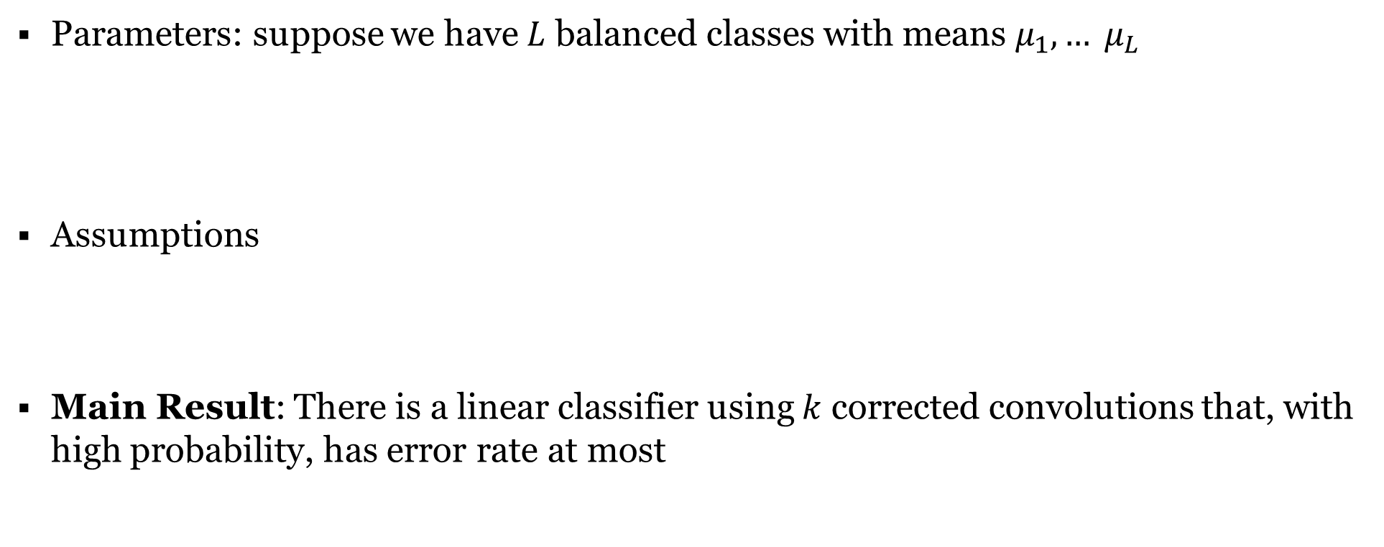
Multi-class Classification: Partial Recovery
Parameters: suppose we have $L$ balanced classes with means $μ_{1}, … μ_{L}$
Assumptions
Main Result: There is a linear classifier using $k$ corrected convolutions that, with high probability, has error rate at most
Graph Signal: $γ= \frac{(p−q)\sqrt{np}}{\sqrt{Lp(1−p)}+L\sqrt{q(1−q)}}$ Feature Separation: $Δ= \min_{i,j}{∥μ_{i}−μ_{j}∥}$

Slide 18
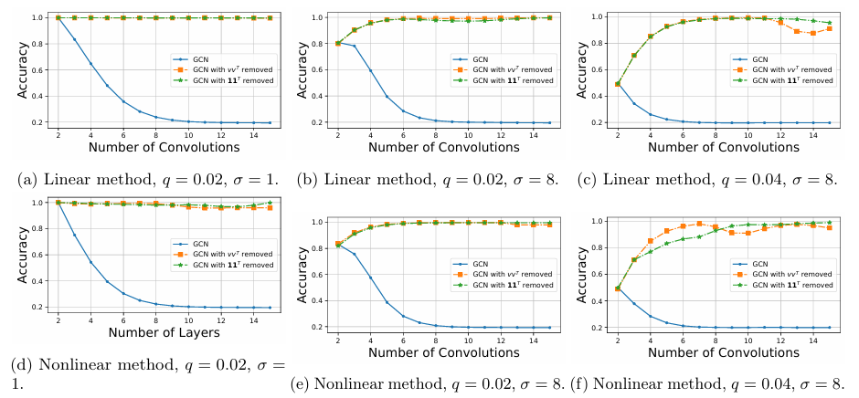
Multi-Class Experiments
Accuracy plot (average over 50 trials) on CSBM data with 5 balanced classes, 500 nodes per class and orthogonal means, with fixed p=0.1.
Notes:
Finally, we conclude this section by presenting additional figures to illustrate the performance of the corrected convolution on synthetic data. We compare the corrected and uncorrected convolutions using both linear and non-linear models. The class means are represented by the standard basis vectors.
For the linear model (Figures 4a–4c), we evaluate five 1-vs-all classifiers followed by a softmax function to predict the class label. For the non-linear model (Figures 4d–4f), we use a typical two-layer MLP-based architecture. In both cases, we observe that the corrected convolutions do not show a performance degradation as the number of convolutions increases.
It is important to note that while the performance is similar between linear and non-linear classification, non-linear classification is generally necessary when the individual class means cannot be separated by a linear hyperplane.

Slide 19
Key Findings
First theoretical guarantees on partial and exact classification after k rounds of graph convolutions in the contextual stochastic block model.
Corrected convolution matrix improves classification accuracy exponentially until a saturation point.
The number of convolutions required for saturation depends on input feature variance.
Linear classifier accuracy at saturation depends only on signal strength from the graph.
Notes:
In this work, we provide, to our knowledge, the first theoretical guarantees on partial and exact classification after k rounds of graph convolutions in the contextual stochastic block model. Our main result is to show that each graph convolution with the corrected matrix reduces the classification error by a multiplicative factor until a certain point of “saturation” and the number of convolutions required until saturation depends on the amount of input feature variance. We show that the accuracy of the linear classifier at the point of saturation only depends on the strength of the signal from the graph. This is in contrast to the uncorrected convolution matrix, which will always exhibit a decrease in classification accuracy after many convolutions. Finally, we show that given slightly stronger assumptions on graph density and signal strength, the convolved data at the point of saturation will be linearly separable with high probability. To quantify our results, we let p and q be the intra- and inter-class edge probabilities with γ(p,q) = |p − q|/(p + q) being the “relative signal strength” in the graph. Let ¯ dbe the expected degree of each vertex. Our results can be summarized as follows:

Slide 20
Key Methodology
Spectral analysis to bound mean-squared error between convolved and true features for partial classification.
Concentration inequalities for exact classification.
Gaussian mixture model for features and L-block stochastic block model for graph for multi-class classification.
Notes:
To obtain our partial classification results, we use spectral analysis to bound the mean-squared-error between the convolved features and the true signal. For exact classification, we prove a concentration inequality on the total amount of message received by a vertex through “incorrect paths” of length k after k rounds of convolution through a combinatorial moment analysis. Using this, we establish entry-wise bounds on the deviation of the convolved feature vector from the true signal. Finally, we extend our partial-recovery result to the multi-class setting. In this setting, we assume our features are distributed according to a Gaussian mixture model with L equal-sized clusters and our graph is distributed according to a L-block stochastic block model. Our analysis for partial recovery generalizes easily to the multi-class setting with the use of basic non-linear classifiers. Just as before, we show that convolution with the corrected, un-normalized adjacency matrix, ˜ A, reduces classification error by a constant fraction each round, until a point of saturation where no further improvement is made

Slide 21
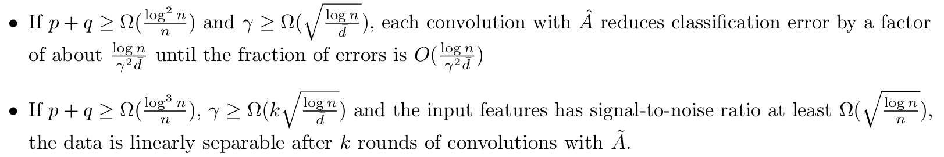
Main Results
For relative signal strength $\frac{(p−q)\sqrt{np}}{p+q}$:

Slide 22
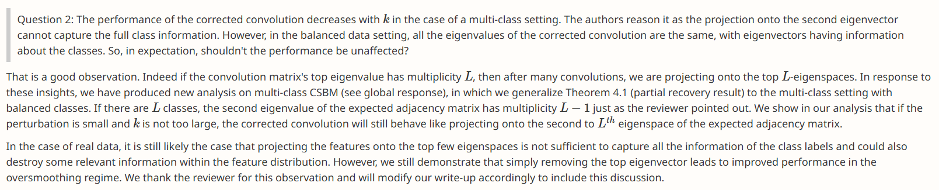
Interesting Discussions from OpenReview.net
If data is balanced, all eigenvalues are the same, and eigenvectors hold class-related information, suggesting performance should be unaffected.
When the convolution matrix's top eigenvalue has multiplicity L (number of classes), repeated convolutions lead to projection onto the top L-eigenspaces.
The second eigenvalue of the expected adjacency matrix has multiplicity L - 1. If perturbation is small and k is not too large, the corrected convolution still projects onto the 2nd to Lth eigenspace.
Projecting onto top eigenspaces may not capture all class label information and can distort feature distribution.

Slide 23
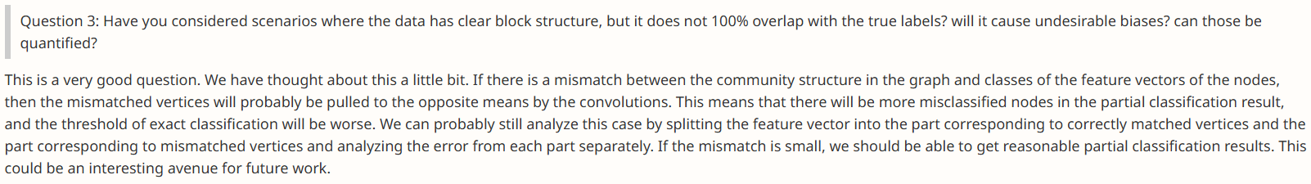
Interesting Discussions from OpenReview.net
When the graph’s community structure does not perfectly align with the true class labels, convolution operations may pull mismatched vertices towards incorrect cluster means.
This misalignment leads to more misclassified nodes, worsening partial classification accuracy. The threshold for correct classification increases, making exact classification more challenging.
Decompose the feature vector into two parts: one for correctly matched vertices; one for mismatched vertices.
Analyze errors separately for a clearer understanding of their impact.

Slide 24
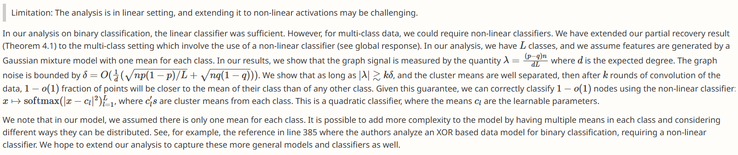
Interesting Discussions from OpenReview.net
The study is based on a linear setting, making it challenging to extend to non-linear activations.
While a linear classifier suffices for binary classification, multi-class classification may require non-linear methods, modeled using a Gaussian mixture model.
The graph signal (λ) must be strong relative to noise (δ) for accurate classification, enabling correct classification of 1−o(1) fraction of nodes using a quadratic classifier.
Potential improvements include multiple means per class, non-linear models (e.g., XOR-based), and extending the analysis to more complex classification settings.

