Slide 1
On the Usage of Global Document Occurrences (GDO) in P2P Information Systems
or…
Avoiding overlapping results in P2P searching
Odysseas Papapetrou^{1,2}
Sebastian Michel¹
Matthias Bender¹
Prof. Dr. Gerhard Weikum¹
Max-Planck-Institut für Informatik, D-5
L3S – Hannover

Slide 2
Overview
Problem Definition: Overlapping Results
Minerva: A P2P web search engine
Using Global Document Occurrences (GDO) for query processing
Experimental Evaluation
Conclusions and Future Work

Slide 3
Problem Definition
Keyword-based query processing in P2P systems
  Query Routing: Query the top-k most relevant peers
  Query Execution: Each peer returns its top-k’ relevant documents
Each peer returns its own local optimum results
Frequent relevant documents are included in many peers
→ returned more than once
  Network waste
  Important rare relevant documents are often outplaced from multiple copies of the same document

Slide 4
Problem Definition (example)
Query term: ‘P2P’
Ask top-3 peers, retrieve top-5 results from each
Peer 1 |  | Doc. | Score
1 | P2P systems |  | 0.29
2 | Minerva |  | 0.17
3 | Gnutella |  | 0.13
4 | Chord |  | 0.11
5 | DHT |  | 0.11
6 | Kazaa |  | 0.09
7 | Pastry |  | 0.09
8 | P-Grid |  | 0.09
Peer 7 |  | Doc. | Score
1 | P2P systems |  | 0.29
2 | Minerva |  | 0.17
3 | Gnutella |  | 0.13
4 | eDonkey |  | 0.10
5 | CAN |  | 0.10
6 | SuperShares |  | 0.09
7 | Napster |  | 0.09
8 | P-Grid |  | 0.09
Peer 4 |  | Doc. | Score
1 | Minerva |  | 0.17
2 | Gnutella |  | 0.13
3 | Chord |  | 0.11
4 | DHT |  | 0.11
5 | eDonkey |  | 0.10
6 | Pastry |  | 0.09
7 | Kazaa |  | 0.09
8 | eShare |  | 0.07
✓
✗
✗
✓
✗
✗
✓
✗
✗
✓
✓
✗
✓
✓
✗

Slide 5
Problem Definition (example)
Query term: ‘P2P’
Ask top-3 peers, retrieve top-5 results from each
Optimal solution
Peer 1 |  | Doc. | Score
1 | P2P systems |  | 0.29
2 | Minerva |  | 0.17
3 | Gnutella |  | 0.13
4 | Chord |  | 0.11
5 | DHT |  | 0.11
6 | Kazaa |  | 0.09
7 | Pastry |  | 0.09
8 | P-Grid |  | 0.09
Peer 7 |  | Doc. | Score
1 | P2P systems |  | 0.29
2 | Minerva |  | 0.17
3 | Gnutella |  | 0.13
4 | eDonkey |  | 0.10
5 | CAN |  | 0.10
6 | SuperShares |  | 0.09
7 | Napster |  | 0.09
8 | P-Grid |  | 0.09
Peer 4 |  | Doc. | Score
1 | Minerva |  | 0.17
2 | Gnutella |  | 0.13
3 | Chord |  | 0.11
4 | DHT |  | 0.11
5 | eDonkey |  | 0.10
6 | Pastry |  | 0.09
7 | Kazaa |  | 0.09
8 | eShare |  | 0.07
✓
✓
✓
✓
✓
✓
✓
✓
✓
✓
✓
✓
✓

Slide 6
Minerva: A P2P web search engine
P2P web search engine (described in [2,3])
Each peer is an independent web crawler and database
Structured over a DHT – Chord
Main Minerva contributors:
D-5 Group@MPII
Prof. Dr. Gerhard Weikum
Sebastian Michel Matthias Bender Christian Zimmer

Slide 7


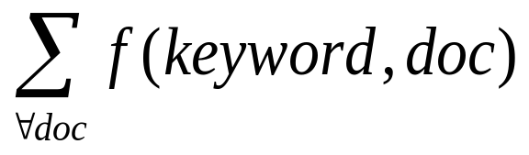
Minerva: A P2P web search engine
…
  Main idea: Keep summaries of each peer collection in a Distributed Hash Table (DHT)
Local Inverted Index (in every peer)
Distributed Hash Table (DHT)
Keyword | Inverted index
 | Score | URL
‘car’ | 0.3 | cars.com
 | 0.2 | bmw.de
 | 0.2 | vw.de
‘dog’ | 0.05 | dogs.org
 | 0.05 | pets.org
… | … | …
… | … | …
Keyword | Peerlist
 | Score | Peer Id
‘car’ hashed at peer 3 | 0.7 | A:194.135.42.4
 | 0.3 | B:132.10.25.1
 | 0.2 | C:125.4.4.7
‘dog’ hashed at peer 8 | 0.4 | D:117.45.54.7
 | 0.3 | B:132.10.25.1
 | … | …
… | … | …
Peerlist
for ‘car’
Peerlist
for ‘dog’

Slide 8
Query Processing in Minerva
…
  Step 2 – Query Execution:
  Each peer returns its top-k’ (e.g. top-20)
  most relevant documents
  Step 1 – Query Routing:
  Each query is routed to the top-k
  (e.g. top-10) most relevant peers
Peer A Query ‘car’ | Inverted index
 | Score | URL
 | 0.3 | cars.com
 | 0.2 | bmw.de
 | 0.2 | vw.de
Keyword | Peerlist
 | Score | Peer Id
‘car’ hashed at peer 3 | 0.7 | A:194.135.42.4
 | 0.3 | B:132.10.25.1
 | 0.2 | C:125.4.4.7
‘dog’ hashed at peer 8 | 0.4 | D:117.45.54.7
 | 0.3 | B:132.10.25.1
 | … | …
… | … | …
Peer B Query ‘car’ | Inverted index
 | Score | URL
 | 0.2 | bmw.de
 | 0.05 | volvo.de
 | 0.05 | honda.com
Distributed Hash Table (DHT)
Local Inverted Index (in every peer)
  Problem: The peer results overlap!

Slide 9
Current Approaches
Ignore the problem. Ask more peers…
Simple
Frequent top-k problem: If the top − k documents are very frequent, then asking more peers may not contribute to the results!
Expensive
Frequent top-k problem
Peer1 | Peer2 | Peer3 | Peer4
Minerva | Minerva | Minerva | Minerva
Gnutella | Gnutella | Gnutella | Gnutella
Chord | Chord | Chord | Chord
Pastry | eShares | Kazaa | DHT
Napster | CAN | Napster | P2PNet
Figure: Asking more than one peer does not necessarily increase recall

Slide 10
Current Approaches (2)
…
Pre-estimate overlap (for each keyword) before routing the query [1]
  Apart from the peer scores for each keyword, the document id’s of all the relevant documents from each peer are also saved in the distributed directory – at the same peer responsible for the peer scores
  During Query Routing, the documents in all the peers already queried are not used for peer-selection purposes
Keyword | Peerlist
 | Score | Peer Id
‘car’ hashed at peer 3 | 0.7 | A:194.135.42.4
 | 0.3 | B:132.10.25.1
 | 0.2 | C:125.4.4.7
… | … | …
Keyword | Peerlist
 | Score | Peer Id | Rel.Docs
‘car’ hashed at peer 3 | 0.7 | A:194.135.42.4 | 1,6,7,11
 | 0.3 | B:132.10.25.1 | 2,5,7
 | 0.2 | C:125.4.4.7 | 6,7
… | … | … | …

Slide 11
Current Approaches (2)
…
Pre-estimate overlap (for each keyword) before routing the query
Compact documents representation with bloomfilters [4]
Increases recall
Does not solve the frequent top-k problem

Slide 12
Global Document Occurrences
Progressively penalize frequent documents as more and more peers contribute their results
  In query routing: Do not query peers with mostly frequent relevant documents if many peers were queried up to now
  In query execution: Do not return frequent relevant documents if many peers were queried up to now

Slide 13
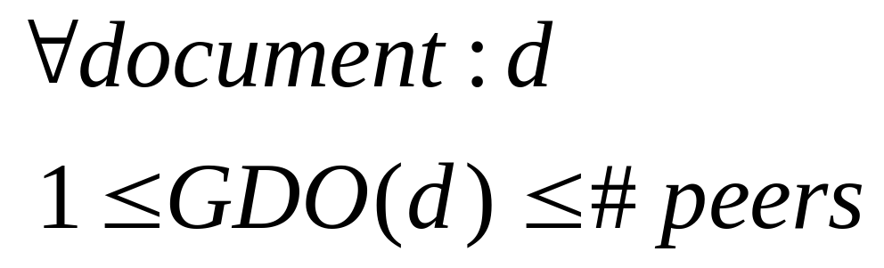
Global Document Occurrences
Global Document Occurrences (GDO): The number of copies of each document in all the peer collections
Idea: Use GDO to estimate the probability of each document being returned from a previously queried peer

Slide 14
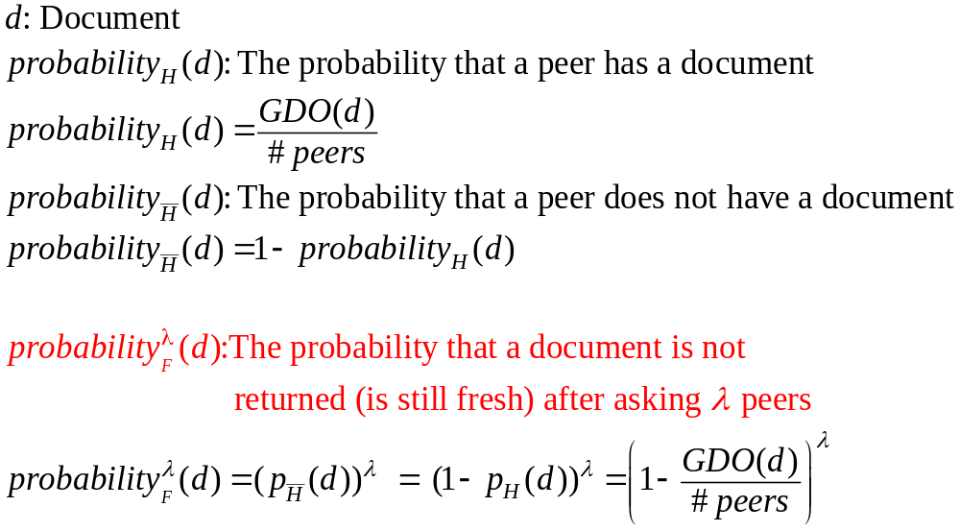
Global Document Occurrences
Definitions
Depended on #peers already queried

Slide 15
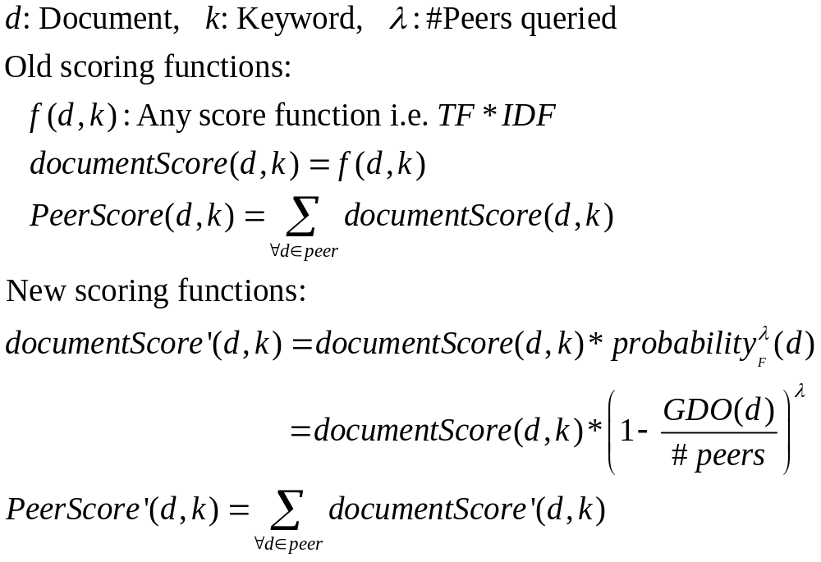

Global Document Occurrences
Scoring the documents and the peers for a query
Depended on #peers already queried

Slide 16
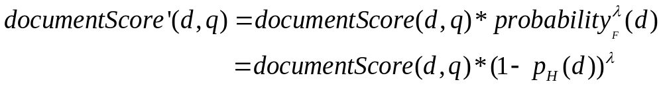

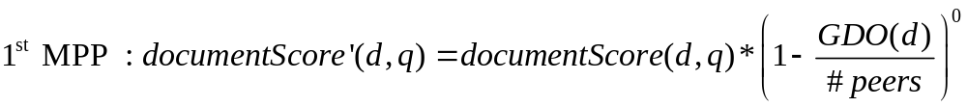
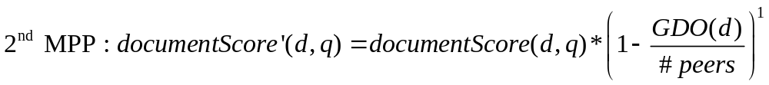
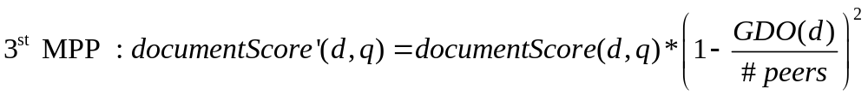
Global Document Occurrences
The GDO-based document score equals to the original document
score, multiplied with the probability of the document to be fresh
…

Slide 17
Query routing with GDO
The peers now have a different score dependent on # of peers already queried
The DHT now stores the peer Scores for each peer being considered the 1st, 2nd, 3rd… most promising peer
Sufficient and inexpensive to build for top − 10 positions (λ<10)
Term | Peerid | Score
Term: ‘car’ Hashed(DHT) on peer 7 | A: 194.1.25.4 | 0.44
 | B: 147.45.45.4 | 0.35
 | C: 191.4.25.4 | 0.32
… | … | …
Term | Order-Position | Peerid | Score
Term: ‘car’ Hashed (DHT) on peer 7 | 1st most promising peer – No peers queried yet | A: 194.1.25.4 | 0.44
 |  | B: 147.45.45.4 | 0.35
 |  | C: 191.4.25.4 | 0.32
 | 2nd most promising peer– one peer queried | B: 147.45.45.4 | 0.27
 |  | A: 194.1.25.4 | 0.17
 |  | C: 191.4.25.4 | 0.13
 | 3rd most promising peer-two peers queried | B: 147.45.45.4 | 0.23
 |  | A: 194.1.25.4 | 0.09
 |  | C: 191.4.25.4 | 0.06
 | … | … | …
… | … | … | …

Slide 18
Query routing with GDO
Peer ‘Q’ asks for query ‘car’
Term | Order | Peer Id | Score
‘car’ hashed at peer 3 | 1st Most Promising Peer | B | 0.75
 |  | A | 0.44
 |  | D | 0.41
 |  | C | 0.39
 | 2nd Most Promising Peer | B | 0.44
 |  | D | 0.33
 |  | A | 0.25
 |  | C | 0.25
 | 3rd Most Promising Peer | D | 0.27
 |  | B | 0.23
 |  | C | 0.16
 |  | A | 0.12

Slide 19
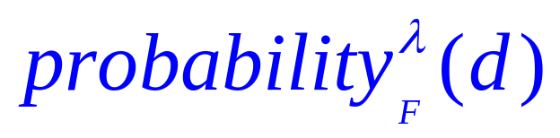
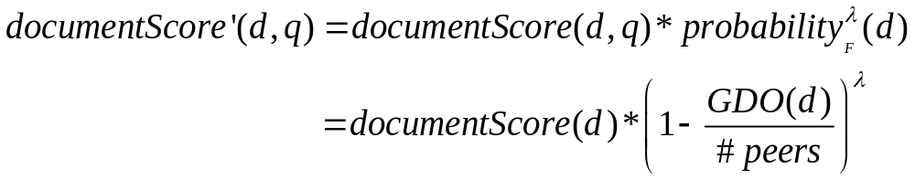
Query execution with GDO
When routing the query to a peer, also include λ
λ: the number of peers asked before it (its position)
Peer uses λ to calculate the probability of each document to be still fresh (not returned from a previous peer)
Pre-calculate from each peer for each document (for λ<10)

Slide 20
Maintaining the GDO
Use a Distributed Directory to store the GDO
Hash the GDO of each document to the peer responsible for the most important keyword for this document
Piggyback the GDO-update messages to the same messages for updating the Peer Scores
Peers can cache the GDOs for all the local documents
Complexity for each peer: linear to the number of documents
n : The number of the peer’s documents
When a peer enters/exits the system: Update (increase/decrease) the GDOs: O(n) messages piggybacked in the Peer Score update messages
When a peer evaluates its documents: Read the GDOs: O(n) messages integrated in the Peer Score update messages

Slide 21
Experimental Evaluation
Experimental Setup:
10000 documents & 500 peers
100 terms randomly assigned to the documents (each document gets exactly 4 terms)
Document replications (GDOs) follow Zipf distribution
Document scores for each term follow independent Zipf distribution
Documents randomly assigned to the available peers
Experiment repeated with 50 peers, 1000 documents, 100 terms

Slide 22
Experimental Evaluation
Compare with
  Summary-based (overlap unaware)
  Near Optimal Greedy method
Enable/disable GDO on query routing and query execution
Interesting measures:
  Number of relevant documents
  Score mass (sum of scores) of retrieved documents

Slide 23
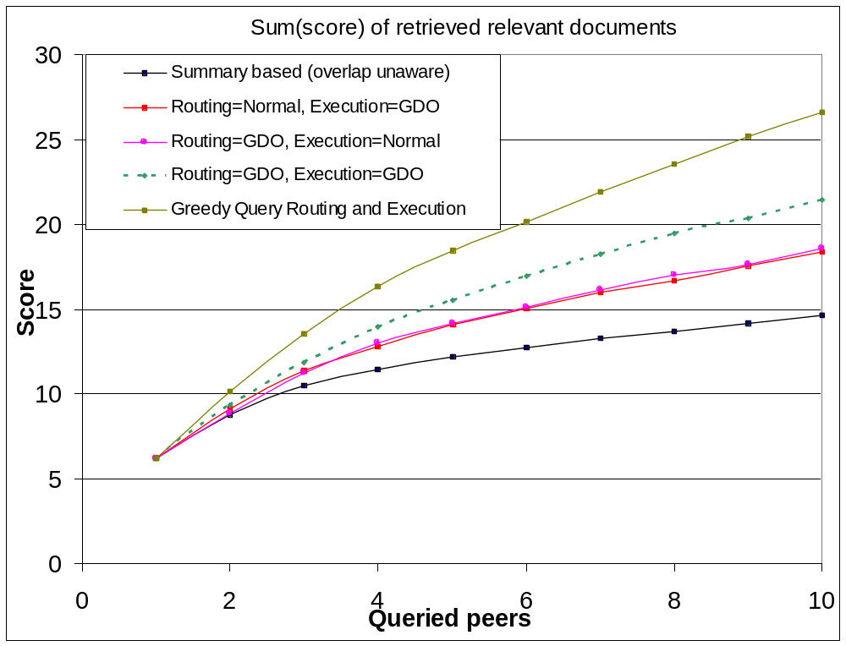
Sum of scores of retrieved documents

Slide 24
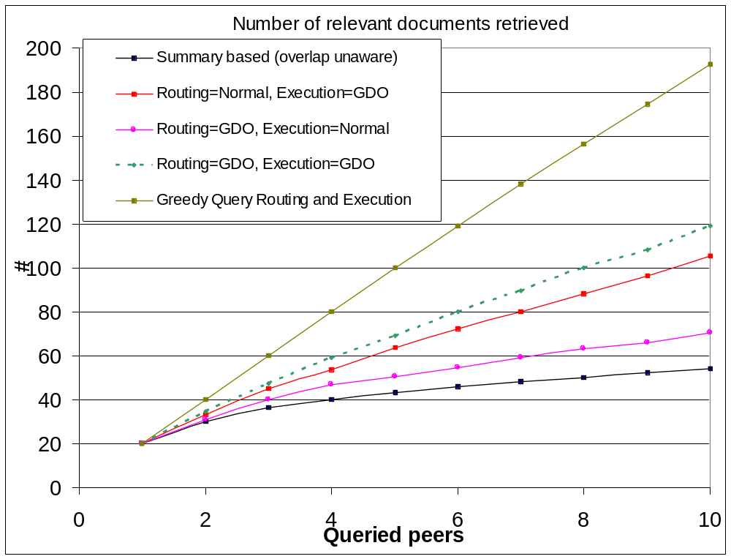
Number of retrieved relevant documents

Slide 25
Conclusions
Probabilistic approach for fresh results in P2P query execution
Solves frequent top − k problem
Does not waste network resources in returning many replicas of the same result
Significantly increases recall (fine-tuning of the approach can lead to better results)
Implemented with a very small network overhead

Slide 26
Future work
A cheaper penalization infrastructure
  Do not keep the GDO for all the documents
  Only detect and penalize the very frequent documents
Evaluate the approach in real-world distributions
Face real-world problems: peers leaving the system without saying ‘goodbye’

Slide 27
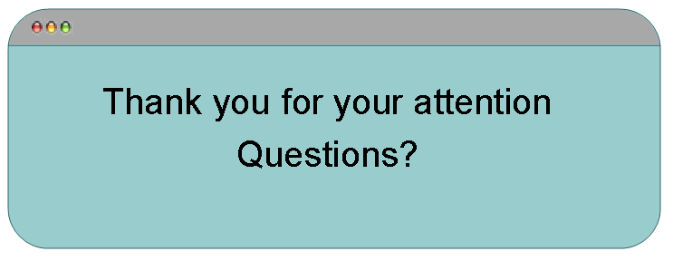
And finally…

Slide 28
Bibliography
Matthias Bender, Sebastian Michel, Peter Triantafillou, Gerhard Weikum, and Christian Zimmer. Improving collection selection with overlap awareness. In SIGIR ’05, 2005.
Matthias Bender, Sebastian Michel, Gerhard Weikum, and Christian Zimmer. The MINERVA project: Database selection in the context of P2P search. In BTW 2005.
Matthias Bender, Sebastian Michel, Christian Zimmer, and Gerhard Weikum. Towards collaborative search in digital libraries using peer-to-peer technology. In Agosti Maristella, Schek Hans-Joerg, and Tuerker Can, editors, Preproceedings of the 6th Thematic Workshop of the EU Network of Excellence (DELOS), pages 61–72, S.
Burton H. Bloom. Space/time trade-offs in hash coding with allowable errors. Commun. ACM, 13(7):422–426, 1970.
Ion Stoica, Robert Morris, David Karger, M. Frans Kaashoek, and Hari Balakrishnan. Chord: A Scalable Peer-to-peer Lookup Service for Internet Applications. in Proceedings of ACM SIGCOMM'01, San Diego, September 2001.

