Slide 1

PCP2P: Probabilistic Clustering for P2P networks
Odysseas Papapetrou* Wolf Siberski* Norbert Fuhr#
* L3S Research Center, University of Hannover, Germany
# Universität Duisburg-Essen, Germany
32nd European Conference on Information Retrieval
28th-31st March 2010, Milton Keynes, UK

Slide 2
Introduction
Why text clustering?
  Find related documents
  Browse documents by topic
  Extract summaries
  Build keyword clouds
  …
Why text clustering in P2P
  An efficient and effective method for IR in P2P
  New application area: Social networking - find peers with related interests
  When files are distributed → too expensive to collect at a central server

Slide 3
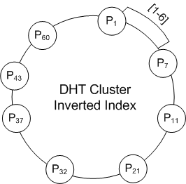
Preliminaries
Distributed Hash Tables (DHTs)
  Functionality of a hash table: put(key, value) and get(key)
  Peers are organized in a ring structure
  DHT Lookup: O(log n) messages
get(key) → hash(key)→47

Slide 4
Preliminaries
K-Means
  Create k random clusters
  Compare each document to all cluster vectors/centroids
  Assign the document to the cluster with the highest similarity, e.g., cosine similarity
  allClusters ← initializeRandomClusters(k)
  repeat
    for document d in my documents do
      for Cluster c in allClusters do
        sim ← cosineSimilarity(d, c)
      end for
      assign(d, cluster with max sim)
    end for
  until cluster centroids converge

Slide 5
PCP2P
An unoptimized distributed K-Means
  Assign maintenance of each cluster to one peer: Cluster holders
  Peer P wants to cluster its document d
    Send d to all cluster holders
    Cluster holders compute cosine(d,c)
    P assigns d to cluster with max. cosine, and notifies the cluster holder
Problem
  Each document sent to all cluster holders
  Network cost: O(|docs| × k)
  Cluster holders get overloaded

Slide 6
PCP2P
Approximation to reduce the network cost…
  Compare each document only with the most promising clusters
  Observation: A cluster and a document about the same topic will share some of the most frequent topic terms, e.g., Topic “Economy”: crisis, shares, finacial, market, …
  Use these most frequent terms as rendezvous terms between the documents and the clusters of each topic

Slide 7
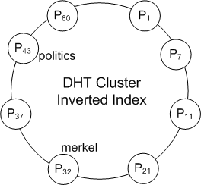
PCP2P
Approximation to reduce the network cost…
  Cluster inverted index : frequent cluster terms → summaries
  Cluster summary
    <Cluster holder IP address, frequent cluster terms, length>
    E.g. <132.11.23.32, (politics,157),(merkel,149), 3211>
Centroid for Cluster 1
Term | Frequency
politics | 157
merkel | 149
obama | 121
sarkozy | 110
world | 98
... | ...
Add to “politics” summary(cluster1)
Add to “merkel” summary(cluster1)

Slide 8
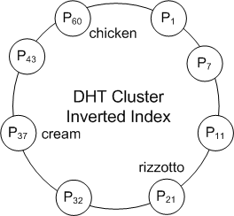
PCP2P
Approximation to reduce the network cost…
  Cluster inverted index : frequent cluster terms → summaries
Centroid for Cluster 2
Term | Frequency
chicken | 138
cream | 132
rizzotto | 130
pasta | 109
pizza | 101
... | ...
Add to “chicken” summary(cluster2)
Add to “cream” summary(cluster2)
Add to “rizzotto”
summary(cluster2)

Slide 9
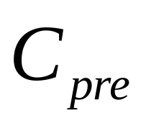
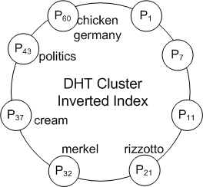
PCP2P
Approximation to reduce the network cost…
  Pre-filtering step: Efficiently locate the most promising centroids from the DHT and the rendezvous terms
    Lookup most frequent terms only → candidate clusters
    Send d to only these clusters for comparing
    Assign d to the most similar cluster
New document
Term | Frequency
politics | 14
germany | 13
merkel | 11
sarkozy | 7
france | 6
... | ...
Which clusters published “politics”
Which clusters published “germany”
cluster1: summary
cluster7: summary
cluster4: summary
Candidate Clusters
cluster1
cluster7
→ Cos: 0.3
→ Cos: 0.2
→ Cos: 0.4
cluster4

Slide 10
PCP2P
Approximation to reduce the network cost…
Probabilistic guarantees in the paper:
  The optimal cluster will be included in with high probability
    Desired correctness probability → # top indexed terms per cluster, # top lookup terms per document
    The cost is the minimal that satisfies the desired correctness probability

Slide 11
PCP2P
How to reduce comparisons even further…
  Do not compare with all clusters in
Full comparison step filtering
  Use the summaries collected from the DHT to estimate the cosine similarity for all clusters in
  Use estimations to filter out unpromising clusters → Send d only to the remaining
  Assign d to the cluster with the maximum cosine similarity

Slide 12
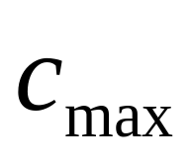
PCP2P
Full comparison step filtering…
  Estimate cosine similarity ECos(d,c), for all c in
  Send d to the cluster with maximum ECos,
  Remove all clusters with ECos< Cos(d, )
  Repeat until is empty
  Assign to the best cluster
New document
Term | Frequency
politics | 14
germany | 13
merkel | 11
sarkozy | 7
france | 6
... | ...
Candidate Clusters in
add
cluster1
cluster7
cluster4
Cos:0.38
cluster1: ECos:0.4
cluster7: ECos:0.2
cluster4: ECos:0.5
Cos:0.37

Slide 13
PCP2P
Full comparison step filtering…
  Two filtering strategies
    Conservative
      Compute an upper bound for ECos → always correct
    Zipf-based
      Estimate ECos assuming that the cluster terms follow Zipf distribution
      Introduces small number of errors
      Clusters filtered out more aggressively → further cost reduction
  Details and proofs in the paper…

Slide 14
Evaluation
Evaluation objectives
  Clustering quality
    Entropy and Purity
    Approximation quality (# of misclustered documents)
  Cost and scalability
    Number of messages, Transfer volume
    Number of comparisons
  Control parameters
    Number of peers, documents, clusters
    Desired probabilistic guarantees
    Document collection:
      Reuters (100 000 documents)
      Synthetic (up to1 Million) created using generative topic models
Baselines
  LSP2P: State-of-the-art in P2P clustering based on gossiping
  DKMeans: Unoptimized distributed K-Means

Slide 15
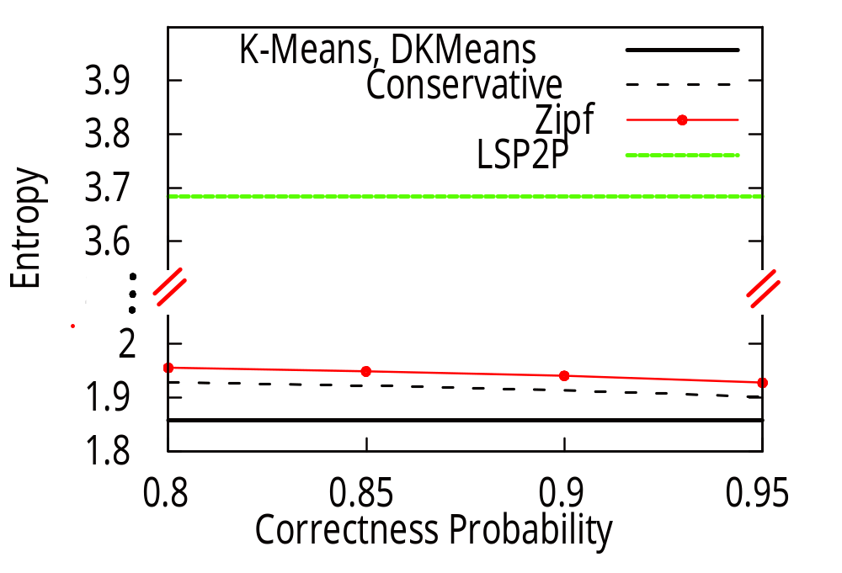
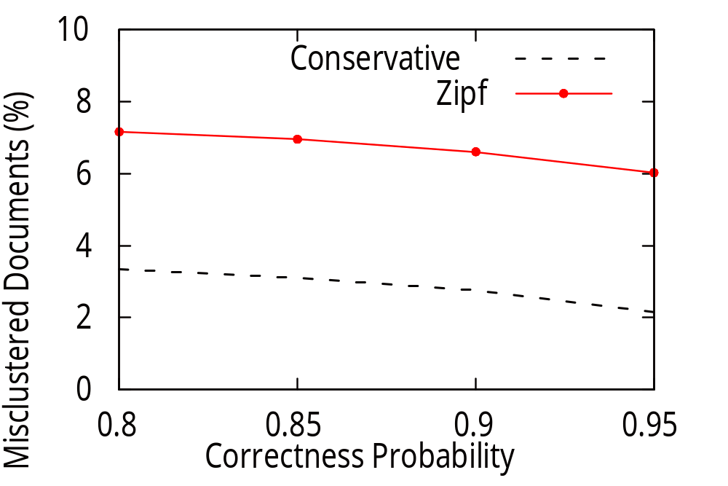
Evaluation – Clustering quality
Entropy
Lower is better
# misclustered documents
Lower is better
  Both conservative and Zipf-based strategy closely approximate K-Means
  Conservative always better than Zipf-based
  Correctness probability always satisfied
  High-dimensionality + large networks → LSP2P not suitable!

Slide 16
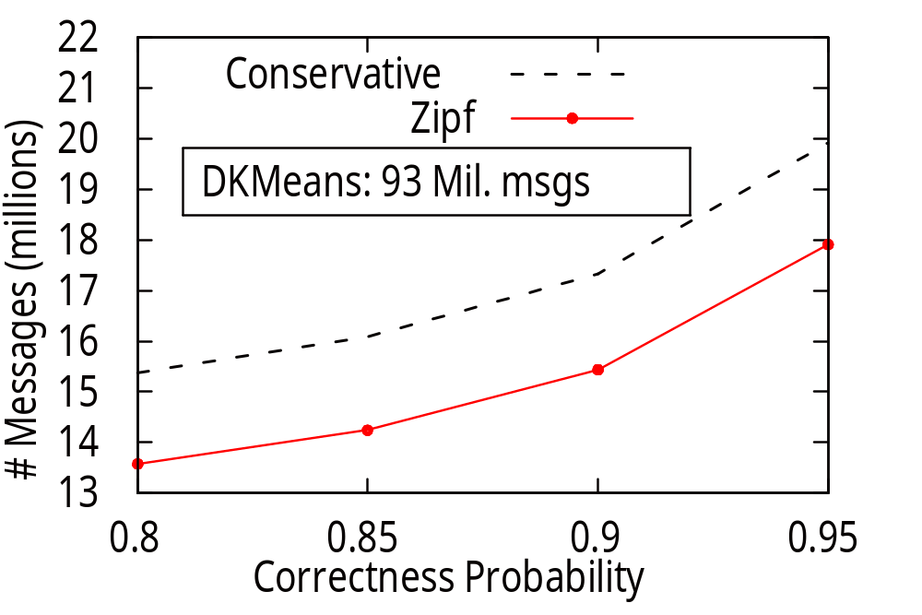
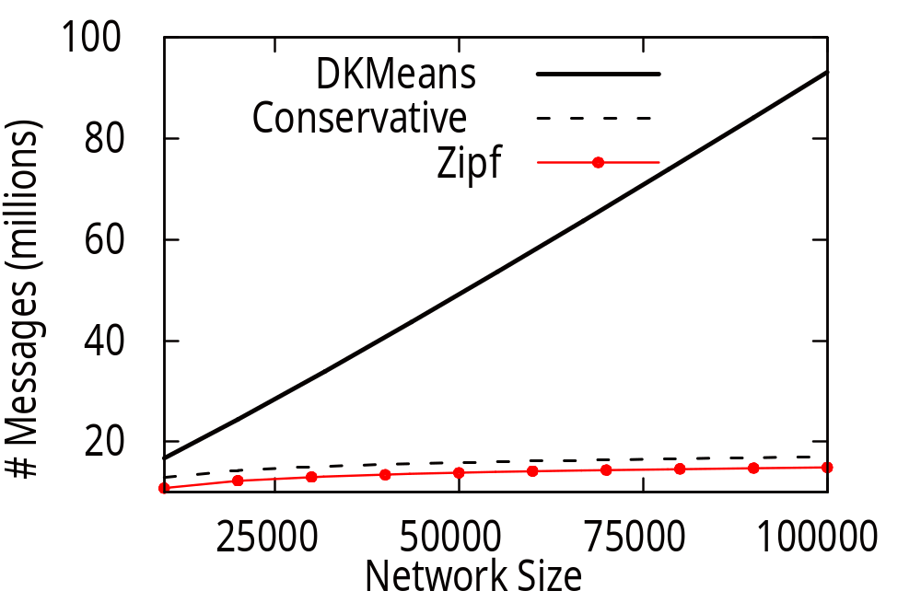
Evaluation – Network Cost
Correctness Probability Network size
  Both conservative and Zipf-based have substantially lower cost than DKMeans
  Zipf-based filters out the clusters more aggressively → more efficient than conservative
  Cost of PCP2P scales logarithmically with network size

Slide 17
Evaluation – Network cost/scalability
More results in the paper:
  Quality
    Independent of network and dataset size
    Independent of number of clusters
    Independent of collection characteristics (zipf exponent)
  Cost
    Similar results for transfer volume and # document-cluster comparisons
    Cost reduction even more substantial for higher number of clusters
    PCP2P cost reduces with the collection characteristic exponent (the Zipf exponent of the documents)
    Load balancing does not affect scalability

Slide 18
Conclusions
  Efficient and scalable text clustering for P2P networks with probabilistic guarantees
  Pre-filtering strategy: rendezvous points on frequent terms
  Two full-comparison filtering strategies
    Conservative filtering
    Zipf-based filtering
  Outperforms current state of the art in P2P clustering
  Approximates K-Means quality with a fraction of the cost
  Current work
    Apply the core ideas of PCP2P to different clustering algorithms, and to different application scenarios
    e.g., more efficient centralized text clustering based on an inverted index

Slide 19
Thank you…
  Questions?

Slide 20
Load Balancing
Load at Cluster Holders
  Maintaining the cluster centroids (computational)
  Compute cosine similarities (networking + computational)
To avoid overloading, delegate the comparison task:
  Helper cluster holders
  Include their contact details in the summary
  Each helper takes over some comparisons
  Cluster size→ #helpers

Slide 21
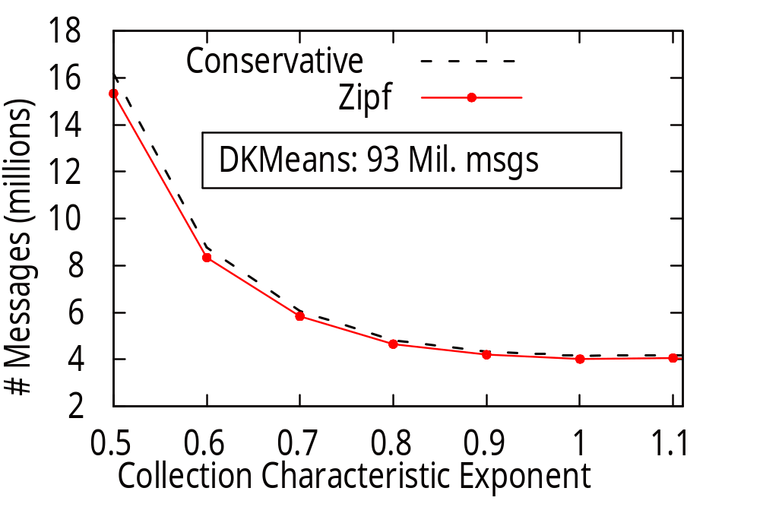
Additional experiments

Slide 22
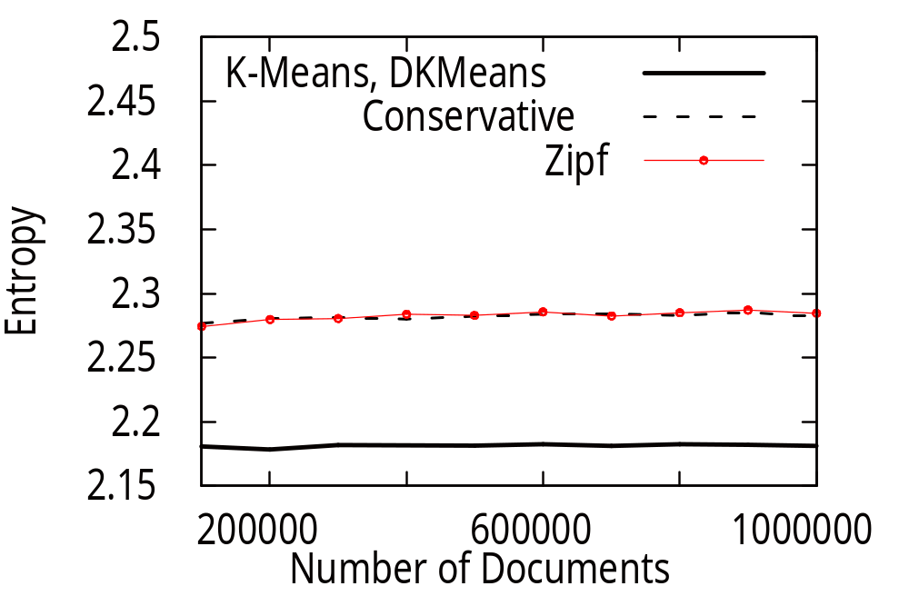
Additional experiments

Slide 23
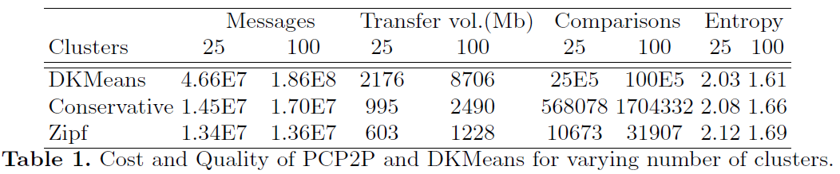
Additional experiments
Experimental configuration
  Reuters dataset
  10000 peers, 20% churn per iteration

