Slide 1


Welcome to
ETHEREUMPRO
2016

Slide 2







What is Ethereum?
A World Computer
Ethereum is a platform and a programming language that makes it possible for any developer to build and publish next-generation distributed applications.
Ethereum can be used to codify, decentralize, secure and trade just about anything: voting, domain names, financial exchanges, crowdfunding, etc.
Ethereum borrows the concept of decentralized consensus that makes cryptocurrencies so resilient, yet makes it trivial to build on its foundation.
Ethereum, like any advanced system, will mean different things to different people.
Ethereum is developed by a worldwide team of passionate developers for the Ethereum Foundation.
Ethereum’s mission is the promotion of developments of new technologies and applications, especially in the fields of new open and decentralized software architectures.
www.ethereumpro.org
admin@ethereumpro.org
>
02
>

Slide 3
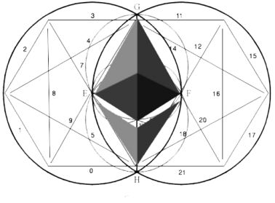
2013
Ethereum was initially described by Buterin in late 2013
2014
In march 2014 launch Ethereum platform
2014
In April 2014, Ethereum was formally described by Gavin Wood
Ethereum allows people to safely interact trustlessly by entering into neutrally enforceable agreements in a completely peer-to-peer fashion.
2015
Ethereum's live blockchain was launched on 30 July 2015
2016
2016 January launch ethereumpro.org
Ethereum can only enforce within its own digital limits.
Ethereum does not remove the need for an external authority for adjudication over disputes outside its realm.
Untraceable
Safe
Easy
Low inflation
www.ethereumpro.org
admin@ethereumpro.org
>
03
>

Slide 4







FOUNDERS
Foundation Team
Vitalik
Buterin
Yessin Schiegg
Ming Chan
Stefano Bertolo
Bernd Lapp
David Ben Kay
Jeffrey Wilcke
www.ethereumpro.org
admin@ethereumpro.org
>
04
>

Slide 5
www.ethereumpro.org
2016
AFFILIATE PROGRAM

Slide 6

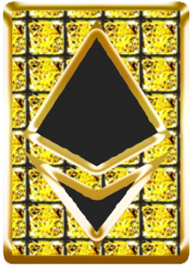
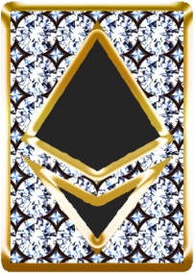
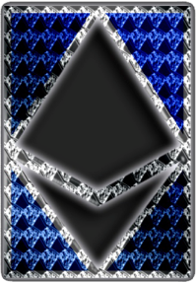
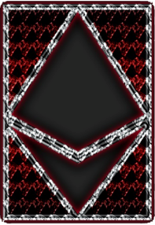

Membership price
Silver
Gold
Diamond
Ethereum
Ethereum
PRO
50
199
499
999
1999
www.ethereumpro.org
admin@ethereumpro.org
>
06
>

Slide 7

Binary
Percentage from lower leg
Binary bonus
Earn up to
100.000 $ weekly
Unlimited depth
8
1
Silver
10
2
Gold
%
12
3
Diamond
15
4
Ethereum
20
5
EthererumPRO
www.ethereumpro.org
admin@ethereumpro.org
>
07
>

Slide 8





Binary
Percentage from lower leg
1
3700 PV
5500 PV
1 EthereumPRO pack
Receive 20 % lower leg = 740 $ (3700pv *20%)
2 Diamond pack receive 12 % lower leg = 48 $ (400 pv *12%)
2
600 PV
400PV
2000 PV
Example
The following illustrations are only for educational purposes and is not intended to serve as a guarantee of income. Success in this business requires hard work, dedication and good sales skills.
www.ethereumpro.org
admin@ethereumpro.org
>
08
>

Slide 9
Silver
Your status
Referral status
Direct bonus (%)
PV
Silver Silver
8
8
8
8
8
10
10
10
10
10
12
12
12
12
12
15
15
15
15
15
20
20
20
20
20
50
199
499
999
1999
50
199
499
999
1999
50
210
525
1050
2100
50
215
550
1100
2200
55
220
600
1200
2500
Silver Gold
Silver Diamond
Silver Ethereum
Gold
Silver EthereumPRO
Gold Silver
Gold Gold
Gold Diamond
Gold Ethereum
Gold EthereumPRO
Diamond
Diamond Silver
Diamond Gold
Diamond Diamond
Diamond Ethereum
Diamond EthereumPRO
Ethereum Silver
Ethereum Gold
Ethereum
Ethereum Diamond
Ethereum Ethereum
Ethereum EthereumPRO
EthereumPRO Silver
EthereumPRO Gold
EthereumPRO Diamond
EthererumPRO
EthereumPRO Ethereum
EthereumPRO EthereumPRO
www.ethereumpro.org
admin@ethereumpro.org
>
09
>

Slide 10
www.ethereumpro.org
2016
MINING POOL

Slide 11
Benefits of mining pool
There are two types of mining with EthereumPRO, you can mine yourself using your pc or you can easily mine
with our mining pool.
Mining pool - it is a complex of computing power that EthereumPRO provides for his members to make mining more simple and more profitable.
Each membership includes mining points that can be sent to mining pool for 30 days, also premium members can purchase additional points.
A pool has a much larger chance of solving a block and winning the reward, that reward will be split between all the pool members.
In ethereum's case, the current difficulty level is so high that it’s practically impossible for soloists to make a profit mining. Unless, of course, you happen to have a garage full of ASICs sitting in Arctic conditions. If you’re a beginner, joining a mining pool is a great way to reap a huge reward over a short period of time. Indeed, pools are a way to encourage small-scale miners to stay involved.
Split - Each membership splits from up to two times, depending on your membership. Split enables to double your mining points. You can always check the split progress bar in your backoffice. Once the progress bar is filled all points will be doubled.
www.ethereumpro.org
admin@ethereumpro.org
>
11
>

Slide 12

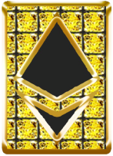
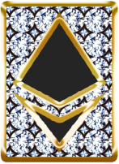


REWARDS IN MINING POOL
SILVER
GOLD
DIAMOND
ETHEREUM
ETHEREUMPRO
5 mining points
1 split
20 mining points
1 split
50 mining points
1 split
110 mining points
2 splits
250 mining points
2 splits
After split 10 points
After30 days of work
15 Ethereums
15*13=195$
Expenses 50$
Profit 195$
After split 40 points
After30 days of work
60 Ethereums
60*13=780$
Expenses 199$
Profit 780$
After split 100 points
After30 days of work
150 Ethereums
150*13=1950$
Expenses 50$
Profit 1950$
After 2 splits 440 points
After30 days of work
660 Ethereums
660*13=8580$
Expenses 999$
Profit 8580$
After splits 1000 points
After30 days of work
1500 Ethereums
1500*13=19500$
Expenses 1999$
Profit 19500$
* Current Ethereum rate 13$
The following illustrations are only for educational purposes and is not intended to serve as a guarantee of income. All calculations are made depending to the current rate. All rates are taken from exchange and regulated by members.
* Splits only points on «ETH mining points» account
* If your package is Silver and you’ve passed one split, after upgrade to Ethereum or EthereumPRO you will have only one more split.
www.ethereumpro.org
admin@ethereumpro.org
>
12
>

Slide 13
Thank you so much
www.ethereumpro.org

