Slide 1
ElektroShag Presents

Slide 2
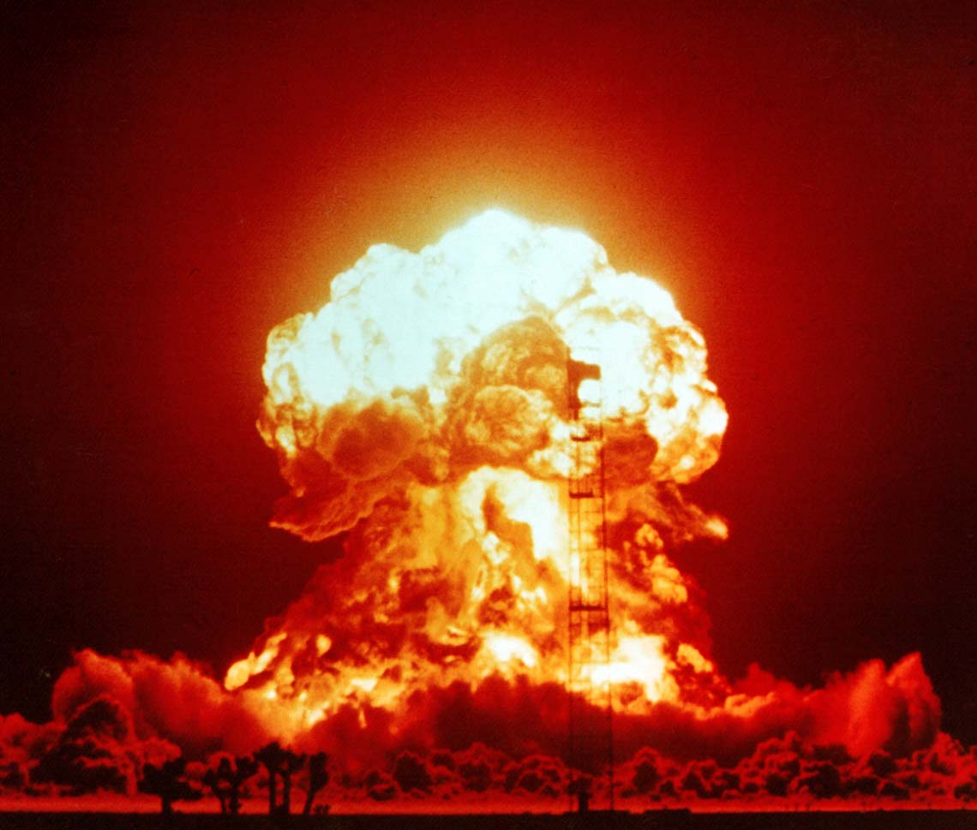
Detecting irregularities in the power grid

Slide 3
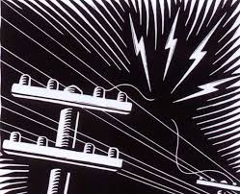
Tasks
- Analyze Data
- Predict the Event from the gathered data
- Localize the Event

Slide 4
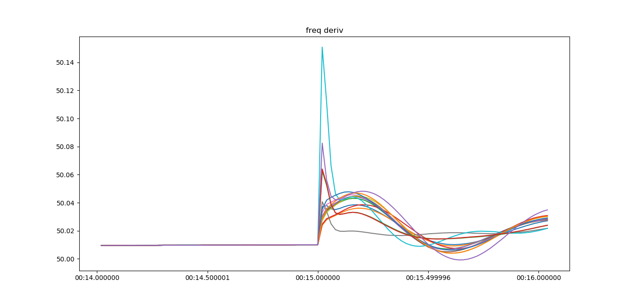
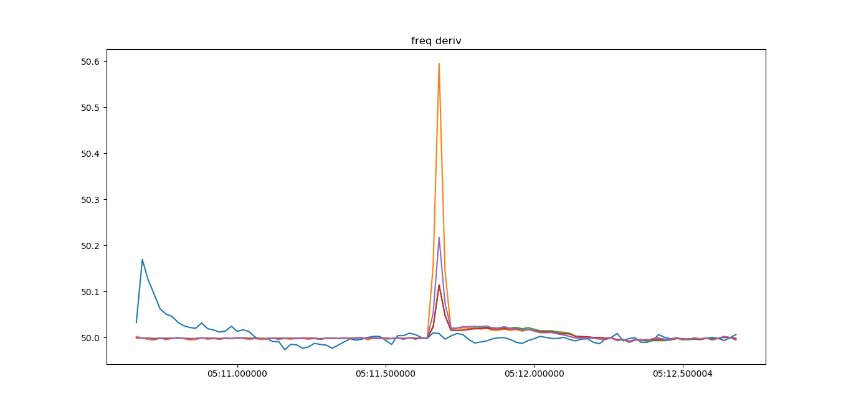
When irregularity occures frequency of the grid oscilates

Slide 5
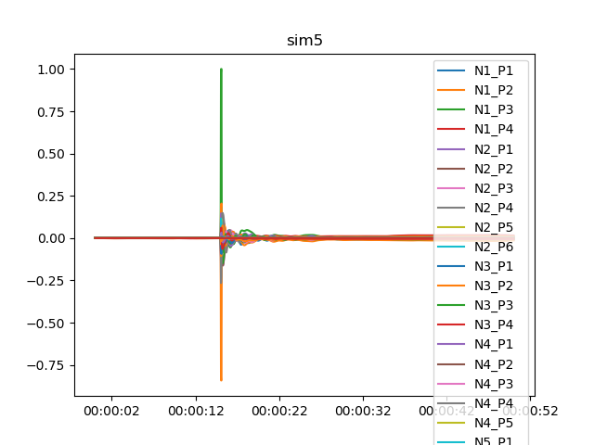
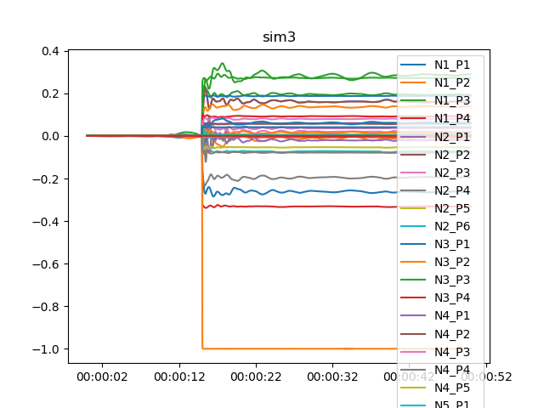
Max
A
B
$D=\frac{B−A}{Max}$

Slide 6
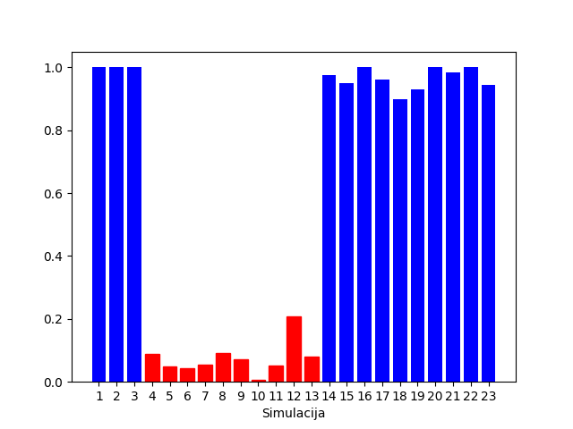
D

Slide 7
