Slide 1

jDMN: A DMN engine in Java
September 2020

Slide 2
Content
What is DMN?
Short history of DMN / jDMN
Overall structure
Translation to Java / Kotlin
Code optimisation
Q&As

Slide 3
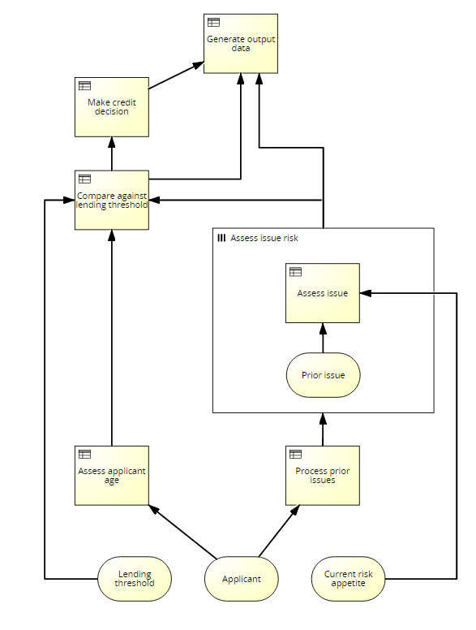
What is DMN?
Decision Model and Notation (DMN)
Standard published by OMG
Notation to support decision management and business rules
Users
Business People: manage and monitor decisions
BAs or Functional Analysists: specify decision models
Technical developers: execution and automation
DSL
Diagrammatic notation
Templates
Expression language FEEL
Standalone or with BPMN & CMMN

Slide 4
Short history of DMN/jDMN
Sep-2015 – DMN 1.0
Jun-2016 – DMN 1.1
Jun-2016 – Project COB
Aug-2016 – jDMN SPR
Feb-2017 – Joined OMG DMN RTF
Feb-2017 – Joined DMN TCK
Feb-2018 – jDMN open-sourced in github (partially)
Sep-2018 – DecisionCamp, Luxembourg
Jan-2019 – DMN 1.2
Feb-2020 – jDMN open-sourced all modules
Mar-2020 – DMN 1.3
July-2020 – DecisionCamp, online

Slide 5
Overall Structure
DMN Processors
Reader / Writer
Validators
Transformers
Interpreter
Translator
Dialects
DMN 1.1 &1.2
Signavio

Slide 6
Overall Structure
Syntax Analyzer
Source
Text
Lexical Analyzer
Source
Tokens
Parser
AST
Semantic Analyzer
Error Manager
& Logger
Semantic
Tree
Code
Generator
Interpreter

Slide 7
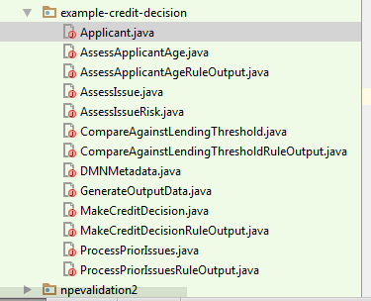
Translation

Slide 8
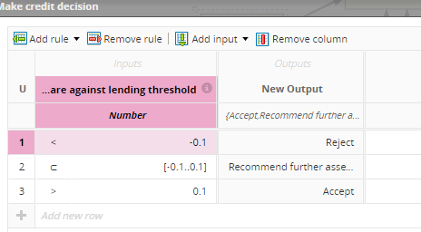
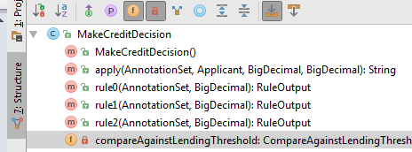
Translation

Slide 9
Translation
How did we built it?
Syntax-Driven Translation Schematas (SDTS)
Based on Knuth’s attributed gramars
Synthesized attributes
Inherited Attributes
Expr₁ → Expr₂ + Term { Expr₁.value = Expr₂.value + Term.value }
Expr → Term { Expr.value = Term.value }
Term₁ → Term₂ * Factor { Term₁.value = Term₂.value * Factor.value }
Term → Factor { Term.value = Factor.value }
Factor → "(" Expr ") { Factor.value = Expr.value }
Factor → integer { Factor.value = strToInt(integer.str) }

Slide 10
Translation
Advantages include
Performance: we have seen runtimes 4-10 times faster than previous engine execution in complex decision tests
Stability: given that we now control the code-generation, we are able to resolve issues in without relying on the vendor
Functionality: the fact that we control the code-generation means that we are also able to enable more advanced functionality for DMN/Java models

Slide 11
Code Optimisation
Local optimisation
Types
Built-in functions
Global optimisation
Lazy evaluation
Code layout – template providers
Caching

Slide 12
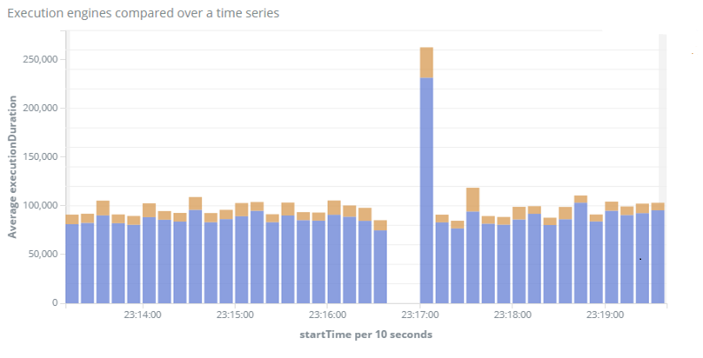
Performance
jDMN
Previous

Slide 13
Recent features
DM composition
Cross-translation for Kotlin
Optimise execution (e.g. map-reduce for MID)
gRPC / protobuf
Tree / Postorder listeners

Slide 14
What next?
DMN 1.3
Enhance lazy evaluation
DMN editor
Semantic validation for DT (e.g. unique hit policy)
DM diffs

Slide 15

Questions?
https://github.com/goldmansachs/jdmn

