Slide 1
Status of work
Ondrej Pavlas

Slide 2
Debugging problem with Timepix2
Setup:
Katherine
For
Timepix2
Conversion
board
Chipboard
with
Timepix2
Reading basic registers : OK
Reading 4-bits counters (D,C) : OK
Problem:
Reading 10 – bits counter (A, B): Problem with one column of pixels -> unable to connect to Katherine

Slide 3
Debuging problem with Timepix2
Setup:
UWB
Chipboard
with
Timepix2
Katherine
For
Timepix2
Conversion
board
Hardpix
Chipboard
with
Timepix2

Slide 4
PCB
Deska s Timepix2
Timepix 2
Napájení
HV zdroj
Měření teploty
USB
Uživatel
(PC)
Základní
deska
Mikrokontrolér
Napájení
Konverze log. úrovní
USB

Slide 5
+5V
USB-C
+3V3
+2V5
+1V2
EN_2V5
EN_1V2

Slide 6
Uživatelský příkaz
Teplota na desce s Timepix 2
Nastavení rozlišení senzoru na 12 bitů
Převod teploty na desetiné číslo
Výběr registru senzoru, kde je uložená informace o teplotě
Vyčtení teploty

Slide 7
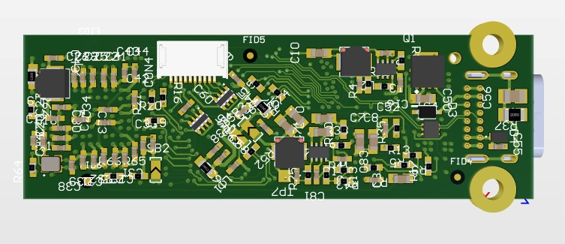
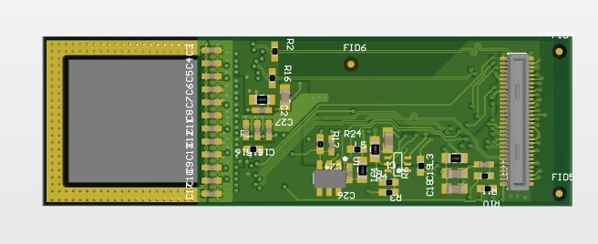
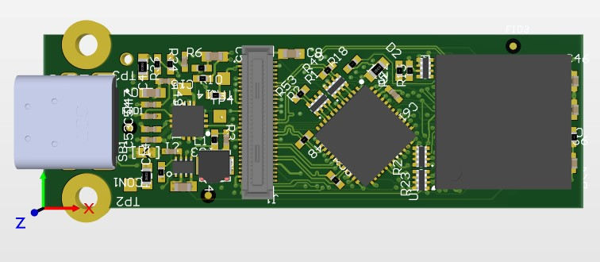
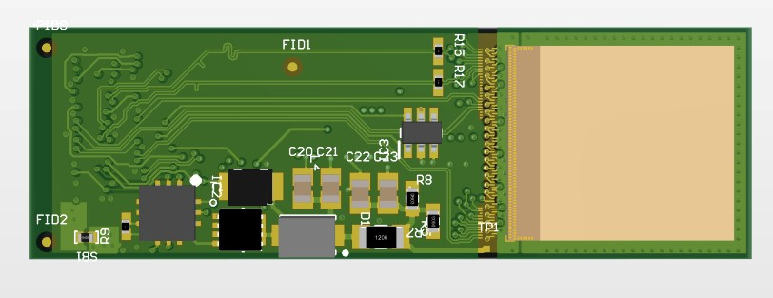
Working on diploma thesis
Mini readout for Timepix2
PCBs:
Mainboard
Chipboard
BOT
BOT
TOP
TOP

Slide 8
Working on diploma thesis
Mini readout for Timepix2
Properties of device:
Interface: USB - type C
Comm. speed : USB High Speed: 480 Mbps
Timepix2 readout speed : up to 50 MHz
HV source: 30 – 150 V
Power consumption low as possible: first test -> 350 mW
MCU : STM32U5A9 : Arm Cortex-M33
RAM: 2.44MB, Flash: 4MB, 160 Mhz
Dimension of device : 70 x 20 x 15 mm

Slide 9
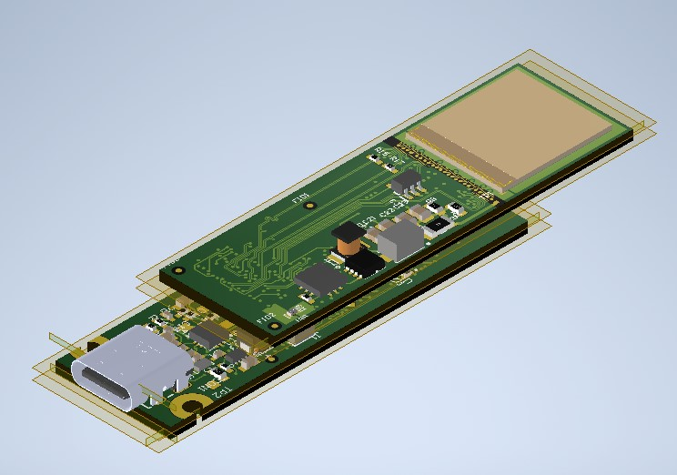
Working on diploma thesis
Mini readout for Timepix2
Progress:
Digital test of Timepix2: OK
USB : Virtual COM port: OK
HV: OK
TODO:
Connect to TrackLab
Housing
Thanks to:
Milan Malich, Pavel Skoták,
Michael Holík, Martin Oblrich,
Petr Burian, Petr Smolyanskiy

Slide 10
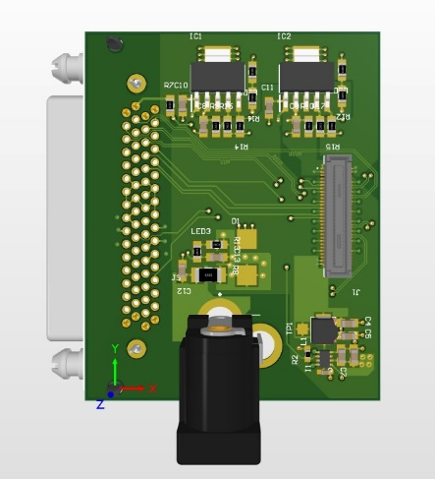
Working on diploma thesis
Mini readout for Timepix2
Testing of chipboard:
After first test looks OK
Katherine
For
Timepix2
Conversion
board
Chipboard
with
Timepix2

Slide 11
Thanks for your attention

