Slide 1
LADS Information Model Bruker MPA III - FT-NIR Multi Purpose Analyzer
Dr. Matthias Arnold November 2024

Slide 2
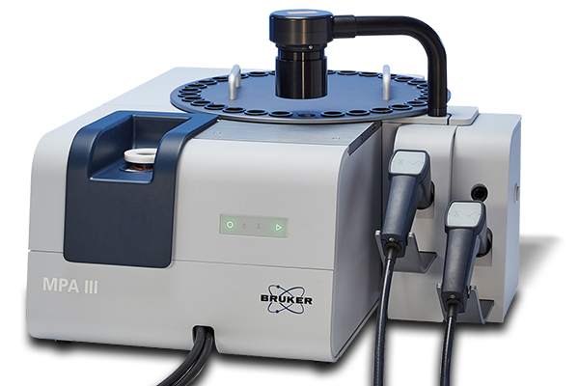
Bruker MPA III - FT-NIR Multi Purpose Analyzer
FT-NIR-Device
FT-NIR-Unit
Program Manager
Carousel Controller

Slide 3
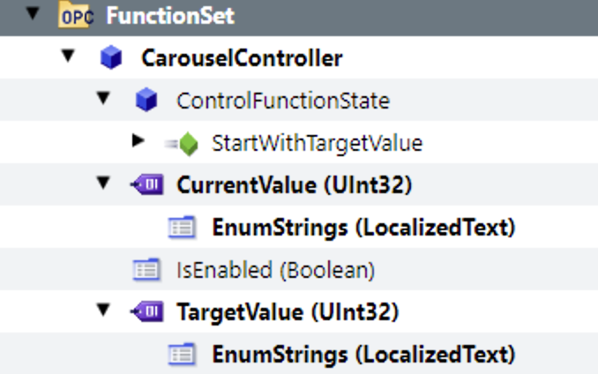
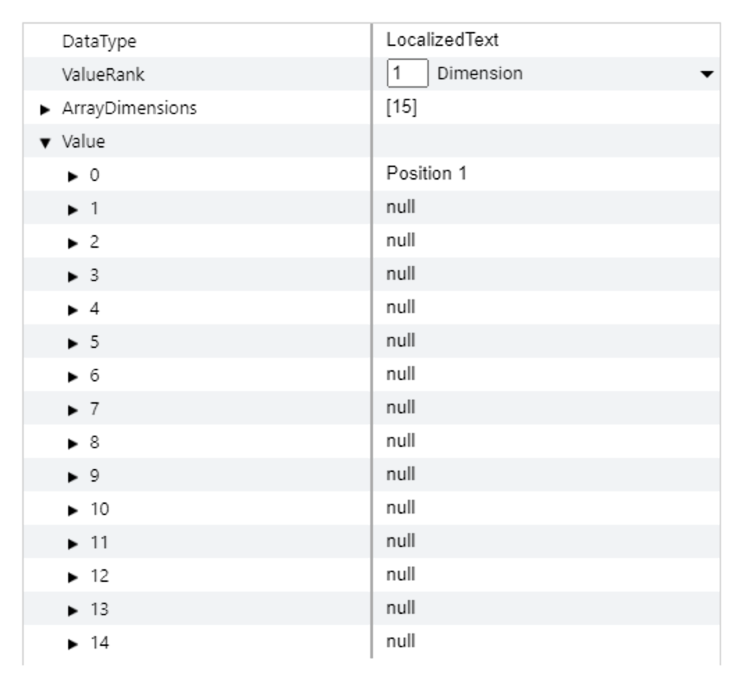
Bruker MPA III – Carousel Controller
Carousel Controller MultiStateDiscreteControlFunctionType

Slide 4
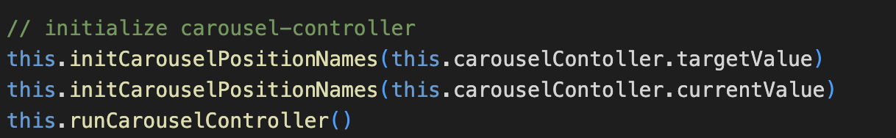
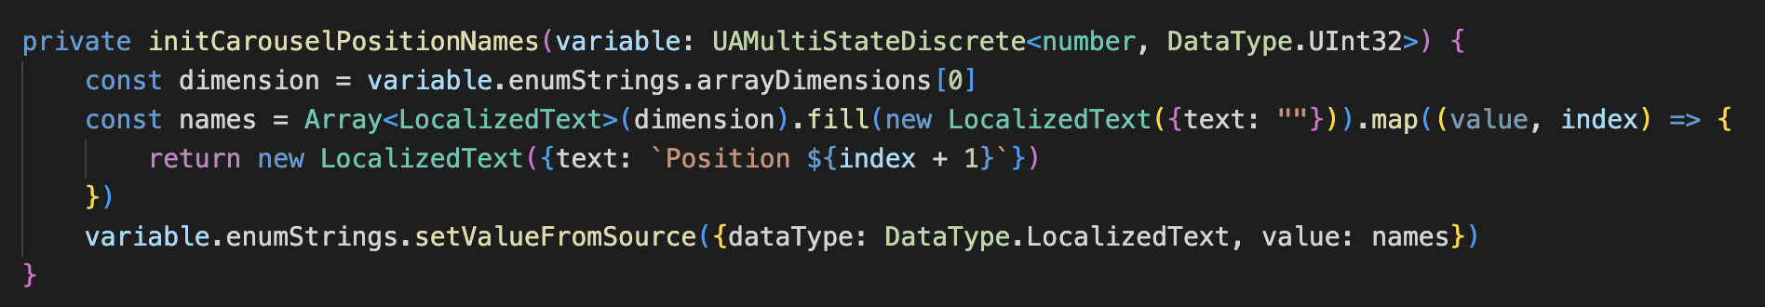
Carousel Controller - Initialization

Slide 5
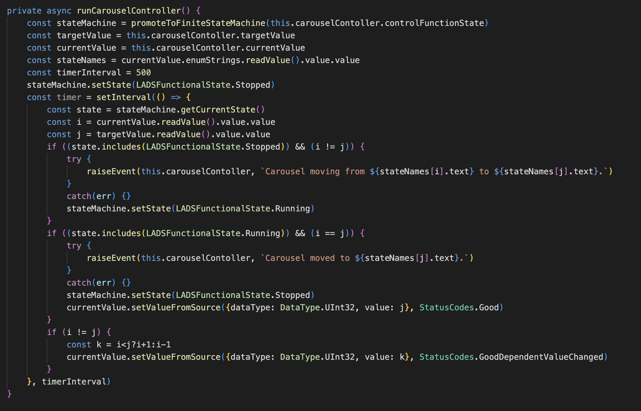
Carousel Controller - Execution

Slide 6
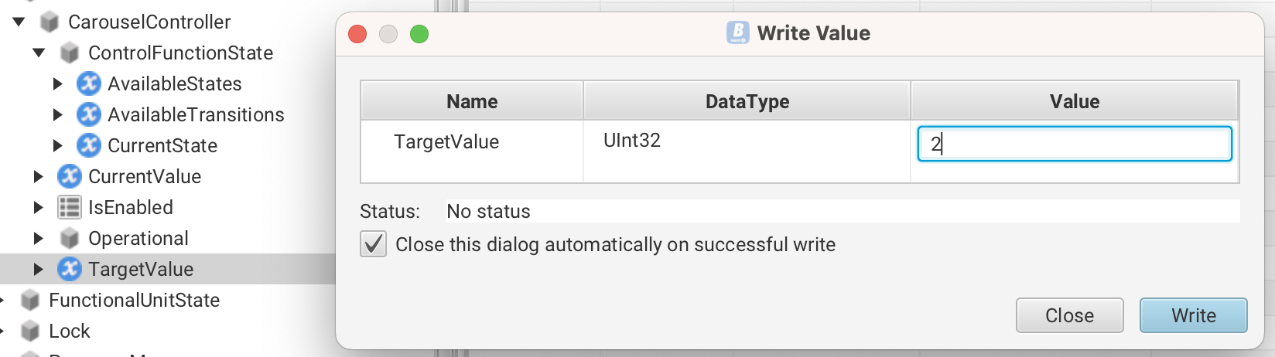
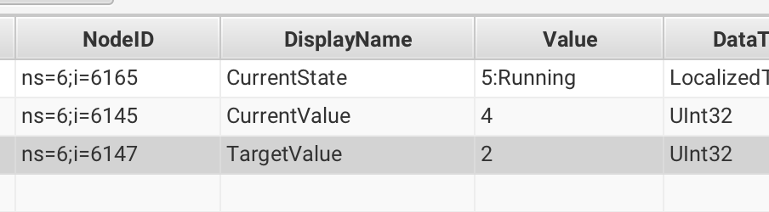
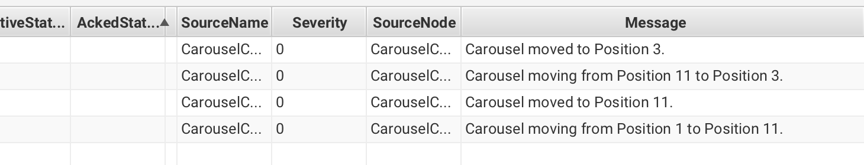
Carousel Controller - Execution

Slide 7
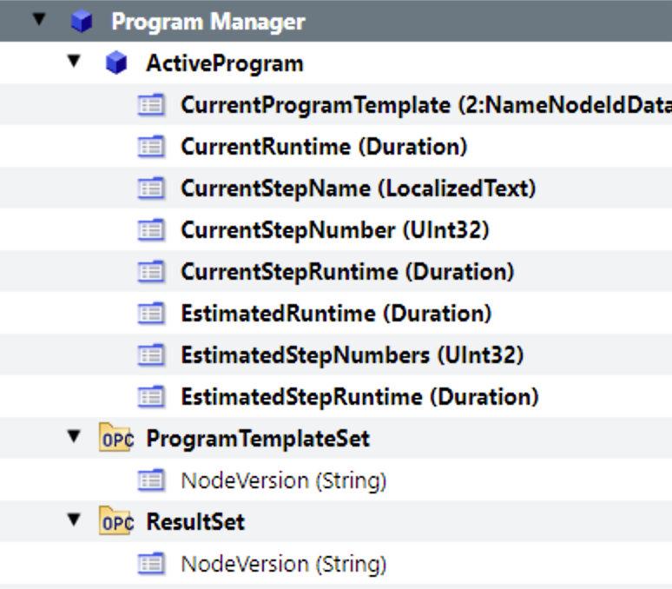
Program Manager
FT-NIR-Unit
Program Manager

Slide 8
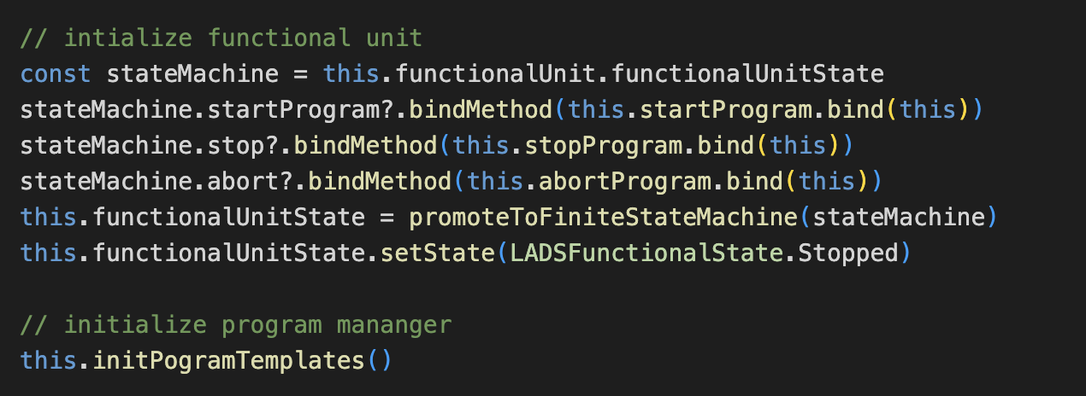
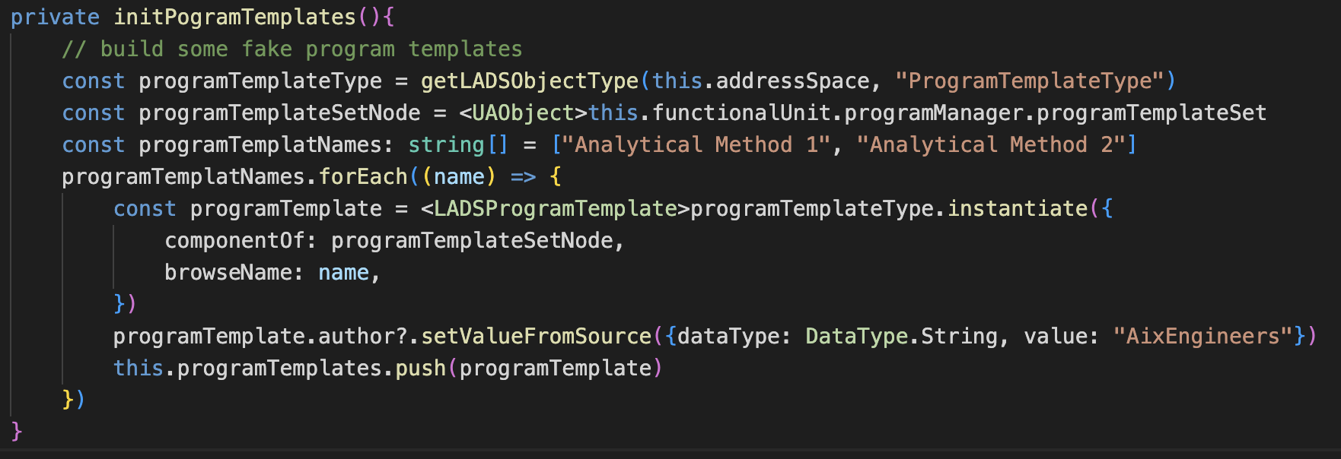
Program Manager - Initialization

Slide 9
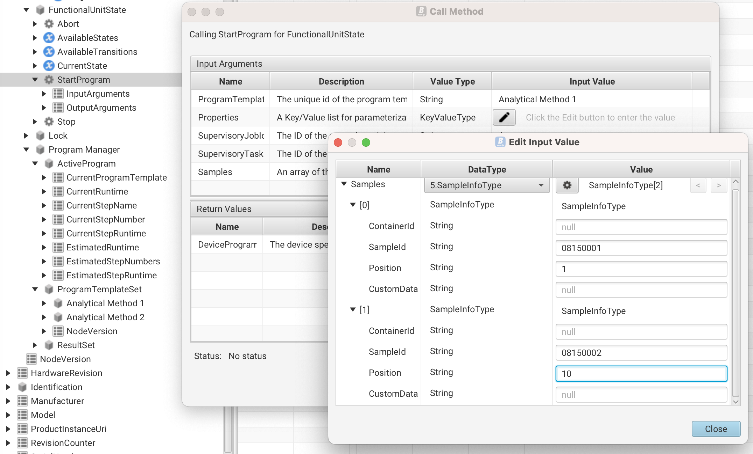
Program Manager – Starting Execution

Slide 10
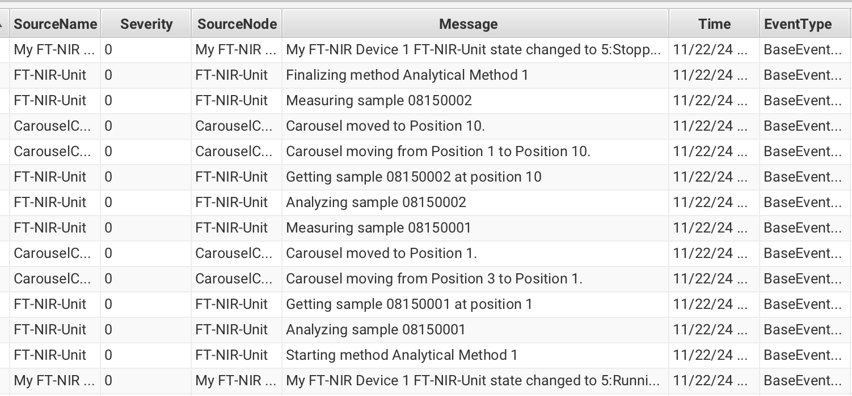
Program Manager - Executing

Slide 11
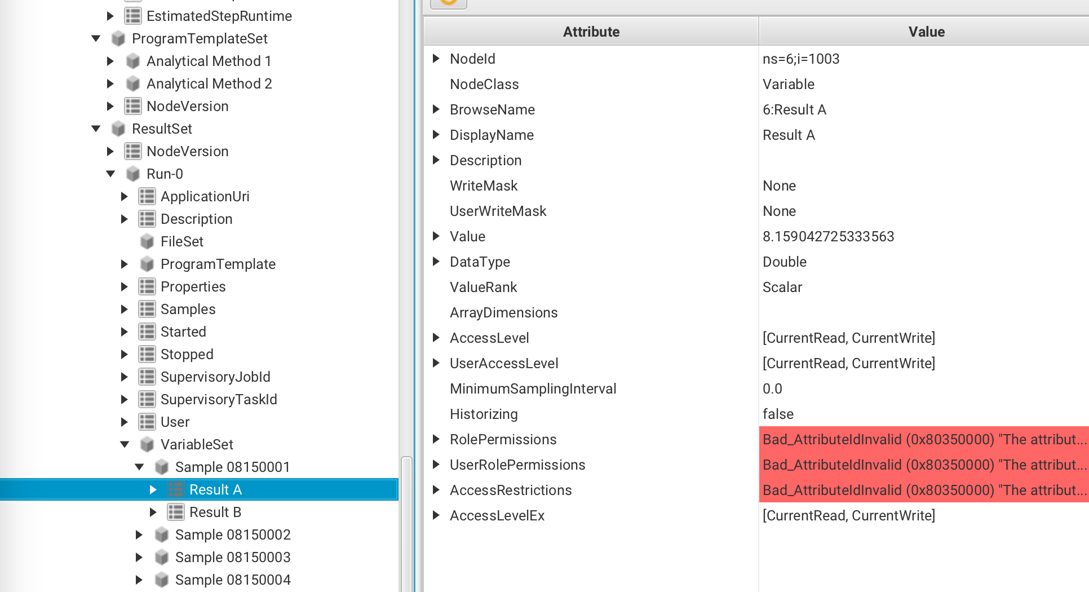
Program Manager - Results

Slide 12



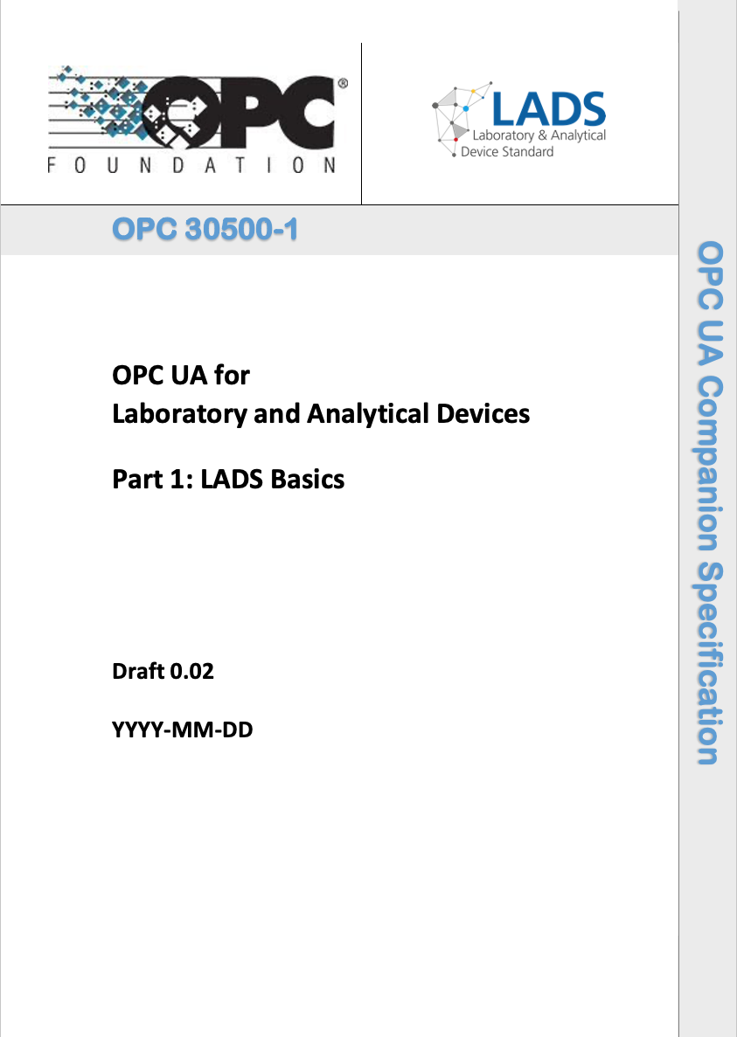
Thank You!
https://opcfoundation.org/markets-collaboration/lads/
https://www.spectaris.de/en/association/thespectarisindustries/networked-laboratory-equipment/
https://www.linkedin.com/company/LADS-OPC-UA/
https://www.linkedin.com/Dr-Matthias-Arnold/
https://opcfoundation-events.com/2023/05/12/opc-day-international-2023/#arnold Allotrope Connect Keynote: https://www.youtube.com/watch?v=l7jXcO0QH7Y
M.Arnold@AixEngineers.de
Notes:
Thank you very much for your interest in LADS OPC UA ,
The Laboratory and Analytical Device Standard
I’m happy to receive your feedback, discuss your comments and answer your questions.

