Slide 1
Test text
Test OPEA data prep micro service

Slide 2
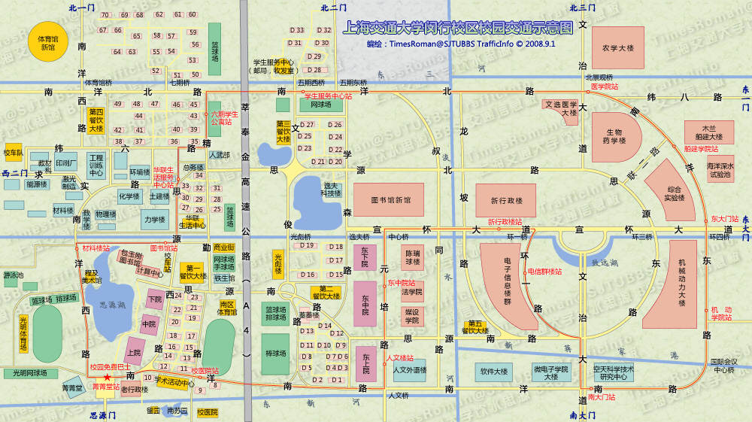
Test Image

