Slide 1
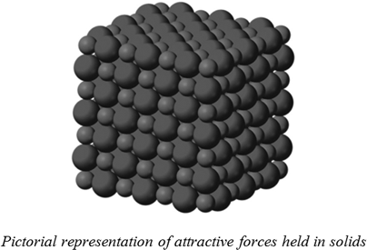
Solids

Slide 2
Solids
Solids consist of atoms, molecules or ions packed very closely together. The forces that hold them in place give rise to distinctive properties of the various kinds of solid.
True solid must have
A definite and sharp melting point.
A definite heat of fusion.
the heat energy required to melt a crystalline solid should have a fixed value.
A regular arrangement of particles i.e. ions, atoms or molecules.

Slide 3
Solids
Only crystalline state satisfies the criteria for a true solid.
Substances which are rigid but do not satisfy those criteria are called amorphous solids.
Note: The energy required to bring about a change of state from a unit mass of the solid to the liquid is called the heat of fusion . The temperature at which it happens is called melting point.

Slide 4
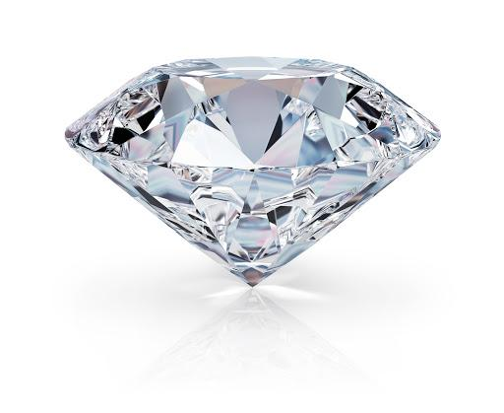

Solids
Consider diamond and cotton candy. Are these substances alike? What differentiates them? What do they have in common?
Types of Solids
Crystalline
Amorphous

Slide 5
Crystalline Solids
A crystalline solid is a solid in which the atoms, ions, or molecules lie in a rigid and orderly array.
crystals have a regular internal structure.
Crystalline solids typically have flat, well defined planar
surfaces called crystal faces, which lie at definite angles to one another. These faces are formed by orderly layers of atoms.
Crystalline Solids
posses rigid and long-range order and atoms, molecules or ions occupy specific (predictable) positions.

Slide 6
Crystalline Solids
The list of crystalline solids is very large; most metals are crystalline.
Binary Crystals
Crystals that are composed of two elements are called binary crystals. There are thousands of binary crystals; some examples are sodium chloride (NaCl), alumina (Al₂O₃) and ice (H₂O).
Polycrystalline solid
A polycrystalline solid is made up of an aggregate of a large number of tiny single crystals called grains oriented in different directions and separated by well-defined boundaries called grain boundaries.

Slide 7
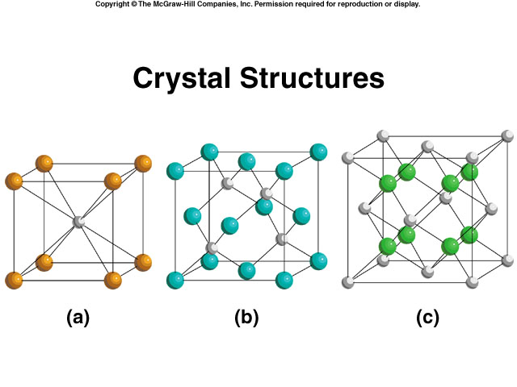
Types of Solid Crystals
The 4 major types of crystal solids are
Ionic Crystals
Covalent Crystals
Metallic Crystal
Molecular Solid
Ionic Crystals
Lattice points occupied by cations and anions
Held together by electrostatic attraction
Hard, brittle, high melting point
Poor conductor of heat and electricity
On dissolving, ionic crystals dissociate into ions and move freely in the solution.
Example: NaCl which is formed by the transfer of electrons between Na and Cl in which Na forms a cation (Na⁺) and Cl forms an anion(Cl⁻)
CsCl
ZnS
CaF₂

Slide 8
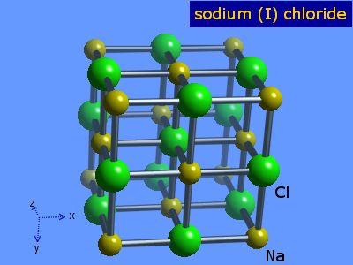
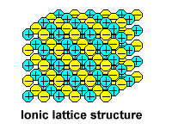
Ionic Solids
An ionic solid is a solid that consists of cations and anions held together by electrostatic attraction of opposite charges (ionic bond).
Brittle, high melting point, good conductors in the aqueous solution or fused state, high heats of fusion.
Salts like NaCl, KNO₃, LiF, BaSO₄ etc.

Slide 9
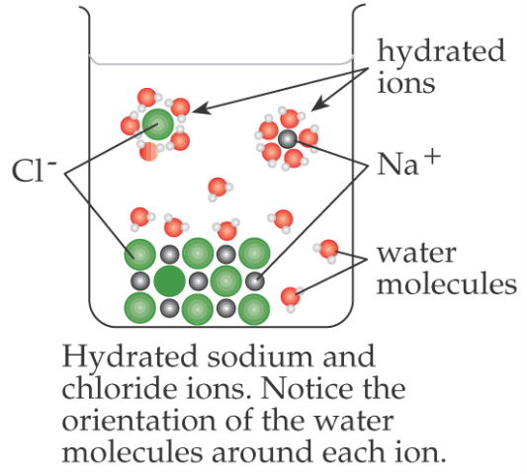
Ionic Solids
Properties:
Do not conduct electricity (no free ions or electrons) except when molten or aqueous (as ions are free to move)
High melting point and boiling point because of very strong electrostatic attractions between cations and anions
Soluble in polar solvents

Slide 10
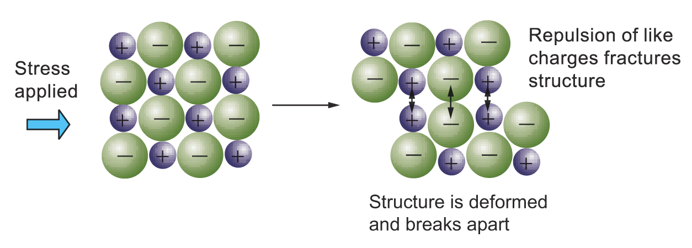
Ionic Solids
Properties:
High melting and boiling points
Hard but brittle
The giant ionic structure fractures when a stress is applied

Slide 11
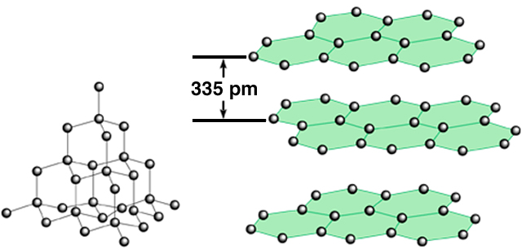
Types of Crystal Solid (Covalent)
Covalent Crystals
Lattice points occupied by atoms
Held together by covalent bonds
Hard, high melting point
Poor conductor of heat and electricity
High heat of fusion
carbon
atoms
sp2
sp3
diamond
allotrope
graphite

Slide 12
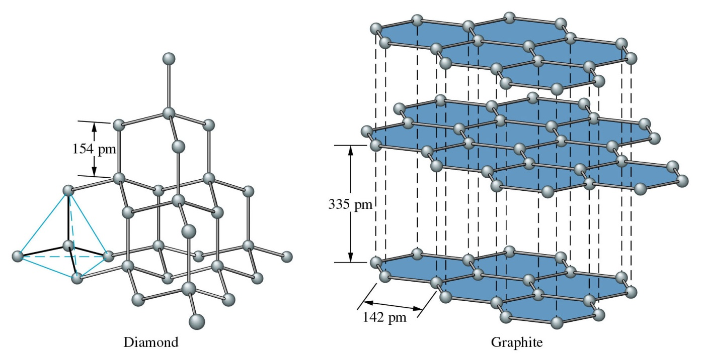
Covalent Solids
A covalent network solid is a solid that consists of atoms held together in large networks or chains by covalent bonds.
Three major types of covalent solids are Linear chains, 2-D layers, and
3-D covalent network
Examples include carbon, in its forms as diamond or graphite; asbestos, and silicon carbide.

Slide 13
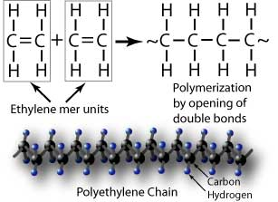
Covalent Solids
Linear chains are infinitely long linear chains held together by van der Waals
Properties:
Low MP, but longer chains have higher MP than shorter ones
Do not conduct electricity
Soft and flexible
Eg. Polythene, rubber,
plastics

Slide 14
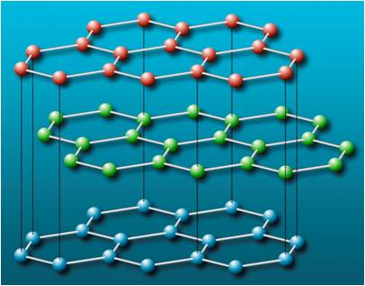
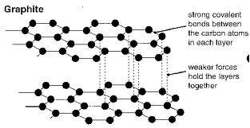
Covalent Solids
2-D Layers held together by weak van der Waals forces.
Graphite is made of layers of covalently bonded C atoms. The layers are held together by weak van der Waals forces and have delocalised electrons between them.
*this is very unusual and graphite is the only non-metal to conduct electricity

Slide 15
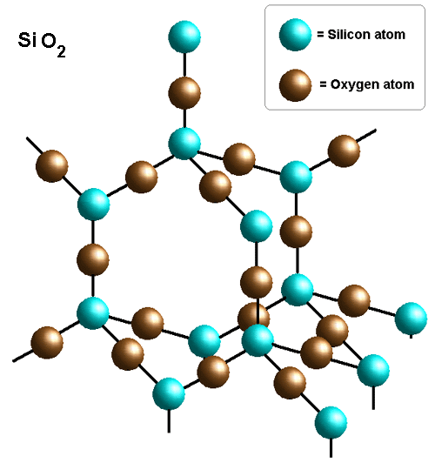
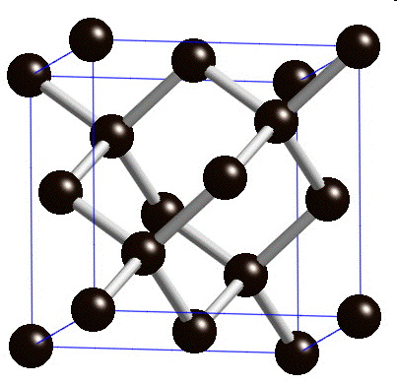
Covalent Solids
3-D covalent network solids are made of atoms held together by strong covalent bonds. Diamond and silica (silicon dioxide) are two examples of covalent network solids. Diamond is the strongest substance known to man.
Covalent network solids have
High MP (strong covalent bonds hold atoms in place)
Do not conduct electricity (all electrons held in covalent bonds)
Very hard/strong
Insoluble in any solvent
Diamond

Slide 16
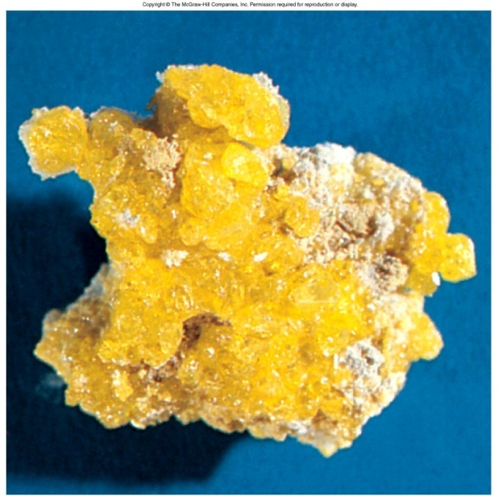
Types of Crystal Solid (Molecular)
Molecular Crystals
Lattice points occupied by molecules
Held together by intermolecular forces
Soft, low melting point
Poor conductor of heat and electricity

Slide 17
Molecular solids
A molecular solid is a solid that consists of atoms or molecules held together by weak intermolecular forces.
Many solids are of this type.
Soft, low melting point, volatile, electrical insulators, poor thermal fusion.
Examples:
Solid neon (melting point of -248ºC), Solid CO₂ (dry ice), Solid H₂O (ice)
Iodine, Sugar
In non-polar molecules, the inter- molecular forces are only weak van der Waals forces.
Polar molecules have dipoles and so have slightly stronger attractions between them meaning that the melting point of a polar molecular solid is a little higher because more energy is needed to overcome the slightly stronger forces.

Slide 18
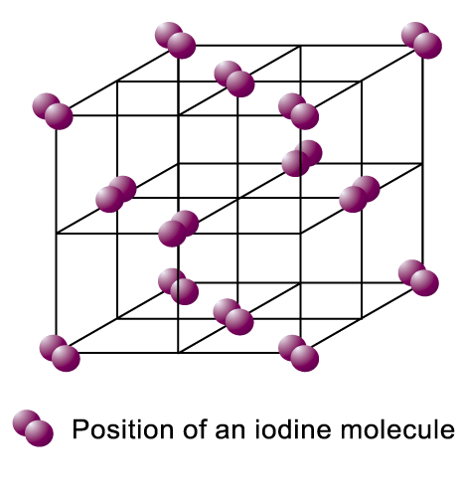
Molecular solids
Examples
forces of attraction between particles weaken
liquid iodine
(by increasing the temp.)
solid iodine (at room temp.)
forces of attraction between particles broken
Gaseous iodine
(by further raising the temp.)

Slide 19
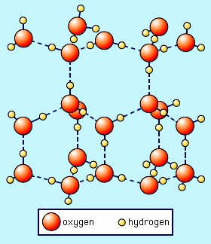
Molecular solids
Ice ( solid form of water) :
Each oxygen atom inside the ice hexagonal lattice is surrounded by four other oxygen atoms in a tetrahedral arrangement.
The distance between oxygens is approximately 2.75 Angstroms. The hydrogen atoms in ice are arranged following the following manner:
1) two protons are close (about 0.98A) to each oxygen atom, much like in a free water molecule;
2) each H₂0 molecule is oriented so that the two protons point toward two adjacent oxygen atoms;
3) there is only one proton between two adjacent oxygen atoms;
4) under ordinary conditions any of the large number of possible configurations is equally probable.

Slide 20
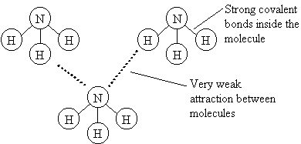
Molecular solids
The covalent bonds inside the molecules are very strong. The molecules don't break apart easily. However the forces attracting neighbouring molecules to each other are very weak. It is therefore very easy to separate molecules from one another: e.g. ammonia
When a molecular solid melts, it is the forces between the molecules which are broken. Very little energy is needed to make this happen, so molecular solids have low melting points

Slide 21
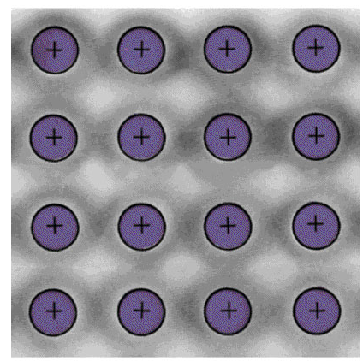
Types of Crystal Solid (Metallic)
Metallic Crystals
Lattice points occupied by metal atoms
Held together by metallic bonds
Soft to hard, low to high melting point
Good conductors of heat and electricity
Cross Section of a Metallic Crystal
nucleus &
inner shell e⁻
mobile “sea”
of e⁻

Slide 22
Metallic Solids
A metallic solid is a solid that consists of positive metal ions held together by a surrounding “sea of electrons “(metallic bonding).
In this kind of bonding, positively charged metal ions form the lattice which is submerged in the “sea of electrons”
Or,
the metal ions occupy fixed position in the lattice structure and they are surrounded by delocalized electrons.
Therefore, the intermolecular forces in metals must be rather strong.
Very soft to very hard, low to high melting point, good conductors of electricity and heat.
Metallic lustre, malleable and ductile, moderate heats of fusion
Examples include iron, copper, and silver.

Slide 23
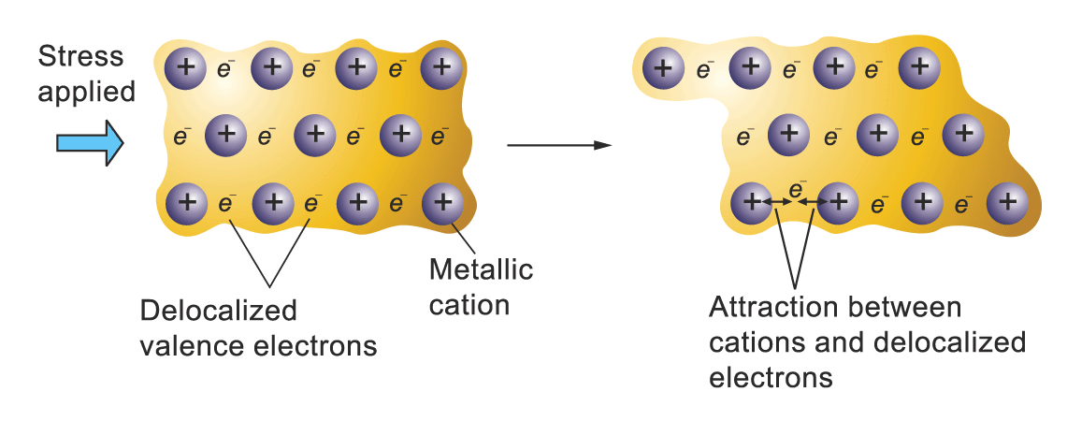
Metallic Solids
The lattice is held by strong electrostatic attraction between the delocalized electrons and metallic cations known as metallic bonds
The strength of metallic bond varies and so consequently the melting and boiling points of different metals varies.
Malleable and ductile due to non-directional metallic bonds
Good conductors of heat and electricity due to high density and mobile electrons
High melting and boiling points due to strong metallic bonds
Illustration of the malleability and ductility of a metal

Slide 24
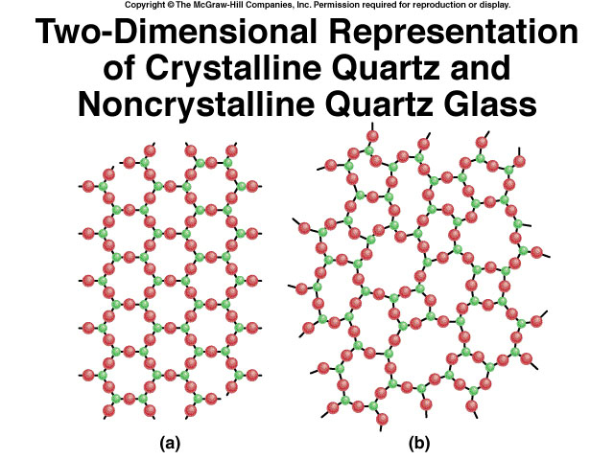
Amorphous Solids
An amorphous solid does not possess a well-defined arrangement and long-range molecular order.
They have no regular internal structure. Many polymers are amorphous solids. Other examples include: glass, plastic, gel and nanostructured materials.
A glass is an optically transparent fusion product of inorganic materials that has cooled to a rigid state without crystallizing.
Crystalline
quartz (SiO₂)
Non-crystalline
quartz glass

Slide 25
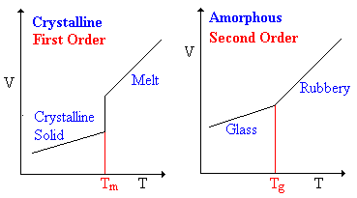
Crystalline vs Amorphous solids

Slide 26
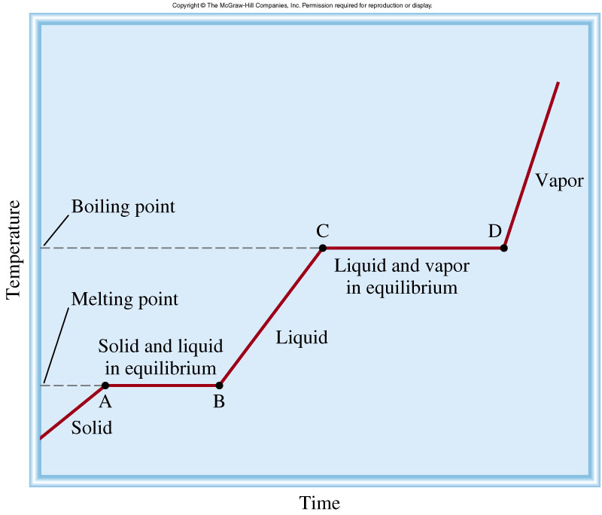
Heating Curve
• Heat of fusion = energy needed to convert a solid to a liquid
• Heat of vaporization = energy needed to
convert a liquid to a gas
Energy is needed to
• heat a solid
• heat a liquid
• heat a gas
• convert a solid to a liquid
• convert a liquid to a gas
• convert a solid to a gas (sublimation)

Slide 27
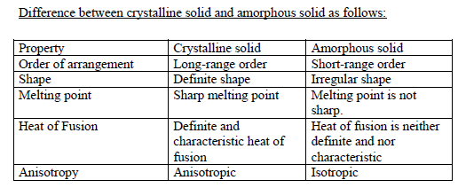

Slide 28
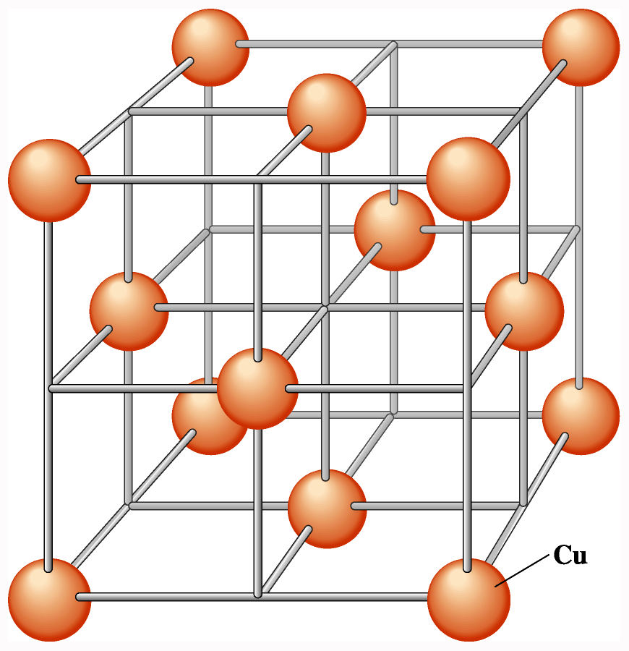
Crystal Lattices
A crystal lattice is the geometric arrangement of lattice points in a crystal.
A unit cell is the smallest boxlike unit from which you can construct a crystal by stacking the units in three dimensions There are seven basic shapes possible for unit cells, which give rise to seven crystal systems used to classify crystals
Notes:
2

Slide 29
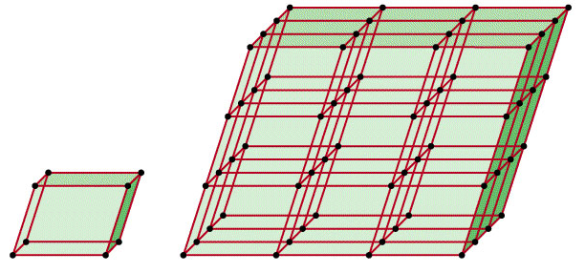
Unit Cell
A unit cell is the basic repeating structural unit of a crystalline solid.
lattice
point
Unit Cell
Unit cells in 3 dimensions

Slide 30
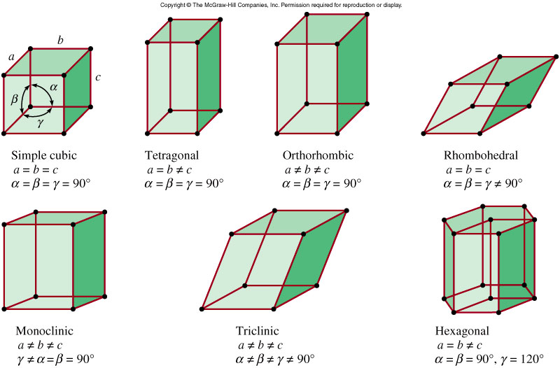
Structures of Crystalline Solids
The unit cells that make up the entire crystalline solid has a fixed value for the length of the edges and the angles between them.
Edges: a, b, c
Angles: α, β, γ

Slide 31
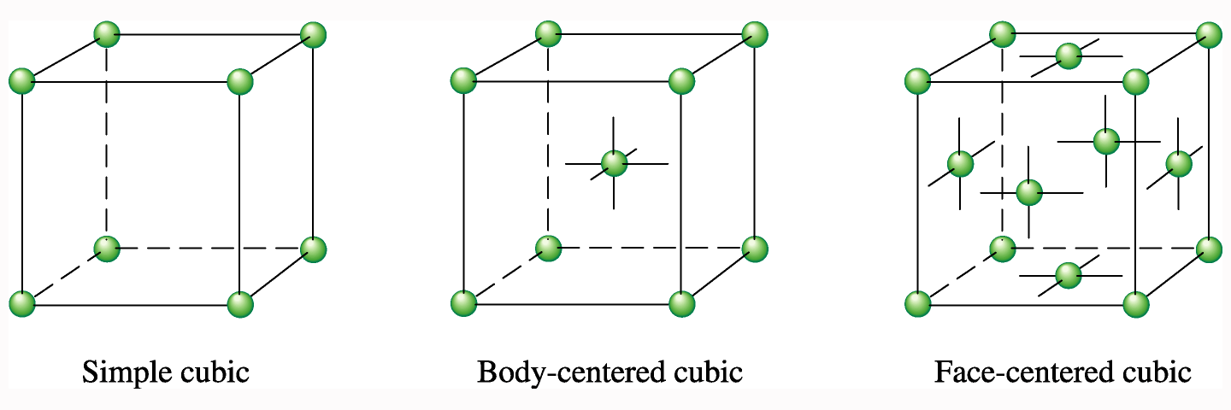
Cubic Unit Cells
A simple cubic unit cell is a cubic cell in which the lattice points are situated only at the corners.
A body-centered cubic unit cell is one in which there is a lattice point in the center of the cell as well as at the corners.
A face-centered cubic unit cell is one in which there are lattice points at the center of each face of the cell as well as at the corners (as shown below).
Notes:
2

Slide 32
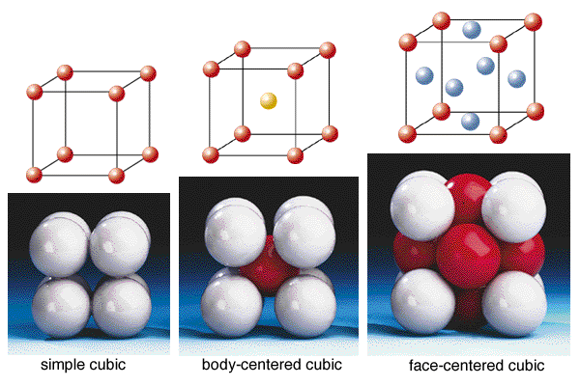
Cubic unit cell
CN = 6
CN = 8
CN = 12
Axial length a=b=c
Axial angle

Slide 33
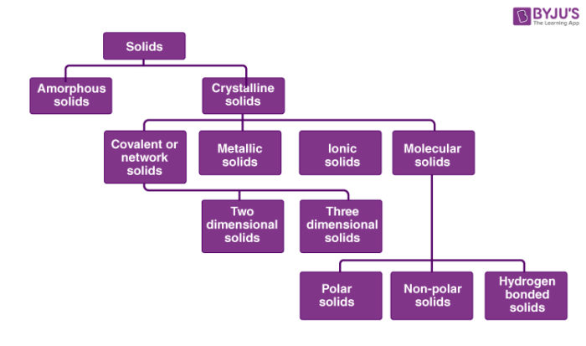
Summary of Classification of Solids

Slide 34
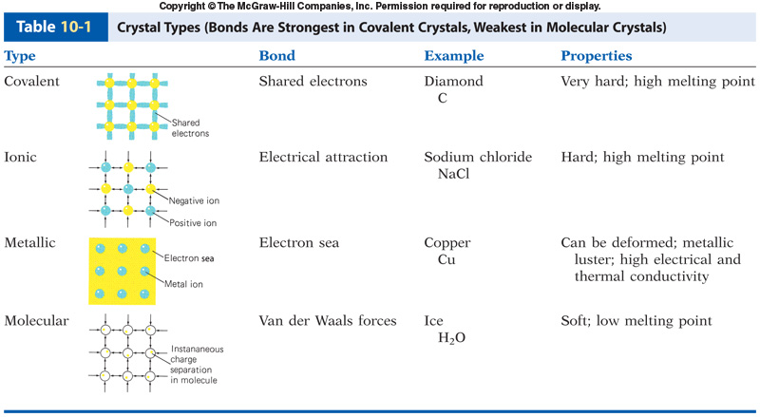
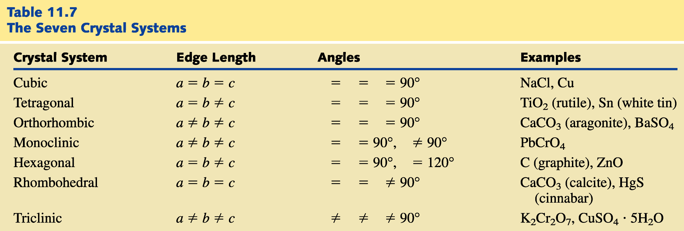
SUMMARY OF TYPES & STRUCTURES OF SOLIDS

Slide 35
Applications
Crystal structures of intermetallic compounds change largely with the combination of constituent elements in them. This is a great contrast to metals and alloys having only a few crystal structures.
As the physical and chemical properties of intermetallic compounds depend on the crystal structures, enormous efforts have been made to improve their properties through the structural modification.
For example, by adding ternary elements into binary compounds.
A ternary compound contains three different elements. Examples: Na₃PO₄ and CaCO_{3.}

Slide 36
Applications
Great attention has been directed toward the improvement in the brittle properties of intermetallic compounds for high temperature structural applications.
The prediction of crystal structures is probably the first step for the design of many materials such as intermetallic compounds.

Slide 37


