Slide 1
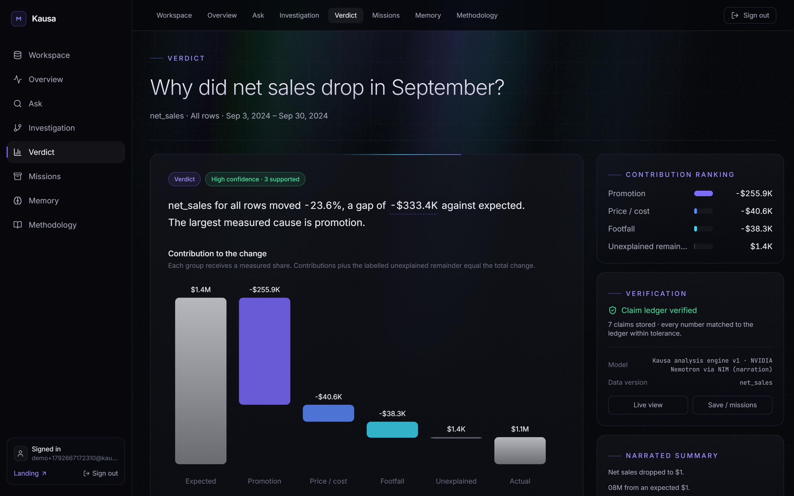
M
Kausa
OPEN AGENT HACKATHON 2026 · TRACK 02
Know why your numbers moved.
An investigative agent for business metrics. Ask why a number changed — Kausa tests competing explanations against your own data and shows the evidence, including what it ruled out.
Live kausa-gqp.pages.dev Demo youtu.be/x4X7j_lqx_k
Notes:
Kausa answers the question every operator asks the morning after a bad week: why did my number move? It is live right now at kausa-gqp.pages.dev, and everything in this deck is from the running product.

Slide 2



Dashboards show what moved. Nobody shows you why.
THE PROBLEM
Dashboards
Analysts
Chat assistants
Show that sales fell 8% — then stop. The “why” is left to whoever has time.
Can answer it properly, but take days, cost money and are not on call for every store.
Answer instantly with a plausible story — never tested against the data, numbers often invented.
The result: wrong decisions. Cutting a promotion that was working, blaming staff for a supplier price rise, missing a competitor opening.
Notes:
Operators see that a number moved but cannot tell why. Dashboards stop at what; analysts are slow; chat assistants tell one confident story that is never checked. A trustworthy answer needs alternatives tested against the data.

Slide 3
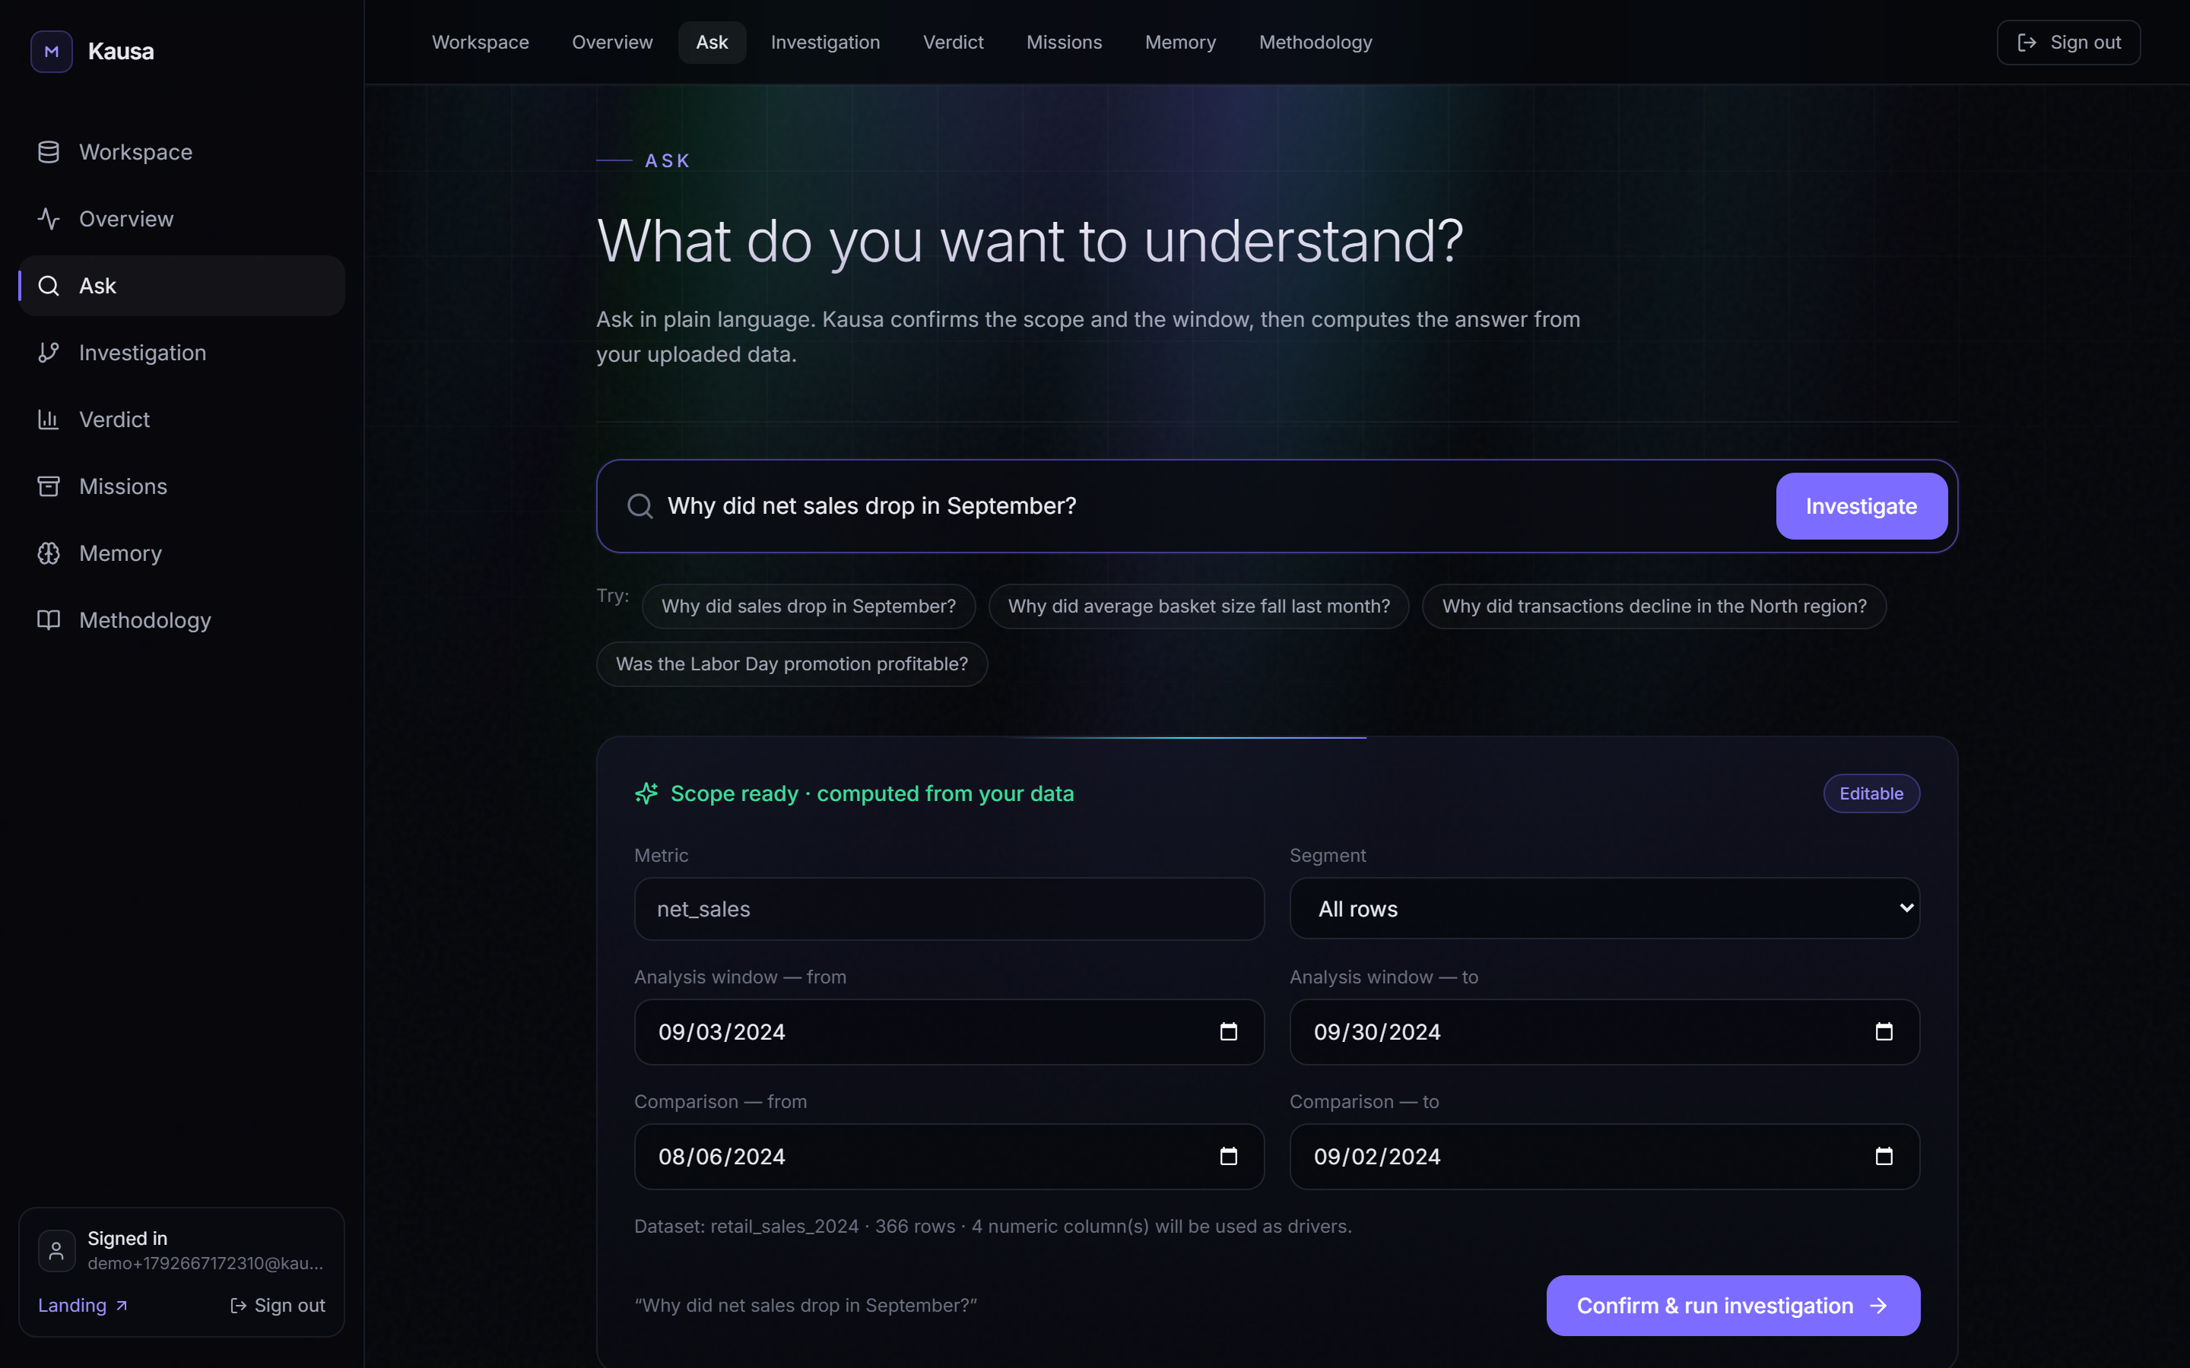



Ask why in plain language. Kausa investigates
THE SOLUTION
1 Upload
A CSV or Excel export. Kausa finds the date, the metric and the driver columns itself.
2 Ask
“Why did net sales drop in September?” Confirm or edit the scope and windows.
3 Get a verdict
Ranked causes, what was ruled out, recommendations — every number clickable to its evidence.
Notes:
Three steps. Upload any export; Kausa detects the schema. Ask in plain language and confirm the scope. Get a verdict in about twenty seconds.

Slide 4






An investigation, not a guess
HOW IT WORKS
01
02
03
04
05
06
Scope
Baseline
Test
Attribute
Narrate & verify
Remember
Metric, segment, analysis and comparison windows
Weekday seasonal-naive expected value + 90% interval
Competing hypotheses: supported, weak or refuted
Regression over drivers + explicit unexplained remainder
Nemotron writes; every number checked against the ledger
H-MEM keeps durable facts for the next investigation
The model never calculates. Every figure is computed in code from your rows; the language model only writes prose about numbers it is given.
Notes:
Six stages run on every question. The statistics are deterministic code; Nemotron only narrates; a verifier blocks any number that isn't in the claim ledger; memory carries useful facts forward.

Slide 5
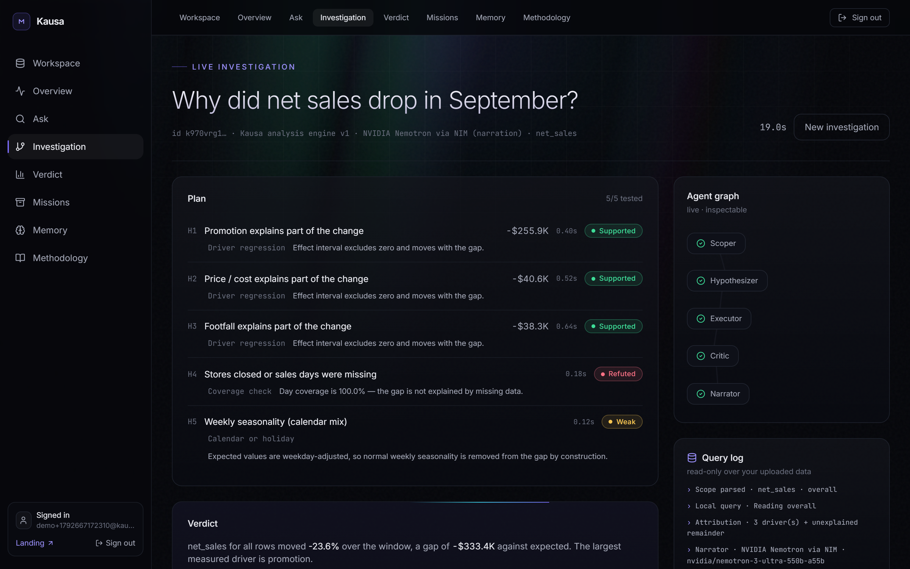
You watch it reason, hypothesis by hypothesis
LIVE INVESTIGATION
5
hypotheses tested
3
supported by the data
1
refuted — and shown
19s
question to verdict
Real run on a sample retail dataset, live app.
Notes:
This is the live investigation screen from a real run. Each hypothesis gets a status and a reason. The coverage check was refuted: missing days don't explain the gap. The whole run took nineteen seconds.

Slide 6
Where the $333K gap actually came from
THE VERDICT
−23.6%
$1.41M
−$255.9K
net sales vs expected, Sep 3–30 · outside normal variation
Largest cause
Promotion depth cut
77% of the gap · supported
−$40.6K
−$38.3K
+$1.4K
$1.08M
Ruled out
Missing or closed days
100% day coverage
Expected
Promotion
Price / cost
Footfall
Unexplained
Actual
Axis starts at $900K to show the drivers. Live app output on a sample dataset.
Notes:
Expected was 1.41 million, actual 1.08 million. Promotion explains 256K of the 333K gap, price and footfall the rest, with a 1.4K unexplained remainder shown honestly. Missing days were tested and ruled out.

Slide 7

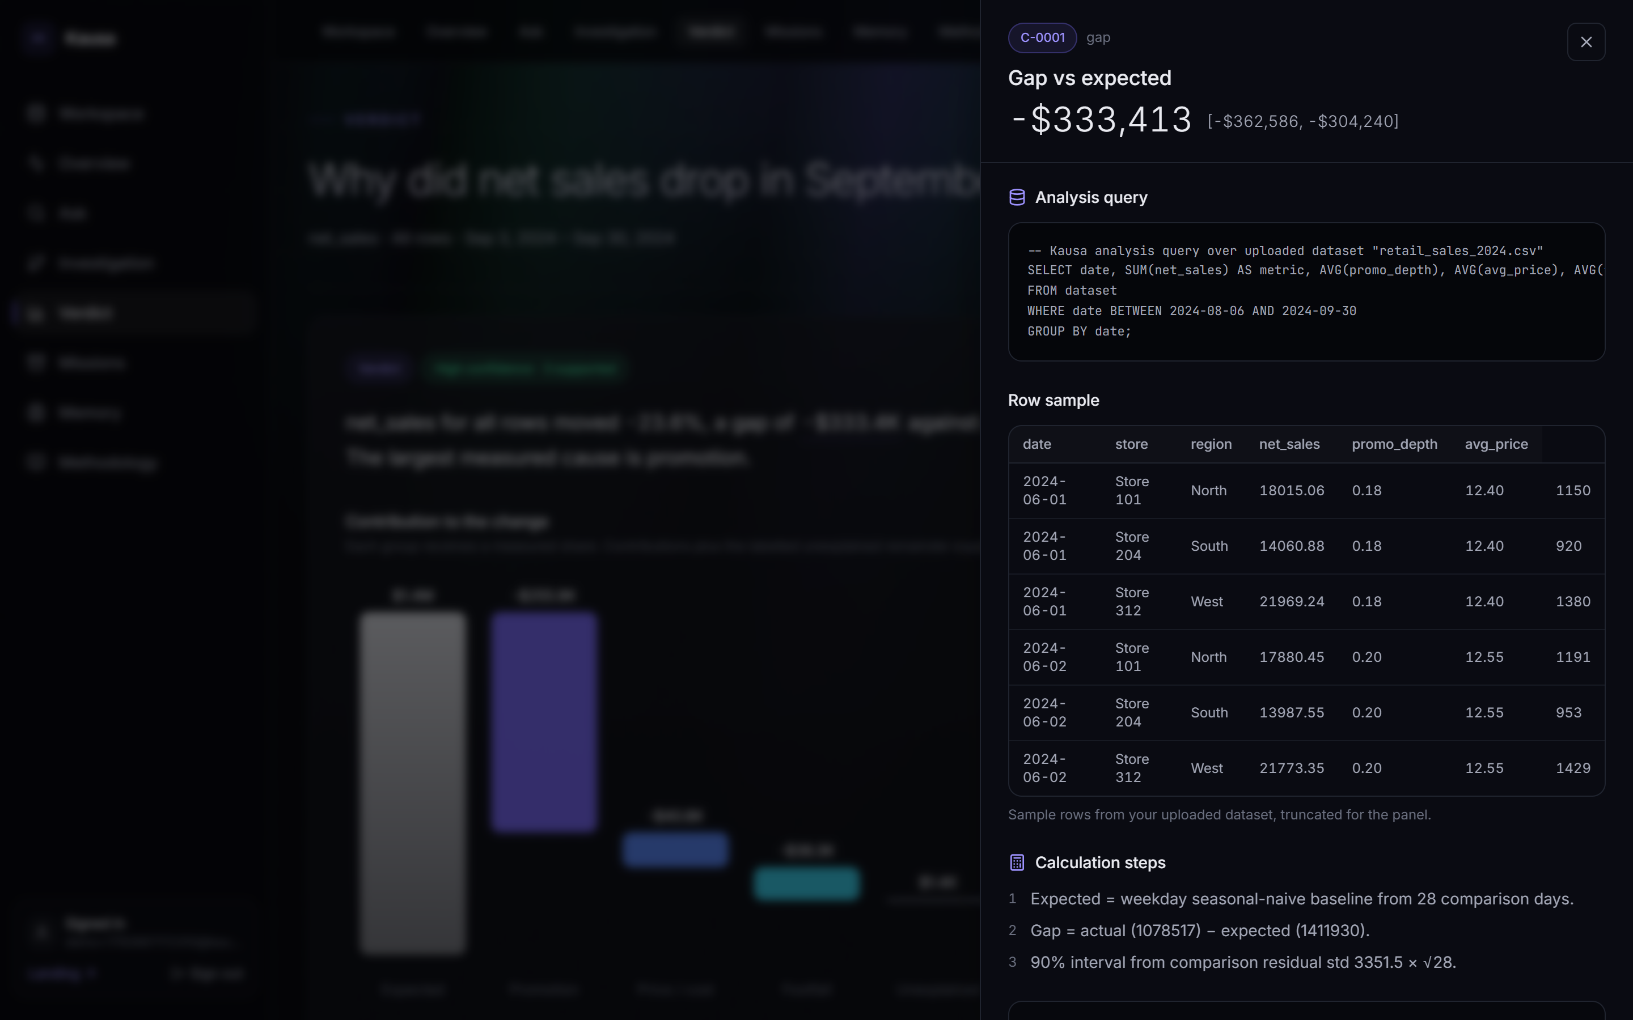


Every number is a claim you can open
TRUST
The query
The exact aggregate that produced the figure.
The rows
A sample of your own rows behind it.
The calculation
Every step, with the interval and model version.
The verifier
Narration with an unmatched number never reaches you.
Notes:
Click any figure and the evidence panel opens: the query, the rows, the calculation and the verifier result. It deep-links, so a claim can be shared with a colleague.

Slide 8




Deterministic maths on one reactive backend
ARCHITECTURE
NVIDIA Nemotron
Narration via NIM (live)
Convex backend
Database · file storage · auth
Web app
React + Vite on Cloudflare Pages. Live updates over one Convex connection.
Meterless H-MEM
Durable memory engine
Background jobs · realtime
Stats engine (baseline, interval, OLS)
Zetaris
Federated SQL (when configured)
Claim ledger + verifier
Notes:
The browser holds one live Convex connection. Convex is the database, storage, auth and job runner. The statistics run in Convex actions. Nemotron narrates, H-MEM remembers, and Zetaris can serve the analysis slice where the data lives.

Slide 9
Each sponsor does real, distinct work
SPONSOR TECHNOLOGY
NVIDIA Nemotron
Meterless H-MEM
Zetaris
Live in production
Built into the product
Federated data harness
nemotron-3-ultra via NIM writes every verdict narrative. It receives computed summaries only — never raw rows — and its output is number-checked against the claim ledger.
The H-MEM memory engine — eight-signal hybrid ranker, trust ledger, feedback — mines durable facts from each run and recalls them into the next. Digit-stripped so memory can't inject numbers.
Kausa runs its per-day aggregate query through the Zetaris AI Data Harness where the data lives, with paging and auth. Falls back to the local store when not configured.
convex/lib/llm.ts
convex/lib/hmem.ts · memories.ts
convex/lib/zetaris.ts
Notes:
Nemotron is live and writes every verdict. The Meterless H-MEM engine is ported into Convex to give each user durable memory. The Zetaris client federates the analysis query when a Zetaris source is configured.

Slide 10



Shipped, deployed and tested end to end
PROOF IT'S REAL
13/13
19 s
7
CI
end-to-end checks passing on the live site
from question to verified verdict
claims stored per run, each verified and inspectable
typecheck + build on every push; backend auto-deploy
Test it yourself: upload any CSV with a date column and a numeric metric at kausa-gqp.pages.dev
Notes:
This is not a mock-up. The end-to-end test signs up, uploads, investigates and opens the evidence on the live site, and passes all thirteen checks.

Slide 11
Built for every judging criterion
WHY KAUSA
Criterion | Pts | How Kausa earns it
Impact | 30 | Answers “why did my number move?” on the user's own data — tested causes, recommendations
Technical | 20 | Deterministic stats, claim verifier, provider failover, CI, e2e test on the live site
Innovation | 15 | Refutation as an output, every number a claim, durable H-MEM memory
Demo | 15 | One path: upload → ask → watch it reason → open the evidence
Product & UX | 10 | Plain-language ask, editable scope, live progress, clear error states
Sponsor tech | 10 | Nemotron narrates live · Meterless H-MEM memory · Zetaris federated SQL
Notes:
Mapped to the six official criteria: impact thirty, technical twenty, innovation and demo fifteen each, product and sponsor tech ten each.

Slide 12
From one file to the whole business
WHAT'S NEXT
Now
Next
Later
Any CSV / Excel upload
Weekday baseline + interval
Driver attribution + remainder
Verified Nemotron narration
Durable memory
Zetaris across POS, promo and price sources
Placebo and control-store tests
Shapley attribution for interactions
Segment drill-down by default
Scheduled monitoring and alerts
“Why” digests by email or Slack
Team workspaces and sharing
Recommendation tracking
Notes:
Today Kausa explains one dataset. Next it federates the sources an operator really has through Zetaris and adds stronger tests. Later it watches the numbers and sends the why before anyone asks.

Slide 13



M
Know why your numbers moved.
Evidence-weighted explanations, not proof of causation — and Kausa always says which is which.
Try it live
kausa-gqp.pages.dev
Watch the demo
youtu.be/x4X7j_lqx_k
Read the code
github.com/opeblow/KAUSA
Open Agent Hackathon 2026 · Track 02: The Agent That Can Explain Why
Notes:
Kausa: know why your numbers moved. Try it live, watch the demo, read the code. Thank you.

