Slide 1
BORDERLESS BYTES HACKATHON
NEXT Africa
a personal execution copilot
Tell it what matters in the same words you would use in a WhatsApp message.
It turns the promise into a dated commitment, then follows through until it is done.
LIVE BUILD
next-africa.pages.dev
API + docs: next-africa.onrender.com
Mobolaji Opeyemi Bolatito Developer
Oluwatamilore Paul Olubanwo Product Manager
NEXT Africa | Borderless Bytes Hackathon
NEXT Africa | Borderless Bytes Hackathon
01

Slide 2
THE PROBLEM
Work here runs on conversation, not calendars
Across Africa the commitment is real and binding - and it is living in a chat thread with 400 other messages.
"send the proposal before the Thursday meeting" - "remind me to follow up with Dana"
Calendar-first apps
Task managers
Assume you block time deliberately. Most African work is reactive and negotiated in the moment.
Assume a desktop and stable bandwidth. Data cost and patchy signal are real constraints.
Email workflows
Enterprise PM tools
Assume email is the record of work. WhatsApp threads and voice notes carry the actual load.
Priced for salaried teams. Our users are students, freelancers, traders and solo operators.
NEXT Africa | Borderless Bytes Hackathon
02
Notes:
Existing tools were not built for this user. None of them start from a WhatsApp message.

Slide 3
TARGET AUDIENCE
Who this is built for
One shared reality: the work arrives as conversation, on a phone, in another language than the software.
Amina, 24 - fashion freelancer, Lagos
Tunde, 31 - trader, Onitsha market
Client messages and voice notes while hand-sewing. Cannot sit at a laptop mid-work, and a calendar assumes she already knows tomorrow hour by hour.
Verbal requests side by side, stock deadlines, payment promises. Task apps need constant typing; his commitments are spoken.
Chioma, 19 - undergrad, Ibadan
Dr. Bola, 45 - clinic owner
Group chats, forwarded PDFs, lecturer announcements. Nothing turns "the EOF document is due Thursday" into a dated, linked task.
Patients, vendors and staff promises over WhatsApp. Enterprise tools are priced for teams, not for a solo operator.
Designed Africa-first: mobile-first, low-data, WhatsApp-native.
NEXT Africa | Borderless Bytes Hackathon
03
Notes:
Personas are drawn from docs/PROBLEM-FIT.md, mapped to real feature moments.

Slide 4
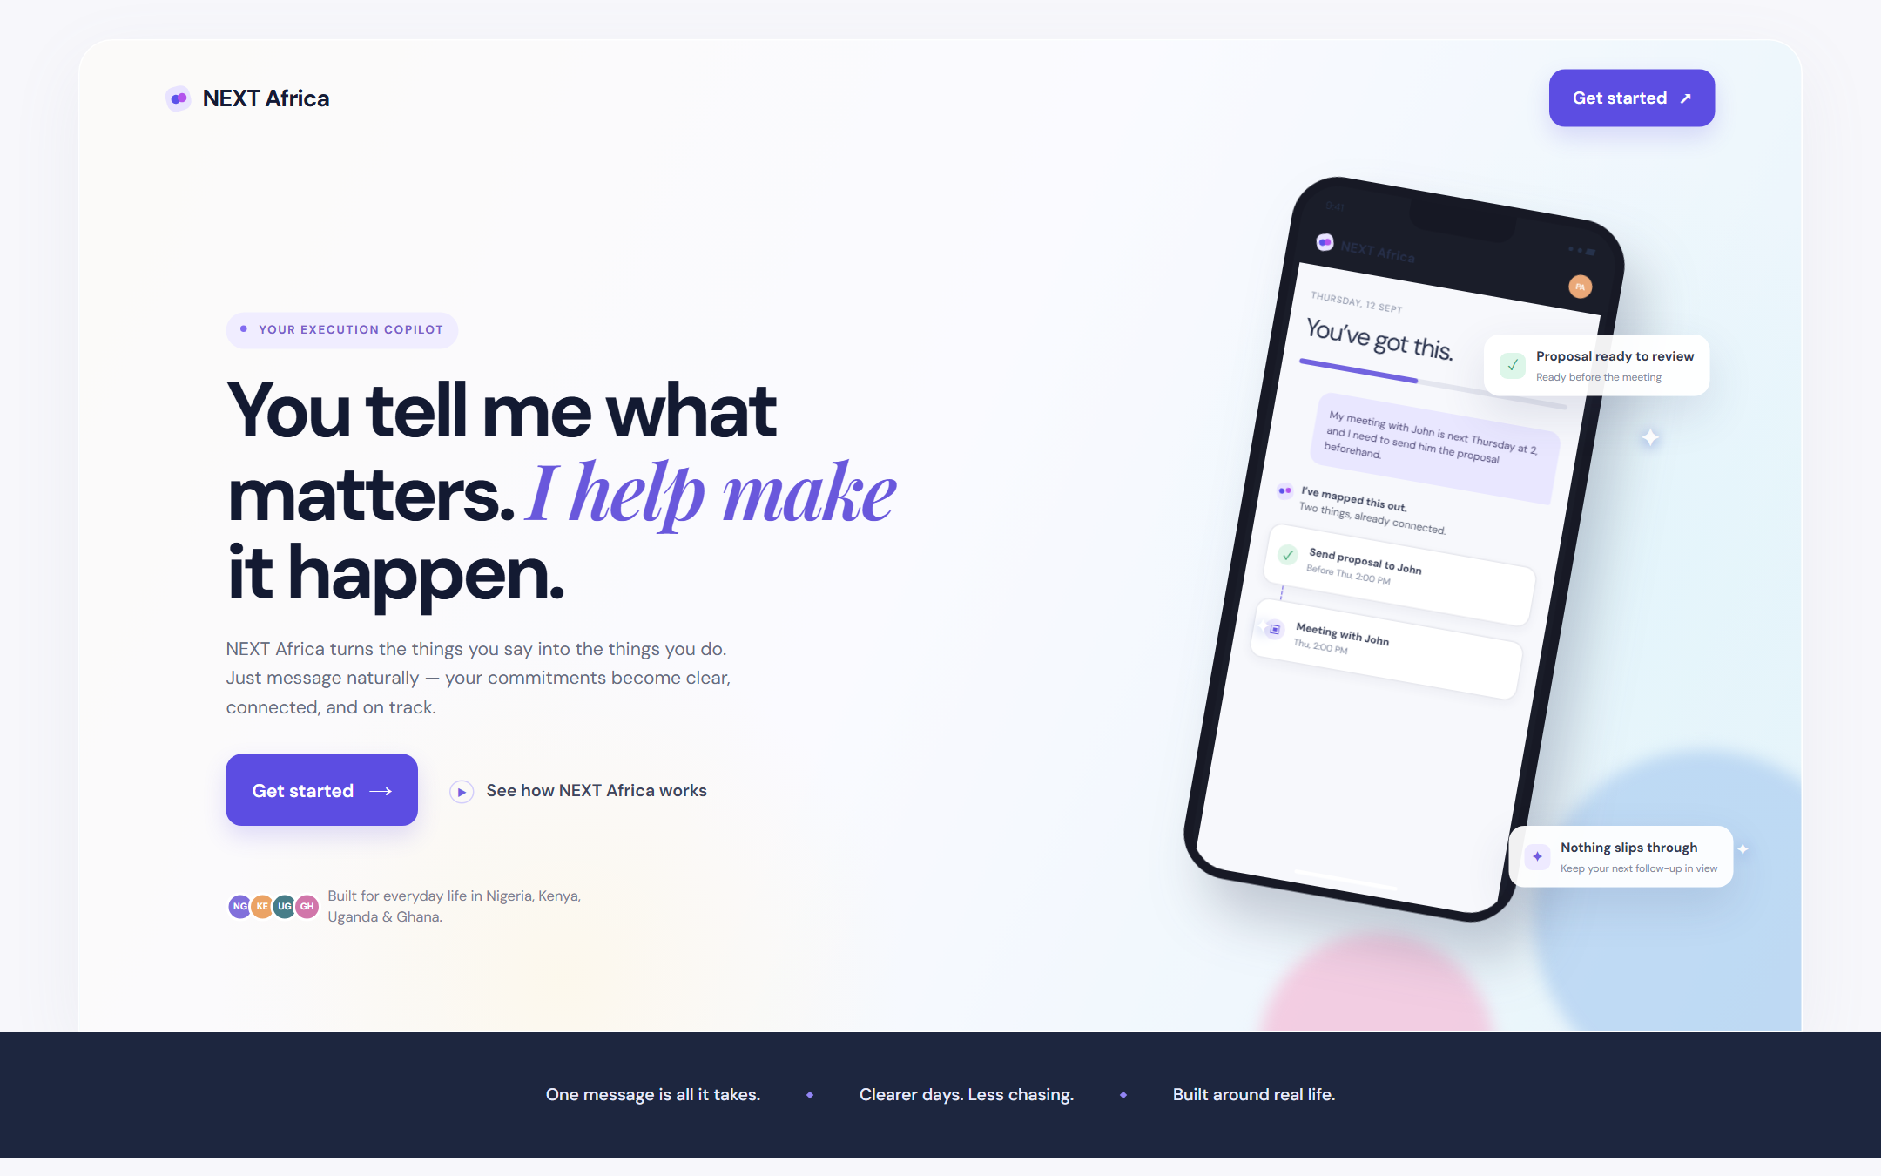
THE SOLUTION
It hears the promise, then makes it happen
Say it once, in your own words. NEXT structures it, dates it, and keeps the follow-through moving.
NEXT Africa | Borderless Bytes Hackathon
04

Slide 5
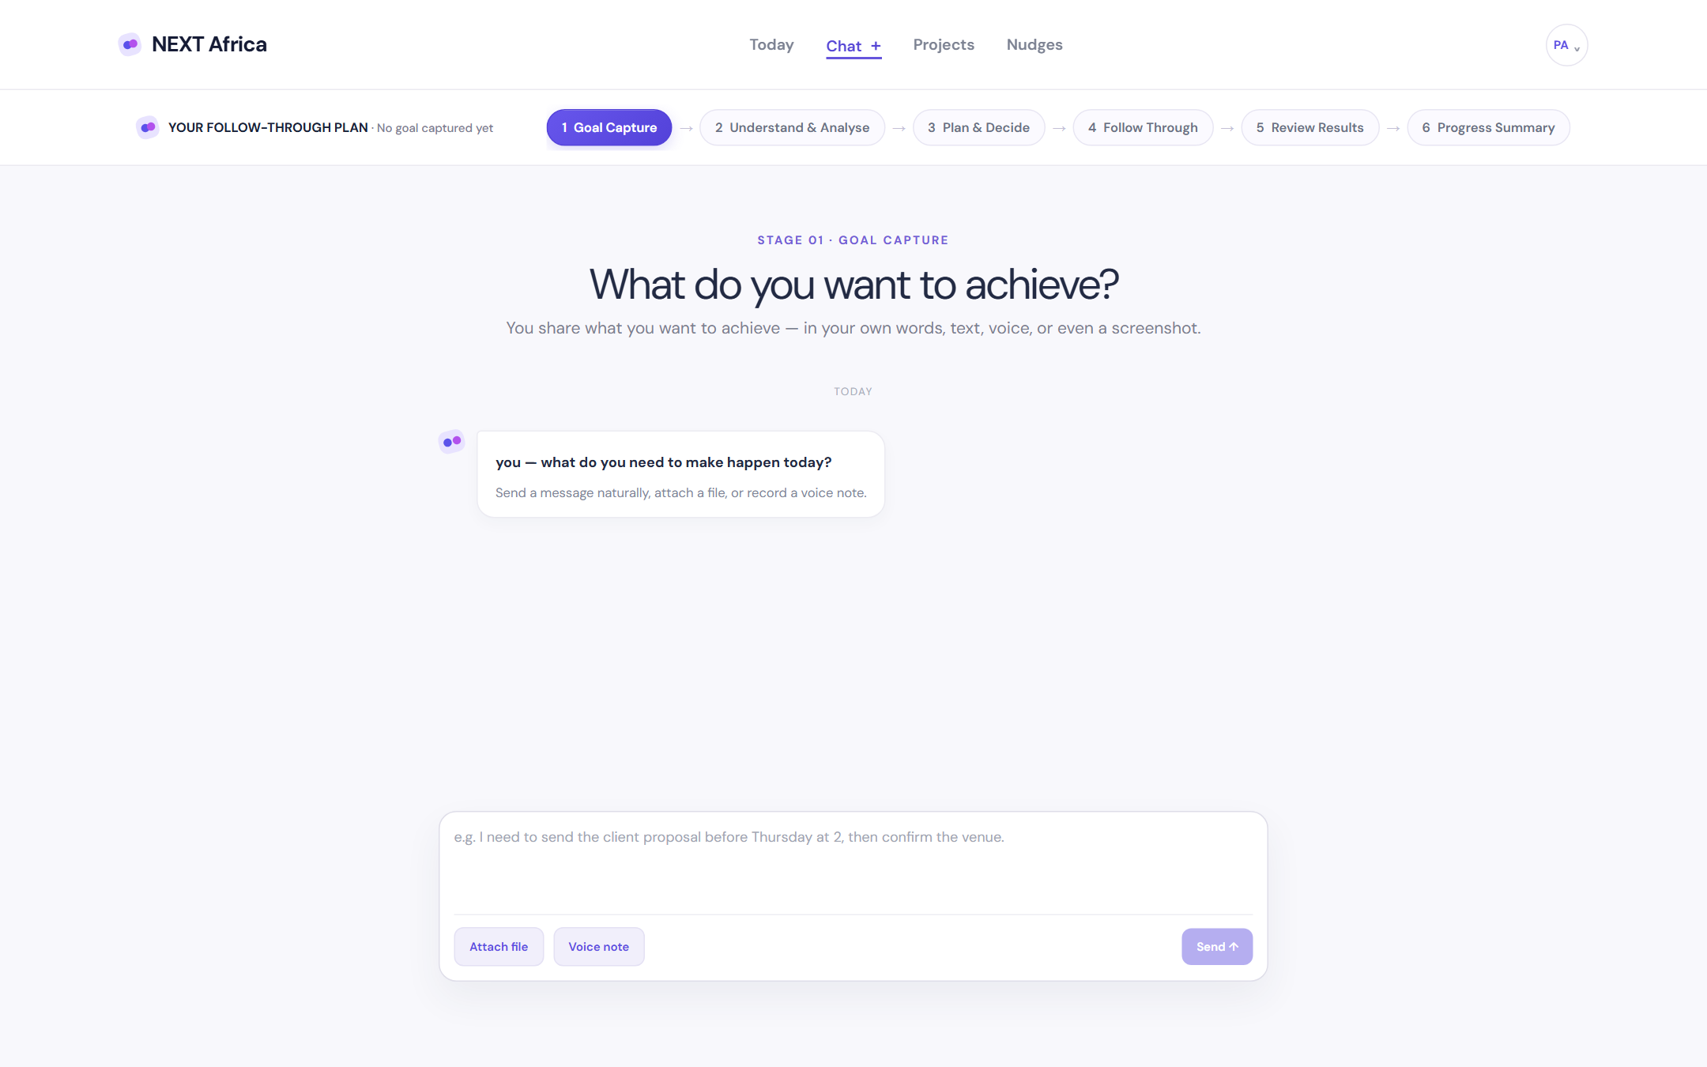
PRODUCT - 01
Capture in the words you already use
Type, attach a file, or send a voice note. It comes out as structured, dated commitments.
One message becomes several commitments, each with a real date and type
Up to 100 recent commitments are private context, so "it" and "the venue" resolve to the right thing
PDF, image, TXT, Markdown and CSV attachments up to 8 MB; voice is transcribed into the same pipeline
NEXT Africa | Borderless Bytes Hackathon
05
Notes:
Capture in the words you already use - live build at https://next-africa.pages.dev

Slide 6
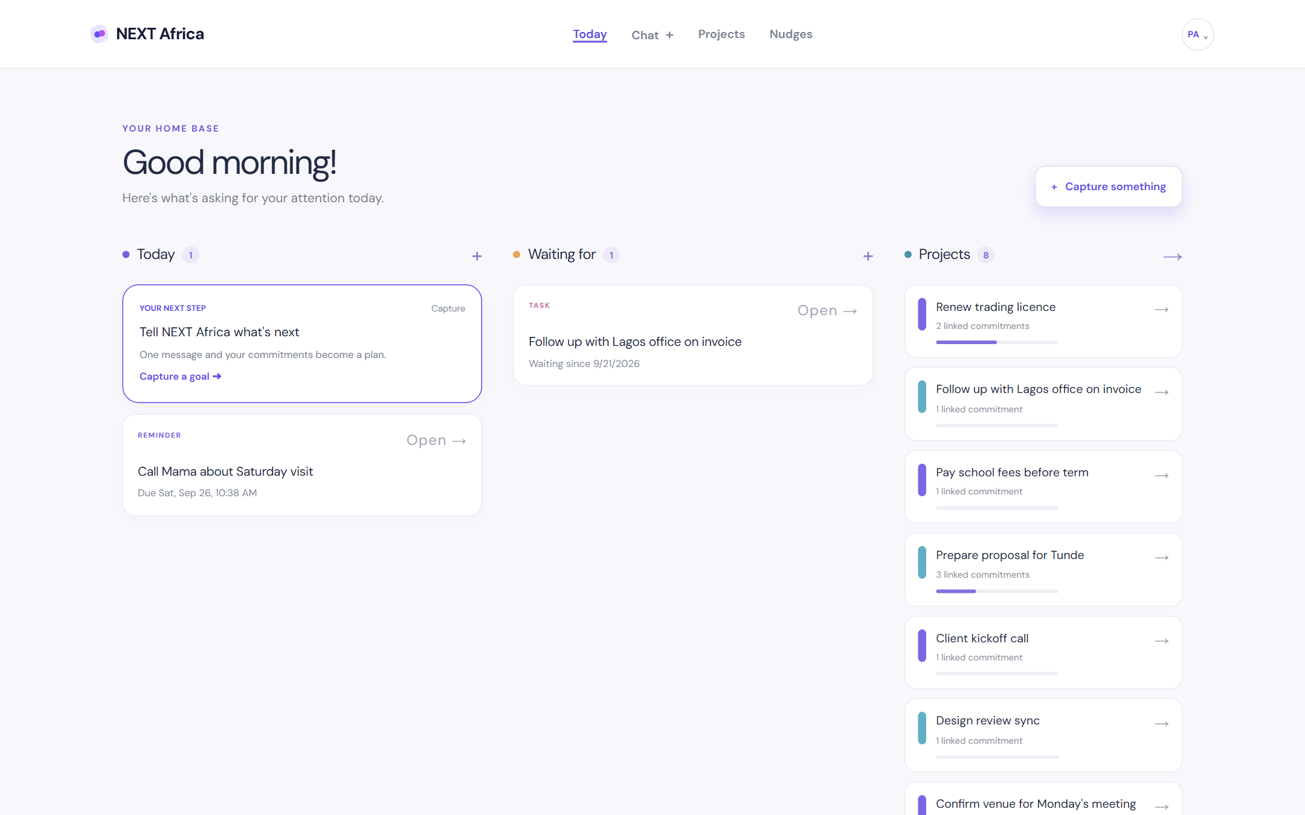
PRODUCT - 02
Today is the only board that matters
A morning board, the waiting list, and live project progress - all data-driven, nothing fabricated.
Today, waiting-for and projects side by side, on one screen
Edit a deadline, prepare a follow-up draft, and mark work done or waiting
Progress is recorded status - never a timer pretending work happened
NEXT Africa | Borderless Bytes Hackathon
06
Notes:
Today is the only board that matters - live build at https://next-africa.pages.dev

Slide 7
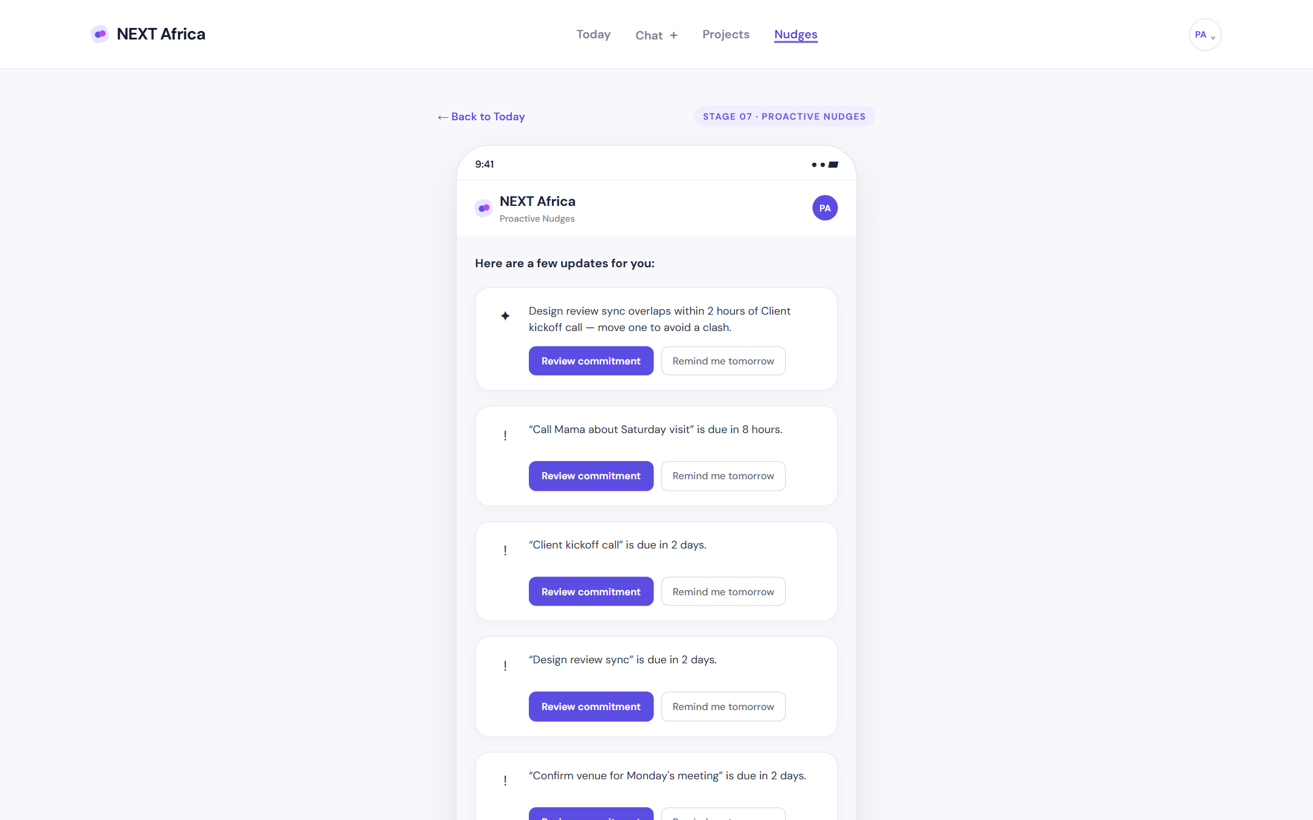
PRODUCT - 03
It follows up, so you do not have to
Proactive nudges surface what is due, what is blocked, and what is waiting on someone else.
Waiting items resurface until they are resolved, then stop
Due windows follow your proactivity level: quiet 24h, balanced 48h, active 7 days
Opt-in Web Push sends a private daily summary with durable delivery records
NEXT Africa | Borderless Bytes Hackathon
07
Notes:
It follows up, so you do not have to - live build at https://next-africa.pages.dev

Slide 8
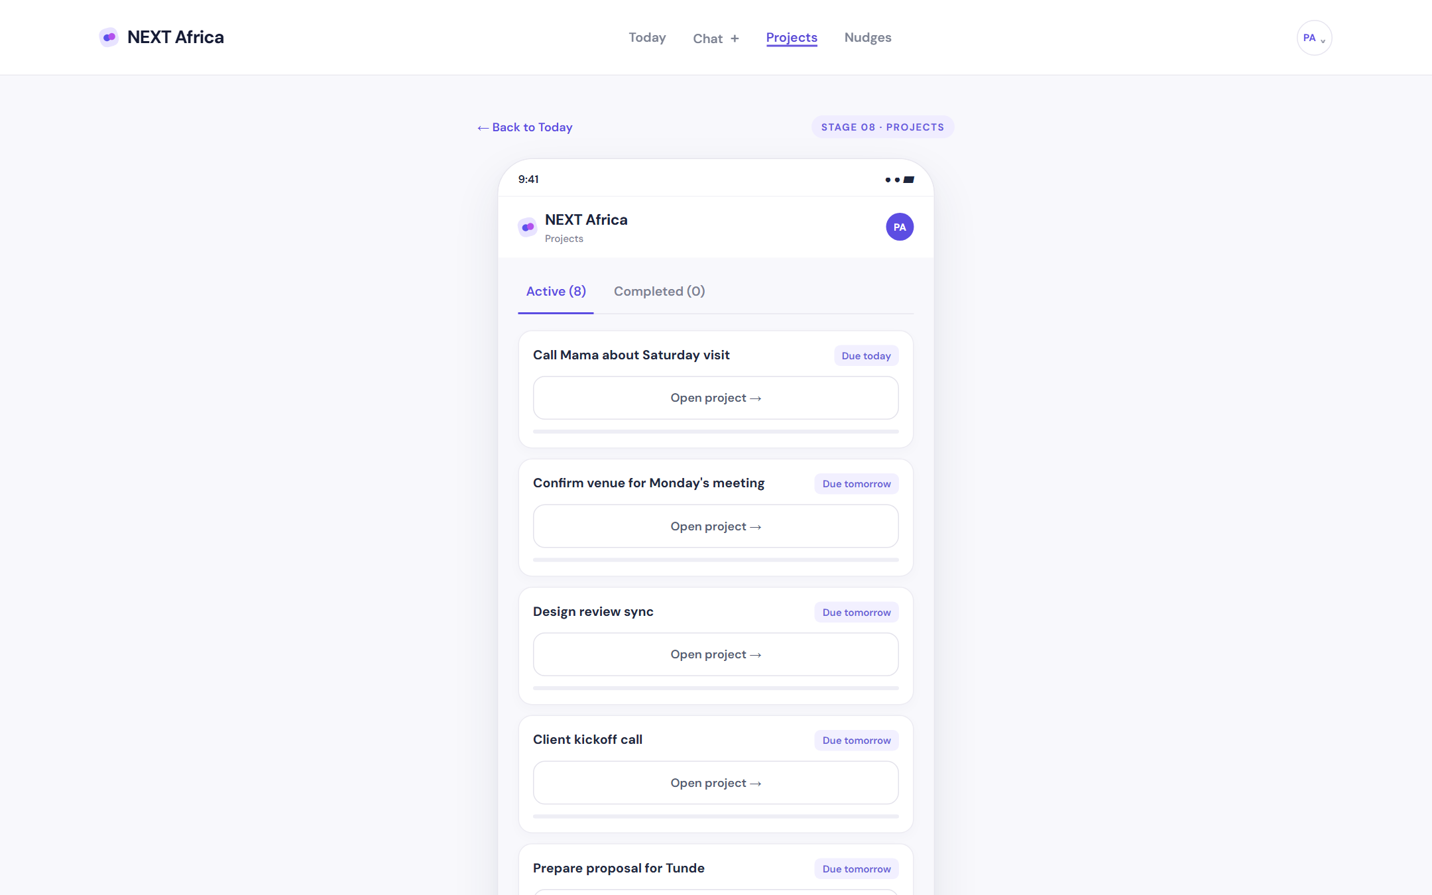
PRODUCT - 04
Projects assemble themselves
A promise made across five days and three chats is auto-linked into one project with progress.
Cross-message linking turns loose commitments into one trackable project
Stage, owner and due tags stay visible without a project-management seat
Built for a solo operator, not a salaried team
NEXT Africa | Borderless Bytes Hackathon
08
Notes:
Projects assemble themselves - live build at https://next-africa.pages.dev

Slide 9
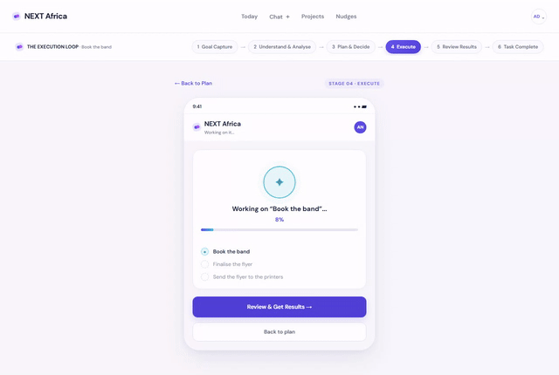
PRODUCT - 05
From approval to done, step by step
The loop you approved, worked through with live progress - this is where a "will do later" sentence stops dying in a thread.
Understand, plan, decide, follow through, review
You approve the plan before anything runs
Every step is visible and recorded
NEXT Africa | Borderless Bytes Hackathon
09
Notes:
Live recording from the deployed build - the execution loop running end to end.

Slide 10
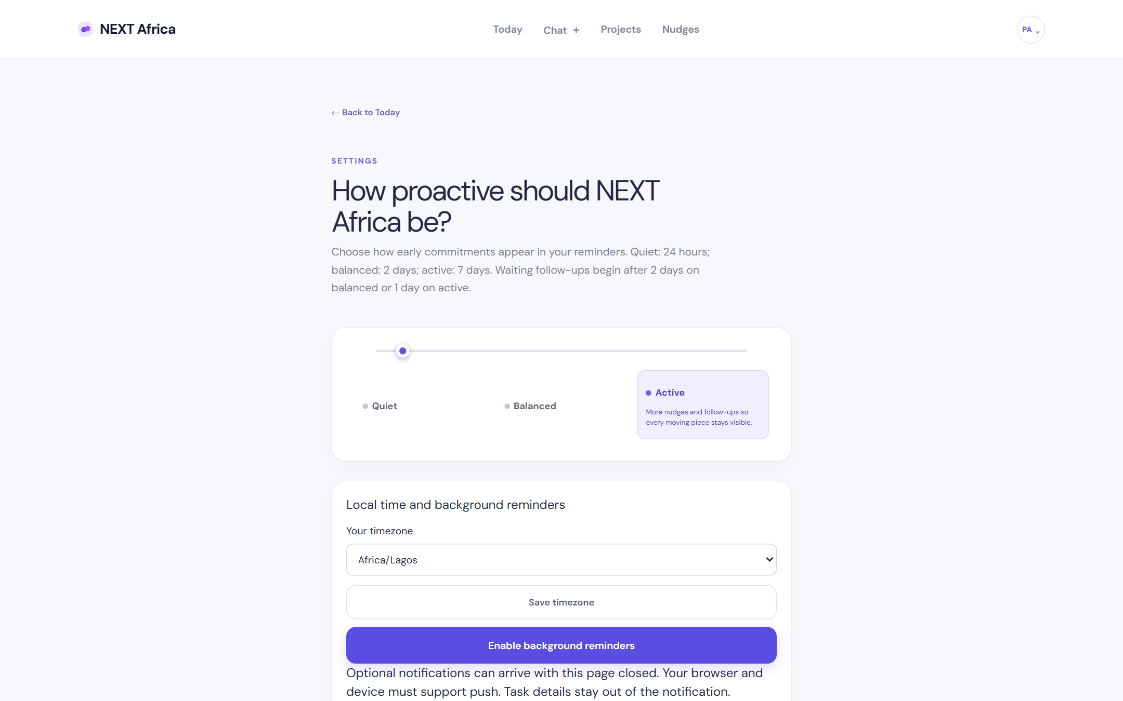
PRODUCT - 06
Tone is the user's call
"Remind me, but do not nag me" is a setting, not a personality test.
Quiet, balanced and active change the due window and waiting follow-ups
"Remind me tomorrow" snoozes for 24 hours
Dates use the timezone chosen in settings, Africa/Lagos by default
NEXT Africa | Borderless Bytes Hackathon
10
Notes:
Tone is the user's call - live build at https://next-africa.pages.dev

Slide 11
UNDER THE HOOD
A small, honest architecture
Three deployable pieces. No queue, no cluster, no vendor lock - and no claim we cannot demonstrate.
Frontend - React 19 + Vite 8
Backend - Node 24 + Express 5
State-based SPA, low-data by design, deployed on Cloudflare Pages. Talks to the API over a single base URL.
REST API with JWT auth, zod validation, helmet, rate limiting and pino logging. Deployed on Render.
Database - PostgreSQL 17
Intelligence - OpenAI
Users, commitments, projects, nudges and push records, with indexes and FK constraints. Migrations apply on boot.
GPT-4o mini for structured extraction via tool calls, Whisper-1 for voice. Timeouts and retries are configured.
Auth is stateless JWT, so any instance can serve any request and horizontal scaling stays trivial.
NEXT Africa | Borderless Bytes Hackathon
11

Slide 12
TECH STACK
Everything we used, and why
Boring, current, and chosen so a teammate could read it on day one.
FRONTEND
BACKEND
React 19, Vite 8, Tailwind CSS 4, Playwright
Node 24, Express 5, zod, pino, helmet, express-rate-limit
DATA
AI
PostgreSQL 17, pg, SQL migrations, JWT (jsonwebtoken), bcrypt
OpenAI GPT-4o mini, Whisper-1, tool-call extraction
PLATFORM
TOOLING
Cloudflare Pages, Render, Render Postgres, Web Push (VAPID)
npm workspaces, ESLint 10, Prettier, commitlint, GitHub Actions CI
NEXT Africa | Borderless Bytes Hackathon
12

Slide 13
WHAT IT DOES NOT DO
The honest limitations slide
Every one of these is a deliberate boundary, stated in the README and in the code.
01
No autonomous task execution and no message sending. Drafts are prepared for your review and stay unsent.
02
Progress is based on saved statuses, never a timer. We do not simulate work that did not happen.
03
AI calls need a real OPENAI_API_KEY. Our automated tests stub them, and we never present mocked calls as live.
04
Browser push needs VAPID keys and a secure origin. Reminders are a best-effort summary, not an alarm service.
05
Google sign-in is not offered. Email and password only, with bcrypt hashing and signed sessions.
Judges: ask us to break any of these claims. We will show you the code.
NEXT Africa | Borderless Bytes Hackathon
13
Notes:
This slide is deliberate. It is the fastest way to earn trust in Q and A.

Slide 14
STATUS
Shipped, deployed, and usable today
Not a prototype on a laptop. This is the live build the demo runs against.
Live app
https://next-africa.pages.dev
Cloudflare Pages, mobile-first
Live API
https://next-africa.onrender.com
Render web service, health-checked
API docs
https://next-africa.onrender.com/api/docs
Interactive, generated from the running app
Database
Render PostgreSQL
Migrations applied, demo data seeded
Tests
26 passing
node:test, covering auth, dates, files and dedupe
Demo account is seeded so a judge can log in without setup.
NEXT Africa | Borderless Bytes Hackathon
14

Slide 15
WHAT COMES NEXT
Roadmap
Now
Working capture-to-done loop, live on the public internet
Next
WhatsApp bot intake, so the promise never has to leave the chat
Then
Local languages and offline-first sync for low-data users
Later
Team and SME tiers for clinics, traders and small studios
NEXT Africa
https://next-africa.pages.dev
https://next-africa.onrender.com
Tell it what matters. It makes sure it happens.
NEXT Africa | Borderless Bytes Hackathon
NEXT Africa | Borderless Bytes Hackathon
15

