Slide 1
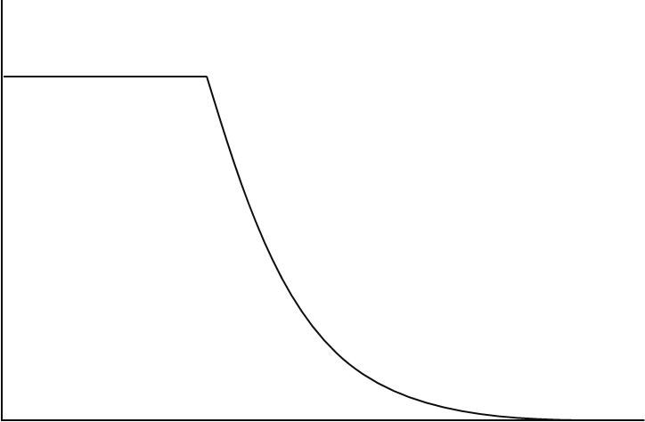
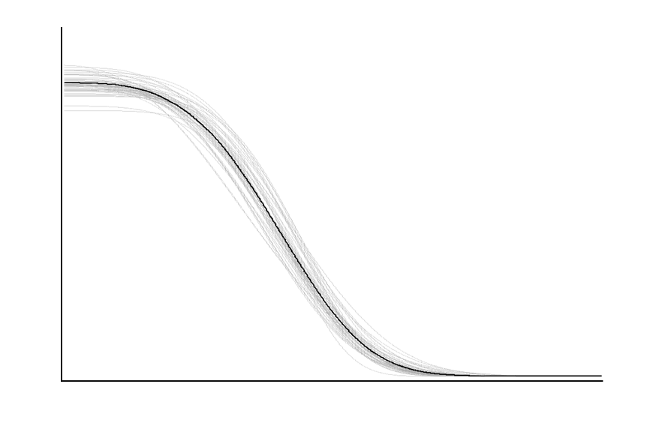
(A)
(B)
mean control response (intercept,α )
mean control response (intercept, β₀)
10% effect
10% effect
decay rate (β)
decay rate (β)
NEC (η)
Response (y)
EC10
EC10
(C)
(D)
mean control response
Lower quantile (β₀)
Median Bayesian posterior prediction
10% effect
Individual Bayesian posterior predicted draws
NOEC
NSEC
EC10
Concentration (x)

