Slide 1
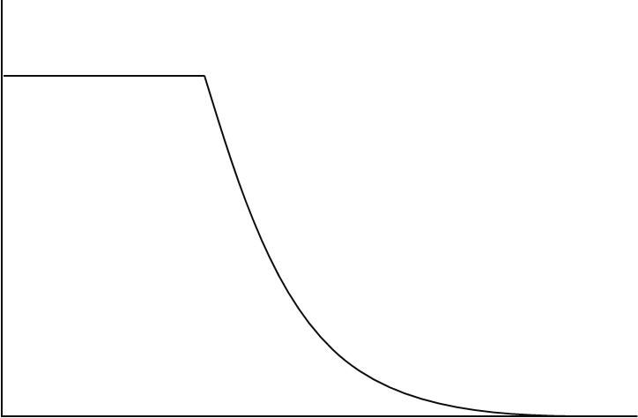
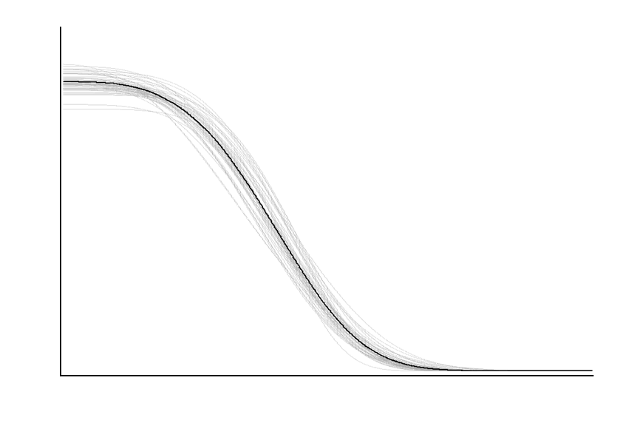
(A) NEC model
(B) Sigmoidal model with estimated ECx
mean control response (intercept,α )
mean control response (intercept, β₀)
NEC (η)
10% effect
10% effect
decay rate (β)
decay rate (β)
Response (y)
EC10
EC10
(C) NOEC derivation
(D) NSEC derivation
mean control response
Lower quantile (β₀)
Median Bayesian posterior prediction
10% effect
Individual Bayesian posterior predicted draws
NOEC
NSEC
EC10
Concentration (x)

