Slide 1
BOM
Weather data
ReefTemp Next Generation
CSIRO Visualisation
Model boundary forcing
Web portals
BOM
Riverflow models
AIMS eReefs Platform
Visualisation + extraction
CSIRO
3D Hydrodynamic / BioGeoChemical models
AIMS
Visualisation / Aggregation / Extraction
DES
Land run off (nutrients, sediments)
Aggregate data
Data services
Raw model data

Slide 2
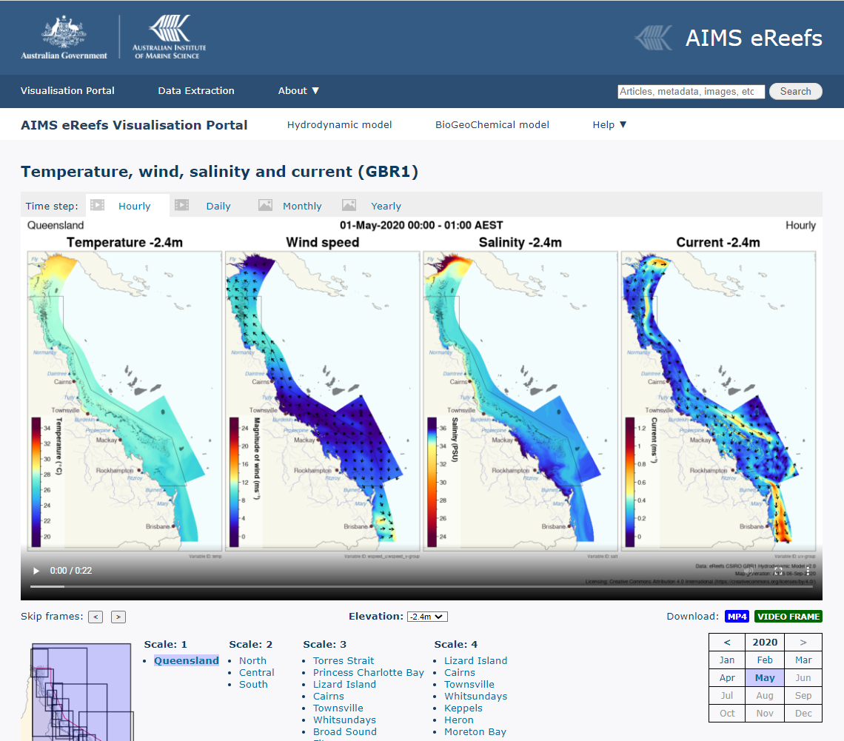
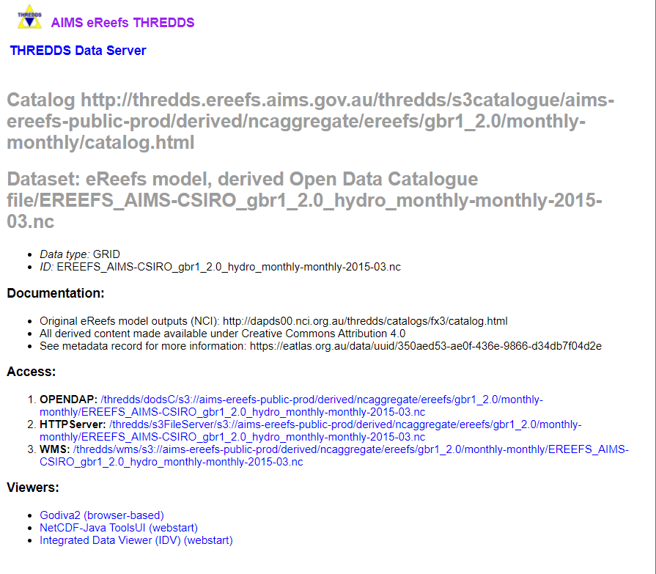
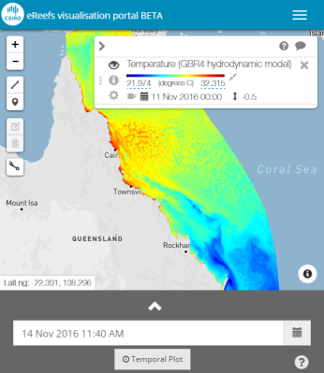
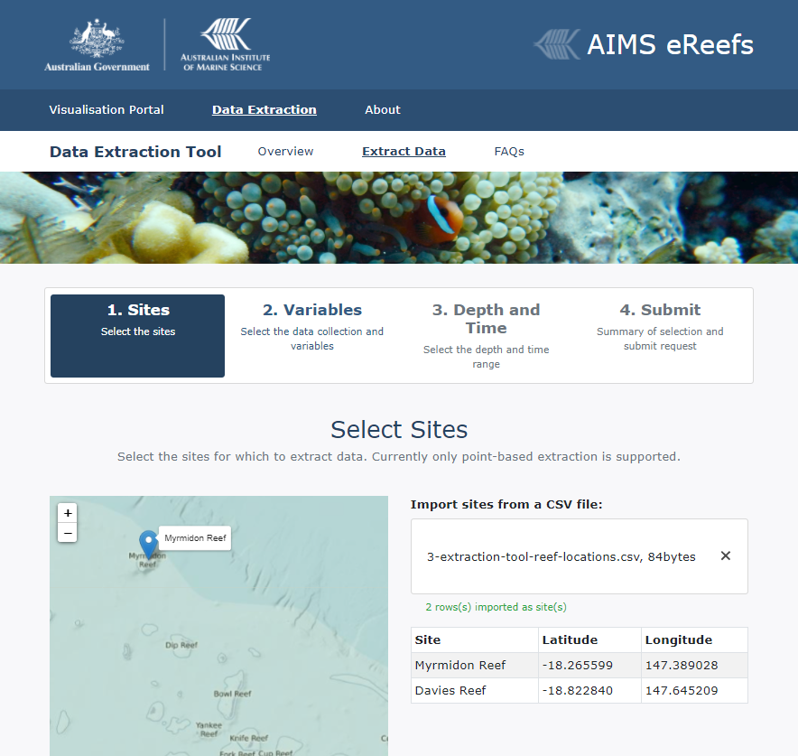
AIMS eReefs Platform
Mirror
GBR4, GBR1 model data
CSIRO
NCI
Data files
NcAggregate
Regrid, Aggregate & Processing
NcAnimate
NcAggregate
Map Rendering
Extract and aggregate
Aggregation
Maps
Map
Videos
Extracted time series data
Daily
Monthly
Annual
THREDDS
Data services
Extraction request
NetCDF / OpeNDAP
Web map
AIMS eReefs Visualisation Portal
Data download
CSIRO eReefs Vis Portal
(To be setup)
Data extraction tool

Slide 3
Original architecture
New scalable cloud architecture
Work is run on a large single server
Work is broken into small jobs – Executed on a dynamic pool of servers
Cloud infrastructure
AWS Batch, Docker, EC2 Spot Instance pool, MongoDB, Lambda
Single large server
16 core EC2 server, EBS storage
Data download jobs
Download software
Aggregation / Extraction Jobs
Aggregation software
Visualisation Jobs
DB of jobs
Visualisation software
Trigger:
Daily update
Run on
Triggers:
Data extraction
Daily update
Generated products
Scalable Compute Pool
Grow and shrink based on job load
Data storage
Products
S3
Large storage disk
Data mirror and generated products
Up to 50 servers

