Slide 1


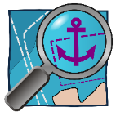
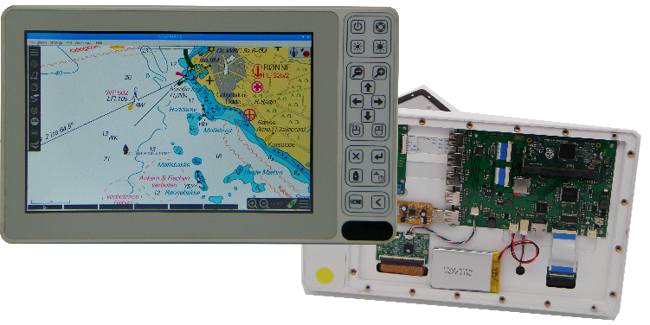

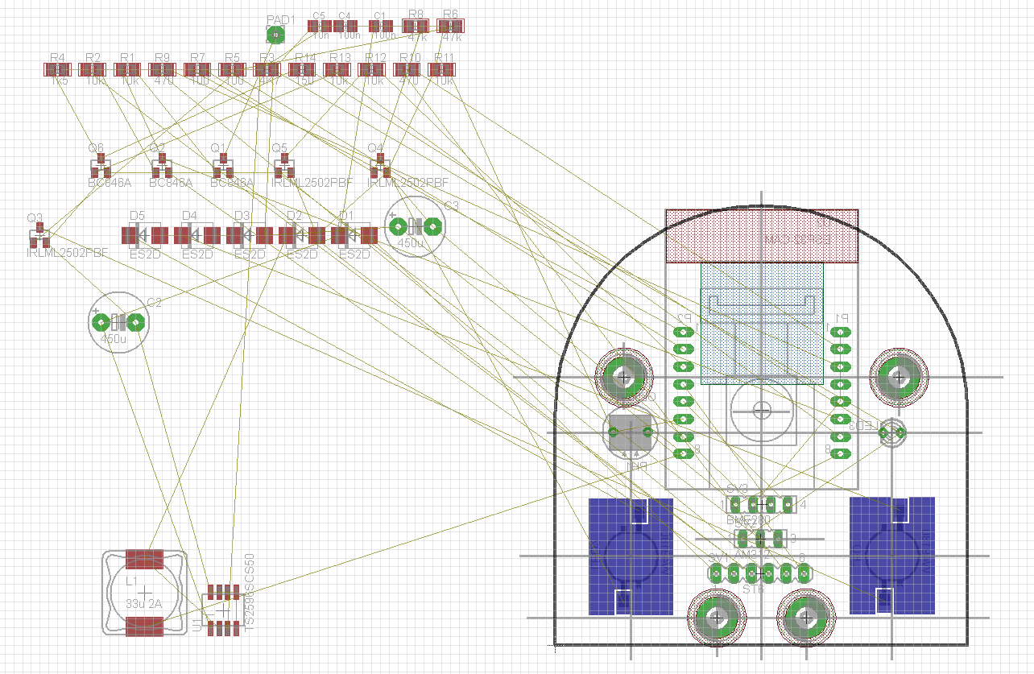
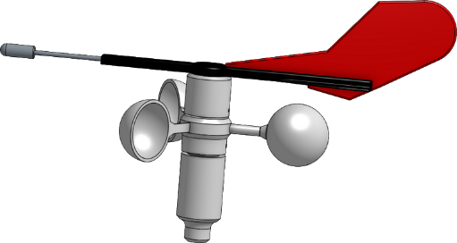
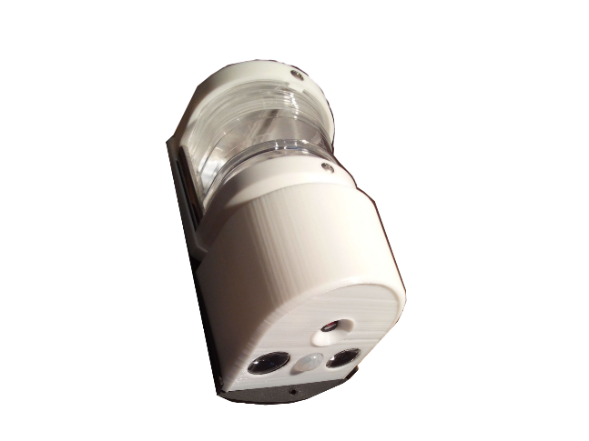
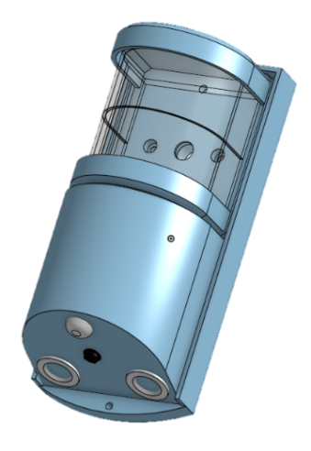
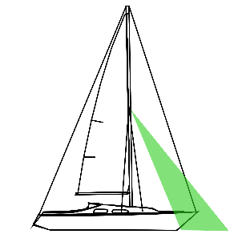
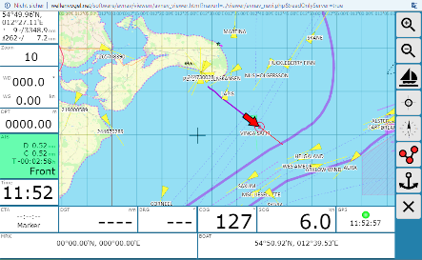

DIY Plotter_CM3
Do-it-yourself plotter construction with professional production techniques
Sophisticated component selection
Free sea charts / OpenData
Since 2009 - free nautical chart project
OpenSeaMap as part of the OpenStreet Map project (since 2004)
2.3 million users (2015)
Who we are…
...a group of sailing-enthusiastic technicians with many ideas committed
to DO-IT-YOURSELF (DIY) thoughts
SignalK
New and open data format for the exchange of maritime data
Developed by sailors for sailors
Data exchange for ships & ports
How we develop…
...with openness,
... participation of the later users,
... hardware and software openness,
... mutual support and with fun at cool maritime projects
DIY Windsor
Own production by means of 3D printing
Wireless data transmission
Display on tablet/mobile phone
Costs from approx. 125 EUR
Projects…
... DIY Plotter_CM3 - DIY Plotter
... DIY Foredeck Camera
... Open data formats
...SignalK
...OpenData / -Maps
... DIY Wind sensor
... DIY plotter software (AvNav)
... DIY Remote Control for Raymarine AP
... DIY Tiller Pilot
... Open Navi Software
OpenPlotter vs OpenCPN
... DIY multifunctional display
... DIY Plotter - Base 10'' Car Radio
... DIY Engine Diagnosis
... Node-RED Sensor integration
... DIY Battery Controller
... DIY Marine Control Server
DIY Foredeck camera
Project start 06/2019
Distance camera, deck lighting & motion detector
Incl. spring sensor (°C/hPa/rel.F.)
Only 5 months to the prototype
AVNav
From Andreas Vogel www.Wellenvogel.net
Fast navigation software for the Rasperry Pi® with access for tablets & mobile phones on board
NMEA Protocols & Multiplexer

Slide 2
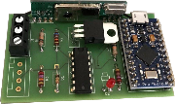
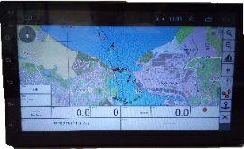
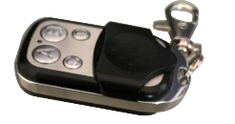
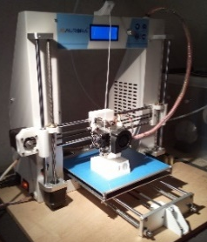
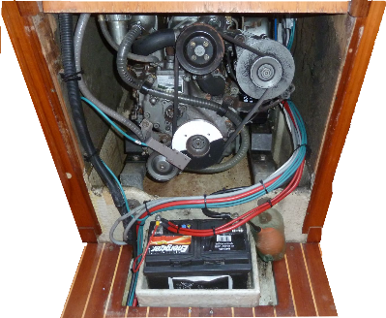

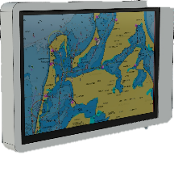

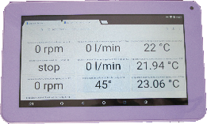

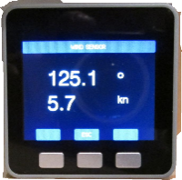
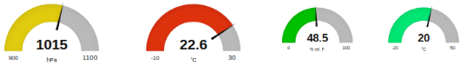
DIY Android Plotter
- Base 2 DIN car radio
- Android 9
- Bluetooth,WLAN
- 4 channel audio
- Touch-capable 7'' device
- Costs: approx. 60-200 EUR
Further information
DIY Remote Control Autopilot
For AP with Seatalk protocol
For reproduction on Arduino basis
optional OLED display for wind indication
Costs: approx. 35 EUR
Production
FabLab & MakerSpaces
Free access to modern production facilities for private persons
e.g. circuit board assembly
Directory - FabLabs worldwide
www.offene-werkstaetten.org
DIY Tiller Pilot
Project start: 2018
further DIY autopilot projects (e.g. pyPilot, .....)
2018 first test series for the position sensor
DIY engine diagnosis
Retrofitting for all engine types
Measurements
Cooling water flow rate
Temperature cooling circuits
Motor Speed
Shaft speed
Early alarm in case of problems to avoid engine damage
3D-printer
Increasingly for private..
user available
from about 180 EUR
OpenPlotter & OpenCPN
Program collection OpenPlotter
free navigation software OpenCPN
Runnable e.g. on Rasperry Pi®
Where you can find us..
...at www.Segeln-Forum.de
... and that on the new homepage
www.open-boat-projects.org
BOAT 2020 HALL 10 - Booth H11
DROP BY - AND JOIN IN!
Presentations in the REFIT Arena, project setups at the stand!
DIY multifunctional display
MD5Stack® Application for NMEA2000
3 versions
Wireless with OpenPlotter
Wireless with ESP32 WiFi Gateway
Directly on the CAN bus
Easily configurable
Easy to expand
Costs approx. 50 EUR
Node-RED Sensor integration
- Free programming environment
Visual programming for beginners
Attractive visualization DIY

