Slide 1

Lunch and Learn Data Science with R
Using the Open Government Portal API within R
Automating R Scripts Using Github Actions
Using the Adobe Analytics API within R for web analytics (another time)
Patrick Little
Product Owner, Open.Canada.ca
Treasury Board of Canada Secretariat
June 2021

Slide 2

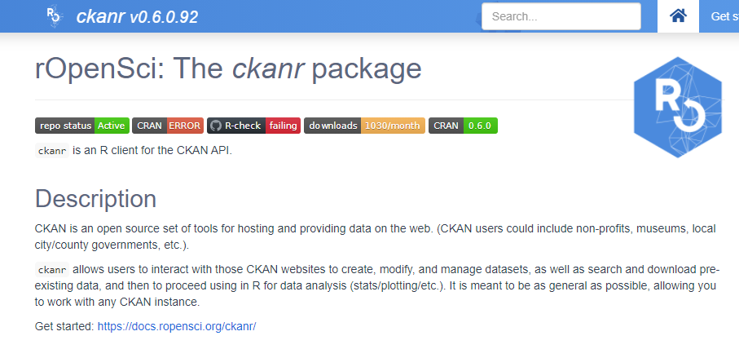
Using the Open Government Portal API within R
CKAN is a very widely used software package for powering open data portal catalogues (data.gov, open.Canada.ca, data.gov.uk,
etc.). CKAN is heavily focused on managing the metadata about datasets, not really serving as a data lake or data warehouse.
CKAN offers an API that can be used to GET metadata from the system - which is the focus of today’s presentation, but also
update and manage existing metadata records.

Slide 3
The CKAN API
The best source for detailed information about using the CKAN API is the API Guide (https://docs.ckan.org/en/2.6/api/index.html)
The CKAN Action API is an RPC style API. To call the CKAN API, post a JSON dictionary in an HTTP POST request to one of CKAN’s API endpoints. The parameters for the API function should be given in the JSON dictionary.
CKAN will also return its response in a JSON dictionary. For API calls where you are only retrieving data, you can use a GET request like you would with a REST API.
When using the ckanr package we don’t need to worry about HTTP methods, everything is nicely wrapped in the R package.

Slide 4

What You Can Do With It
Function | API Command | CKANR function
Get information about the system | action/status_show | ckan_info()
List organizations that publish data | action/organization_list | organization_list()
Get a list of datasets on the portal | action/package_list | package_list()
Retrieve the metadata for a dataset | action/package_show/{id} | package_show()
Search for datasets | action/package_search?q={something-to-search-for} | package_search()
Get a list of recently updated datasets | action/recently_changed_packages_activity_list
And more!

Slide 5
Example Use Case
What datasets relating to COVID-19 are available on the portal?
Web Browser: https://open.canada.ca/data/api/action/package_search?q="COVID“
Batch: curl --verbose https://open.canada.ca/data/api/action/package_search?q=“COVID”
ckanr: package_search(q=“COVID”)
Notes:
Example Explained:
1st lets click on the link in the web browser. Here we can see the API call in the browser, and we can see the API response in the window. When we use the browser like this, in the same way you would surf the internet, there are lots of things done automatically behind the scenes. If we dive into it, by inspecting the page in EDGE or CHROME, we can see a lot more information. You will notice the GET method, and the 200 OK response. This is like we were mentioning earlier in the presentation, you can use the get method with most API calls where you are not changing any data.
2nd let’s do the exact same thing we did in the browser, but do it in a more programmatic way. We can open up a command prompt (windows+R, cmd, enter). Then we can type curl https://open.canada.ca/data/api/action/package_search?q=“COVID-19”, you’ll notice that the output looks nearly identical. We can use the parameter - –verbose to get the system to show all the hidden header information.
3rd as we mentioned we can also use the post method with this API, so let’s try and POST to the same endpoint. curl --verbose –X POST https://open.canada.ca/data/api/action/package_search?q=“COVID”.
4th lets save that JSON as a file so we can use it to do something else. Cd desktop-> > searchresults.json

Slide 6
GitHub Actions
GitHub Actions make it easy to automate all your software workflows. Github Actions let you build, test, and deploy your code right from GitHub. You can also assign code reviews, manage branches, and triage issues the way you want with actions.
Whether you want to build a container, deploy a web service, or automate welcoming a new user to your open-source project — there’s an automated action for that.
From: https://betterprogramming.pub/github-actions-the-what-why-and-how-3868d5a86292
Notes:
Example Explained:
1st lets click on the link in the web browser. Here we can see the API call in the browser, and we can see the API response in the window. When we use the browser like this, in the same way you would surf the internet, there are lots of things done automatically behind the scenes. If we dive into it, by inspecting the page in EDGE or CHROME, we can see a lot more information. You will notice the GET method, and the 200 OK response. This is like we were mentioning earlier in the presentation, you can use the get method with most API calls where you are not changing any data.
2nd let’s do the exact same thing we did in the browser, but do it in a more programmatic way. We can open up a command prompt (windows+R, cmd, enter). Then we can type curl https://open.canada.ca/data/api/action/package_search?q=“COVID-19”, you’ll notice that the output looks nearly identical. We can use the parameter - –verbose to get the system to show all the hidden header information.
3rd as we mentioned we can also use the post method with this API, so let’s try and POST to the same endpoint. curl --verbose –X POST https://open.canada.ca/data/api/action/package_search?q=“COVID”.
4th lets save that JSON as a file so we can use it to do something else. Cd desktop-> > searchresults.json

Slide 7
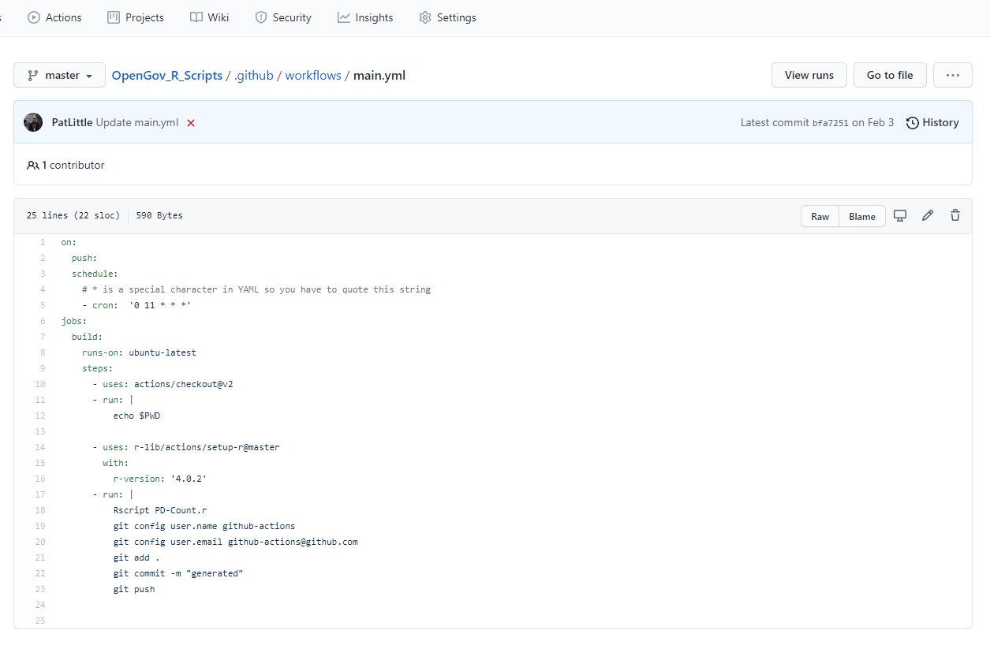
Running an R Script in GitHub Actions
The workflow is defined in a YAML file
On push – runs every time you push to the repo
On schedule – runs on cron times
Good to echo $PWD on 1st run – then you can modify the Rscript to refer to files within the repo
r-lib setup-r will setup your container
Then Rscript is the script to run,
git . add
git commit
git push
Notes:
Example Explained:
1st lets click on the link in the web browser. Here we can see the API call in the browser, and we can see the API response in the window. When we use the browser like this, in the same way you would surf the internet, there are lots of things done automatically behind the scenes. If we dive into it, by inspecting the page in EDGE or CHROME, we can see a lot more information. You will notice the GET method, and the 200 OK response. This is like we were mentioning earlier in the presentation, you can use the get method with most API calls where you are not changing any data.
2nd let’s do the exact same thing we did in the browser, but do it in a more programmatic way. We can open up a command prompt (windows+R, cmd, enter). Then we can type curl https://open.canada.ca/data/api/action/package_search?q=“COVID-19”, you’ll notice that the output looks nearly identical. We can use the parameter - –verbose to get the system to show all the hidden header information.
3rd as we mentioned we can also use the post method with this API, so let’s try and POST to the same endpoint. curl --verbose –X POST https://open.canada.ca/data/api/action/package_search?q=“COVID”.
4th lets save that JSON as a file so we can use it to do something else. Cd desktop-> > searchresults.json

