Slide 1
An Introduction to the HLA
Part 1
Roger McFarlane
School of Computer Science
McGill University
Montreal, CANADA

Slide 2
Overview
Introduction
  What is the HLA?
  Motivation
  Goals
  History
HLA Components
  The RTI
  HLA Rules
  Object Model Templates
For Next Time …

Slide 3
Introduction
What is the HLA?
Motivation
Goals
History

Slide 4
What is the HLA?
A general framework facilitating interoperability and reusability of distributed simulation components
Developed by the Defense Modeling and Simulation Office (DSMO)
Developed for the United States Department of Defence (DoD)
IEEE Standard 1516-2000

Slide 5
Motivation
Many large/complex simulations involve individual “sub-simulations” of components
“Sub-simulations” are often heterogeneous (in the type of simulation and type of component)
Simulators for the components may already exist
Re-implementing or retrofitting a simulation system is risky and expensive

Slide 6
Goals
Reusability
  A component simulation may be used in different scenarios and applications over its lifetime
Interoperability
  Aggregate simulations composed of multiple component simulations
  Aggregate simulations distributed across heterogeneous hardware and software platforms
  Reuse without significant code change or development cost
  Combine component simulations with diverse models of computation and representation

Slide 7
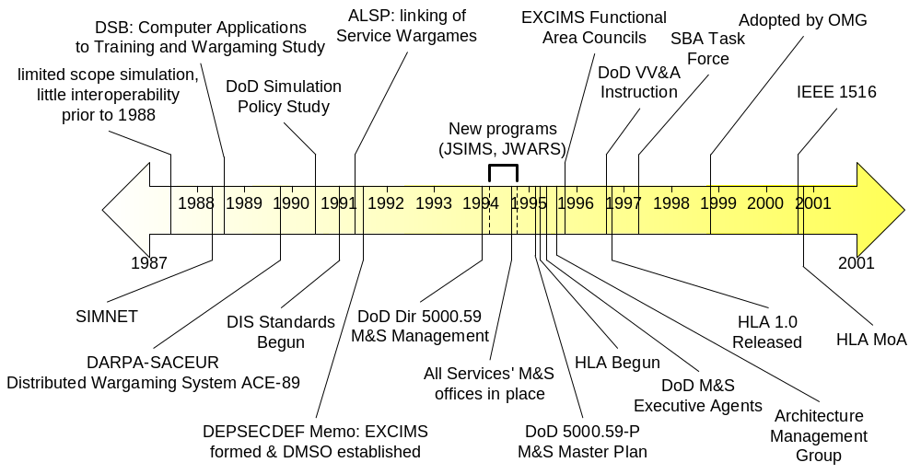
History

Slide 8
HLA Components
Definitions & Terms
Technical Architecture
HLA Rules
Object Model Templates
Run-Time Interface Specification

Slide 9
Definitions & Terms (1)
Federate
  An application which supports the HLA and is capable of participating in a simulation.
Federation
  A declaration between federates describing how and what will be simulated.
Federation Execution
  A run-time instantiation of a Federation; that is, an actual simulation execution.

Slide 10
Definitions & Terms (2)
The HLA provides the Federation formalism by which Federates can be modeled such that the framework can support Federation Execution
This is really no different from any other type of modelling and simulation application!

Slide 11
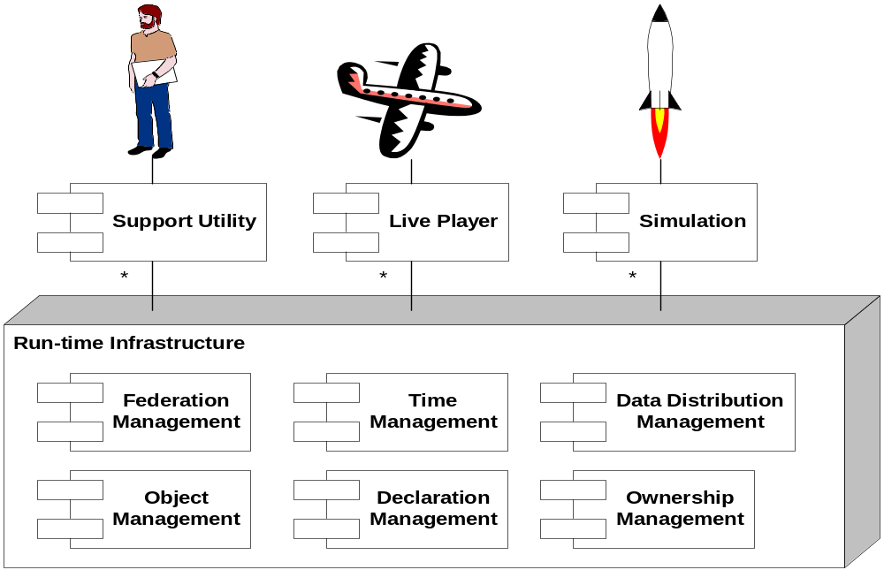
Technical Architecture

Slide 12
Run-Time Infrastructure (1)
Software layer providing common services to federates
RTI Specification defines the interfaces federates must use to obtain services and interact with other federates
RTI Specification defines interfaces to be exposed by federates in order to be recognizable by the services and by other federates

Slide 13
Run-Time Infrastructure (2)
Improvements on older standards
  DIS
  ALSP
Provides efficient inter-federate communications
Separate simulation concerns from communication concerns
Language and platform independent

Slide 14
Service Groups
Federation management
Declaration management
Object management
Ownership management
Time management
Data Distribution management
Support services

Slide 15
Federation Management
Controls federation-wide activities during a federation execution
Services offered:
  Creation and destruction of federation executions
  Joining and resigning of federates
  Pause/Resume federation execution
  Save/Restore federation execution

Slide 16
Declaration Management
Manages the publisher/subscriber model for information exchange
Services Offered:
  Publish Object/Interaction class
  Subscribe to Object Class Attribute
  Subscribe to Interaction Class
  Control Updates
  Control Interactions

Slide 17
Object Management
Manages the lifecycle and message passing for object instances
Services Offered:
  Register/Discover Object
  Update/Reflect Attribute Values
  Send/Receive Interaction
  Remove Object
  Manage Transport/Ordering

Slide 18
Ownership Management
Supports cooperative modelling by allowing attribute ownership to be transferred across instances
Services Offered:
  Assume/Divest Attribute Ownership
  Acquire/Release Attribute Ownership
  Notification of ownership changes

Slide 19
Time Management (1)
Coordinates federate time advancement along the federation time axis
Attempts to preserve causality and ordering
Mechanisms supported:
  Conservative synchronization (with look ahead)
  Optimistic synchronization (e.g., time warp)
  Hybrid methods
  Time-stepped
  Real-time driven

Slide 20
Time Management (2)
Federates request permission to advance their local time
Services offered
  Request Time Advance
  Notification of Granting of Time Advance
  Request Next Event
  Notification of Granting of Next Event
  Queue Management

Slide 21
Data Distribution Management
Efficient data transmission between federates
Uses routing spaces to direct data only to the interested parties
  Publisher specifies the update region
  Subscribes specify their interest region
  Intersection define routing space

Slide 22
Support Services
Miscellaneous functionality useful to joined federates
  Name-to-handle transformation
  Handle-to-name transformation
  Setting advisory switches
  Manipulating regions
  RTI start-up and shutdown

Slide 23
HLA Rules
Define the behaviour and capabilities of federates and federations
Five rules for Federates
Five rules for Federations

Slide 24
Federation Rules
Must have an Federation Object Model (FOM) documented using the OMT
All object representation occur in the Federates, not in the RTI
Data exchange between instances of objects in different Federates occurs via the RTI
Federates must interact with the RTI in accordance with the HLA Interface Specification
During Federation Execution, an instance attribute may be owned by at most one federate at any given time

Slide 25
Federate Rules
Must have a Simulation Object Model (SOM) documented using the OMT
Must be able to update/reflect instance attributes and send/receive interactions as specified in their SOM
Must be able to dynamically transfer/accept ownership of attributes during federation execution as specified in their SOM
Must be able to vary the conditions under which they provide attribute updates as specified in their SOM
Must manage their local time in a manner which allows them to coordinate data exchange with other federates

Slide 26
Object Model Templates
Provide a mechanism for specifying data exchange and coordination within a federation
Provide a mechanism for describing the capabilities of federate
Facilitates design and implementation of common tools for building HLA compliant objects

Slide 27
Types of Object Models
Simulation Object Model (SOM)
Federation Object Model (FOM)
Management Object Model (MOM)

Slide 28
SOM – Simulation Object Model
Information exposed/consumed by a federate
  Objects
  Interactions
  Attributes (of Objects and Interactions)
  Parameters (of Objects and Interactions)

Slide 29
FOM – Federation Object Model
Specifies data exchange between federates
  Objects
  Interactions
  Attributes (of Objects)
  Parameters (of Interactions)
Provides the “information model contract” which governs the simulation
Provides the foundation for interoperability

Slide 30
MOM – Management Object Model
A predefined set of information elements to be included in the FOM
Contains data relevant to Federation Execution
Federates may also include referenced to the MOM if they may influence Federation execution.

Slide 31
OMT Components (1)
Object model identification table
Object class structure table
Interaction class structure table
Attribute table
Parameter table
Dimension table
Time representation table

Slide 32
OMT Components (2)
User-supplied tag table
Synchronization table
Transportation type table
Switches table
Datatype tables
Notes table
FOM/SOM lexicon

Slide 33
Object Model Identification Table
Describes object model’s identity
Useful for developers seeking reusable object models
Why the object model was constructed
How the object model was constructed
Who knows about the object model
Where to look for more information

Slide 34
Example –
Object Model Identification Table
Category | Information
Name | Object Model Name
Type | “SOM” or “FOM”
Version | Version Identifier
Modification Date | Last Modified Date (YYYY-MM-DD)
Purpose | Why was this object model developed
Application Domain | Type of Application
Sponsor | Name of Sponsoring Organization
POC | Point of Contact’s Name
POC Organization | Point of Contact’s Organization
POC Telephone | Point of Contact’s Telephone Number
POC Email | Point of Contact’s Email Address
References | Where to look for further information
Other | Any other relevant data

Slide 35
Object Class Structure Table
Defines super/sub-class relationships
For a SOM, classes may be tagged …
  P: The federate is capable of publishing at least one attribute of the object class.
  S: The federate is capable of subscribing to at least one attribute of the object class.
  PS: Both publish and subscribe
  N: The federate is neither capable of publishing nor subscribing to any attributes of the object class.
For a FOM, the same tags indicate if least one federate is capable of publishing or subscribing to any attribute of the object class

Slide 36
Example –
Object Class Structure Table
HLA Object Root (N) | Customer (PS)
 | Bill (PS)
 | Order (PS)
 | Employee (N) | Greeter (PS)
 |  | Waiter (PS)
 |  | Cashier (PS)
 | Food (S) | Main Course (PS)
 |  | Appetizer (S) | Soup (S) | Clam Chowder (PS) | Manhattan (P)
 |  |  |  |  | New England (P)
 |  |  |  | Beef Barley (PS)
 |  |  | Salad (S)
 |  | Entrée (S) | Seafood (S) | Shrimp (PS)
 |  |  |  | Salmon (PS)
 |  |  | Pasta (PS)

Slide 37
Interaction Class Structure Table
Specific actions which a federate may perform
Hierarchy similar to Object Class Structure Table
SOM Interactions may be tagged
  P: The federate is capable of publishing the interaction class
  S: The federate is capable of subscribing to the interaction class
  PS: Both publish and subscribe
  N: The federate is neither capable of publishing nor subscribing to the interaction class
Same tags used for a FOM meaning there does (not) exist a federate capable of publishing/subscribing to the interaction class.

Slide 38
Example –
Interaction Class Structure Table
HLA Object Root (N) | Customer Transaction (P) | Customer Seated (PS)
 |  | Order Taken (P) | From Kids Menu (P)
 |  |  | From Adult Menu (P)
 |  | Food Served (P) | Drink Served (P)
 |  |  | Appetizer Served (P)
 |  |  | Main Course Served (P)
 |  |  | Dessert Served (P)
 |  | Customer Pays (P) | By Credit Card (P)
 |  |  | By Cash (P)
 |  | Customer Leaves (P)

Slide 39
Attribute Table
Properties of an object
May be published by the object
Other objects may subscribe to an attribute
Declare how/when an attribute value changes
Declares if attribute ownership may be transferred between objects
  DA = Divest & Acquire
  N = Neither
The transport used to communicate the attribute

Slide 40
Example – Attribute Table
Object | Attribute | Data Type | Update Type | Update Condition | D/A | P/S | Available Dimensions | Transportation | Order
Root | PTDO | NA | NA | NA | N | N | NA | HLAReliable | Timestamp
Employee | PayRate | Dollars | Cond. | Merit | DA | PS | NA | HLAReliable | Timestamp
 | Seniority | Years | Periodic | +1/year | DA | PS | NA | HLAReliable | Timestamp
 | Phone | Text | Cond. | Empl. Req. | DA | PS | NA | HLAReliable | Timestamp
 | Address | Text | Cond. | Empl. Req. | DA | PS | NA | HLAReliable | Timestamp
Employee.Waiter | Efficiency | WaiterValue | Cond. | Perf. Rev. | DA | PS | NA | HLAReliable | Timestamp
 | Manner | WaiterValue | Cond. | Perf. Rev. | DA | PS | NA | HLAReliable | Timestamp
 | State | WaiterTask | Cond. | Work Flow | DA | PS | NA | HLAReliable | Timestamp
Food. Drink | Cups | DrinkCount | Cond. | Cust. Req. | N | PS | BarQuantity | HLAReliable | Timestamp
Food. Drink. Soda | Flavour | FlavourType | Cond. | Cust. Req. | N | PS | BarQuantity, SodaFlavour | HLAReliable | Timestamp

Slide 41
Parameter Table
Additional information to characterize an interaction
Identify the transport used to deliver the parameter
Identify the ordering constraints for the parameter
  Timestamp
  Receive (indeterminate order)

Slide 42
Example – Parameter Table
Interaction | Parameter | Datatype | Available Dimensions | Transportation | Order
Customer Seated | NA | NA | NA | HLAReliable | Timestamp
FoodServed. MainCourse Served. | TemperatureOK | ServiceStat | WaiterID | HLAReliable | Timestamp
 | AccuracyOK | ServiceStat
 | TimelinessOK | HLABoolean

Slide 43
Dimension Table
Maps domain specific data values onto integer values ranging from zero to some upper bound
Specifies the legal values which may be transmitted across the RTI
Enables Data Distribution Management (DDM) and Declaration Management (DM)
Used to specify update and subscribe regions to the RTI

Slide 44
Example – Dimension Table
Name | DataType | Upper Bound | Normalization | Value If Not Specified
SodaFlavour | flavourType | 3 | LinearEnumerated( Flavour, {Cola, Orange, Grape}) | [0..3)
BarQuantity | DrinkCount | 25 | Linear( NumberCups, 0, 25) | [0..1)
WaiterId | EmpId | 20 | Linear(WaiterId, 0, 20) | Excluded

Slide 45
Time Representation Table
Declares the format used to represent time
  For a federate
  Across a federation
Declares the semantics of time
  For a federate
  Across a federation
Used by the RTI to coordinate federates during federation execution

Slide 46
Example –
Time Representation Table
Category | Datatype | Semantics
Timestamp | TimeType | Floating point value expressed in minutes
LookAhead | LAType | Non-negative floating point value expressed in minutes

Slide 47
User-Supplied Tag Table
Extensible mechanism for specifying auxiliary data
Provides additional control and coordination of services provided by the HLA

Slide 48
Example –
User-Supplied Tag Table
Category | Datatype | Semantics
Update/Reflect | NA | NA
Send/Receive | NA | NA
Delete/Remove | HLAascii | Reason for deletion
Divestiture Request | PriorityLevel | High value for immediate transfer
Divestiture Completion | NA | NA
Acquisition Request | PriorityLevel | High value for immediate transfer
Request Update | NA | NA

Slide 49
Synchronization Table
Provides a federate synchronization mechanism
Federates declare the synchronization points they support
Federations describe the synchronization points to be used

Slide 50
Example –
Synchronization Table
Label | Tag Datatype | Capability | Semantics
InitialPublish | NA | Achieve | Achieved when all classes are published and subscribed, and all initially present objects are registered
InitialUpdate | NA | Achieve | Achieved when instance attribute values for all initially present objects are updated
BeginTimeAdvance | NA | Achieve | Achieved when time management services are invoked
PauseExecution | TimeType | Register Achieve | Achieved when the time advance after the time in the user-supplied tag is attained; time advance requests should then cease

Slide 51
Transportation Type Table
The RTI provides different mechanisms for transport of interactions and attributes between federates
Allows a federate designer to describe the transports supported by the federate
Allows federation designers to describe the transportation contracts between federates

Slide 52
Example –
Transportation Type Table
Name | Description
HLAreliable | Provide reliable delivery of data in the sense that TCP/IP delivers its data reliably
HLAbestEffort | Make an effort to deliver data in the sense that UDP provides best-effort delivery
LowLatency | Choose the delivery mechanism that results in the lowest latency from service initiation to callback invocation at the receiving federate

Slide 53
Switches Table
Configuration of RTI activities performed on behalf of a federate
A few services are configured globally for the federation
  Auto Provide, Convey Region Designator Sets
Most services are configured per federate
  Attribute Scope Advisory, Attribute Relevance Advisory, Object Class Relevance Advisory, Service Reporting
Services may be either enabled or disabled

Slide 54
Switch Definitions (1)
Auto Provide
  (Global) Should the RTI automatically solicit updates from instance attribute owners when an object is discovered.
Convey Region Designator Sets
  (Global) Should the RTI provide the optional Sent Region Set argument with invocations of Reflect Attribute Values and Receive Interaction.
Attribute Scope Advisory
  Should the RTI advise federates when attributes of an object instance come into or go out of scope.

Slide 55
Switch Definitions (2)
Attribute Relevance Advisory
  Should the RTI advise federates about whether they should provide attribute value updates for the value of an attribute of an object instance.
Object Class Relevance Advisory
  Should the RTI advise federates about whether they should register instances of an object class.
Interaction Relevance Advisory
  Should the RTI advise federates about whether they should send interactions of an interaction class.
Service Reporting
  Should the RTI report service invocations using MOM.

Slide 56
Example – Switches Table
Switch | Setting
Auto provide | Disabled
Convey region designator sets | Disabled
Attribute scope advisory | Enabled
Attribute relevance advisory | Enabled
Object class relevance advisory | Enabled
Interaction relevance advisory | Enabled
Service reporting | Disabled

Slide 57
Data Type Tables (1)
Globally define data types referenced in other tables
Basic Data Table
  Name, Size in Bits, Interpretation, Endian, Encoding
Simple (Scalar) Data Table
  Name, Representation, Units, Resolution, Accuracy, Semantics
Enumerated Data Table
  Name, Representation, Enumerator, Values, Semantics

Slide 58
Data Type Tables (2)
Array Data Table
  Name, Element Type, Cardinality, Encoding, Semantics
Fixed Record Data Table
  Record Name, Field-{Name,Type,Semantics}*, Encoding, Semantics
Variant Record Data Table
  Record Name, Encoding, Semantics,
  Discriminant-{Name, Type, Semantics}*,
  Alternative--{Name,Type,Semantics}*

Slide 59
Notes Table
Named annotations may be attached to any OMT entry
A set of name/value pairs
Value is free form explanatory text
Name uniquely identifies the corresponding explanatory text
Notes may be referenced multiple times

Slide 60
FOM/SOM Lexicon
Name/Value pairs
Dictionary tables associating every class, attribute, interaction, parameter, etc (by name) with a free form text description (value)

Slide 61
For Next Time …
A deeper look at the RTI

Slide 62
References (1)
IEEE Std 1516-2000, IEEE Standard for Modeling and Simulation (M&S) High Level Architecture (HLA) - Framework and Rules.
IEEE Std 1516.1-2000, IEEE Standard for Modeling and Simulation (M&S) High Level Architecture (HLA) - Federate Interface Specification
IEEE Std 1516.2-2000, IEEE Standard for Modeling and Simulation (M&S) High Level Architecture (HLA) - Object Model Template (OMT) Specification.

Slide 63
References (2)
Roy Crosbie and John Zenor, “High Level Architecture, Module 1 – Basic Concepts, Parts 1-6.” California State University, Chico.
http://www.ecst.csuchico.edu/~hla
<Steffen Strassburger's text>

