Slide 1
Generating Distributed Interactive Simulation (DIS) Codebases using opendis7-source-generator
TUTORIAL
Don Brutzman
Modeling Virtual Environments Simulation (MOVES) Institute
Naval Postgraduate School (NPS), Monterey California USA
SISO Simulation Interoperability Workshop (SIW)
7 February 2022
brutzman@nps.edu

Slide 2
Tutorial sections
top
Programmers: Configuring your system with NetBeans
Developers: building opendis7-source-generator
Developers: building opendis7-java library
Programmers: using opendis7-java.full.jar library
Programmers: Example applications
Community: Getting involved

Slide 3
1. Configuring Your System for opendis-java
Distributed Simulation
to top
Setting up Java, Netbeans, Git, Wireshark
and Utility Tools
brutzman@nps.edu

Slide 4

Configuring your System
Good collaboration setup is important!
This illustrated slideset covers
  Java OpenJDK and Javadoc
  Netbeans and Netbeans plugins
  Git and gitlab.nps.edu
  Collaboration and Troubleshooting
Full configuration details
are maintained at
Savage Developers Guide

Slide 5
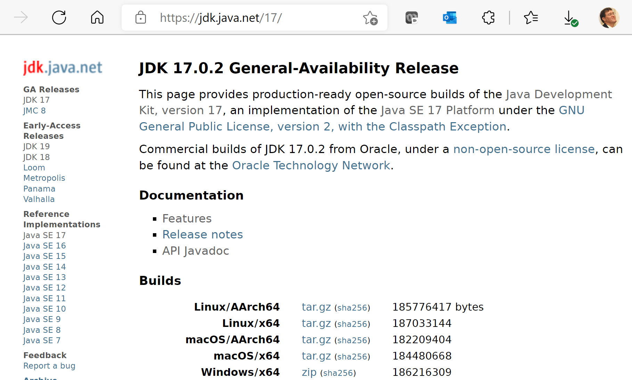
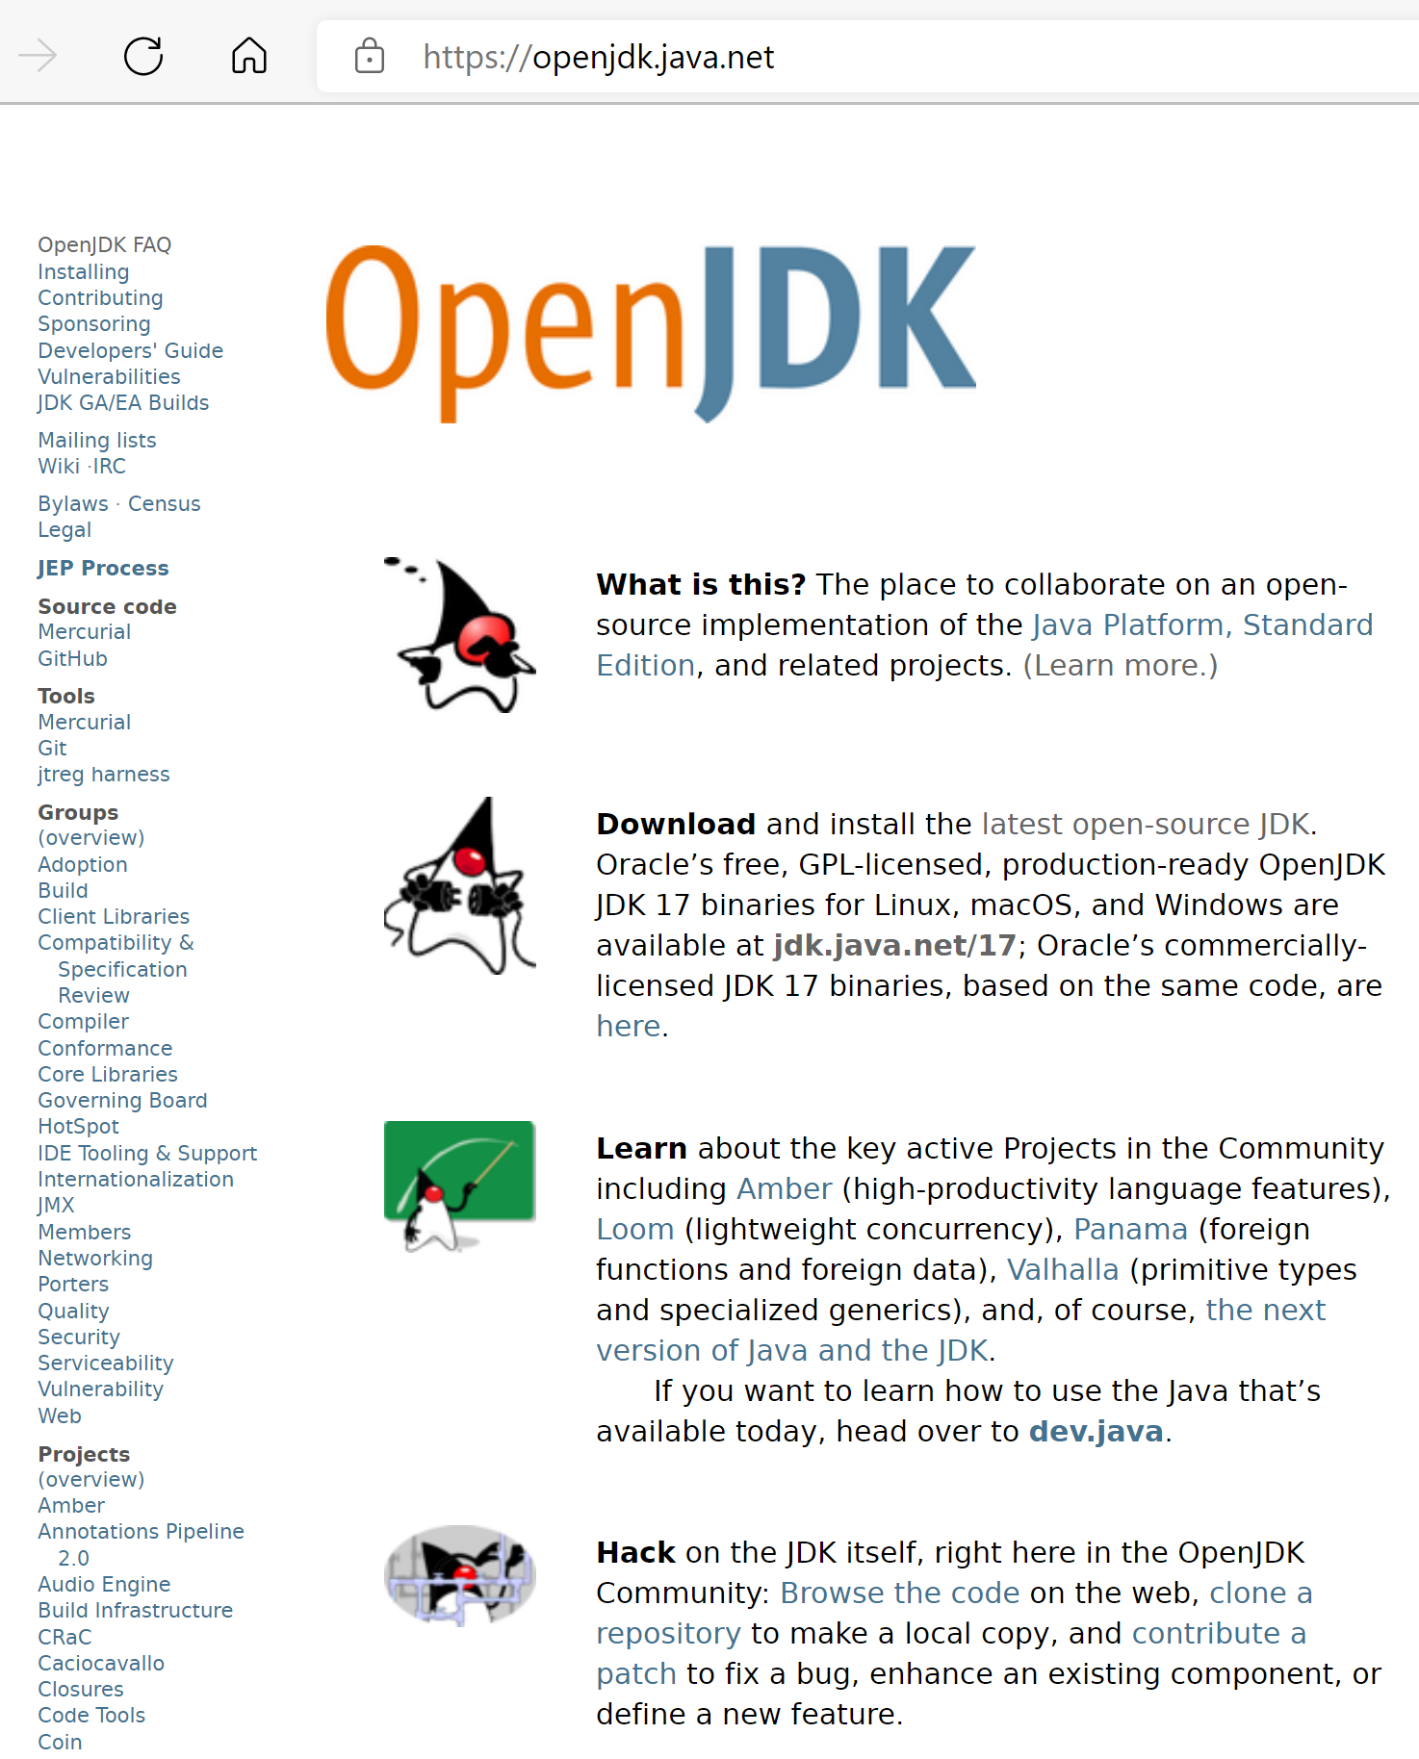
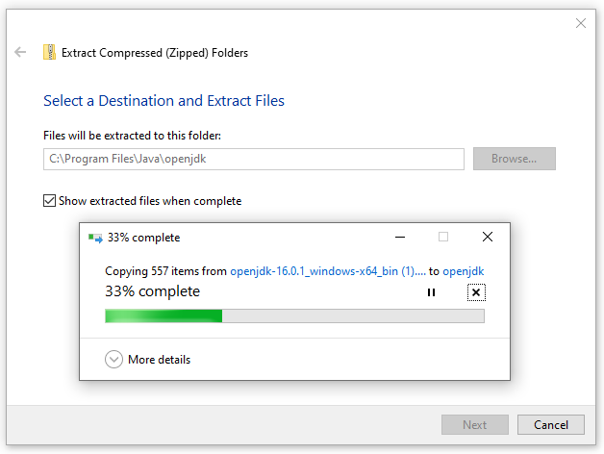
Java install
https://openjdk.java.net
Requires admin permissions

Slide 6
Javadoc
JDK 17 Javadoc Documentation describes all Java interfaces in full detail. Good to download local copy with your Java install.
You can go to build.xml and run Javadoc on your local projects for MV3500 examples and MV3500 assignments.
Be sure to update or add Javadoc entries in your programs. Having Javadoc available greatly aids understanding and will often uncover flaws that might otherwise go unnoticed.
Guidance: How to Write Doc Comments for the Javadoc Tool

Slide 7
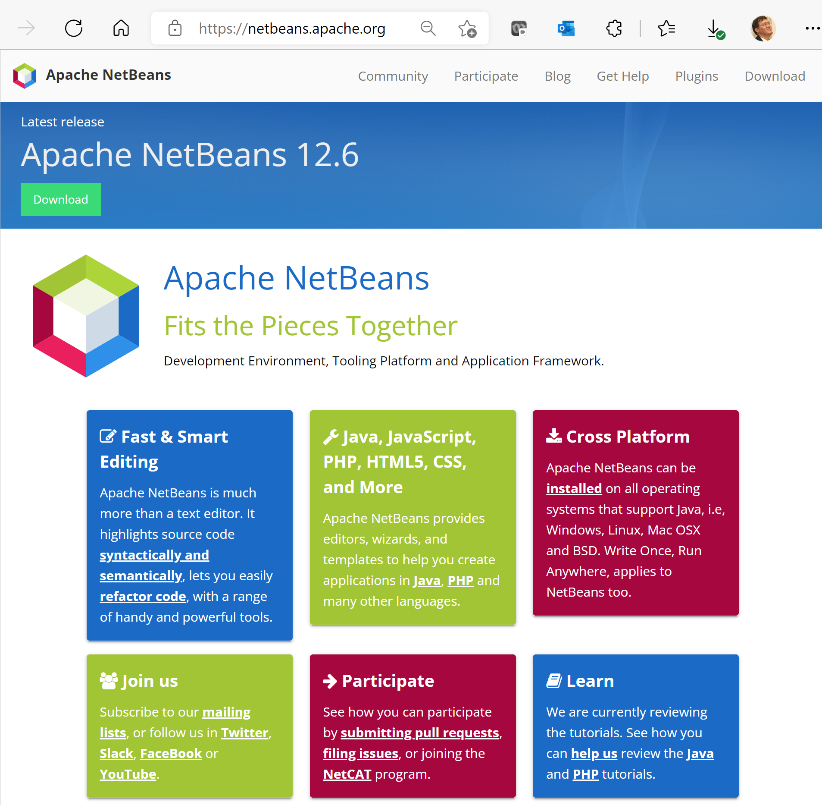
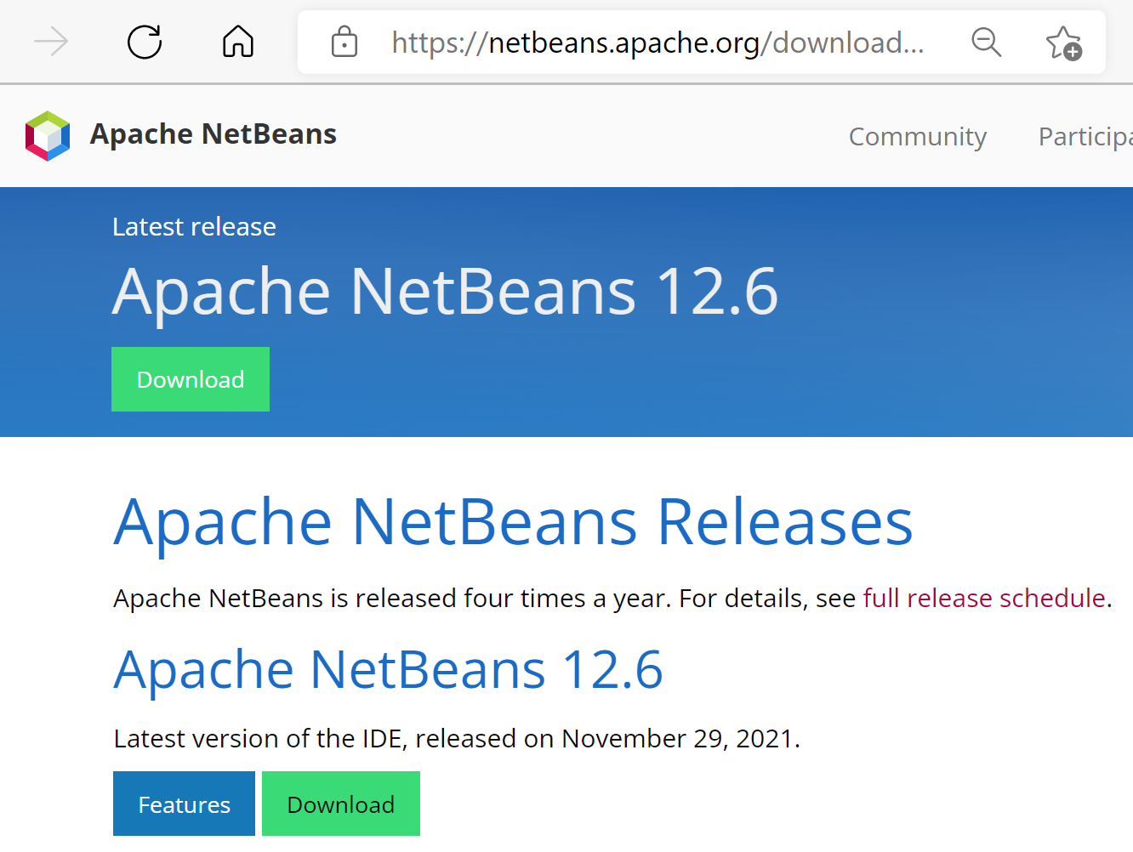
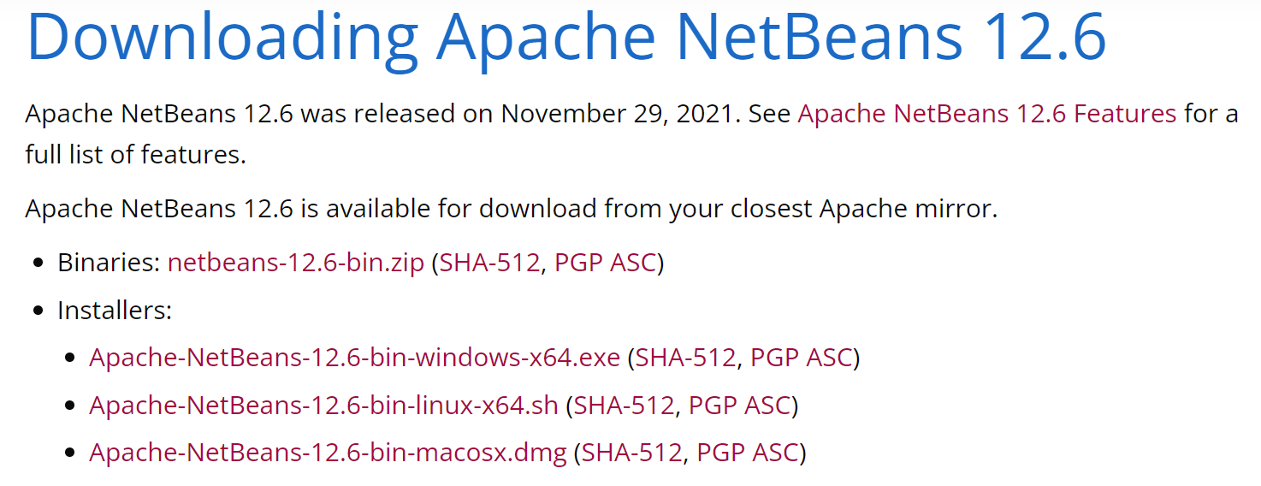
Apache Netbeans Installation

Slide 8
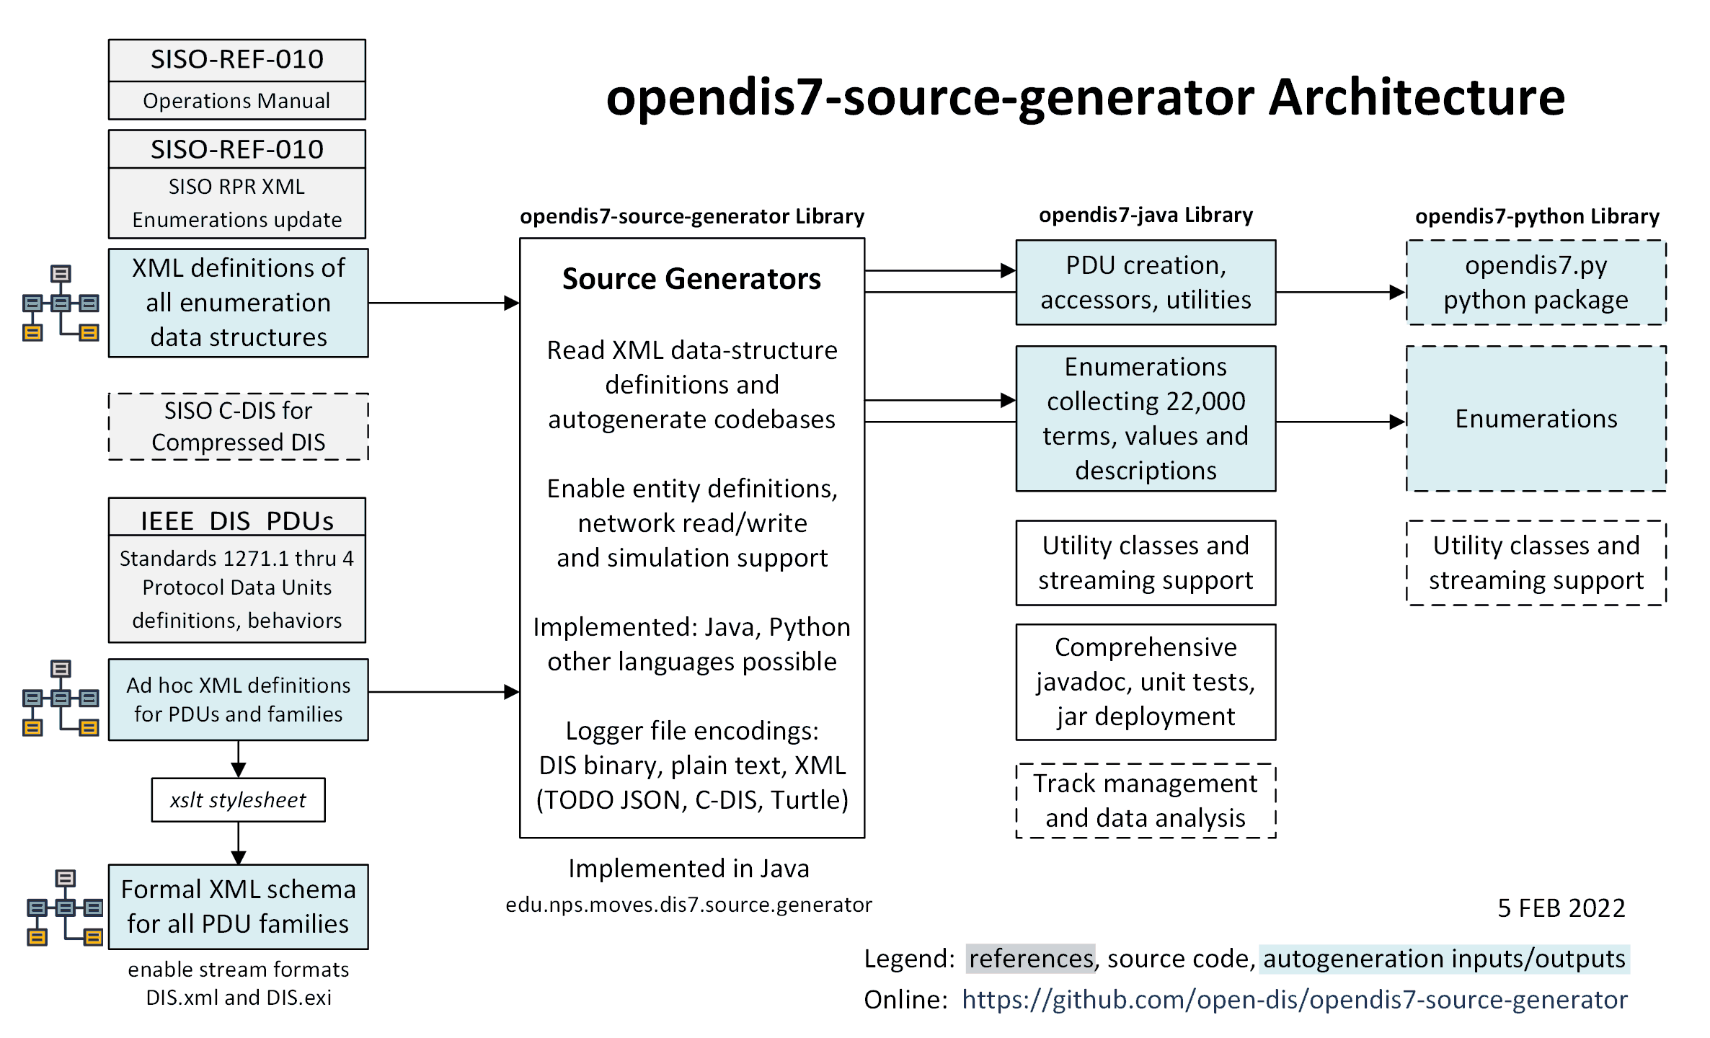
opendis7-source-generator Architecture
8

Slide 9
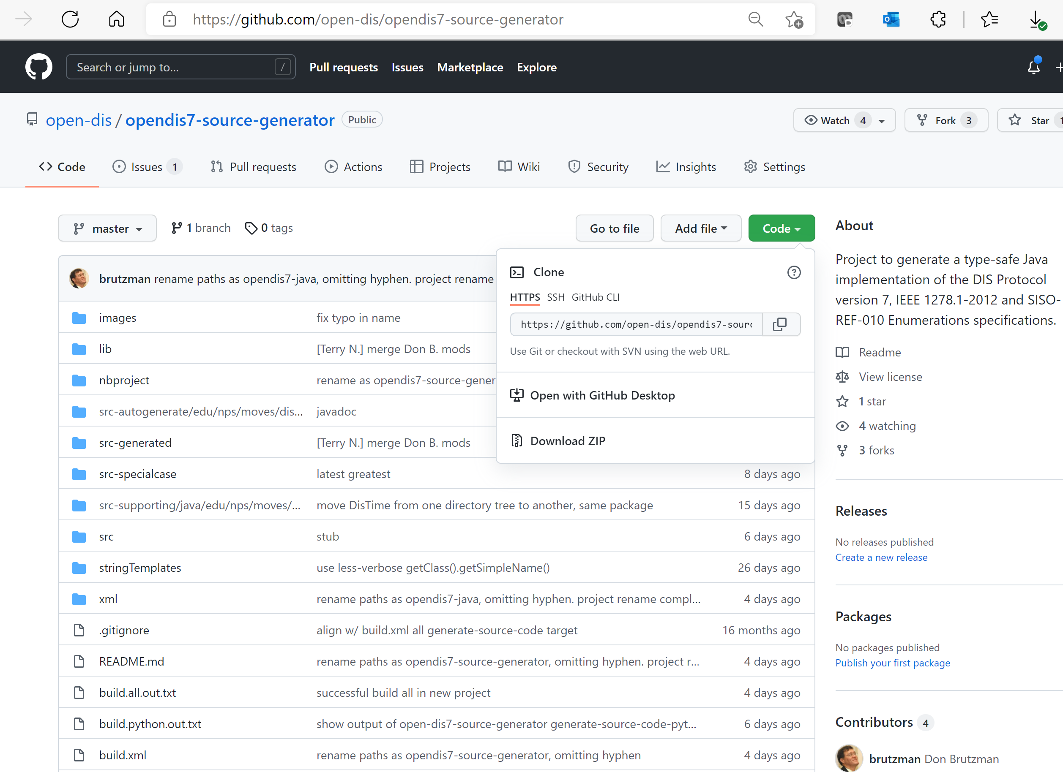
opendis7-source-generator

Slide 10
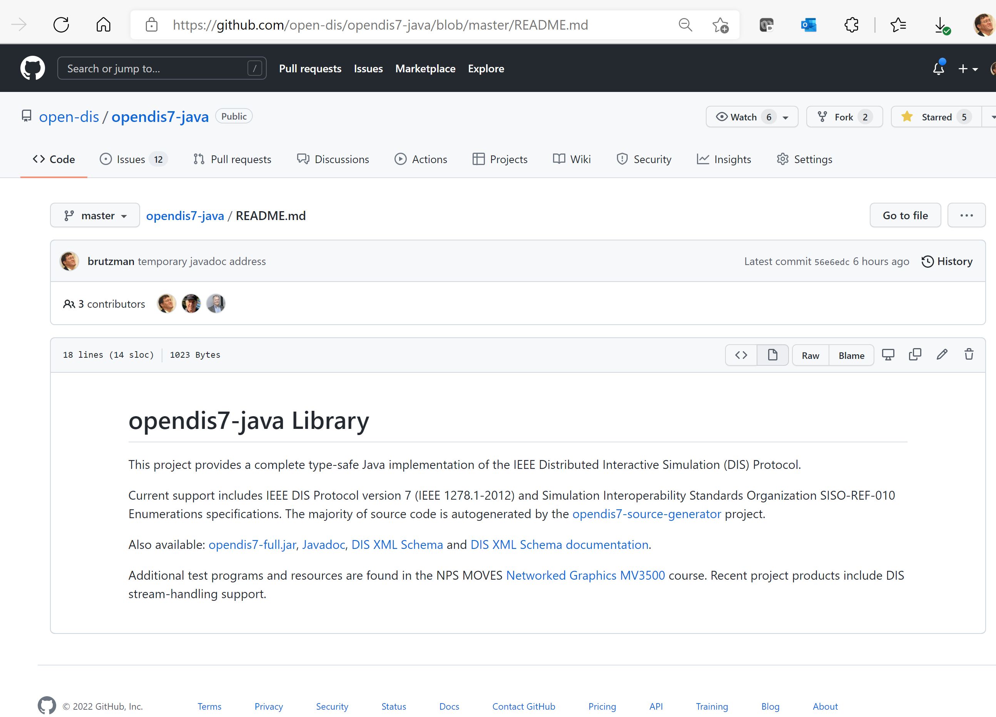
opendis7-java

Slide 11
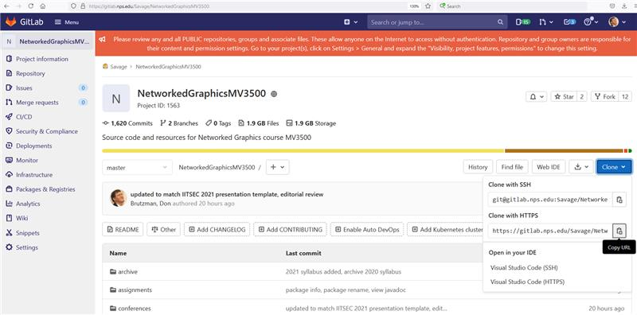
MV3500 course repository clone address
https://gitlab.nps.edu/Savage/NetworkedGraphicsMV3500.git

Slide 12
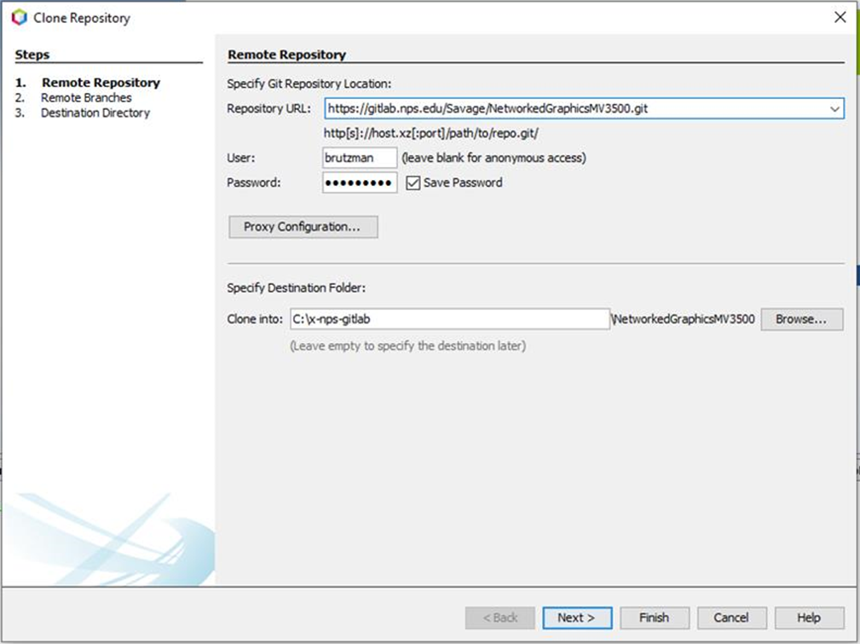
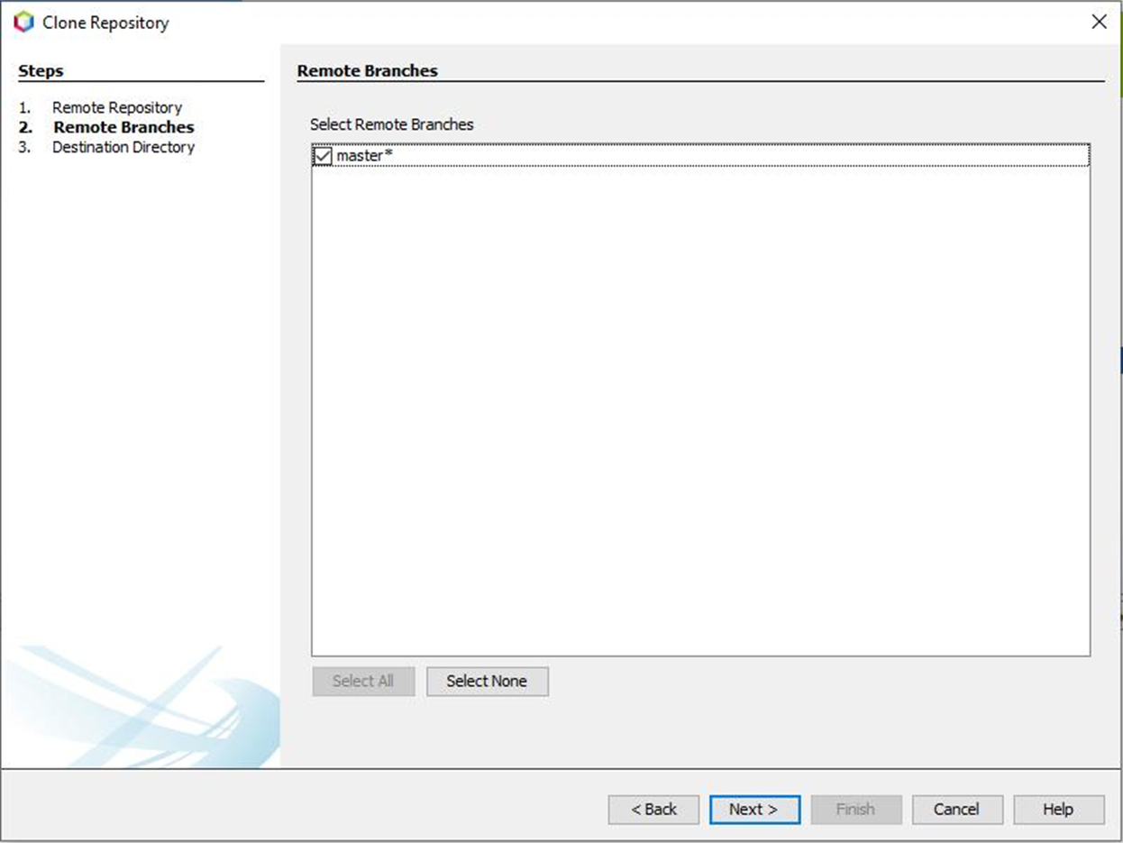
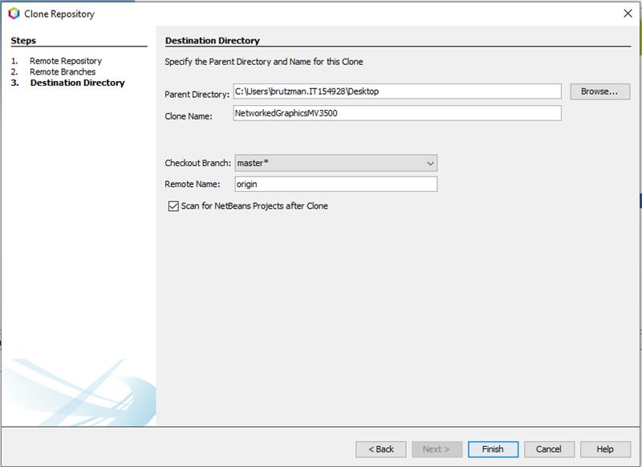
Cloning course projects using NetBeans git
Netbeans can clone copies of git repositories and open projects:
  Netbeans menu: Team > Git > Clone …
https://gitlab.nps.edu/Savage/NetworkedGraphicsMV3500.git

Slide 13
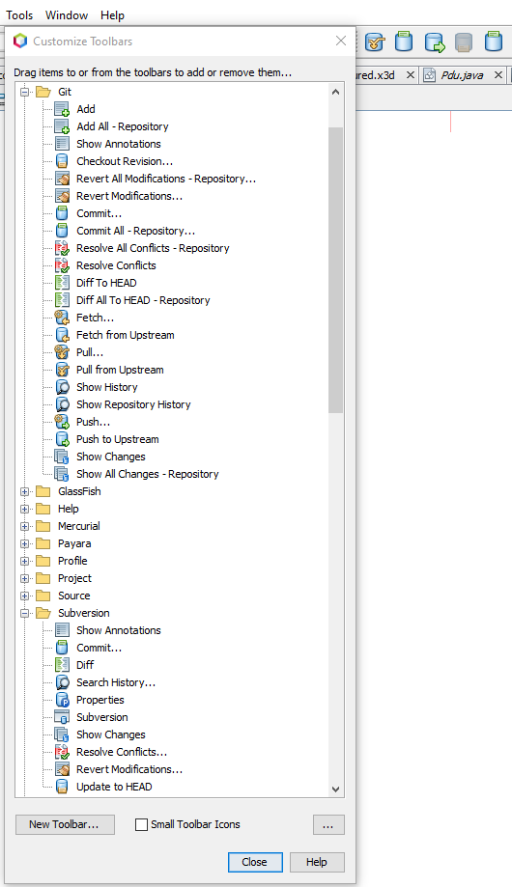
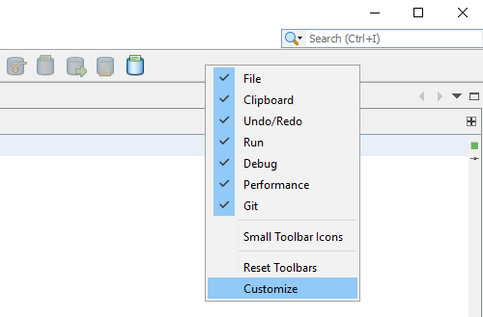
NetBeans toolbar buttons
(shortcuts) for subversion, git
NetBeans toolbar > right-click > Customize
Drag suggested buttons on/off the toolbar
git: Pull from Upstream, Commit…, Push to Upstream
Subversion: Update to head, Commit…

Slide 14
Additional git Tutorial References
Using Git in Apache NetBeans
https://netbeans.apache.org/kb/docs/ide/git.html
How to Use Git and GitHub from NetBeans
https://www.youtube.com/watch?v=MbwHOw6JXI8
GitLab Tutorial For Beginners | What Is GitLab And How To Use It?
https://www.youtube.com/watch?v=mX7lKoabmDw
GitLab Beginner Tutorial 1 | Introduction and Getting Started
https://www.youtube.com/watch?v=Jt4Z1vwtXT0

Slide 15
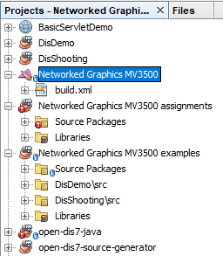
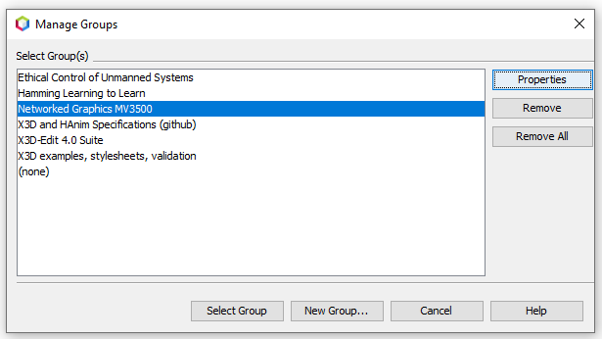
NetBeans: Open Projects
Netbeans offers to open projects after git cloning.
Alternative manual method:
  Netbeans menu: File > Open Project
  Select directory for project you have cloned
Need to also select subprojects
  (so that build.xml files work)
You can also create a Project Group for
convenience when handling many projects.

Slide 16
Netbeans Debugger
Critical feature for testing, understanding and improving code
Using the Visual Debugger in NetBeans IDE
https://netbeans.apache.org/kb/docs/java/debug-visual.html
How to Use the NetBeans Debugger for Java
https://www.youtube.com/watch?v=2Z9B8wYhKWw
NetBeans - Debugging Project
https://www.youtube.com/watch?v=-ioCLAGrWGs

Slide 17
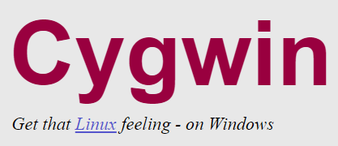
Cygwin Unix Tools on Windows
Utility tools in the Cygwin distribution provide a full repertoire of Unix command-line functionality for Windows systems.
  These Unix tools are already present on MacOSX or Linux systems
Needed for NetBeans Windows users to run terminal window
Administrator permissions required for installation, setting PATH.
Helps project development across multiple operating systems.
  Savage Developers Guide: Cygwin
  https://savage.nps.edu/Savage/developers.html#Cygwin

Slide 18

Wireshark
Wireshark lets you monitor traffic and inspect packet contents.
  https://www.wireshark.org
  “Wireshark is the world’s foremost and widely-used network protocol analyzer. It lets you see what’s happening on your network at a microscopic level and is the de facto (and often de jure) standard across many commercial and non-profit enterprises, government agencies, and educational institutions. Wireshark development thrives thanks to the volunteer contributions of networking experts around the globe and is the continuation of a project started by Gerald Combs in 1998.”
Installation, configuration, references and video links found at
  NetworkedGraphicsMV3500 > documentation > Wireshark > README
  https://gitlab.nps.edu/Savage/NetworkedGraphicsMV3500/-/blob/master/documentation/Wireshark/README.md

Slide 19
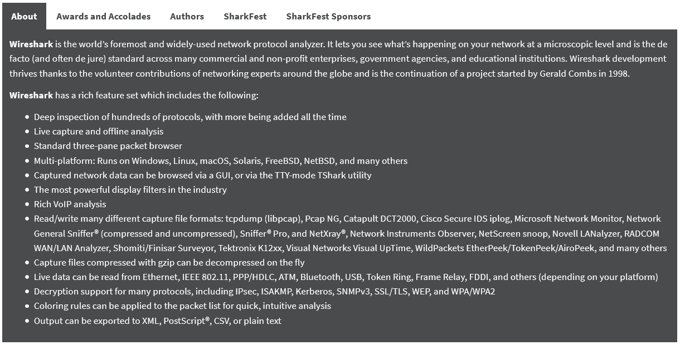
About Wireshark

Slide 20

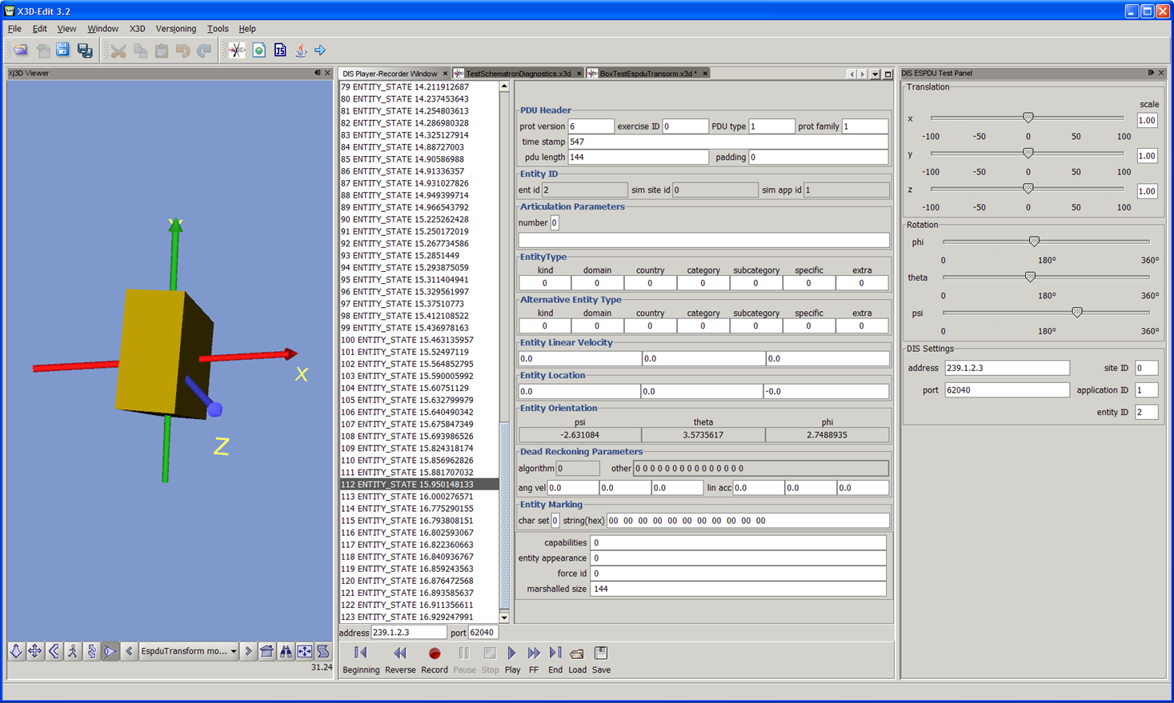
X3D-Edit 4.0 Authoring Tool for Extensible 3D (X3D) Graphics
To support recording, inspection and playback of DIS PDUs
https://savage.nps.edu/X3D-Edit
WARNING:
YMMV, rewrite planned

Slide 21
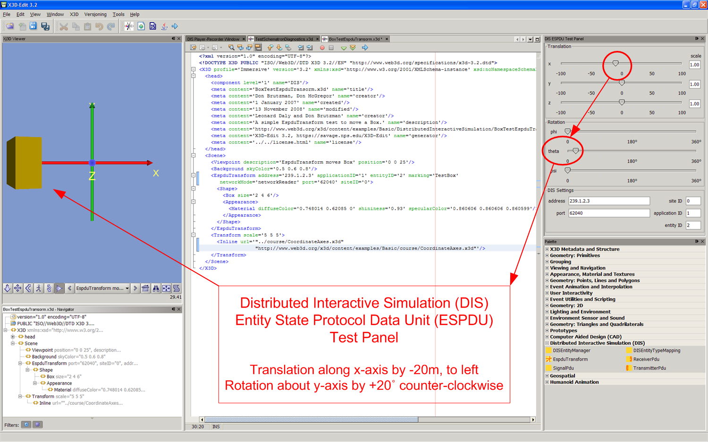
X3D-Edit and DIS example

Slide 22
2. Developers: building opendis7-source-generator
to top
How the process works, part one.
Not necessary for regular Java programmers!
brutzman@nps.edu

Slide 23
build.xml target tasks
build all: clean, compile, create autogenerated classes, then copy results to opendis7-java project
Performs intermediate compilation to ensure correct syntax
Produces preliminary Javadoc, again to ensure correct syntax
Modifying source generators is highly tricky, not recommended

Slide 24
Internal directories to produce source code
directory | Description
build | Class files and Javadoc for intermediate compilation
dist | Distribution directory for intermediate jar files
nbproject | Netbeans project configuration files
src-autogenerate | Source generator library, written in Java, to create various new codebases
src-generated | Autogenerated source code
src-specialcase | Classes requiring special treatment and bugfixes
src-supporting | Classes from master library
stringTemplates | Special Java formatting files to facilitate creation of large source programs
xml | SISO enumerations, DIS PDU XML descriptions, autogenerated DIS XML schema
src-python | Work in progress

Slide 25
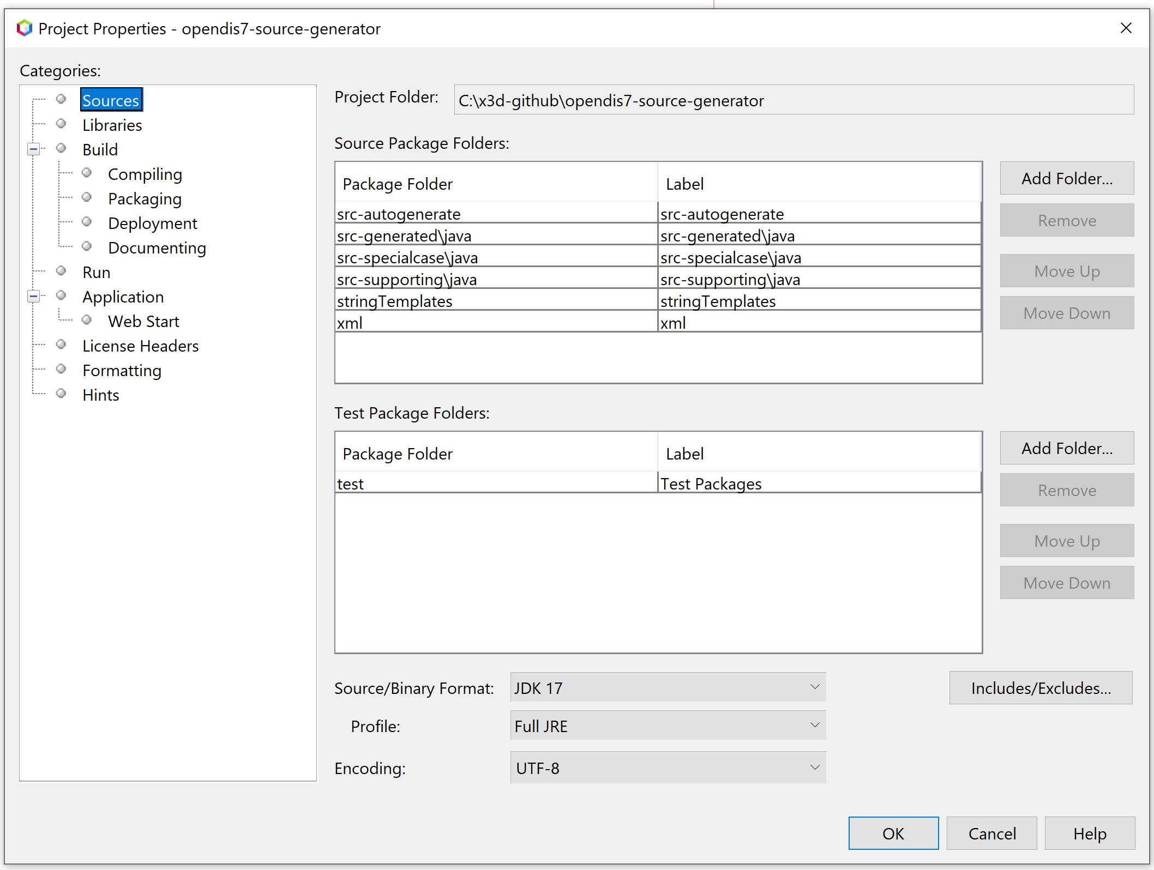
Netbeans project properties opendis7-source-generator

Slide 26
3. Developers: building opendis7-java library
to top
How the process works, part two.
Not necessary for regular Java programmers!
brutzman@nps.edu

Slide 27
build.xml target tasks
build all: clean, compile autogenerated and supporting classes, create distribution products
Performs final compilation and unit testing
Produce integrated Javadoc for all PDU and Enumeration classes
Modifying source generators is highly tricky, not recommended

Slide 28
Internal directories to create Java distribution
directory | description
build | Class files and Javadoc for final compilation
dist | Distribution directory for final jar files, especially “fat jar” opendis7-java-full.jar
nbproject | Netbeans project configuration files
lib | Library jar files
src | Supporting utility classes that cannot be autogenerated
src-generated | Autogenerated source code
test | Test classes, maintained separately from regular tree for independent checks

Slide 29
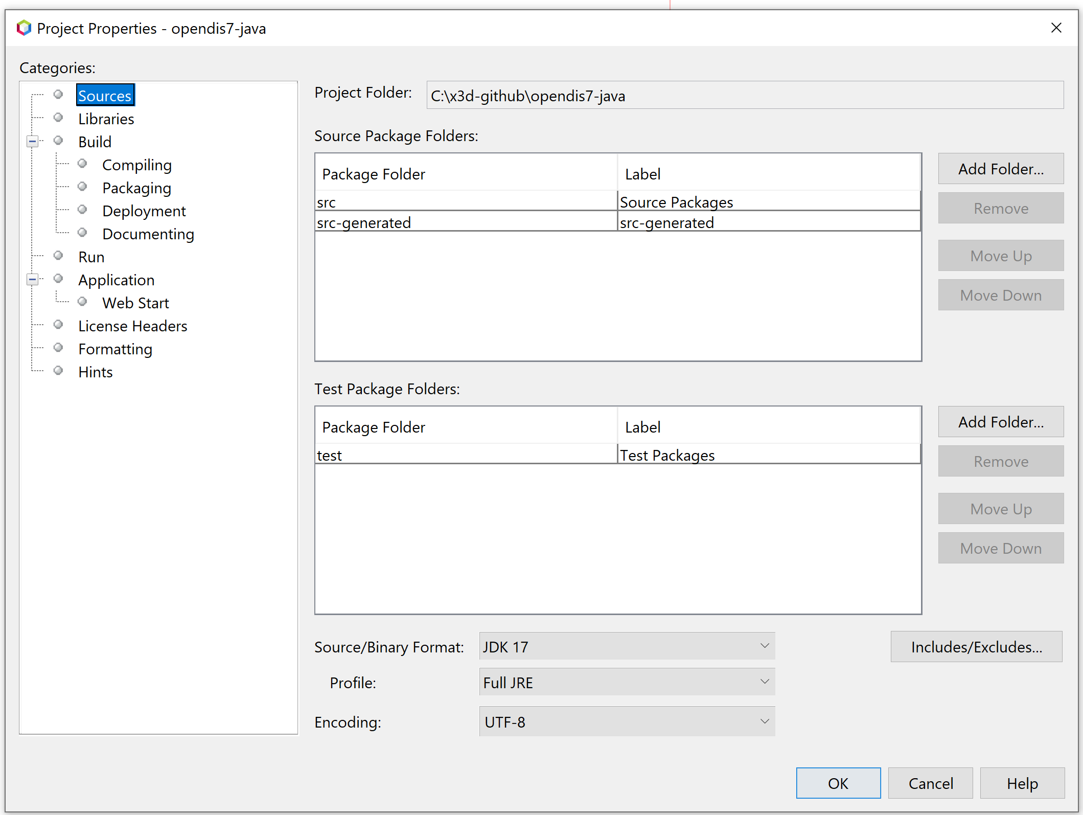
Netbeans project properties opendis7-java

Slide 30
4. Programmers: using opendis-java library
to top
Add DIS to your Java application
brutzman@nps.edu

Slide 31
opendis7-java.full.jar
Contains all classes, source (for context-sensitive Javadoc)
https://gitlab.nps.edu/Savage/NetworkedGraphicsMV3500/-/raw/master/lib/opendis7-full.jar (200MB) also available at
https://savage.nps.edu/open-dis7-java
Add local copy of opendis7-full.jar to your CLASSPATH
Also available: smaller open-dis7-pdus-classes.jar (880KB) for embedded use

Slide 32
Confirmation of design notes
Plain Old Java Objects (POJO)
Open source, free for any use
Minimal inclusion of external libraries in “fat” opendis7-full.jar
may get reduced even further when possible
Traceable in debug mode to aid troubleshooting

Slide 33
Javadoc
JDK 17 Javadoc Documentation describes Java interfaces in detail, providing online documentation and context-sensitive help
Be sure to update or add Javadoc entries in your programs. Having Javadoc available greatly aids understanding and will often uncover flaws that might otherwise go unnoticed.
Guidance: How to Write Doc Comments for the Javadoc Tool

Slide 34
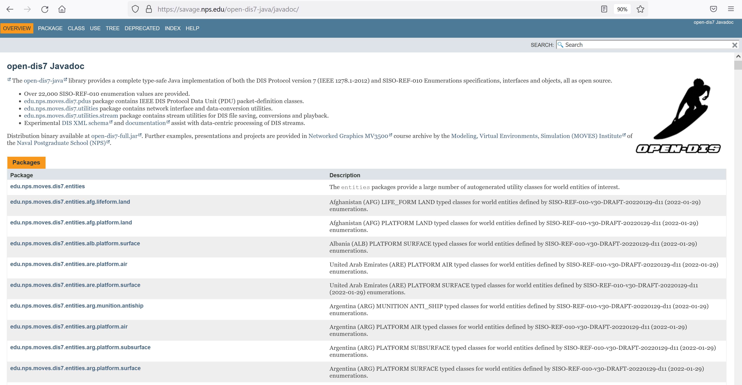
Javadoc screenshot
https://savage.nps.edu/open-dis7-java/javadoc

Slide 35
5. Programmers: Example Applications
to top
Unit tests and sample programs
brutzman@nps.edu

Slide 36
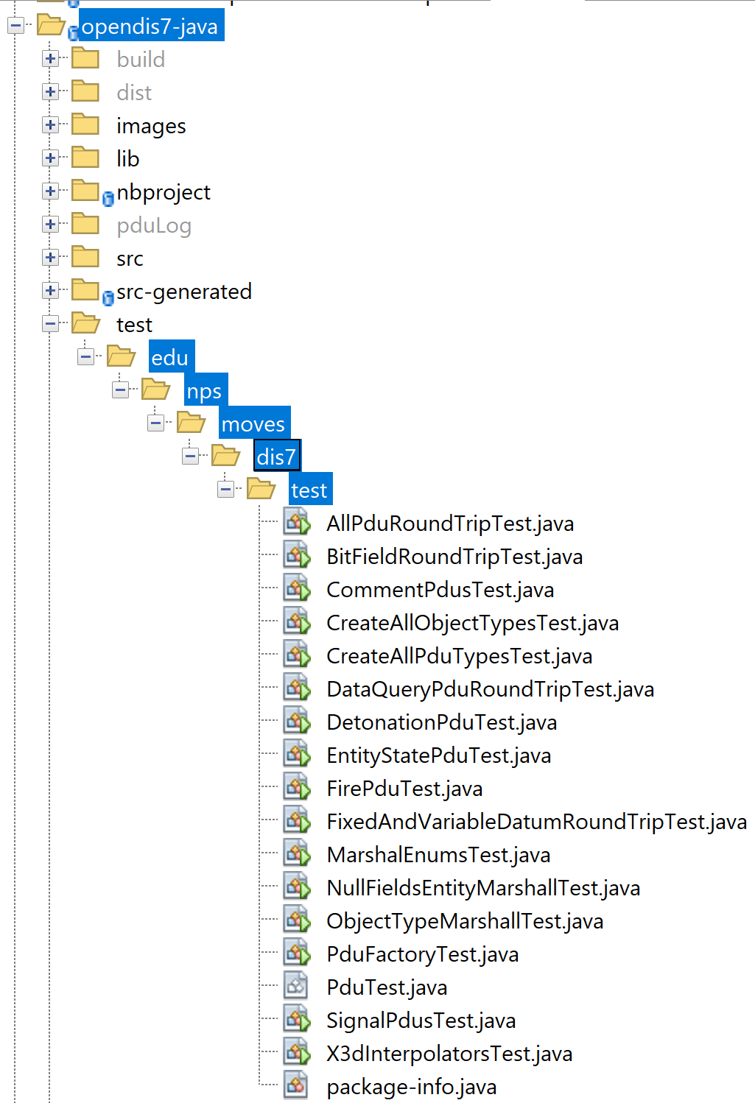
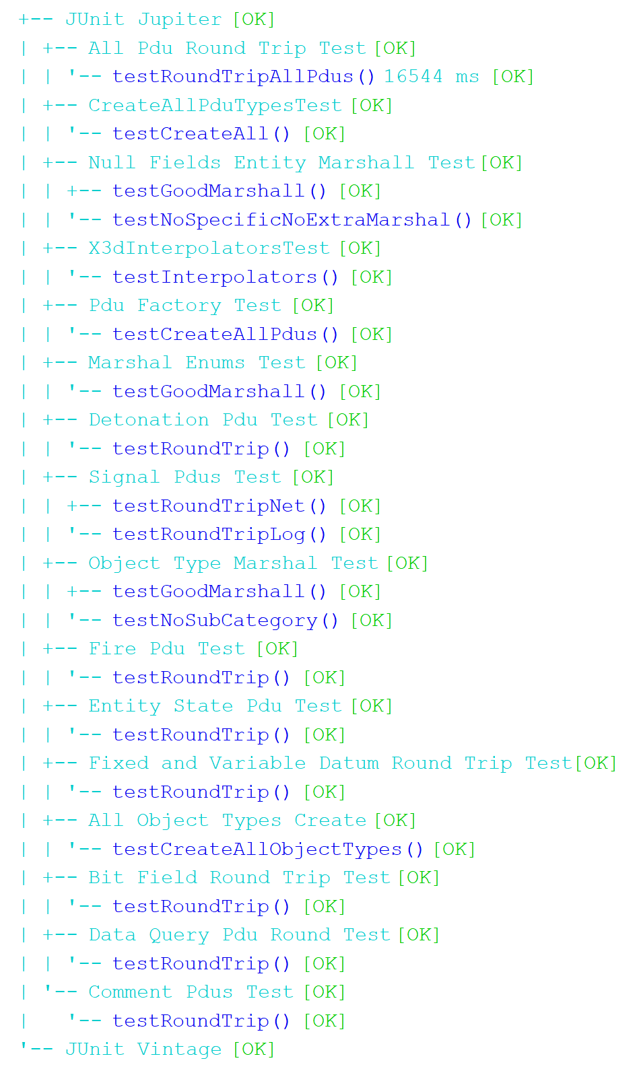
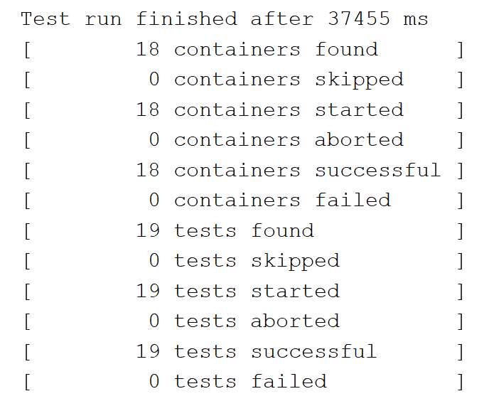
build.xml: ant test test subdirectory
full build results
available in
build.all.out.txt

Slide 37
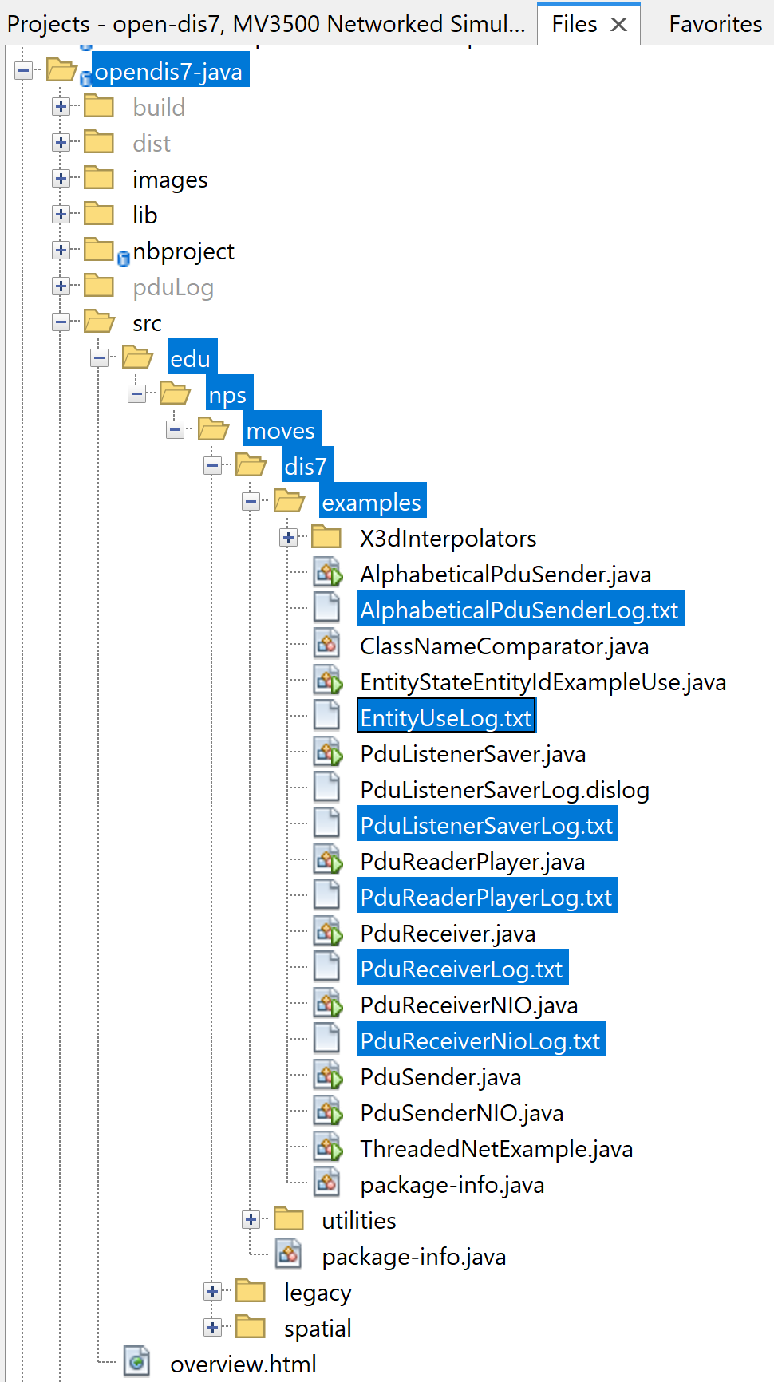
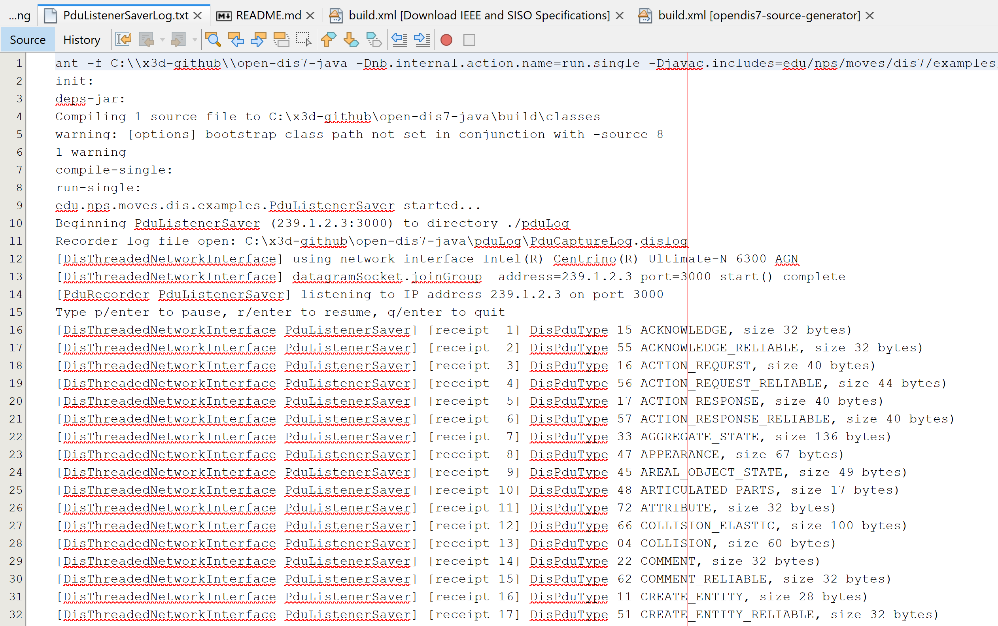
examples subdirectory has further tests, results as SomeNameLog.txt

Slide 38
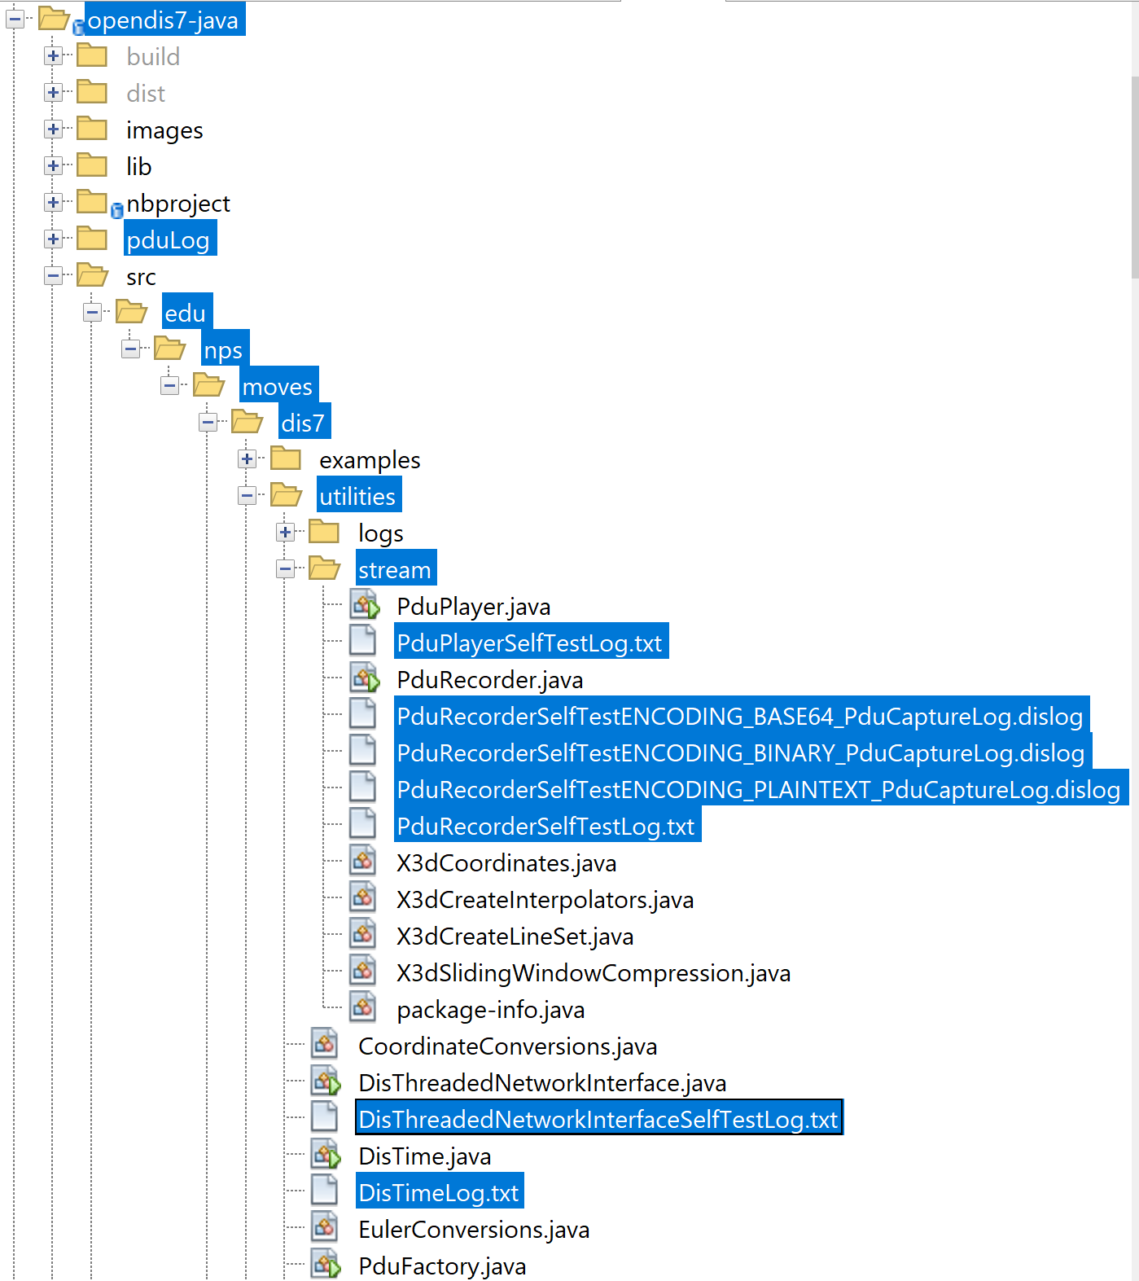
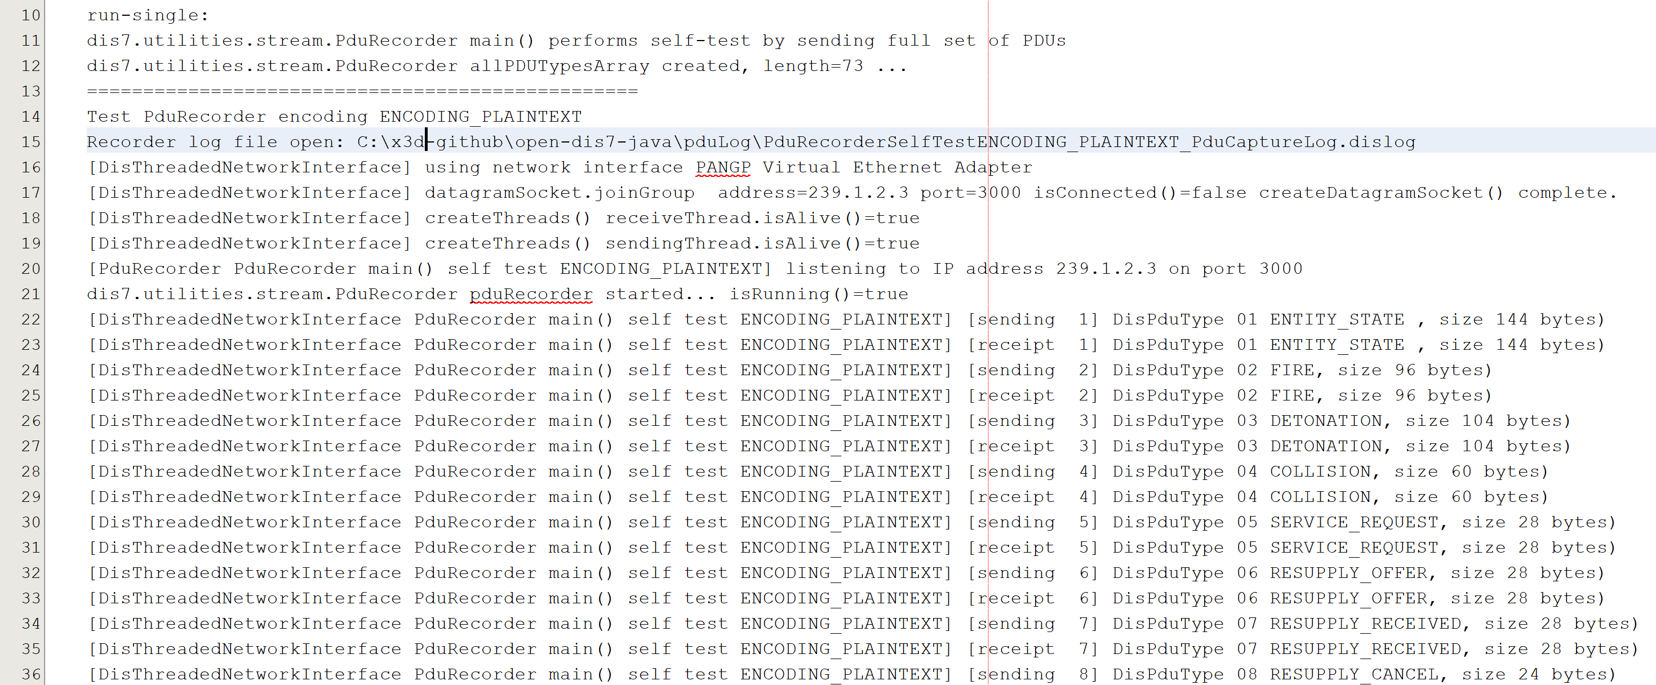
Some built-in classes have self-test main() methods

Slide 39
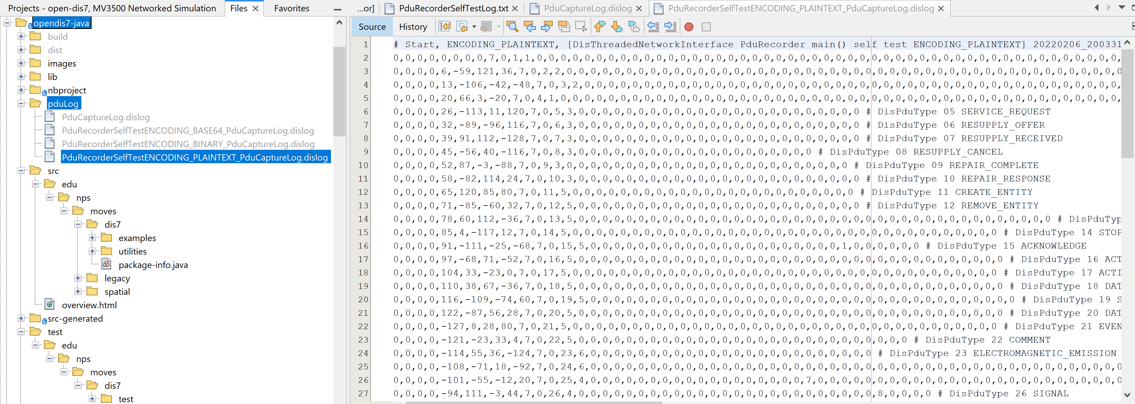
pduLog subdiretory contains *.dislog outputs

Slide 40
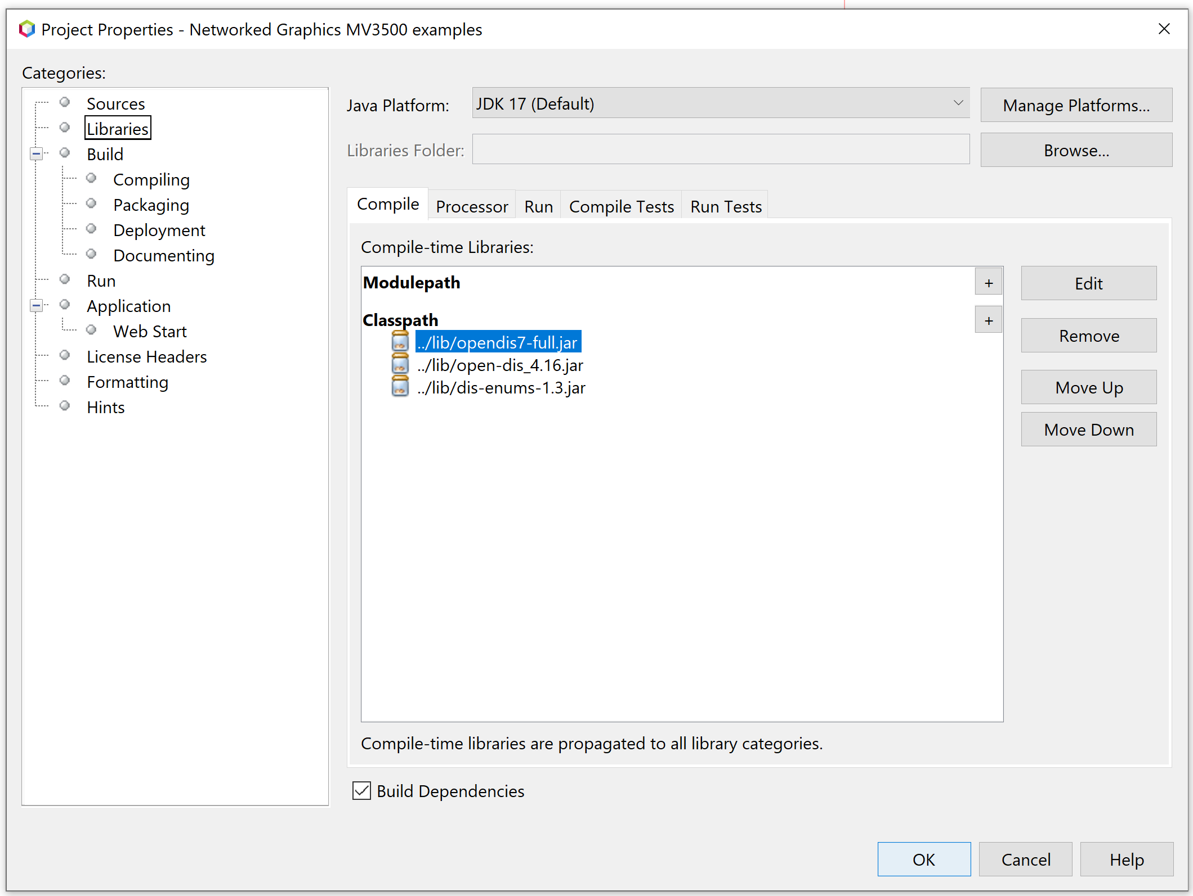
MV3500 examples use Netbeans project settings to add opendis7-full.jar to CLASSPATH
You can also set operating system ENVIRONMENT variable

Slide 41
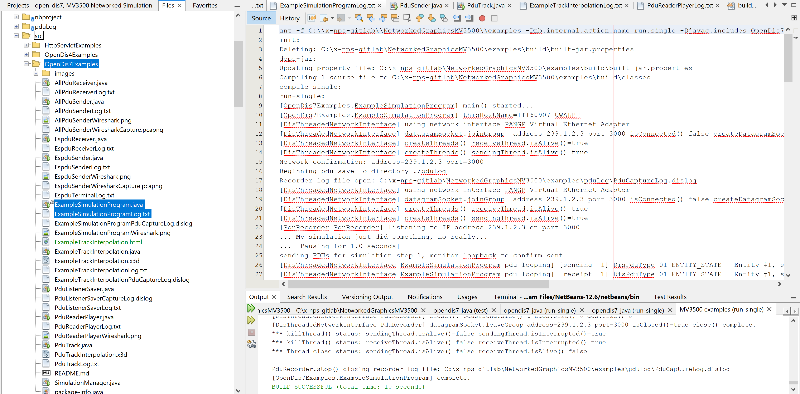
MV3500 examples, OpenDis7Examples, ExampleSimulationProgram.java

Slide 42
6. Community: Get involved
to top
We are opening everything up and sharing the fun!
brutzman@nps.edu

Slide 43
Discussion
Lots of ideas, no shortage of worthwhile work to pursue…

Slide 44
Contact
Don Brutzman
brutzman@nps.edu
http://faculty.nps.edu/brutzman
Code USW/Br, Naval Postgraduate School
Monterey California 93943-5000 USA
1.831.656.2149 work
Notes:
Questions and feedback are always welcome. Thanks for considering the possibilities.

