Slide 1


Compressed DIS V1.3
2019-SIW-Presentation-xxx
Lance Call, L3 Technologies – Air Force Research Lab(AFRL), USA

Slide 2
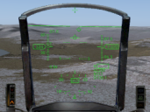

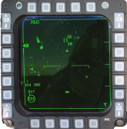

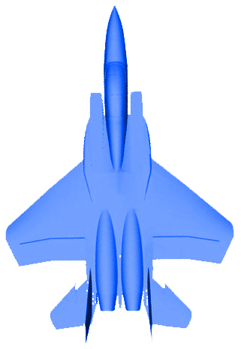


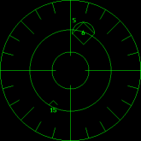






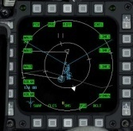
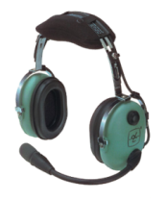






Secure Live Virtual Constructive Advanced Training Environment (SLATE)
HUD
L
Non Voice/
Link16 Data
4th Gen
ive Virtual Constructive Advanced Training Environment (SLATE)
Radar
V
DIS Standard
5th Gen
Pod/LRU
5G-ATW
Red Air /
Aggressor
RWR/ESM
C-DIS
1553/1760 Bus
AWACS/GCI
ECM
A/C TSPI
DIS Voice Radios
DIS Standard Link16
JTAC
UAV
Link16
DIS Voice Radio
Weapon
Servers
C
Voice Radio
UHF/VHF
Computer
Generated Forces
DIS LAN/WAN

Slide 3
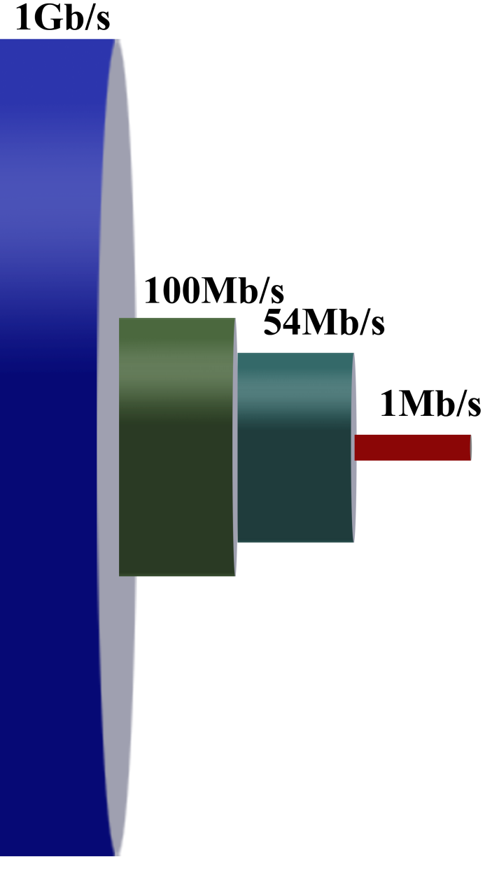
Why Bother with Compression?
Long Range Broadcast RF Network Bandwidths are much smaller than Fiber Optic or Wired Networks
Maximum Transmission Unit (MTU) may be smaller than 1500 bytes/12000 bits typically used for Ethernet MTU
Landline vs 5G-ATW Ratios
1000:1 Bandwidth
16:1 MTU
5G-ATW 1MBit/s
96 Bytes / 768 User Bits

Slide 4
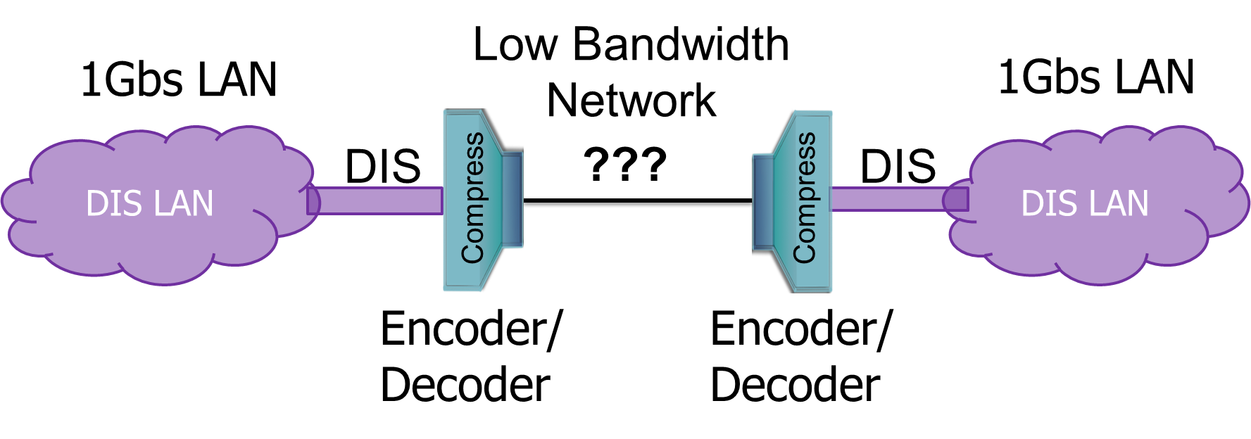
Main Goal
Create a compression scheme to allow connectivity of two standard Distributed Interactive Simulation (DIS) networks that run standard unmodified DIS applications, over a relatively low bandwidth connection, using less bandwidth than standard DIS. Target at least 50% compression.

Slide 5
Alternative Approaches
IEEE 1278 Live Entity (LE Information/Interaction Protocol)
  Not all DIS Protocol Data Units (PDU’s) supported
  Significant mapping between Entity State and LE Time Space Position Information PDU
General Purpose Compression
  Lempel-Ziv-Welch, etc
  Small number of Bits in DIS PDU insufficient for compression ratio desired
  Required to be Lossless which limits the compression ratio
Compressed DIS (C-DIS)
  Based on a knowledge of DIS data, required precision and common usage

Slide 6

Status
C-DIS was first created in 2013 for use in SLATE
Version C-DIS V1.2 (Implemented in 2014)
New Proposed Version is C-DIS V1.3 Sept 2017 (~100 pages)
Government Non-Proprietary standard that supports
  Entity State, Fire, Detonate, Collision, All Simulation Management (SIMAN) PDUs, Emission, Designator, Transmitter, Signal, Receiver, and IFF Layers 1,2,3,4 & 5. Compressed Variable Records in V1.3.
  Service Request, Resupply, and Reliable PDUs not required for SLATE are not yet supported.
Both AFRL and Cubic have implemented C-DIS V1.2 encoder/decoders
C-DIS V1.2 used in SLATE flight test with 16 live aircraft in September 2018 at Nellis, AFB and also at Naval Air Station Patuxent River

Slide 7
C-DIS Goals
Maintain existing PDU timing, simplicity, and fidelity
One-for-one mapping of every DIS field, but compressed
Direct mapping from DIS to C-DIS and back without complex translations, or new enumerations
Support all DIS PDU’s and Simulation Interoperability Standards Organization (SISO) and Combat Air Forces Distributed Mission Operations (CAF DMO) enumerations
Compress as much as possible with a target of >= 50%
Retain as much precision as possible
Fit into the 768 bit (96 byte) (*690 bit original estimate) user payload size of the 5th Generation Advanced Tactical Waveform (5G-ATW) network

Slide 8
C-DIS – Compression Techniques
Make C-DIS a bit-based standard with no byte boundary requirements
Reduce data field sizes as much as possible
Remove padding and other unnecessary fields
Replace floating point with scaled integers or custom Floating points
Uses Lat/Lon/Alt instead of Geocentric Earth Centered Earth Fixed (ECEF)
Add bit flags to indicate the presence of seldom used, optional, or non-applicable fields
Add Units flag if necessary to support a large range of values
Allow partial updates

Slide 9
Selected Precision / Max Values
Item | Precision | Maximum Value
Position | 1 cm/ Dekameters | 8388607
Velocity | 0.1 m/s | 6369 Knots
Acceleration | 0.1 m/s/s | 83.5 G
Angle | 0.0439° | 180°, 360°
Angular Velocity | 0.35°/s | 720°/s
Frequency/ Frequency Range | 4 or 5 decimal places | 131071/16777215 x10¹⁵
PRF | 100 Hz | 102.3 KHz
Pulse Width | 0.1 µs | 102.3 µs
Power | 1 dBm | 255 dBm

Slide 10
Full vs Partial Updates
Full Update Mode
  All required fields are passed in every update (Static entities would still not pass velocities or accelerations or rotation rates for example)
  Decoders don’t need to maintain the state of any object
Partial Update Mode
  Only items that change are sent every update & decoders maintain state
  Follow partial update rules
No Mixed Mode (Partial/Full) operations are allowed
  All Encoders/Decoders on a network must operate in one or the other modes

Slide 11
Partial Update Rules
The first update is always a full update
There must be at least one full update before a DIS timeout period is reached (12 second default for aircraft)
Decoders must create and store and update the state of stateful objects (i.e., Entity State, Emissions, Transmitters, & IFF)
Decoders will set C-DIS specified values for data items that are not received (typically 0)
Decoders must be able to remove stateful objects and timeout stateful objects as needed

Slide 12
Partial Update Encoder/Decoder Requirements
Significantly more complex
Encoder must track how long it’s been since last full update and decide if a full or partial update is required
More CPU intensive because have to track and update objects in the database
Adds some latency due to lookup and update of objects
More memory intensive because every object has to be stored for quick reference. Particularly a concern with large scenarios or limited physical memory situations.
Have to monitor and timeout objects if necessary
Full Update encoder/decoders used for SLATE demonstration

Slide 13
C-DIS – General PDU Format
C-DIS
Standard DIS
C-DIS PDU Header
DIS PDU Header
C-DIS Field Present Flags and Units
New C-DIS
fields added only if needed
DIS PDU Data
C-DIS PDU Data

Slide 14
Color Key
Meaning of Text colors
Red Text indicates new items that have been added to the DIS Standard PDUs or indicates that field sizes have been altered.
Blue Text Indicates items that are optional for most updates but are required as part of a "Full" update. "Full" updates are required for the first PDU update, at least once during the PDU Timeout period, and for the final PDU update.
Orange Text indicates items that are completely optional and are not required as part of a "Full" PDU update. These items may simply not be applicable for a particular entity or system being modeled and may never be provided.
Green Text indicates items that are new in the DIS 2012 Standard
Purple indicates Field sizes that are variable depending on a bit flag
Black Text indicates items that are the same as the DIS 2012 standard.
Grayed out Text indicates items that are not used in compressed DIS such as padding fields.

Slide 15
Entity State

Slide 16
Entity State
Original DIS Info/Misc Black Text
C-DIS Differences,Required - BlueText
Field Name |  | DIS Size (Bits) | C-DIS Size Required Bits | Optional Bits | Notes
PDU Header | Protocol Version | 8 | 2 |  | 4 simultaneous, enumerated versions; old ones would have to be retired eventually
 | Exercise ID | 8 | 3 |  | 8 exercises
 | PDU Type | 8 | 8
 | Protocol Family | 8 | 0 |  | Not necessary - Derive from the PDU type using a local lookup if needed
 | Time Stamp | 32 | 26 |  | 107 us smallest time unit (LSB = Absolute Time Flag just like DIS, DIS 31 bits = 1.67us)
 | Length | 16 | 14 |  | Length in bits 16383 max = 2047 bytes (not bytes like standard DIS)
 | PDU Status | 8 | 8 |  | DIS 2012 new field
 | Padding | 8 | 0 |  | Not applicable
Compression Statistics
 | Total Size | 96 | 61 | 61
 |  | 100.00% | 63.54% | 63.54% | % Packet Size VS Standard DIS
C-DIS Unused Red Text

Slide 17
C-DIS – Entity State Added Fields
(Field Present & Units Flags)
Field Name |  | DIS Size (Bits) | C-DIS Size Required Bits | Optional Bits | Notes
PDU Header | See Compressed DIS PDU Header Definition
Field Present Flags | Variable Parameters |  | 1 |  | Num Variable Param Records, Variable Param Records 0=None 1=All Present
 | Entity Type |  | 1 |  | 0=None 1=Present
 | Alternate Entity Type |  | 1 |  | 0=None 1=Present
 | Entity Appearance |  | 1 |  | 0=None 1=Present
 | Entity Linear Velocity |  | 1 |  | 0=None 1=Present
 | DR Params-Other |  | 1 |  | 0=None 1=Present
 | DR Params- Entity Linear Acceleration |  | 1 |  | 0=None 1=Present
 | DR Params- Entity Angular Velocity |  | 1 |  | 0=None 1=Present
 | Entity Marking |  | 1 |  | 0=None Present 1=Entity Marking Present
 | Capabilities |  | 1 |  | Capabilities 0=None 1=Present
Units | Entity Location Altitude |  | 1 |  | 0=Centimeters (cm) 1=Dekameters (dam)

Slide 18
C-DIS – Entity State
(Standard DIS Fields in Standard Order)
Field Name |  | DIS Size (Bits) | C-DIS Size Required Bits | Optional Bits | Notes
Entity ID | SAE Size |  | 1 |  | 0=Standard DIS SAE 1=Small SAE
 | Site | 16 | 8 |  | small max 255
 | Application | 16 | 8 |  | small max 255
 | Entity | 16 | 12 |  | small max 4095
Force ID |  | 8 | 2 |  | 0=Other, 1=Friendly, 2=Opposing, 3=Neutral
Number of Variable Params |  | 8 |  | 8 | Present only if Variable Parameters present flag is true
Entity Type | Kind | 8 |  | 4 | CAF DMO max 9, SISO Max 9 - Allow 15 Max
 | Domain | 8 |  | 4 | CAF DMO max 11, SISO Max 12 - Allow 15 Max
 | Country | 16 |  | 9 | CAF DMO max 225, SISO Max 266 - Allow 511 Max
 | Cat | 8 |  | 8 | CAF DMO max 89, SISO max 101
 | Subcat | 8 |  | 8 | CAF DMO max 246
 | Specific | 8 |  | 8 | CAF DMO max 102
 | Extra | 8 |  | 4 | CAF DMO max 7, SISO Max 190- Allow 15 Max
C-DIS Variable Size Field Purple Text
C-DIS Optional Data (May never be provided) Orange Text
Added in 2015 Lifeforms

Slide 19
C-DIS – Entity State Continued
Field Name |  | DIS Size (Bits) | C-DIS Size Required Bits | Optional Bits | Notes
Alternate Entity Type | Kind | 8 |  | 4 | CAF DMO max 9, SISO Max 9 - Allow 15 Max
 | Domain | 8 |  | 4 | CAF DMO max 11, SISO Max 12 - Allow 15 Max
 | Country | 16 |  | 9 | CAF DMO max 225, SISO Max 266 - Allow 511 Max
 | Cat | 8 |  | 8 | CAF DMO max 89, SISO max 101
 | Subcat | 8 |  | 8 | CAF DMO max 246
 | Specific | 8 |  | 8 | CAF DMO max 102
 | Extra | 8 |  | 4 | CAF DMO max 7, SISO Max 190- Allow 15 Max

Slide 20
C-DIS – Entity State Continued
Field Name |  | DIS Size (Bits) | C-DIS Size Required Bits | Optional Bits | Notes
Entity Linear Velocity | X | 32 |  | 16 | ±32767 dm/s (6369.59 kt max)
 | Y | 32 |  | 16 | ±32767 dm/s (6369.59 kt max)
 | Z | 32 |  | 16 | ±32767 dm/s (6369.59 kt max)
Entity Location | X (Lat) | 64 | 31 |  | ±90° Lat (approx 0.93 cm accuracy)
 | Y (Lon) | 64 | 32 |  | ±180° Lon (approx 0.93 cm accuracy)
 | Z (Alt MSL) | 64 | 24 |  | ±8388607 cm (275Kft) or Dekameter as indicated by Entity Location Altitude Units Flag
Entity Orientation | Psi | 32 | 13 |  | 0.0439° resolution
 | Theta | 32 | 13 |  | 0.0439° resolution
 | Phi | 32 | 13 |  | 0.0439° resolution

Slide 21
C-DIS – Entity State Continued
Appearance |  | 32 | 32
Dead Reckoning Parameters | Algorithm | 8 | 3 |  | Only support World Based DR Algorithms (0 to 5) (Body based 6-9 not supported)
 | Other | 120 |  | 120 | Present only if DR Param Other Flag = 1
 | Entity Linear Acceleration X | 32 |  | 14 | +-8191 decimeters/sec/sec (Aprox 83.5 g)
 | Entity Linear Acceleration Y | 32 |  | 14 | +-8191 decimeters/sec/sec (Aprox 83.5 g)
 | Entity Linear Acceleration Z | 32 |  | 14 | +-8191 decimeters/sec/sec (Aprox 83.5 g)
 | Entity Angular Velocity Psi | 32 |  | 12 | +-720 degrees per second max 0.35 degrees/sec resolution
 | Entity Angular Velocity Theta | 32 |  | 12 | +-720 degrees per second max 0.35 degrees/sec resolution
 | Entity Angular Velocity Phi | 32 |  | 12 | +-720 degrees per second max 0.35 degrees/sec resolution

Slide 22
C-DIS – Entity State Continued
Field Name |  | DIS Size (Bits) | C-DIS Size Required Bits | Optional Bits | Notes
Entity Marking | Marking Length |  |  | 4 | Number of characters in the Marking. Example "Viper1" = 6.
 | Char Set | 8 |  | 8
 | Marking | 88 |  | 0-88 | Marking Length*8
Capabilities |  | 32 |  | 32

Slide 23
C-DIS V1.2 vs V1.3 Variable Record
SLATE Tested V1.2
C-DIS V1.2 Variable Parameter Records
Variable Parameter Record #N | Record Type | 8 |  | 8 | No Compression Applied to Variable Parameter Records
 | Record-Specific Fields | 120 |  | 120
Proposed V1.3
C-DIS V1.3 Variable Parameter Records
Variable Parameter Record #N | Compressed Flag |  | 1 |  | 0=Normal, 1=Compressed Record Type - SISO MAX 5 Allow 8 Params of variable bit length ≠ 120
 | Record Type | 8 |  | 3
 | Record-Specific Fields | 120 |  | NN

Slide 24
Emission PDU

Slide 25
Emission PDUs are made up of Parts
Emission PDU - Basic
  System
    Beam
      Track/Jam List
Emission PDU - Complex
  System 1
    Beam 1
    Beam 2
      Track/Jam List
    Beam 3
      Track/Jam List
  System 2
    Beam 1
      Track/Jam List
  System 3
    Beam 1

Slide 26
C-DIS - Emission PDU
Compressed DIS MESSAGE Format - Emission PDU
Field Name |  | DIS Size (Bits) | Smallest Possible Message | Optional Bits | Notes
PDU Header | See Compressed DIS PDU Header Definition
Emitting ID | SAE Size |  | 1 |  | 0=Standard DIS SAE 1=Small SAE
 | Site | 16 | 8
 | Application | 16 | 8
 | Entity | 16 | 12
Event ID | SAE Size |  | 1 |  | 0=Standard DIS SAE 1=Small SAE
 | Site | 16 | 8
 | Application | 16 | 8
 | Event Number | 16 | 12

Slide 27
Emission PDU Continued
Field Name |  | DIS Size (Bits) | Smallest Possible Message | Optional Bits | Notes
State Update Indicator |  | 8 | 1 |  | SISO 0=State Update 1=Changed Data Update
Number of Systems |  | 8 | 5 |  | 31 Emitter Systems per PDU
Padding |  | 16 | 0 |  | Not applicable

Slide 28
Emission PDU Continued – Emitter System
Emitter System
System Field Present Flags | Emitter System Details |  | 1 |  | Emitter System Name and Function 0=None 1=All Present
 | Location with Respect to Entity |  | 1 |  | 0=None 1=Present
System Data Length |  | 8 | 0 |  | Informational Not required to Parse-Byte Count N/A
Number of Beams |  | 8 | 5 |  | 31 Max Beams per PDU
Padding |  | 16 | 0 |  | Not applicable
Emitter System | Emitter Name | 16 |  | 16 | 65535 Max ( CAF DMO max = 65044)
 | Emitter Function | 8 |  | 8 | CAF DMO max =71, siso max = 97
 | Emitter ID Number | 8 | 8 |  | Could make 5 bits if only Sequential ID's are used
Location with Respect to entity | X | 32 |  | 10 | +- 511 meters
 | Y | 32 |  | 10 | +- 511 meters
 | Z | 32 |  | 10 | +- 511 meters

Slide 29
Emission PDU Continued – Emitter Beam Part 1 of 4
Emitter Beam
Beam Field Present Flags | Fundamental Parameters-Frequency and Power Details |  | 1 |  | Fundamental Parameters - Frequency, Frequency Range and ERP 0=None 1=All Present
 | Fundamental Parameters-Pulse Details |  | 1 |  | Fundamental Parameters - PRF and Pulse Width 0=None 1=All Present
 | Beam Data Details |  | 1 |  | Beam Data - Beam Az Center, Beam Az Sweep, Beam El Center, Beam El Sweep, Beam Sweep Sync 0=None 1=All Present
 | Jamming Technique |  | 1 |  | 0=None 1=All Present
Beam Data Length |  | 8 | 0 |  | Informational Not required to Parse-Byte Count N/A
Beam ID Number |  | 8 | 8 |  | Could make 5 bits if only Sequential ID's are used
Beam Parameter Index |  | 16 | 16 |  | Full BPI support

Slide 30
Emission PDU Continued – Emitter Beam Part 2 of 4
Fundamental Params | Frequency | Mantissa | 32 |  | 17 | Frequency * 10Exponent
 |  | Exponent |  |  | 4 | Exponent
 | Frequency Range | Mantissa | 32 |  | 17 | Frequency Range * 10Exponent
 |  | Exponent |  |  | 4 | Exponent
 | ERP |  | 32 |  | 8 | 0 to 255 dBm
 | PRF |  | 32 |  | 10 | Freq *100 (Max 102.3 KHZ)
 | Pulse Width |  | 32 |  | 10 | tenths of Micro second (102.3 usec max)

Slide 31
Emission PDU Continued – Emitter Beam Part 3 of 4
Beam Data | Beam Az Center | 32 |  | 13 | 0.00076 Radian = 0.0439 degrees resolution
 | Beam Az Sweep | 32 |  | 13 | 0.00076 Radian = 0.0439 degrees resolution
 | Beam El Center | 32 |  | 13 | 0.00076 Radian = 0.0439 degrees resolution
 | Beam El Sweep | 32 |  | 13 | 0.00076 Radian = 0.0439 degrees resolution
 | Beam Sweep Sync | 32 |  | 10 | Percent of the scan (0.097 percent max accuracy)

Slide 32
Emission PDU Continued – Emitter Beam Part 4 of 4
Beam Function |  | 8 | 5 |  | Allow 31 (SISO-REF-10 2011 17 beam functions, CAF DMO 17)
Number of Targets in Track Jam Field |  | 8 | 4 |  | If more than 15 list first 15, 10 is High Density
High Density Track Jam |  | 8 | 1 |  | Bit Flag
Beam Status |  | 8 | 1 |  | Beam Active Flag 0=No 1=Yes
Jamming Technique | Kind | 8 |  | 8 | (optional all or no Jamming Technique)
 | Category | 8 |  | 8 | (optional all or no Jamming Technique)
 | Sub Category | 8 |  | 8 | (optional all or no Jamming Technique)
 | Specific | 8 |  | 8 | (optional all or no Jamming Technique)

Slide 33
Emission PDU Continued – Track Jam List
Track Jam List
Track Jam | SAE Size |  | 1 |  | 0=Standard DIS SAE 1=Small SAE
 | Site | 16 | 8
 | Application | 16 | 8
 | Entity | 16 | 12
 | Emitter number | 8 | 8 |  | Could make 5 bits if only Sequential ID's are used
 | Beam number | 8 | 8 |  | Could make 5 bits if only Sequential ID's are used

Slide 34
Variable Records

Slide 35
5 Variable Record Types
Articulated Part VP Record
Attached Part VP Record
Entity Separation VP Record
Entity Type VP Record
Entity Association VP Record

Slide 36
C-DIS V1.2 vs V1.3 Variable Record
SLATE Tested V1.2
C-DIS V1.2 Variable Parameter Records
Variable Parameter Record #N | Record Type | 8 |  | 8 | No Compression Applied to Variable Parameter Records
 | Record-Specific Fields | 120 |  | 120
Proposed V1.3
C-DIS V1.3 Variable Parameter Records
Variable Parameter Record #N | Compressed Flag |  | 1 |  | 0=Normal, 1=Compressed Record Type - SISO MAX 5 Allow 8 Params of variable bit length ≠ 120
 | Record Type | 8 |  | 3
 | Record-Specific Fields | 120 |  | NN

Slide 37
Variable Records – Articulated Part VP Record
Compressed DIS MESSAGE Format -Articulated Part VP Record
Field Name |  | DIS Size (Bits) | Smallest Possible Message | Optional Bits | Notes
Compressed Flag |  |  | 1 |  | Indicate if Variable Record is compressed 0 = Normal 128 bits, 1=Compressed
Type | Articulated Part Record Type = 0 | 8 | 3 |  | SISO defines 5 types Allow 8 (Record Type = 0)
Change Indicator |  | 8 | 8 |  | Increments all values
ID Part Attached to |  | 16 | 10 |  | Allow up to 1023 subparts

Slide 38
Variable Records – Articulated Part VP Record Continued
Parameter Value |  | 32 | 14 |  | Type Class + Type Metric SISO Defines 8128 Allow 16383
Parameter Value | Mantissa | 32 | 15 |  | Signed Value +-16383 x 10^{Exponent} (Approx Four Decimal Place accuracy 9999) Smallest = 1x10⁻⁴ Largest 16383x10³
 | Exponent |  | 3 |  | Signed Exponent +3,-4
Padding |  | 32 | 0
Compression Statistics
 | Size | 128 | 53 | 53
 | Header | 0 | 0 | 0
 | Total Part Size | 128 | 53 | 53
 |  | 100.0% | 41.4% | 41.4% | Percentage of Packet Size VS Standard DIS

Slide 39
Variable Records – Attached Part VP Record Continued
Compressed DIS MESSAGE Format -Attached Part VP Record
Field Name |  | DIS Size (Bits) | Smallest Possible Message | Optional Bits | Notes
Compressed Flag |  |  | 1 |  | Indicate if Variable Record is compressed 0 = Normal 128 bits, 1=Compressed
Type | Attached Part Record Type = 1 | 8 | 3 |  | SISO defines 5 types Allow 8 (AP Record Type = 1)
Detached Indicator |  | 8 | 1 |  | 0=Attached, 1=Detached
ID Part Attached to |  | 16 | 10 |  | Allow up to 1023 Subparts
Parameter Type |  | 32 | 11 |  | SISO [UID 57] Max 1023 Allow 2047

Slide 40
Variable Records – Attached Part VP Record Continued
Attached Part Type | Kind | 8 | 4 |  | CAF DMO max 9, SISO Max 9 - Allow 15 Max
 | Domain | 8 | 4 |  | CAF DMO max 11, SISO Max 12 (Munition) - Allow 15 Max
 | Country | 16 | 9 |  | CAF DMO max 225, SISO Max 266 - Allow 511 Max
 | Cat | 8 | 8 |  | CAF DMO max 89, SISO max 101
 | Subcat | 8 | 8 |  | CAF DMO max 246
 | Specific | 8 | 8 |  | CAF DMO max 102
 | Extra | 8 | 4 |  | CAF DMO max 7 - Allow 15 Max
Compression Statistics
 | Size | 128 | 70 | 70
 | Header | 0 | 0 | 0
 | Total Part Size | 128 | 70 | 70
 |  | 100.0% | 54.7% | 54.7% | Percentage of Packet Size VS Standard DIS

Slide 41
C-DIS DIS V-8 and SISO
C-DIS techniques could be applied to DIS V8
Just beginning to look at this
Looking into making C-DIS V1.3 a SISO or IEEE standard

Slide 42
C-DIS Compression Testing Results

Slide 43
C-DIS Performance Test Setup
Packet Logger
DIS
C-DIS V1.2 Encoder
C-DIS
Packet Logger
In the following slides “LVC PDUs” are everything except Voice and Link16 (SLATE doesn’t pass voice or Link16 over 5G-ATW)

Slide 44
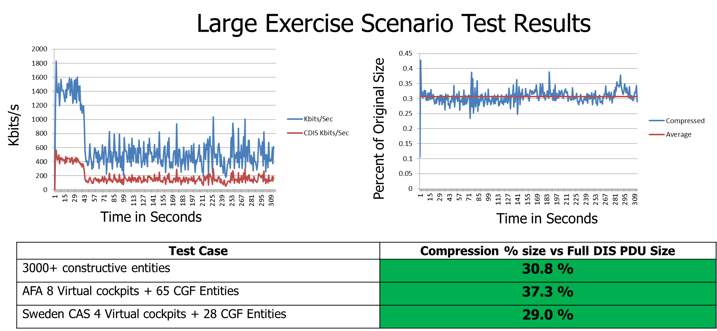
C-DIS LVC PDU Results (2015)

Slide 45
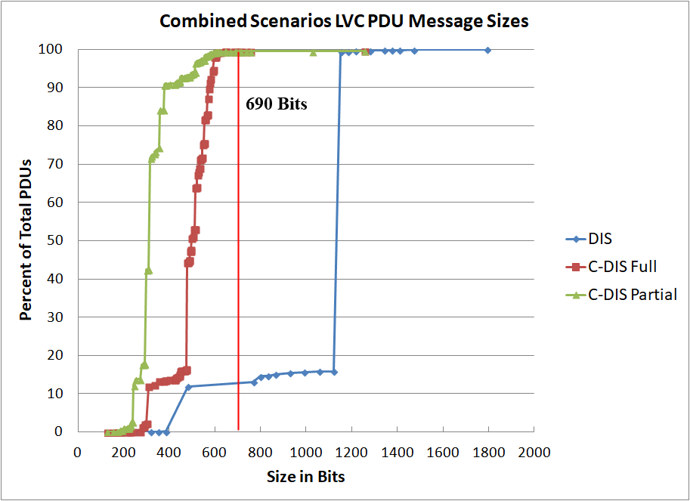
Combined Scenario LVC PDU Results (2015)
*690 Bits Original Size Estimate for 5G-ATW Messages

Slide 46
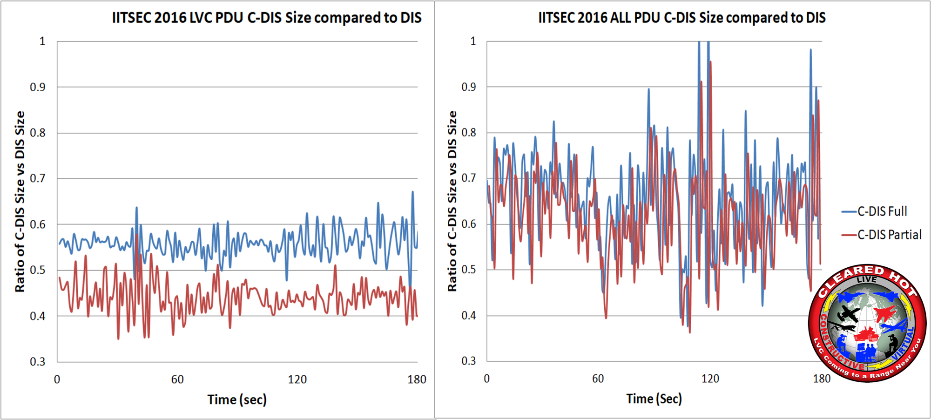
Second by Second Compression Ratios
LVC PDUs & All PDUs Cleared Hot Event (2016)

Slide 47
Variable Records & Datums
I/ITSEC 2016 Entity States had 2-9 variable records (Average = 3) which can significantly increase the size of the Entity State and possibly exceed 768 bits
SLATE ATD did not use many variable records so this was not an immediate issue for SLATE
    C-DIS V1.3 Proposal for a method to compress Variable Records by 40-60 percent has been identified but not implemented or tested

Slide 48
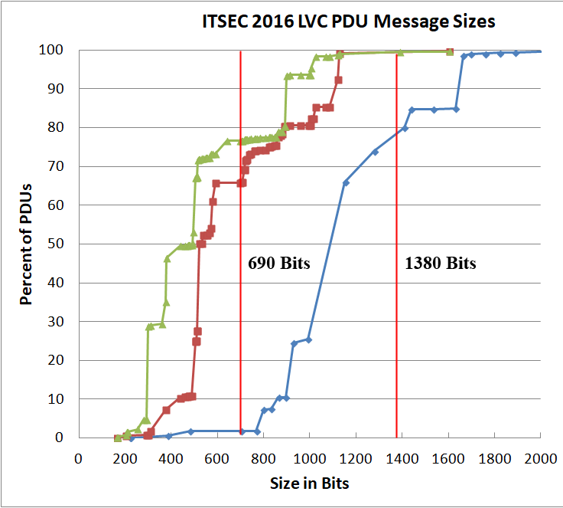
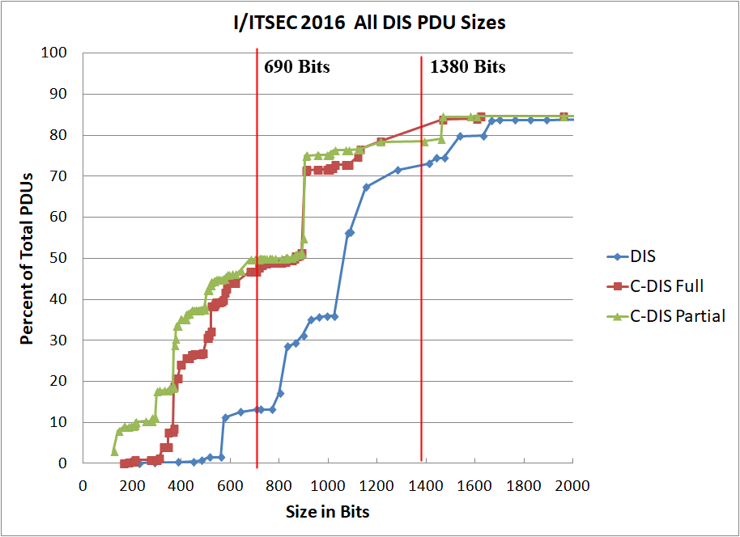
I/ITSEC 2016 PDU Results

Slide 49
Siman/DATA PDUs
Some CAF DMO Datums that contribute significantly to bandwidth have been compressed
  Radar Track Report
  Jammer Report
  Jammer False Targets Report
  Data is in an Annex of C-DIS due to releasability
Other user Datums that contribute significantly to bandwidth could apply C-DIS techniques and be added to the C-DIS standard

Slide 50
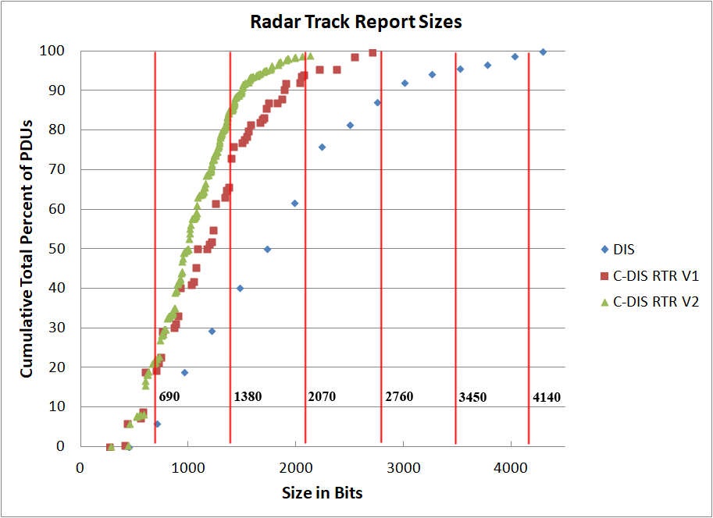
Radar Track Report (2015)

Slide 51
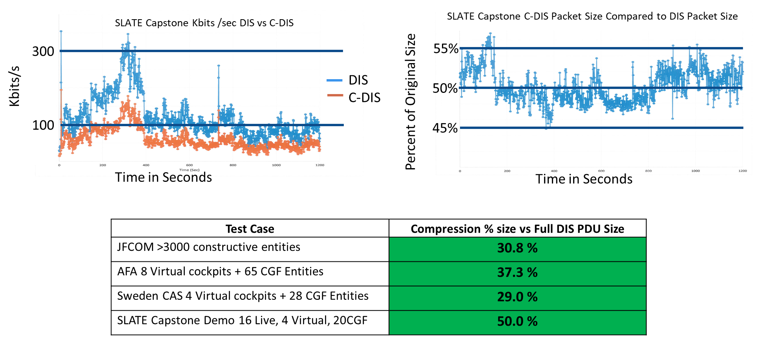
C-DIS SLATE Demonstration Results (Sept 2018)

Slide 52
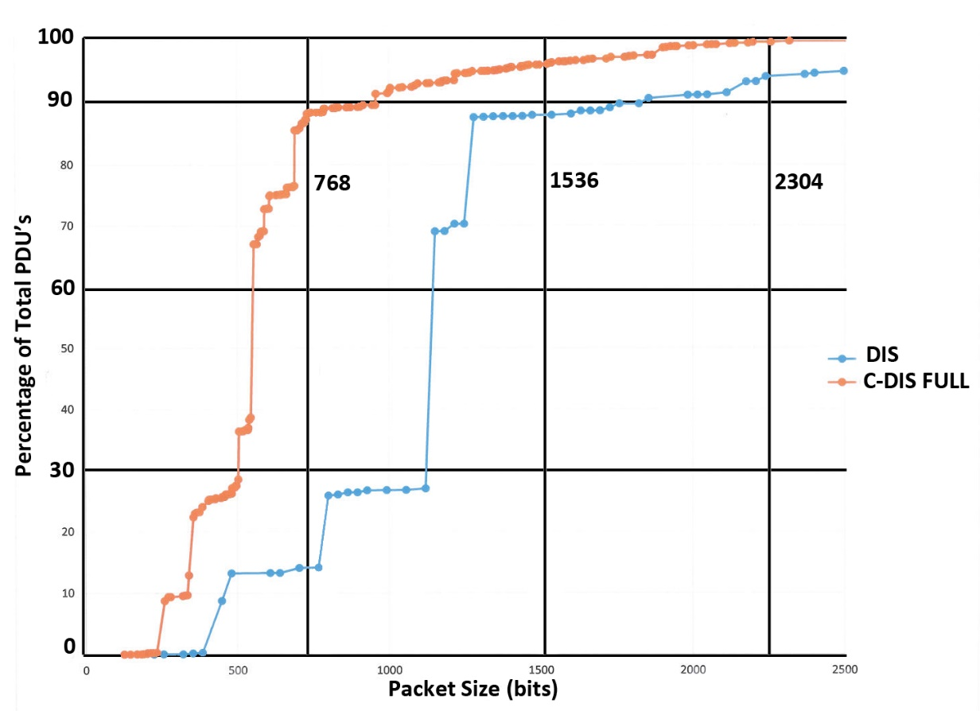
C-DIS SLATE Demonstration Results (Sept 2018)

Slide 53
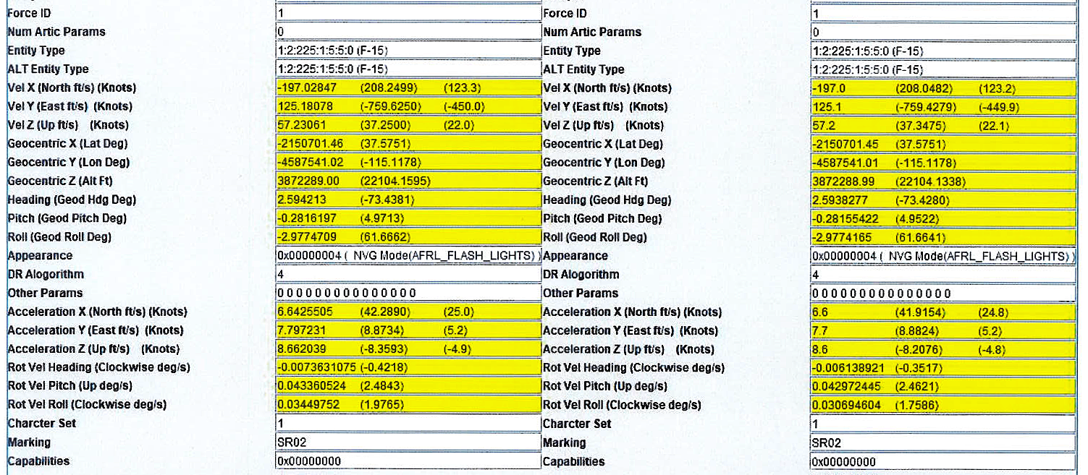
C-DIS Packet Difference Output – Yellow Highlights
Airplane PDU Sent
Ground PDU Received

Slide 54
Limitations
Service Request, Resupply, and Reliable PDUs not required for SLATE are not yet supported, but could be if there is a need.
Voice and Large custom Data PDU’s only compress common Siman/Signal PDU header bytes and therefore compression is limited
C-DIS V1.2 Variable Records/Articulated Parts are not compressed
C-DIS V1.3 Proposal for a method to compress Variable Records by 40-60 percent has been defined but not implemented or tested

Slide 55
Summary
C-DIS requires additional computations (Encoder/Decoder)
C-DIS relies on data originators to use thresholds and timeouts to change the number of messages per second
C-DIS reduces the size of each message (Effectively doubles the available network bandwidth for SLATE)
C-DIS compression rates depend on the mix of DIS PDU types and use of variable records, voice/signal PDUs and custom Datums

Slide 56
Conclusions
C-DIS allows significantly more entities, sensors, and complex interactions to be modeled over a given bandwidth, which improves training
C-DIS could be used over any data link or bus where bandwidth is limited

Slide 57
Contact Info
Dave Noah
SLATE Program Manager, 711 HPW/RHAS
Phone 937-938-3982 (DSN 798)
john.noah.4@us.af.mil
Lance Call, Principle Software Engineer
711 HPW/RHAS; L-3 Technologies
Phone 480-840-3944 ext. 102
lance.call.ctr@us.af.mil

