Slide 1
Repeatable Unit Testing of Distributed Interactive Simulation (DIS) Protocol Behavior Streams using Web Standards
“A Stream is a Stream”
LTC Tobias Brennenstuhl, German Army
tobias.brennenstuhl.gy@nps.edu tobiasbrennenstuhl@bmvg.bund.de
12 June 2020
Thesis advisor: Dr. Don Brutzman

Slide 2
Problem Statement
It is hard for simulation systems to interconnect, especially with partner nations and C2 systems
Utilizing open-source Web Technology is a valuable resource that can help numerous systems regardless of data classification
Partnerships with NATO partners are needed to improve shared understanding of mutual goals and challenges
M&S is not relevant to active warfighting unless we can achieve interoperability between Live, Virtual and Constructive (LVC) simulations, robot telemetry, and Command and Control (C2)

Slide 3
Research Questions
Stability of IEEE DIS specs and capabilities of MOVES LVC Lab offer excellent new opportunities for broad interoperation
  Open-source codebase by Mike Bailey offers entire vocabulary
  Curt Blais dissertation work on Rich Semantic Track (RST)
  How can these best be adapted and applied?
How to promote DIS behavior streams as first-class media type?
  Coherent data streams for collaboration, simulation, telemetry
  Unit testing of recorded streams for adaptable repeatability
  Establish archivable annotated records of simulation activity

Slide 4
Basic Premises
A stream is a stream, at rest in a file or in motion over the network
  Playback recorded manipulation of a model using PDUs
  Stream manipulation of models using OpenDIS7 library
Multiple open-source codebases available, initially Java with more languages to follow (JavaScript, Python, XML, JSON, etc.)
X3D Graphics standard allows dynamic 3D in any Web browser
  Record remote animation of a model using PDUs
  Distill concise first-order linear interpolators from streams

Slide 5

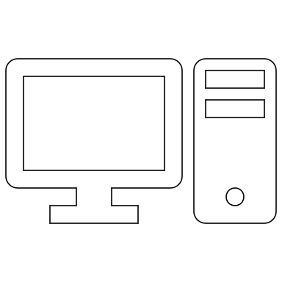
Use Case 1: Long-Haul DIS for Collaboration
Monterey
LVC Lab
Poznan, PL
Bydgoszcz, PL
HPC
Spiders3D
Spiders3D
Future Work

Slide 6
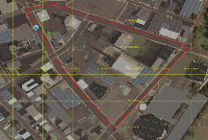
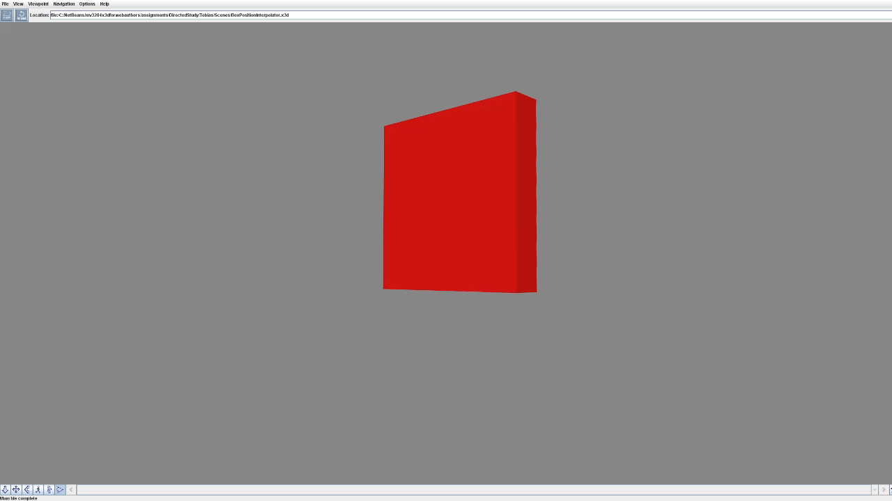
Use Case 2: Record in LVC Lab / Playback in X3D
Monterey
LVC Lab
Web server
Internet
DIS to X3D Conversion
DIS application
Web browser

Slide 7
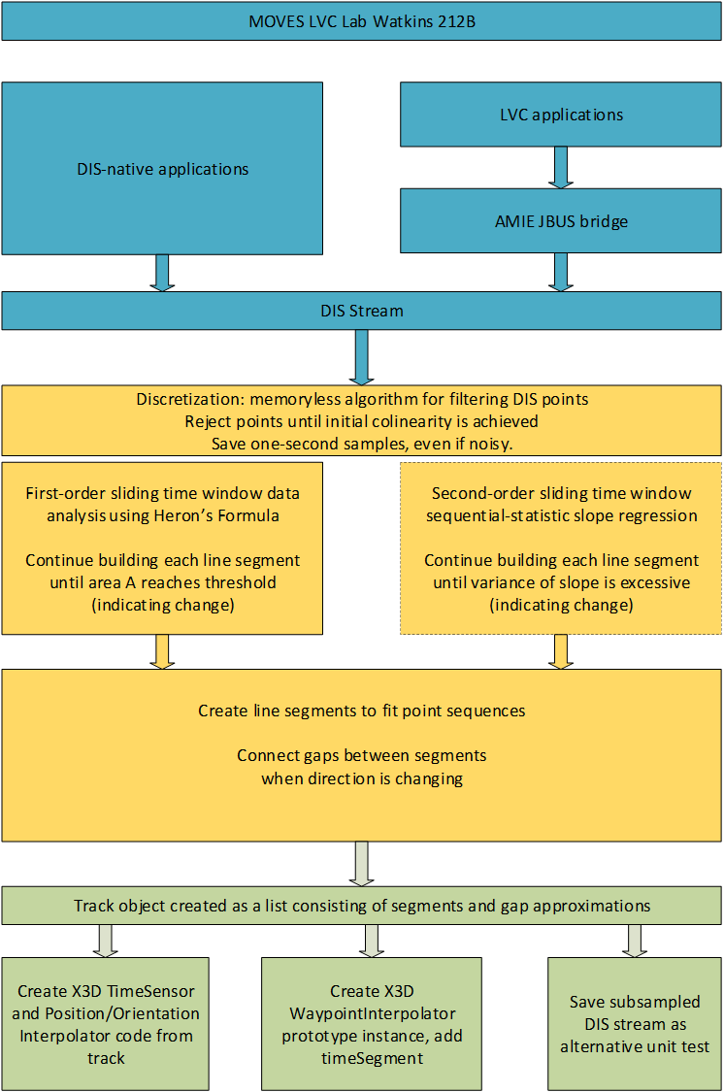
Thesis Component Relationship
Local Application
Local Application
External Events of interest can trigger Sliding Window reset IOT maintain maximum fidelity at key points in time
Future Work

Slide 8

Testscenario for Playback Compression
Raw Data from Simulation/Live:
Dead Reckoning (DR)
Sliding Window Interpolator for Playback:
X3D PositionInterpolator

Slide 9
Completed research:
Generating X3D PositionInterpolator from DIS Stream (Example)
1 m
1 m
500 m
<TimeSensor DEF='BoxTimeInterval' cycleInterval='1' loop = 'true'/>
<PositionInterpolator DEF='Entity' key = '0.0 0.25 0.5 0.75 1.0 ' keyValue = '0 0 0 0 1 0 0 2 0 0 1 0 0 0 0' />

Slide 10
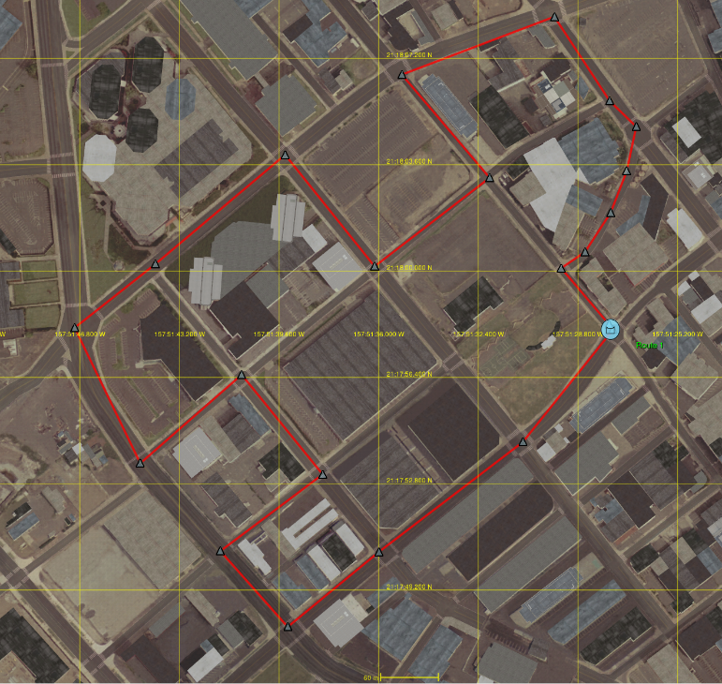
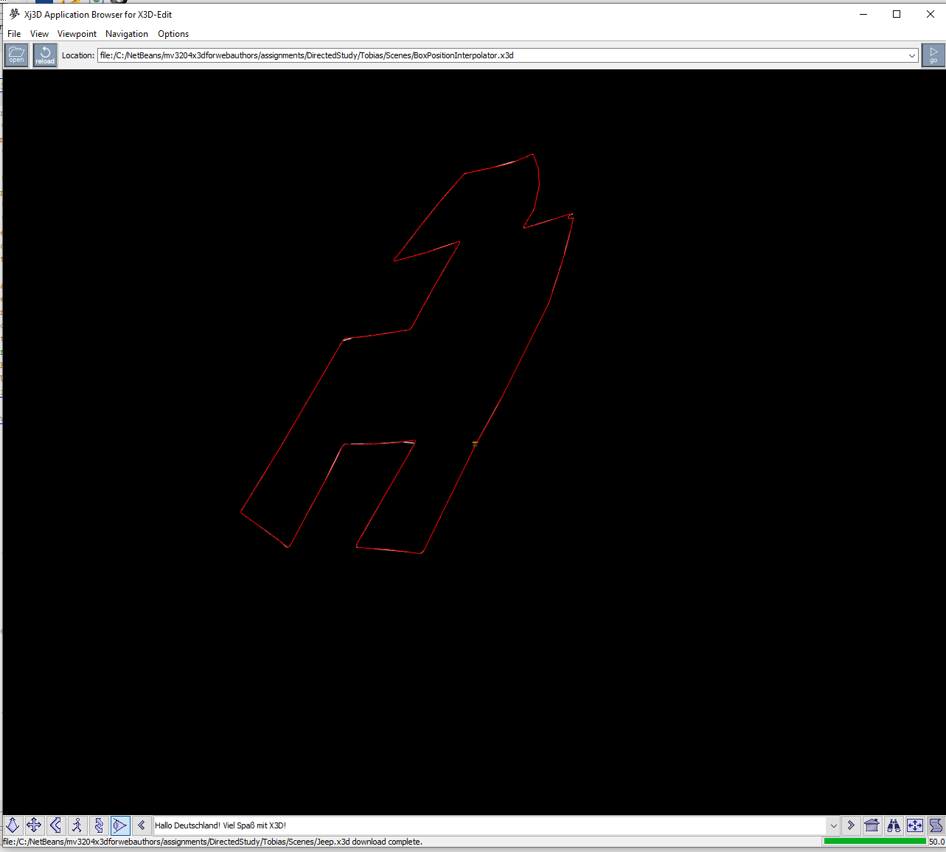
Autogenerate X3D Code:
Generating PositionInterpolator and OrientationInterpolator from DIS Stream
DIS Converter
DIS stream
VR Forces
Xj3D
X3D TimeSensor and X3D PositionInterpolator are distilled from raw DIS streams and saved as XML.

Slide 11
Goal: Compression
<TimeSensor DEF='PduStreamClock' cycleInterval='114.735954' loop = 'true'/>
<PositionInterpolator DEF='Entity' key = '0 0.024 0.025 0.026 0.027 0.028 0.029 0.03 0.031 0.032 0.033 0.034 0.035 0.036 0.038 0.039 0.041 0.041 0.043 0.043 0.044 0.046 0.046 0.048 0.049 0.05 0.051 0.052 0.053 0.055 0.056 0.058 0.059 0.063 0.067 0.071 0.077 0.078 0.084 0.086 0.092 0.102 0.105 0.116 0.118 0.12 0.13 0.167 0.172 0.19 0.19 0.255 0.32 0.346 0.385 0.39 0.435 0.452 0.454 0.456 0.468 0.475 0.517 0.518 0.52 0.522 0.522 0.523 0.525 0.525 0.527 0.528 0.528 0.53 0.53 0.533 0.534 0.535 0.536 0.537 0.538 0.539 0.54 0.541 0.542 0.544 0.545 0.546 0.547 0.548 0.549 0.558 0.564 0.569 0.578 0.62 0.625 0.641 0.642 0.657 0.673 0.673 0.713 0.713 0.714 0.735 0.735 0.751 0.751 0.767 0.767 0.782 0.782 0.814 0.844 0.844 0.867 0.896 0.903 0.905 0.912 0.925 0.927 0.931 0.932 0.946 0.949 0.954 0.974 0.975 0.992 0.993 0.996 0.997 0.998 0.999 1 '
keyValue = ' 0 0 0 0.007 0.003 0.018 0.014 0.005 0.038 0.038 0.014 0.103 0.054 0.019 0.146 0.097 0.029 0.257 0.123 0.034 0.323 0.187 0.04 0.481 0.225 0.041 0.57 0.267 0.039 0.668 0.363 0.025 0.882 0.418 0.012 1 0.542 -0.031 1.252 0.611 -0.062 1.388 0.851 -0.204 1.82 0.941 -0.271 1.971 1.137 -0.438 2.278 1.243 -0.54 2.432 1.469 -0.785 2.734 1.589 -0.93 2.88 1.712 -1.091 3.021 1.968 -1.459 3.278 2.099 -1.667 3.391 2.414 -2.229 3.606 2.497 -2.394 3.647 2.643 -2.703 3.702 2.766 -2.984 3.728 2.867 -3.231 3.732 2.948 -3.445 3.723 3.063 -3.772 3.685 3.137 -3.996 3.645 3.278 -4.473 3.518 3.321 -4.638 3.461 3.595 -5.773 3.014 3.916 -7.104 2.49 4.219 -8.345 2 4.958 -11.234 0.839 5.114 -11.855 0.592 5.967 -15.285 -0.773 6.135 -15.975 -1.046 7.162 -20.299 -2.74 9.053 -28.241 -5.855 9.703 -30.95 -6.92 11.988 -40.467 -10.664 12.316 -41.831 -11.199 12.712 -43.466 -11.835 14.821 -52.177 -15.219 22.634 -84.441 -27.754 23.69 -88.782 -29.444 27.66 -105.114 -35.795 27.683 -105.205 -35.828 41.954 -161.927 -56.738 56.241 -218.71 -77.67 62.154 -242.195 -86.33 70.611 -275.782 -98.714 71.697 -280.164 -100.321 81.364 -320.067 -114.837 83.629 -329.408 -118.236 83.752 -329.908 -118.419 83.841 -330.27 -118.551 84.369 -332.426 -119.338 84.686 -333.702 -119.806 86.533 -341.037 -122.511 86.585 -341.244 -122.587 86.68 -341.679 -122.781 86.732 -341.975 -122.946 86.753 -342.13 -123.044 86.771 -342.287 -123.153 86.795 -342.607 -123.408 86.798 -342.768 -123.554 86.786 -343.083 -123.888 86.769 -343.235 -124.075 86.744 -343.382 -124.276 86.667 -343.651 -124.721 86.613 -343.769 -124.963 86.384 -344.039 -125.768 86.173 -344.123 -126.35 86.05 -344.131 -126.65 85.915 -344.114 -126.954 85.61 -343.996 -127.563 85.442 -343.892 -127.862 85.079 -343.589 -128.431 84.887 -343.389 -128.695 84.689 -343.156 -128.939 84.285 -342.592 -129.354 83.698 -341.537 -129.729 83.541 -341.195 -129.771 83.258 -340.481 -129.753 83.024 -339.737 -129.59 82.93 -339.365 -129.452 82.803 -338.751 -129.162 81.527 -332.9 -126.538 80.538 -328.282 -124.478 79.585 -323.714 -122.453 77.938 -315.823 -118.956 70.493 -280.143 -103.141 69.562 -275.759 -101.188 66.427 -261.386 -94.736 66.409 -261.297 -94.693 63.715 -248.042 -88.276 61.468 -235.099 -81.099 61.455 -235.014 -81.048 56.336 -202.176 -61.466 56.321 -202.089 -61.418 56.055 -200.997 -60.996 49.848 -182.231 -57.608 49.818 -182.136 -57.587 45.452 -168.162 -54.456 45.424 -168.067 -54.431 41.326 -154.152 -50.719 41.3 -154.059 -50.691 37.436 -140.376 -46.647 37.411 -140.284 -46.618 29.742 -112.301 -37.795 22.739 -85.889 -28.905 22.715 -85.796 -28.872 17.387 -65.111 -21.586 10.823 -39.611 -12.606 9.204 -33.307 -10.387 8.692 -31.298 -9.683 7.324 -25.919 -7.797 5.175 -17.47 -4.835 5.054 -17.001 -4.67 4.784 -15.961 -4.302 4.717 -15.702 -4.211 4.081 -13.254 -3.346 3.954 -12.779 -3.176 3.691 -11.814 -2.829 2.769 -8.431 -1.611 2.7 -8.176 -1.52 1.899 -5.184 -0.45 1.841 -4.966 -0.372 1.745 -4.577 -0.214 1.681 -4.267 -0.058 1.654 -4.118 0.027 1.615 -3.807 0.228 1.601 -3.648 0.345 ' />
<TimeSensor DEF='PduStreamClock' cycleInterval='114.735954' loop = 'true'/>
<PositionInterpolator DEF='Entity' key = '0 0.035 0.036 0.044 0.046 0.055 0.056 0.071 0.077 0.116 0.118 0.167 0.172 0.255 0.32 0.385 0.39 0.435 0.454 0.517 0.518 0.527 0.528 0.535 0.536 0.54 0.541 0.544 0.545 0.548 0.549 0.569 0.578 0.62 0.641 0.713 0.713 0.735 0.735 0.767 0.767 0.814 0.844 0.896 0.903 0.946 0.949 0.992 0.993 0.996 0.997 0.998 0.999 1 '
keyValue = ' 0 0 0 0.542 -0.031 1.252 0.611 -0.062 1.388 1.712 -1.091 3.021 1.968 -1.459 3.278 3.063 -3.772 3.685 3.137 -3.996 3.645 4.219 -8.345 2 4.958 -11.234 0.839 11.988 -40.467 -10.664 12.316 -41.831 -11.199 22.634 -84.441 -27.754 23.69 -88.782 -29.444 41.954 -161.927 -56.738 56.241 -218.71 -77.67 70.611 -275.782 -98.714 71.697 -280.164 -100.321 81.364 -320.067 -114.837 83.752 -329.908 -118.419 86.533 -341.037 -122.511 86.585 -341.244 -122.587 86.786 -343.083 -123.888 86.769 -343.235 -124.075 86.05 -344.131 -126.65 85.915 -344.114 -126.954 84.887 -343.389 -128.695 84.689 -343.156 -128.939 83.698 -341.537 -129.729 83.541 -341.195 -129.771 82.93 -339.365 -129.452 82.803 -338.751 -129.162 79.585 -323.714 -122.453 77.938 -315.823 -118.956 70.493 -280.143 -103.141 66.427 -261.386 -94.736 56.336 -202.176 -61.466 56.321 -202.089 -61.418 49.848 -182.231 -57.608 49.818 -182.136 -57.587 41.326 -154.152 -50.719 41.3 -154.059 -50.691 29.742 -112.301 -37.795 22.739 -85.889 -28.905 10.823 -39.611 -12.606 9.204 -33.307 -10.387 4.081 -13.254 -3.346 3.954 -12.779 -3.176 1.899 -5.184 -0.45 1.841 -4.966 -0.372 1.745 -4.577 -0.214 1.681 -4.267 -0.058 1.654 -4.118 0.027 1.615 -3.807 0.228 1.601 -3.648 0.345 ' />
Uncompressed
Compressed

Slide 12
Goal: Parsability/ Readability
BASE64:
!Begin!Beginning of DIS capture file, Pdusave3.dislog.
AAAAABnRSPQ=,BwAFAwAAAAAAAAAAAAAAAAAAAAAAAAAAAAAAAA==
AAAAAB/m8kg=,BwAGAwAAAAAAAAAAAAAAAAAAAAAAAAAAAAAAAA==
AAAAACXtWVw=,BwAHAwAAAAAAAAAAAAAAAAAAAAAAAAAAAAAAAA==
AAAAACvzmWA=,BwAIAwAAAAAAAAAAAAAAAAAAAAAAAAAA
AAAAADH7KVQ=,BwAJAwAAAAAAAAAAAAAAAAAAAAAAAAAAAAAAAA==
AAAAADgffug=,BwAKAwAAAAAAAAAAAAAAAAAAAAAAAAAAAAAAAA==
AAAAAD5FCqQ=,BwALBQAAAAAAAAAAAAAAAAAAAAAAAAAAAAAAAA==
AAAAAERbrfg=,BwAMBQAAAAAAAAAAAAAAAAAAAAAAAAAAAAAAAA==
!End!End of DIS capture file, Pdusave3.dislog.
536 bytes
Future Work
Compressed DIS (C-DIS) encoding
Plain Text:
!Begin!Beginning of DIS capture file, Pdusave4.dislog. [PDU Header],[PDU Stream]
[0,0,0,0,25,-31,0,0],[7,0,5,3,0,0,0,0,0,0,0,0,0,0,0,0,0,0,0,0,0,0,0,0,0,0,0,0]
[0,0,0,0,32,5,-36,88],[7,0,6,3,0,0,0,0,0,0,0,0,0,0,0,0,0,0,0,0,0,0,0,0,0,0,0,0]
[0,0,0,0,38,43,-73,96],[7,0,7,3,0,0,0,0,0,0,0,0,0,0,0,0,0,0,0,0,0,0,0,0,0,0,0,0]
[0,0,0,0,44,49,-50,-60],[7,0,8,3,0,0,0,0,0,0,0,0,0,0,0,0,0,0,0,0,0,0,0,0]
[0,0,0,0,50,56,113,56],[7,0,9,3,0,0,0,0,0,0,0,0,0,0,0,0,0,0,0,0,0,0,0,0,0,0,0,0]
[0,0,0,0,56,62,-116,32],[7,0,10,3,0,0,0,0,0,0,0,0,0,0,0,0,0,0,0,0,0,0,0,0,0,0,0,0]
[0,0,0,0,62,69,-56,124],[7,0,11,5,0,0,0,0,0,0,0,0,0,0,0,0,0,0,0,0,0,0,0,0,0,0,0,0]
[0,0,0,0,68,93,94,-56],[7,0,12,5,0,0,0,0,0,0,0,0,0,0,0,0,0,0,0,0,0,0,0,0,0,0,0,0]
!End!End of DIS capture file, Pdusave4.dislog.
781 bytes

Slide 13
VV&A

Slide 14
Way Ahead
Further test Java implementation, then create JavaScript
Expand code for multiple entities
Further Optimization Coding Sliding Window Algorithm
Assess Spiders3D JavaScript Virtual Environment Web Server
Collaborate on distributed LVC models and simulations
  Take advantage, test campus-wide Multicast capability
  Test with #Xj3D Java-based x3d browser
  Explore possible HPC network connection to Germany
  Consider NATO C2SIM and CWIX 2021 participation
              Continue Experimentation and Unit Testing!

Slide 15
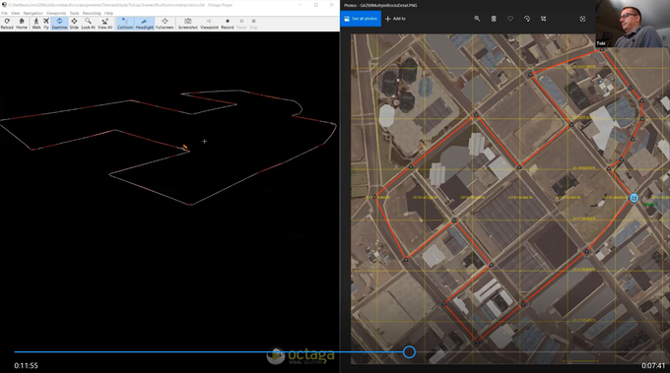
Thesis, presentation and video demonstration online at gitlab.nps.edu

Slide 16
Contact
Don Brutzman
brutzman@nps.edu
LTC Tobias Brennenstuhl
tobias.brennenstuhl@bmvg.bund.de

