Slide 1
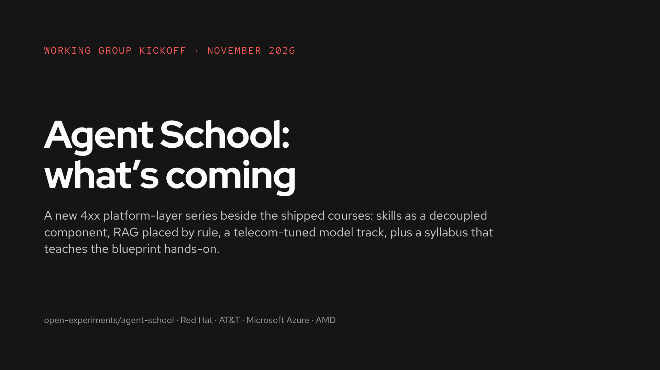
Notes:
Agent School rebuilds proven Telco-AIX experiments as governed agent workloads on OpenShift AI, following the open blueprint article. This kickoff sets the next cycle: four talking points and the decisions this group owns. Everything on these slides is a proposal to react to.

Slide 2
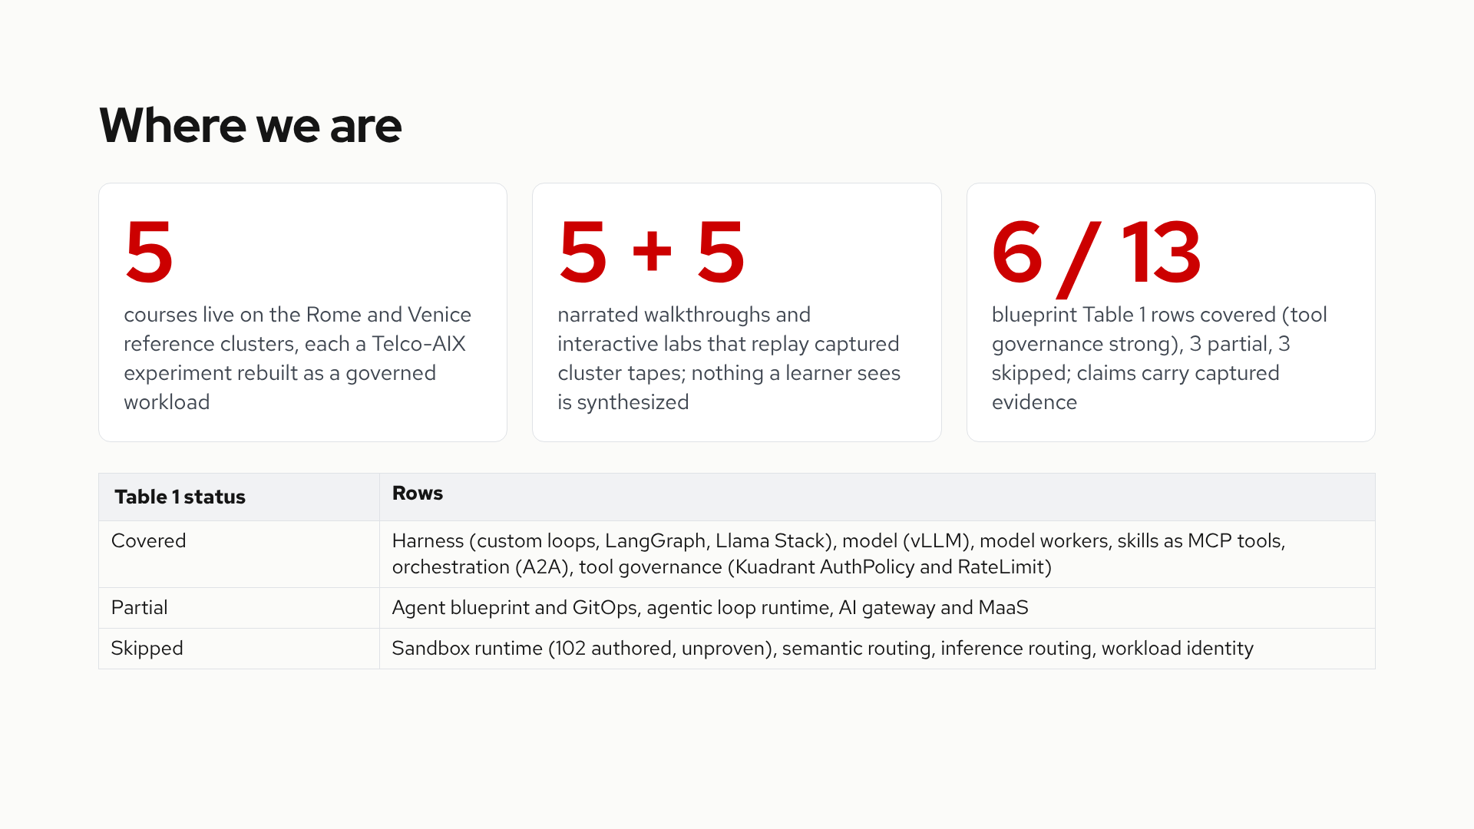
Notes:
Five courses run live on both reference clusters. The site replays captured tapes, so the course experience outlives the hardware. The scoreline against the article’s Table 1 is the honest ledger: the harness, model, skills and tool-governance rows are the spine; sandbox, routing and identity are the gaps the roadmap names.

Slide 3
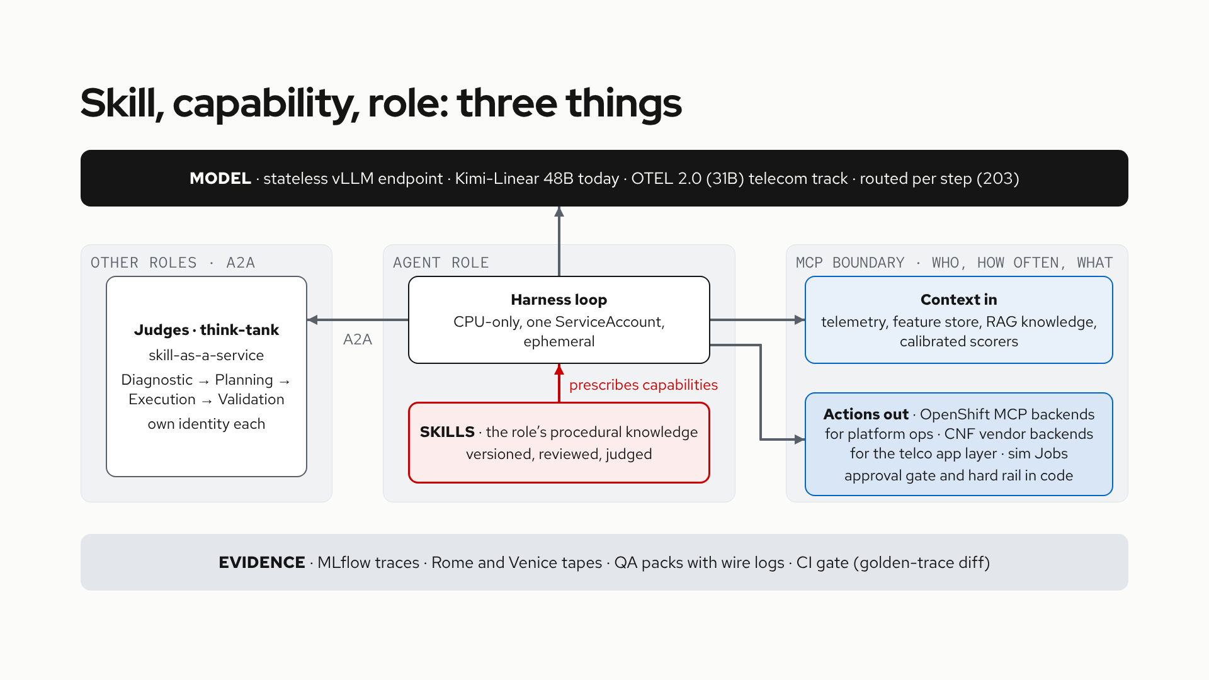
Notes:
The cut: a skill is procedural knowledge bound to a role, how the job gets done. MCP is the trust-boundary protocol for everything outside the agent process: context in on the read side, actions out on the write side. On the write side the backends are the platform's own: OpenShift ships MCP backends for platform operations, and CNF vendors are being onboarded to provide backends for the telco application layer; the shipped courses run stand-ins for both. A2A is role delegation. The two kinds get two governance regimes: skills as content (review, version, judge), capabilities at runtime (identity, rate, catalog). The whole stack sits on one evidence rail.

Slide 4
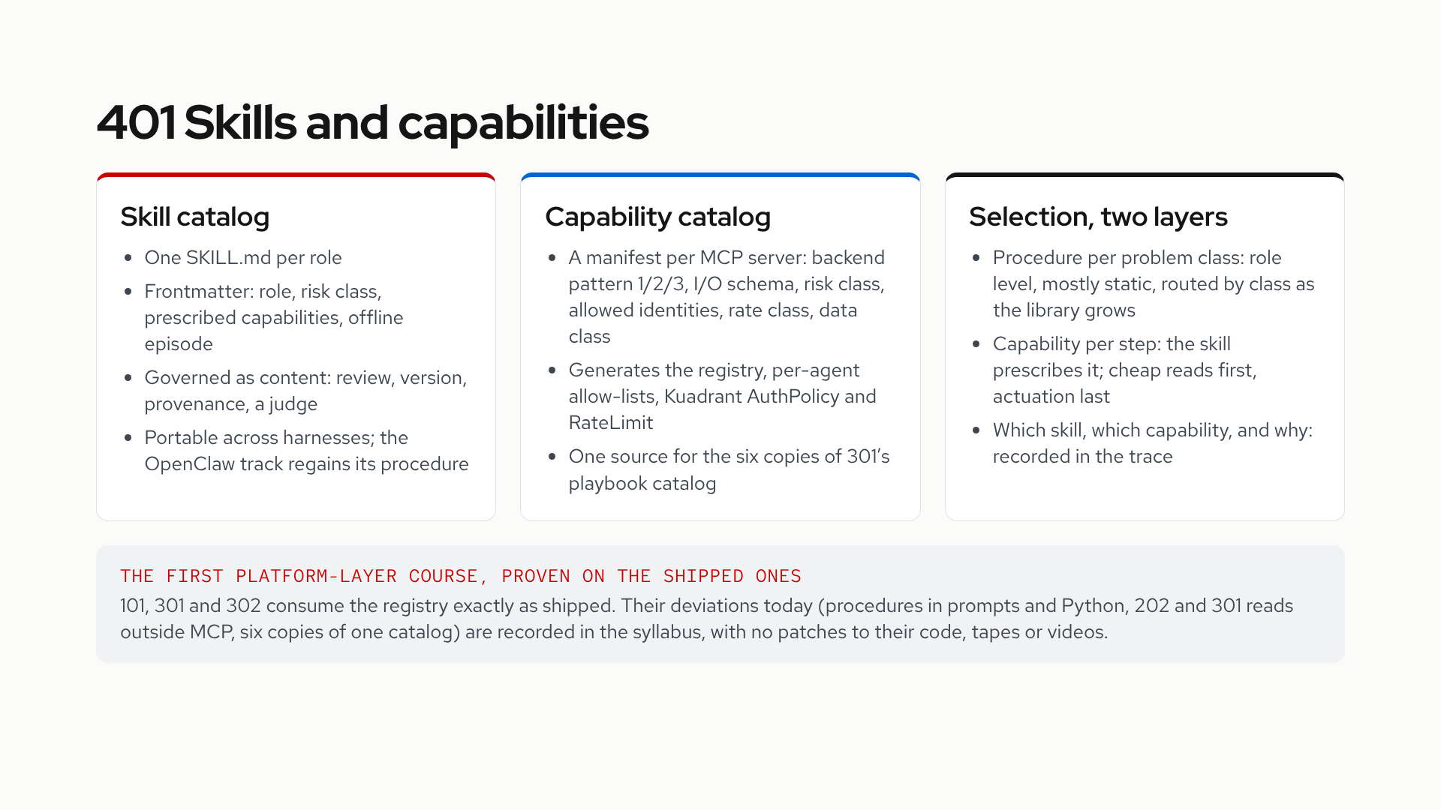
Notes:
4xx is the platform layer: each course builds one cross-workload component and proves it against the existing courses as consumers, without modifying them. 401 is the first. The skill catalog carries procedure and is reviewed like code. The capability catalog is a manifest per MCP server, and a generator turns it into the registry and the gateway policies, the way the tape generator turns manuals into labs. Selection splits into two questions with different mechanisms, and both answers land in the trace.

Slide 5
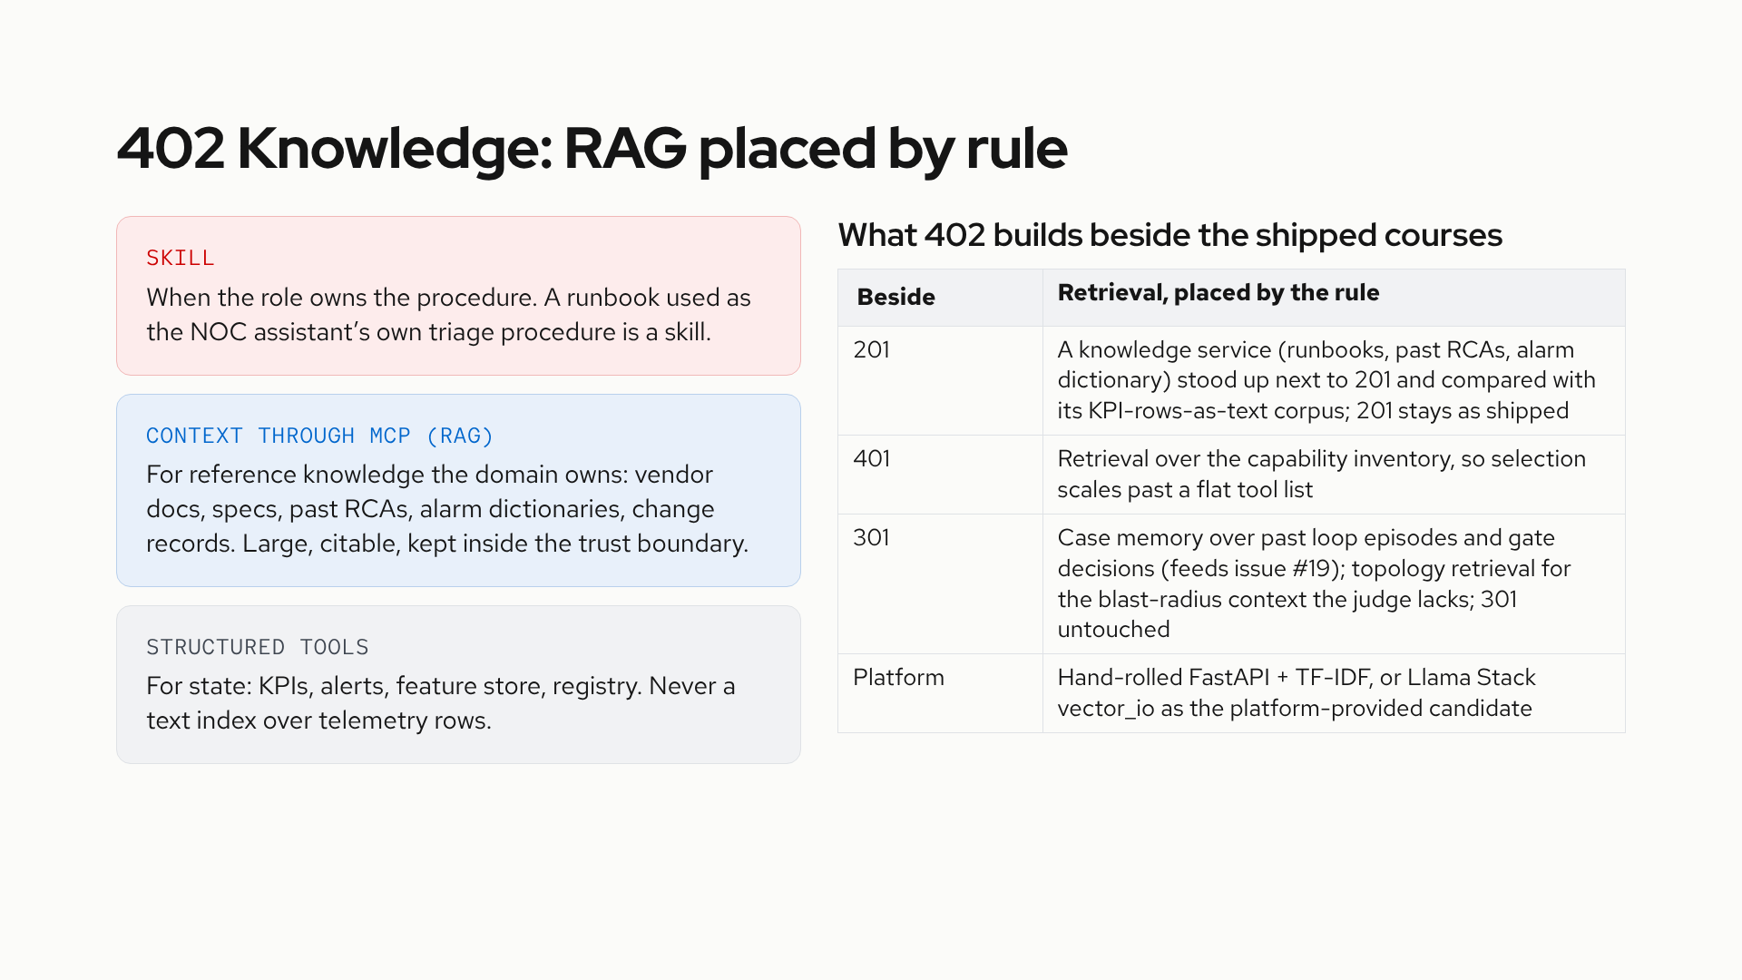
Notes:
201’s corpus is the wrong shape for retrieval: per-minute KPI rows under TF-IDF. The pattern-2 lesson, the citations and the judge all hold, and the placement rule was missing. Retrieval holds knowledge the domain owns, tools carry state, and a procedure the role owns is a skill. 402 makes that rule a platform service and proves it beside 201 and 301 without modifying either.

Slide 6
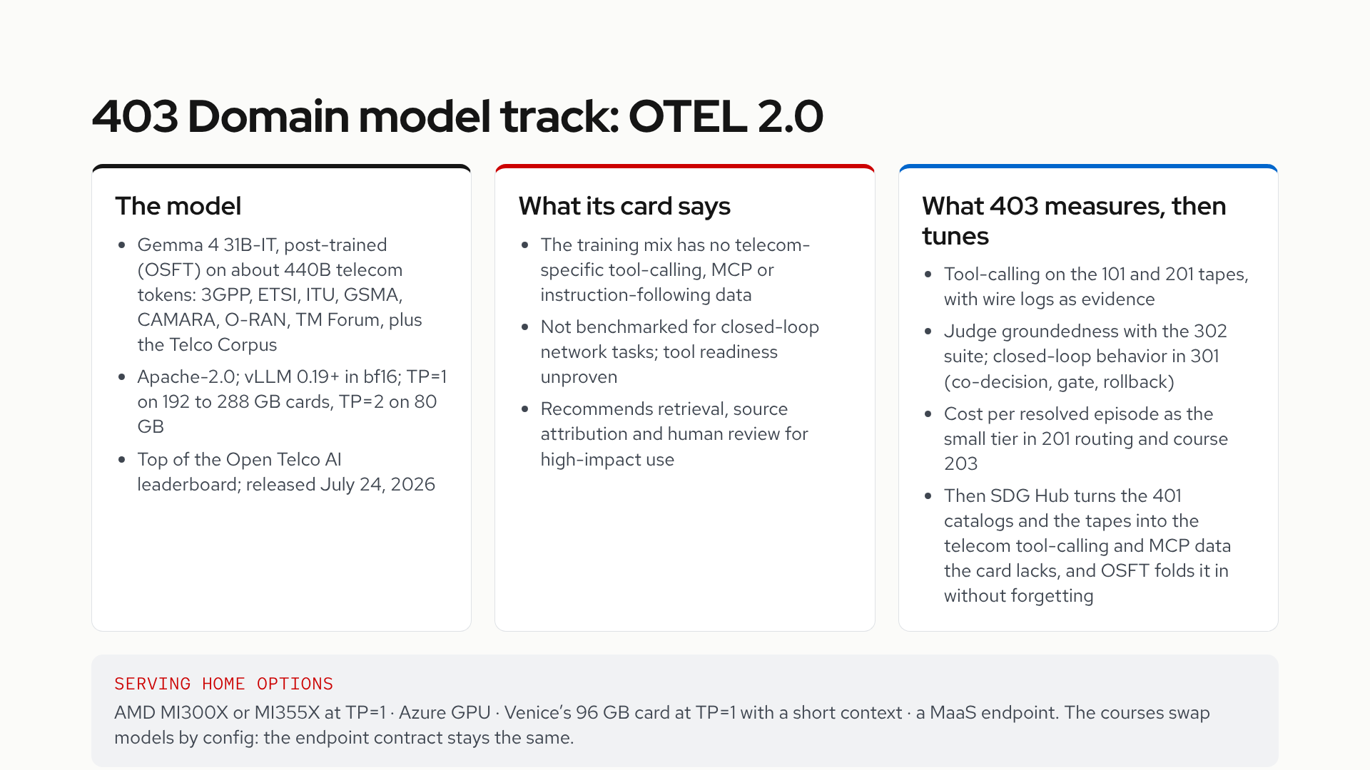
Notes:
OTEL 2.0 drops into the model slot every course already treats as a stateless endpoint. The model card is candid about what it does not cover, and those three gaps are exactly what the courses measure: tool-calling, groundedness, and closed-loop behavior. The card credits Red Hat for OSFT and SDG Hub, Microsoft Azure for data processing, AMD for MI300X and MI355X compute, and GSMA for the corpus.

Slide 7
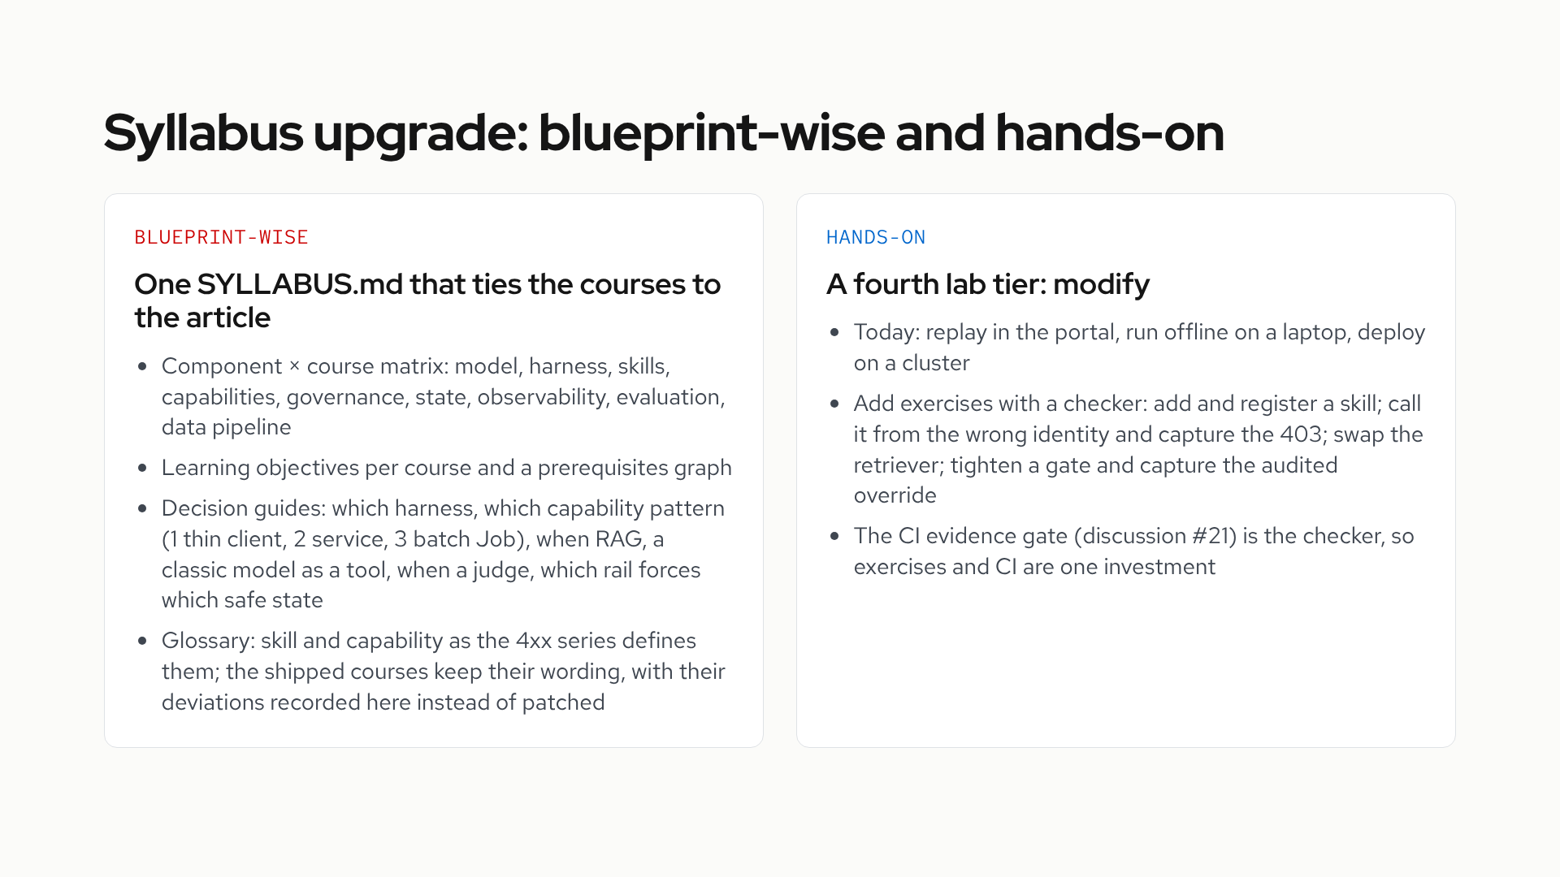
Notes:
The blueprint mapping exists per course and in the roadmap, and nothing ties it together for a learner. The syllabus adds objectives, the matrix and the decision guides a solution architect needs. On the hands-on side the labs stop at deploy; the modify tier makes the learner change the system and prove it with the same evidence gate the repo uses.

Slide 8
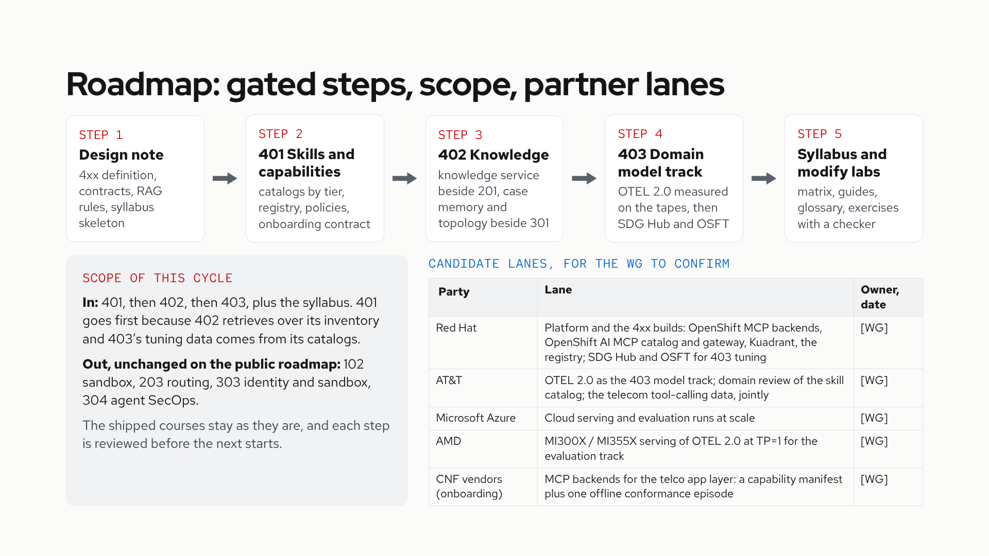
Notes:
Five gated steps, each reviewed before the next starts; 401 to 403 are the new 4xx series, built beside the shipped courses. The scope box says what is in and out of this cycle: 401 leads because the other two depend on its inventory and catalogs, and the 1xx to 3xx candidates stay on the public roadmap unscheduled. The lanes are candidates drawn from what each party already contributed to OTEL 2.0; owners and dates are for this group to fill in, nothing here is a commitment yet. The CNF vendor lane is a dependency still in onboarding: the vendors stay unnamed until each confirms, and the contract they sign up to is the capability manifest plus one offline conformance episode.

Slide 9
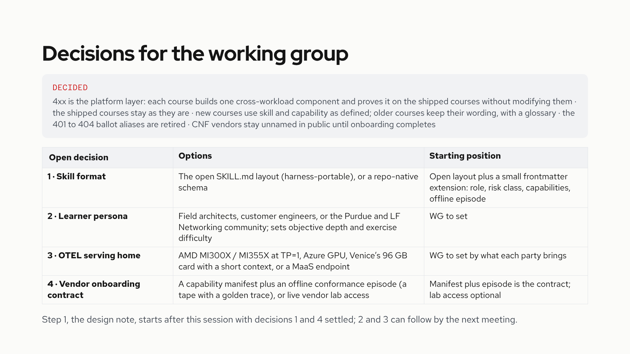
Notes:
Five things are decided and recorded in the repo roadmap. Two decisions block the design note: the skill format and the vendor onboarding contract, since the note defines both contracts. The other two shape later steps and can wait a meeting. The starting positions are proposals to argue with, and the WG can overrule any of them.

