Slide 1
TLS Offloading Solution Using Heterogeneous HW management
OTC Cloud Software Eng
Wang, Xin-Ran(xin-ran.wang@intel.com)

Slide 2
Outline
Existing problems
Intel’s QuickAssist Technology solution
Intel QAT card enabling in OpenStack Cloud

Slide 3
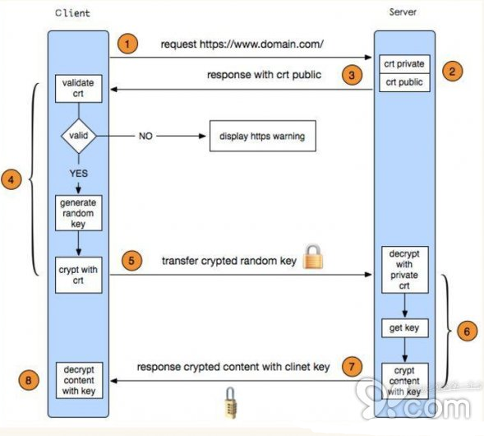
Problems
As the complexity of applications continues to grow, systems need more and more computational resources for workloads, including cryptography and data compression.
Latency need to be reduced
Better to free up CPU cores

Slide 4
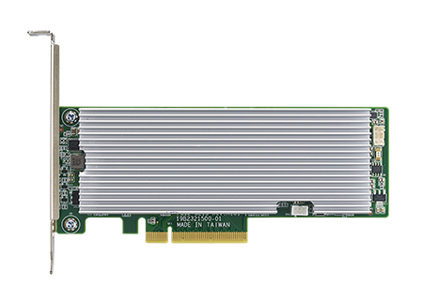
Intel QuickAssist Technology Overview
Intel® QuickAssist Adapter 8950
Key Features
  Intel® QuickAssist Technology Services supporting IPsec, SSL Acceleration and Compression services
  Intel® DH8955 controller for scalable performance
  Support for SR-IOV: 1 Physical/32 Virtual
  Low profile, PCIe compliant card
  PCI Express* Gen 3 x 8
Notes:
24 Gbps compression
50 Gbps crypto

Slide 5
Intel QuickAssist Technology Overview
A QAT device can host multiple acceleration services:
  Symmetric cryptography (AES, DES etc.)
  Asymmetric cryptography (RSA, DSA etc.)
  Hash/Authenticate operations (SHA-1, MD5 etc.)
  Data compression/decompression

Slide 6
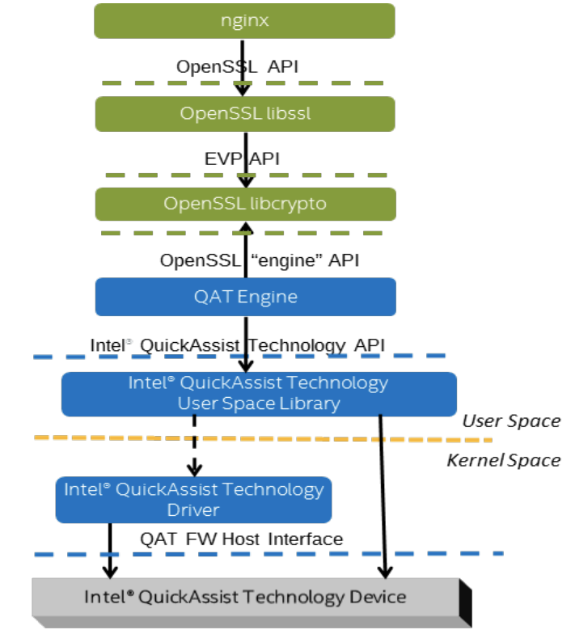
Intel QuickAssist Technology Overview
TLS offloading using Intel QAT
  Intel® QuickAssist Technology accelerator is accessed through a device driver in kernel space and a library in user space
  Cryptographic services are provided to OpenSSL through the standard engine framework.

Slide 7
QAT Virtualization
2 modes: PCI-e passthrough, SR-IOV
  SR-IOV only supported by Linux kernel older than 2.6.38
Steps:
  Enable Intel VT-D, SR-IOV in BIOS
  “intel_iommu = on” required as kernel parameter
  Virtualization related packages need to be installed
  Install QAT driver on host
    lspci to see VFs
  Attach VF to an VM
    unbind device from Host driver and bind ig to vfio-pci driver
  Install QAT software package on Guest OS

Slide 8
QAT Enabling in OpenStack(Plan)
1 device - >16/32 VFs
Implement cyborg-internal driver
  discover QAT’s VFs from host driver
  report device topology to cyborg-agent
Attach/Detach VF to an instance like other PCI devices(FPGA etc)
Some tips:
  can add/remove QAT VFs while Guest OS is running
  User can choose QAT work mode in configuration file.

Slide 9
Links of References
QAT overview:
  https://www.intel.com/content/www/us/en/architecture-and-technology/intel-quick-assist-technology-overview.html
  https://01.org/intel-quick-assist-technology
QAT-OpenSSL Engine:
  https://github.com/intel/QAT_Engine
Accelerate OpenSSL using Intel QAT performance:
  https://01.org/sites/default/files/downloads/intelr-quickassist-technology/intelquickassisttechnologyopensslperformance.pdf

Slide 10
Thanks

