Slide 1

.crashcourse
Roel De Coninck & Ruben Baetens
roel.deconinck@tme.kuleuven.be,
ruben.baetens@bwk.kuleuven.be
26th of October 2012

Slide 2
Modelica.crashcourse
Purpose
  Introduction in
    what is Modelica ?
    basic syntaxis, language concepts and model structuring
    how to get started (tutorials, reference docs, libraries, software implementations, ...)
  Just enough to
    jumpstart on your own,
    decide for yourself if it is something useful or not for your own purposes, and
    see how simple it may be ... (or how complex ...)
  Combination of ex cathedra and DIY

Slide 3
Content /1
  Intro Modelica (slides)
  Language concepts part I (demo openmodelica)
  DIY: simple model with connectors, instantiation, modification
  Language concepts part II (demo dymola)
    DIY : arrays, inheritance, partials, redeclare, replaceables
  Language concepts part III (demo dymola)
Notes:
20’ - Intro Modelica (slides)
30’ - Language concepts part I (demo dymola)
30’ - DIY: simple model with connectors, instantiation, modification
20’ - Language concepts part II (demo dymola)
30’ - DIY : inheritance, redeclare replaceables
20’ - Language concepts part III (demo dymola)
2u30’ totaal

Slide 4
Content /2
  OpenModelica /Dymola (covered before)
  JModelica (demo)
  Tutorials and reference documentation (slides)
  Libraries (dymola demo)
    MSL
    IDEAS
    Buildings
    BuildingSystems
  awesim (python demo)
  Coding conventions (slides)
  Dymola licenses at TME (slides)
Notes:
10’ - JModelica (demo)
5’ - Tutorials and reference documentation (slides)
30’ - Libraries: MSL and own libraries (dymola demo)
10’ - simman and pymosim (python demo)
5’ - Coding conventions (slides)
5’ - Dymola licenses at TME (slides)
1u05 min

Slide 5
INTRODUCTION TO MODELICA

Slide 6
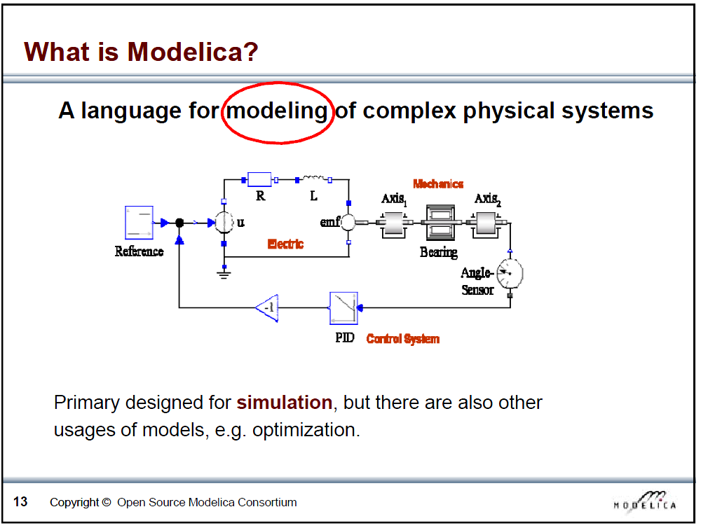
Slide from Peter Fritzson, Introduction to Object-Oriented Modeling, Simulation and Control with Modelica, Tutorial for Modelica Conference 2011, Dresden

Slide 7
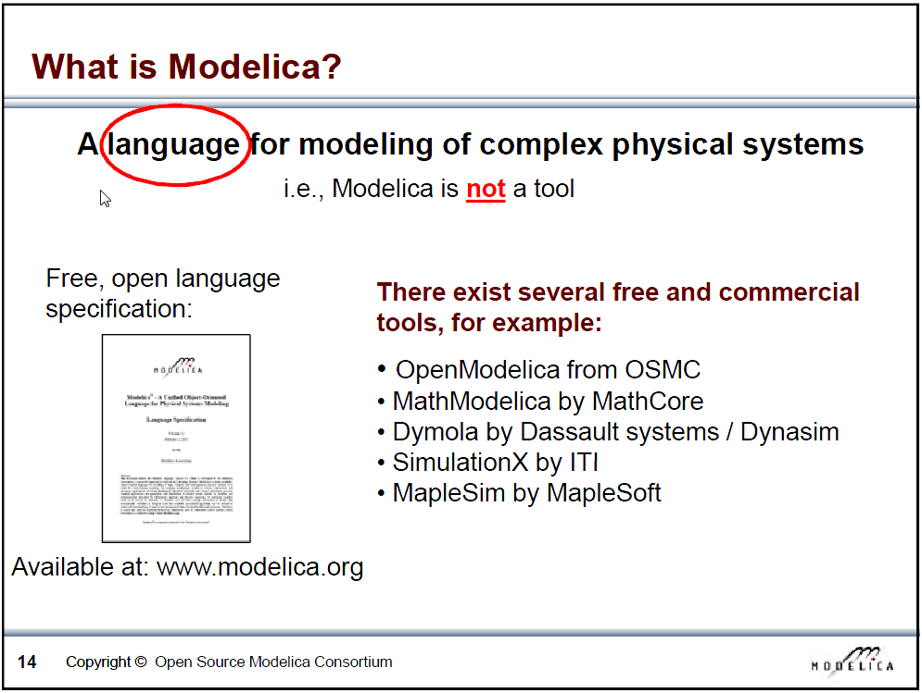
Slide from Peter Fritzson, Introduction to Object-Oriented Modeling, Simulation and Control with Modelica, Tutorial for Modelica Conference 2011, Dresden

Slide 8
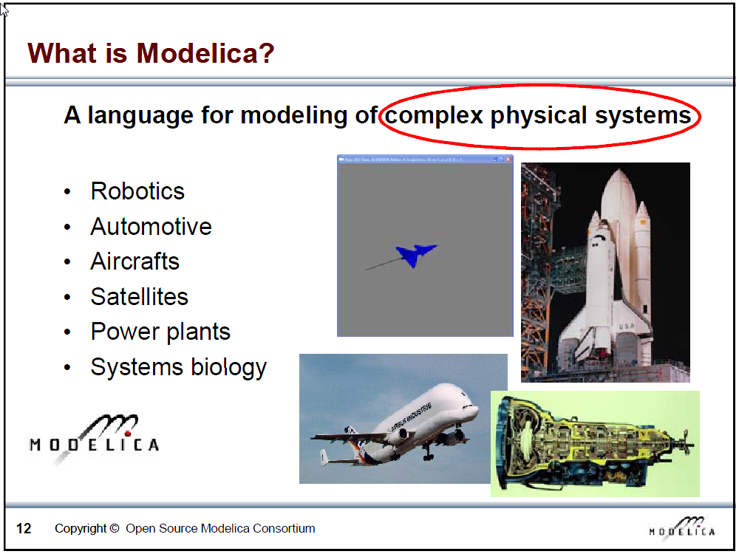
Slide from Peter Fritzson, Introduction to Object-Oriented Modeling, Simulation and Control with Modelica, Tutorial for Modelica Conference 2011, Dresden

Slide 9
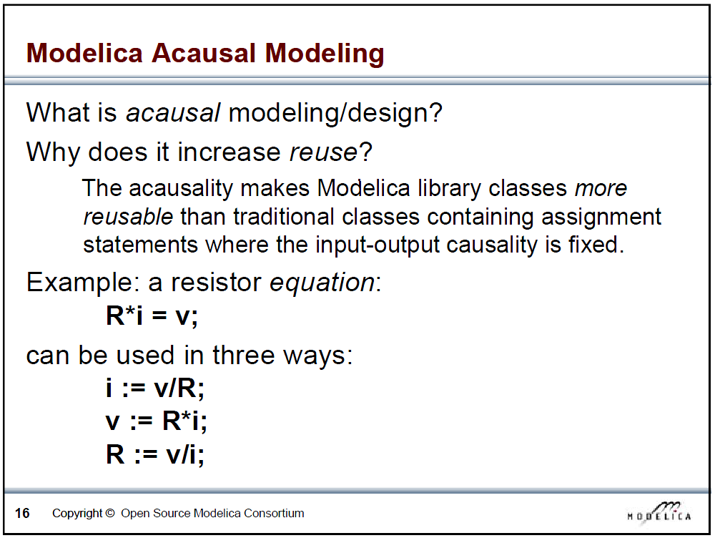
Slide from Peter Fritzson, Introduction to Object-Oriented Modeling, Simulation and Control with Modelica, Tutorial for Modelica Conference 2011, Dresden

Slide 10
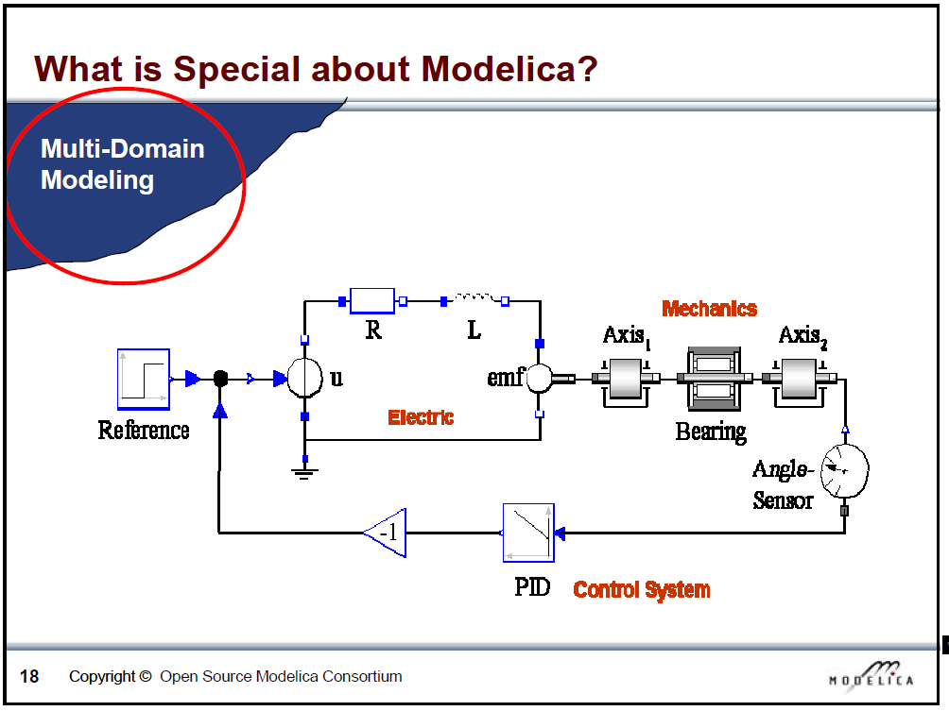
Slide from Peter Fritzson, Introduction to Object-Oriented Modeling, Simulation and Control with Modelica, Tutorial for Modelica Conference 2011, Dresden

Slide 11
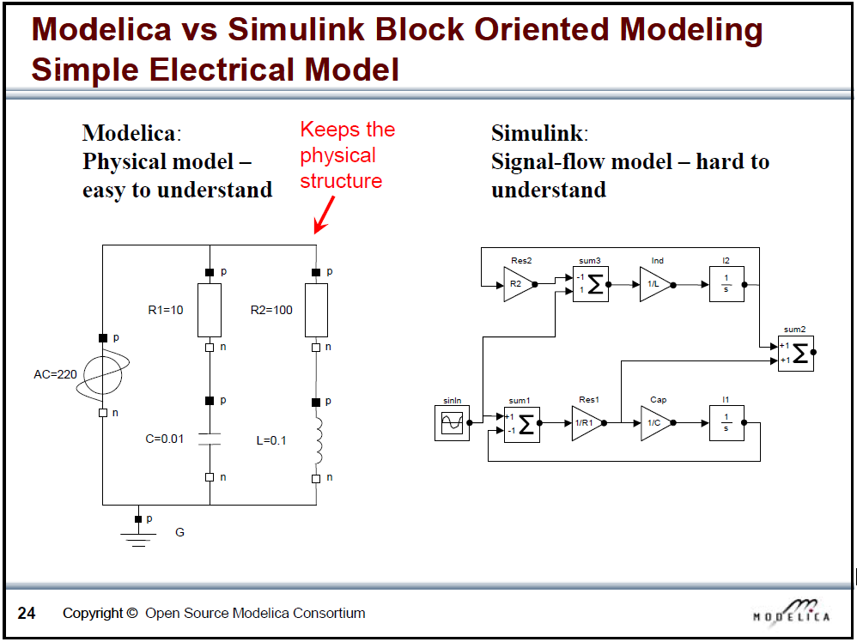
Slide from Peter Fritzson, Introduction to Object-Oriented Modeling, Simulation and Control with Modelica, Tutorial for Modelica Conference 2011, Dresden

Slide 12
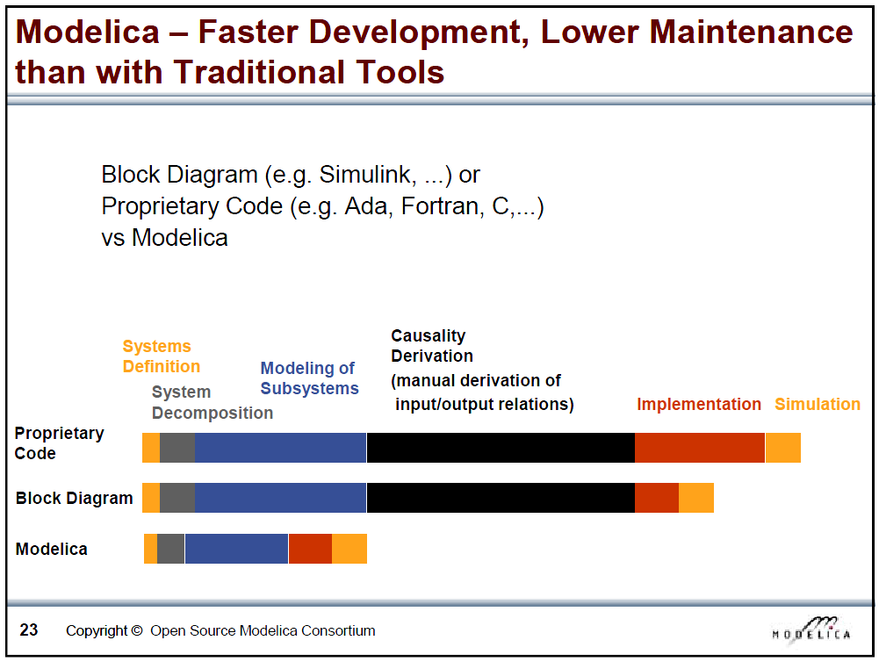
Slide from Peter Fritzson, Introduction to Object-Oriented Modeling, Simulation and Control with Modelica, Tutorial for Modelica Conference 2011, Dresden

Slide 13
What is Modelica
Modelica is a language for modeling of physical systems
  open source
  object oriented
  Acausal modeling (equation based)
  multi-domain
  primarily for simulation, but usable for optimization
  small and large models (> 100 000 equations)
  many model libraries (free and commercial)
  textual and graphical modeling
  different Modelica tools

Slide 14
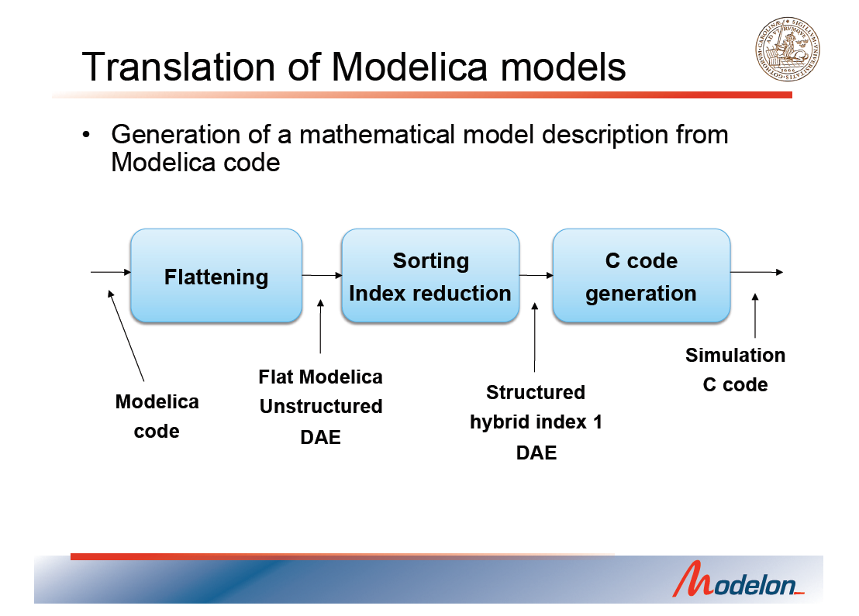
Slide from Johan Akesson, Optimization of Modelica Models with JModelica.org and Optimica, Tutorial for Modelica Conference 2011, Dresden

Slide 15
Modelica environments
Commercial software packages
Dymola (Dassault Systèmes, Sweden)
MathModelica (MathCore, Sweden)
SimulationX (ITI, Germany)
MapleSim (Maplesoft, Canada)
Free and open source packages
OpenModelica (Open Source Modelica Consortium, Sweden and other countries)
JModelica (Modelon, Sweden)

Slide 16
THE MODELICA LANGUAGE

Slide 17
Language concepts part I
Basic intro Dymola
Structure of a model
  class definition
  parameter and variable declaration
  equations
  initialization, initial equation
  der() operator
  algorithms
  instantiation and modification
Notes:
Demo sequence
show dymola
start a new package
write a first model like below
check it
run it
model FirstModel
parameter Real a=2;
parameter Real b=-10;
Real x;
equation
x^2 + a*x + b = 0 ;
end FirstModel;
Explain the warning and show initialization: Real x (start=-10);
Show the package + model in text view
Make a new model by copy/paste
add other variables of different types:
Integer, boolean
example:
parameter Integer n = 6;
Boolean biggerThan5(start=false);
equation
biggerThan5= n>5;
add an algorithm
Real y;
algorithm
y:=5*n;
From here, switch to the prefabricated models
Model of mass m with specific heat capacity cp and temperature T exchanging heat with heat transfer coefficient UA with environment at temperature Ta
m.cp.der(T)+UA(T-Ta)=0
siumulation, first 1s, later changing to 3600s
Instantiation: TwoMasses
keyword final

Slide 18
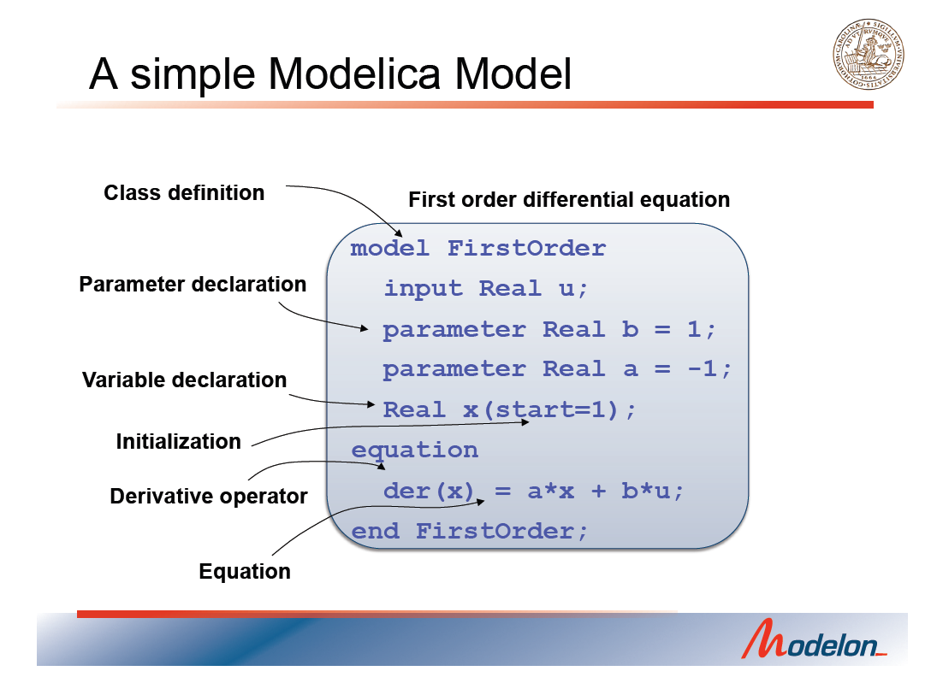
Slide from Johan Akesson, Optimization of Modelica Models with JModelica.org and Optimica, Tutorial for Modelica Conference 2011, Dresden

Slide 19
Connectors
We want to couple the masses in model TwoMasses with a thermal resistance in between
➔ Ta is no parameter anymore, but the temperature of the other mass
Conservation of energy:
heatflow1 + heatflow2 = 0
We can define a connector for easy coupling

Slide 20
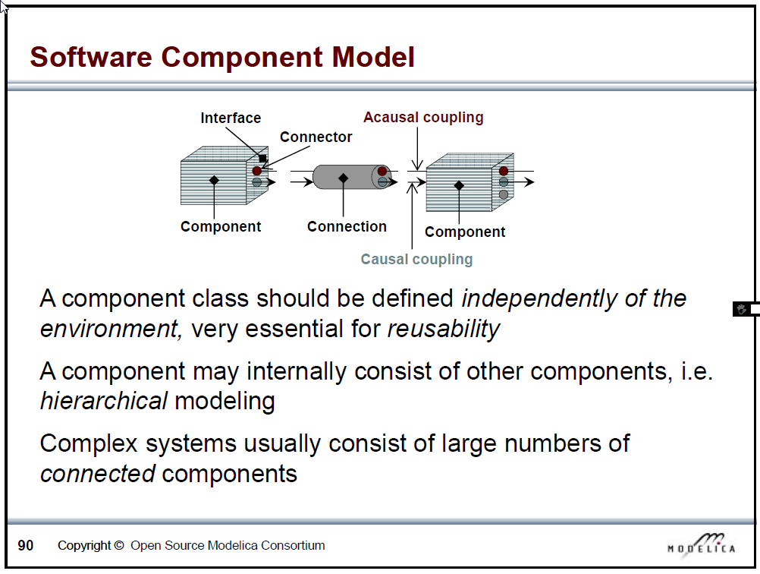
Slide from Peter Fritzson, Introduction to Object-Oriented Modeling, Simulation and Control with Modelica, Tutorial for Modelica Conference 2011, Dresden

Slide 21
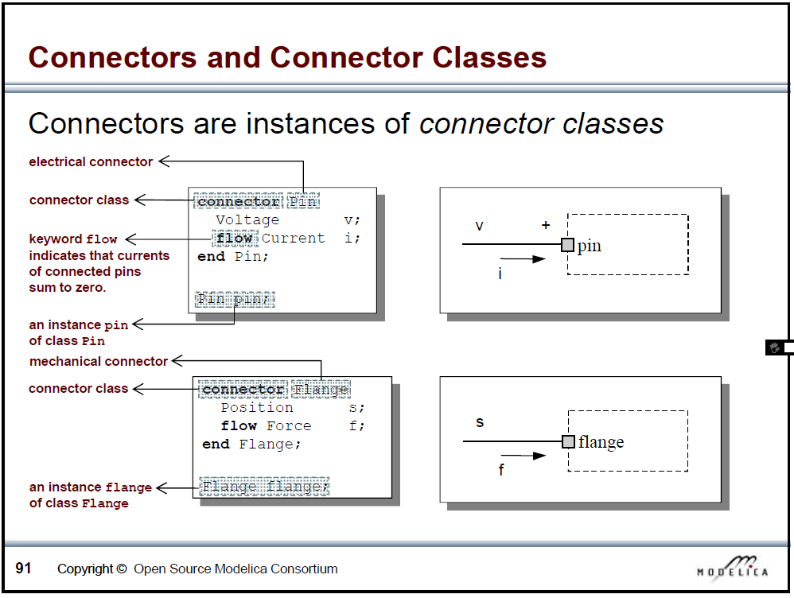
Slide from Peter Fritzson, Introduction to Object-Oriented Modeling, Simulation and Control with Modelica, Tutorial for Modelica Conference 2011, Dresden

Slide 22
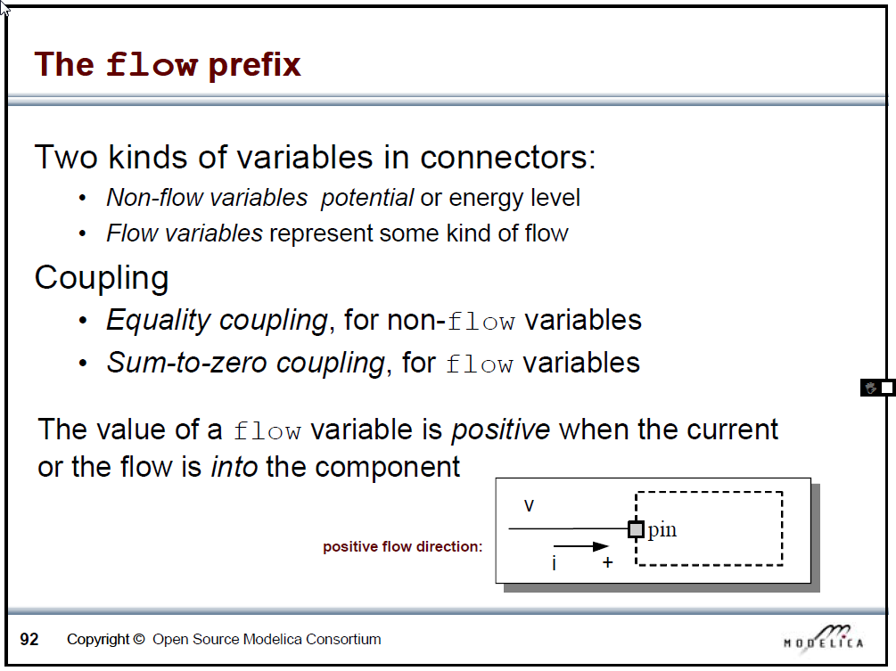
Slide from Peter Fritzson, Introduction to Object-Oriented Modeling, Simulation and Control with Modelica, Tutorial for Modelica Conference 2011, Dresden

Slide 23
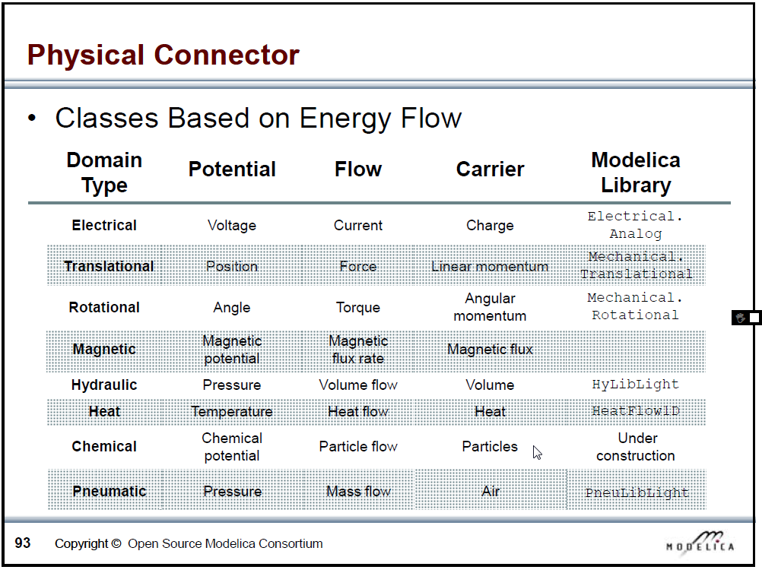
Slide from Peter Fritzson, Introduction to Object-Oriented Modeling, Simulation and Control with Modelica, Tutorial for Modelica Conference 2011, Dresden

Slide 24
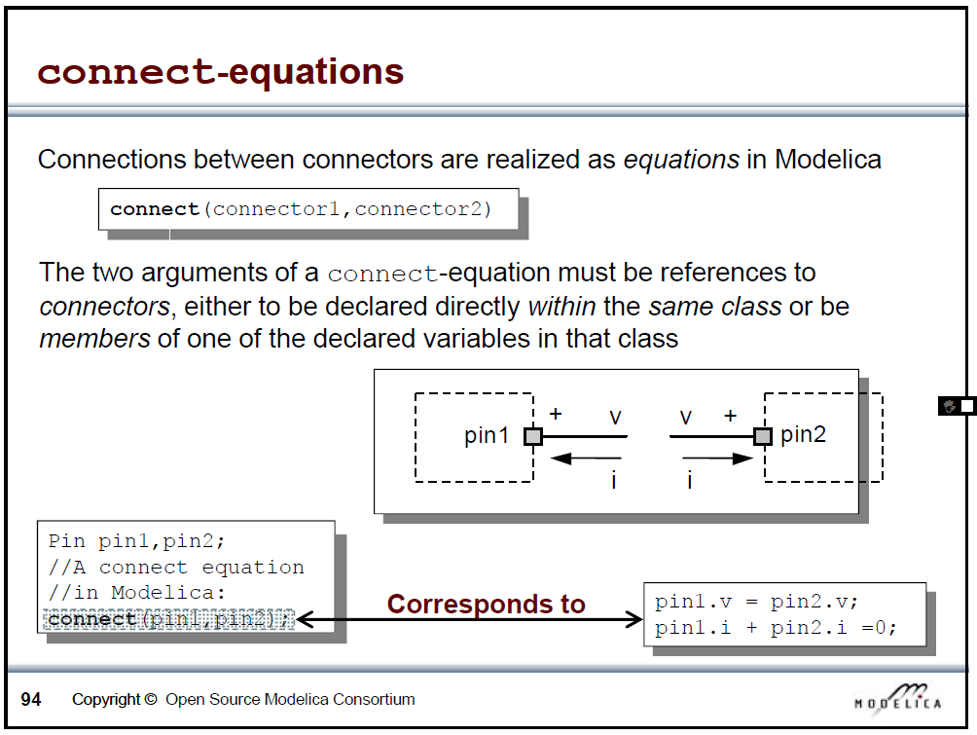
Slide from Peter Fritzson, Introduction to Object-Oriented Modeling, Simulation and Control with Modelica, Tutorial for Modelica Conference 2011, Dresden

Slide 25
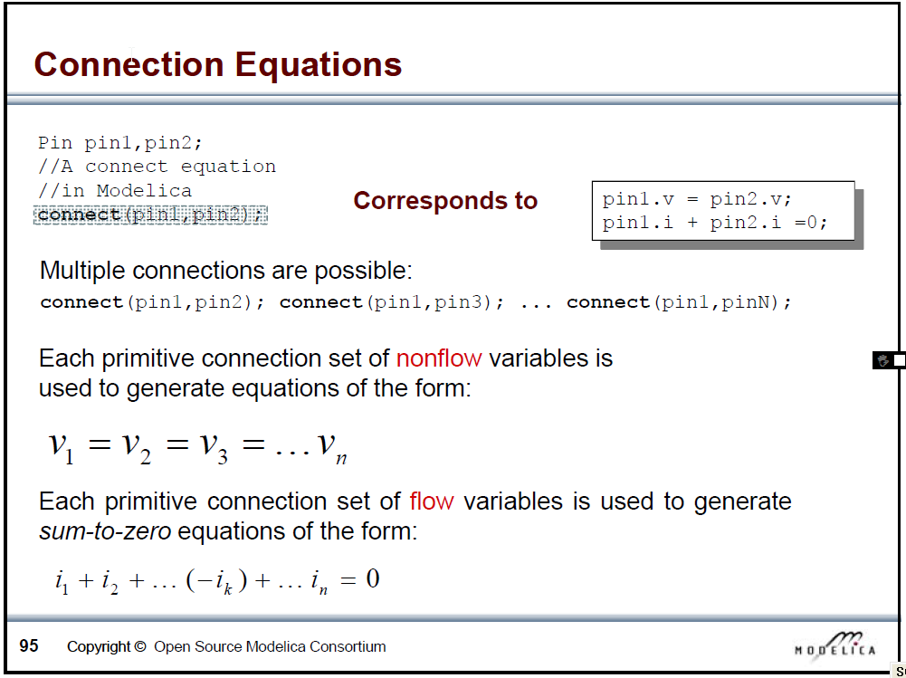
Slide from Peter Fritzson, Introduction to Object-Oriented Modeling, Simulation and Control with Modelica, Tutorial for Modelica Conference 2011, Dresden

Slide 26
DIY part I
Create a connector class HeatPort. Which variables are required?
Create a thermal capacity with an instantiation of the HeatPort , and capacity c
Create a thermal resistance with two instantiations of the HeatPort and thermal resistance R
Create a model with two capacities linked by the resistance

Slide 27
Language concepts part II
Heritance (extends)
Nested instantiation
Partial models
Replaceable
Redeclare – constrainedby
Graphic modelling

Slide 28
DIY part II
Rewrite Layer and LayerFiniteElement so they extend from a class Partial_Layer
Rewrite class TwoLayers to make it possible to change the type of layer model: lumped or discretized

Slide 29
Language concepts part III
Another example: fluid flow modelling for a typical heating simulation

Slide 30
Open source Modelica environments
OpenModelica and Dymola: demonstrated so far
Jmodelica
Optimica is an extension of the Modelica language in order to enable dynamic optimisation (optimal control) of a model
demo JModelica
More details: see tutorial on www.jmodelica.org

Slide 31
Tutorials and reference docs /1
This presentation ☺
Book Principles of Object-Oriented Modeling and Simulation with Modelica 2.1 from Peter Fritzson: complete overview of Modelica including many examples, tips and tricks, ...
Modelica language specifications 3.2 – also contains examples: very important reference doc

Slide 32
Tutorials and reference docs /2
Introductory presentations (on Toledo community)
  OpenModelica tutorials Fritzson
  JModelica tutorial
Manuals
  OpenModelica (Notebook, DrControl, OMShell, ...)
  Dymola Manual 1 and 2 (not only about dymola, also covers Modelica language issues, scripting, ...)
  JModelica tutorials

Slide 33
Websites
www.modelica.org
www.openmodelica.org
www.jmodelica.org
http://www.claytex.com/tech-blog/
Etc...

Slide 34
Fora
http://www.modelica-forum.com/forums/index.php?act=idx (not very active)
http://www.openmodelica.org/index.php/forum
http://www.jmodelica.org/forum
www.stackoverflow.com (tag Modelica)
And last but not least: https://groups.google.com/d/forum/modelicans

Slide 35
Libraries: MSL and own libraries
Overview in dymola
MSL
IDEAS (demo building and solar)
Buildings
BuildingSystems

Slide 36
awesim: Simulation Management in Python
Own developments, open source, easily downloadable here: https://github.com/saroele/awesim
  Class Simulation
  Class Simdex
  Class Process
  Class Result
Module pymosim
  Functions for running the executable created by dymola (dymosim.exe)
  Solvertest, parametric run with parallelization, sensitivity, ...

Slide 37
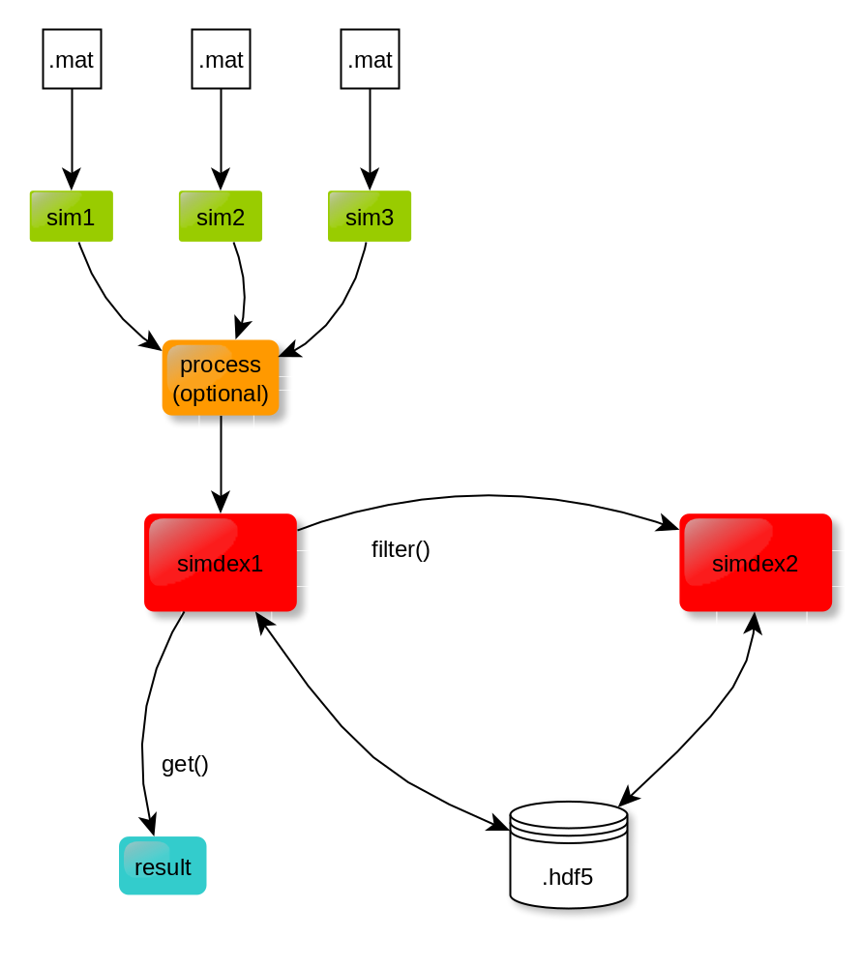

awesim classes

Slide 38
Coding conventions
Medium to long term goal: well documented and tested library of Modelica models
Collaboration
Coding conventions are crucial!

Slide 39
Coding conventions
Always use SI units
➔ start your package with import SI = Modelica.SIunits;
Classnames start with Capital (no exceptions)
Object names start with lowercase (there are exceptions)
CamelCase for object names: mFlowBoilerIn,
Names of elementary variables start with the quantity/symbol. Eg TSet instead setTemperature
Flow INTO a component is positive

Slide 40
Good coding practice
Apply the coding conventions
Document your code
Update your documenation
Test your code
  During development
  When other models change
  → scripts can be very useful for testing
Use a version control system (eg GIT), also when you work alone

Slide 41
Use of Dymola with KULeuven license
From any computer in the \\mech network you can access a server with Dymola installed
Remote desktop (windows/run/mstsc)
  Connect with tme-11-002-2 and login with your mech account (ask Jan Thielemans to get a permission if it does not work)
  Use Dymola, python, matlab, ...

Slide 42
Use of Dymola with KULeuven license
Attention: only TWO (2) licenses available at the moment
Only use Dymola when you really need it
Try to use jmodelica or OpenModelica
When your simulations are finished, CLOSE dymola
In case of unavailable license, send mail to me (roel.deconinck@mech.kuleuven.be) with the date+hour when you had the problem. I will check and find a solution if this problem recurs

Slide 43
Thank you and enjoy!
This presentation, some reference docs and the code used in this crash course can be found on Toledo in the community ‘Thermische systemen in gebouwen’

