Slide 1

.crashcourse
Roel De Coninck, Ruben Baetens, Mats Vande Cavey, Dieter Patteeuw & Damien Picard
roel.deconinck@mech.kuleuven.be,
ruben.baetens@bwk.kuleuven.be,
mats.vandecavey@mech.kuleuven.be,
dieter.patteeuw@mech.kuleuven.be,
damien.picard@mech.kuleuven.be
September 17, 2013

Slide 2
Modelica.crashcourse
Purpose
  What is Modelica ?
  Syntaxis, language concepts and model structuring
  Modelica tools
  Use of IDEAS library
  Getting started (tutorials, reference docs, libraries, software implementations, ...)
  ➔ To get you started with Modelica!

Slide 3
Program
Part I (13h30-15h45)
  Introduction to Modelica
  Using Dymola (commercial Modelica package, student licenses available at KU Leuven)
  Language concepts and syntax (mix of lecture and exercises)
  Quick tour through debugging
Part II (16h00-18h00)
Libraries
  Modelica standard library
  IDEAS: kuleuven library for simulation of energy concepts for buildings and neighbourhoods
  Buildings library
IDEAS exercise: modelling of a 2-zone office with concrete core activation and air handling unit

Slide 4
INTRODUCTION TO MODELICA

Slide 5
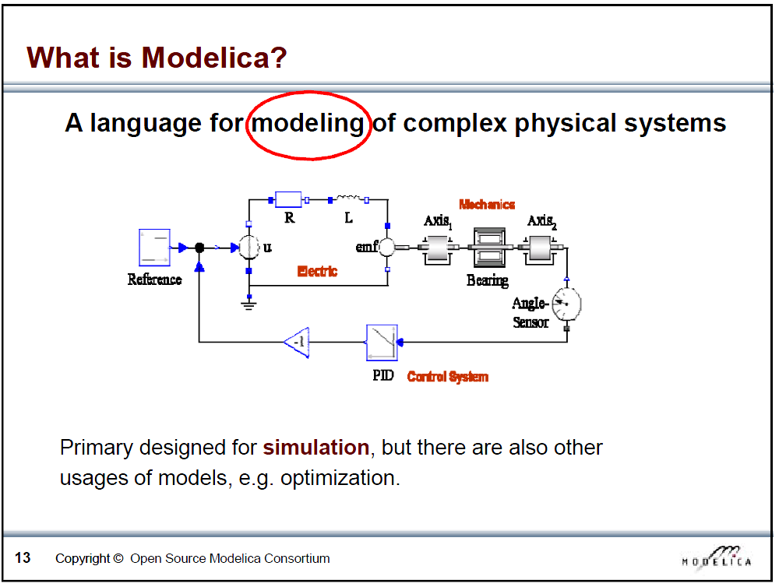
Slide from Peter Fritzson, Introduction to Object-Oriented Modeling, Simulation and Control with Modelica, Tutorial for Modelica Conference 2011, Dresden

Slide 6
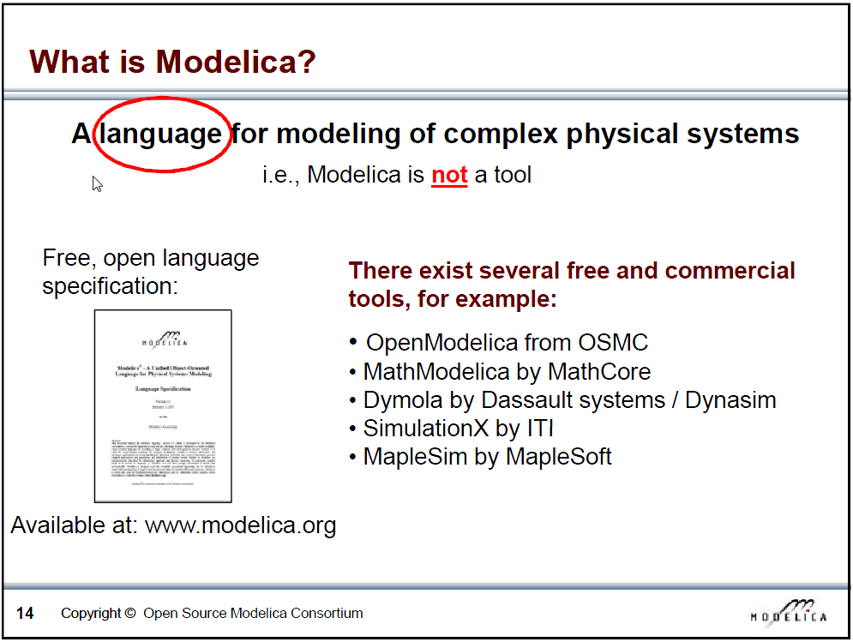
Slide from Peter Fritzson, Introduction to Object-Oriented Modeling, Simulation and Control with Modelica, Tutorial for Modelica Conference 2011, Dresden

Slide 7
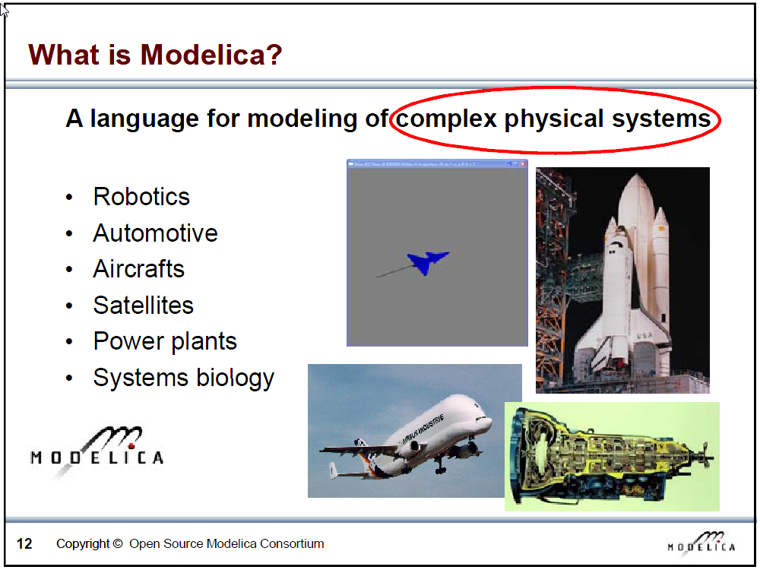
Slide from Peter Fritzson, Introduction to Object-Oriented Modeling, Simulation and Control with Modelica, Tutorial for Modelica Conference 2011, Dresden

Slide 8
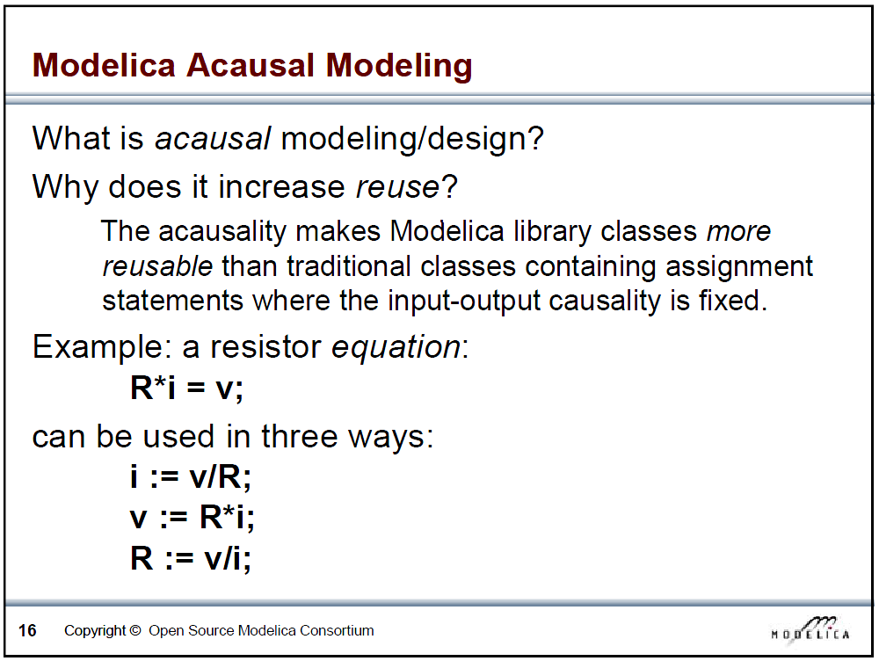
Slide from Peter Fritzson, Introduction to Object-Oriented Modeling, Simulation and Control with Modelica, Tutorial for Modelica Conference 2011, Dresden

Slide 9
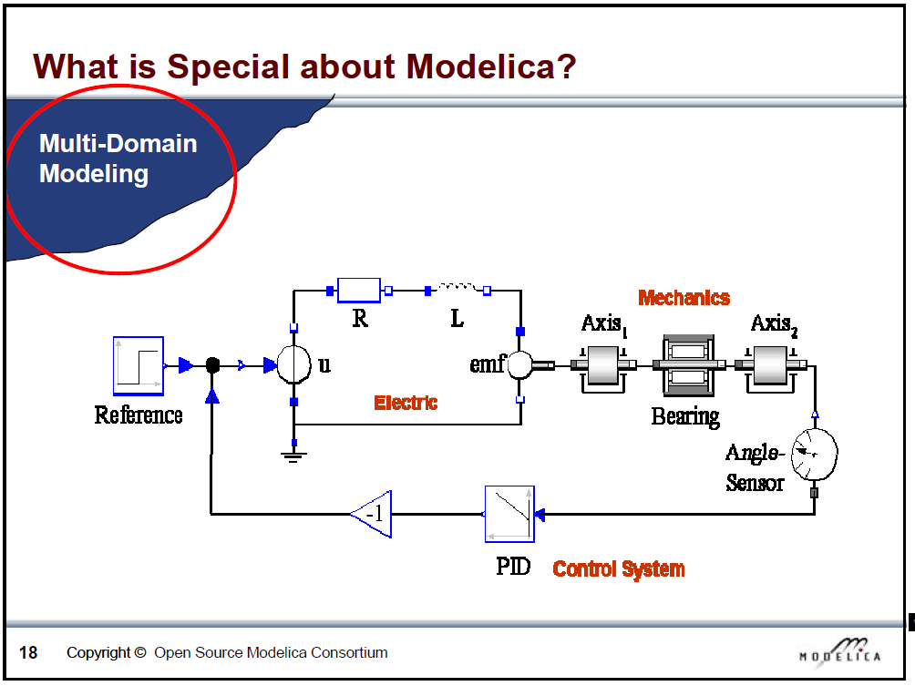
Slide from Peter Fritzson, Introduction to Object-Oriented Modeling, Simulation and Control with Modelica, Tutorial for Modelica Conference 2011, Dresden

Slide 10
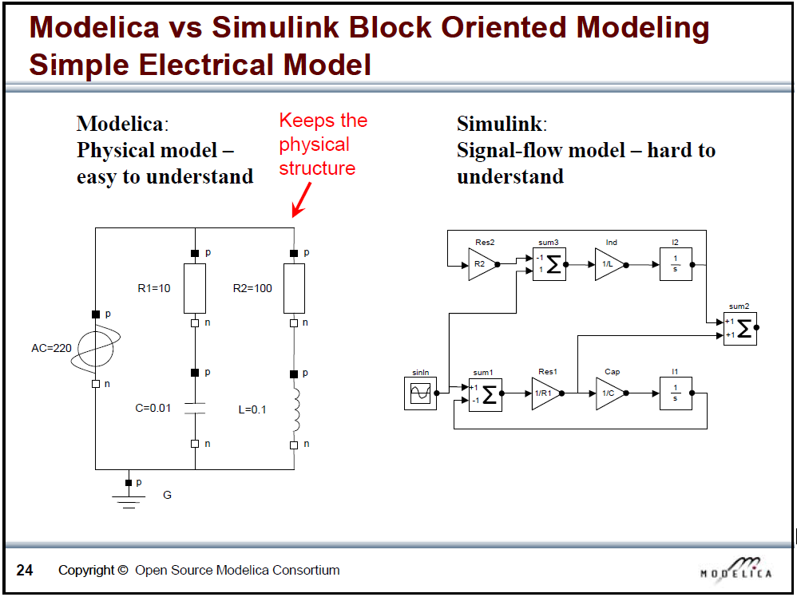
Slide from Peter Fritzson, Introduction to Object-Oriented Modeling, Simulation and Control with Modelica, Tutorial for Modelica Conference 2011, Dresden

Slide 11
What is Modelica
Modelica is a language for modeling of physical systems
  open source
  object oriented
  Acausal modeling (equation based)
  multi-domain
  primarily for simulation, but usable for optimization
  small and large models (> 100 000 equations)
  many model libraries (free and commercial)
  textual and graphical modeling
  different Modelica tools

Slide 12
Modelica environments
Commercial software packages
Dymola (Dassault Systèmes, Sweden)
MathModelica (MathCore, Sweden)
SimulationX (ITI, Germany)
MapleSim (Maplesoft, Canada)
Free and open source packages
OpenModelica (Open Source Modelica Consortium, Sweden and other countries)
JModelica (Modelon, Sweden)

Slide 13
Websites
General
www.modelica.org
www.openmodelica.org
www.jmodelica.org
http://www.claytex.com/tech-blog/
Modelica language
http://modref.xogeny.com/
KUL modelling conventions
https://docs.google.com/document/d/1MaNKTdLz-YPpEEH3Eg12ECzG0ErK-rIK9IHd6gsBp7Q/edit?usp=sharing
Buildings library:
https://simulationresearch.lbl.gov/modelica

Slide 14
Fora
http://www.modelica-forum.com/forums/index.php?act=idx (not very active)
http://www.openmodelica.org/index.php/forum
http://www.jmodelica.org/forum
www.stackoverflow.com (tag Modelica)
And last but not least: https://groups.google.com/d/forum/modelicans

Slide 15
Use of Dymola with KULeuven license
Access to licence on the buildings physics server.
Connected physically to the buildingsphysics or to the mech network
  Soon server updated to 10.112.72.4
More information on Modelicans (google groups)

Slide 16
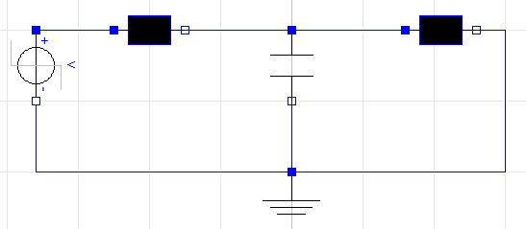

Exercise 1
Create connector with voltage and current (flow)
Create partial class OnePin and TwoPin with variable v, I + Kirchhoff
Create a resistor: v = R*I
Create a capcitor: i = C*der(v)
Create a ground: v = 0
Make the circuit (use StepVoltage of Modelica)

Slide 17
Exercise 2
Look at Lib.Examples
Try to understand the different models
Combine them to make your own model

Slide 18
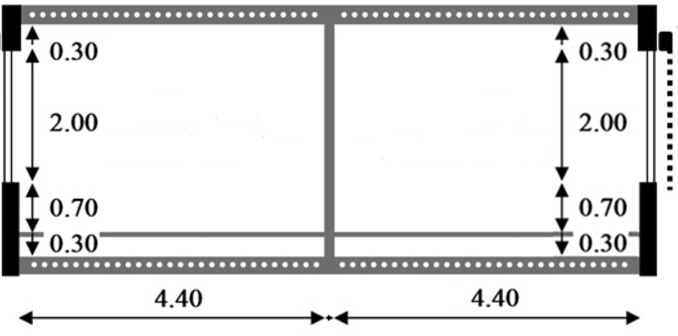
Exercise 3
IDEAS demo
Low energy office building with 2 thermal zones
→Simulate for 1 month, check indoor temperatures & heat demand
*In the back and front as well as above and below there are other offices which maintain the same temperature.
NORTH
TABS heating
(depth: 2.7m)
SOUTH
TABS heating
(depth: 2.7m)
Notes:
10’ - JModelica (demo)
5’ - Tutorials and reference documentation (slides)
30’ - Libraries: MSL and own libraries (dymola demo)
10’ - simman and pymosim (python demo)
5’ - Coding conventions (slides)
5’ - Dymola licenses at TME (slides)
1u05 min

Slide 19
Exercise 3
IDEAS demo
Low energy office building with 2 thermal zones
Envelope
Materials (to model)
  Tile: λ=1.4 W/mK, c=840 J/kgK, ρ=2100 kg/m³
  Screed: λ=0.6 W/mK, c=860 J/kgK, ρ=1100 kg/m³
  Concrete: λ=1.7 W/mK, c=840 J/kgK, ρ=2400 kg/m³
Windows
  Glazing: Saint Gobain Clima Plus Futur (U = 1.4 W/m²K, g = 0.755)
  Frame: U-value=2.5 W/m²k , fraction of the window: f=0.15
Infiltration: n₅₀=0.4 ACH. No ventilation.
Geometry: use internal dimensions (not completely right)
 | Composition (out→in or propsBus b→a)
Floor (to model) | Tile (d=0.01m) | Screed (0.06) | Concrete (0.20) | Plaster (0.02)
Exterior wall | Brick (0.10) | MW (0.16) | Brick (0.14) | Plaster (0.02)
Interior wall | Plaster (0.02) | Brick (0.10) | Plaster (0.02)
Notes:
10’ - JModelica (demo)
5’ - Tutorials and reference documentation (slides)
30’ - Libraries: MSL and own libraries (dymola demo)
10’ - simman and pymosim (python demo)
5’ - Coding conventions (slides)
5’ - Dymola licenses at TME (slides)
1u05 min

Slide 20
Exercise 3
IDEAS demo
Low energy office building with 2 thermal zones
Ideas for playing around
Add shading blinds to south windows (+ shading schedule) Change occupants model to more realistic office occupancy profiles
Floor heating (change floor composition & add embedded heat gains)
 | Composition (propsBus b→a) * heating source located in Screed
Heated Floor | Tile (d=0.01m) | Screed (0.14) | PUR (0.06) | Concrete (0.20) | Plaster (0.02)
Notes:
10’ - JModelica (demo)
5’ - Tutorials and reference documentation (slides)
30’ - Libraries: MSL and own libraries (dymola demo)
10’ - simman and pymosim (python demo)
5’ - Coding conventions (slides)
5’ - Dymola licenses at TME (slides)
1u05 min

Slide 21
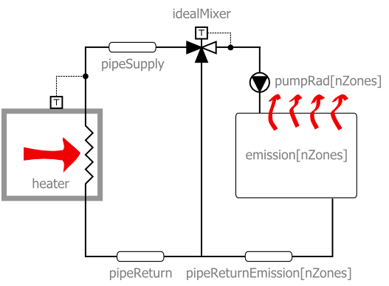
Heating system
Notes:
Idea:
Info over case study tonen (schema, eigenschappen)
Vertrekken van interfaces.building: tonen verschillende componenten voor gebouwsimulatie
Tonen gebouw (structure) (ruben)
Configuratie verwarming(100W/zone)
Gebruikers: Tset en voorlopig niets anders
Ventilatie: voorlopig geen: wel een model met None kiezen
Simulatie doen en tonen dat het comfort niet goed is (500W nominaal per zone)?

Slide 22
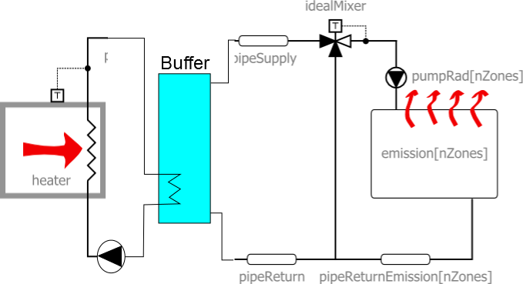
Heating system
Notes:
Idea:
Info over case study tonen (schema, eigenschappen)
Vertrekken van interfaces.building: tonen verschillende componenten voor gebouwsimulatie
Tonen gebouw (structure) (ruben)
Configuratie verwarming(100W/zone)
Gebruikers: Tset en voorlopig niets anders
Ventilatie: voorlopig geen: wel een model met None kiezen
Simulatie doen en tonen dat het comfort niet goed is (500W nominaal per zone)?

Slide 23
Case study: 2-zone office
Ideas for playing around
  Change parameters heating (heating curve, type of heater)
  Change parameters structure (insulation, windows, materials)
  Add internal gains according to schedule
  Night temperature set back
  Add ventilation system
  Different water set temperature per zone (tough)
  Add a thermal zone (tougher)
  Include pressure drops (toughest)

Slide 24
Thank you and enjoy!
This presentation, some reference docs and the code used in this crash course can be found on Toledo in the community ‘Thermische systemen in gebouwen’

