Slide 1

.crashcourse
Christina Protopapadaki, Damien Picard & Filip Jorissen
Christina.Protopapadaki@bwk.kuleuven.be
damien.picard@kuleuven.be,
filip.jorissen@mech.kuleuven.be
October 09, 2014

Slide 2
Modelica.crashcourse
Purpose
  What is Modelica ?
  Syntaxis, language concepts and model structuring
  Modelica tools
  Use of IDEAS library
  Getting started (tutorials, reference docs, libraries, software implementations, ...)
  ➔ To get you started with Modelica!

Slide 3
 | Agenda
13:00 - 13:15 | What is modelica? Where do I find information?
13:15 - 13:30 | Theory + Dymola + style guide (give printed version) + task
13:30 - 14:45 | Exercise
14:45 – 15:00 | Break
15:00 – 16:00 | Hydraulics annex 60 + buildings IDEAS: demo
16:00 - 17:30 | IDEAS: exercise + licenses
17:30 - 18:00 | Debug and typical mistakes

Slide 4
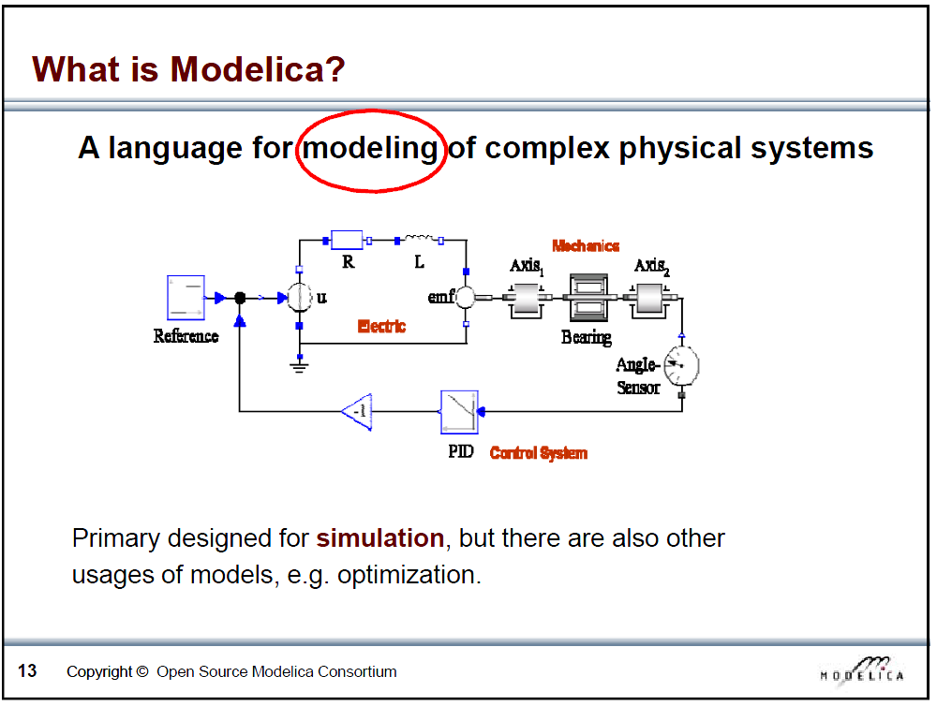
Slide from Peter Fritzson, Introduction to Object-Oriented Modeling, Simulation and Control with Modelica, Tutorial for Modelica Conference 2011, Dresden

Slide 5
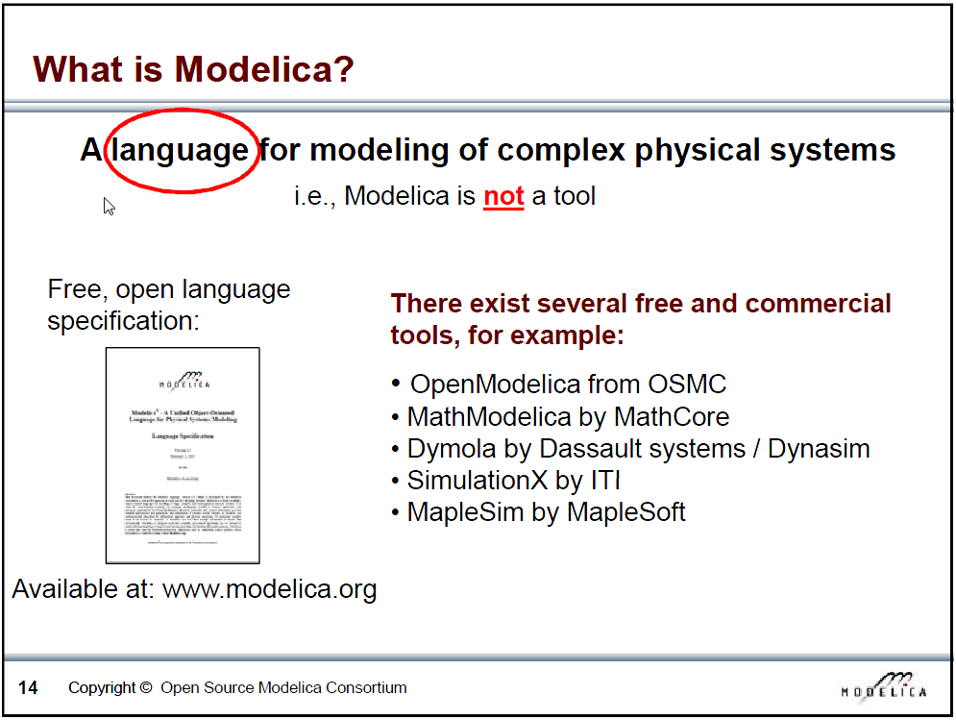
Slide from Peter Fritzson, Introduction to Object-Oriented Modeling, Simulation and Control with Modelica, Tutorial for Modelica Conference 2011, Dresden

Slide 6
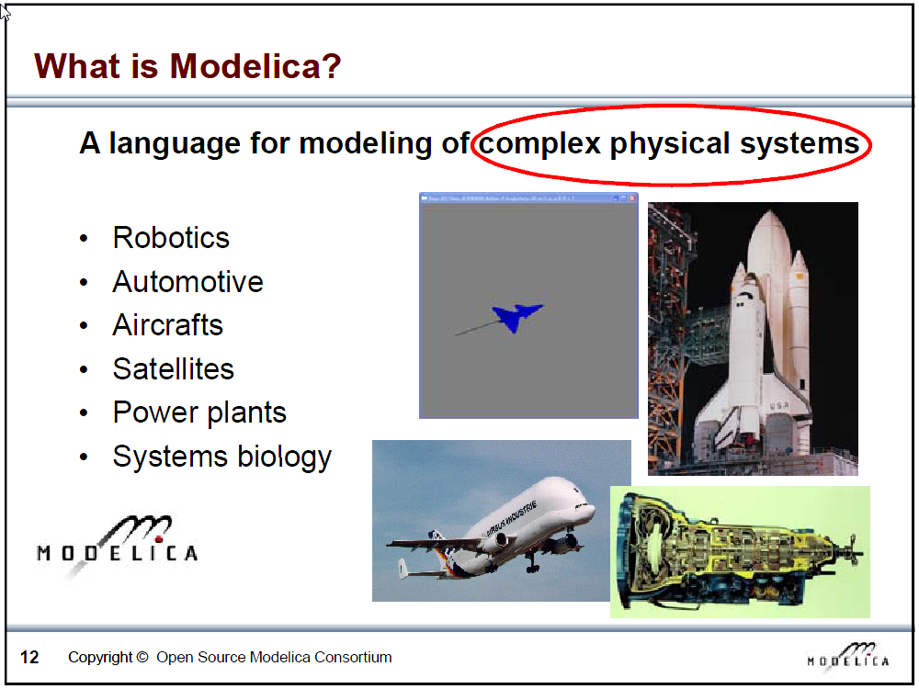
Slide from Peter Fritzson, Introduction to Object-Oriented Modeling, Simulation and Control with Modelica, Tutorial for Modelica Conference 2011, Dresden

Slide 7
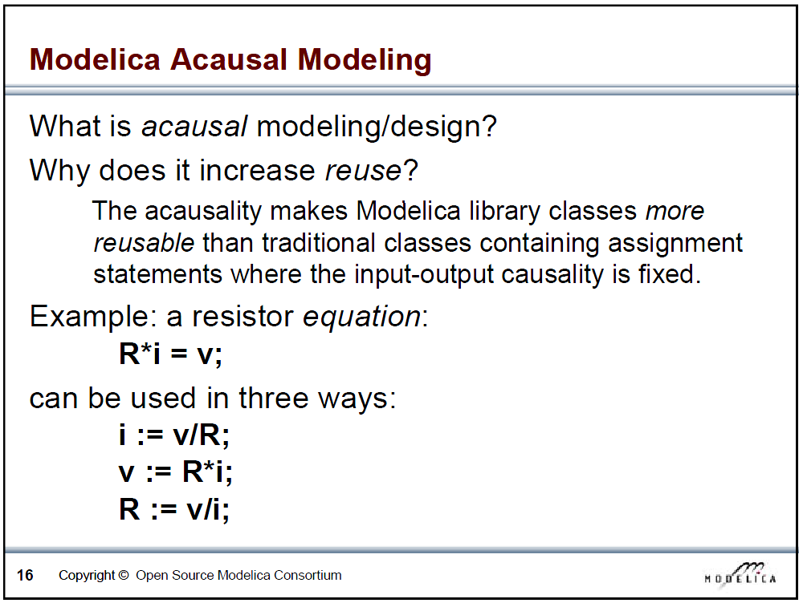
Slide from Peter Fritzson, Introduction to Object-Oriented Modeling, Simulation and Control with Modelica, Tutorial for Modelica Conference 2011, Dresden

Slide 8
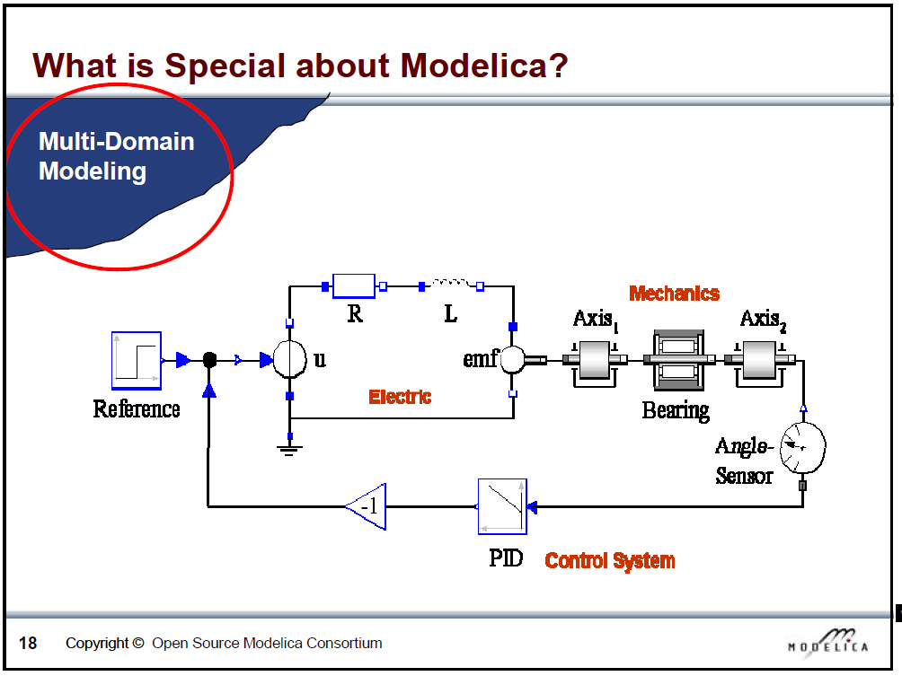
Slide from Peter Fritzson, Introduction to Object-Oriented Modeling, Simulation and Control with Modelica, Tutorial for Modelica Conference 2011, Dresden

Slide 9
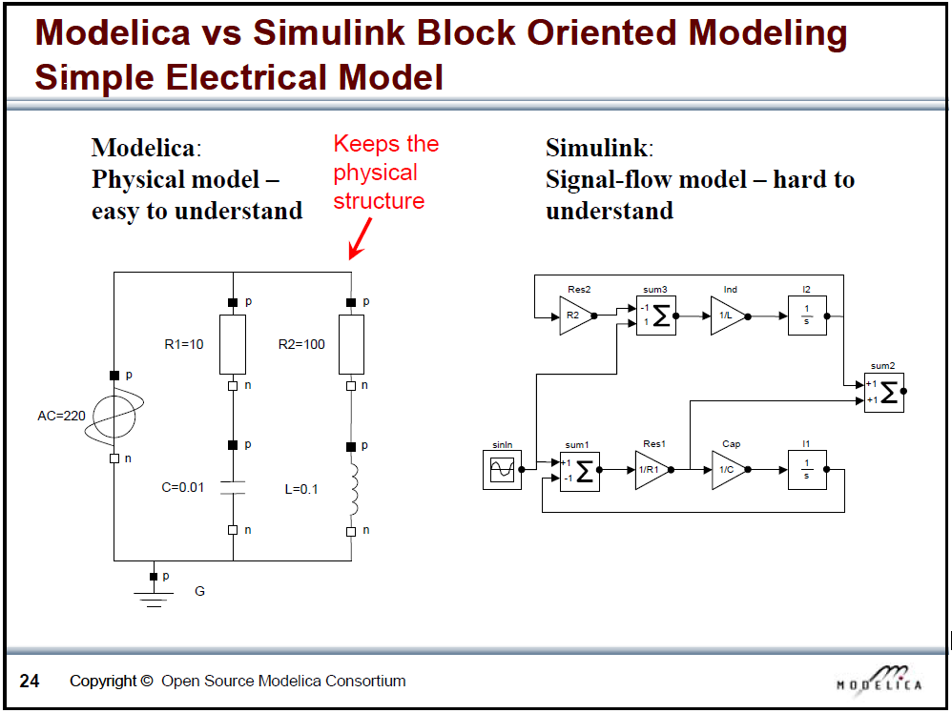
Slide from Peter Fritzson, Introduction to Object-Oriented Modeling, Simulation and Control with Modelica, Tutorial for Modelica Conference 2011, Dresden

Slide 10
What is Modelica
Modelica is a language for modeling of physical systems
  open source
  object oriented
  Acausal modeling (equation based)
  multi-domain
  primarily for simulation, but usable for optimization
  small and large models (> 100 000 equations)
  many model libraries (free and commercial)
  textual and graphical modeling

Slide 11
Modelica environments
Commercial software tools
Dymola (Dassault Systèmes, Sweden)
MathModelica (MathCore, Sweden)
SimulationX (ITI, Germany)
MapleSim (Maplesoft, Canada)
Free and open source tools
OpenModelica (Open Source Modelica Consortium, Sweden and other countries)
JModelica (Modelon, Sweden)

Slide 12
Websites
General
www.modelica.org
www.openmodelica.org
www.jmodelica.org
http://www.claytex.com/tech-blog/
Modelica language
http://modref.xogeny.com/ !!!
http://book.xogeny.com/ !!!
KUL modeling conventions
https://docs.google.com/document/d/1MaNKTdLz-YPpEEH3Eg12ECzG0ErK-rIK9IHd6gsBp7Q/edit?usp=sharing
Libraries:
https://github.com/open-ideas --> IDEAS + Crash Course
https://simulationresearch.lbl.gov/modelica --> look at Buildings.Examples.Tutorial
Dymola user guide
Volume 1 & 2: C:\Program Files (x86)\Dymola 2015 FD01\Documentation \Dymola User Manual Volume 1) or via Dymola > help.

Slide 13
Fora
http://www.openmodelica.org/index.php/forum
http://www.jmodelica.org/forum
www.stackoverflow.com (tag Modelica)
And last but not least: https://groups.google.com/d/forum/modelicans

Slide 14
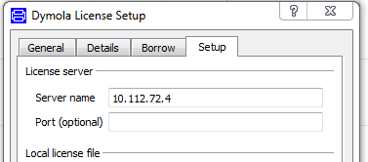
Use of Dymola with KULeuven license
Access to a floating licence (on the building physics server).
Connected physically (cable) to the building physics or mech network
Open Dymola and go to help>licence..
Enter 10.112.72.4
and follow instructions
More information on Modelicans (google groups)

Slide 15
Language constructs from Lib.Introduction
Keywords: model, parameter, type, equation
start value
boolean
non-linear system, nb eq = nb var
conditional statement

Slide 16
Language constructs from task: eq. based
Type of varibales
Type of equations (thermal resistance, capacitance, Kirchhoff-rules, ... ) (see picture)
Loop construction
Remarks:
  use start values instead of initial eq.
  ones(n)
  pre-made types (Modelica.SIunits)
  use “dummy variables” to split code (Q_flows)
  time
  protected vs public
  give formula after declaration of variable
  checkModel: what happen if synthax incorrect or what happen if eq. missing?

Slide 17
Language constructs from task: object-based
Open the different object (resistor, ...)
Modelica standard library
extends
object.Q_flow, direction of flow
connectors: potential variable (= in connector), flow variable (sum = 0 in connector).
partial
real expression, each, connect, annotation

Slide 18
Language constructs
Classes and instances
Connectors
Inheritance
  partial model
  Extends
Use external data

Slide 19
Exercise 1
See exercise sheet

Slide 20
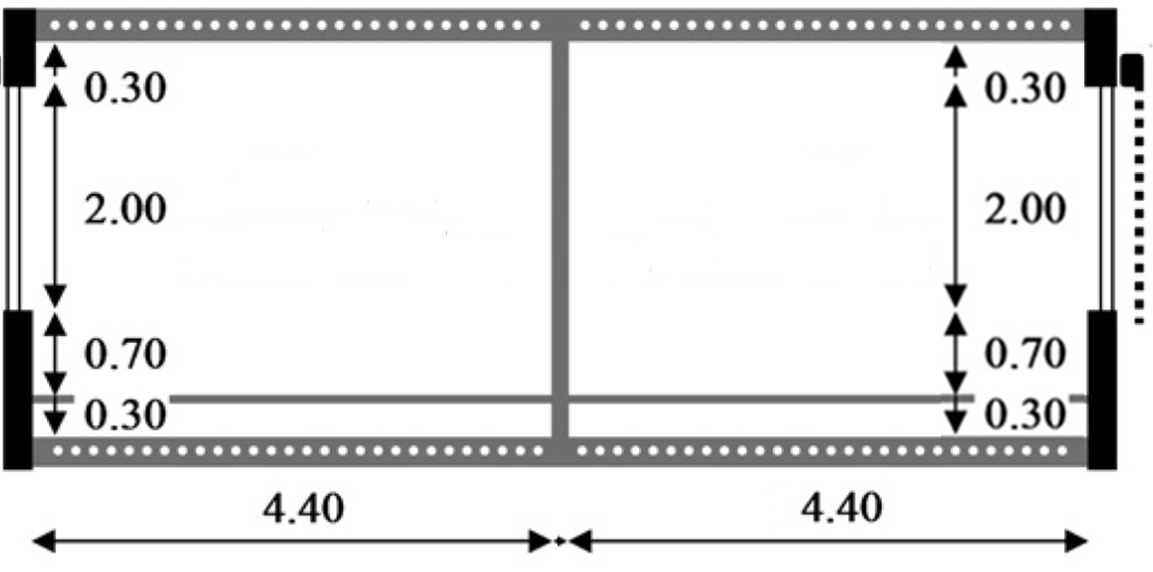
Exercise 2
IDEAS demo
Low energy office building with 2 thermal zones & floor heating
→Simulate for 1 month, check indoor temperatures & heat demand
*In the back and front as well as above and below there are other offices which maintain the same temperature.
NORTH
(depth: 2.7m)
SOUTH
(depth: 2.7m)
Notes:
10’ - JModelica (demo)
5’ - Tutorials and reference documentation (slides)
30’ - Libraries: MSL and own libraries (dymola demo)
10’ - simman and pymosim (python demo)
5’ - Coding conventions (slides)
5’ - Dymola licenses at TME (slides)
1u05 min

Slide 21
Exercise 2
IDEAS demo
Low energy office building with 2 thermal zones & floor heating
Envelope
Materials (to model, optional)
  Tile: λ=1.4 W/mK, c=840 J/kgK, ρ=2100 kg/m³
  Screed: λ=0.6 W/mK, c=860 J/kgK, ρ=1100 kg/m³
  Concrete: λ=1.7 W/mK, c=840 J/kgK, ρ=2400 kg/m³
Windows
  Glazing: Saint Gobain Clima Plus Futur (U = 1.4 W/m²K, g = 0.755)
  Frame: U-value=2.5 W/m²k , fraction of the window: f=0.15
Infiltration: n₅₀=12 ACH (ventilation indirectly included)
Geometry: use internal dimensions (not completely right)
 | Composition (out→in or propsBus b→a)
Floor (to model) | Tile (d=0.01m) | Screed (0.06)* | PUR (0.04) | Concrete (0.20) | Plaster (0.02)
Exterior wall | Brick (0.10) | MW (0.16) | Brick (0.14) | Plaster (0.02)
Interior wall | Plaster (0.02) | Brick (0.10) | Plaster (0.02)
* Floor heating tube is situated at position 2 (between Screed and PUR)
Notes:
10’ - JModelica (demo)
5’ - Tutorials and reference documentation (slides)
30’ - Libraries: MSL and own libraries (dymola demo)
10’ - simman and pymosim (python demo)
5’ - Coding conventions (slides)
5’ - Dymola licenses at TME (slides)
1u05 min

Slide 22
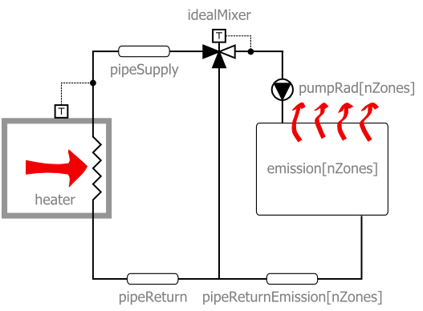
Exercise 2
IDEAS demo
Low energy office building with 2 thermal zones & floor heating
Heating system (use IDEAS heating systems)
  Radiators (no floor heating)
  Floor heating

Slide 23
Exercise 2
IDEAS demo
Low energy office building with 2 thermal zones & floor heating
Ideas for playing around
  Change parameters heating (heating curve, type of heater)
  Change parameters structure (insulation, windows, materials)
  Add internal gains according to schedule
  Night temperature set back
  Add shading blinds to south windows (+ shading schedule)
  More realistic office occupancy profiles
  Add ventilation system
  Different water set temperature per zone (tough)
  Add a thermal zone (tougher)
  Include pressure drops (toughest)

Slide 24
Thank you and enjoy!
This presentation, some reference docs and the code used in this crash course can be found on Toledo in the community ‘Thermische systemen in gebouwen’

Slide 25
Thank you and enjoy!
This presentation, some reference docs and the code used in this crash course can be found on Toledo in the community ‘Thermische systemen in gebouwen’

