Slide 1
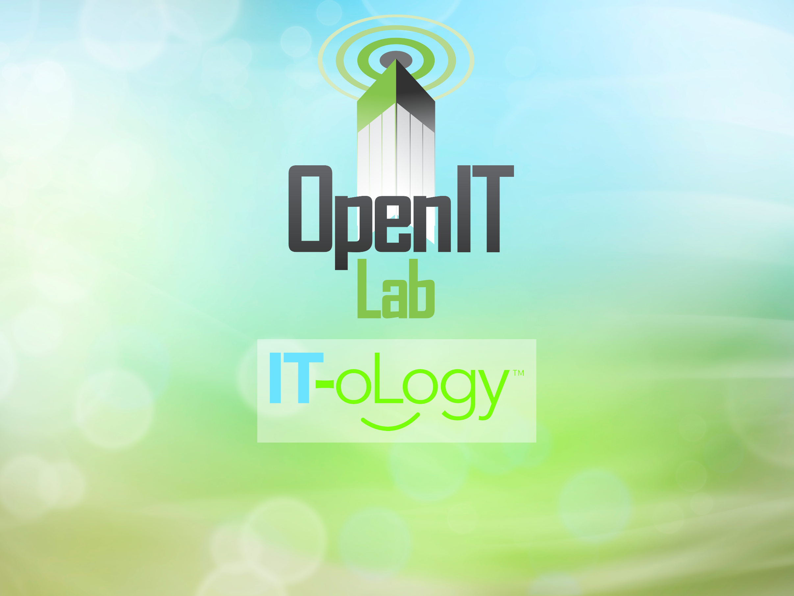
Todd Lewis,
Jarrell Waggoner

Slide 2


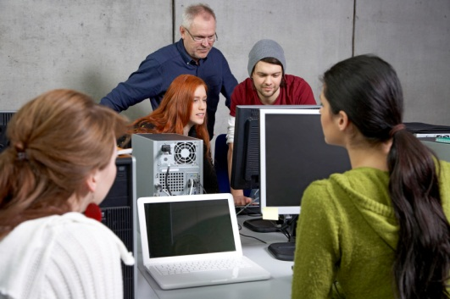

IT-oLogy is a non-profit collaboration of businesses, academic institutions and organizations dedicated to growing the IT talent pipeline, fostering economic development and advancing the IT profession.
IT-oLogy has 3 initiatives:
Promote IT
Teach IT
Grow IT
IT-oLogy works with K-12 schools to encourage the best and brightest young people and their parents to learn more about the IT profession.
In collaboration with IT-oLogy, companies work with colleges and universities on applied business research projects and experiential learning opportunities that strengthen and align classroom skills to current and future IT business needs.
IT-oLogy partners with IT professionals and their companies to provide
innovative and life-long learning and professional development
opportunities.

Slide 3



Who We Are
Open Source training and consulting services since 2008
www.palmettocomputerlabs.com
Started the Palmetto Open Source Software Conference (POSSCON) in 2008
www.posscon.org
Started the Open IT Lab at IT-oLogy in 2011
www.open-it-lab.com

Slide 4
600 people from 20+ states in 2012
The world’s top technology companies:
Google, Red Hat, IBM, Oracle, Microsoft, HP
World’s top open source experts:
Scott McNealy keynoted in 2012

Slide 5
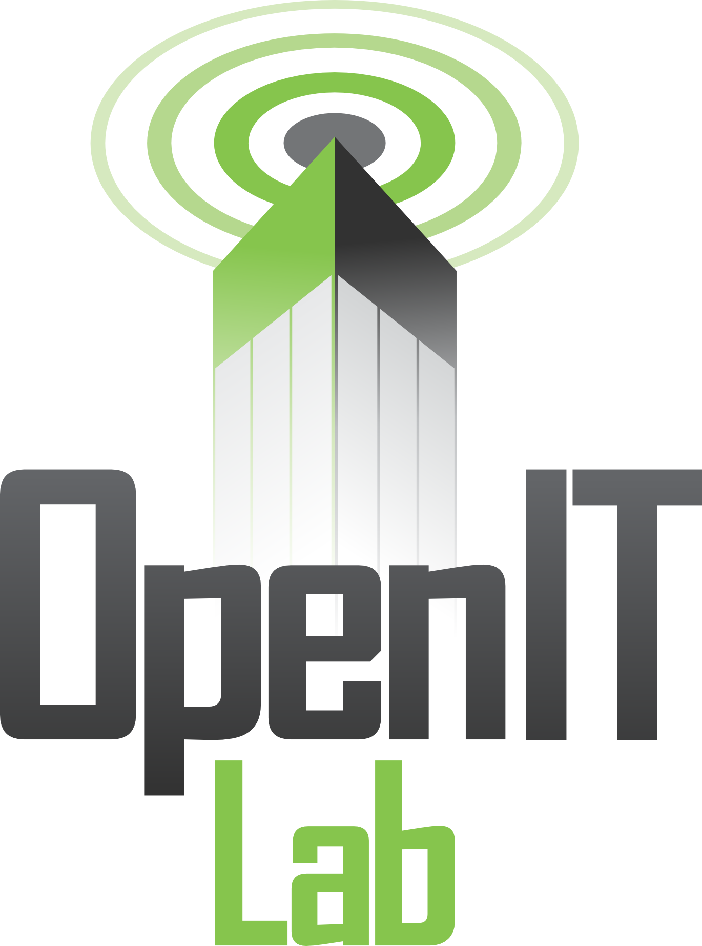
Center for open source awareness, education and research & development
Multiple platforms and OS technologies
Regular workshops and training opportunities
Project-based work

Slide 6

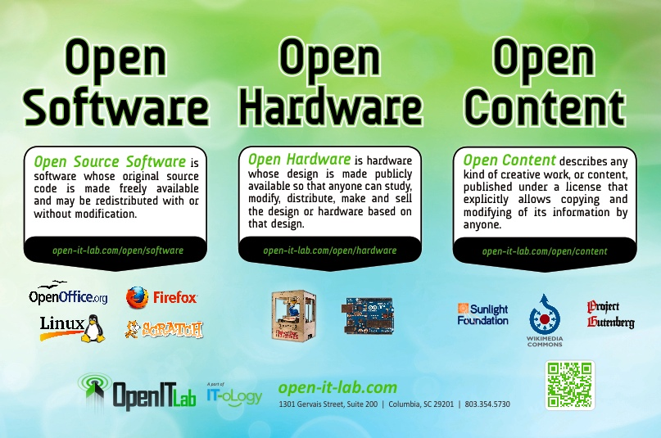

Slide 7
Awareness

Slide 8
Education
One Hour Lab Tour
Open 101
Ubuntu 101/102 –Introduction and Advanced
System Administration 101 – OS included
Command Line 101
Version Control 101
Arduino Open Hardware Workshop
Drupal 101/102
Graphics 101 - GIMP

Slide 9
Research and Development
Demonstrate that Open Source can be applied
Students, teachers/professors, IT professionals can join a project and contribute
Current project – Columbia Police Department
  Make crime report information widely available
  Web application
  Mobile applications – Android, iPhone

Slide 10
Open Source
{
}
What? | Examples | Why?
Notes:
Double-Negative: UK's largest film-only VFX company

Slide 11
"Knowledge is the only resource that multiplies when you share it."
Notes:
Double-Negative: UK's largest film-only VFX company

Slide 12
Definition
Open:
The freedom to share, explore, reproduce, and contribute ideas and projects based on these ideas.

Slide 13

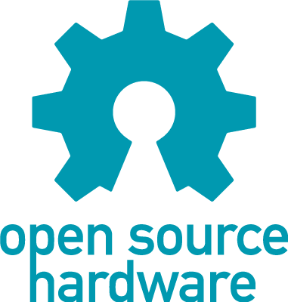
Open
Software: source code available to share and modify
Hardware: documentation available to reproduce components
Content: license to share and remix

Slide 14
"Free software is a matter of liberty, not price. To understand the concept, you should think of free as in free speech, not as in free beer."
–Richard Stallman, MIT
Notes:
Double-Negative: UK's largest film-only VFX company

Slide 15
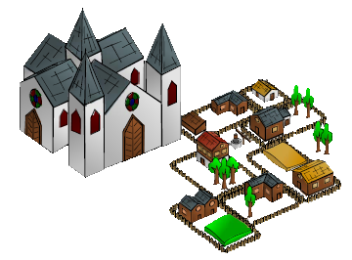
Development Methodology

Slide 16

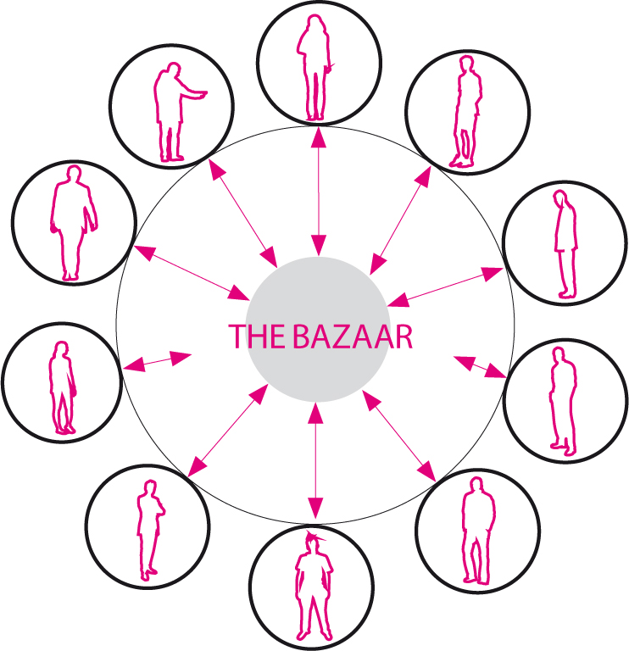
Development Methodology

Slide 17
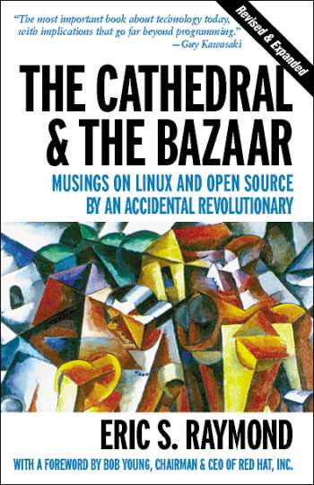

Slide 18
Examples
{
}
Open Source
Notes:
Double-Negative: UK's largest film-only VFX company

Slide 19
What's out there?
Open content/learning management systems
OpenCourseWare (MIT, Kahn Academy)
Open Source Curriculum (OER)
Open content (Wikimedia Commons)
Archives (Project Gutenberg)
Open Software alteratives to proprietary programs

Slide 20
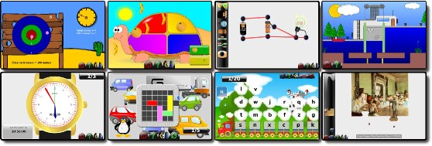
GCompris
“GCompris is a high quality educational software suite comprising of numerous activities for children aged 2 to 10. “

Slide 21
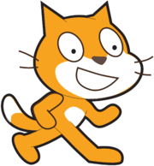
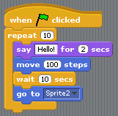
Scratch
Visual programming “language” designed at MIT
Designed for teaching young students how to program
Everything done with drag and drop
All open source and freely available for instructional use

Slide 22
KDE Edu (http://edu.kde.org/)
Memory games
Typing exercises
Math tools
Flash card training
Physical simulator
Planetarium application
Many more....

Slide 23



Open Courseware
MIT Open Courseware
  http://ocw.mit.edu/
Kahn Academy
  www.kahnacademy.com
Udacity
  www.udacity.com

Slide 24

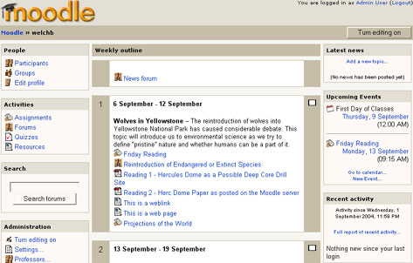
Moodle
Course Management System
Integrated system with roles for:
  Administrators
  Mangers
  Teacher
  Students
Built-in support to manage
  Grades
  Forums
  Blogs
  Calendaring
  Much, much more...

Slide 25
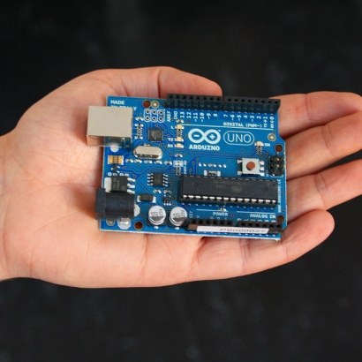
Arduino
Small programmable microcontroler
Open hardware, so all build specs freely available
Freely available educational curriculum
Used in many different projects (instruments, clothing, ...)

Slide 26
{
}
Why?
Open Source
Notes:
Double-Negative: UK's largest film-only VFX company

Slide 27







Using open source...
80% of companies use Open Source in some way.

Slide 28
Some Statistics
More than 50% of leading IT organizations are using open source
30% of software at these companies is open source, up from 10% five years ago
4 out of 5 developers use open source for development, application deployment, or both
1 out of 4 developers target Linux as their primary platform
1 out of 5 developers contribute to at least one open source project

Slide 29
Some Statistics
80% of front line IT people say they use open source in some way
US adoption is closing the gap with Europe

Slide 30
Regional adoption in the Southeast
“Which of the OSS infrastructure tools have you included as part of your development activities or deployed an application or software project to? “(Select all that apply.)
US
Southeast
Base: 1,900 software decision-makers at North American and European enterprises and SMBs
Source: Enterprise And SMB Software Survey, North America And Europe, Q4 2009

Slide 31





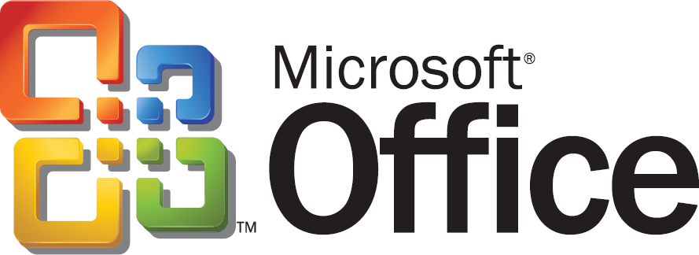


Open vs. Proprietary
Firefox
Android
Blender ($0)
Security
Standards
Freedom
Price
Internet Explorer
3ds max ($3,500)

Slide 32
Benefits for Students & Teachers
Students can participate at every level of the process
Professors can give students real-world projects to help them build their resume without a job
Possible to learn the internals of complex systems
Access to professional-grade tools

Slide 33
Why Open Source?
Price (no license costs)
No “lock-in” with single vendor
Data interoperability
Try as much as you like before committing
Better reliability and security – seen by more eyes
Easier to customize
More resources available for help
No upgrading “gotchas”

Slide 34
Why Not Open Source?
License may not always fit what you want to do
Formal support may not be as readily available
May take effort to integrate in an environment with other proprietary or custom products
Documentation or user interface design might not always be as high-quality as the code

Slide 35
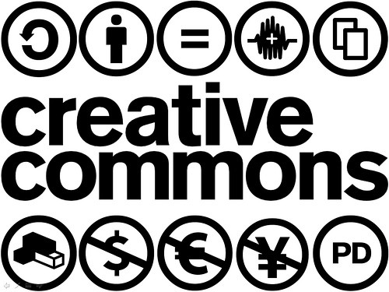
Creative Commons

Slide 36
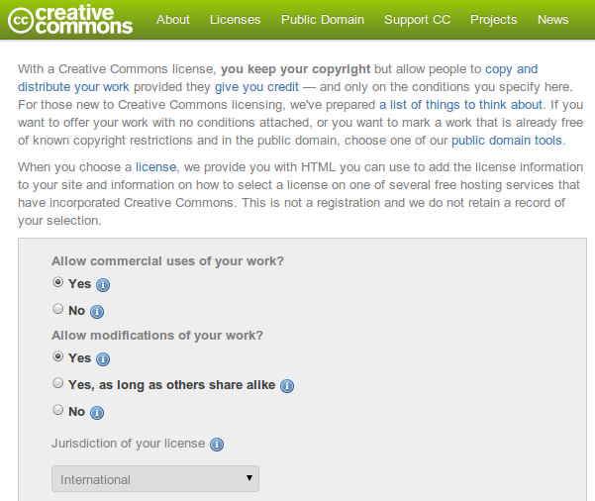

Slide 38
{
}
Questions?
Notes:
Double-Negative: UK's largest film-only VFX company

