Slide 1
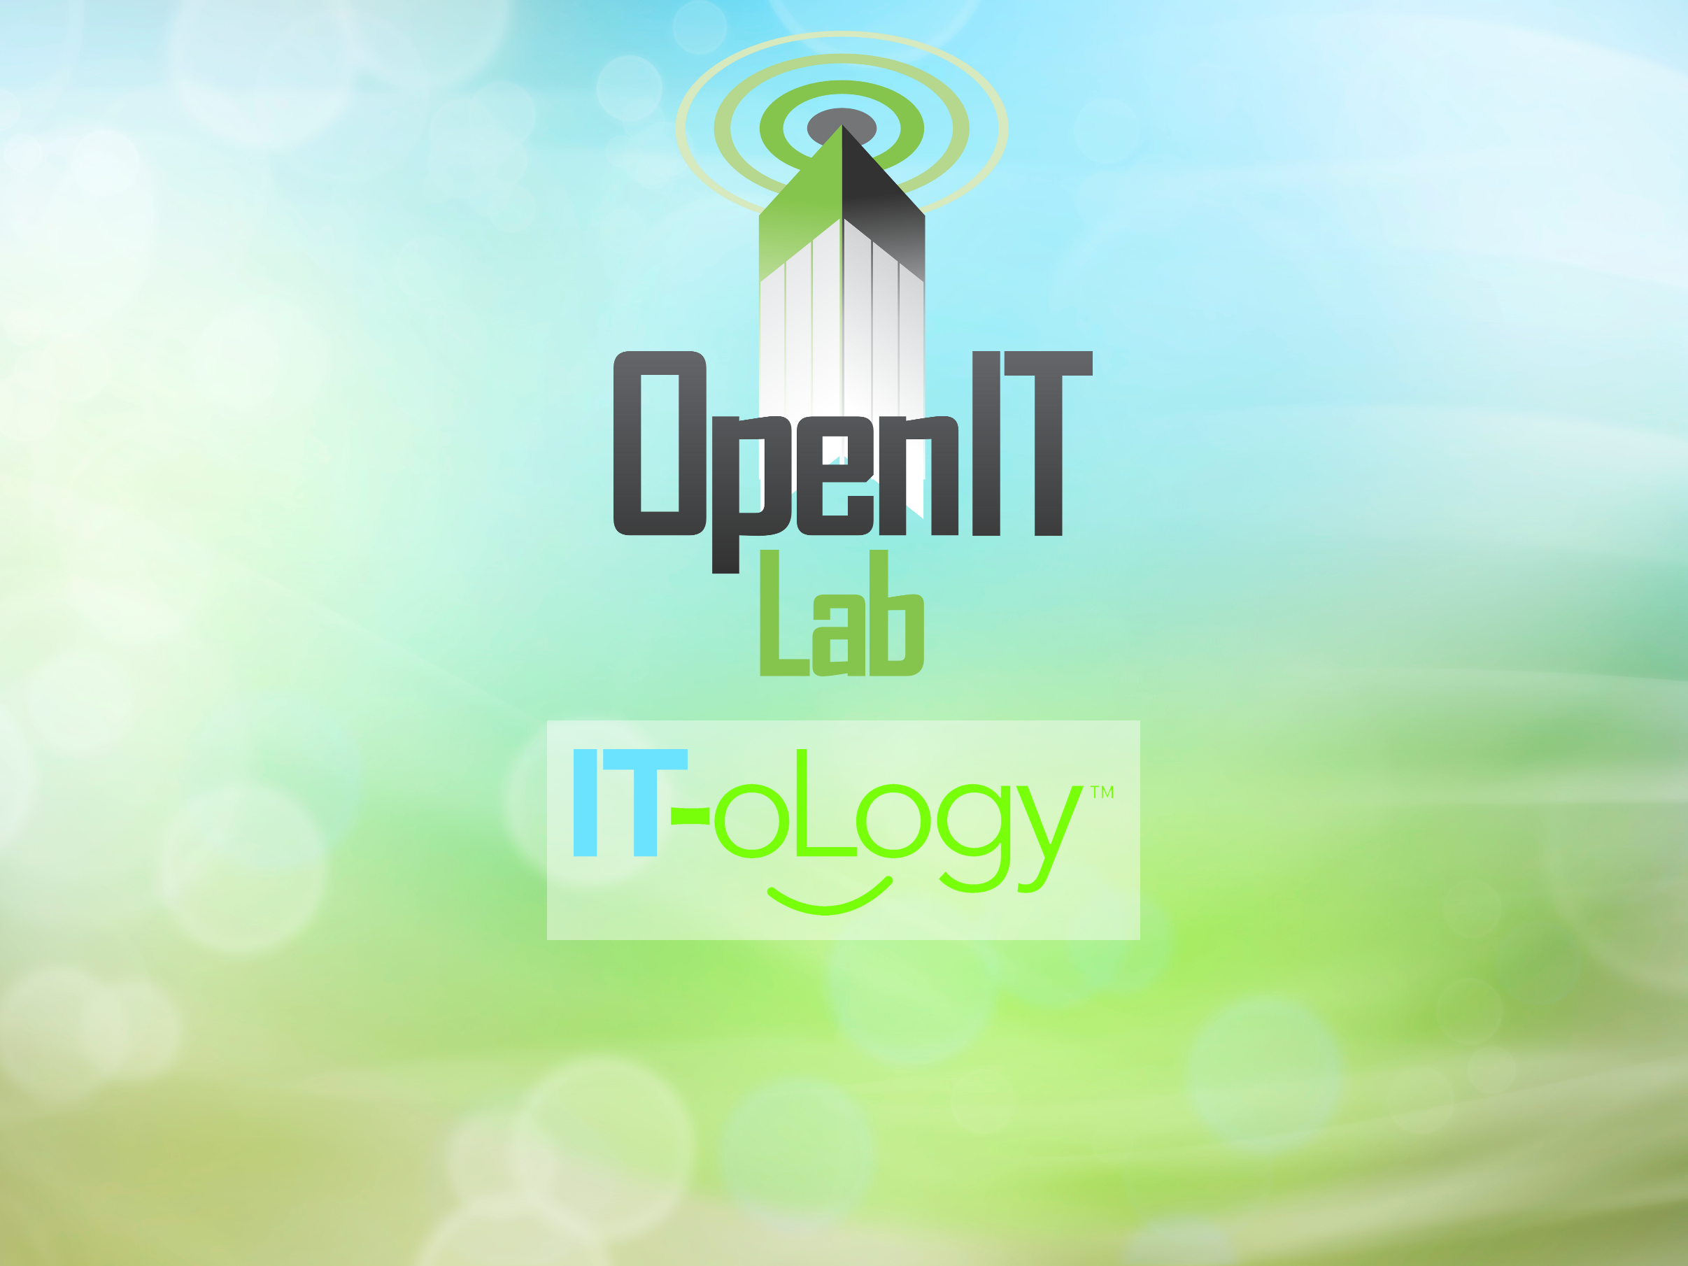
Todd Lewis, Jarrell Waggoner

Slide 2
{
Open Source
What
}
is, and
Why it's important
Notes:
Double-Negative: UK's largest film-only VFX company

Slide 3
Open Source Software
Software that is free to use, share, or change.
It gets its name because the source code is available for anyone to examine or modify, in contrast to proprietary software where you don't get the source code or those freedoms.

Slide 4
Open Content
Applies the freedoms to stuff beyond just software, such as images, videos, books, curriculum, etc.
Often associated with Creative Commons licenses.

Slide 5
Open Standards
Complete public specification of a data format or protocol with no restrictions or fees to implement it
Prevents vendor lock-in and encourages interoperability
You can take your data with you

Slide 6
Open Hardware
Examples include:
  Arduino micro-controllers
  Raspberry Pi mini-computers
  3D printers (RepRap, Makerbot, etc.)
  OLPC

Slide 7
Why Open Source?
Distributes cost of development
  “Commons-based peer production”
Better reliability and security – seen by more eyes
Control for efficiency tradeoff
  Community can help develop and maintain
  Existing OSS might solve a business problem
Freedom from control vs. one vendor
Value/innovation created when developers are free from legal constraints – Google's 20% time

Slide 8
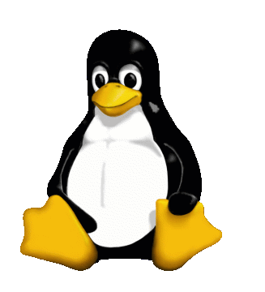

Proprietary vs. Open

Slide 9
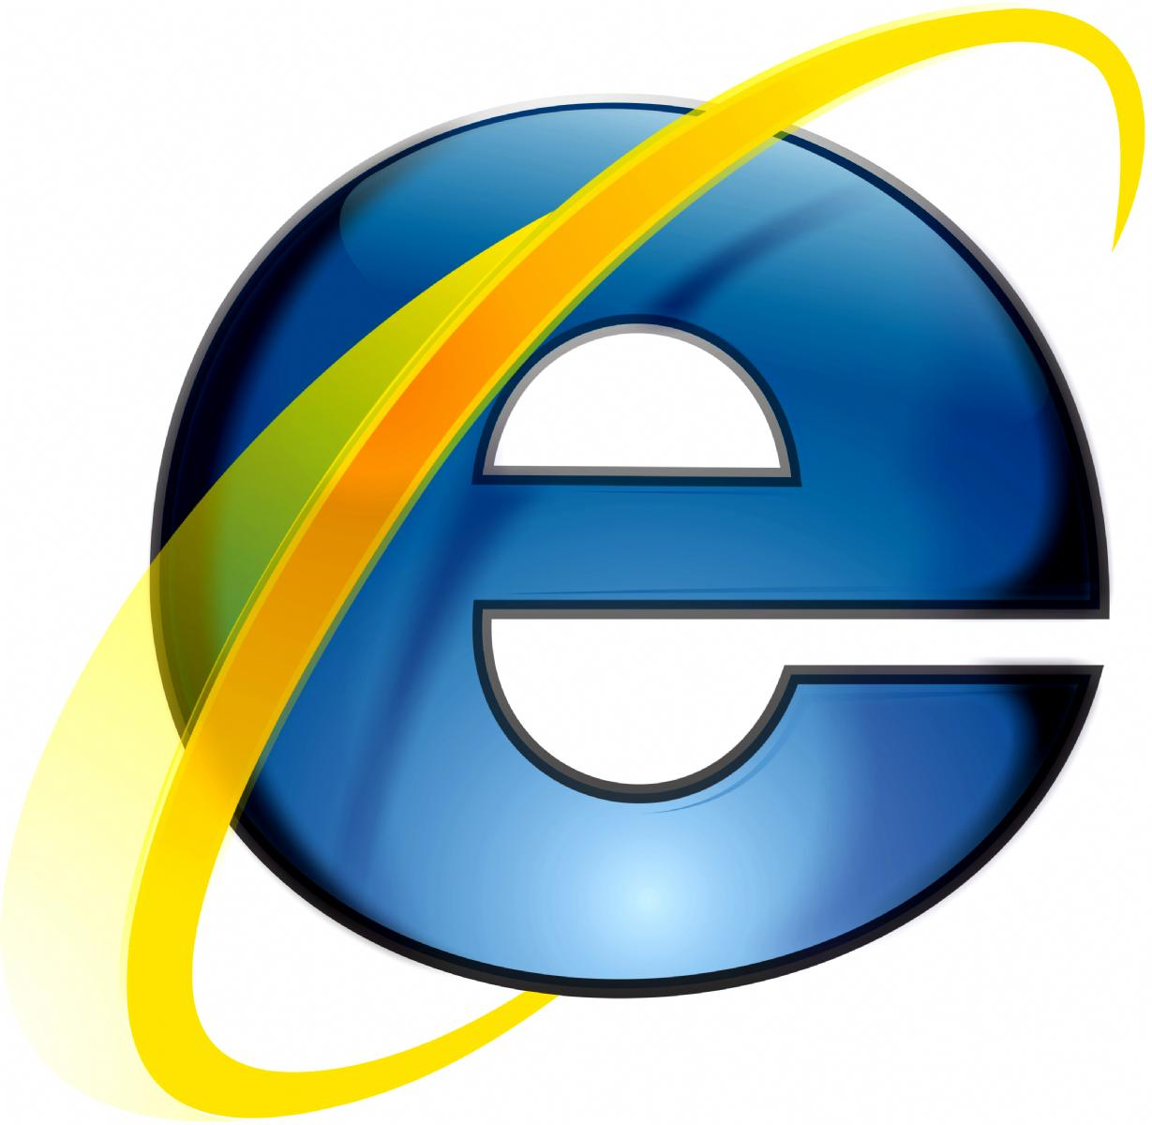

Case Study
Internet Explorer
  Funded by Microsoft
  Security up to Microsoft alone
  Community can complain
  Dedicated to making profit for Microsoft
Firefox
  Run by Mozilla
  Routinely vetted for security by experts
  Community can contribute anything
  Dedicated to making the internet better for everyone

Slide 10


Case Study
iOS
  Apple
  Unix-based
  Only one app store
  App listing price: $100
  No sideloading
  Jailbreaking discouraged
Android
  Google
  Linux-based
  Other app stores allowed
  App listing price: $25
  Sideloading allowed
  Rooting sometimes included as a feature

Slide 11
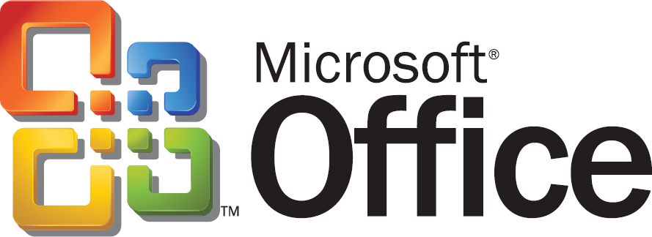

Case Study
Microsoft Office
  $119 - $350
  Upgrades cost money
  Uses proprietary file formats that are less easy to share
  Available only on selected platforms
  Closed-source
Libre Office
  Free
  Will always be free
  Uses open standards compatible with a variety of platforms
  Available on all major platforms (e.g. Linux)
  Open Source; patches and bug reports are welcome

Slide 12


Case Study
3ds Max
  $3,500
  Must pay for upgrades
  Some versions required dongle (hardware device) for licensing
  Requires online registration
  Proprietary MaxScript for scripting
Blender
  $0
  All versions are no cost
  No restrictions or requirements on use or distribution
  Built-in game engine unlike other commercial competitors
  Python for scripting

Slide 13

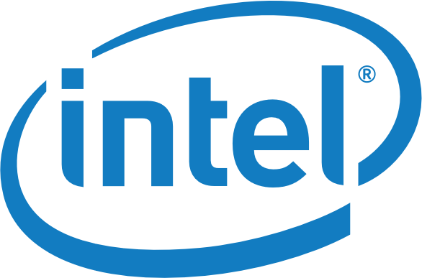

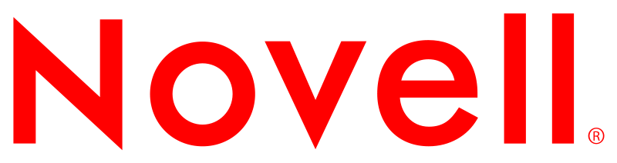

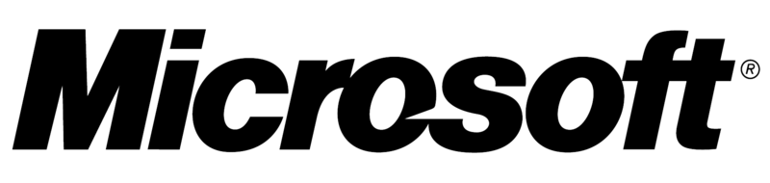

Using open source...
80% of companies use Open Source in some way.

Slide 14

"When it comes to hiring, I'll take a Github commit log over a resume any day."
–John Resig, Khan Academy
Notes:
Double-Negative: UK's largest film-only VFX company

Slide 15
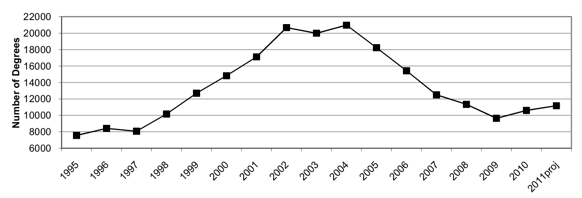
Bachelor's Degrees
Why the drop?
The bubble + outsourcing
http://www.cra.org/resources/taulbee/

Slide 16
Benefits for Schools
Licensing cost savings
Independence from a single vendor
Flexibility and customizability
Stability, reliability, and security
Data integrity and interoperability

Slide 17
Benefits for Students & Teachers
Students can participate at every level of the process
Professors can give students real-world projects
Possible to learn the internals of complex systems
Access to professional-grade tools

Slide 18

Open Source Developer
15 Year Old Paid to Work on Ubuntu

Slide 19
{
Code
Open Source
What
}
is, and
Why it's important
What are we doing?
Notes:
Double-Negative: UK's largest film-only VFX company

