Slide 1
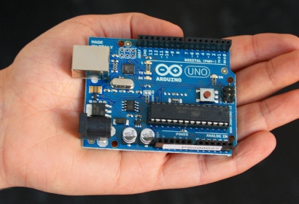
Open Hardware 101: Fundamentals of
Electronic Design
Jeremy Bicha
Open IT Lab

Slide 2
What is a Microcontoller?
A microcontroller is a single chip containing a processor, minimal memory, and programmable input/output.
Microcontrollers are designed for embedded devices instead of as general purpose PCs.
Notes:
From the world's largest supercomputers to the smallest embedded devices, Linux is everywhere. Every ebook reader I've seen runs Linux; that includes the Kindle, the Nook, Sony Reader and more. Most webservers run either Linux or BSD which is similar to Linux. So if you use Google or Amazon, you're using Linux in a way.
Microsoft 14%, nginx, 10%

Slide 3
Brief History
The Processing language & IDE were created at MIT in 2001, for the electronic arts community
Wiring was created by a Colombian artist-programmer in Italy in 2003 and added a microcontroller
Arduino was created in 2005 to create a low-cost micro-controller prototype system for students.
Over 500,000 Arduinos sold
Notes:
From the world's largest supercomputers to the smallest embedded devices, Linux is everywhere. Every ebook reader I've seen runs Linux; that includes the Kindle, the Nook, Sony Reader and more. Most webservers run either Linux or BSD which is similar to Linux. So if you use Google or Amazon, you're using Linux in a way.
Microsoft 14%, nginx, 10%

Slide 4
More than Hardware
“An Arduino board is more than a piece of hardware. It's also the software that lets you program and communicate with it, the documentation and tutorials that explain how to use it, and the community that can help you when you have trouble.”
- http://arduino.cc/en/Main/Policy
Notes:
As useful as the kernel is, it's only a part of what you need. Developers bundle the kernel and useful apps into what are called distributions. Some of the more popular include Red Hat and its community Fedora version, SUSE, Debian, and Ubuntu.

Slide 5
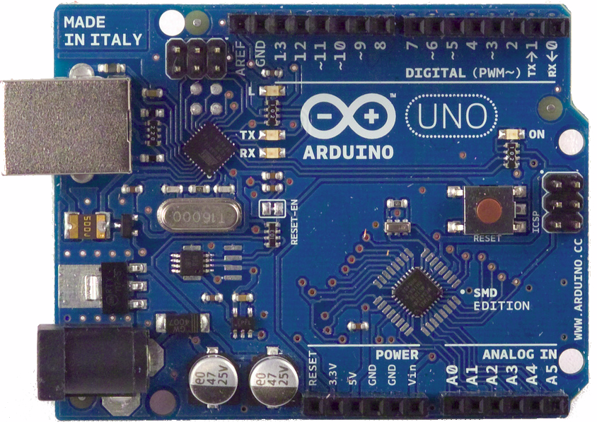
Linux
Notes:
From the world's largest supercomputers to the smallest embedded devices, Linux is everywhere. Every ebook reader I've seen runs Linux; that includes the Kindle, the Nook, Sony Reader and more. Most webservers run either Linux or BSD which is similar to Linux. So if you use Google or Amazon, you're using Linux in a way.
Microsoft 14%, nginx, 10%

Slide 6
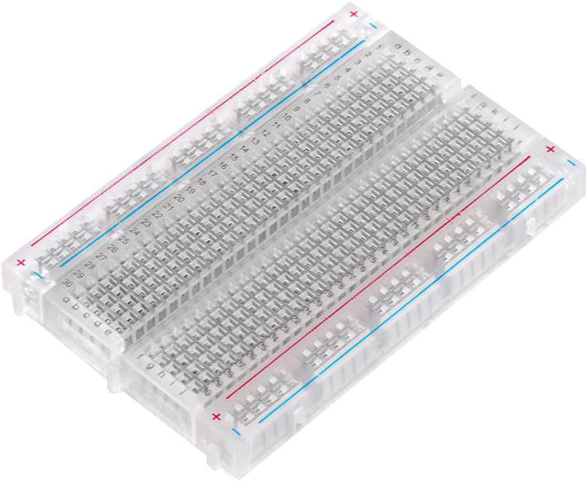
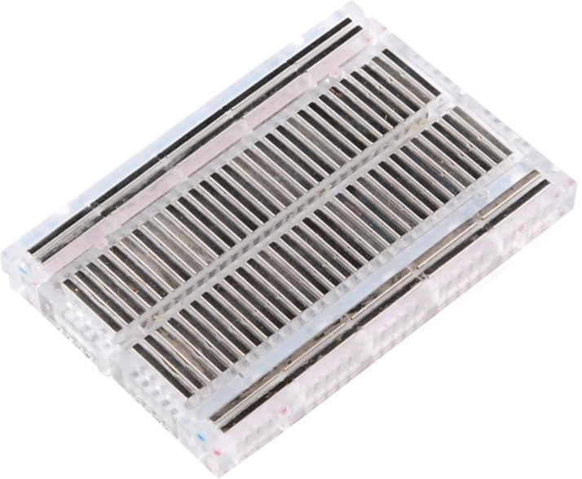
Breadboard

Slide 7
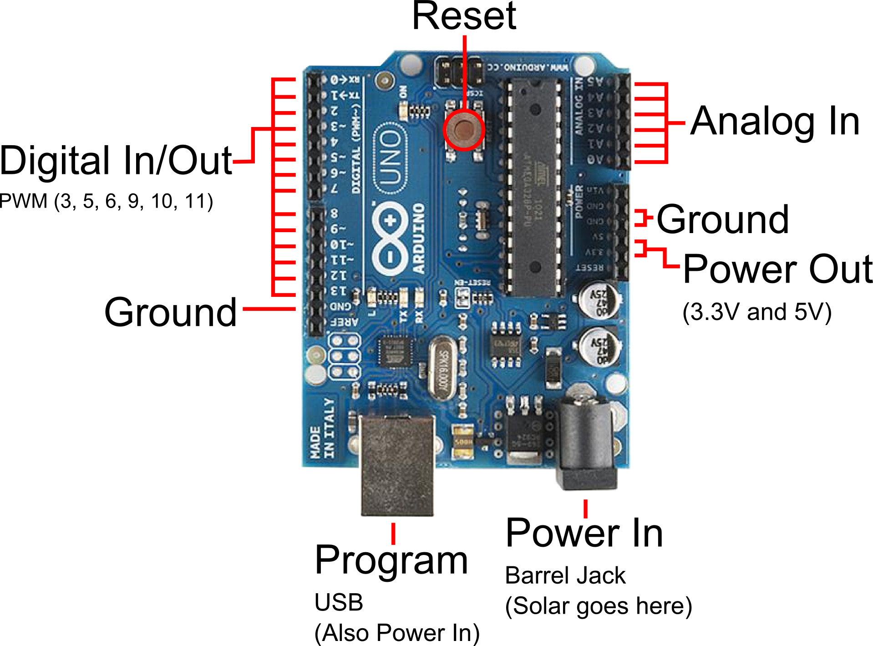

Slide 8
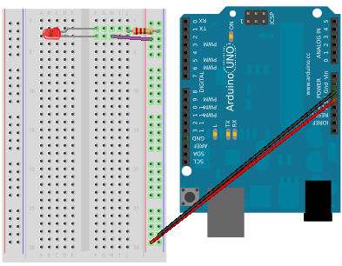
Circuit 0: Basic LED
Short leg of the LED is negative and goes on top in this circuit
Notes:
These are all of the Ubuntu releases starting with the Warty Warthog, which got its name because the small group of developers expected it to have some ugly spots. The releases in the right column are the Long Term Support (LTS) releases. The first LTS was Dapper Drake was the only release not in April or October. It was released in June to get an extra 6 weeks of attention especially since the decision to make it LTS happened later in the cycle. As you can see, the next release, Precise Pangolin will also be an LTS in April.

Slide 9
Input and Output
All 19 Arduino pins are input by default

Slide 11
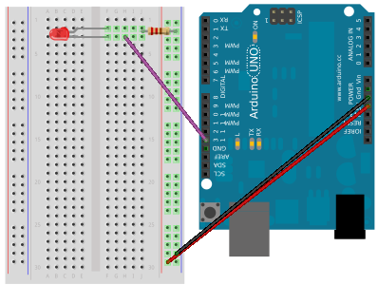
Circuit 1: Blink
Notes:
These are all of the Ubuntu releases starting with the Warty Warthog, which got its name because the small group of developers expected it to have some ugly spots. The releases in the right column are the Long Term Support (LTS) releases. The first LTS was Dapper Drake was the only release not in April or October. It was released in June to get an extra 6 weeks of attention especially since the decision to make it LTS happened later in the cycle. As you can see, the next release, Precise Pangolin will also be an LTS in April.

Slide 12
Reading Arduino Code
Functions
  Contained inside { } brackets
  setup() and loop() are required
  setup() is called once when the program starts; loop() is called over and over
  Except for functions & comments, every line of code must end in a semicolon ;

Slide 13
Reading Arduino Code
Variables
  Variables
  Constants are variables that can't be changed
  Const int kPinLed = 13;

Slide 14
Reading Arduino Code
Comments
  Just for humans, computers ignore them
  Multi-line comments start with */ and end with /*
  Single-line comments start with //

Slide 15
Analog and Digital
Digital is either 0 (LOW) or 1 (HIGH)
Analog input ranges from 0 to 1023
Analog output uses pulse-width modulation and ranges from 0 to 255
Analog input only works on pins A0-A5
Digital input works on all pins
Analog signals require a conversion

Slide 16
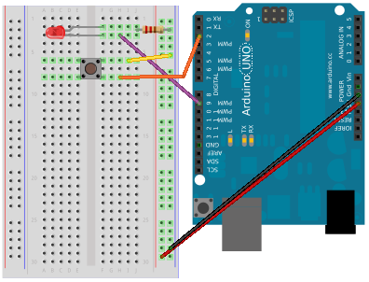
Circuit 2: Button
Notes:
These are all of the Ubuntu releases starting with the Warty Warthog, which got its name because the small group of developers expected it to have some ugly spots. The releases in the right column are the Long Term Support (LTS) releases. The first LTS was Dapper Drake was the only release not in April or October. It was released in June to get an extra 6 weeks of attention especially since the decision to make it LTS happened later in the cycle. As you can see, the next release, Precise Pangolin will also be an LTS in April.

Slide 17
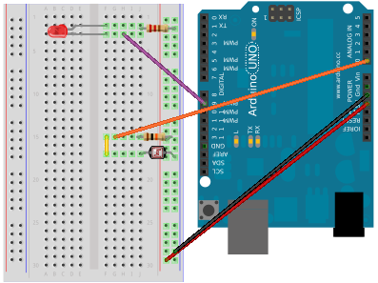
Circuit 3: Light Sensor
Notes:
These are all of the Ubuntu releases starting with the Warty Warthog, which got its name because the small group of developers expected it to have some ugly spots. The releases in the right column are the Long Term Support (LTS) releases. The first LTS was Dapper Drake was the only release not in April or October. It was released in June to get an extra 6 weeks of attention especially since the decision to make it LTS happened later in the cycle. As you can see, the next release, Precise Pangolin will also be an LTS in April.

Slide 18
Serial monitor
Add Serial.begin(9600); to the setup() function
Serial.println();
Click the far right button in the Arduino software

Slide 19
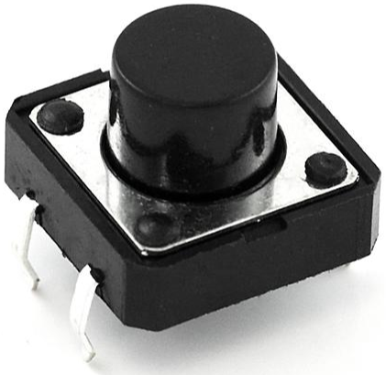
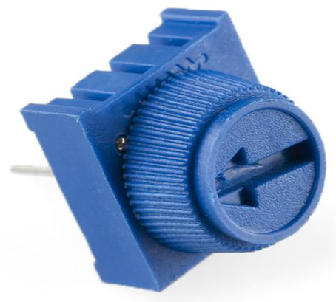
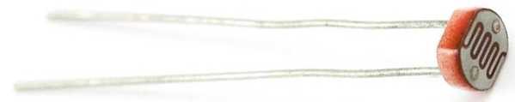
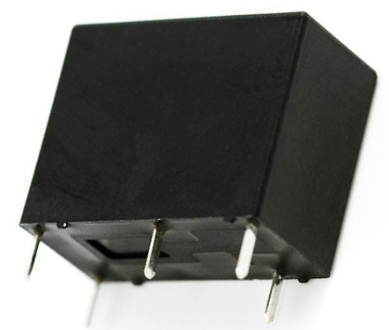
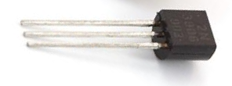

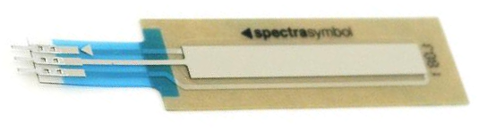
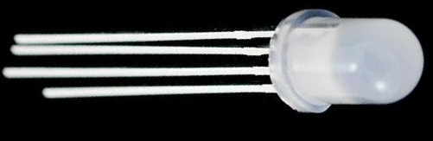
Components
Name Image Type Function Notes
Button |  | Digital Input | Closes or opens circuit | Polarized, needs resistor
Trimpot |  | Analog Input | Variable resistor
Photoresistor |  | Analog Input | Variable resistor
Relay |  | Digital Output & Input | Switches between circuits | Used to control larger voltages
Temp Sensor |  | Analog Input | Variable resistor
Flex Sensor |  | Analog Input | Variable resistor | Only bends one way
Soft Trimpot |  | Analog Input | Variable resistor | Careful of shorts
RGB LED |  | Dig. & Analog Output | 16,777,216 different colors | Ooh... So pretty.

Slide 20
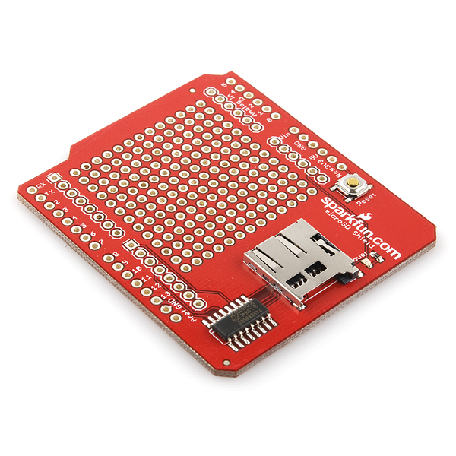
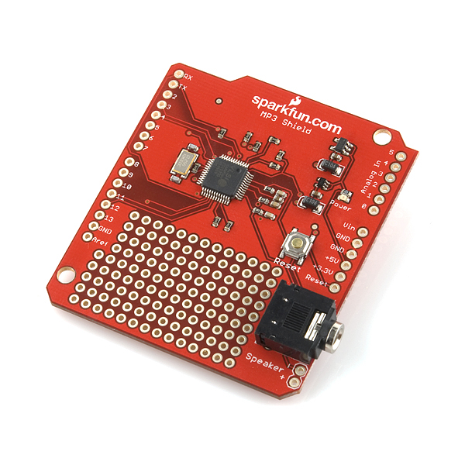
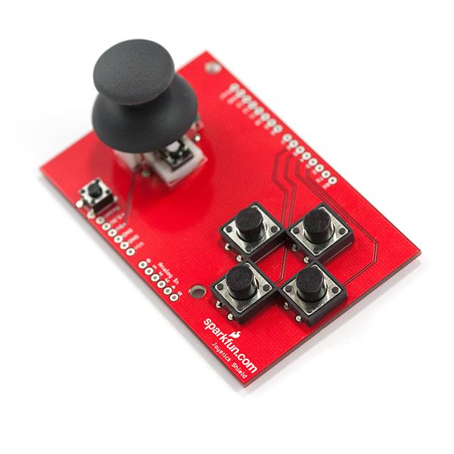
Arduino Shields
Micro SD MP3 Trigger Joystick

Slide 21
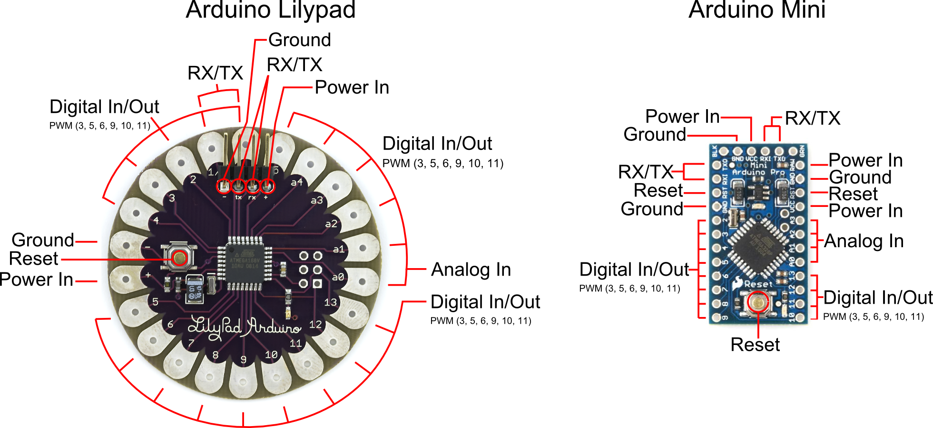
Arduino Variations
Notes:
From the world's largest supercomputers to the smallest embedded devices, Linux is everywhere. Every ebook reader I've seen runs Linux; that includes the Kindle, the Nook, Sony Reader and more. Most webservers run either Linux or BSD which is similar to Linux. So if you use Google or Amazon, you're using Linux in a way.
Microsoft 14%, nginx, 10%

Slide 22
Help! (and learning resources)
http://arduino.cc/
http://sparkfun.com/products/10173
http://forum.sparkfun.com/viewforum.php?f=32
http://learn.sparkfun.com/
http://introtoarduino.com/
http://instructables.com/
Notes:
#ubuntu on Freenode. You can use Empathy for IRC. Also see https://help.ubuntu.com/community/InternetRelayChat for other choices.

Slide 23


