Slide 1












Tracks
Technical
Big Picture
Education
Demo

Slide 2
Technical
AMQP, RabbiMQ (Messaging)
GIS
C++11
Mobile App Development
Databases, NoSQL
Groovy/Grails
Boost Libraries
Twitter
The Cloud

Slide 3
Big Picture
SC Dept. of Corrections
Open Security-DHS
Build a Business on Open Source
Freedom Box
Open Identity in Ecommerce
Licensing
Starting an Open Source Project
Convert Projects to Open Source

Slide 4
Education
Classes using Open Source
Reforming K-12 Education using Open Source
Google Summer of Code / Code-in
Open Source in Art
3D Printing and Intellectual Property
Kickstarter
Open Hardware
Classroom Adoption of Open Source

Slide 5
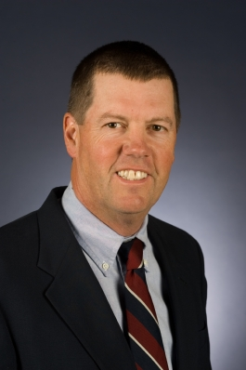
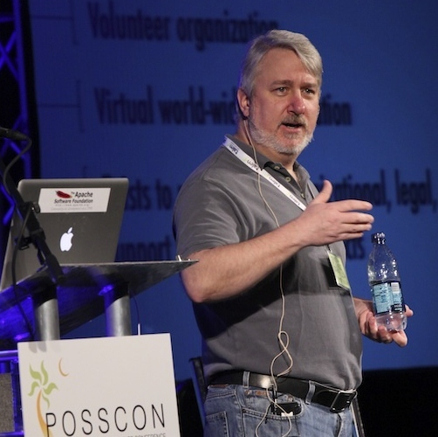
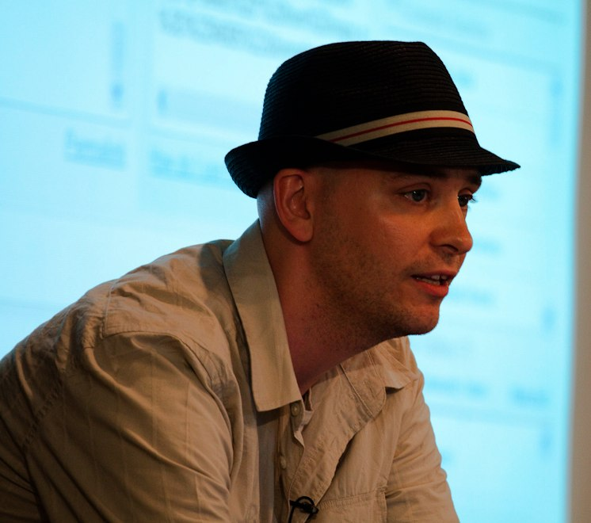
Speakers
Scott McNealy Sun Microsystems
Jim Jagielski Apache Software Foundation
Steve Graham EMC
Chris Aniszczyk Twitter
Bdale Garbee HP
Jonathan LeBlanc PayPal
Carol Smith Google
Dave Abrahams Boost Consulting

Slide 6
So Far
Changed perception of Columbia and SC in IT/software circles
Positive coverage in IT/Open Source world–articles/blogs/twitter
Heads-on-beds – actual
Economic Development
Workforce Development – hard and soft skills
Better informed, more technically cultured community
Business retention and expansion – perceived momentum + resulting synergy + pride
Unprecedented opportunity
  One of only ? OS conferences in South/East
  Year 5 – start-up phase completed
  Southeast’s/South’s Open Source City – Portland, OR

Slide 7


1301 Gervais St.
Columbia, SC http://open-it-lab.com

Slide 8

Open-it-lab.com

Slide 9
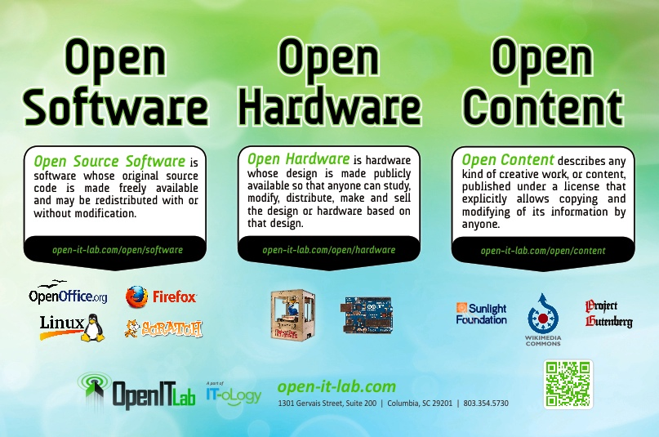

Slide 10
Awareness

Slide 11
Education
One Hour Lab Tour
Open 101 (2hr – Intro/Ad, 4 hr – Intro/Ad)
Open 101 for Teachers
Ubuntu 101 –Introduction and Advanced
Open 201 – Open Software in Depth
Open 202 – Open Hardware in Depth
System Administration 101 – OS included
OS From the Geospatial Perspective

Slide 12
Research and Development
Demonstrate that Open Source can be applied
Students, teachers/professors, IT professionals can join a project and contribute
Current project – Columbia Police Department
  Make crime report information widely available
  Web application
  Mobile applications – Android, iPhone

Slide 13
Why?
Educational
Cool projects to work on in supportive environment
Provides opportunity to get experience WITHOUT a job

Slide 14
Let's Imagine...
Company/individual looking to open new office, look at Columbia
Cost of living/quality of life, taxes, financial/relocation incentives
Infrastructure needs – work space, broadband
Education system (educated workforce), existing IT base, IT clusters
Progressive/forward thinking/emerging

Slide 15
1301 Gervais St.
Columbia, SC http://open-it-lab.com
Todd Lewis
todd@posscon.org
803-240-1213

Slide 16


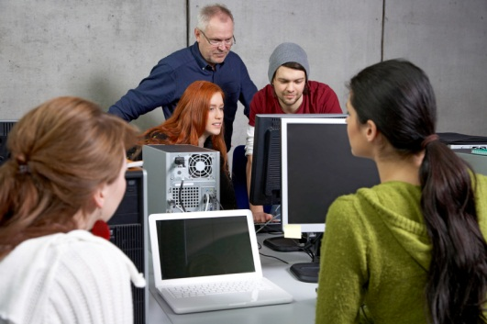

IT-oLogy is a non-profit collaboration of businesses, academic institutions and organizations dedicated to growing the IT talent pipeline, fostering economic development and advancing the IT profession.
IT-oLogy has 3 initiatives:
Promote IT
Teach IT
Grow IT
IT-oLogy works with K-12 schools to encourage the best and brightest young people and their parents to learn more about the IT profession.
In collaboration with IT-oLogy, companies work with colleges and universities on applied business research projects and experiential learning opportunities that strengthen and align classroom skills to current and future IT business needs.
IT-oLogy partners with IT professionals and their companies to provide
innovative and life-long learning and professional development
opportunities.

Slide 18






























Corporate Partners

Slide 19


























Academic Partners

Slide 20

Student as Professional

Slide 21
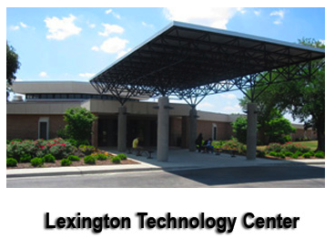

Student as Professional

Slide 22
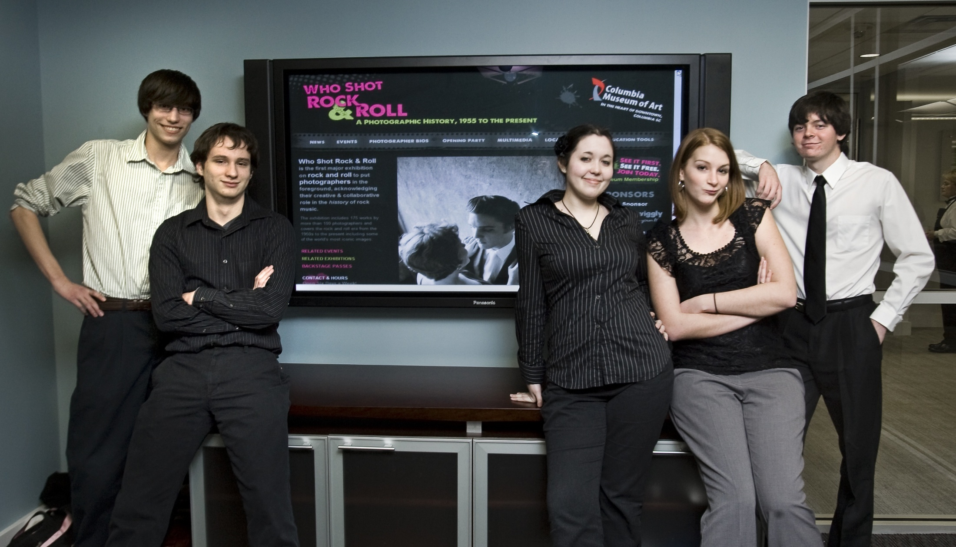
Student as Professional
Nov 2010 – Jan 2011
Team Members
Project Manager
Business Analyst
Designer
Developer/Programmer
Quality Assurance

Slide 23

Student as Professional
Finished Product
http://www.columbiamuseum.org/exhibitions/whoshotrock/index.php

Slide 24
Lessons Learned
Different Careers in IT
What it takes to complete a successful project
  Unexpected things ALWAYS happen
  Communication is key
I can do this for a living

Slide 25




Do you want to be a part of
?
Connect with us!
www.IT-oLogy.org
www.IT-oLogy-blog.org
IT-oLogy
IT_oLogy
IT-oLogy

