Slide 1
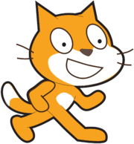
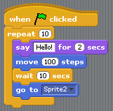
Scratch
Visual programming “language” designed at MIT
Designed for teaching young students how to program
Everything done with drag and drop
All open source and freely available for instructional use

Slide 2
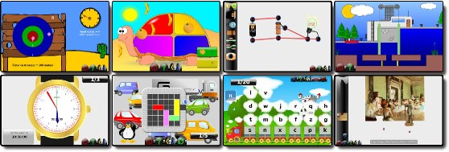
GCompris
“GCompris is a high quality educational software suite comprising of numerous activities for children aged 2 to 10. “

Slide 3
KDE Edu (http://edu.kde.org/)
Memory games
Typing exercises
Math tools
Flash card training
Physical simulator
Planetarium application
Many more....

