Slide 1
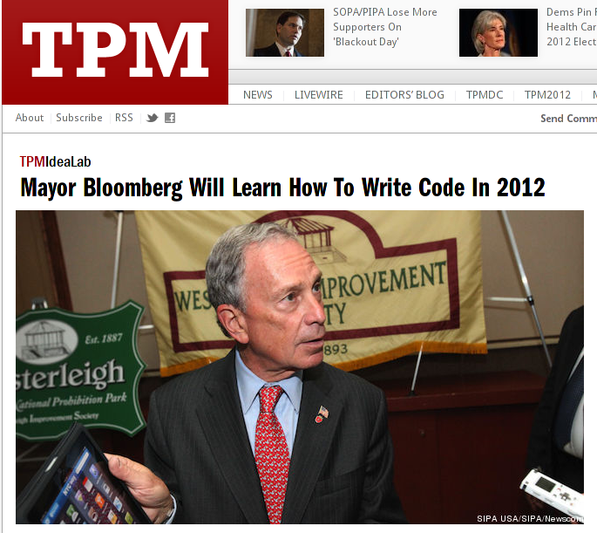

Slide 2
2012: Code Year

Slide 3
"Coding is the new Latin"
–Alex Hope, Double-Negative Ltd.
Notes:
Double-Negative: UK's largest film-only VFX company

Slide 4
What is code?

Slide 5
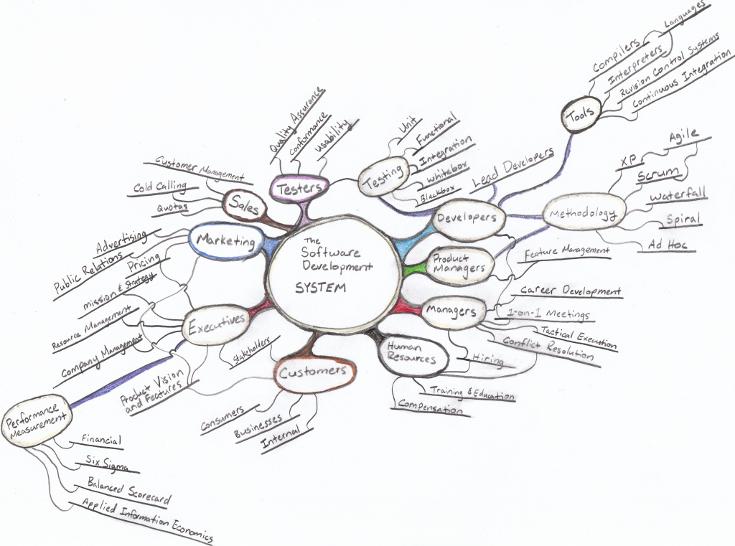

Slide 6
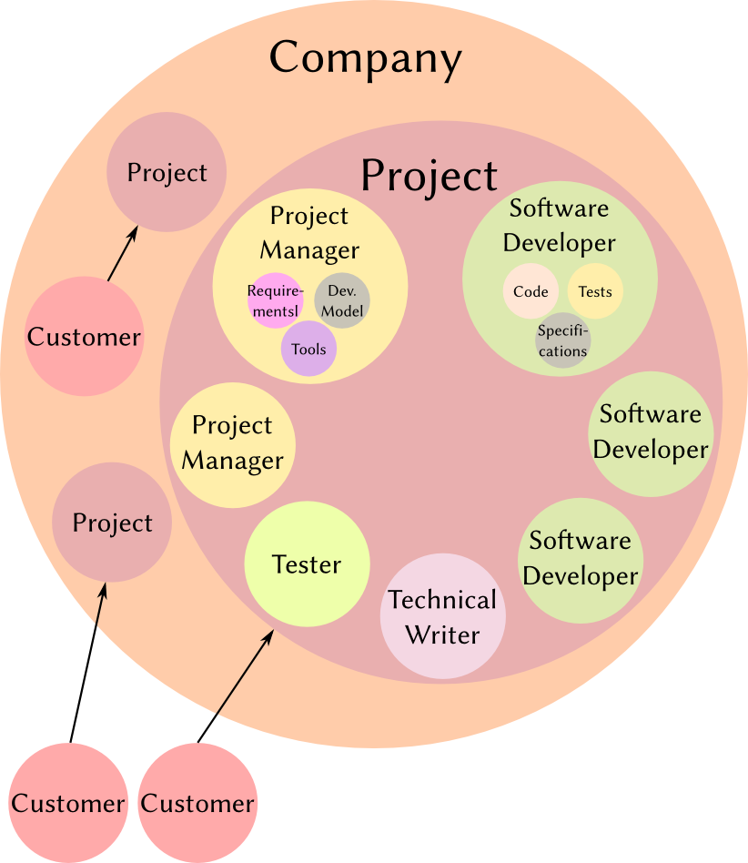

Slide 7
"Program or be programmed"
–Douglas Rushkoff, CNN
Notes:
Double-Negative: UK's largest film-only VFX company

Slide 8
Languages
C
void quick_sort (int *a, int n) {
if (n < 2)
return;
int p = a[n / 2];
int *l = a;
int *r = a + n – 1;
while (l <= r) {
while (*l < p)
l++;
while (*r > p)
r--;
if (l <= r) {
int t = *l;
*l++ = *r;
*r-- = t;
}
}
quick_sort(a, r - a + 1);
quick_sort(l, a + n – l);
}

Slide 9
Languages
Python
def qsort(L):
return (qsort([y for y in L[1:] if y < L[0]]) +
L[:1] +
qsort([y for y in L[1:] if y >= L[0]]))
if len(L) > 1 else L

Slide 10
Languages
Shakespeare
Romeo, a young man with a remarkable patience.
Juliet, a likewise young woman of remarkable grace.
Ophelia, a remarkable woman much in dispute with Hamlet.
Hamlet, the flatterer of Andersen Insulting A/S.
Act I: Hamlet's insults and flattery.
Scene I: The insulting of Romeo.
[Enter Hamlet and Romeo]
Hamlet:
You lying stupid fatherless big smelly half-witted coward! You are as
stupid as the difference between a handsome rich brave hero and thyself!
Speak your mind!
You are as brave as the sum of your fat little stuffed misused dusty
old rotten codpiece and a beautiful fair warm peaceful sunny summer's
day. You are as healthy as the difference between the sum of the
sweetest reddest rose and my father and yourself! Speak your mind!
You are as cowardly as the sum of yourself and the difference
between a big mighty proud kingdom and a horse. Speak your mind.
Speak your mind!
[Exit Romeo]

Slide 11
Languages
Chef
Hello World Souffle.
Ingredients.
72 g haricot beans
101 eggs
108 g lard
111 cups oil
32 zucchinis
119 ml water
114 g red salmon
100 g dijon mustard
33 potatoes
Method.
Put potatoes into the mixing bowl.
Put dijon mustard into the mixing bowl.
Put lard into the mixing bowl.
Put red salmon into the mixing bowl.
Put oil into the mixing bowl.
Put water into the mixing bowl.
Put zucchinis into the mixing bowl.
Put oil into the mixing bowl.
Put lard into the mixing bowl.
Put lard into the mixing bowl.
Put eggs into the mixing bowl.
Put haricot beans into the mixing bowl.
Liquefy contents of the mixing bowl.
Pour contents of the mixing bowl into the baking dish.
Serves 1.

Slide 12

Recipe Writing
Programming as writing a recipe
  May be used by many chefs (Computers)
  Can be done in many styles
  Can be written in many languages
  Different ingredients to create the same meal
  Different meals are tastier (buggier) than others
  Different types of meals (specialties)
Recipe Testers

Slide 13


Deploying Code
Compiler
  Converts code to a language a computer can read all at once
  Very, very fast
Interpeter
  Sits in background and converts code as needed
  Slower, but more flexible

Slide 14
Specialties
Frontend (web/interface) vs. Backend (servers/tools)
Application vs. Systems
Architects vs. Maintanance
Developers vs. Engineers vs. Scientists vs. Analysts
Web vs. Database vs. System vs. Game vs. Cloud

